Slide 1
SNPP and N20 CrIS double difference from inter-calibration results for AHI
OKUYAMA Arata and KODERA Kazuki
Meteorological Satellite Center / JMA
7 Oct. 2021 GSICS GRWG (IR) online meeting

Slide 2
References used for AHI cal/val
References
SNPP/CrIS
(N20/CrIS)
Metop-A/B IASI
(Metop-C/IASI)
AQUA/AIRS
Contents
Tb bias at the std. rad., 220K, 250K and 290K and their SE
Correction (regression) coefficients and their SE
Trends
The AHI cal/val monitor by NOAA-20/CrIS and Metop-C/IASI is in preparation.
cf. https://www.data.jma.go.jp/mscweb/data/monitoring/gsics/ir/monit_geoleoir.html

Slide 3
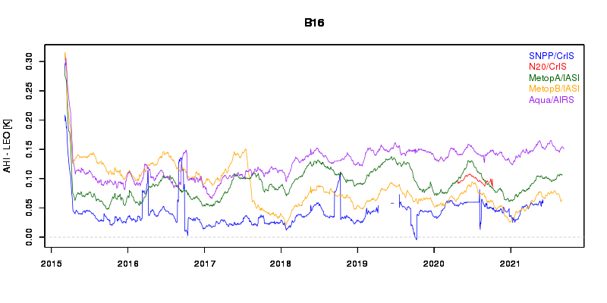
SNPP/CrIS vs AHI
SW, MW, LW bands of CrIS correspond to B07, B08-10 and B12-16, respectively, for AHI. (B11 SRF is located in a spectral gap between the LW and the MW.)
SNPP/CrIS have been utilized as one of the reference hyperspectral sounders for AHI calibration performance monitoring since 2015/03.
The computed Tb biases based on SNPP/CrIS are consistent with that based on IASIs and AIRS.
Preliminary results of the computed Tb based on N20/CrIS is shown in the next slides in detail.
CrIS Band | AHI Band | wl [um]
SW | B07 | 3.9
MW | B08 | 6.2
 | B09 | 6.9
 | B10 | 7.3
- | B11 | 8.6
LW | B12 | 9.6
 | B13 | 10.4
 | B14 | 11.2
 | B15 | 12.4
 | B16 | 13.3
AHI/B16 Tb bias
AHI – LEO [K]
2015
2016
2017
2018
2019
2020
2021

Slide 4
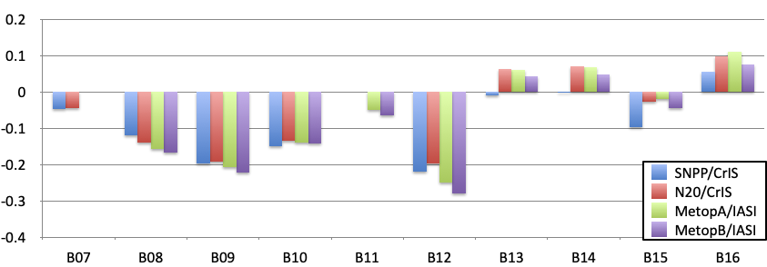
AHI vs CrIS(SNPP, N20), IASI(MetopA/B)
Mar. 2020
The Tb bias values are consistent within the 0.1K of differences among the references.
The double differences of SNPP/CrIS – N20/CrIS is less than 0.08K.
ΔTb@Tb_std (2020/05/15 +/- 14d)
Double differences | B07 3.9μm | B08 6.2μm | B09 6.9μm | B10 7.3μm | B11 8.6μm | B12 9.6μm | B13 10.4μm | B14 11.2μm | B15 12.4μm | B16 13.3μm
N20 - SNPP [K] | 0.003 | -0.021 | 0.006 | 0.016 | N/A | 0.023 | 0.071 | 0.073 | 0.069 | 0.040
MetopA -MetopB [K] | N/A | 0.010 | 0.014 | 0.003 | 0.015 | 0.029 | 0.020 | 0.019 | 0.025 | 0.033

Slide 5
AHI vs CrIS(SNPP, N20), IASI(MetopB/C)
Sep. 2021
The DD range is same order as the one before the SNPP/CrIS trouble in the last June.
ΔTb@Tb_std (2021/09/01 +/- 14d)
Double differences | B07 3.9μm | B08 6.2μm | B09 6.9μm | B10 7.3μm | B11 8.6μm | B12 9.6μm | B13 10.4μm | B14 11.2μm | B15 12.4μm | B16 13.3μm
N20 - SNPP [K] | 0.043 | N/A | N/A | N/A | N/A | 0.021 | 0.075 | 0.078 | 0.073 | 0.043
MetopC -MetopB [K] | -0.002 | 0.006 | 0.011 | -0.004 | 0.019 | 0.061 | 0.016 | 0.016 | 0.018 | 0.027

Slide 6
Summary
SNPP/CrIS have been utilized as one of the reference hyperspectral sounders for AHI calibration performance monitoring since 2015/03.
The computed Tb biases based on SNPP/CrIS are consistent with that based on IASIs and AIRS.
The double differences of SNPP/CrIS – N20/CrIS is less than 0.08K, before and after the SNPP/CrIS trouble in the last June.
The AHI cal/val monitor by using N20/CrIS and Metop-C/IASI is in preparation.

