Slide 1
GSICS Correction at NOAA
Xiangqian Wu and Fangfang Yu
2 December 2021, GSICS IR Monthly
Disclaimer: The scientific results and conclusions, as well as any views or opinions expressed herein, are those of the author(s) and do not necessarily reflect those of NOAA or the Department of Commerce.

Slide 2
Introduction
GSICS Correction will be disseminated with ABI L1b data stream.
Decision has been made. Details are being worked out.
That prompted a review of GSICS Correction.
EUMETSAT User Guide was timely and helpful.

Slide 3
Implementation
$R_{GEO}=a_{r}+b_{r}R_{LEO}$; $a_{c}=−\frac{a_{r}}{b_{r}}, b_{c}=\frac{1}{b_{r}}$; $R_{cor}=a_{c}+b_{c}R_{GEO}$
Near Real Time and Re-Analysis Correction (NRTC & RAC)
a_{r} & b_{r} and a_{c} & b_{c} are provided on website for both NRTC & RAC.
Only a_{c} & b_{c} are for NRTC are embedded with L1b data.
a_{c} & b_{c} for RAC will be embedded in re-calibrated L1b (if produced).
Three-tier (prelaunch, last, current) for fallback.
May not or no longer necessary for all agencies or NOAA.
Continue with NOAA’s protocol.
User of the ABI L1b products has the option of whether to apply the GSICS Correction for each channel.

Slide 4
Summary
Variable | Name | Dimension 1 | Dimension 2 | Type | Unit
a_{c}(3,16) | Coefficient of NRTC* (Eq. 2) | 3 times – prelaunch, last, current | 16 channels | Real | Same as ABI L1b radiance
b_{c}(3,16) | Coefficient of NRTC* (Eq. 2) | 3 times – prelaunch, last, current | 16 channels | Real | Unitless
*: For operational L1b radiance. Replaced with RAC for re-calibrated L1b radiance if produced.

Slide 5
Documentation
ATBD: Broad and detailed for deep divers.
What is GSICS.
Theoretical basis of the GSICS Correction algorithm.
Expected results of applying GSICS Corrections in terms of inter-operability, SI traceability, and uncertainty.
Considerations when applying GSICS Correction.
User Guide: Narrow and brief for practitioners.
What comes with ABI L1b data and how to use it.
Website: Library and tool kit.
All data – Regression & correction coefficients; NRTC & RAN; Levels of maturity; Operation status; etc.
All documents – link to User Guide and ATBD.

Slide 6
What is GSICS Correction, Really?
GSICS Correction harmonizes or homogenizes similar radiance products generated by the same or different sensors over time, operated by the same or different agencies.
A distinction was made between “harmonization” and “homogenization” – which is the right word here?
The harmonized radiance is not necessarily more or less accurate than the unharmonized radiance, but is in better agreement with the GSICS selected reference.

Slide 7
What’s In A Name (1/2)
Replace “GSICS Correction” with “GSICS Harmonization”.
When “GSICS Correction” was adopted in 2009, it was meant to correct Imager, SEVIRI, FY-2, MTSAT, MI calibration with AIRS/IASI.
That was appropriate when GEO calibration was inferior to LEO.
But it could be a barrier to harmonize among LEO measurements (AIRS, IASI, CrIS, MODIS, VIIRS, etc.) if some would not consider their calibration needs such correction.
Actually that happened to some ABI channels already.
We’d either have to convince all those instrument teams, or concede that GSICS harmonization is applicable only to pairs of superior and inferior instruments.
“Harmonization” is a more neutral and hopefully acceptable term.

Slide 8
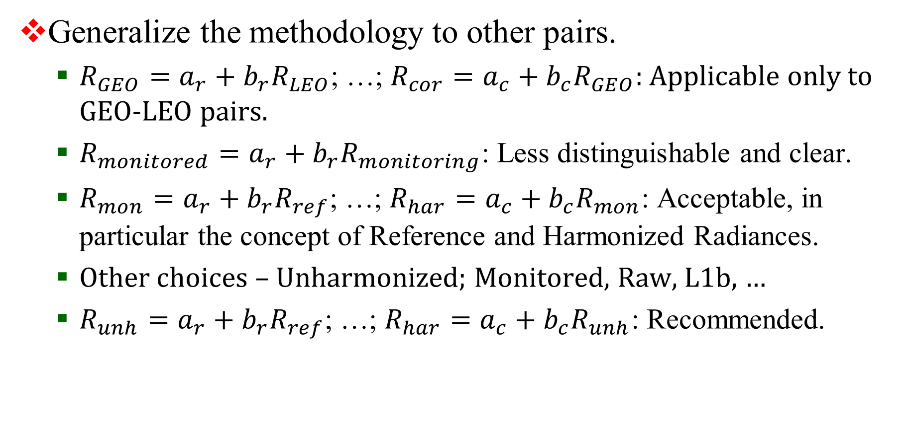
What’s In A Name (2/2)
Generalize the methodology to other pairs.
$R_{GEO}=a_{r}+b_{r}R_{LEO}$; …; $R_{cor}=a_{c}+b_{c}R_{GEO}$: Applicable only to GEO-LEO pairs.
$R_{monitored}=a_{r}+b_{r}R_{monitoring}$: Less distinguishable and clear.
$R_{mon}=a_{r}+b_{r}R_{ref}$; …; $R_{har}=a_{c}+b_{c}R_{mon}$: Acceptable, in particular the concept of Reference and Harmonized Radiances.
Other choices – Unharmonized; Monitored, Raw, L1b, …
$R_{unh}=a_{r}+b_{r}R_{ref}$; …; $R_{har}=a_{c}+b_{c}R_{unh}$: Recommended.

