Slide 1
Past, Current, and Future of EUMETSAT Microwave Radiometers
Tim Hewison, Vinia Mattioli, Christophe Accadia, Jörg Ackermann
GSICS Microwave Sub-Group Workshop
2022-03-01
Input from User Preparation Webinar on EPS-SG Microwave Sounding & Imaging and Sub-mm Imaging missions (MWS, MWI, ICI) (October 2021)

Slide 2
Outline
MWS: Microwave Sounder of EPS-SG
MWI: Microwave Imager of EPS-SG
ICI: Ice Cloud Imager of EPS-SG
AWS: Arctic Weather Satellite

Slide 3
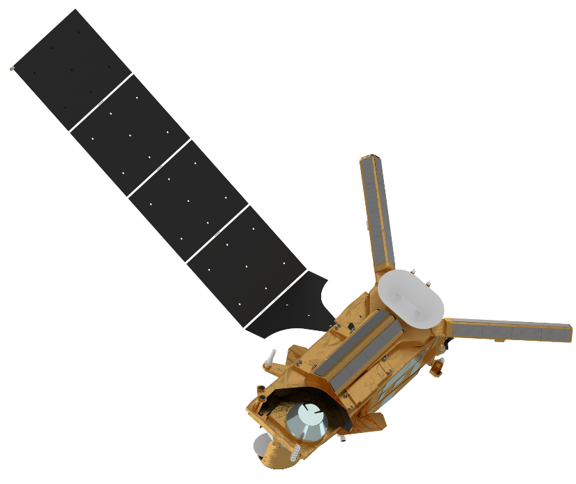
EPS-SG Satellites and Instrumentation
Two-satellite configuration Metop-SG-A and –B
in the same orbital plane (Metop-like):
🡪 Sun synchronous (~98° inclination) 🡪 low earth orbit at 835 km mean altitude 🡪 09:30 (descending node) Equatorial
Crossing Time
Intended launch dates:
2024 Metop-SG A1 2025 Metop-SG B1
2031 Metop-SG A2 2032 Metop-SG B2
2038 Metop-SG A3 2039 Metop-SG B3
Metop-SG A
Radio Occultation
RO
3MI
Multi-viewing,
-channel,
-polarisation Imager
MWS Microwave Sounder
Metop-SG B
Copernicus Sentinel-5 UV-VIS-NIR-SWIR Sounder
SCA Scatterometer
METimage Visible-Infrared Imager
MWI Microwave Imager
IASI-NG Infrared Atmospheric Sounding Interferometer – New Generation
Radio Occultation
RO
ICI sub-mm wave Ice Cloud Imager

Slide 4
EPS-SG Microwave Sounding Mission Objectives
The primary objective of the Microwave Sounding mission is to support Numerical Weather Prediction at regional and global scales.
The main users of the MWS mission will be the WMO real time users, i.e. NWP centres of National Meteorological Services and ECMWF. Operational nowcasting services of National Meteorological Services may also be users of the MWS mission. The MWS mission is also relevant to non real-time users and services (e.g. the Climate Monitoring SAF) that will use data from the MWS mission to continue temperature and humidity sounding records, mainly for climate monitoring applications.
The primary products to be derived from the MWS mission include in order of decreasing priority spectral radiances with information on:
Temperature profile
Water-vapour profile
Cloud liquid-water total column (droplet size < 100µm)
Further products to which MWS contributes are spectral radiances with information on:
Cloud liquid-water profile (droplet size < 100 µm)
Cloud ice total column

Slide 5
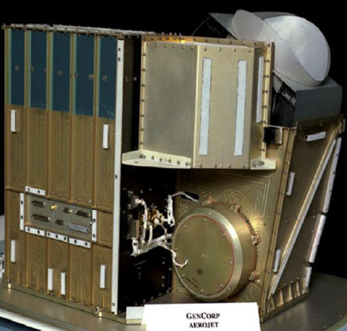
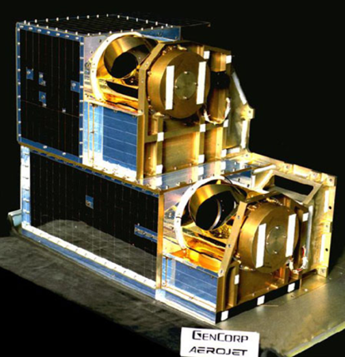
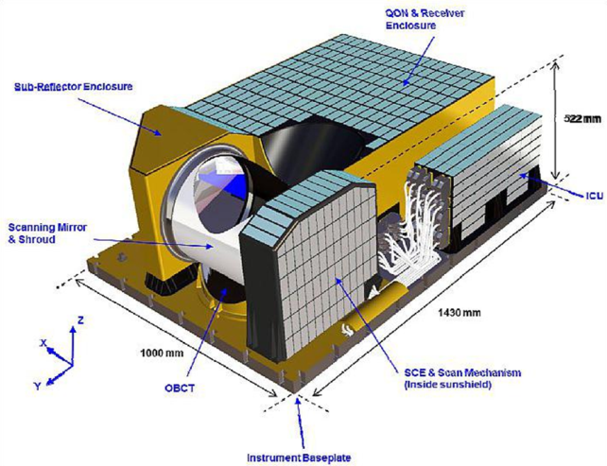
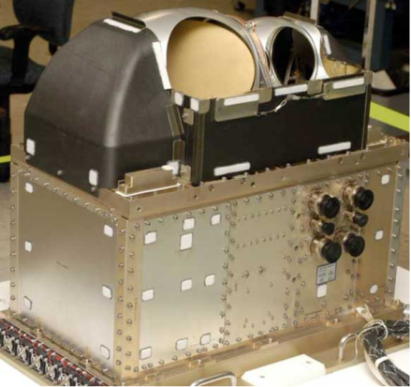
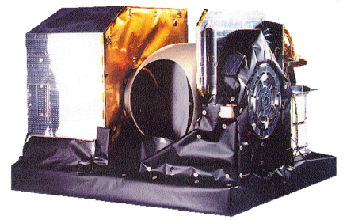
MWS: Instrument Heritage and Basic Design
NOAA 15 16 17 18 19, Aqua, Metop ABC
S-NPP
NOAA-20
JPSS-2
Metop-SG A1
Metop-SG A2
Metop-SG A3
AMSU/A2:
2 channels
1 antenna system
23-31 GHz
30 pixels/scan
3 years lifetime
54 kg
75x30x60 cm
ATMS:
22 channels
2 antenna systems
96 pixels/scan
8 years lifetime
85 kg
70x40x60 cm
MWS:
24 channels
1 antenna system
95 pixels/scan
7.5 years lifetime
110 kg
143x100x52 cm
AMSU/A1:
13 channels
2 antenna systems
50-89 GHz
30 pixels/scan
3 years lifetime
50 kg
75x70x65 cm
MHS:
5 channels
1 antenna system
89-191 GHz
90 pixels/scan
4 years lifetime
50 kg
75x56x69 cm
NOAA 18 19, Metop ABC
(credit: http://npp.gsfc.nasa.gov/atms.html)
(credit: https://directory.eoportal.org/web/eoportal/
satellite-missions/m/metop-sg)
credit: http://www.eumetsat.int/website/home/Satellites/
CurrentSatellites/Metop/MetopDesignl

Slide 6
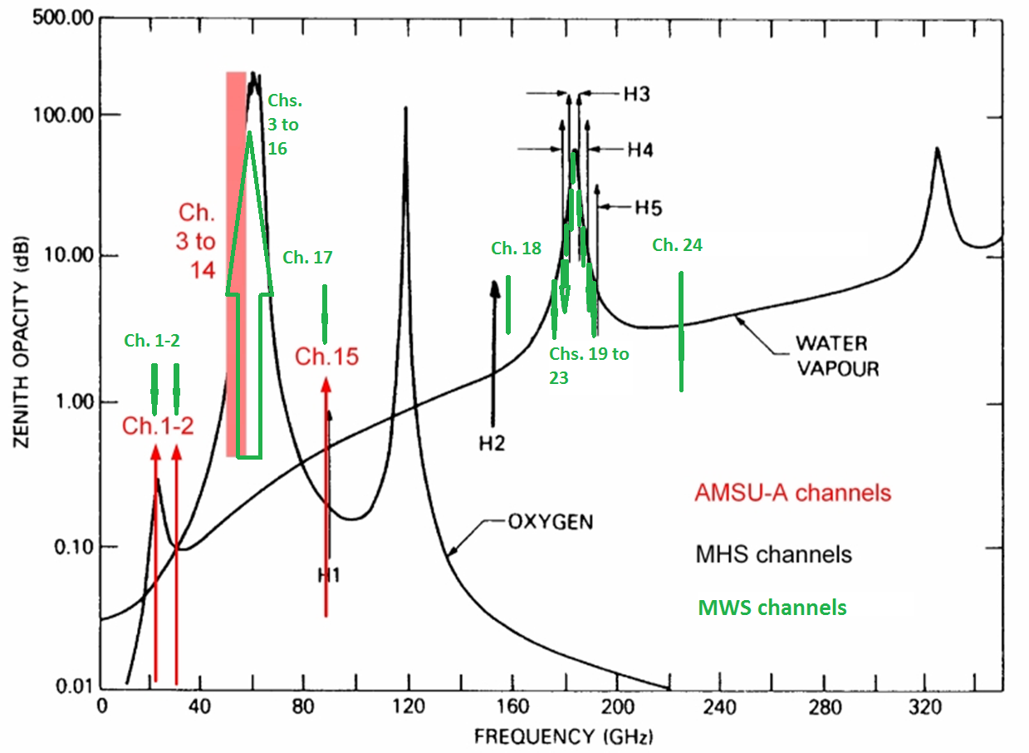
MWS: Frequency Range of Measurements

Slide 7
MWS: Channels Comparison with Heritage Instruments
AMSU/MHS |  |  |  |  | ATMS |  |  |  | MWS
Ch. | GHz |  | Pol. |  | Ch. | GHz |  | Pol. | Ch. | GHz |  | Pol.
1 | 23.8 |  | QV |  | 1 | 23.8 |  | QV | 1 | 23.8 |  | QH
2 | 31.4 |  | QV |  | 2 | 31.4 |  | QV | 2 | 31.4 |  | QH
3 | 50.3 |  | QV |  | 3 | 50.3 |  | QH | 3 | 50.3 |  | QH (QV)
 |  |  |  |  | 4 | 51.76 |  | QH
4 | 52.8 |  | QV |  | 5 | 52.8 |  | QH | 4 | 52.8 |  | QH (QV)
 |  |  |  |  |  |  |  |  | 5 | 53.246 ± 0.08 |  | QH (QV)
5 | 53.595±0.115 |  | QH |  | 6 | 53.596±0.115 |  | QH | 6 | 53.596±0.115 |  | QH (QV)
 |  |  |  |  |  |  |  |  | 7 | 53.948 ± 0.081 |  | QH (QV)
6 | 54.4 |  | QH |  | 7 | 54.4 |  | QH | 8 | 54.4 |  | QH (QV)
7 | 54.94 |  | QV |  | 8 | 54.94 |  | QH | 9 | 54.94 |  | QH (QV)
8 | 55.50 |  | QH |  | 9 | 55.50 |  | QH | 10 | 55.50 |  | QH (QV)
9 | 57.290344 |  | QH |  | 10 | 57.290344 |  | QH | 11 | 57.290344 |  | QH (QV)
10 | 57.290344±0.217 |  | QH |  | 11 | 57.290344±0.217 |  | QH | 12 | 57.290344±0.217 |  | QH (QV)
11 | 57.290344 ±0.3222±0.048 |  | QH |  | 12 | 57.290344 ±0.3222±0.048 |  | QH | 13 | 57.290344 ±0.3222±0.048 |  | QH (QV)
12 | 57.290344±0.3222±0.022 |  | QH |  | 13 | 57.290344±0.3222±0.022 |  | QH | 14 | 57.290344±0.3222±0.022 |  | QH (QV)
13 | 57.290344±0.3222±0.010 |  | QH |  | 14 | 57.290344±0.3222±0.010 |  | QH | 15 | 57.290344±0.3222±0.010 |  | QH (QV)
14 | 57.290344±0.3222±0.0045 |  | QH |  | 15 | 57.290344±0.3222±0.0045 |  | QH | 16 | 57.290344±0.3222±0.0045 |  | QH (QV)
15 | 89.0 |  | QV
16 | 89.0 |  | QV |  | 16 | 88.2 |  | QV | 17 | 89.0 |  | QV
17 | 157.0 |  | QV |  | 17 | 165.5 |  | QH | 18 | 164-167 |  | QH
18 | 183.311±1.0 |  | QH |  | 22 | 183.311±1.0 |  | QH | 23 | 183.311±1.0 |  | QV
 |  |  |  |  | 21 | 183.31 ± 1.8 |  | QH | 22 | 183.311±1.8 |  | QV
19 | 183.311±3.0 |  | QH |  | 20 | 183.311±3.0 |  | QH | 21 | 183.311±3.0 |  | QV
 |  |  |  |  | 19 | 183.311±4.5 |  | QH | 20 | 183.311±4.5 |  | QV
20 | 191.31 |  | QV |  | 18 | 183.311±7.0 |  | QH | 19 | 183.311±7.0 |  | QV
 |  |  |  |  |  |  |  |  | 24 | 229 |  | QV
Matched Specificat. |  | Pol. is Different |  | Unique Passband |  |  | Pol. is Different and Unique Passband |  |  |  | New channel

Slide 8
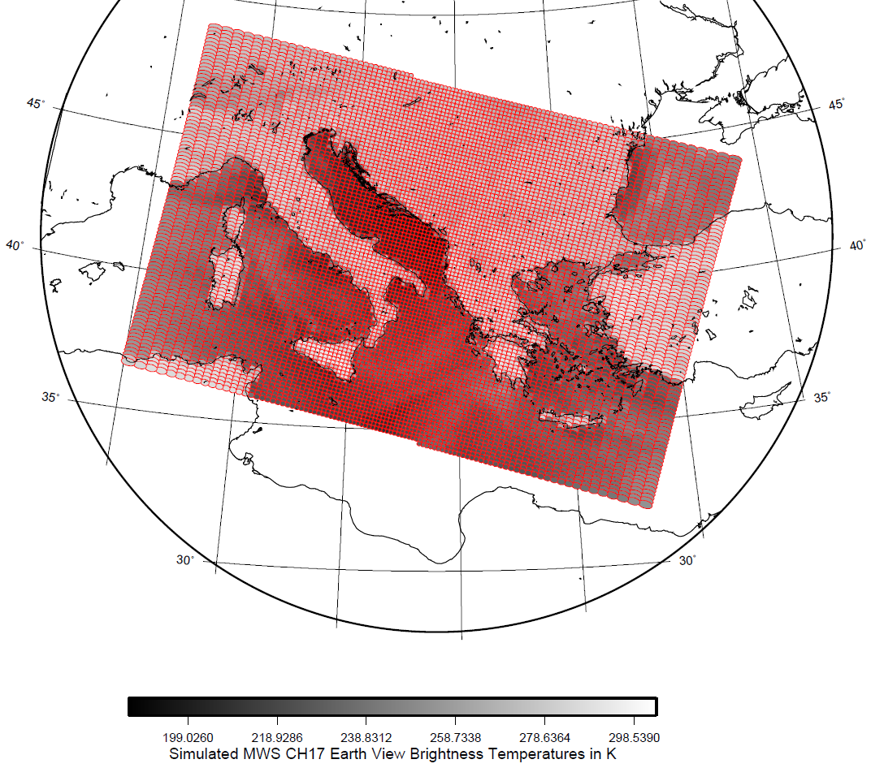
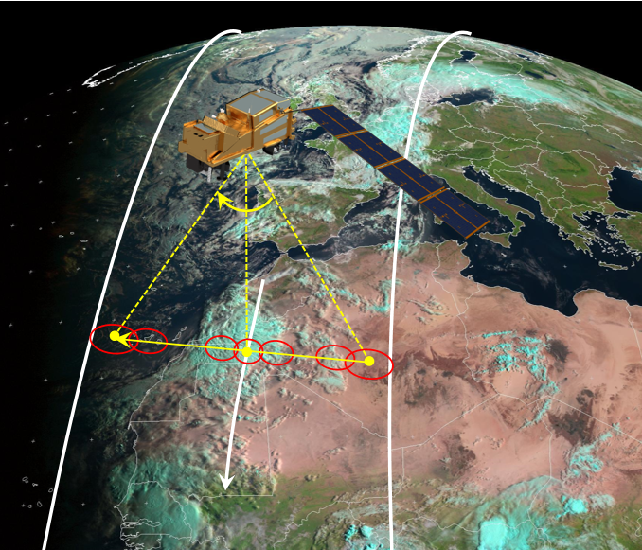
MWS Scanning Characteristics
Cross-track scanner
95 pixels per scan line for each channel
2.25 seconds scan duration
49.85° maximum scanning angle
~2250 km swath width
MWS Channel 17 scan pattern and brightness temperature simulations.

Slide 9
MWS: Pixel Size Comparison with Heritage Instruments
Instantaneous Footprint Diameters (3dB level) near Nadir
Observation Frequency (GHz) | AMSU-A/MHS | ATMS | MWS
23.8 | 48 km | 75 km | 40 km
31.4 | 48 km | 75 km | 40 km
50-58 | 48 km | 32 km | 20 km
89 | 48 km/ 16 km | 32 km | 17 km
157-167 | 16 km | 16 km | 17 km
183-191 | 16 km | 16 km | 17 km
229 | N/A | N/A | 17 km

Slide 10
Outline
MWS: Microwave Sounder of EPS-SG
MWI: Microwave Imager of EPS-SG
ICI: Ice Cloud Imager of EPS-SG
AWS: Arctic Weather Satellite

Slide 11
EPS-SG Microwave Imaging Missions Objectives
Provision of cloud and precipitation products
Support Numerical Weather Prediction at regional and global scales
Nowcasting and very short-range forecasting at regional scales
Support observations of sea ice parameters and snow cover, snow water equivalent, sea surface wind.
Continuity of measurements of key microwave imager channels as observed by SSM/I, TMI, SSMIS, AMSR-E, GMI, in support of long-term climate records
MicroWave
Imager (MWI)
Provision of ice cloud products for climate monitoring
Support the validation of ice clouds models and the parameterisation of ice clouds in weather and climate models
Fill observational gap: provide information on non-precipitating ice that are not covered either in the optical/thermal IR or in the mm-wave range
Ice Cloud Imager
(ICI)

Slide 12
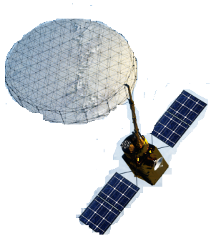
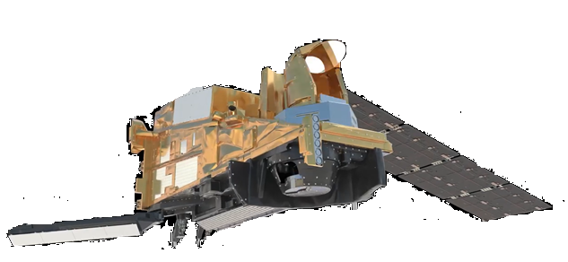
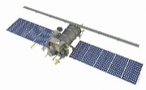
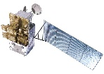
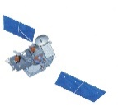
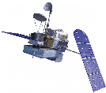
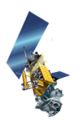
Background and heritage of MWI and ICI
Key microwave channels (10.65, 18.7/19.35, 23.8/22.235, 31.4/37.0, and 85.5/89.0 GHz) data are well suited for estimates of precipitation rate, column water vapour, and cloud liquid water, as well as surface parameters such as ocean surface wind speed, sea ice extent and concentration, snow cover, soil moisture, and land surface emissivity.
MWI has a long heritage form instruments such as DSMP Special Sensor Microwave–Imager (SSM/I) and Special Sensor Microwave-Imager/Sounder (SSMIS), TRMM Microwave Imager (TMI), Advanced Microwave Scanning Radiometer for EOS (AMSR-E), GCOM-W Advanced Microwave Scanning Radiometer–2 (AMSR 2), GPM Microwave Imager (GMI).
Continuous long-term record of high-quality global satellite microwave observations in support of long-term climate records, which now extends over 30 years.
today
ESA CIMR
EUMETSAT/ ESA MWI and ICI
RosHydroMet/Roscosmos (Russia) Meteor-M N2 MTVZA-GY
CMA (China) Feng-Yun-3 MWRI
NASA/JAXA TMI / GMI
JAXA (Japan) AMSR-E / GCOM-W AMSR 2
GOSAT-GW AMSR3
DOD (USA) WindSat
DOD (USA) DSMP SSM/I / SSMIS F17/F18
Current and future passive microwave coverage

Slide 13
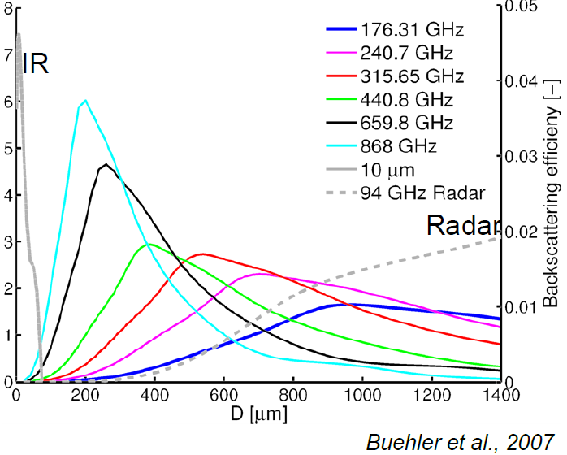
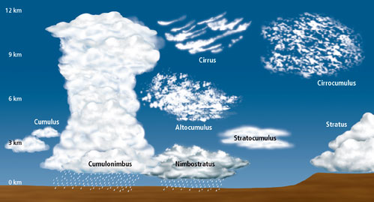
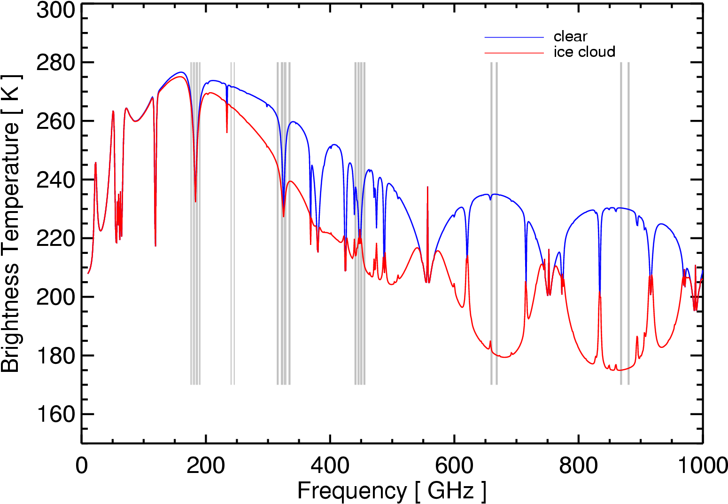
Sub-mm channels for ice cloud observations
ICI is the first operational radiometer of this type designed with the objective of remote sensing of cloud ice. ICI will open up the sub-millimetre region for NWP and climate monitoring. Measurements by other instruments at such wavelengths already exist, mainly by limb sounding instruments such as Aura MLS, Odin/SMR and SMILES or demonstrational cubesat missions (ICECUBE). Pioneering airborne instruments were MIR (Millimeter-wave Imaging Radiometer), CoSSIR (Compact Scanning Submillimeter Imaging Radiometer) and more recently ISMAR (International SubMillimetre Airborne Radiometer).
Sensitivity of measurements at different frequencies to particle size *
VIS/IR
Cloud Ice
Sub-mm
Millimeter/
Microwave
Cloud Liquid/
Mixed phase
Precipitation
Microwave
*: Buehler, S. A., Jiménez, C., Evans, K. F., Eriksson, P., Rydberg, B., Heymsfield, A. J., Stubenrauch, C. J., Lohmann, U., Emde, C., John, V. O., Sreerekha, T. R., and Davis, C. P., 2007: A concept for a satellite mission to measure cloud ice water path, ice particle size, and cloud altitude”, Q. J. Roy. Meteorol. Soc., 133, 109–128.

Slide 14
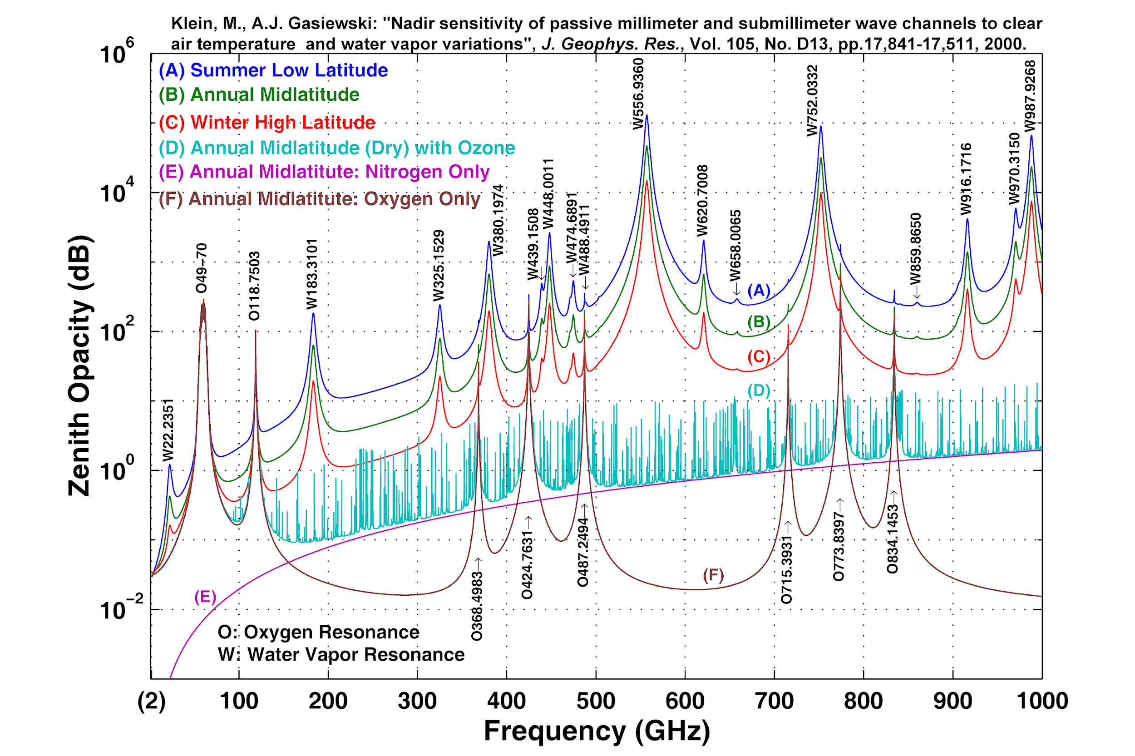
Main channels of EPS-SG MWI and ICI in spectrum
Imaging channels
in the “windows”
Temperature sounding in the
60-118 GHz line
Humidity sounding in the 183 GHz line
..and beyond: Ice Cloud Imager (ICI)

Slide 15
MWI channel performance requirements
Continuity of key microwave imager channels for weather forecast (e.g. SSM/I, AMSR-E, GMI) for precipitation over sea, total column water vapour, cloud liquid water and surface parameters
All MWI channels up to 89 GHz measured with both vertical (V) and horizontal (H) polarisations.
Innovative set of channels in the oxygen absorption band near 50–60 GHz and 118 GHz. Precipitation over sea and land including light precipitation and snowfall
Channels MWI-13 to MWI-18 provide information on water vapour profiles and snowfall. Less sensitive to surface, more usable globally and enabling cloud slicing.
Channel | Frequency (GHz) | Bandwidth (MHz) | NEΔT (K) | Polarisation | Footprint Size 3dB (km)
MWI-1 | 18.7 | 200 | 0.8 | V, H | 50
MWI-2 | 23.8 | 400 | 0.7 | V, H | 50
MWI-3 | 31.4 | 200 | 0.9 | V, H | 30
MWI-4 | 50.3 | 180 | 1.1 | V, H | 30
MWI-5 | 52.70 | 180 | 1.1 | V, H | 30
MWI-6 | 53.24 | 400 | 1.1 | V, H | 30
MWI-7 | 53.750 | 400 | 1.1 | V, H | 30
MWI-8 | 89.0 | 4000 | 1.1 | V, H | 10
MWI-9 | 118.7503±3.20 | 2x500 | 1.3 | V | 10
MWI-10 | 118.7503±2.10 | 2x400 | 1.3 | V | 10
MWI-11 | 118.7503±1.40 | 2x400 | 1.3 | V | 10
MWI-12 | 118.7503±1.20 | 2x400 | 1.3 | V | 10
MWI-13 | 165.5±0.75 | 2x1350 | 1.2 | V | 10
MWI-14 | 183.31±7.0 | 2x2000 | 1.3 | V | 10
MWI-15 | 183.31±6.1 | 2x1500 | 1.2 | V | 10
MWI-16 | 183.31±4.9 | 2x1500 | 1.2 | V | 10
MWI-17 | 183.31±3.4 | 2x1500 | 1.2 | V | 10
MWI-18 | 183.31±2.0 | 2x1500 | 1.3 | V | 10

Slide 16
ICI channel performance requirements
In support of a synergetic use of MWI and ICI both instruments carry common spectral channels at 183 GHz.
Set of channels providing information related to total vertical column of cloud ice and ice particles size
Use of channels around weak absorption lines (around 325.15 GHz and 448 GHz) allows performing cloud slicing
ICI-4 and ICI-11 measure both V and H polarisation providing information on ice hydrometeors habits and orientation
Channel | Frequency (GHz) | Bandwidth (MHz) | NEΔT (K) | Polarisation | Footprint Size 3dB (km)
ICI-1 | 183.31±7.0 | 2x2000 | 0.8 | V | 16
ICI-2 | 183.31±3.4 | 2x1500 | 0.8 | V | 16
ICI-3 | 183.31±2.0 | 2x1500 | 0.8 | V | 16
ICI-4 | 243.2±2.5 | 2x3000 | 0.7 | V, H | 16
ICI-5 | 325.15±9.5 | 2x3000 | 1.2 | V | 16
ICI-6 | 325.15±3.5 | 2x2400 | 1.3 | V | 16
ICI-7 | 325.15±1.5 | 2x1600 | 1.5 | V | 16
ICI-8 | 448±7.2 | 2x3000 | 1.4 | V | 16
ICI-9 | 448±3.0 | 2x2000 | 1.6 | V | 16
ICI-10 | 448±1.4 | 2x1200 | 2.0 | V | 16
ICI-11 | 664±4.2 | 2x5000 | 1.6 | V, H | 16

Slide 17
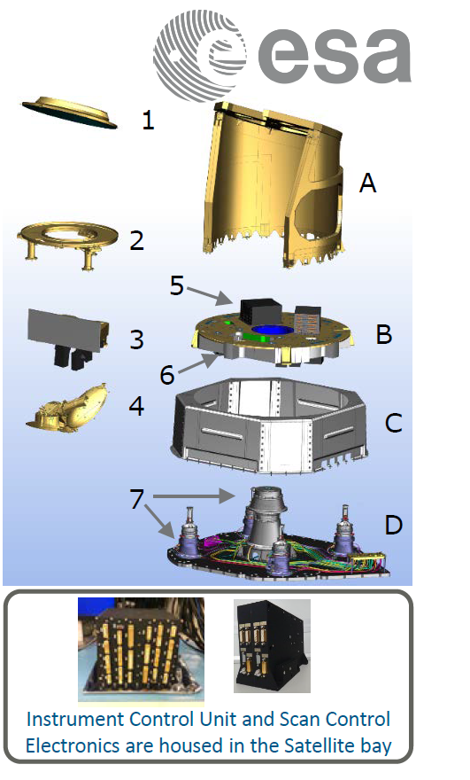
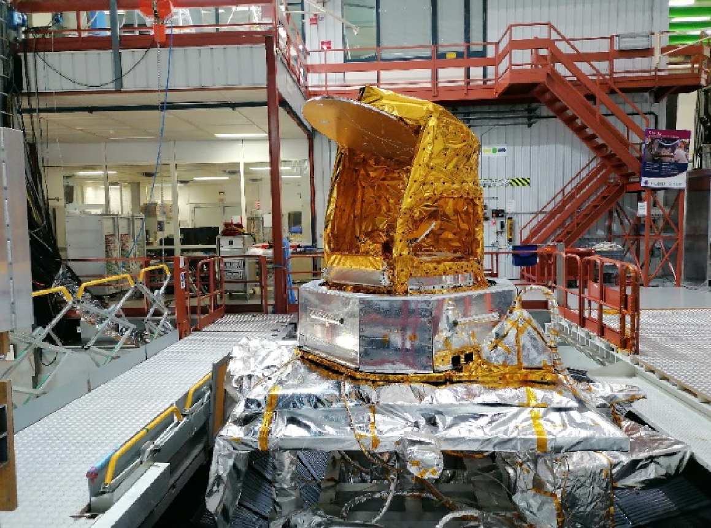
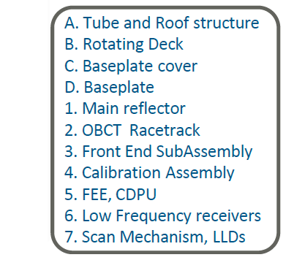
MWI Instrument description
MWI is composed of one rotating part and one fixed part.
The rotating part includes the main reflector antenna, the feed assembly, the receivers and the control and data processing unit (CDPU), which acquires the measurement data and performs the thermal control of the rotating part.
The fixed part contains the hot calibration target, the reflector antenna for viewing the cold-sky, the instrument control unit (ICU) responsible for the instrument control and interface with the platform.
A tubular structural design minimizes the sun intrusions inside the instrument cavity.
Antenna: offset parabolic reflector with feed cluster of 7 horns
Receivers:
- direct detection at 23.8/31.4 and 89 GHz; heterodyne detection for other frequencies.
internal noise diodes for lower frequencies MWI-1 to MWI-3.
RFI mitigation filter on MWI-1
Few data:
mass: 250 kg
height: 1.8 m
reflector diameter: 80 cm

Slide 18
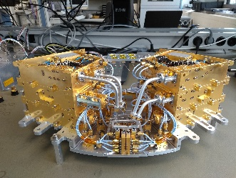
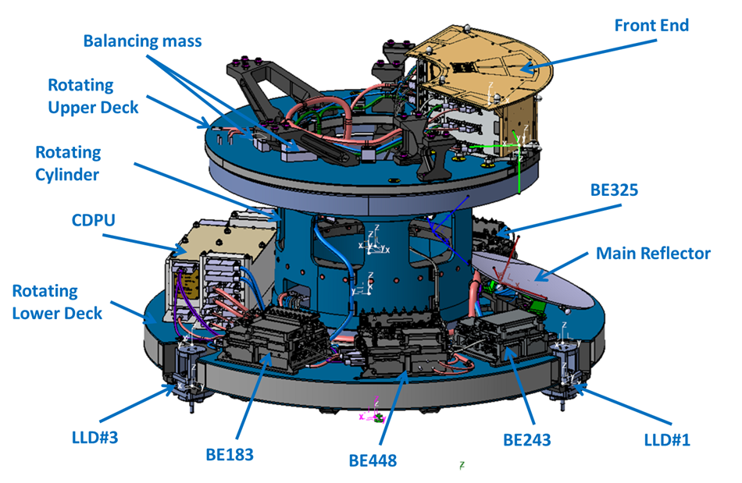
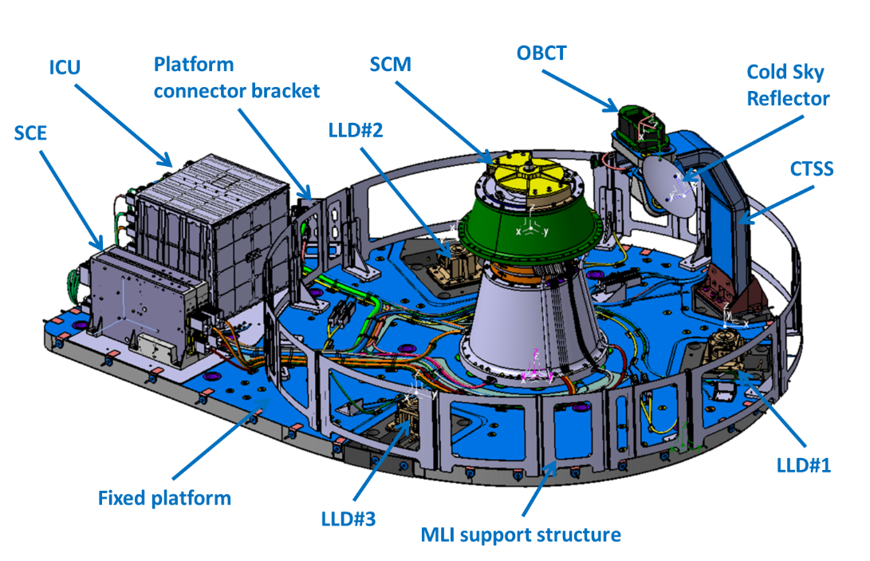
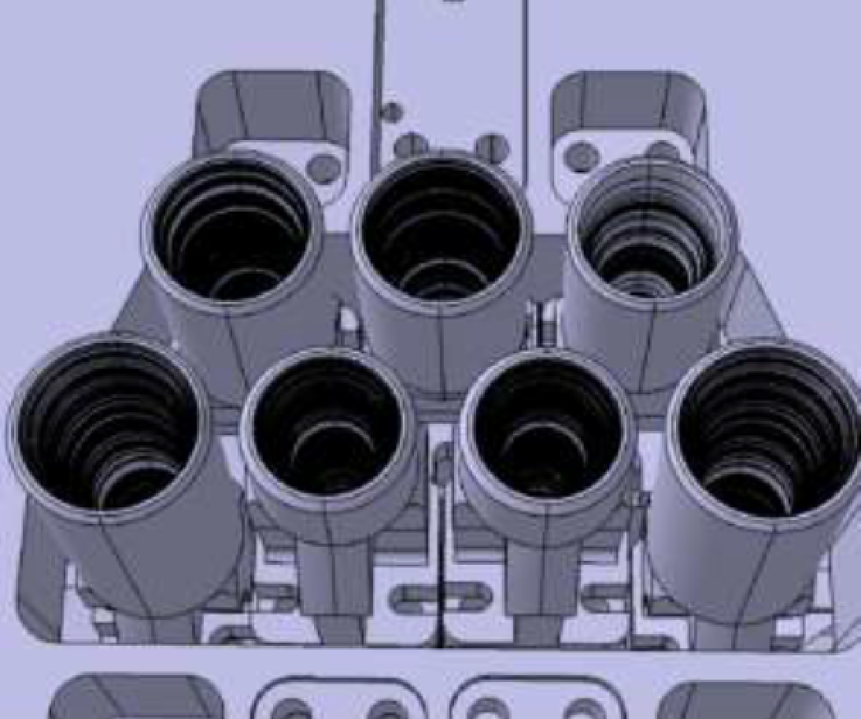
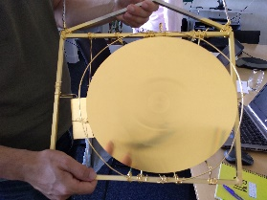
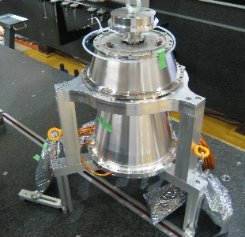
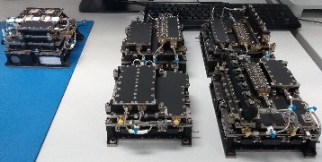
ICI Instrument description
ICI consists of a fixed and a rotating part. A scan mechanism assembly interfaces between both parts.
- The rotating part includes the main reflector antenna, the feed assembly, the receivers and the CDPU.
- The fixed part contains the hot calibration target, the cold-sky reflector, the ICU.
Feed cluster made of 2 rows of 7 horns (4 and 3 per raw). Implementation of a different horn/receiver per polarization.
Receivers technologies: heterodyne detection, double side band mixer.
Few data:
mass: 175 kg
height: 0.7 m
reflector diameter: 30 cm
ICI rotating part showing the main elements
ICI fixed part

Slide 19
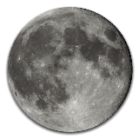
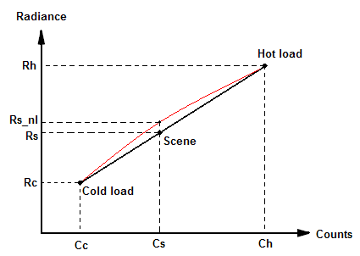
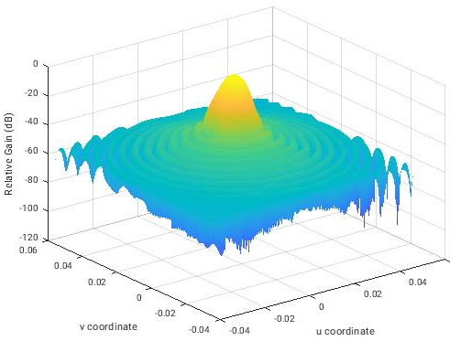
Calibration approach
Cosmic MW Background
C_{C} = Smoothed cold counts
R_{C} = smoothed effective cold radiances
On-Board Calibration Target
C_{h} = Smoothed hot counts
R_{h} = smoothed effective OBCT radiances
Moon
Correction
MWI simulated antenna pattern at 89 GHz
COLD
HOT
ICI
seen from zenith
MWI
seen from zenith
HOT
COLD
EARTH
EARTH
Sun glint
flagging
RFI correction
at MWI 18.7 GHz
Earth scene counts C_{S}
Antenna scene radiances R_{S}
TOA radiances
CALIBRATION
Calculation of gain, offset
and non-linear parameters
APC
MR Spillover and losses
Cross-polarization
Near/Far sidelobe

Slide 20
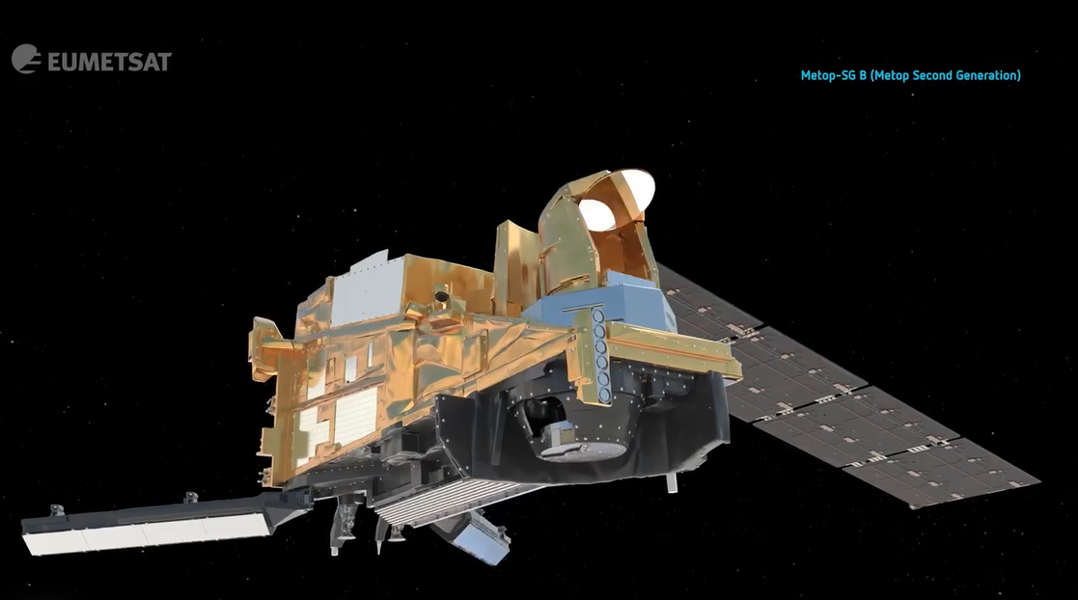
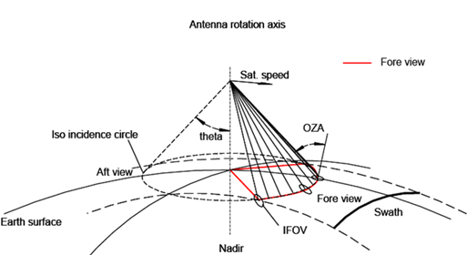
MWI and ICI scanning characteristics
Conically scanning at 45 rpm (about 1.3333 seconds). Incidence angles within 53°±2°. Observations acquired ± 65° in azimuth in the fore view (about 1700 km swath).
ICI: conically scanning counterclockwise, MWI: conically scanning clockwise (as seen from zenith) and are not synchronized.
MWI
ICI
Microwave Imager
Ice Cloud Imager

Slide 21
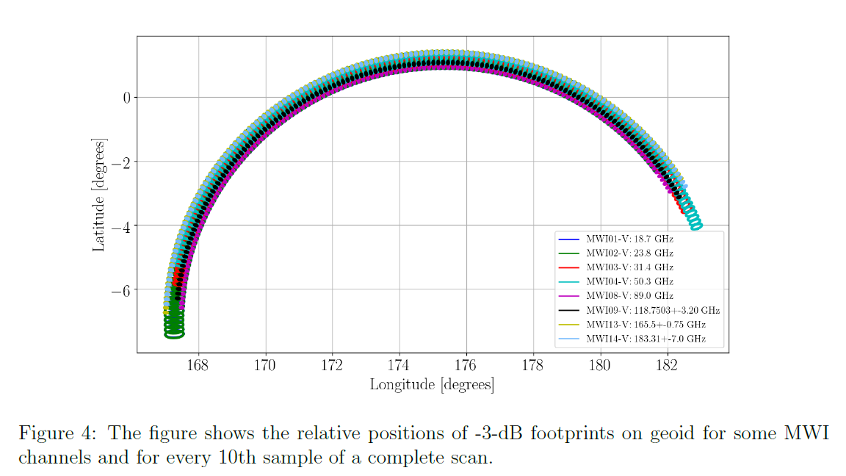
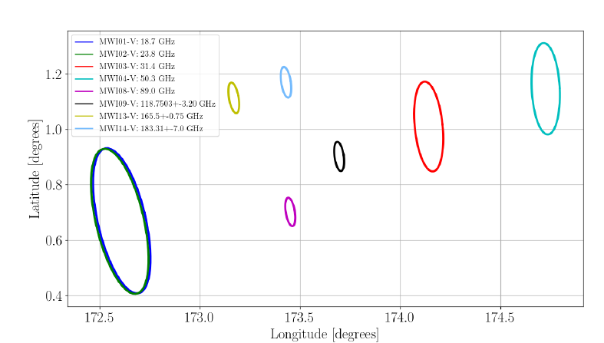
MWI Swath - about 1400 samples per scan
MWI footprint: MWI-1/2 (18.7 / 23.8 GHz): 50 km (59km x 36km); MWI-3/7 (31.4 / 50-54 GHz): 30 km (36km x 22km); MWI-8-18 (89/118/165.5/183 GHz): 10km (12km x 7km)
The number of samples is 1394 for all the channels. The sampling time is about 0.394 ms. The oversampling factor is about 20 for MWI-1 and MWI-2, about 10 at MWI-3 to MWI-7, and 3-5 for MWI-8 to MWI-18.
The distance along-track between subsequent scans will be about 9 km. Footprints overlap along-track requirement is 20%.
36 km x 22 km
59 km x 36 km
12 km x 7 km
Instantaneous, relative positions of -3-dB footprints on the geoid for MWI channels.
Relative positions of -3-dB footprints on geoid for MWI channels of a complete scan.

Slide 22
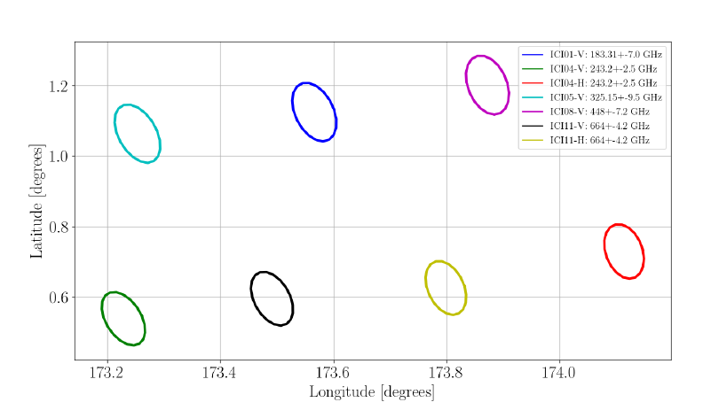
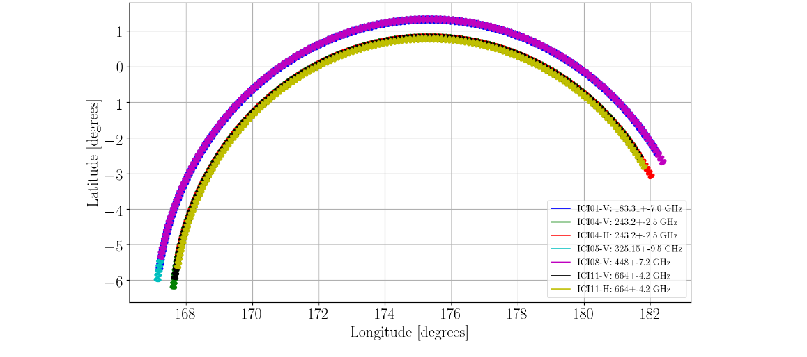
ICI Swath - about 800 samples per scan
ICI footprint: 16 km requirement (ICI-1 to ICI-11): about 20 km along-track and about 12 km across-track for the footprints (at -3 dB).
The number of samples is 782 for all the channels. The sampling time is about 0.663 ms. The oversampling factor is about 3-4.
The distance along-track between subsequent scans will be about 9 km. Footprints overlap along-track requirement is 40%.
20 km x 12 km
Instantaneous, relative positions of -3-dB footprints on the geoid for ICI channels.
Relative positions of -3-dB footprints on geoid for ICI channels of a complete scan.

Slide 23
Outline
MWS: Microwave Sounder of EPS-SG
MWI: Microwave Imager of EPS-SG
ICI: Ice Cloud Imager of EPS-SG
AWS: Arctic Weather Satellite

Slide 24
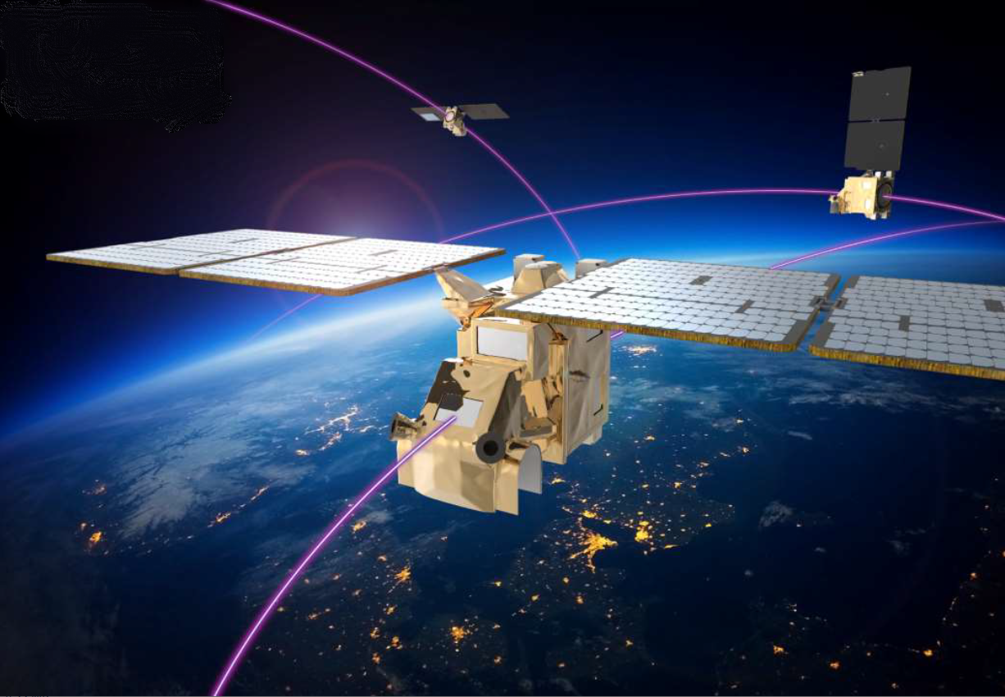
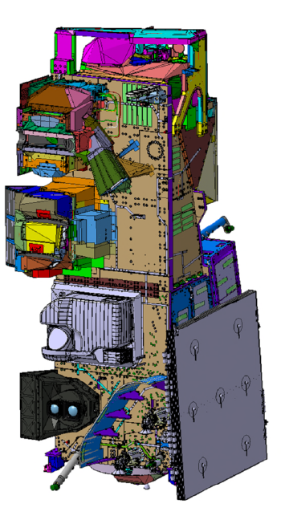
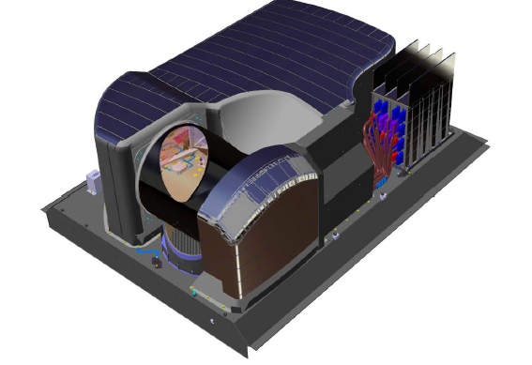
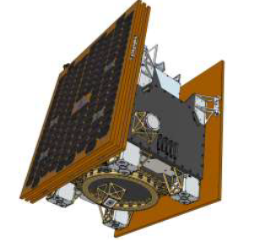
Arctic Weather Satellite*
Spacecraft- three axis stabilised Small Satellite:
135 kg ( MWS on EPS-SG ca.150 kg)
130W (MWS alone ca.120W)
1x 0.5 x 0.7m (MWS 1x1.4x0.5 m)
Sun-synchronous orbit ~600km
Electric Propulsion
Launch: 2024
Satellite lifetime: 5 years
New space approach:
COTS components
Almost no redundancy
* To be renamed

Slide 25
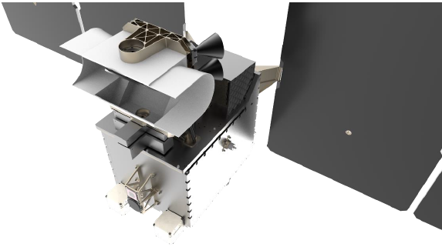
AWS Microwave Sounder
Passive Microwave Radiometer
19 channels to retrieve temperature and water vapour profiles
Requirements derived from MWS on EPS-SG
Cross-track scanner
Rotating antenna 45rpm
4 Feedhorns
Different pointing
Corrected in processing
Calibration:
Onboard blackbody
Deep Space
Arctic Weather Satellite microwave radiometer
Courtesy of ESA

Slide 26
AWS Microwave Radiometer Channels
Channel | Frequency (GHz) | Bandwidth (MHz) | NEdT (K) | Footprint (km) | Utilisation
11 | 50.3 | 180 | <0.6 | ≤ 40 | Temperature sounding
12 | 52.8 | 400 | <0.4 | ≤ 40 | Temperature sounding
13 | 53.246 | 300 | <0.4 | ≤ 40 | Temperature sounding
14 | 53.596 | 370 | <0.4 | ≤ 40 | Temperature sounding
15 | 54.4 | 400 | <0.4 | ≤ 40 | Temperature sounding
16 | 54.94 | 400 | <0.4 | ≤ 40 | Temperature sounding
17 | 55.5 | 330 | <0.5 | ≤ 40 | Temperature sounding
18 | 57.290344 | 330 | <0.6 | ≤ 40 | Temperature sounding
21 | 89 | 4000 | <0.3 | ≤ 20 | Window and Cloud detection
31 | 165.5 | 2800 | <0.6 | ≤ 10 | Window/humidity sounding
32 | 176.311 | 2000 | <0.7 | ≤ 10 | Humidity sounding
33 | 178.811 | 2000 | <0.7 | ≤ 10 | Humidity sounding
34 | 180.311 | 1000 | <1 | ≤ 10 | Humidity sounding
35 | 181.511 | 1000 | <1 | ≤ 10 | Humidity sounding
36 | 182.311 | 500 | <1.3 | ≤ 10 | Humidity sounding
41 | 325.15±1.2 | 800 | <1.7 | ≤ 10 | Humidity sounding/cloud detection
42 | 325.15±2.4 | 1200 | <1.4 | ≤ 10 | Humidity sounding/cloud detection
43 | 325.15±4.1 | 1800 | <1.2 | ≤ 10 | Humidity sounding/cloud detection
44 | 325.15±6.6 | 2800 | <1 | ≤ 10 | Humidity sounding/cloud detection

Slide 27
Thank You
Any Questions?

