Slide 1
Full Waveform Metrology Methods with Frequency-domain Techniques
Yichi Zhang
National Institute of Metrology, Beijing, China

Slide 2
Outline
Full waveform metrology
Time-domain techniques and traceability
Frequency-domain approach
Typical Applications
Discussion

Slide 3
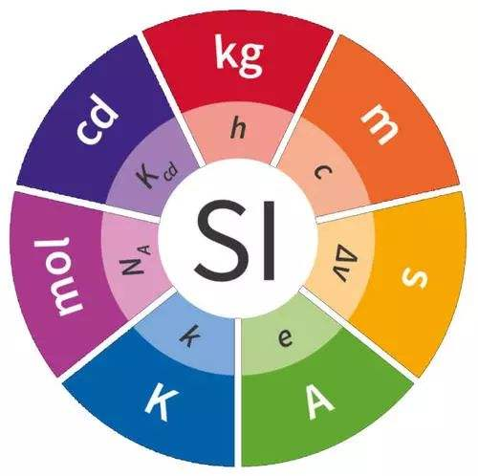
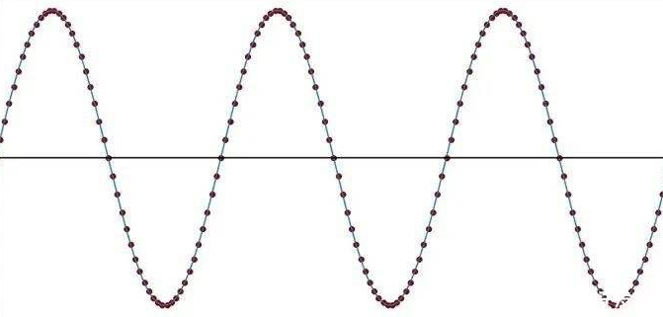
Standards of Fundamental RF Parameters
P
(watt)
Z
(Ω)
Radio-Frequency
Metrology
A
(dB)
V_{RF}
(Volt)
Defined on
Sine Waves
(CW Signals)
E
(V/m)
Noise
(K)
Gain
(dB)

Slide 4
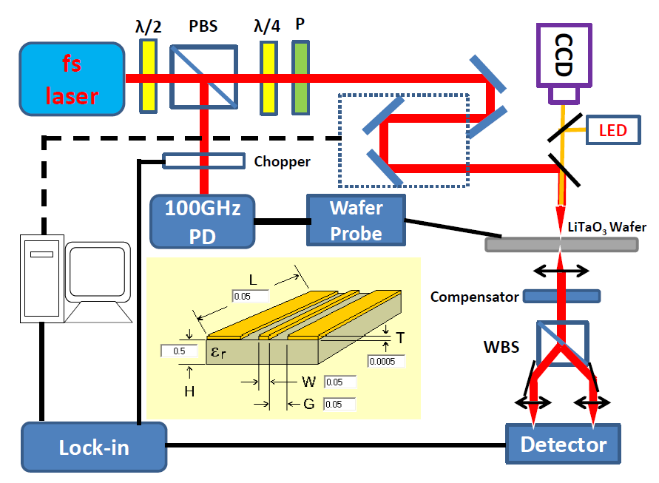
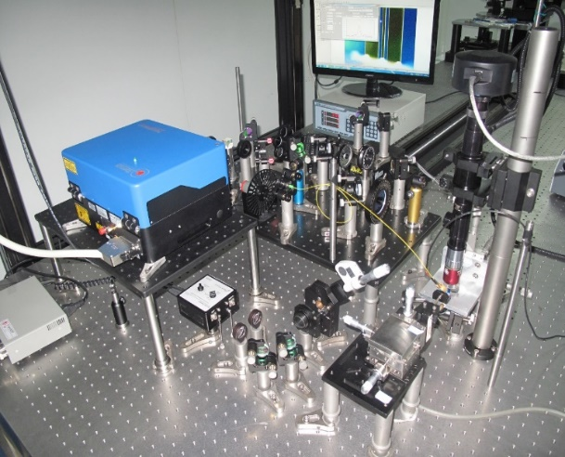
Impulse Waveform Standard
Electro-Optic Sampling (EOS) systems by NMIs
The ONLY primary standard for non-sine RF signals
Traditional application: ultra-fast measurement

Slide 5
Development of Waveform Metrology
Increasing demand by 5G industry
From ultra-fast to wideband complex modulation
From impulse characteristics to point-by-point waveforms
Characteristics
Full waveform metrology
5G signals
V
V
Δt
h
t
t

Slide 6
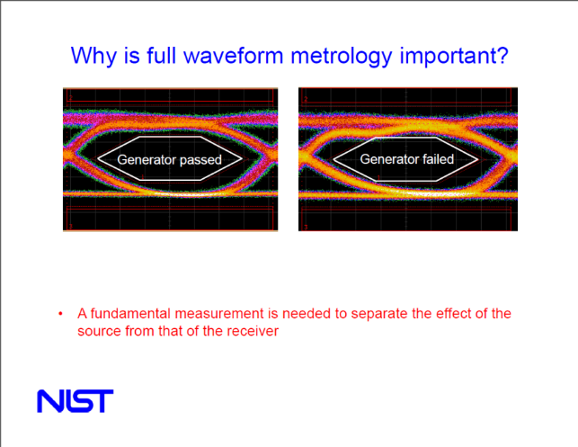
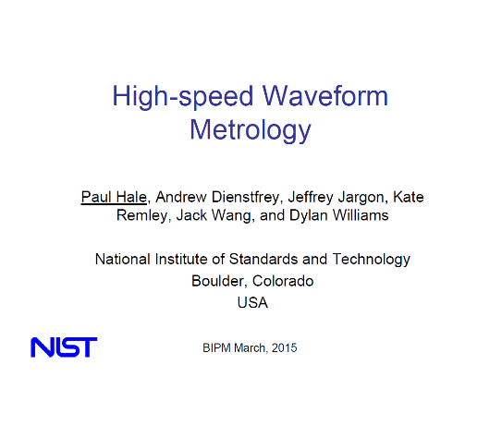
Full Waveform Metrology by NIST
2015, concept proposed by the NIST
2017, strategy of CCEM
Voltage to waveform: Technology trend from voltage to waveform measurements, voltage comparisons will become waveform comparisons at higher frequencies.
Digital communication, 5G, Internet of Things, THz technologies: Need for traceability of fundamental RF&MW measurement quantities at higher frequencies.

Slide 7
Outline
Full waveform metrology
Time-domain techniques and traceability
Frequency-domain approach
Typical Applications
Discussion

Slide 8
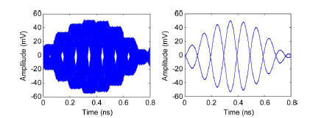
Classic Time-domain Approach
Sampling oscilloscope based measurement system
Precise synchronization between test and auxiliary signals
K. A. Remley, et al, “Millimeter-Wave Modulated-Signal and Error-Vector-Magnitude Measurement With Uncertainty,” IEEE Trans. Microw. Theory Techn., vol. 66, no. 5, pp.1710–1720, May 2015.

Slide 9
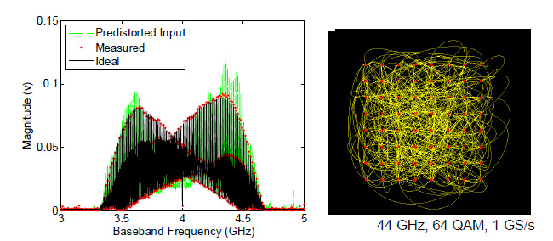
Traceability and Applications
Direct traceability to the EOS primary standard
2015, 64-QAM (44 GHz, 1 GS/s)
2020, OTA reference (92.4 GHz , 1.1 GS/s)
K. Remley, IEEE T-MTT, 2015.
P. Manurkar, IEEE T-MTT, 2020.

Slide 10
Outline
Full waveform metrology
Time-domain techniques and traceability
Frequency-domain approach
Typical Applications
Discussion

Slide 11
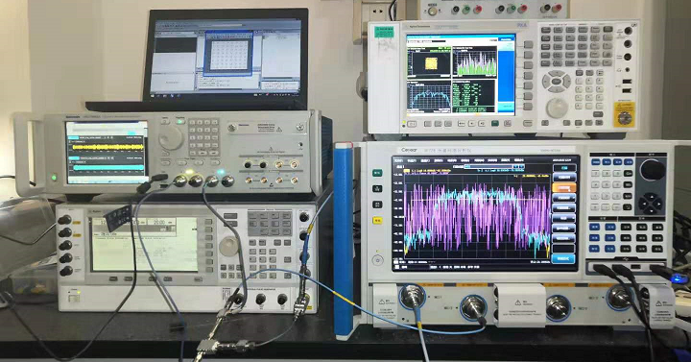
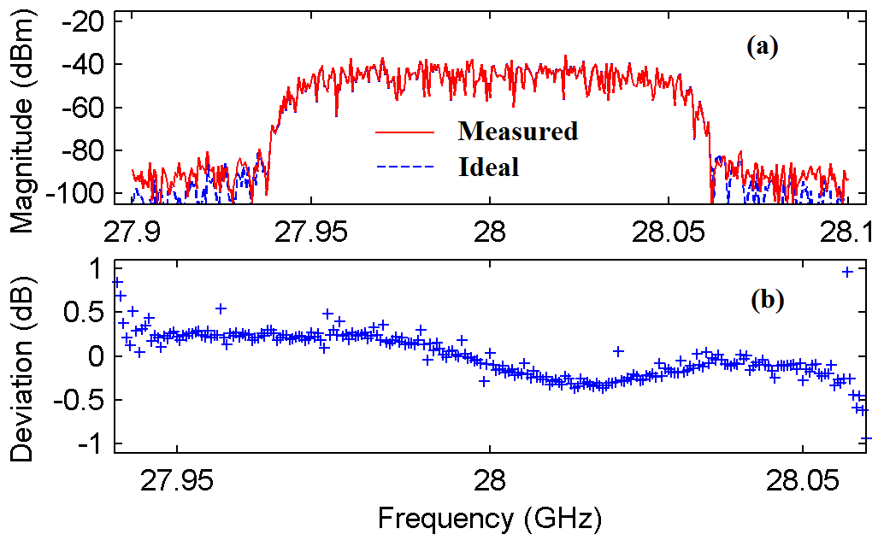
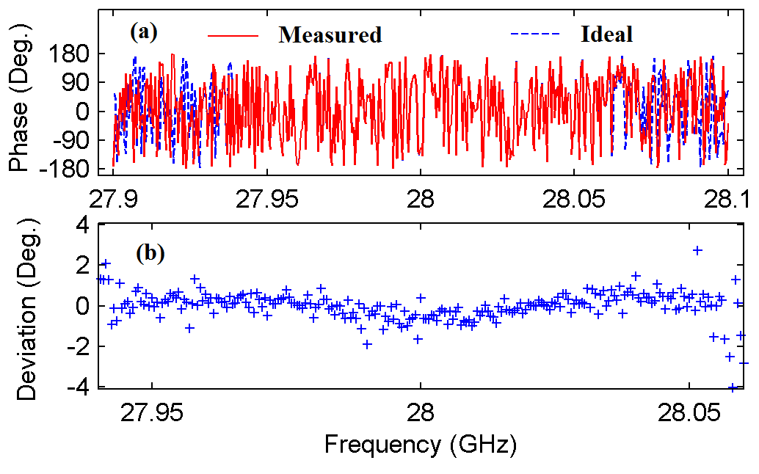
Measurement Principle
Vector Network Analyzer (VNA) based measurement system
Magnitude and phase spectra characterization
Waveform reconstruction

Slide 12
Magnitude and Phase Calibration
Sweep-sine magnitude calibration using power sensor
Dense-spectral-grid phase calibration using pulsed-RF signals

Slide 13
Comparison with Time-domain Technique
Traceability
Time-domain: EOS standard
Frequency-domain: Power standard
Precise synchronization
Time-domain: test signals (LO & IF) and time-base-correction signals
Frequency-domain: test signals and phase REF. / CAL. signals
Advantages
Dynamic range
Simplicity

Slide 14
Outline
Full waveform metrology
Time-domain techniques and traceability
Frequency-domain approach
Typical Applications
Discussion

Slide 15
Standard of Digital Modulation Signal
User-defined 64-QAM / Multisine / Pulsed-RF
Precise synchronization between IF and LO signals

Slide 16
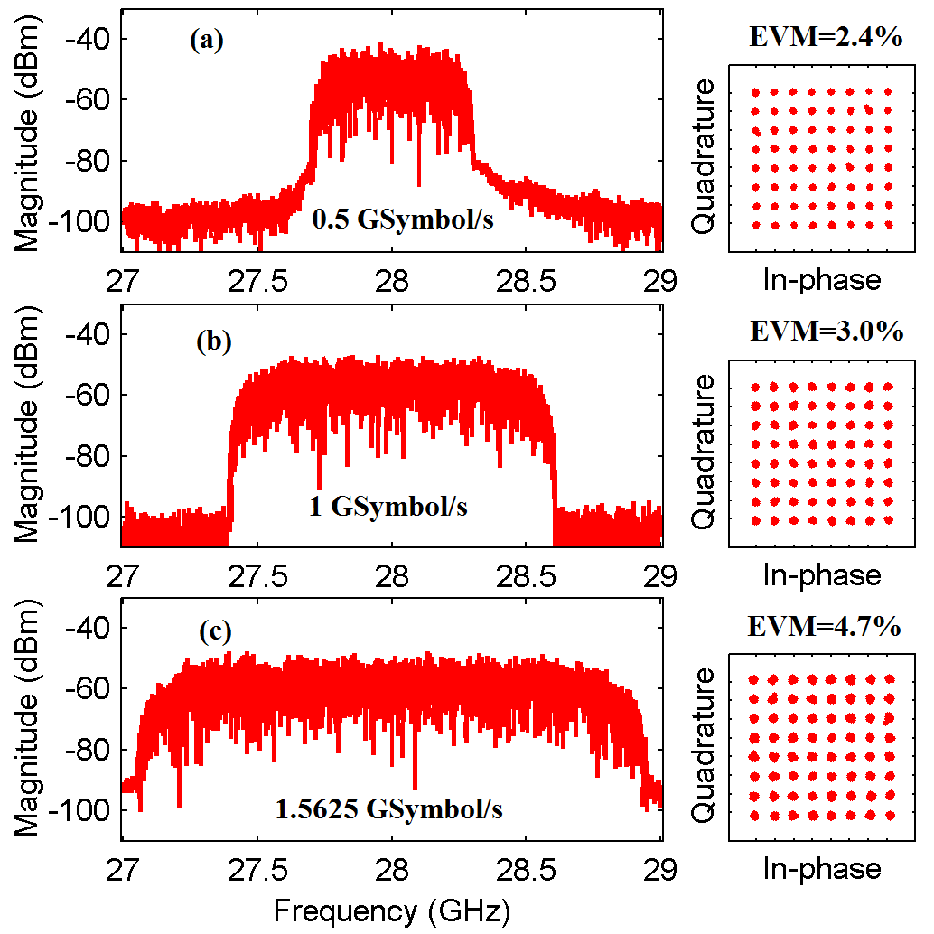
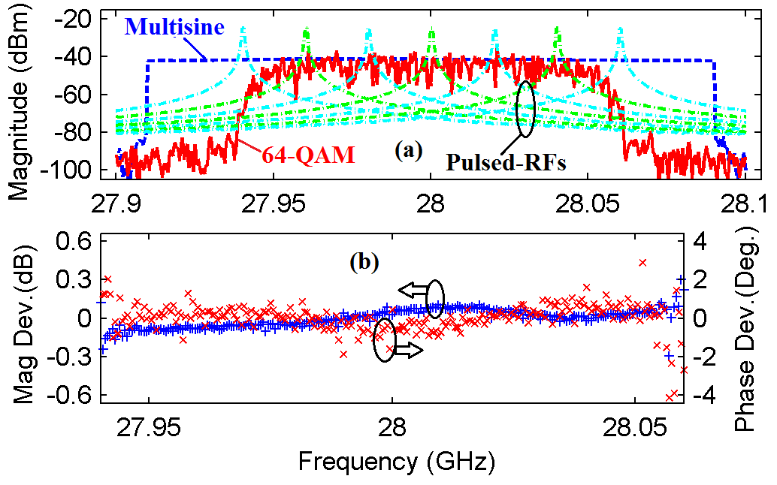
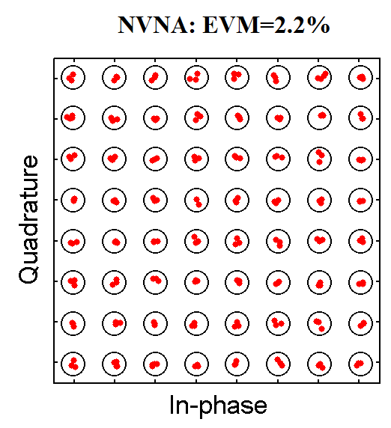
Standard of Digital Modulation Signal
EVM traceable to magnitude and phase measurements
Modulation bandwidth up to 2 GHz
Y. Zhang et al, “Precisely Synchronized NVNA Setup for Digitally Modulated Signal Generation and Measurement at 5G-Oriented Millimeter-Wave Test Bands,” IEEE Trans. Microw. Theory Techn., 2021.

Slide 17
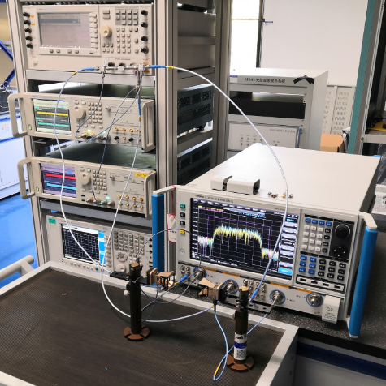
OTA Test of IBFD Antenna Systems
In-band full-duplex (IBFD) test scenario
Non-overlapping spectral design of test stimuli

Slide 18
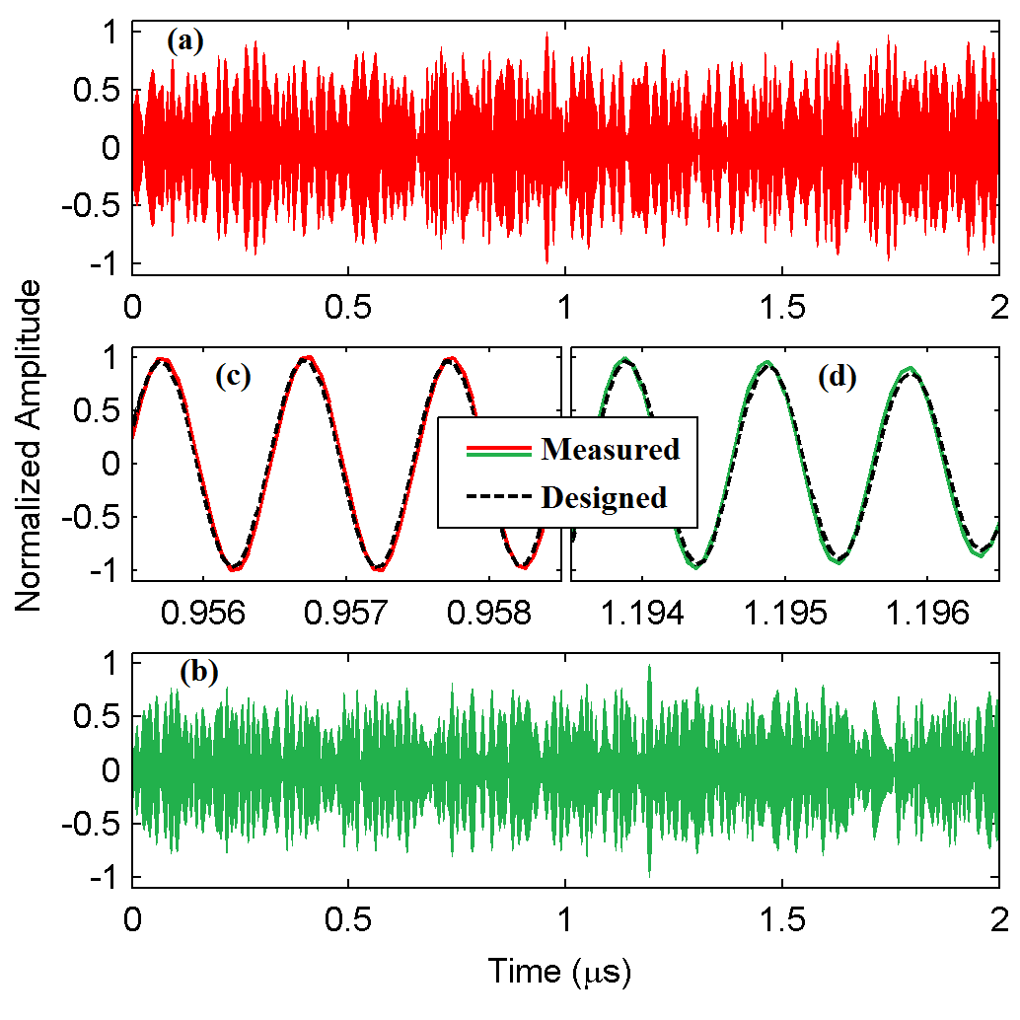
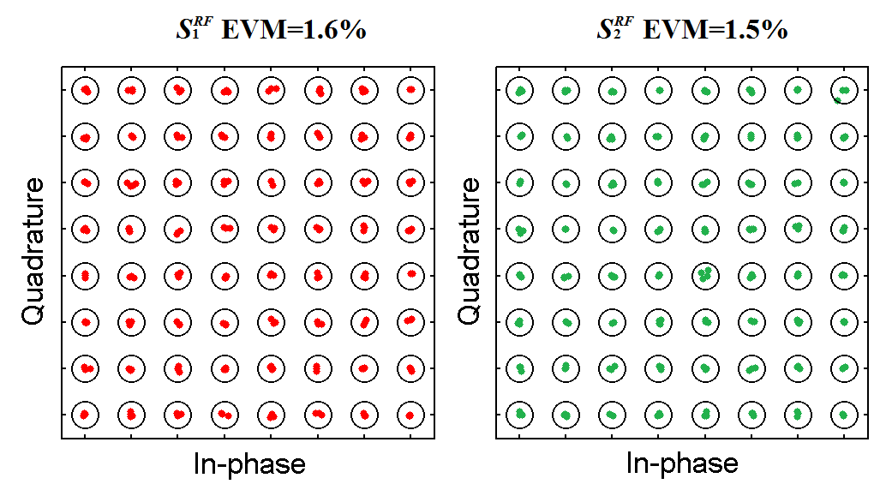
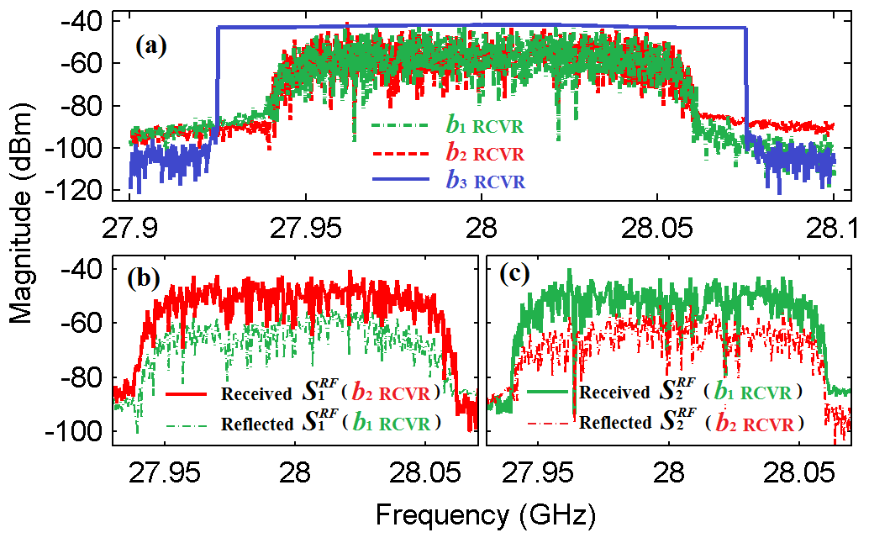
OTA Test of IBFD Antenna Systems
Easy separation of TR and RX signals
EVM performance under ON- and OFF-axis setups
Y. Zhang et al, “NVNA Test Bench for Characterizing In-band Full Duplex Performance of Millimeter-Wave Antennas,” IEEE Trans. Antennas Propag., 2021

Slide 19
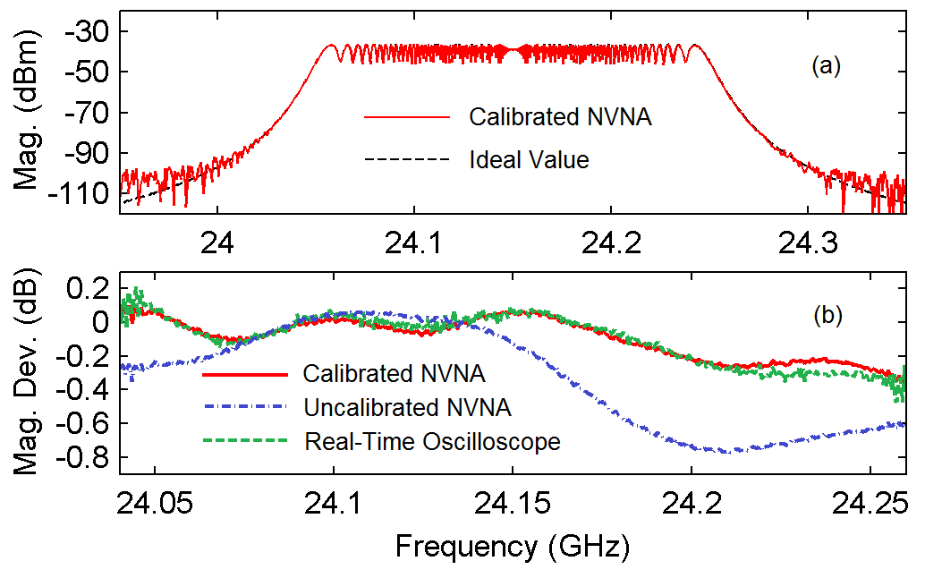
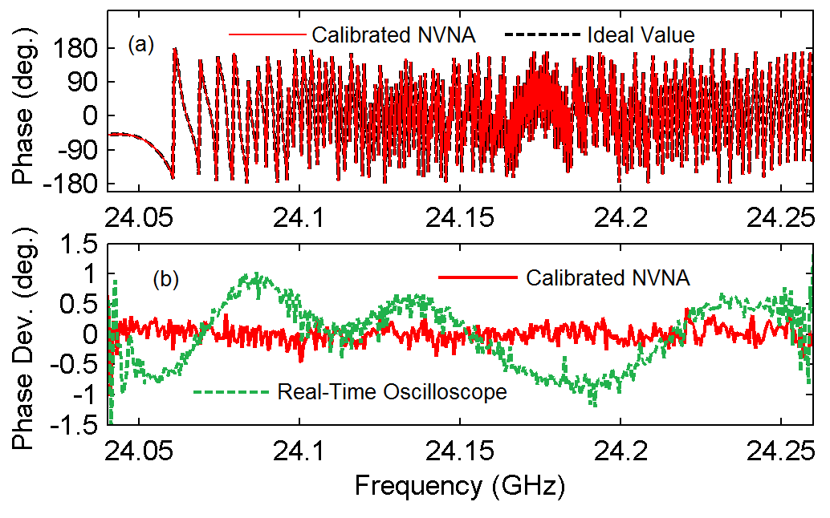
FMCW Calibration for Automotive Radar
Frequency modulation continuous wave (FMCW)
Characterization of chirp parameters

Slide 20
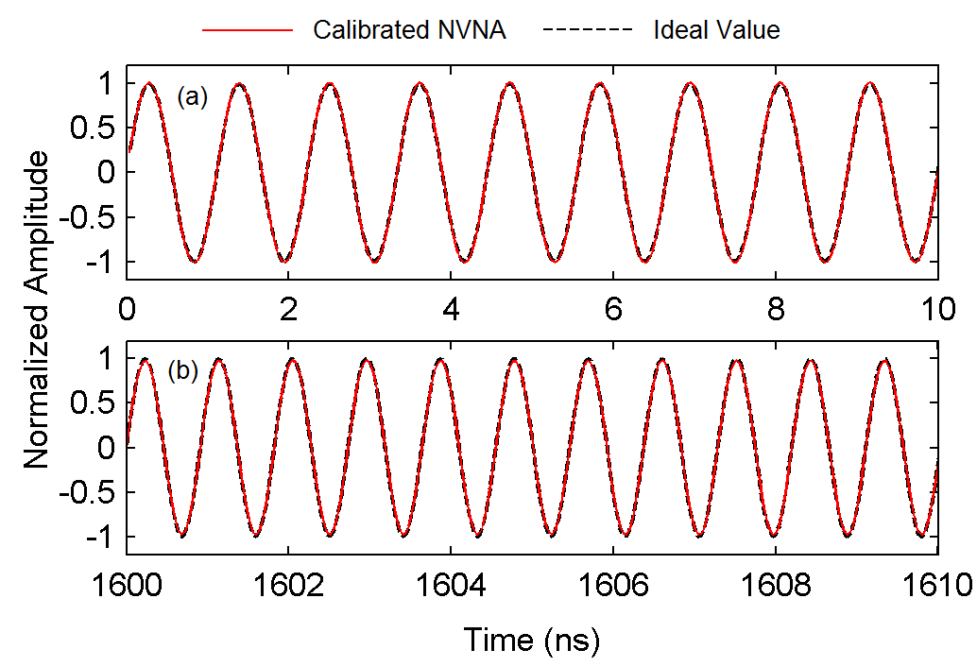
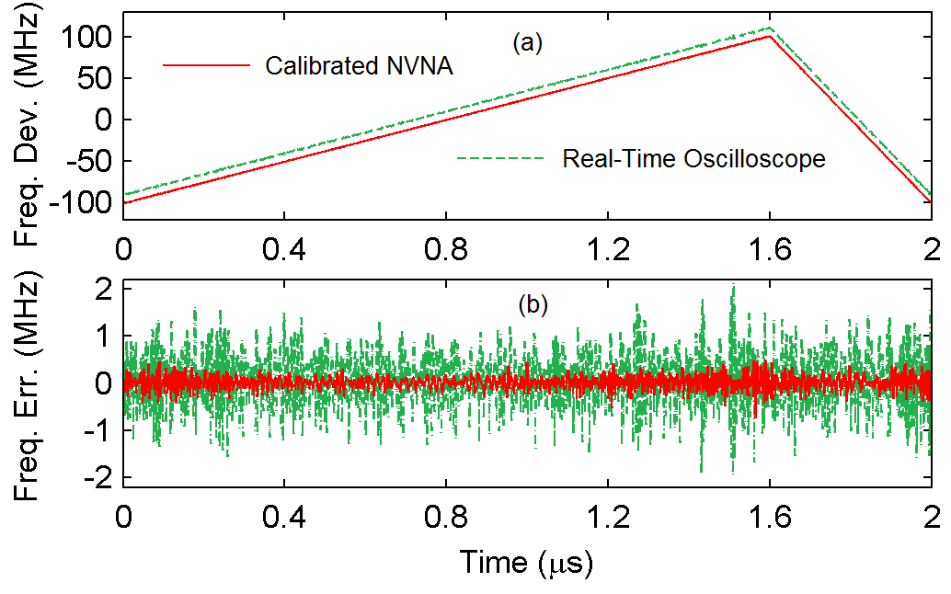
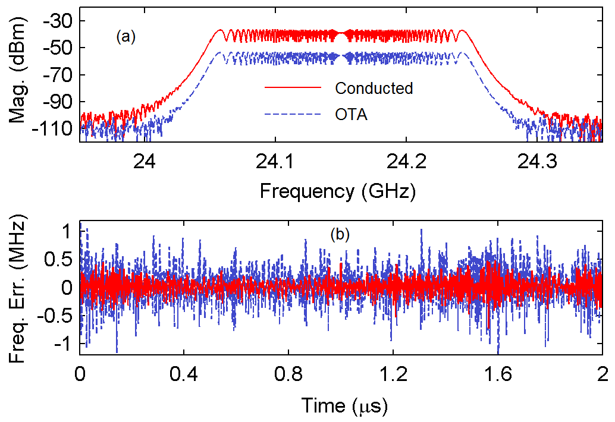
FMCW Calibration for Automotive Radar
Traceable FMCW parameters
Instrument calibration for automotive radar systems
Y. Zhang et al, “Frequency-domain Characterization of Millimeter-wave FMCW Signal based on a precisely synchronized NVNA Measurement Setup,” accepted by IMS2022

Slide 21
Outline
Full waveform metrology
Time-domain techniques and traceability
Frequency-domain approach
Typical Applications
Discussion

Slide 22
Potential Applications for Remote Sensing
Signal level
Measurement standard of wideband complex signals
Traceability to primary RF standards
Instrument level
Calibration of wideband transmitters and receivers
Non-classic parameters of RF metrology
System level
OTA test and verification under realistic working scenarios

Slide 23
Thanks for your attention

