Slide 1
CEOS WGCV Report 2021
Akihiko KUZE (JAXA) and Philippe Goryl (ESA)
Committee on Earth Observation Satellites
Working Group Calibration and Validation

Slide 2
CEOS WGCV and its sub working goups
CEOS Cal-VAL portal
Work plan 2021-2023
Contribution to Global Stocktake of Paris Agreement
Collation with GSICS

Slide 3
CEOS WGCV and its Sub Groups
Committee on Earth Observation Satellites (CEOS) working groups, virtual consternation, and Ad Hoc teams
WGCapD: The Working Group on Capacity Building & Data Democracy
WGClimate: The CEOS/CGMS Working Group on Climate
WGCV: The Working Group on Calibration & Validation
WGDisasters: The Working Group on Disasters
WGISS: The Working Group on Information Systems & Services
Atmospheric Composition (AC-VC) Land Surface Imaging (LSI-VC) Ocean Colour Radiometry (OCR-VC) Ocean Surface Topography (OST-VC) Ocean Surface Vector Wind (OSVW-VC) Precipitation (P-VC) Sea Surface Temperature (SST-VC)
The Ad Hoc Team on Sustainable Development Goals
The Coastal Observations Applications Services and Tools (COAST) Ad Hoc Team
WGCV Sub-groups
Atmospheric Composition (ACSG)
Infrared Visible Optical Sensors (IVOS)
Land Product Validation (LPV)
Microwave Sensors (MSSG)
Synthetic Aperture Radar (SAR)
Terrain Mapping (TMSG)

Slide 4
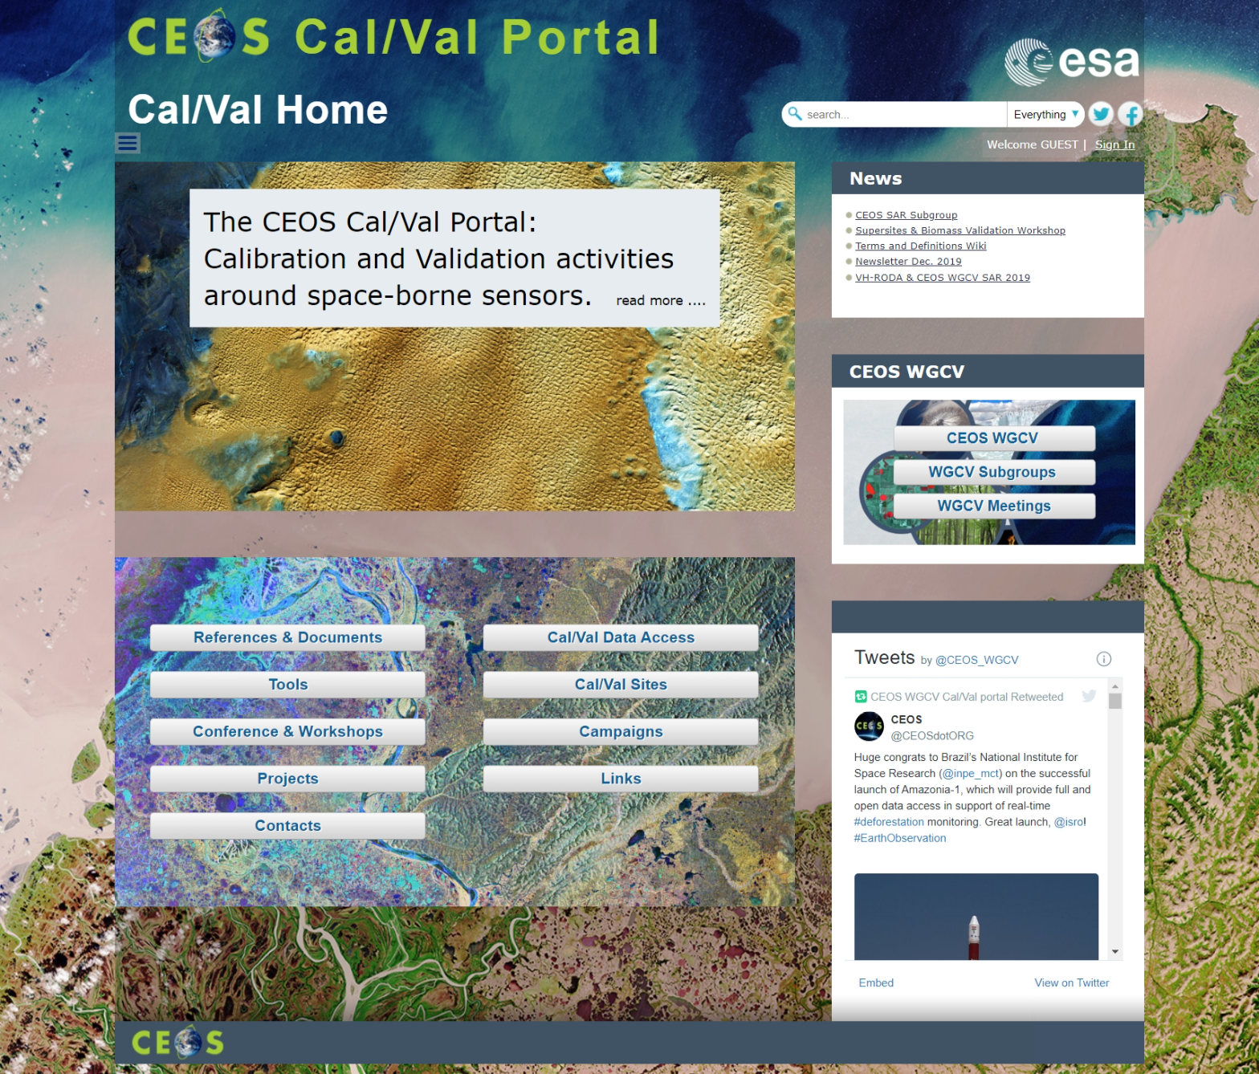
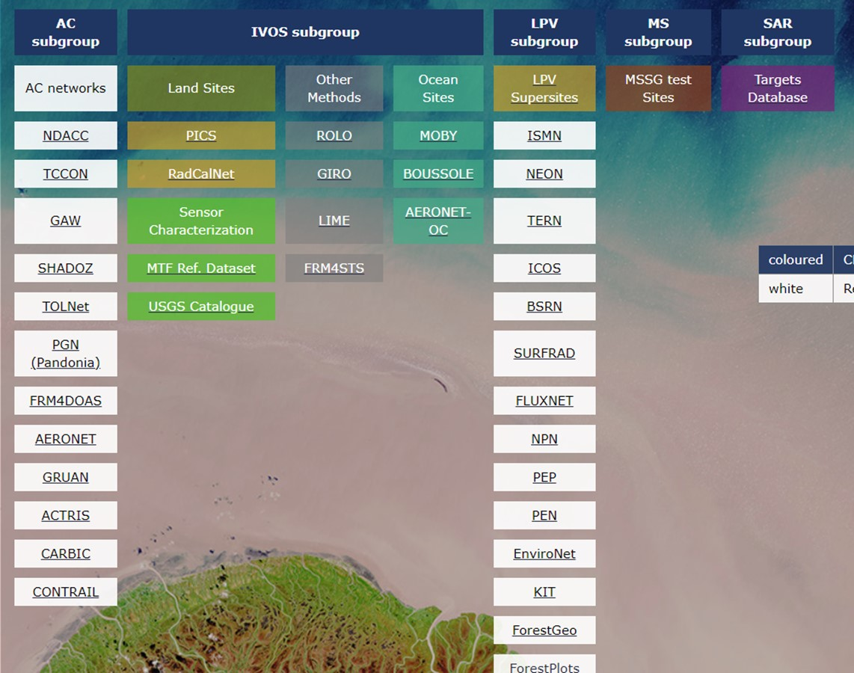
CEOS CAL-Val portal http://calvalportal.ceos.org/
CAL/VAL sites
Campaigns
Tools

Slide 5
CEOS WGCV Work Plan 2021-2023
Two topics on in WP2021-2023
(1) Coordinate and contribute to the development of suitable methodologies for the on-ground characterization of satellite-based EO sensors, the on-orbit calibration of EO missions, and the validation of satellite-based Level 1 and Level 2 products.
Interoperability and utility of Analysis Ready Data (ARD) products
ARD beyond Land (CARD4L)
A similar effort to greenhouse gases (GHG) products such as radiance spectra, densities, and flux suitable for inter-comparisons across multiple missions.
(2) Continue cooperation with GEO, Global Space-based Inter-calibration System (GSICS), and WMO and ground-based networks in the provision of high quality EO data products.
The WGCV will continue to strengthen its cooperation with GSICS in the topic of sensor calibration following the joint effort on a recommendation for a GSICS/CEOS solar spectrum that ensures interoperability.

Slide 6
CEOS WGCV Priorities Contribution to Paris Agreement
(1)GHG CAL-VAL
<Recent results>
• Intercomparison Radiance Spectra: Radiometric calibration consistency between OCO-2,-3, GOSAT, -2, TROPOMI by intense vicarious calibration campaign in Railroad Valley NV, U.S.A (RRV2020 analysis and plan for RRV2021 campaign)
•Recent lunar calibration progress for both NIR and SWIR
•XCO₂, XCH₄ products Intercomparison between different satellites and algorithms (more than 5 instruments)
•Support Flux: Multi satellite data input to assimilation model, use of short-lived NO₂ data for local flux, flux validation data by ground, air-borne observations
<Further investigations>
•Large footprint and BRDF corrections for intercomparison with high spectral resolution spectrometers
•High spectral resolution Solar data, especially in SWIR such as 2.3 μm.
(2) Biomass CAL-VAL
<Recent results>
(Published) The Soil Moisture Product Validation Good Practices Protocol (Nov. 30) http://ceos.org/about-ceos/publications-2/.
(Endorsed) The Biomass Validation Protocol by the WGCV LPV
<Further investigations>
Second Biomass Retrieval Inter-comparison eXperiment (BRIX-2).
New products such as solar-induced fluorescence (SIF)

Slide 7
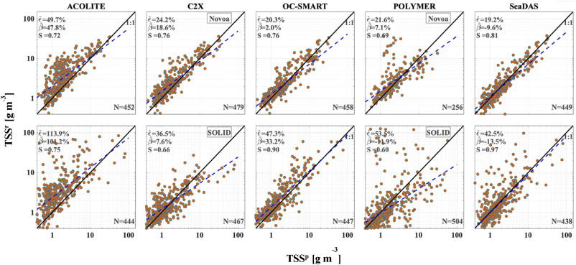
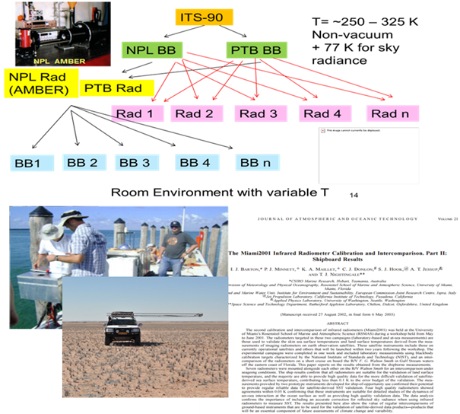
CEOS WGCV Intercomparison
Algorithm Intercomparison exercise
→ Algorithm knowledge
ACIX – Atmospheric correction
CMIX – Cloud Masking
DEMIX – DEM intercomparisom
BRIX – Biomass Algorithm Intercomparsion
Insitu – FRM Intercomparison exercise
Community agreed protocols and reference
FRM4ST – Sea and Land Surface Temperature
FRM4OC – Ocean Colour
SRIX4VEG – Surface reflectance
FRM4GHG – Green House Gases
Reference Calibration / Validation Network
RadCalNet - SI-traceable Top-of-Atmosphere (TOA)
spectrally-resolved reflectances
SarCalNet – in preparation – network for SAR calibration

Slide 8
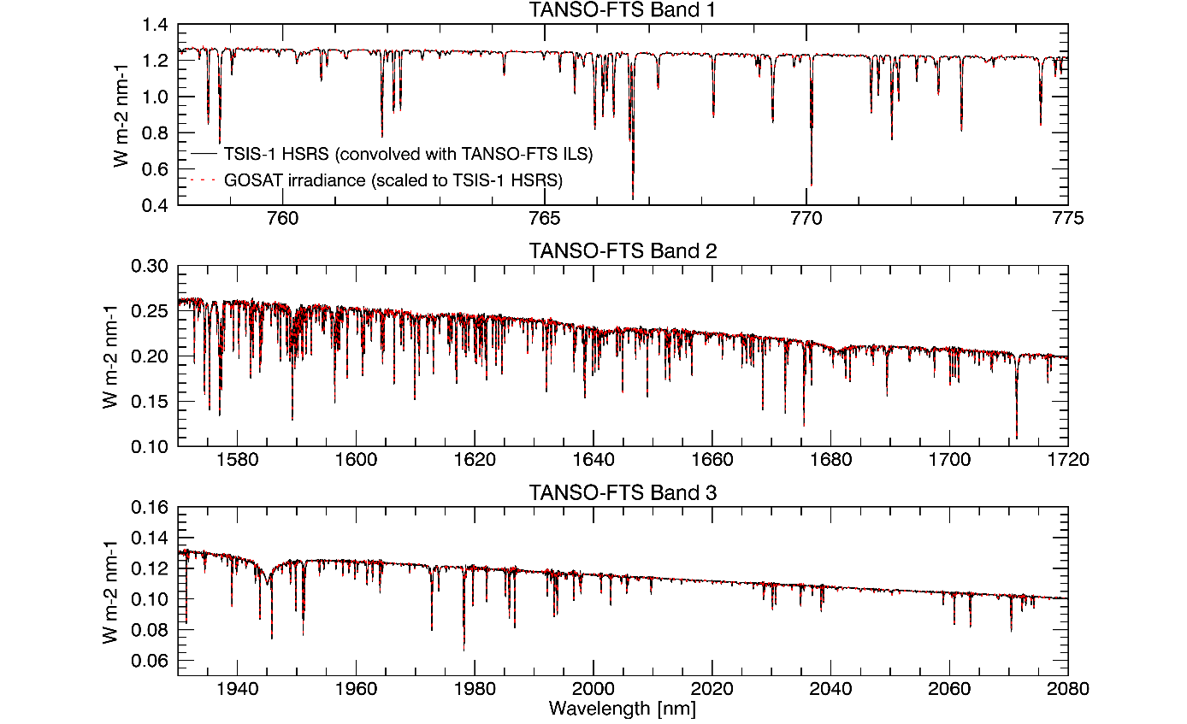
Collaboration with GSICS
Possible collaboration items
Rayleigh intercomparison activities
Solar irradiance : New Sun Irradiance (SI) dataset from the NASA's Total and Spectral Solar Irradiance Sensor, TSIS-1.
Standards for calibration of space-based CO₂ and CH₄ sensors.
MWR subgroup
…….
TSIS HYBRID (0.001nm) convoluted with GOSAT ILS vs. GOSAT solar calibration data. Courtesy of Odele Coddington, LASP

