Slide 1
JMA Agency Report 2021
OKUYAMA Arata, KODERA Kazuki
and TANAKA Hideaki
Meteorological Satellite Center of JMA

Slide 2
Presentation Overview
Summary of Agency’s GSICS Activities, Action & Achievements
Agency’s support to GDWG Activities
Agency’s support to GRWG Activities
Agency’s Instruments Updates
Level 1 Reprocessing Activities

Slide 3
Agency’s GSICS Activities for an Action
Status of GSICS Correction by JMA
Near-Real Time Correction
Himawari-8 / AHI / IR vs. IASI-A/-B, AIRS : in Demonstration phase
MTSAT-2 / IMAGER / IR vs. AIRS, IASI-A : in Demonstration phase
Re-analysis Correction
Himawari-8 / AHI / IR vs. IASI-A/-B, AIRS : in Demonstration phase
MTSAT-2 / IMAGER / IR vs. AIRS, IASI-A : in Demonstration phase
1 activity responding to actions or recommendation is achieved.
R.GIR.20210113.3 | JMA is recommended to present the inter-calibration results with and without gap filling to the team .
 | → will be reported in the web meeting on 8 April.

Slide 4
Support to GDWG Activities
A landing page of JMA/MSC is updated responding to the update of WMO/OSCAR.
WMO/OSCAR page’s structure was updated in the last October. JMA/MSC landing page (calibration portal page) has some links to the WMO/OSCAR. The links were updated. (in response to an action in CGMS)
The CGMS action also recommend for members to make SRF information available on their landing page. We confirmed that JMA/MSC landing page has the information.
JMA/MSC landing page
https://www.data.jma.go.jp/mscweb/en/oper/calibration/calibration_portal.html

Slide 5
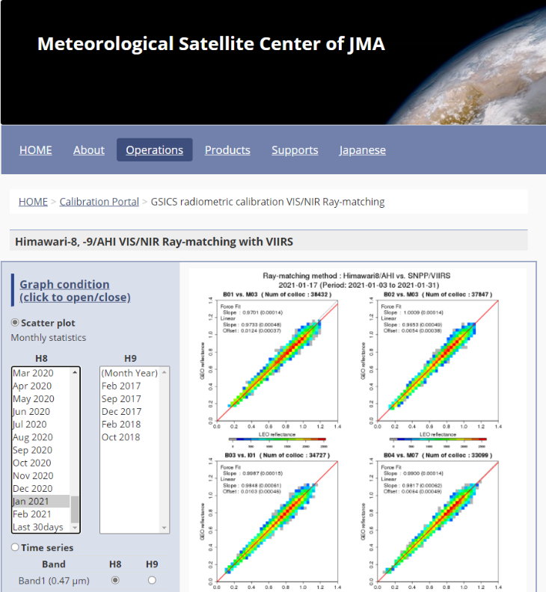
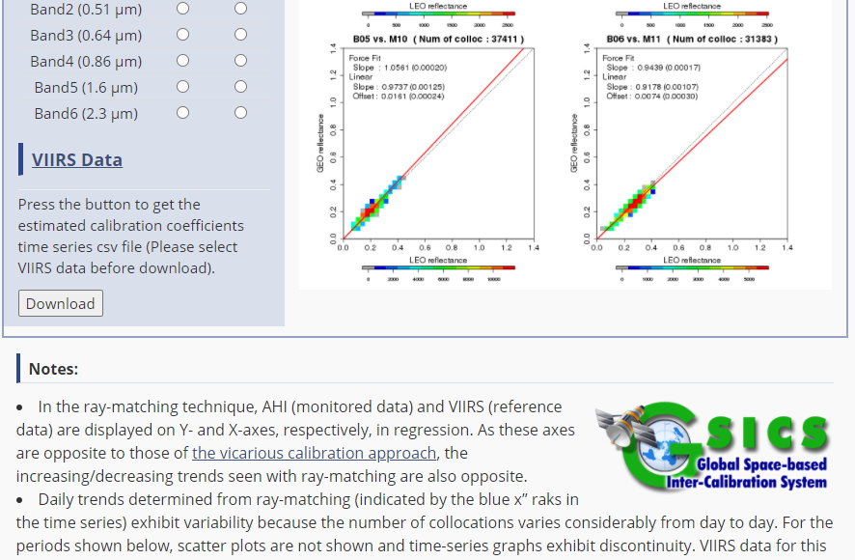
Support to GRWG Activities for AHI
Ray-matching approach
The results for SNPP/VIIRS will be published on the JMA/MSC web page in Q2 2021.
N20/VIIRS will be utilized in the future.
Vicarious calibration approach
The approach using liquid cloud target is currently published based on MODIS. Support to SNPP/VIIRS is in preparation.
Lunar cal
Investigation of E-W dependencies of AHI scan mirror reflectivity was reported in the Third Joint GSICS/IVOS Lunar Calibration Workshop (Nov. 2020)
IR
The inter-calibration supports IASI-A/B, AIRS, and SNPP/CrIS. N20/CrIS and IASI-C will be supported in 2021.
B07 (3.9um) inter-calibration is reported in the web meeting (Jan. 2021). The update is reported in the meeting on 8 April.

Slide 6
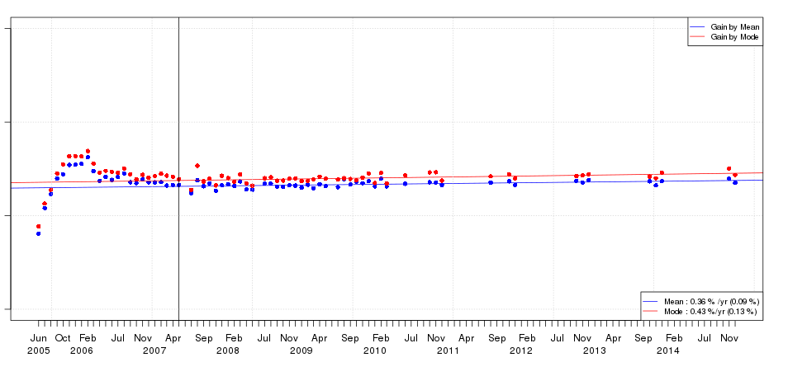
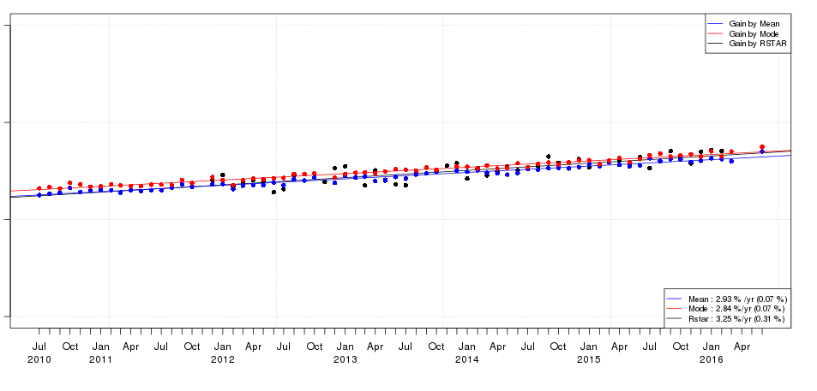
Level 1 Reprocessing Activities
degradation
Gain (MODIS / GEO)
2.0
MTSAT-1R
DCC
The following visible band data are processed as a contribution to the DCC paper.
MTSAT-1R VIS: 2005 to 2014
MTSAT-2 VIS: 2010 to 2016
Himawari-8 B01-B06: 2015 to 2020
This work will be reported in the VNIR sub-group web meeting in the future.
1.5
1.0
(After May 2007)
Mode: 0.43±0.13%/y
Mean: 0.36±0.09%/y
0.5
2.0
MTSAT-2
1.5
1.0
Mode: 2.84±0.07%/y
Mean: 2.93±0.07%/y
0.5
1.2
Himawari-8
1.1
1.0
0.9
Mode: 0.58±0.09%/y
Mean: 0.40±0.09%/y
0.8

Slide 7
Instruments Updates
Himawari-8 (operational since Jul. 2015)
Advanced Himawari Imager (AHI) with 16 spectral bands
Full-disk observation every 10 min + regional observations every 2.5/0.5 min
Scheduled data outage due to maintenance:
17 Dec. 2019, 18 Feb. 2020 and 17 Feb. 2021
Event log: https://www.data.jma.go.jp/mscweb/en/oper/event_H8.html
Himawari-9 (in-orbit standby since Mar. 2017)
will take over a role of operational satellite from Himawari-8 in 2022 (JFY). Detail of the schedule will be announced in the future.
JFY 2010 2015 2022 2029
Himawari-8 Himawari-9
Launch
Operational
In-orbit standby
Manufacturing
In-orbit standby
Operational
Launch

Slide 8
Additional Slides not Presented
Introduce/Confirm the Agency’s Personnel supporting GSICS

Slide 9
Personnel supporting GSICS
EP
YAMADA Kazutaka
GRWG
OKUYAMA Arata
IR, Lunar, GEO-GEO
KODERA Kazuki
VNIR Ray-matching, DCC
TANAKA Hideaki (leave GSICS work in March 2021)
A new person (in April 2021)
VNIR DCC, vicarious calibration (RTM approach using LEO)
GDWG
OKUYAMA Arata
GPRC Points of contacts for operational matters
OKUYAMA Arata

Slide 10
Thank you for your attention
JMA/MSC Calibration portal
https://www.data.jma.go.jp/mscweb/en/oper/calibration/calibration_portal.html

