Slide 1
FCDR Activities at EUMETSAT
Presented by Viju John
GSICS Annual Meeting, March 2021

Slide 2
Outline
New datasets and highlights
Quality control
SCOPE-CM – “GEO-Ring FCDR”
Summary

Slide 3
Released datasets since last GSICS Annual Meeting
Data Record | Period | Satellite | Status
Visible
MVIRI R1 | 1981 – 2017 | Meteosat-2, -3, -4, -5, -6, -7 | Available from https://navigator.eumetsat.int/product/EO:EUM:DAT:0080
Infrared
MVIRI R1 | 1981 – 2017 | Meteosat-2, -3, -4, -5, -6, -7 | Available from https://navigator.eumetsat.int/product/EO:EUM:DAT:0080
HIRS R1 | 1978 – 2020 | TIROS-N, NOAA-6 to 19, Metop-A & -B | Available on request to ops@eumetsat.int
Microwave
SSM/T-2 R2 | 1994 – 2005 | DMSP-11, -12, -14, -15 | Available from https://navigator.eumetsat.int/product/EO:EUM:DAT:0343
MHS R2 | 2006 – 2018 | Metop-A & -B | Available from https://navigator.eumetsat.int/product/EO:EUM:DAT:0344
MWHS-1 R1 | 2008 – 2018 | FY-3A & -3B | Available from https://navigator.eumetsat.int/product/EO:EUM:DAT:0348
MWHS-2 R1 | 2013 – 2018 | FY-3C | Available from https://navigator.eumetsat.int/product/EO:EUM:DAT:0349
ATMS R1 | 2011 – 2018 | SNPP | Available from https://navigator.eumetsat.int/product/EO:EUM:DAT:0345
Radio Occultation
GRAS R3 | 2006 – 2020 | Metop-A, -B, & -C | Available on request to ops@eumetsat.int
IGOR R1 | 2006 – 2020 | COSMIC | Available on request to ops@eumetsat.int
Black Jack R1 | 2007 – 2017 | GRACE | Available on request to ops@eumetsat.int
Black Jack R1 | 2001 – 2008 | CHAMP | Available on request to ops@eumetsat.int

Slide 4
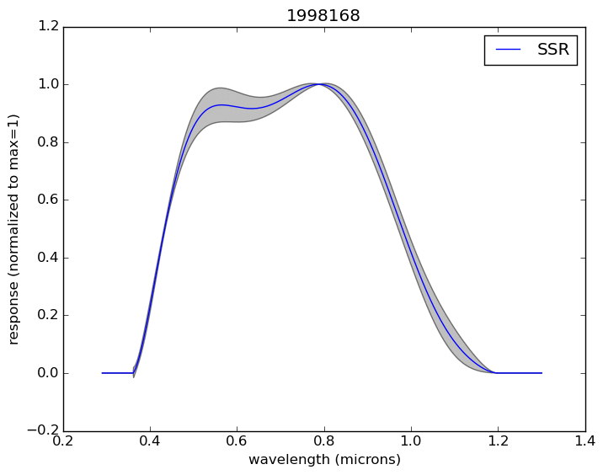
Uncertainty Characterised MVIRI VIS Channel FCDR
SRF Reconstruction
Rüthrich, F., V. O. John, R. A. Roebeling, R. Quast, Y. Govaerts, E. Wooliams, and J. Schulz (2019) Climate Data Records from Meteosat First Generation Part III: Recalibration and Uncertainty Tracing of the Visible channel on METEOSAT 2-7 using Reconstructed, Spectrally Changing Response Functions, Remote Sens., 11, 1165, https://www.mdpi.com/2072-4292/11/10/1165

Slide 5
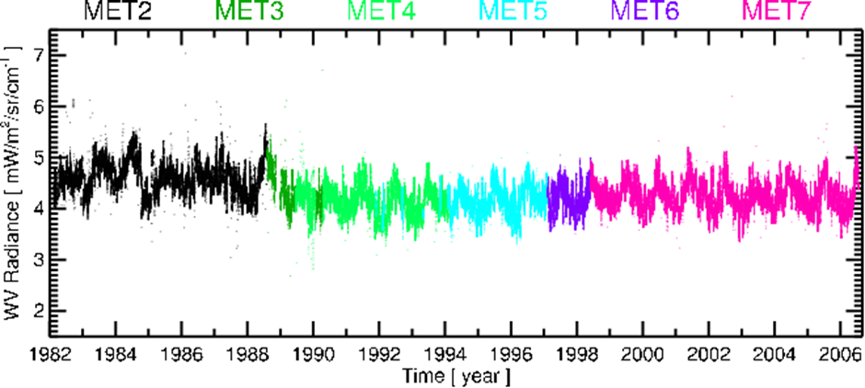
Recalibrated Meteosat IR and WV channel radiances
Recalibration using HIRS/2, AIRS, IASI
Following GSICS methods for colocations
Calibration coefficients to from counts-to-radiance
In collaboration with JMA, infrared channels of GMS, MTSAT-1R and MTSAT-2 were also recalibrated
John, V. O.; T. Tabata; F. Rüthrich; R. Roebeling; T. Hewison; R. Stöckli; J. Schulz (2019) On the Methods for Recalibrating Geostationary Longwave Channels Using Polar Orbiting Infrared Sounders, Remote Sens. 11, no. 10: 1171. https://doi.org/10.3390/rs11101171
Tabata, T.; John, V.O.; Roebeling, R.A.; Hewison, T.; Schulz, J. Recalibration of over 35 Years of Infrared and Water Vapor Channel Radiances of the JMA Geostationary Satellites. Remote Sens. 2019, 11, 1189. https://doi.org/10.3390/rs11101189

Slide 6
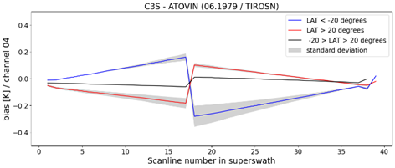
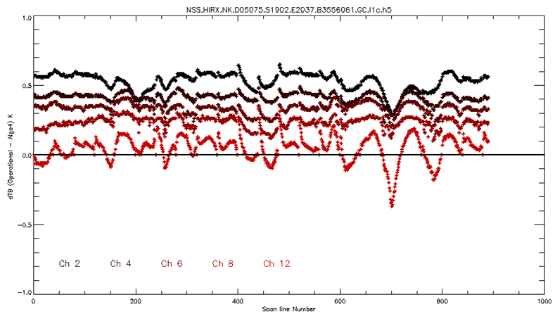
New HIRS data record
Consistent calibration across three generations of instruments (HIRS/2, HIRS/3, and HIRS/4) using Cao et al. (2007) algorithm:
Biases in the centre of super-swath (~0.5 K) for HIRS-2 measurements is removed;
Biases (up to 0.6 K) in the version 3 algorithm (1998-2005) is removed;
Application results in filled gaps in operational time series and more temporal consistency.
Operational
FDR
Notes:
Channel-4 Upper troposphere temperature
The second figure is a replicate of a plot from the paper introducing V4 algorithm. NOAA15 March 16. Cao, C., Jarva, K., & Ciren, P. (2007). An Improved Algorithm for the Operational Calibration of the High-Resolution Infrared Radiation Sounder, Journal of Atmospheric and Oceanic Technology, 24(2), 169-181.
Left is operational time series, right FDR. Red median, blue mean, grey is standard deviation, yellow= 1% percentile, green = 99% percentile
Gaps in operational are times with no calibration or bad quality flag. With better calibration and cleaning the data (orbit merging of consecutive orbits) gets us more data. Percentiles looks more regular because of less bad flagged data.

Slide 7
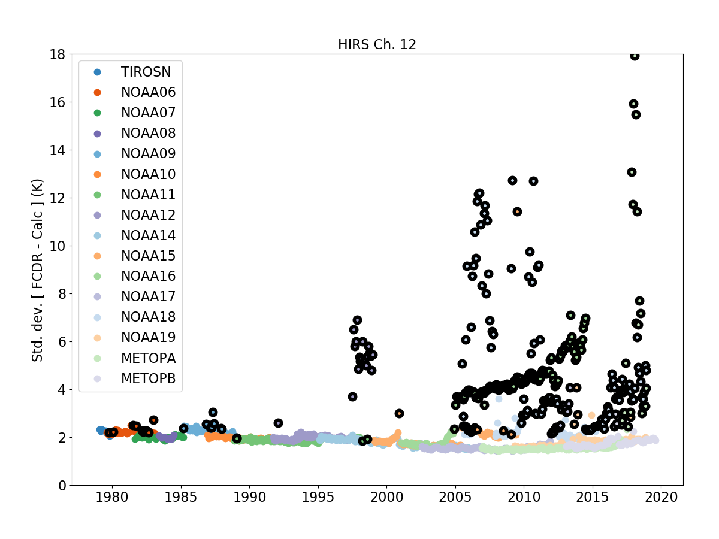
New HIRS - NEDT
New HIRS FDR (1979-2019): includes uncertainties (instrument noise)
HIRS channel 12 (6µm; upper trop. water vapor, clear sky, FCDR QC checked))
Performance outside NEDT specifications
Year
Notes:
About this slide:
The EUMETSAT HIRS FDR (1979-2019) is the first complete recalibration of the entire HIRS series including the instrument noise as uncertainty measure.
The slide shows the standard deviation of differences between the new HIRS FDR and clear sky radiative transfer simulations using ERA-Interim profiles of temperature, humidity, and ozone as well as time-varying CO2 in the simulations.
Data are selected after cloud screening and FDR QC is indicating good data. The cloud screening is based on differences between the observed and simulated brightness temperatures for channel 8 (window channel).
The dots with black circles are those with noise exceeding specifications (episodes of data with lower quality from the data record)
The comparison with reanalyses shown here indicates that the timings of the instrumental noise exceeding specifications are well-captured ; this should matter for user’s applications, not just for reanalyses.
More background:
A large part of the HIRS data record was reprocessed previously at ECMWF (for ERA-40, so only until 2002), but using the original calibration data – there was no attempt at the time to revisit the operational calibrations ; this was not deemed important back then because reanalyses handle changing instrument biases using adaptive bias correction schemes.
Instrument noise is only one part of the total instrumental uncertainties, but it is one that varies significantly over time, hence starting by estimating and including NEDT in this first FDR release.
Closing the budget in terms of uncertainties is another topic to address in future work; this will require to analyse other instrumental uncertainties from the HIRS series.
With the ‘approaching’ end of the METOP series (as a programme), instrument expertise is also retiring (individuals) and it is important to analyse the uncertainties of this instrument while the knowledge is still available.

Slide 8
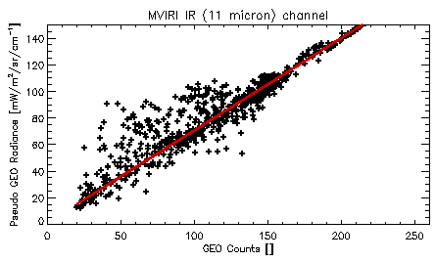
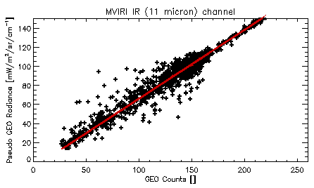
Improvement of MVIRI recalibration
1984-04-01
Operational HIRS
Decontamination event
1984-04-01
New HIRS
Notes:
Adapted latest operational HIRS/4 calibration to work with all HIRS instruments. Reprocessed HIRS instruments and used it in recalibration of Meteosat data.
New calibration algorithm applied to older data leads to less scatter for the calibration fit – outliers leading to apparent higher radiance for calibration coefficients determined from operational HIRS data.
For older HIRS data (e.g., NOAA-07/1984), new HIRS data shows significant improvement to the calibration over operational HIRS data – more stable coefficients;
Pseudo Geo Radiance = HIRS radiances adjusted to match MVIRI spectral characteristics
Calibration coefficients determination for one day (1 April 1984) accumulating 5 days of co-locations

Slide 9
Uncertainty characterised Microwave Humidity Sounder data
Again, it has all started with FIDUCEO – their Release 1 contains data from SSM/T-2, AMSU-B, and MHS – Brightness temperatures and fully traceable uncertainties – Independent, structured, and common
We extended it to MWHS, MWHS-2, and ATMS – only for 183 GHz channels
Currently working on the harmonisation of these individual data records
I. Hans, M. Burgdorf, S. A. Buehler, M. Prange, T. Lang, V. O. John (2019) An Uncertainty Quantified Fundamental Climate Data Record for Microwave Humidity Sounders, Remote Sens., 11, 548.

Slide 10
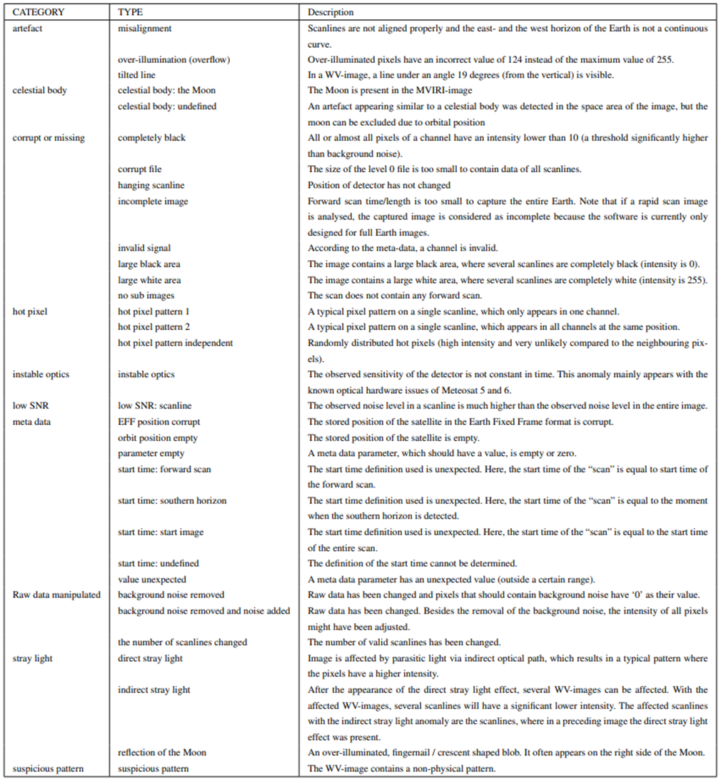
Quality Control
(a) A scan line contains an interference pattern (file: METEOSAT4-MVIRI-MTP10-NA-NA-19911216110000, channel: WV). (b) A block of scan lines (inside the red lines) with a much lower signal-to-noise ratio than neighbouring scan lines (file: METEOSAT2-MVIRI-MTP10-NA-NA-19831016120000, channel: WV). (c) Image contains an unknown disturbance pattern (file: METEOSAT2-MVIRI-MTP10-NA-NA-19810817223000, channel: WV). The pixel values are the raw digital counts
Liefhebber, F., Lammens, S., Brussee, P. W. G., Bos, A., John, V. O., Rüthrich, F., Onderwaater, J., Grant, M. G., and Schulz, J. (2020) Automatic quality control of the Meteosat First Generation measurements, Atmos. Meas. Tech., 13, 1167–1179, https://doi.org/10.5194/amt-13-1167-2020

Slide 11
Quality control – continues…
Meteosat-1
MSG 1-4
GMS 1-5
MTSAT 1R
MTSAT 2
GOES 9

Slide 12
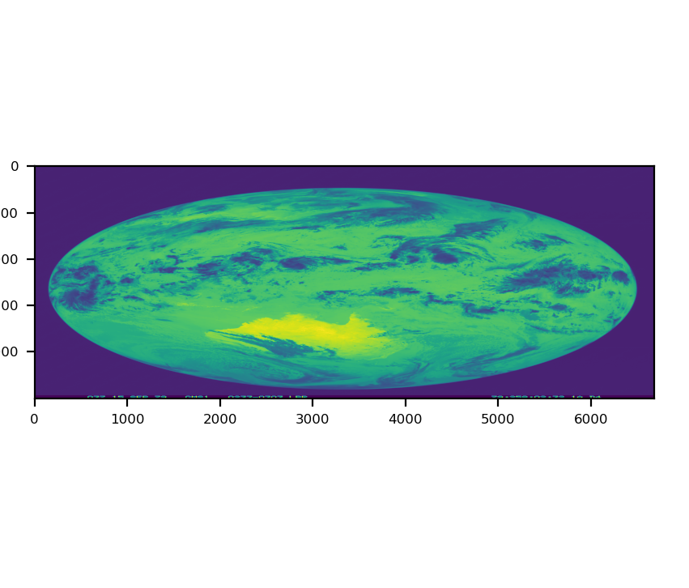
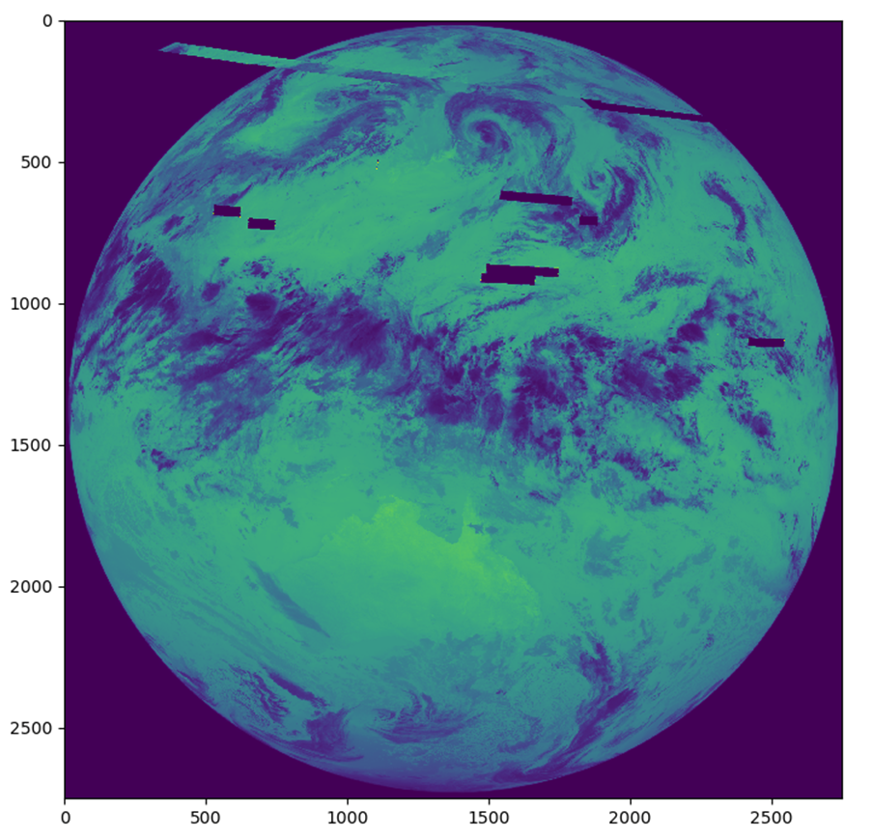
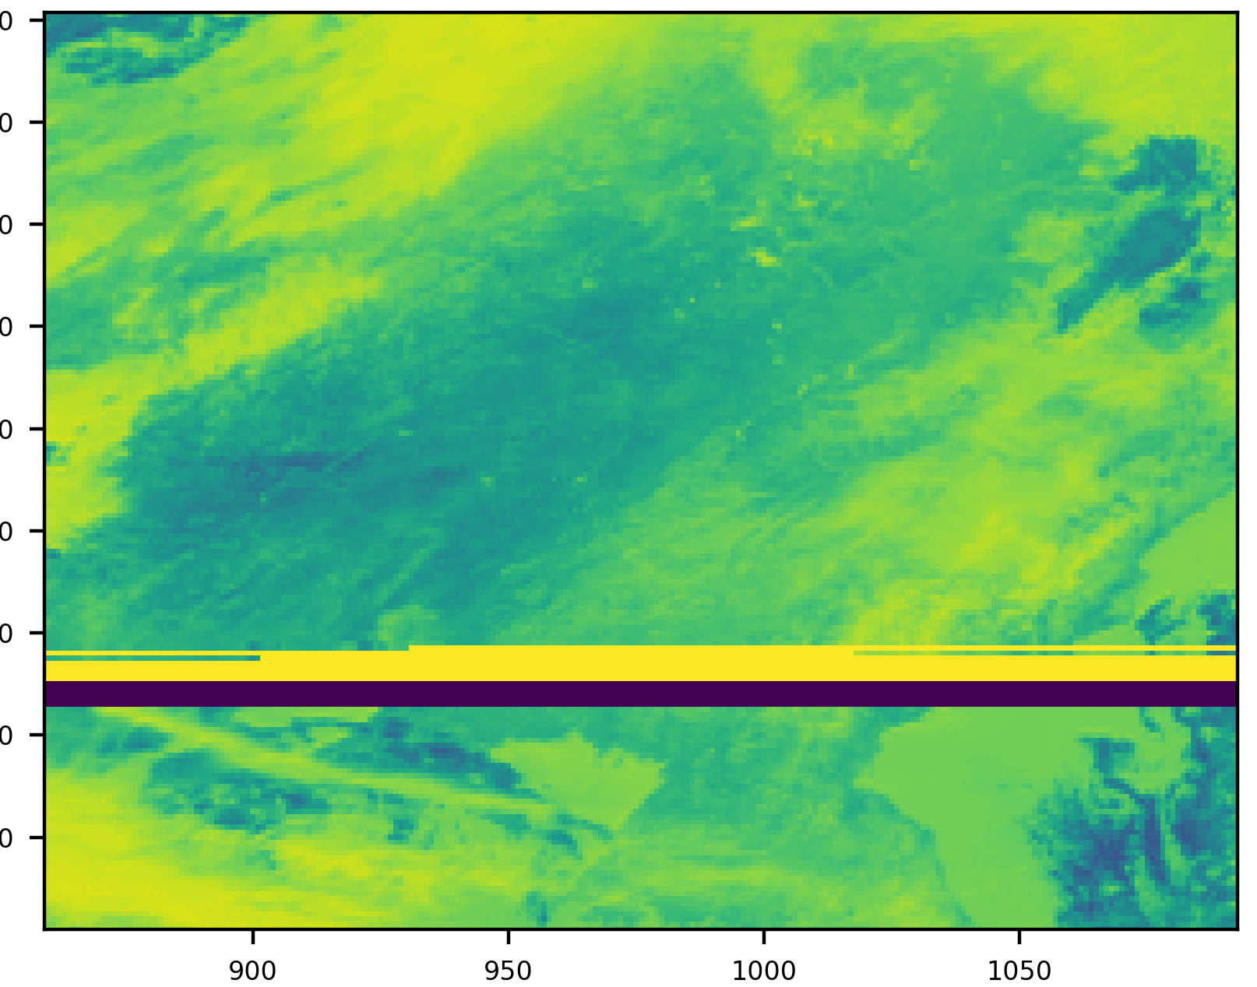
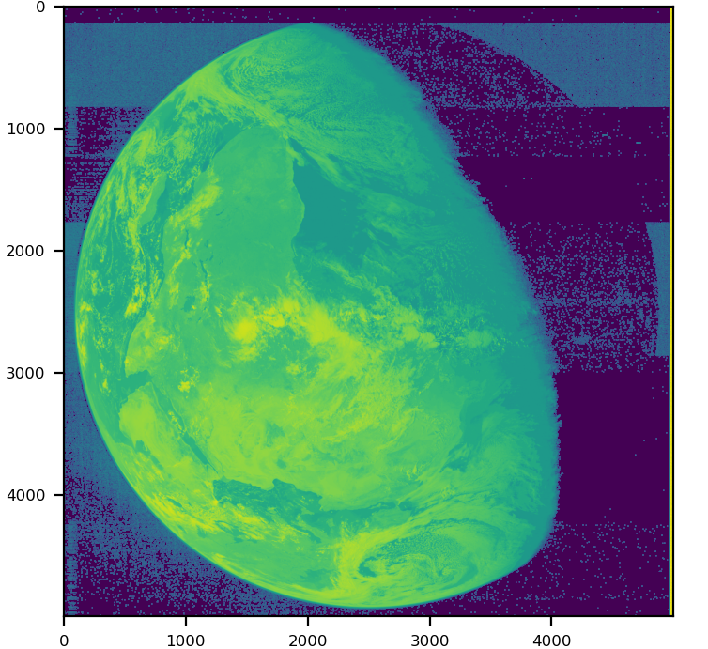
Anomaly examples
Study on automated detection of anomaly in imagery of Meteosat 1/8-10 and GMS/MTSAT
GMS-1 over illumination IR
15 Sep 1979
MTSAT-1R swath slip and missing data IR
27 Aug 2005
Meteosat-1 VIS
non-uniform background noise
16 Dec 1978
MTSAT-2 IR data loss
16 Nov 2006
Notes:
About the slide:
Slide shows examples from Image anomaly study II addressing MVIRI on Meteosat-1, SEVIRI on Meteosat 8-10, GMS 1-5, GOES-9 in MTSAT orbit position, MTSAT-1R, and MTSAT-2 – results shall support JMA to reprocess historical geostationary data for the SCOPE-CM project IOGEO
Anomalies are detected by image (partly ML), spectral and temporal analysis
About 30 different types of anomalies can be detected
Results are stored for every pixel in a data base to allow usage of partial images for data processing
Results are converted into image bitmasks to enable data processing
EUMETSAT owns unique data base of image anomalies that will be used by many for processing geo-’ring’ data in the future

Slide 13
GEO-Ring FCDR
Quality control and recalibration of Meteosat and JMA satellite data have been achieved (JMA VisSci at EUM for a year for the recalibration work);
Uncertainties for MVIRI VIS channel is already estimated, other MVIRI channels and SEVIRI channels will be addressed in the coming years;
QC method development is done by several study contracts paid by EUM;
JMA has helped with providing data, preparing statement of work, and participation in regular study progress meetings;
JMA also has the QC software procured through the study which they plan to adapt for new Himawari satellites;
We would like to extend these activities to data of other satellites to arrive at homogeneous approach for QC as a basis for FDRs;
In the international context, we would like to start a SCOPE-CM project to act as a factory for producing the FDRs for all instruments (so all agencies can contribute) and for the global FCDR (cross-calibrated, ideally with uncertainty estimates);
This FCDR shall support initiatives such as the ISCCP-NG but should also be useful for all other parameters retrievable from the geo satellite measurements;
We strive for a discussion about this with agencies in spring 2021 to prepare some reporting for SCOPE-CM to CGMS-49 (WG-II and Plenary, if feasible);

Slide 14
Summary
Produced and validated several radiance and bending angle datasets;
Finalised data rescue study for image anomaly detection for Meteosat-1, SEVIRI, and JMA geo satellites;
Improved calibration for historic HIRS and used to further improve calibration of MVIRI;
Harmonisation of the Microwave Humidity Sounder FCDR is ongoing;
A SCOPE-CM project on generating GEO-Ring FCDR is being conceived.

