Slide 1
CMA GDWG ANNUAL REPORT 2020
XU Zhe
CMA GDWG
2021-3-31 WEBEX

Slide 2
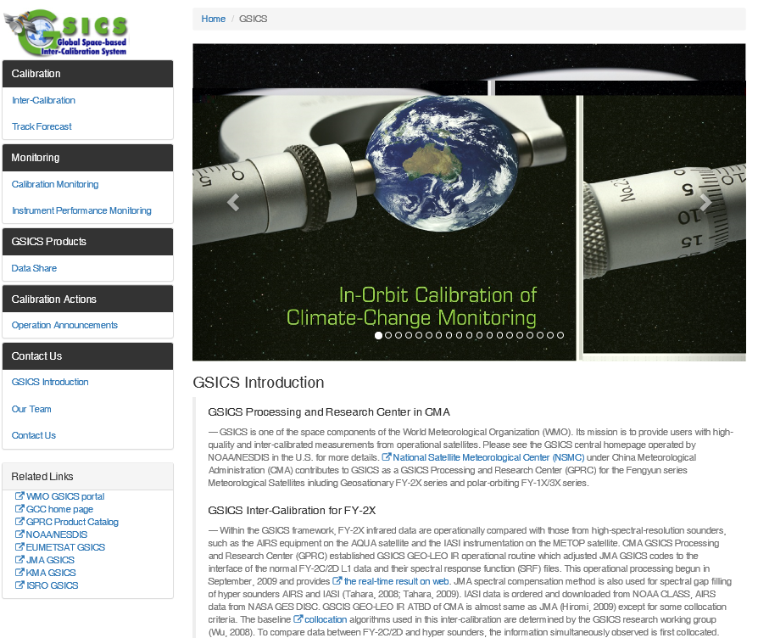
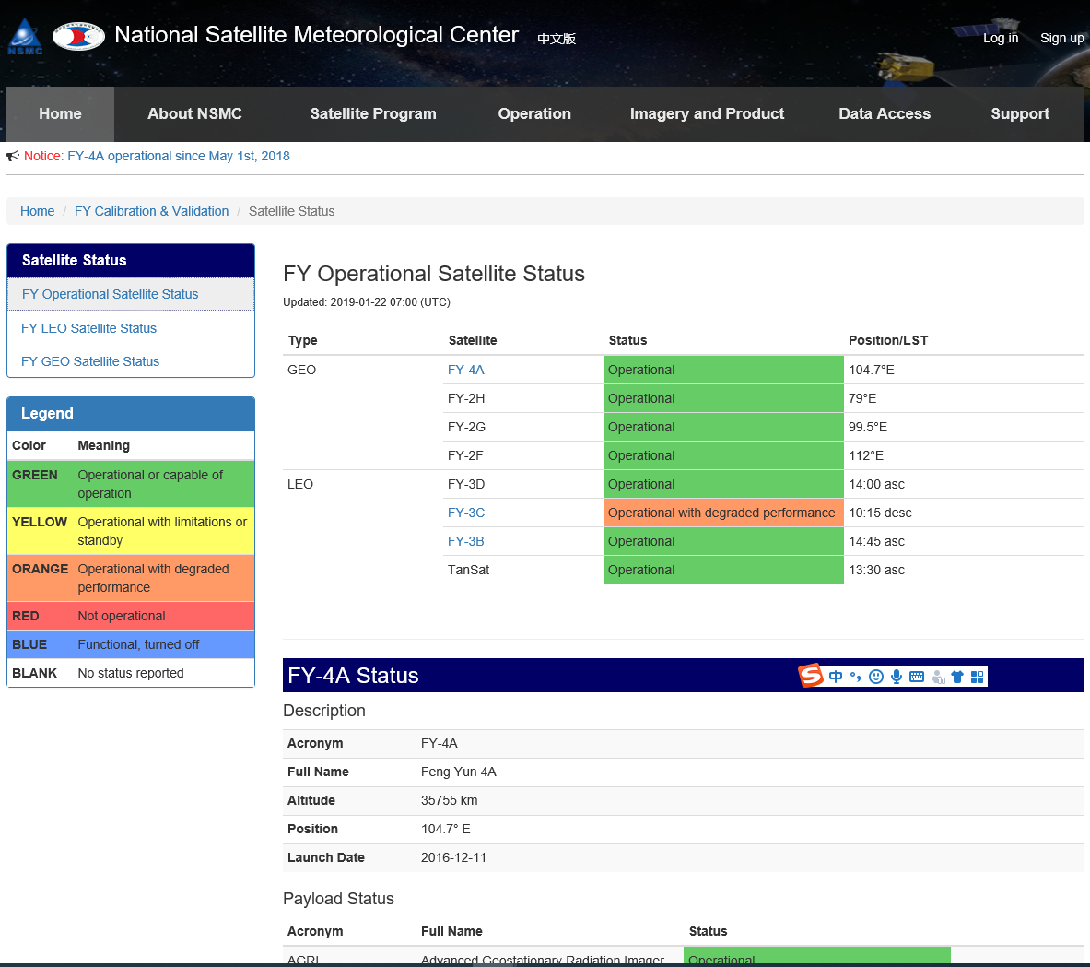
CMA GDWG TASK: CMA GPRC Website Operation
Keep CMA GPRC Website Content updating:
GPRC Information
CMA GSICS product sharing (Thredds)
FengYun Satellites Instrument Operation Status (Landing Page）
CMA GDWG: Website construction and maintain
Notes:
GSICS Processing and Research Centres (GPRC)
Content: GPRC Information, CMA GSICS product sharing, Instrument Operation Status
CMA GRWG: Content provider
CMA GDWG: Website construction and maintain

Slide 3
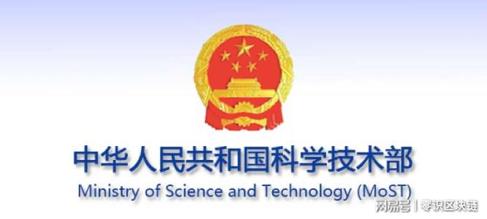
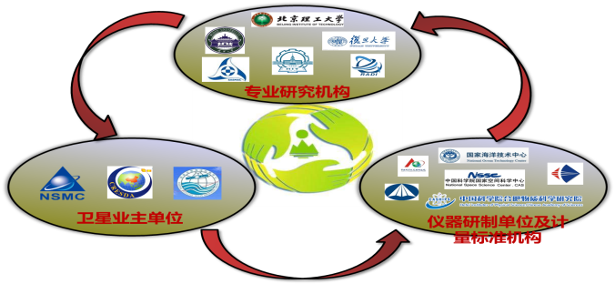
CMA GDWG TASK: Supporting RICH-CEOS Program
RetrospectIve Calibration of Historical Chinese Eerth Observation Satellite Data (RICH-CEOS)
National Key R&D Program of China Founded since 2018
18 Institutions Involved
National Satellite Meteorological Centre (NSMC)
RICH-FY ： Chinese Meteorological Satellites
RICH-ZY : Chinese Land Resources Satellites
RICH-HY : Chinese Marine Satellites
National Satellite Ocean Application Center (NSOAC)
China Center for Resources Satellite Date and Application (CRESDA)

Slide 4
CMA GDWG TASK: Supporting RICH-CEOS Program

Slide 5
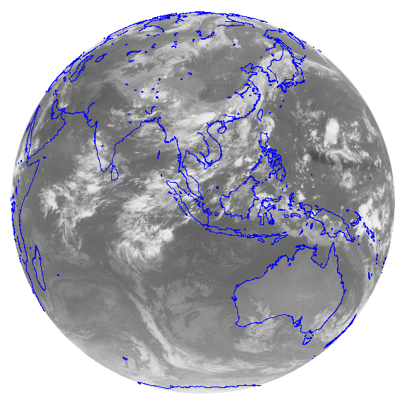
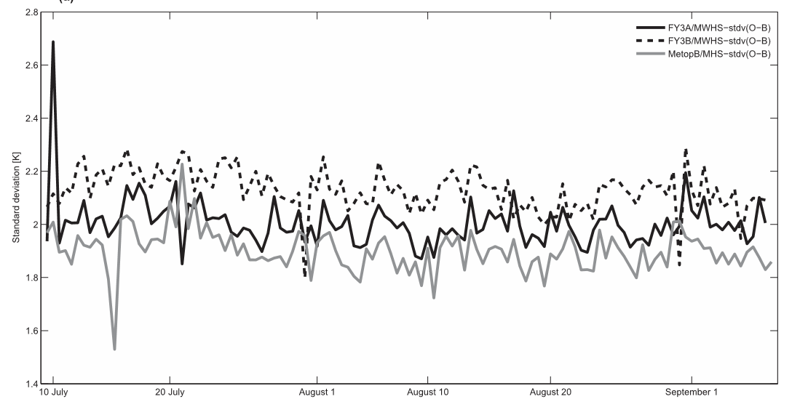
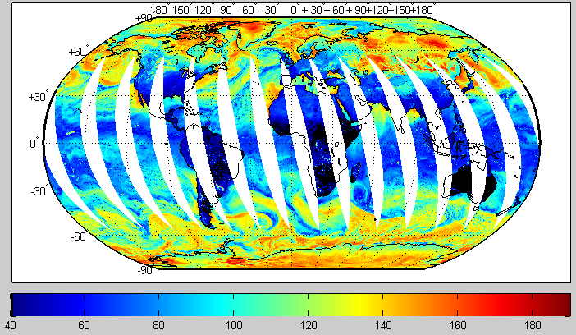
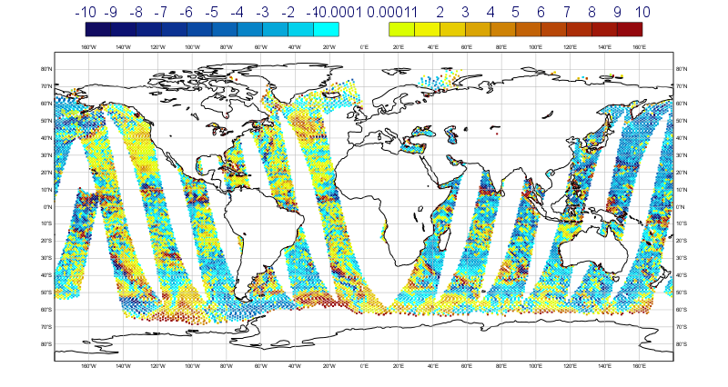
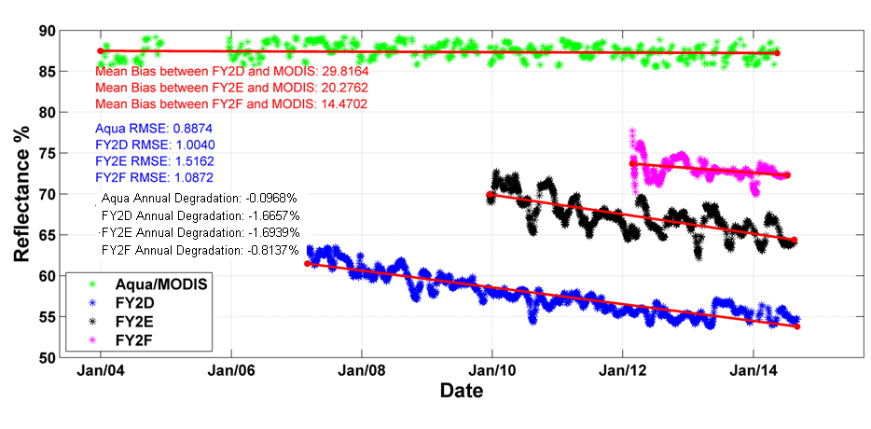
Reprocessing Dataset
Satellite |  | Instrument | Data sets
GEO | FY-2A/B/C/D/E/F/G | VISSR | L1, OLR, SST
LEO | FY-1A/B/C/D | AVHRR | L1,OLR,SST,LST,NDVI
 | FY-3A/B/C | VIRR, MERSI, MWRI,MWHS,MWTS,IRAS | L1,OLR,SST,LST,NDVI
19V Channel

Slide 6
Thank you for your attention
WMO GSICS Portal
http://gsics.wmo.int
GSICS Coordination Centre http://www.star.nesdis.noaa.gov/smcd/GCC/index.php
GSICS Product Catalog https://www.star.nesdis.noaa.gov/smcd/GCC/ProductCatalog.php
GSICS Wiki
http://gsics.atmos.umd.edu/wiki/Home

