Slide 1
GOME-2 Level1
Alessandra Cacciari, Rosemary Munro, Ruediger Lang,
Rasmus Lindstrot, Sebastian Gimeno Garcia, Frank Ruethrich, Gabriele Poli, Malcolm Taberner

Slide 2
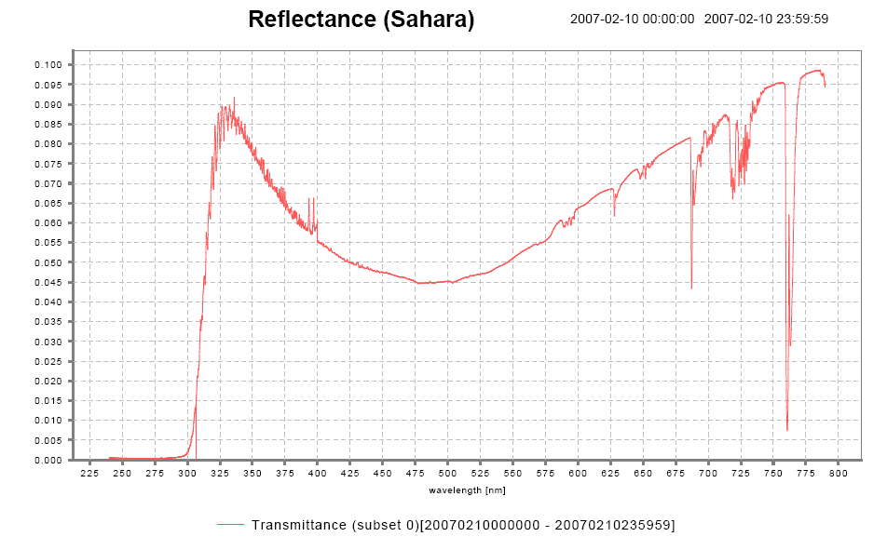
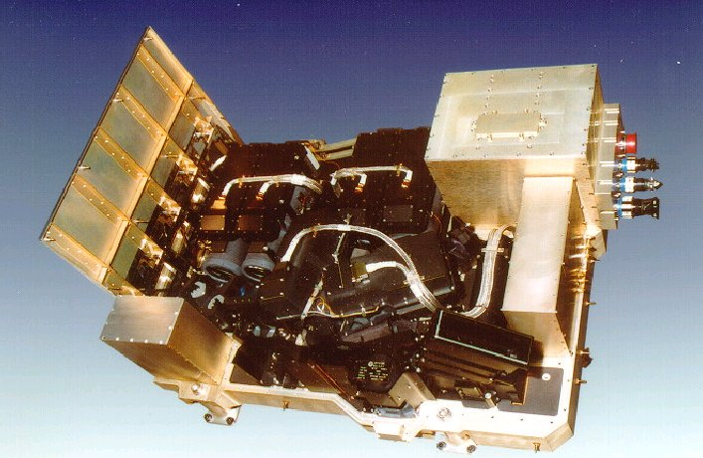
The GOME-2 instrument on Metop
GOME-2 main channel transmittance
GOME-2:
series of 3 instruments on Metop
sun-synchronous orbit, 09:30
412 orbits (29 days) repeat cycle
Global coverage 1.5 days
240 nm to 800 nm
0.25 to 0. 5 nm spectral resolution (FWHM)
4 channels with 4098 energy measurements of polarisation corrected radiances (40 x 80 km²)
2 channels with 512 energy measurements of linear polarised light in perpendicular direction (S/P) (40 x 10 km²)
Aerosol
HCHO
SO₂
NO₂
O₃
BrO
I/I₀
H₂O
O₃
(O₂)₂
OClO
O₂
240
790
Wavelength [nm]

Slide 3
Metop satellites in mid-morning orbit
Metop-B launched 2012
is the prime satellite (LST 09:30 LST desc. node)
Metop-A launched 2006
is drifting since 2017
de-orbiting planned by mid November 2021
Metop-C launched 7 Nov. 2018
operational since 3 July 2019 (LST 09:30 LST desc. node)
GOME-2 FM2 Metop-B
GOME-2 FM3 Metop-A
GOME-2 FM1 Metop-C

Slide 4
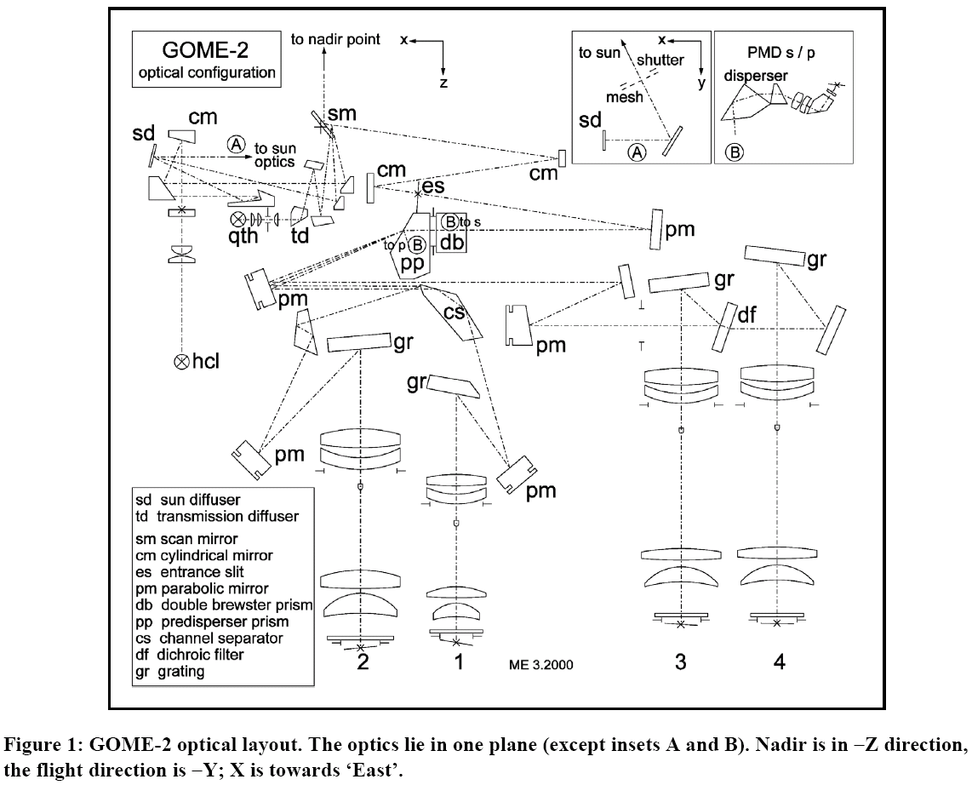
GOME-2 optical layout
Scanning grating spectrometer with a random-access linear silicon photodiode array
Earthshine
Sun (daily)
Scan Mirror
Solar diffuser
White Light Source
WLS (daily)
Calibration
Unit
Spectral Light Source
SLS (daily)
Common (Earth/Solar/Cal) path

Slide 5
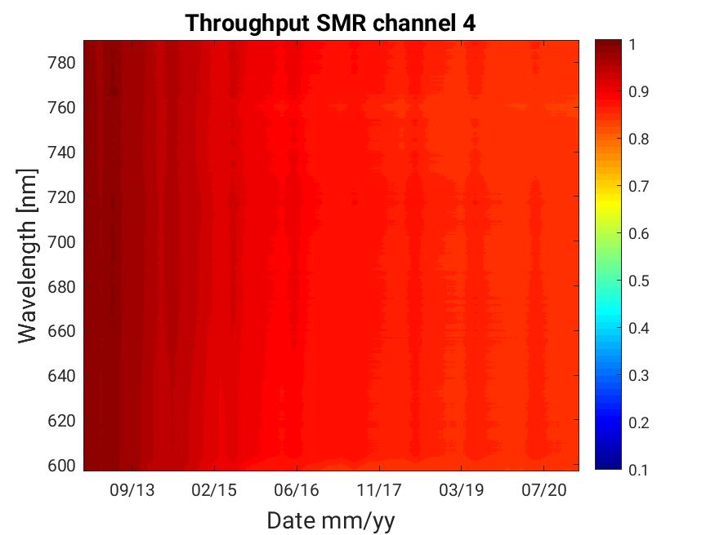
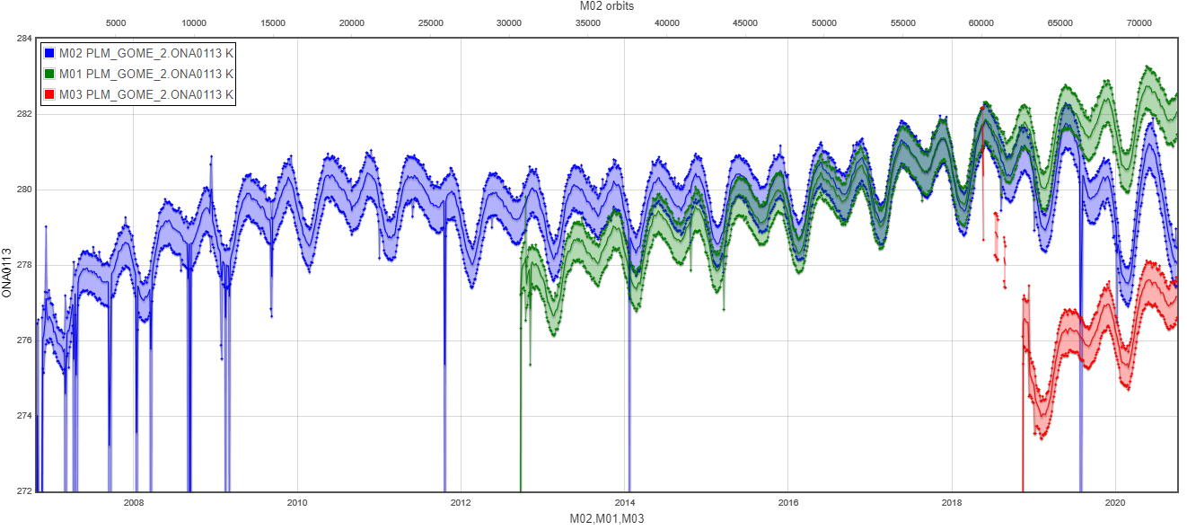
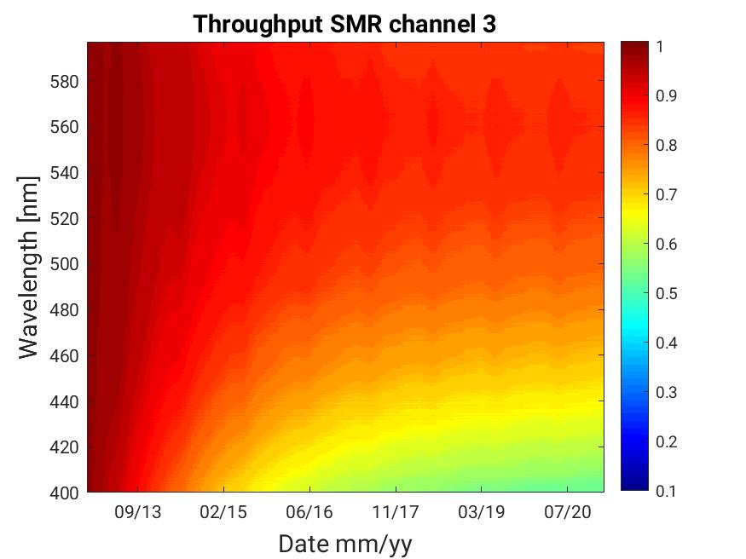
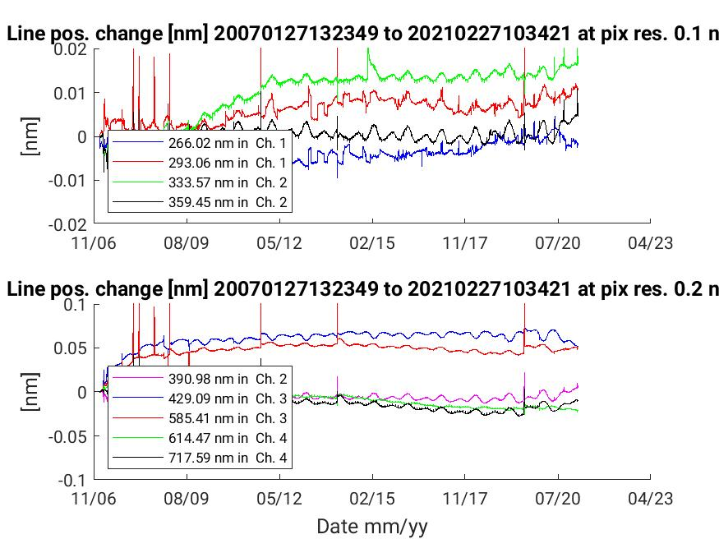
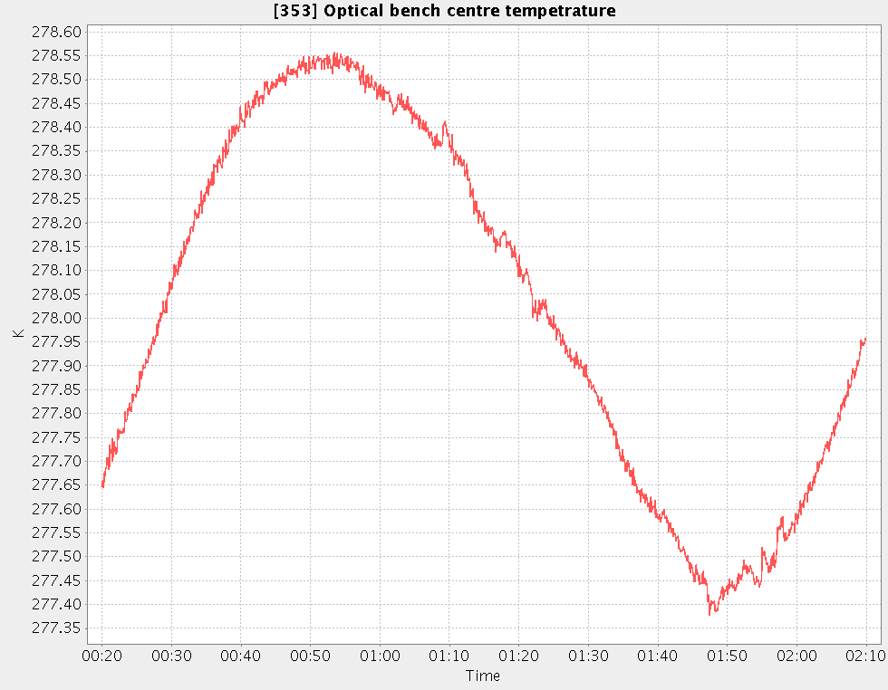
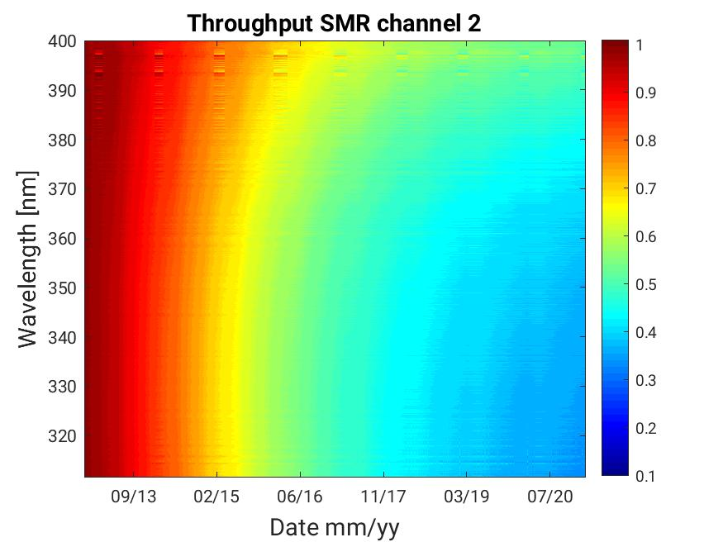
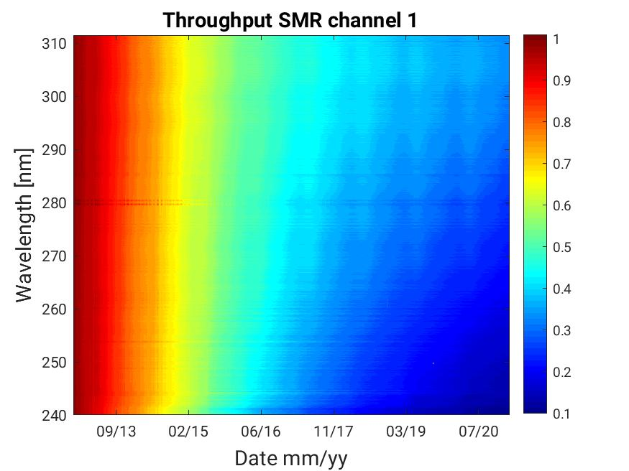
Instrument design aspects
Thermal control and degradation
Throughput of SMR GOME-2 Metop-B
Optical bench temperature (long term)
Spectra stability (long-term and orbital)
Spectral resolution (long-term and orbital)
Quality on-ground calibration measurements
On-ground to in-orbit changes
The correction/control over contamination and its dynamic
ΔT=7K
ΔT=3K
Optical bench temperature over 1 orbit
- thermally uncontrolled optical bench
degradation in the optical path through degradation and contamination of optical surfaces
dominate large parts of the observed in-orbit continuous calibration aspects
ΔT=1K

Slide 6
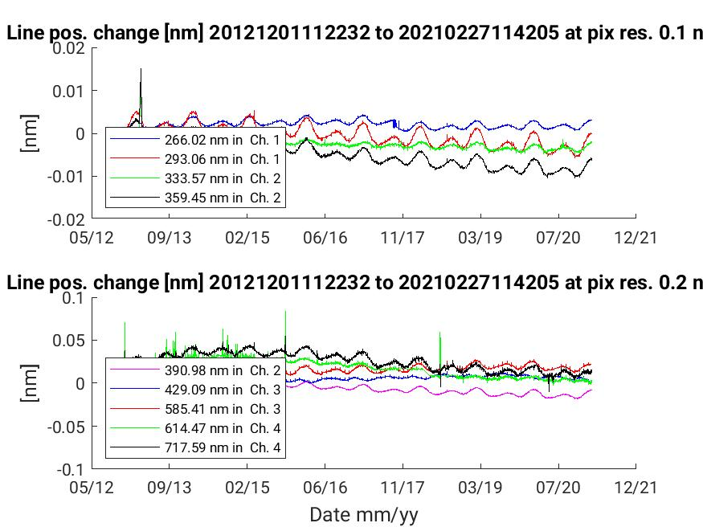
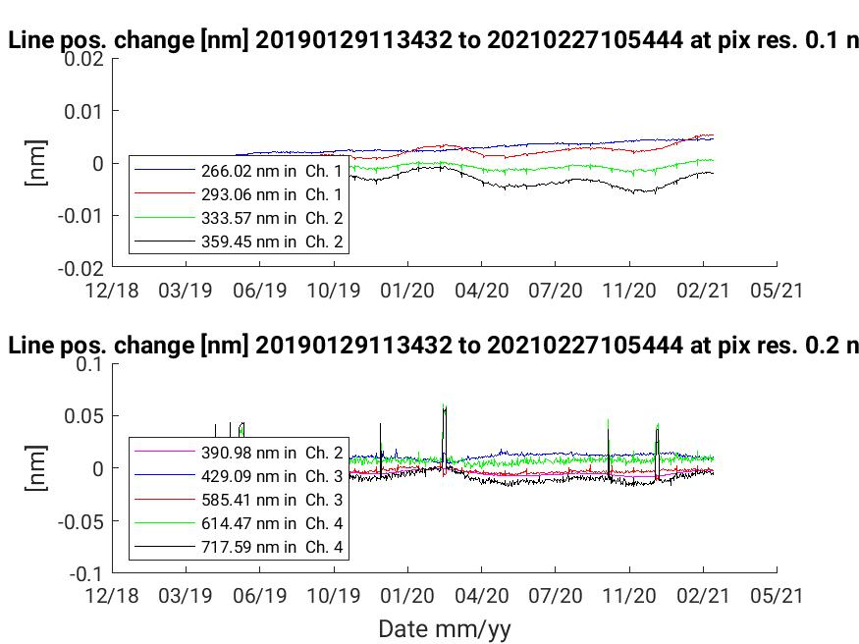
Spectral calibration and stability full mission to Feb 2021
GOME-2 FM2 Metop-B
GOME-2 FM1 Metop-C
The change in the centre line position does not exhibit any long-term trend
It is predominantly correlated with seasonal changes of the OB temperature
(and orbital as known from level-2 retrievals)

Slide 7
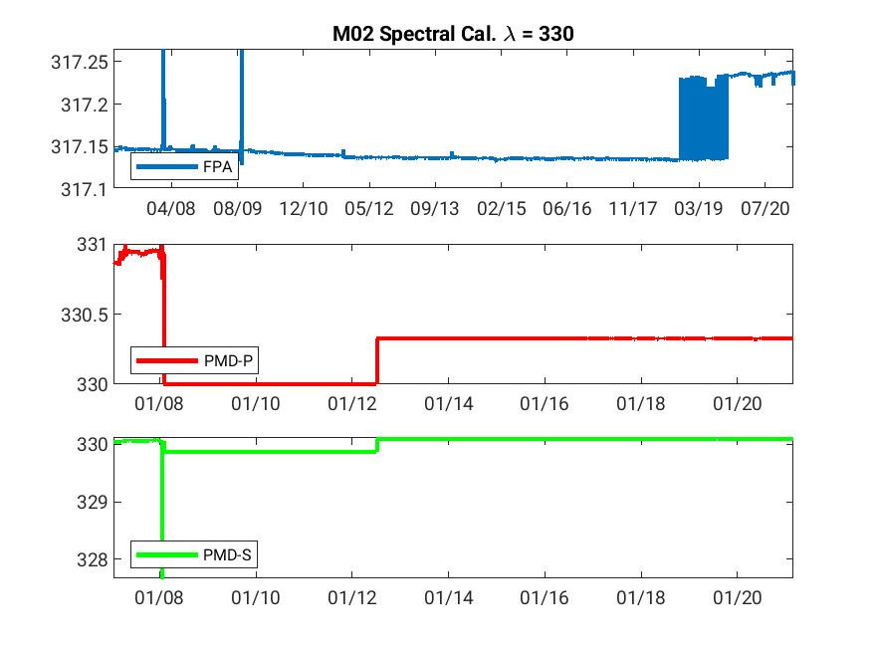
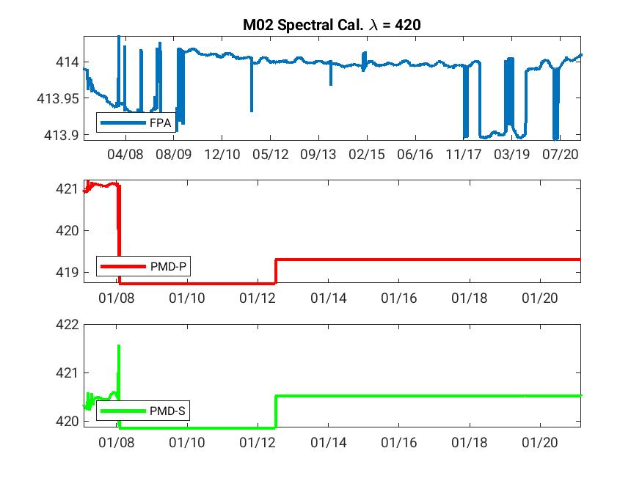
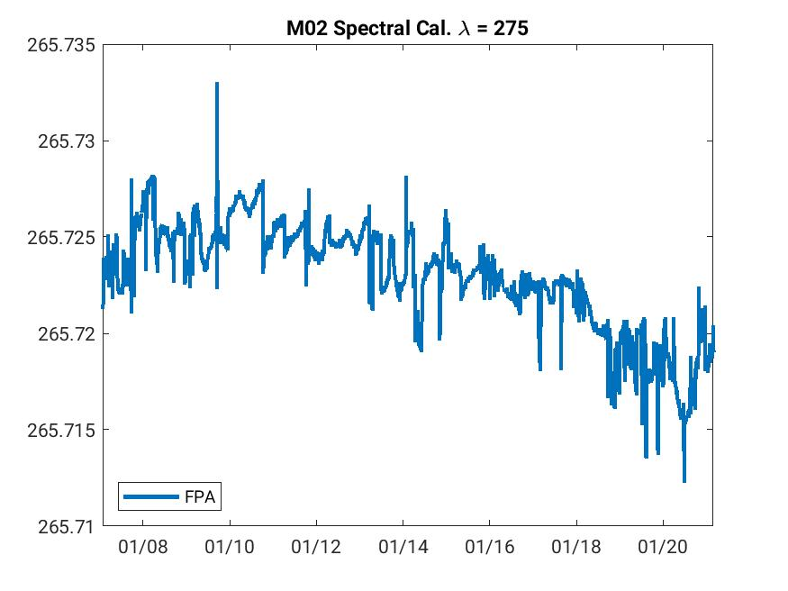
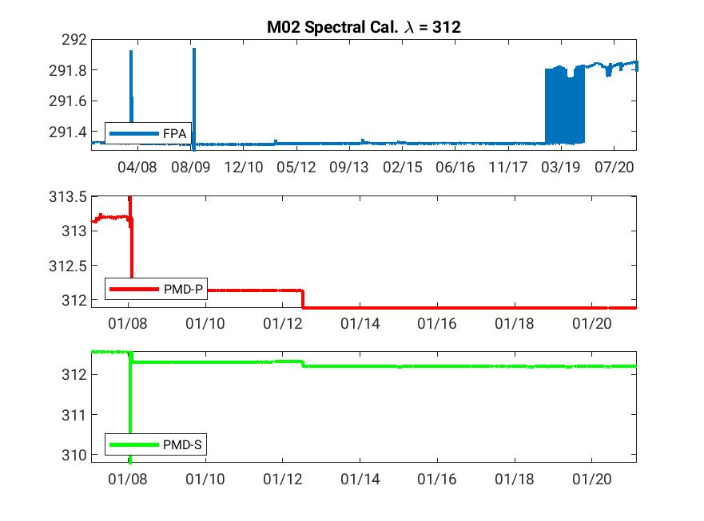
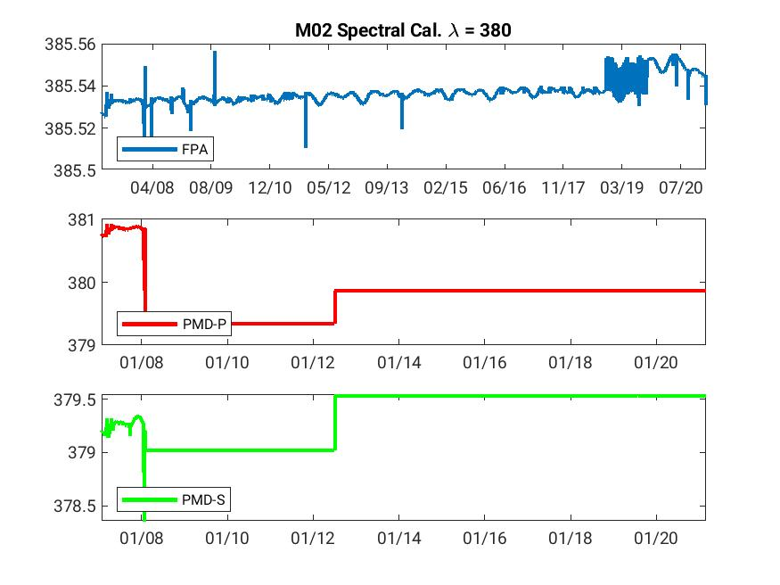
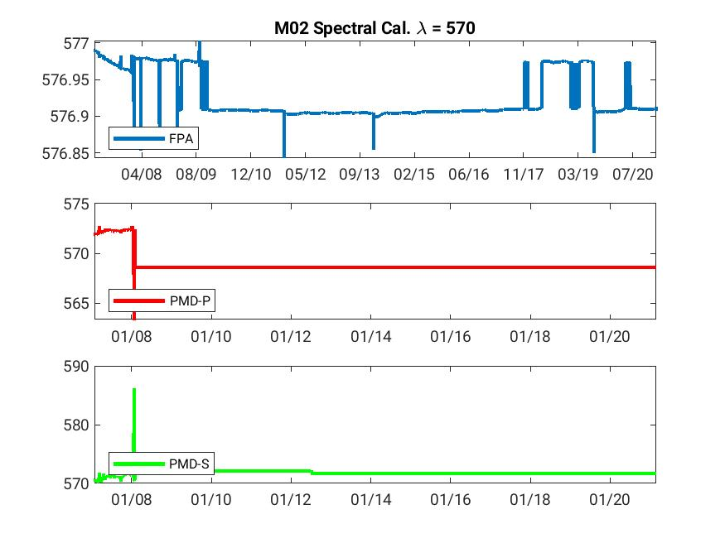
Spectral calibration and stability full mission to Feb 2021
GOME-2 FM3 Metop-Ac
Jumps observed
0.4 nm around 315nm,
0.01 nm around 340,
0.03 nm around 380nm
Impact observed on Lev2 retrieval
(SO2, O3)
~ + 2% O3 TOC
Negative SO2 Col
The different regimes are most likely triggered by the change in OB temperature.

Slide 8
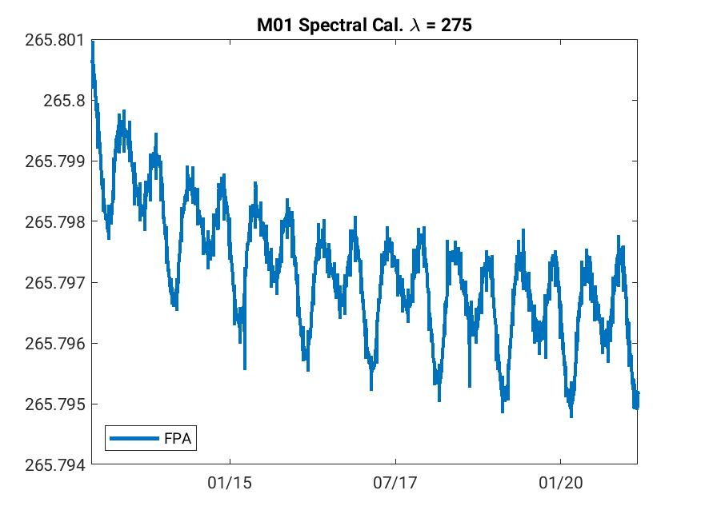
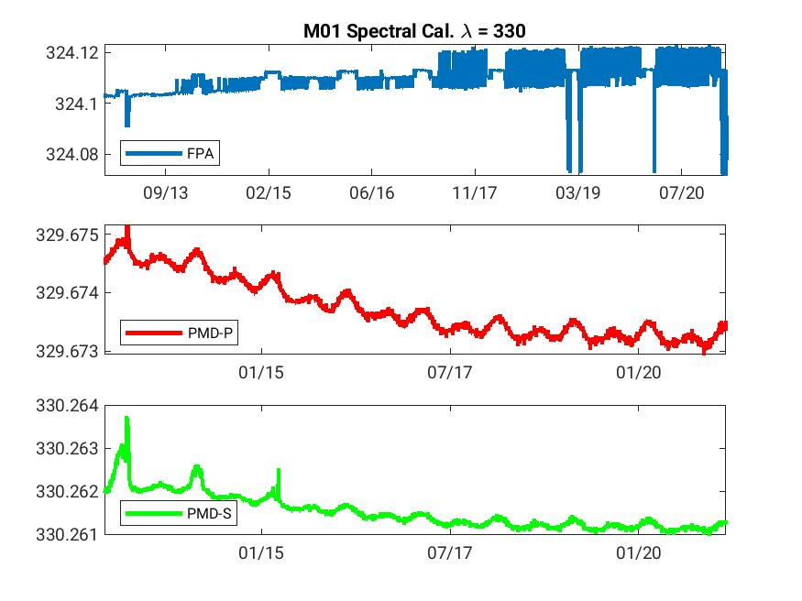
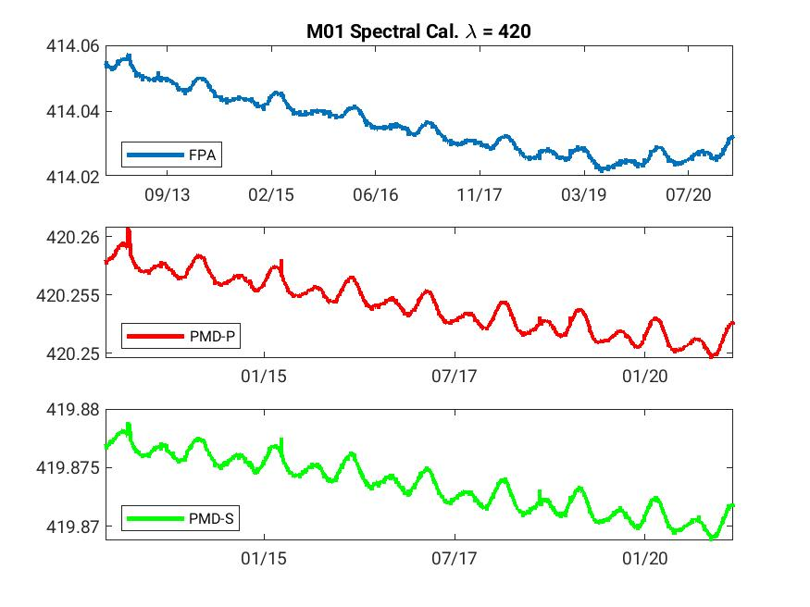
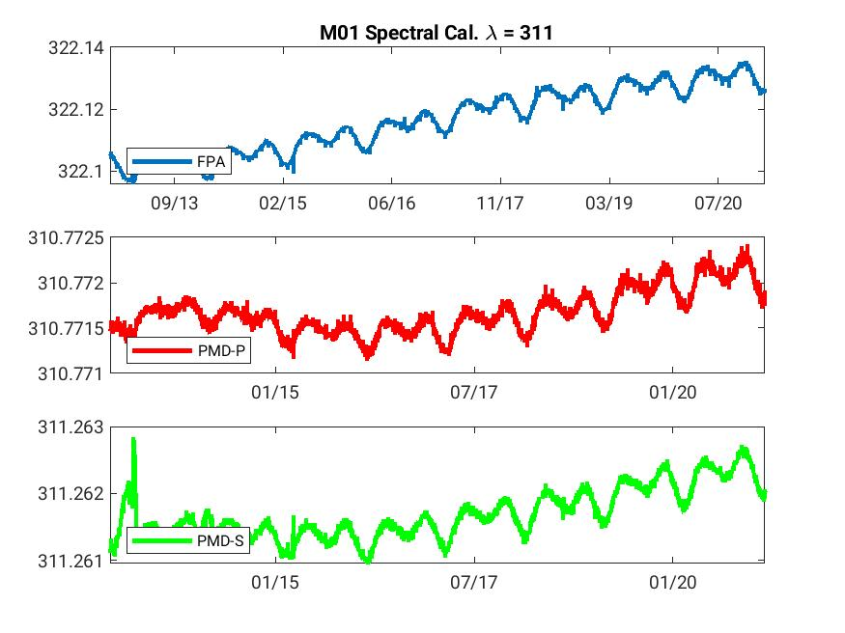
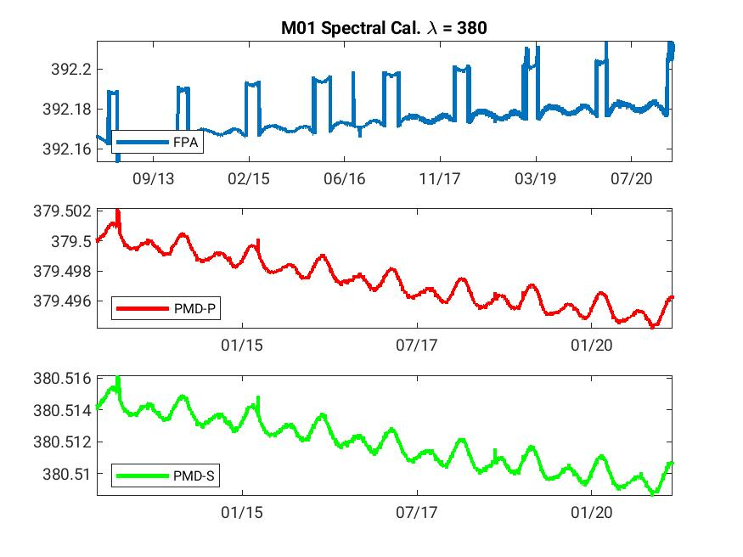
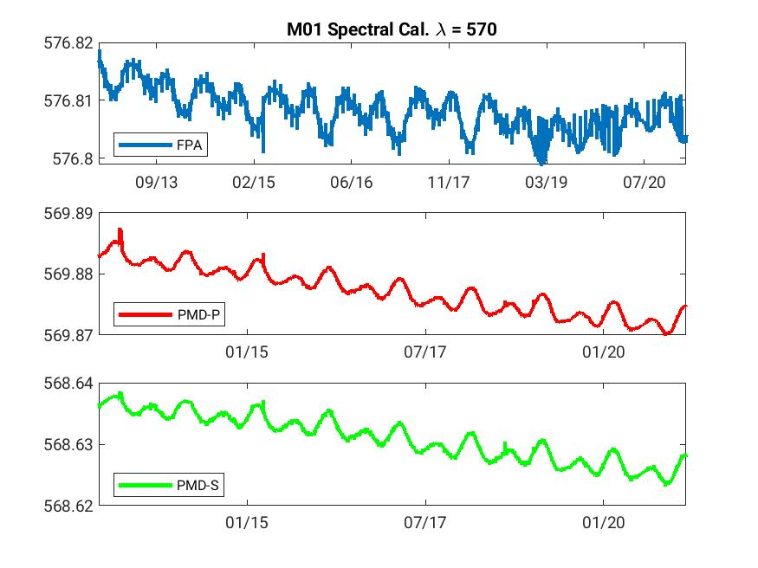
Spectral calibration and stability full mission to Feb 2021
GOME-2 FM2 Metop-B
Jumps observed
0.01 nm around 315nm,
0.004 nm around 340,
0.02 nm around 380nm
Impact observed on Lev2 retrieval
(SO2, O3)
~ - 2% O3 TOC

Slide 9
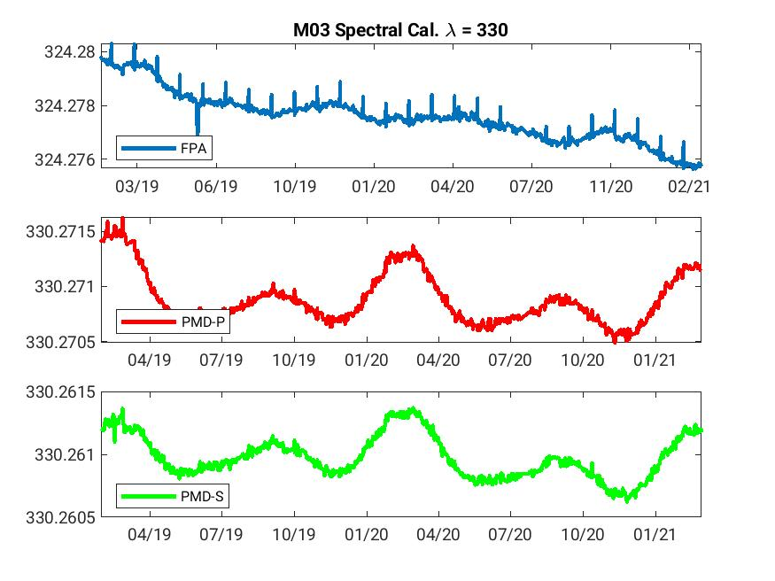
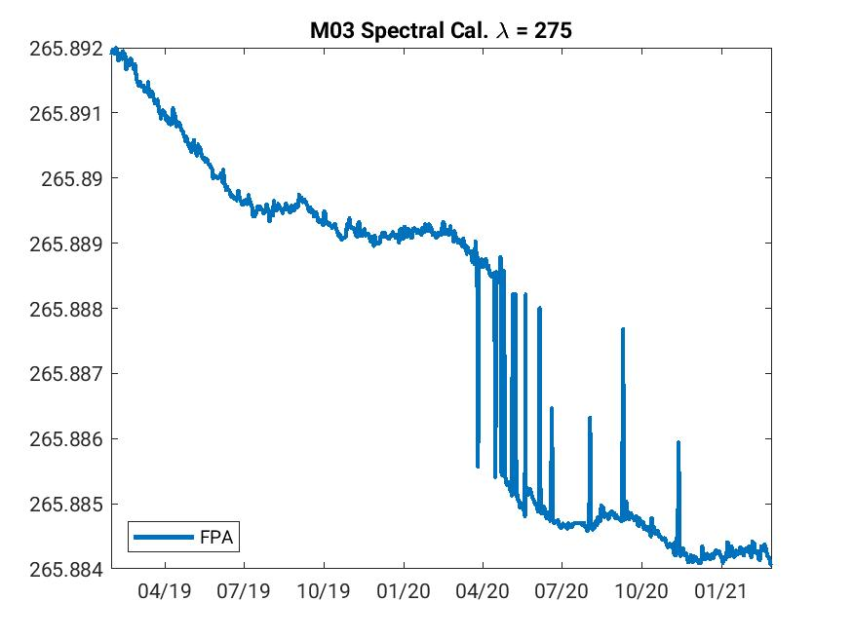
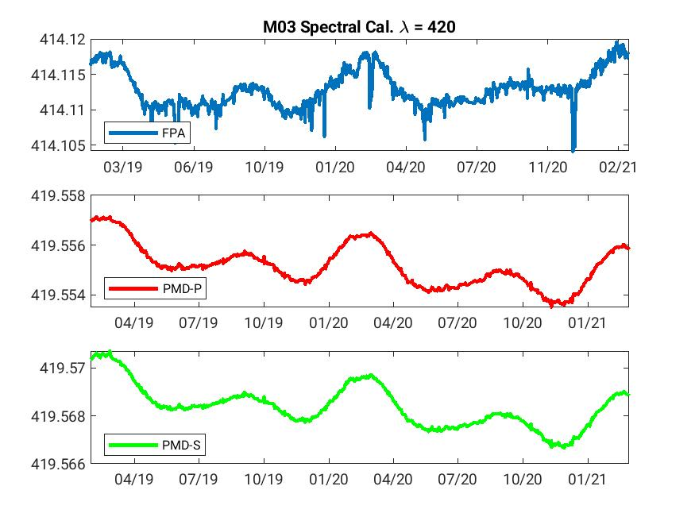
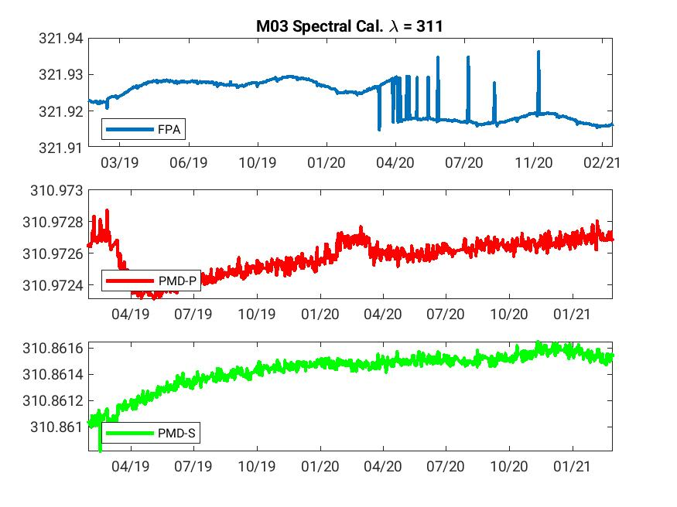
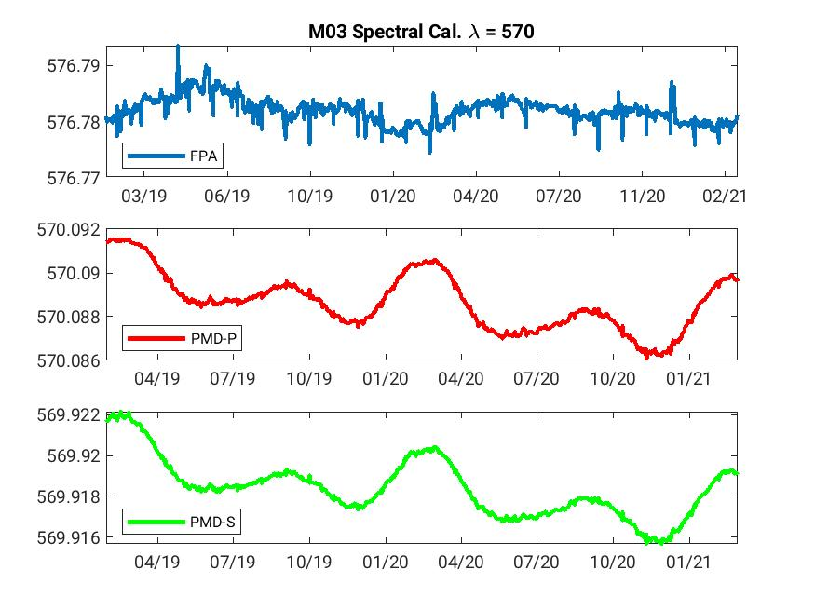
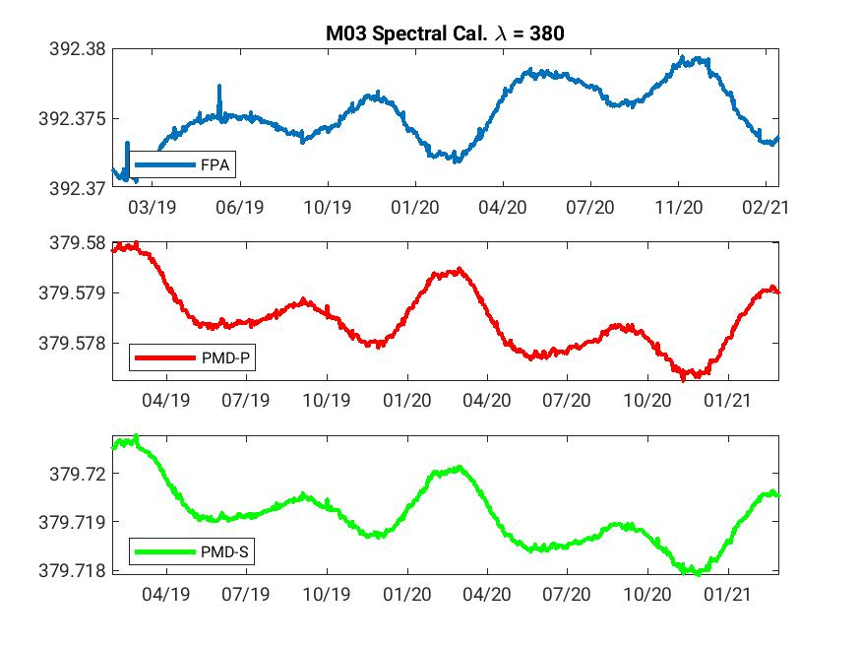
Spectral calibration and stability full mission to Feb 2021
GOME-2 FM1 Metop-C

Slide 10
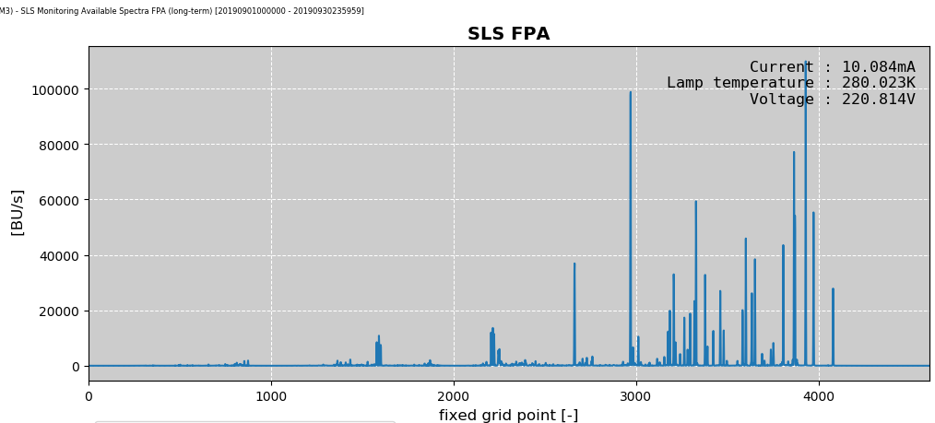
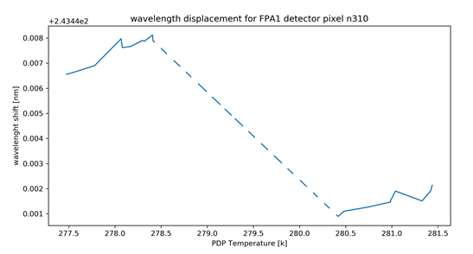
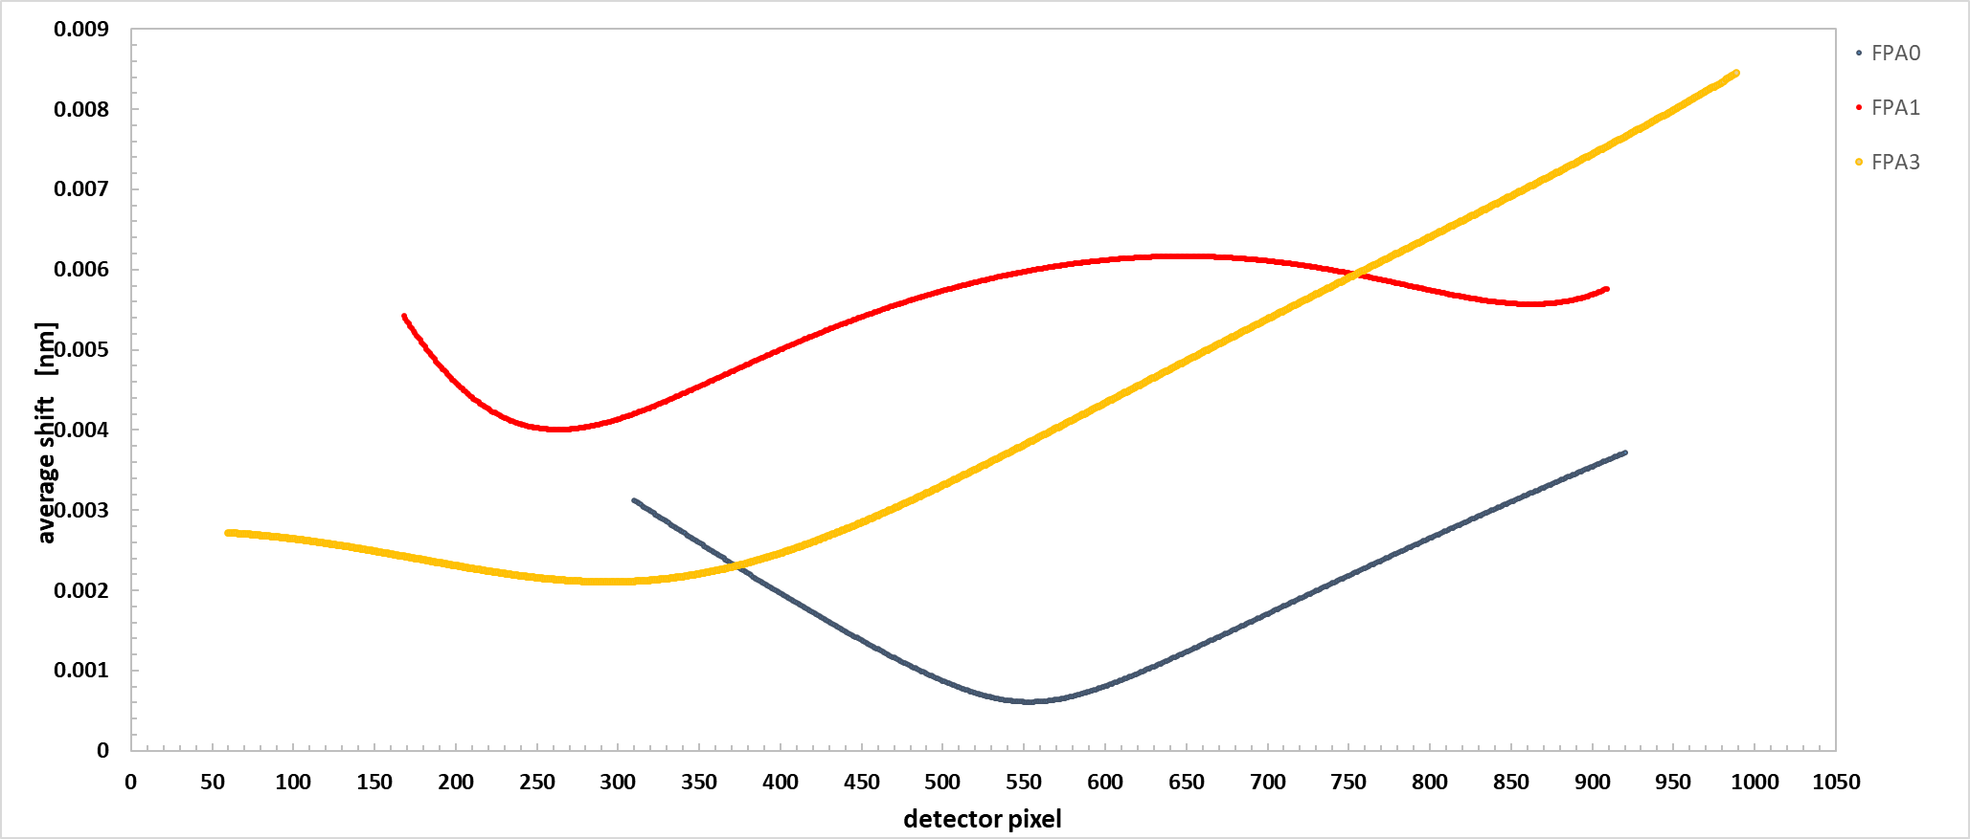
GOME2 /A EOL test campaigns Test EOL 09
understanding spectral calibration and its stability
GOME-2 FM3 Metop-A
NOMINAL CONDITIONS
GOME-2 detectors are cooled and actively controlled whereas the Optical Bench and therefore pre-disperser prism controlling spectral dispersion are not
during nominal operations spectral calibration measurements are taken at a fixed point in the orbit
→ fixed pixel to wavelength assignment with no dependence on temperature
→ effect of orbital variation in temperature of the OB and PDP on spectral assignment not captured
temperature dependence of spectral calibration can only be assessed using long-time series due to gradual change in platform temperature
TEST
SLS active for one full orbit to capture the variation along the orbit
1st instance 16.06.2020
2nd instance 28.09.2020
3rd instance April 2021
Optical Bench Temperature
16/06/2020 28/09/2020
FPA1
FPA2
FPA3
FPA4
average shift per detector pixel
Average changes (min – max)
found in the pixel to wavelength assignment
FPA1 Δλ [nm] (0.0005 – 0.0035)
FPA2 Δλ [nm] (0.004 – 0.006)
FPA3 Δλ [nm] (0.02 – 0.04)
FPA4 Δλ [nm] (0.0025 – 0.008)

Slide 11
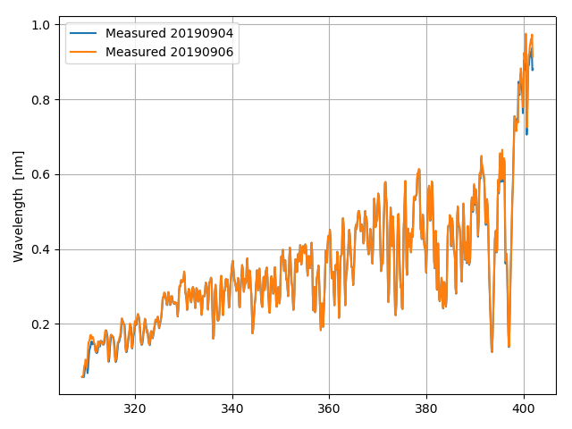
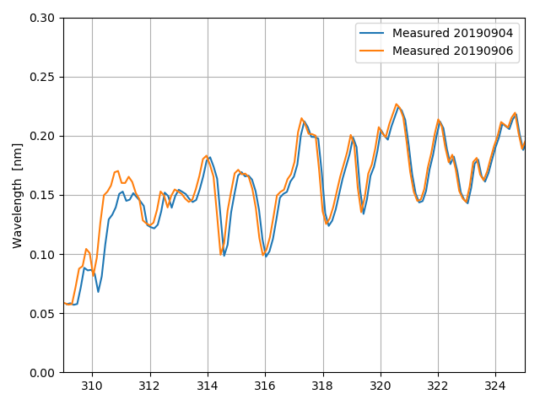
Spectral calibration and stability alternative Fraunhofer-based method
GOME-2 FM3 Metop-A
Comparison between two solar spectra calibrated with the daily spectral calibration SLS based algorithm

Slide 12
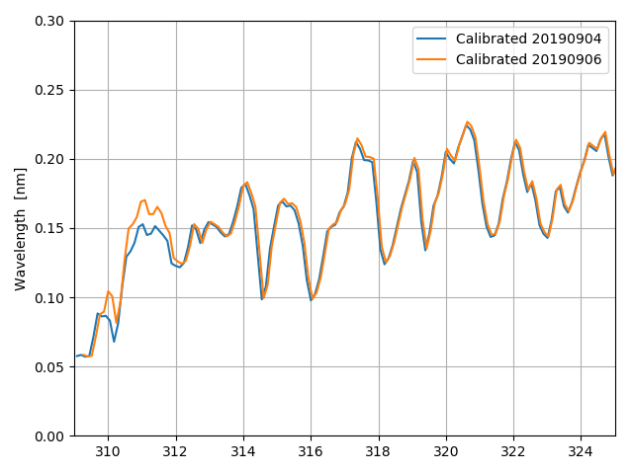
Spectral calibration and stability alternative Fraunhofer-based method
GOME-2 FM3 Metop-A
Comparison between two solar spectra calibrated with Fraunhofer algorithm prototype

Slide 13
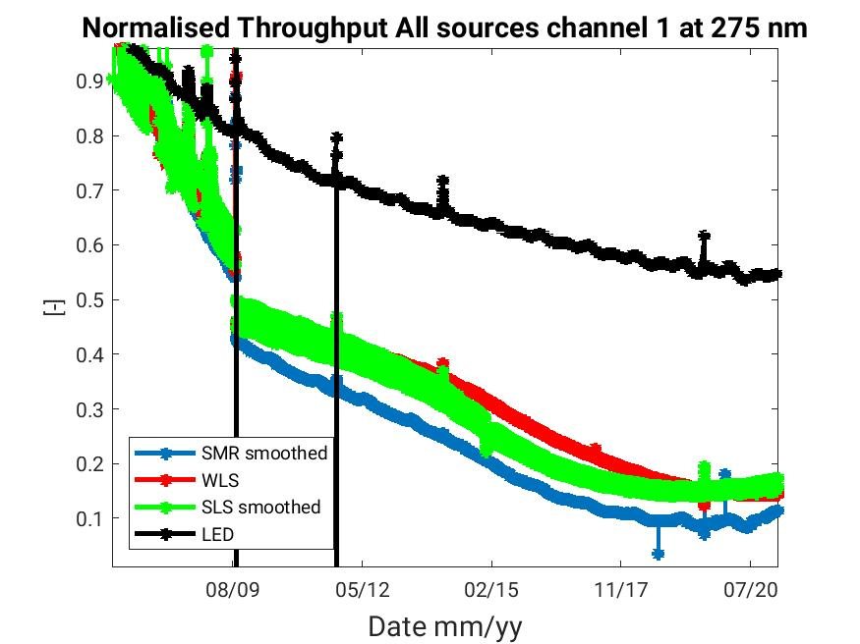
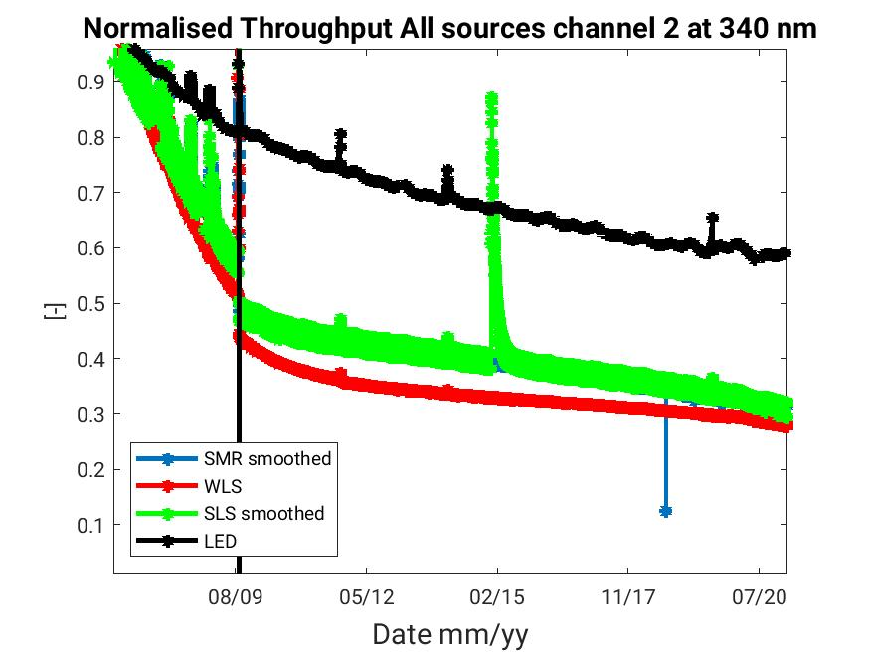
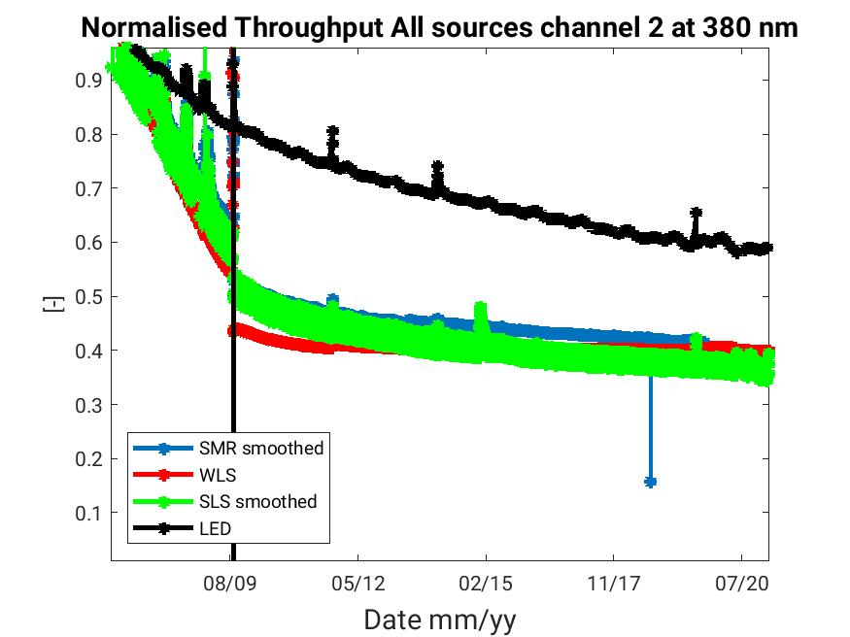
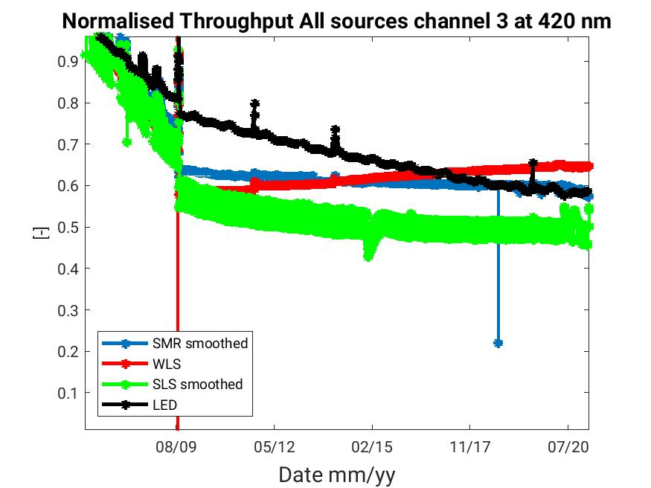
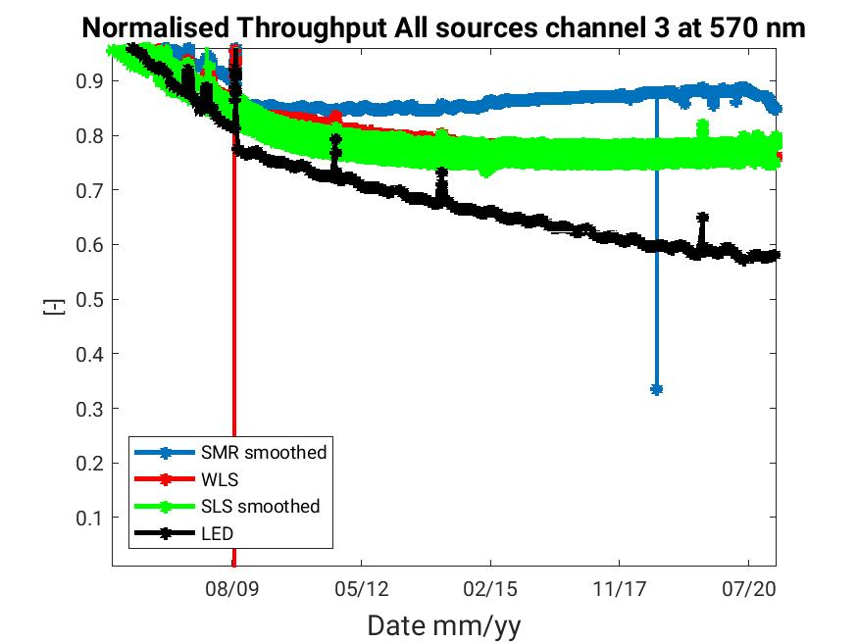
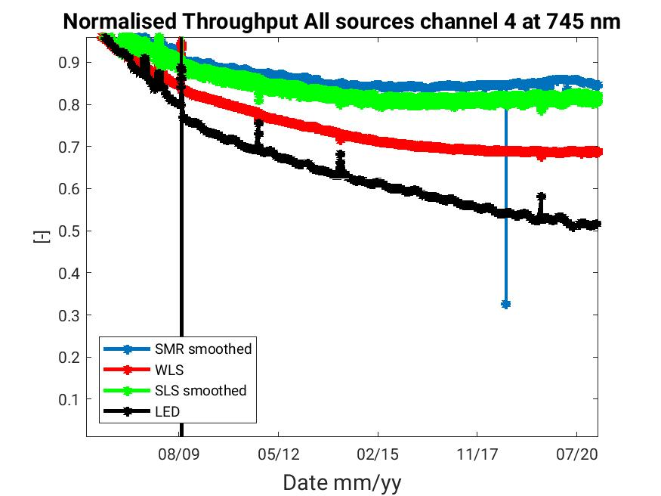
Throughput of GOME-2 sources
Full mission to Feb 2021 normalised to mission’s beginning
GOME-2 FM3 Metop-A

Slide 14
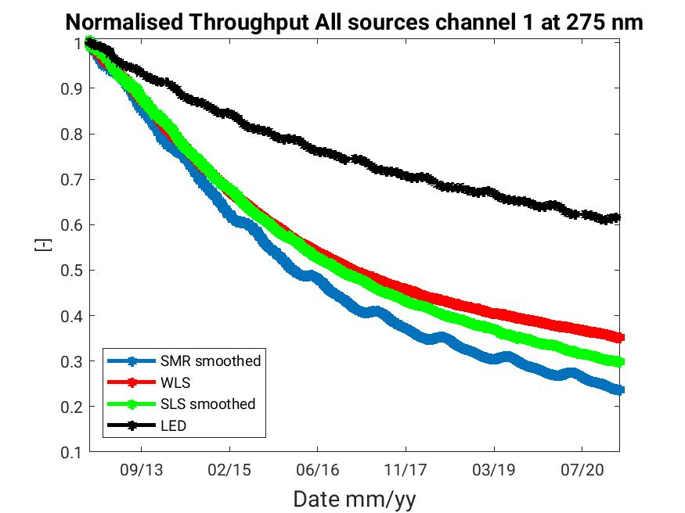
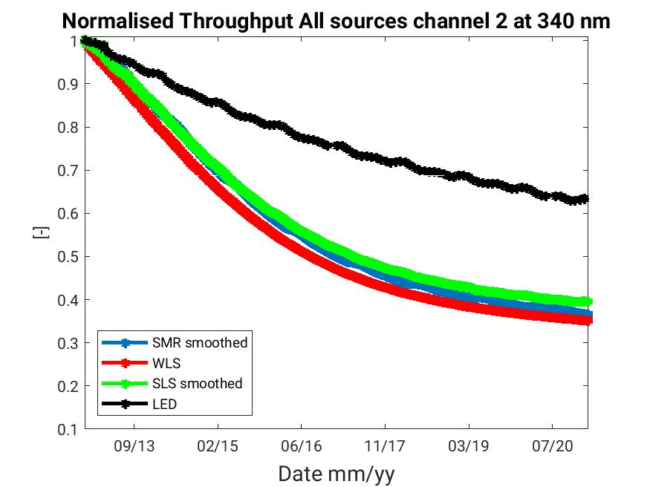
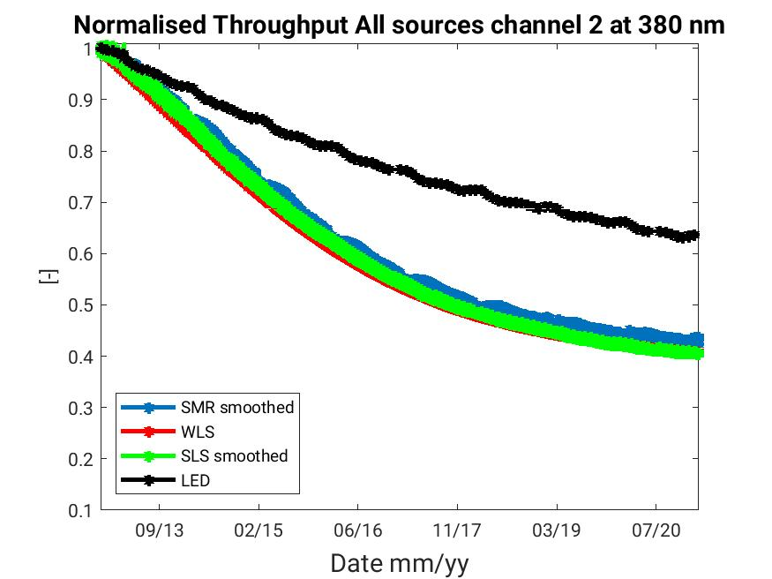
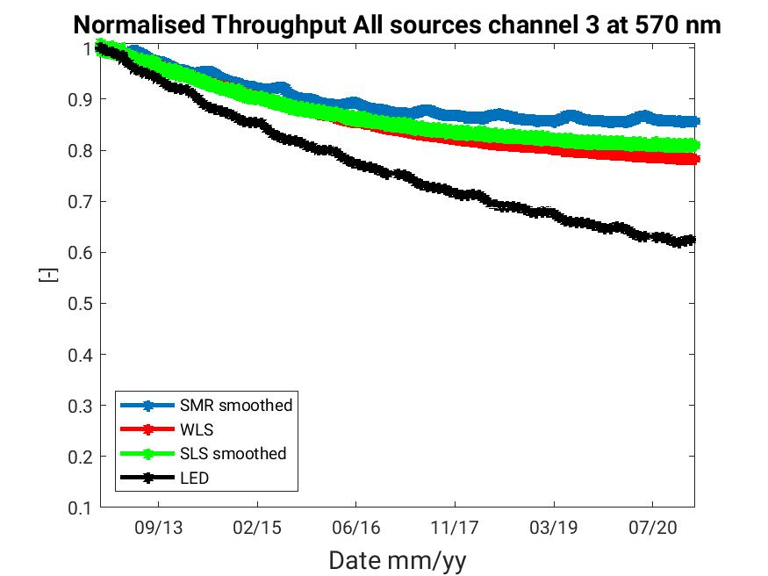
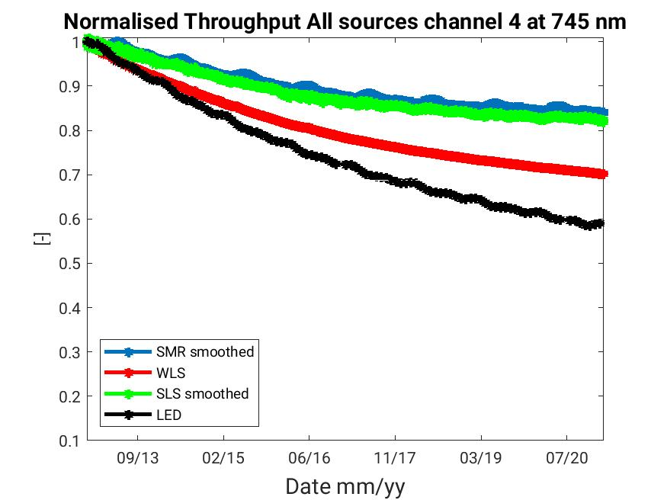
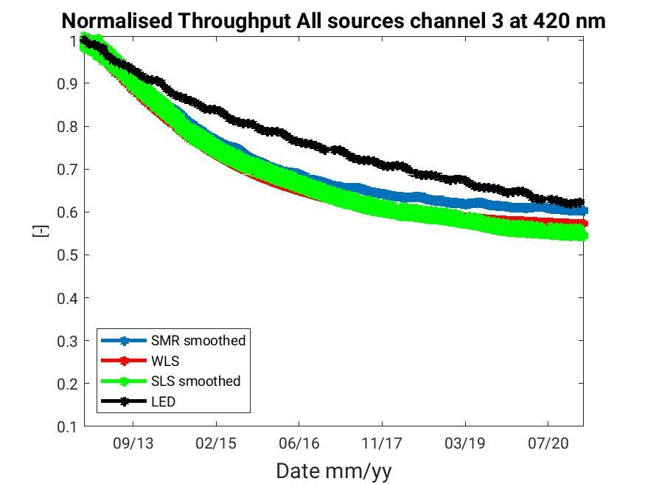
Throughput of GOME-2 sources
Full mission to Feb 2021 normalised to mission’s beginning
GOME-2 FM2 Metop-B

Slide 15
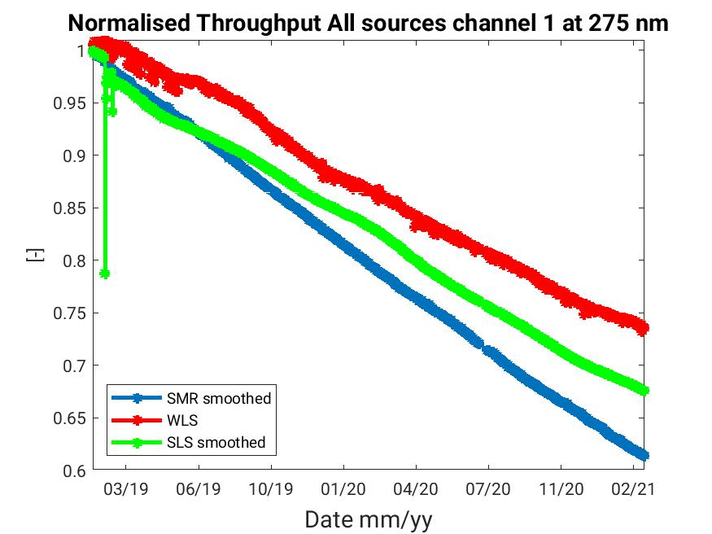
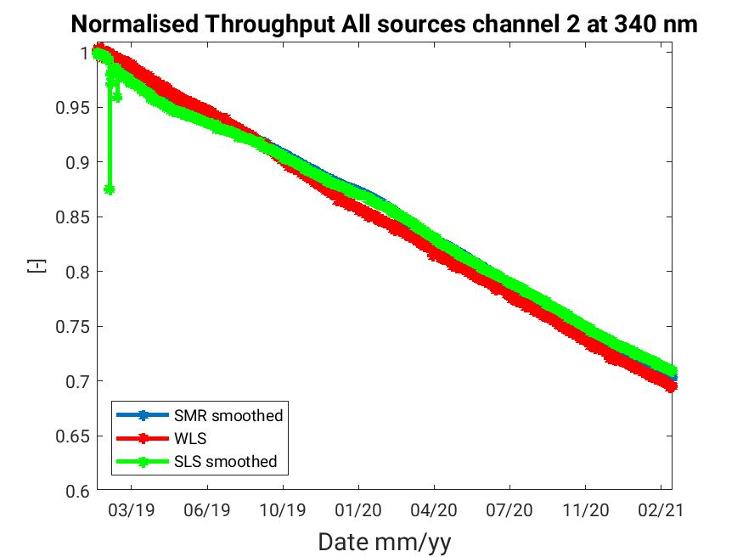
Throughput of GOME-2 sources
Full mission to Feb 2021 normalised to mission’s beginning
GOME-2 FM1 Metop-C

Slide 16
Throughput of GOME-2 SMR
Full mission to Feb 2021 normalised to mission’s beginning FPA channels
GOME-2 FM3 Metop-A
GOME-2 FM2 Metop-B
GOME-2 FM1 Metop-C
Colorbar limits
[0.05 ,1]
Colorbar limits
[0.1 ,1]
Colorbar limits
[0.6 ,1]

Slide 17
PPF 6.3.3 and Repro R3 campaign
Reprocessing campaign R3 (GOME2-A/B) - 2007-2018
R3. PPF 6.3.3 (current CGS settings)
Repro data-set production completed end of Nov 2020 (~ 130 TB)
L1b Validation process ongoing
Offline L1C processor with degradation correction for Earthshine and solar path
Updated GOME-2 level-1C coefficients
Evaluation ongoing of the Degradation correction coefficients
R4 PPF 7.1 – next reprocessing campaign
A/B/C beginning of missions – 2020

Slide 18
PPF 6.3.3 and Repro R3 campaign
Updated GOME-2 level-1C coefficients
Evaluation ongoing of the Degradation correction coefficients

Slide 19
PPF 6.3.3 and Repro R3 campaign
GOME-2 FM3 Metop-A

Slide 20
GOME-2 FM2 Metop-B
PPF 6.3.3 and Repro R3 campaign

Slide 21
PPF 7.0 and beyond OPE processing
PPF development Status
PPF 7.0.1
Implementation of solar model for solar gaps (PPF 6.2 / Jan 2018)
Updated SMR error calculation (formulation for SMR values from solar model)
Added SMR_Backup (SMR measured values, also in case of solar visibility loss)
Spectral calibration
Continuous over-orbit spectral calibration shift using LUT w.r.t. PDP temperature → to be integrated with results from Metop-A EOL tests
Fresco+ version 2 with GOME-2 directional LER database
Update of product format to version 13.0
Test-data and documentation available for reader update
Test ongoing in the TEST OPE computing environment
Planned to be operational
May 2021
PPF 7.1.0
Spectral calibration from solar measurements - Fraunhofer based algorithm
Improved stability and accuracy
Including slit-function fitting and provision of Super-gauss slit-function parameters
Test ongoing in Offline + TEST OPE computing environments
Planned for Q4 2021

Slide 22
Thank you

