Slide 1
Watching The Earth Breathe…Mapping CO₂ From Space.
GSICS UVNS Spectrometer Subgroup Meeting
Thursday, 1 April 2021, 14:30-14:45 GMT
OCO-2 and OCO-3 Level 1
Robert Rosenberg
Lars Chapsky, Graziela Keller, Vance Haemmerle, Richard Lee, Yuliya Marchetti, Robert Schneider, Gary Spiers, Shanshan Yu, David Crisp, Annmarie Eldering
Jet Propulsion Laboratory, California Institute of Technology
© 2021. California Institute of Technology. Government sponsorship acknowledged.

Slide 2
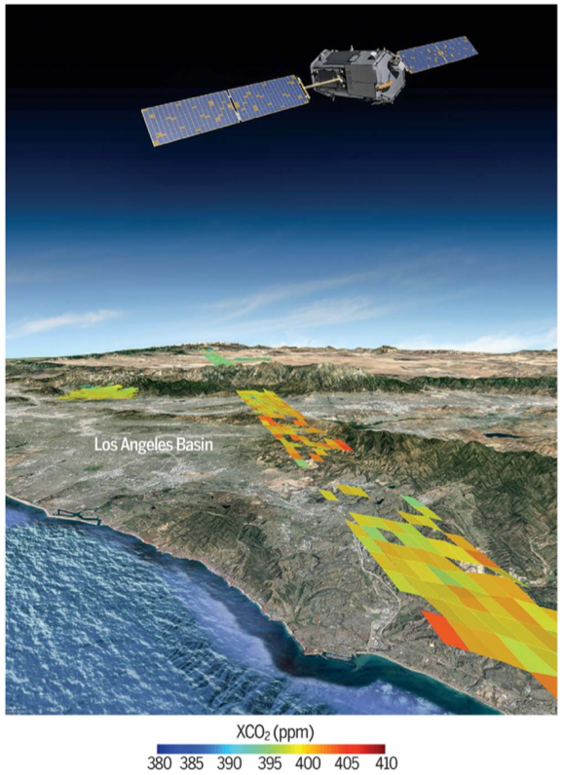
Program Overview
Orbiting Carbon Observatory lost due to launch failure February 2009
OCO-2 was launched in July 2014, completed prime mission October 2016, currently in second extended mission (3 year cycle)
OCO-3 was launched in May 2019, prime mission ends August 2022, uninstall in 2023
OCO-3 was built as the OCO-2 flight spare, then modified to accommodate the change from a free flying satellite to an ISS payload
Calibration process is largely the same, but there are several important differences that require treating them separately

Slide 3
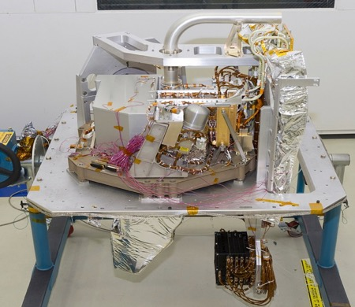
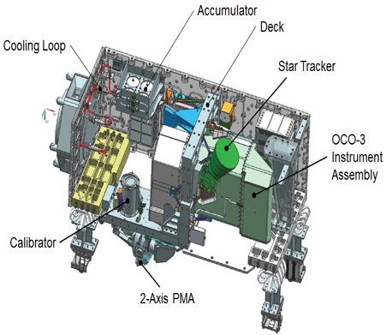
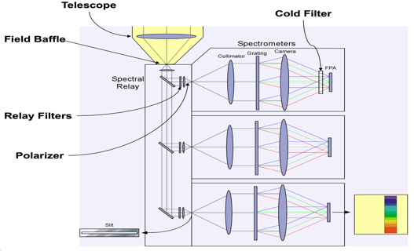
Instrument Overview
Measures O₂ and CO₂ absorption of reflected sunlight in the near infrared using a 3 channel grating spectrometer with common entrance optics
Each band contains 1016 spectral samples x 8 spatial footprints, and acquires 3 frames per second
Science goals require X_{CO2} retrievals with precision better than 1 ppm (less than 0.25%), placing strict demands on preflight & inflight calibration

Slide 4
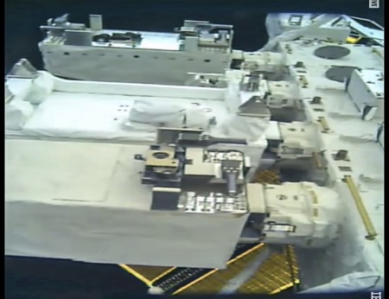
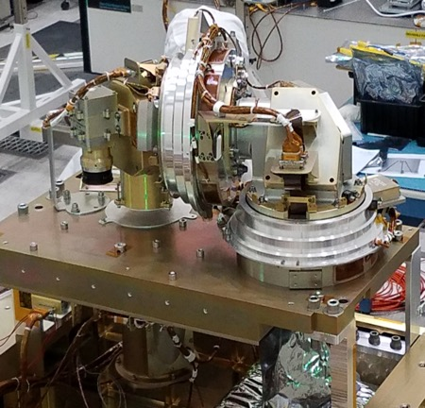
OCO-3 Pointing Mirror Assembly (PMA)
OCO-2 has lamp & solar diffusers that move in front of the telescope, open for science
OCO-2 is a dedicated satellite that changes orientation to acquire nadir, glint, or target data
ISS cannot reorient for OCO-3, so an agile 2-axis, 4-mirror assembly installed at front of telescope
PMA moves to new onboard calibrator with identical lamps, but solar is impossible
Can acquire far more targets, mix nadir & glint, and has new “snapshot area map” mode, but requires an Az-El dependent pointing correction table
Updated geolocation is central to OCO-3 Build 10.3 release coming in summer 2021

Slide 5
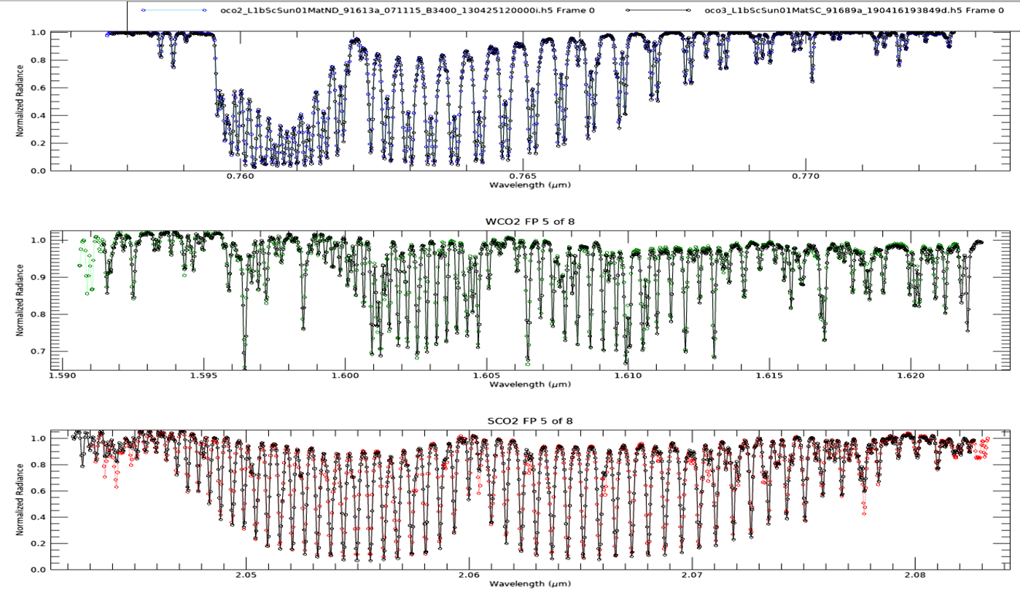
Example Uplooking Spectra
OCO-2
OCO-3

Slide 6
Calibration Data Flow
Level 1A:
Uncalibrated Signal & Temperatures
Level 1B: Calibrated Radiance & Uncertainty
Level 2:
Modeled Radiance & Retrieved State of Atmosphere
Level 1B Inputs: Radiometric Calibration
Dark Correction | Function of temperature
Stray Light | Function of avg signal
Preflight Gain | Corrects nonlinearity
Gain Degradation | Linear inflight scaling
Level 2 Inputs: Calibration and More
Dispersion | Wavelength vs column
Inst Line Shape | 200 element lookup table
SNR Model | Background and photon
Bad Sample List | Remove outliers
ABSCO Tables | High resolution spectra
Geolocation | To resample meteorology
Retrieval Config | Prior, covariance, + more
Forward (r01) & Retrospective (r02) data streams updated weekly

Slide 7
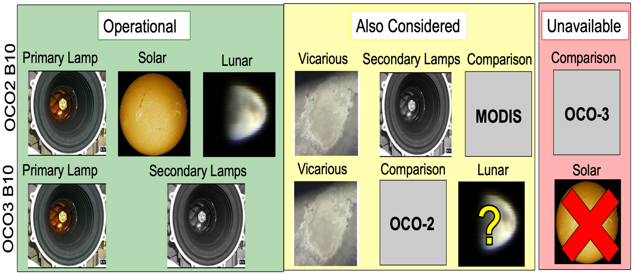
How is Radiometric Degradation Derived?
Spectrally smooth onboard lamps essential to correct column-by-column artifacts, but absolute scale poorly constrained because they age
Secondary calibration sources (solar diffuser, other lamps) also age

Slide 8
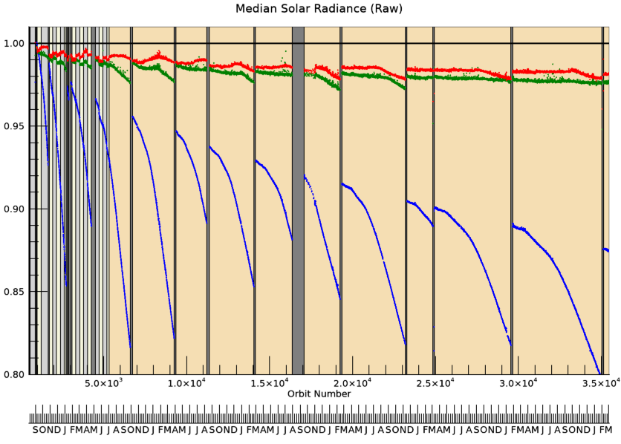
OCO-2 Radiometric Trend – Raw Solar

Slide 9
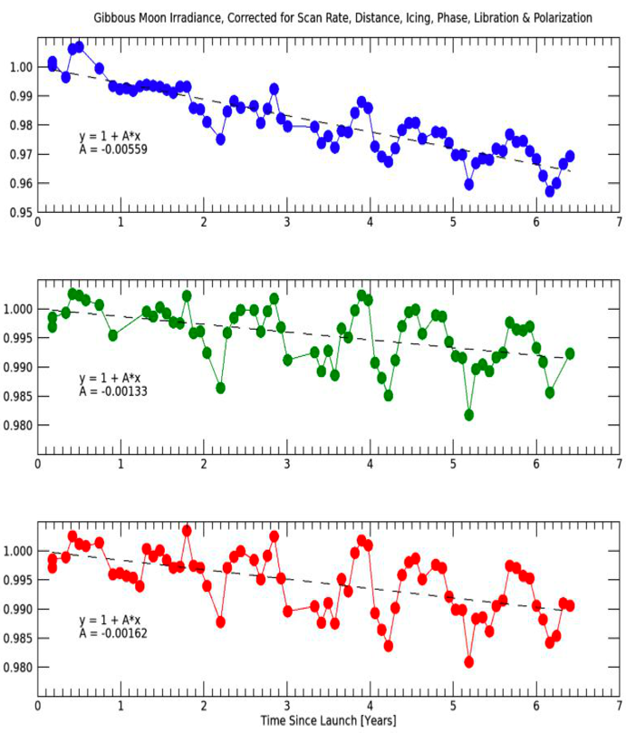
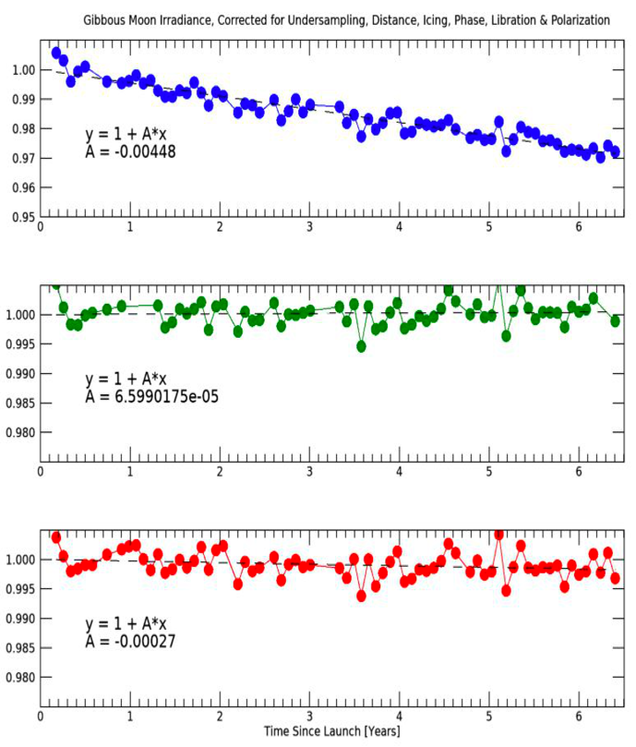
OCO-2 ¾ Waxing Gibbous Relative Trend
B10
B11

Slide 10
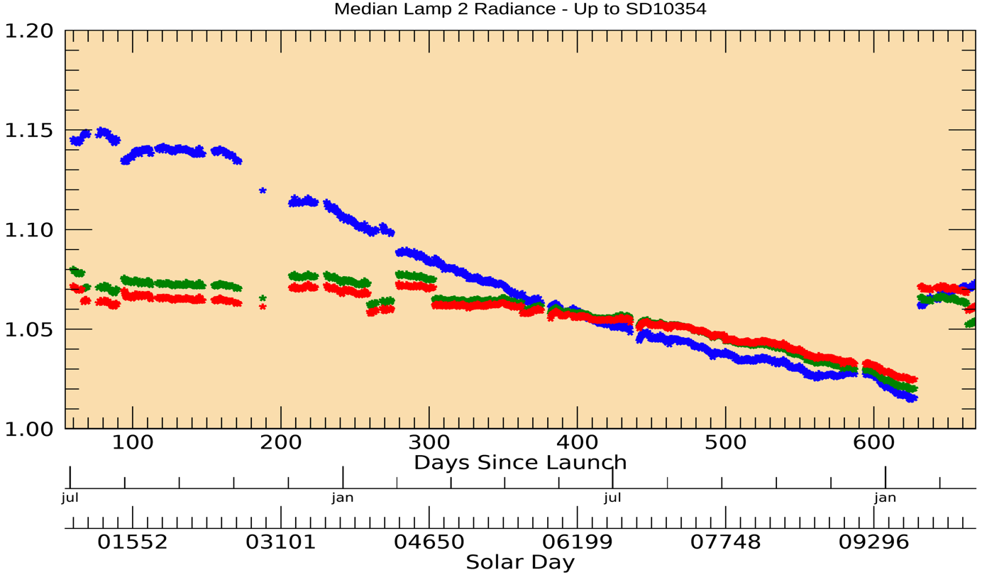
OCO-3 Radiometric Trend – Raw Lamp 2

Slide 11
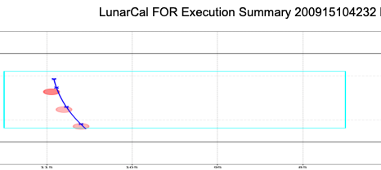
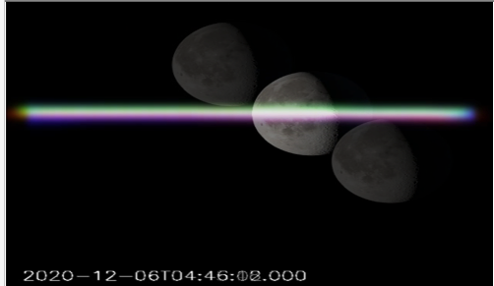
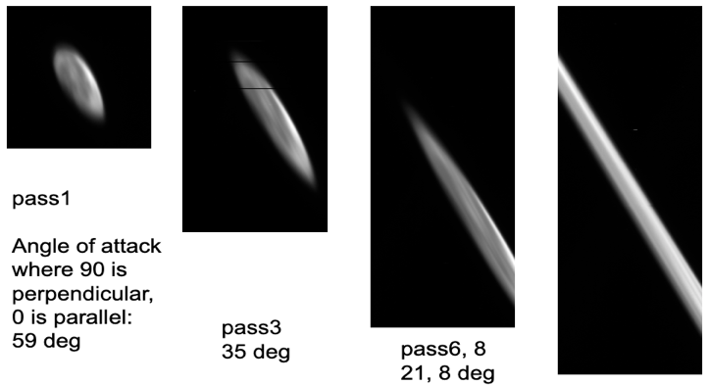
OCO-3 Lunar Calibration
Can only view Moon in limited FOV on port side, approx. 5x/year at varying phases, need to avoid obstructions
Several orbits per group, many scans per orbit
Hoping to exploit OCO-2 coincidences

Slide 12
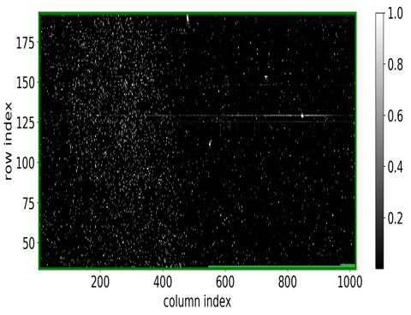
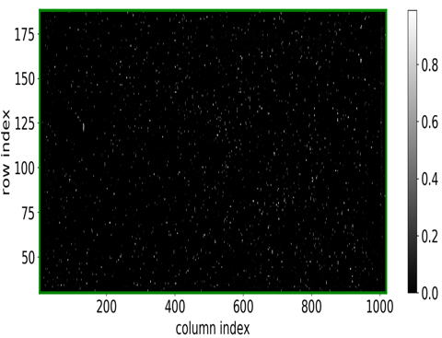
Bad Pixels and Samples
OCO-2 FPAs are OCO flight spares, instrument stored warm for 2+ years after final test due to launch vehicle change
Sharp increase in # of bad pixels after test, concentrated on long wavelength ends of WCO2 & SCO2
ML classifier to identify bad pixels used for OCO-3 test in Apr 2018, OCO-2 flight in Aug 2019, and OCO-3 flight in Jul 2019
Bad pixels irreversibly removed in FSW, but can remove entire samples (sums of 20 px) from retrieval in ground processing
Bad samples identified from Level 1A cal data, Level 1B cal data, and spectral residuals from the Level 2 algorithm
OCO-2 WCO2: 5262 bad pixels
OCO-3 WCO2: 1936 bad pixels

Slide 13
Conclusion
Continuing routine updates with dark and lamp data collected daily, analyzing broader trends to improve future versions
Absolute radiometric scaling remains a challenge for both missions, but fortunately those errors impact retrieved albedo more than retrieved X_{CO2}
We continue to work with the algorithm & uncertainty quantification teams to identify how calibration errors impact higher level products, and how much
Spectral calibration is essential, but harder to track ILS on orbit
OCO-2 has benefited from almost 7 years of data, stable operations
OCO-3 has benefited from mature OCO-2 algorithms and calibration processes
Exciting opportunities to link OCO-2 and OCO-3 at all levels of data processing

