Slide 1
Outcome of the 3rd Joint GSICS/IVOS Lunar Calibration Workshop
S. Wagner (EUMETSAT), V. Mattioli (EUMETSAT), T. Stone (USGS), X. Hu (CMA), X. Wu (NOAA)

Slide 2
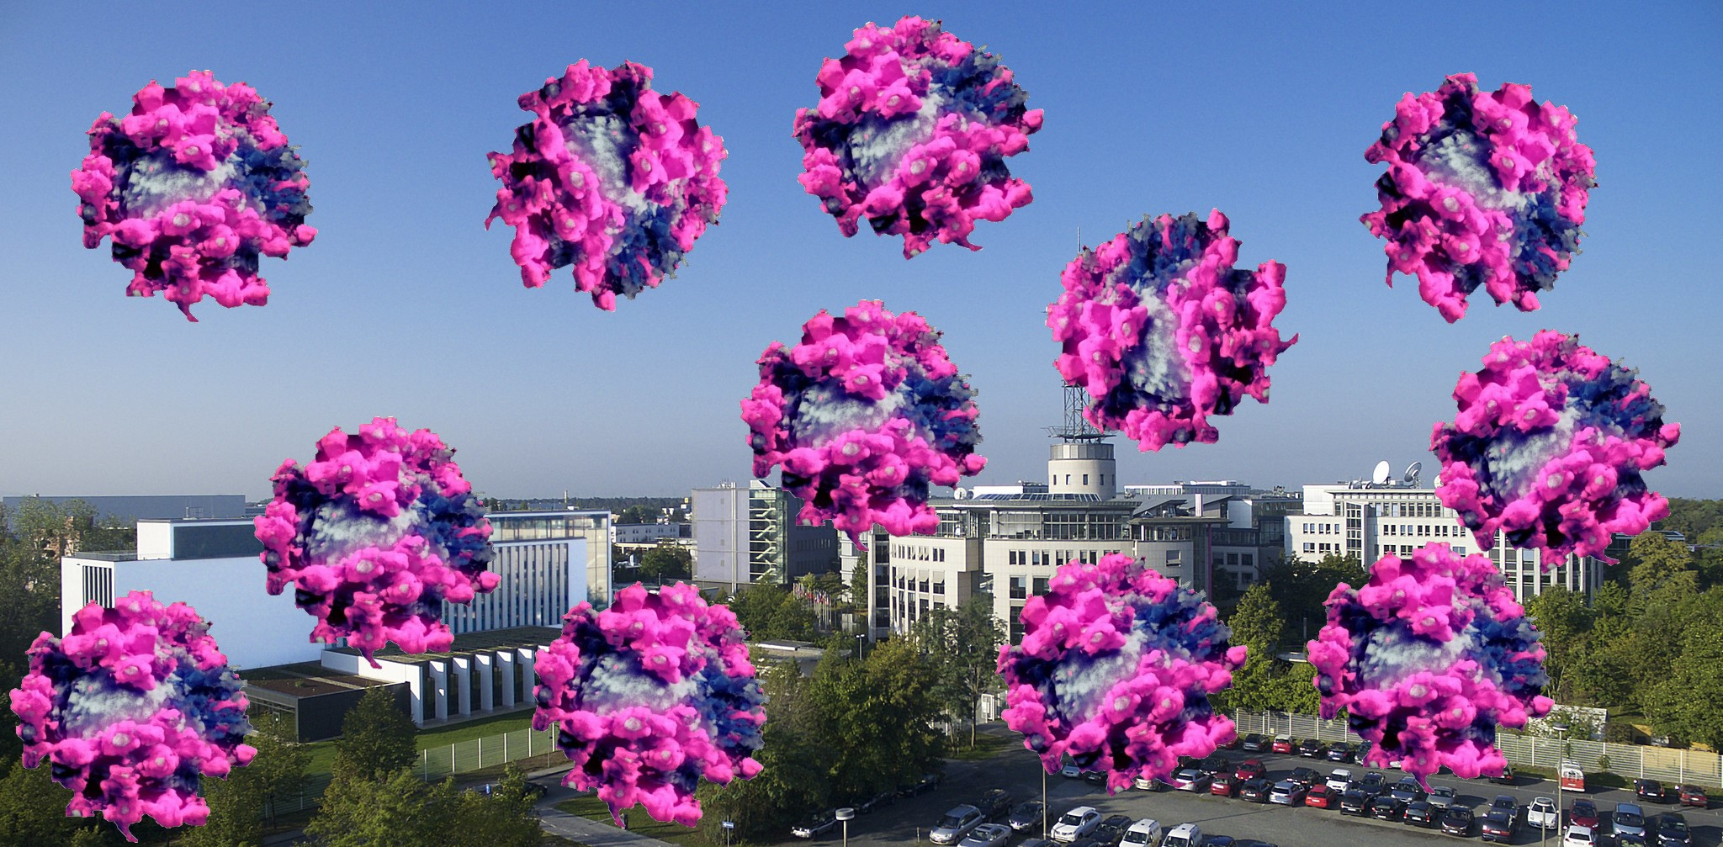
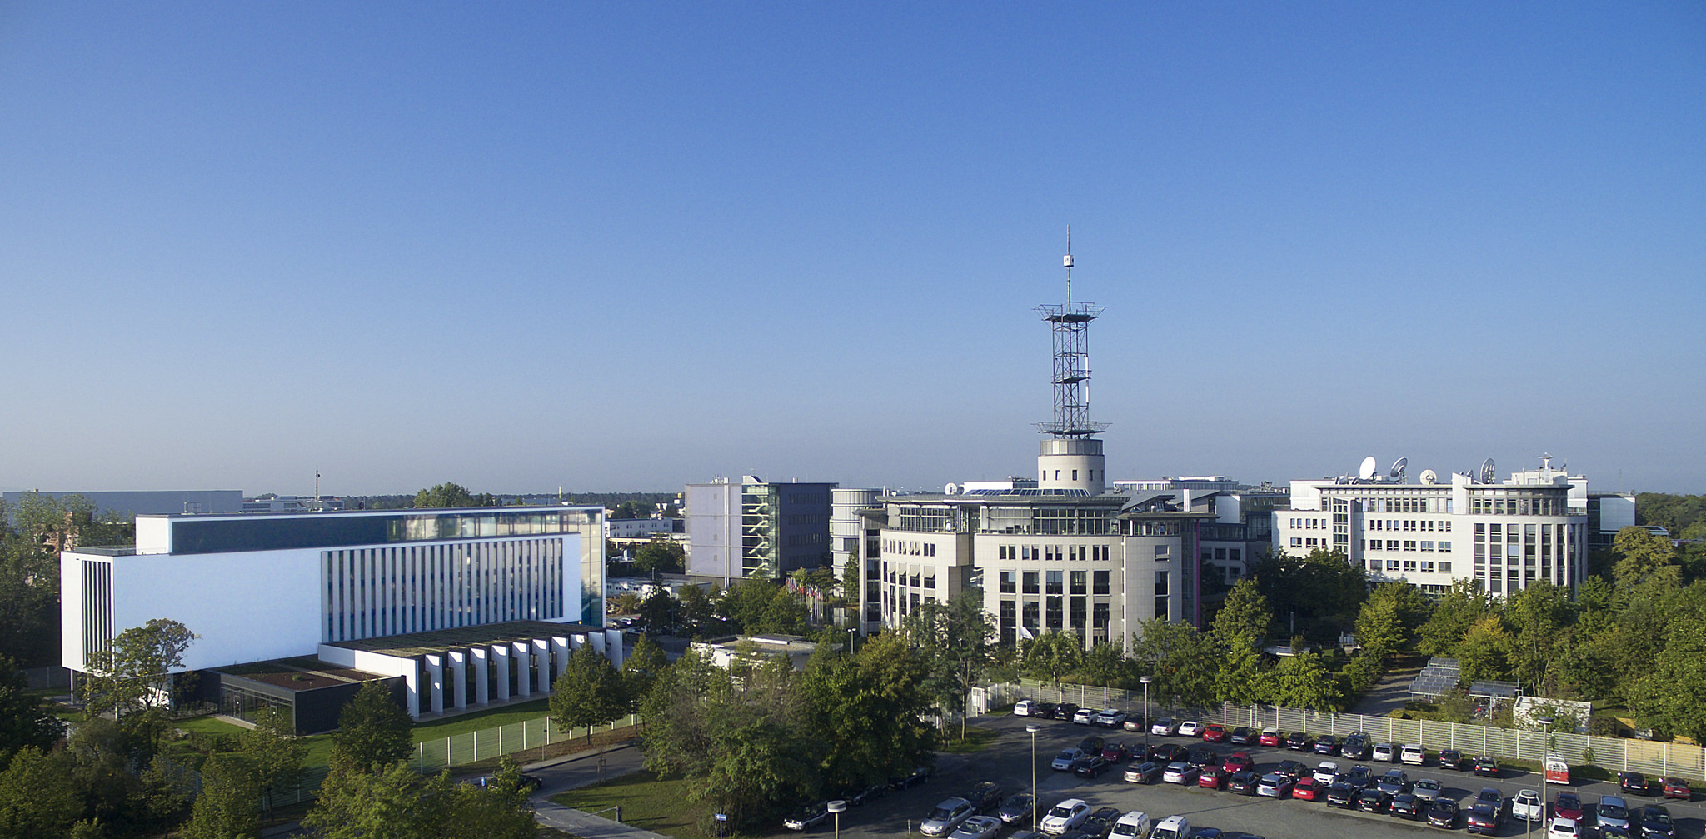
3rd Joint GSICS/IVOS Lunar Calibration Workshop
Third workshop after the meetings organised in 2014 at EUMETSAT and in Xi’an in 2017
Venue: Darmstadt (Germany) – 16-19 November 2020
Ok, we go virtual!
16-19 November 2020
Webex meetings between 13:00 and ~15:30 ECT
Credits: Peter Mindek/Nanographics/apa/dpa/picture alliance

Slide 3
3rd Joint GSICS/IVOS Lunar Calibration Workshop
Topics addressed by the virtual meetings
Measurements and Moon observations: towards SI traceability ➔ initiated at LCWS#2
Lunar calibration reference and model development ➔ continuation from LCWS#1 and #2
Instrument monitoring using lunar calibration ➔ continuation from LCWS#1 #2
Thermal infrared and microwave remote sensing and lunar observations ➔ NEW
Alternative applications of lunar observations for calibration purposes or post-launch assessments, including MTF characterization ➔ initiated at LCWS#2
High level of discussion and exchange maintained!

Slide 4
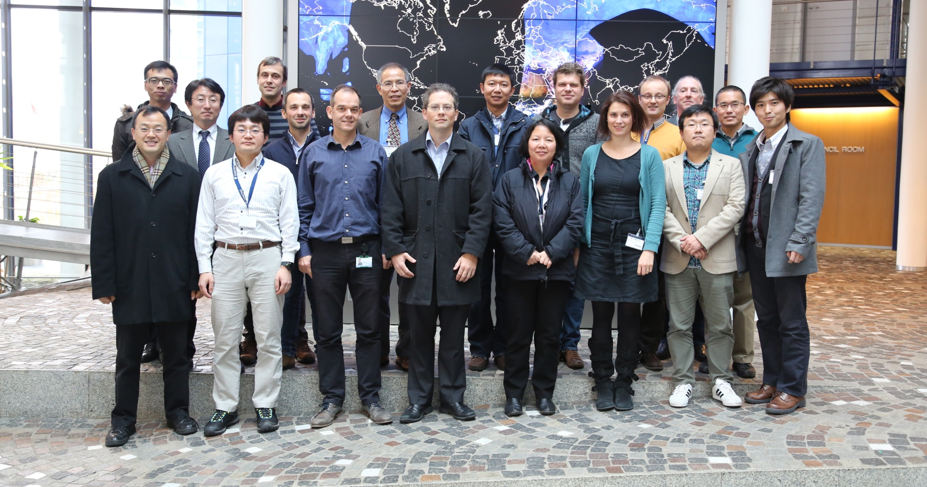
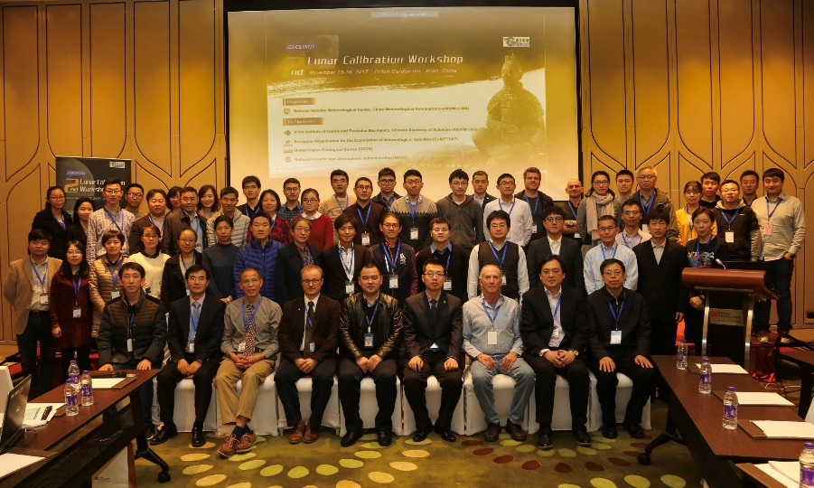
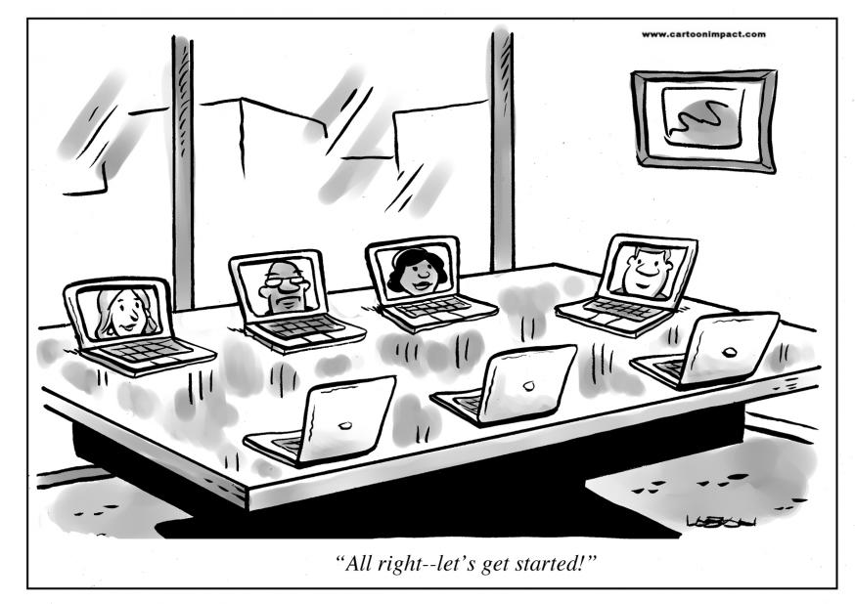
A growing interest…
First Lunar Calibration Workshop (2014):
14 agencies + departments
26 people (including remote attendees)
Second Lunar Calibration Workshop (2017):
22 agencies + departments
More than 60 scientists (including remote attendees)
Third Lunar Calibration Workshop (2020):
Almost 30 agencies / departments / institutes / universities
Between 70 and 80 participants from Asia / Europe / US
www.cornerstoneondemand.com/rework/cartoon-coffee-break-virtual-meetings

Slide 5
Measurements and Moon observation: towards SI traceability
Hopefully, many projects will record lots of lunar observations and contribute to reducing uncertainties in lunar calibration ☺
Air LUSI
ARCSTONE
ESA Tenerife
MLO LUSI
Courtesy Steve Maxwell - NIST

Slide 6
Lunar calibration reference and model development
Presentations of four different models:
Spectral Profile (SP) model – Radiance model (AIST / JAXA)
Lunar Irradiance Model ESA (developed for ESA by VITO, NPL, Univ. Valladolid)
Lunar Extended Satellite Simulation Solar Reflectance (developed for EUMETSAT by Earth Space Solutions)
SLIMED (H. Kieffer – Celestial Reasonings)
Part of the lunar model inter-comparison exercise, with ROLO + GIRO
➔ see presentation by T. Stone
Interfaces to the model ➔ need for decoupling models from the observation parameters in order to easy inter-comparison + benchmarking (see R.GVNIR.2020.16f.1)
Question of the access to the GIRO ➔ see R.GVNIR.2020.16f.2

Slide 7
Instrument monitoring using lunar calibration
Presentations on LEO sensors, including micro-satellites ones (RISESAT – AIST – see pres. 17b) + GEO radiometers
Further iterations on the recommendation for estimated the observed lunar irradiance:
Identification of the Moon pixels
Solid angle + oversampling estimates
Offsets for deep space + potential straylight
Need for lunar models to address accurately phase + libration effects ➔ even for limited range of phase + libration variations, residual dependencies may have several % impact
Lunar Calibration Workshop shows the benefits of confronting many observation datasets + models
Clearly lunar calibration becomes more and more part of mission CAL/VAL plans and monitoring activities (just at the LCWS: GCOM-C, RISESAT, OLCI, SLSTR, VIIRS, ABI, AHI, AMI)

Slide 8
Instrument monitoring using lunar calibration
Taichiro Hashiguchi – RESTEC
Additional uncertainty from residual phase dependence in the models
➔ Varies spectrally

Slide 9
Instrument monitoring using lunar calibration
Presentations on LEO sensors, including micro-satellites ones (RISESAT – AIST – see pres. 17b) + GEO radiometers
Further iterations on the recommendation for estimated the observed lunar irradiance:
Identification of the Moon pixels
Solid angle + oversampling estimates
Offsets for deep space + potential straylight
Need for lunar models to address accurately phase + libration effects ➔ even for limited range of phase + libration variations, residual dependencies may have several % impact
Lunar Calibration Workshop shows the benefits of confronting many observation datasets + models
Clearly lunar calibration becomes more and more part of mission CAL/VAL plans and monitoring activities (just at the LCWS: GCOM-C, RISESAT, OLCI, SLSTR, VIIRS, ABI, AHI, AMI)

Slide 10
IR and MW remote sensing and lunar observations
New topic within the context of the Lunar Calibration Workshops
Presentations + discussions on:
Lunar contamination correction methods for microwave imager and sounding instruments
Channel co-registration, pointing error identification, and antenna beam width characterization
Lunar disk-averaged microwave brightness temperature spectrum from satellite observations and model simulations
Lunar calibration and TIR – potential for monitoring (calibrating?) IR hyperspectral missions
CNES continues its effort on mission monitoring + model development (SUMULU see 1.h) ☺
Further work with regular dedicated IASI observations in collaboration with EUMETSAT
Proposal prepared by UMD + EUMETSAT for developing MW activities within GSICS (+enlarged) community shared with GSICS subgroup chair

Slide 11
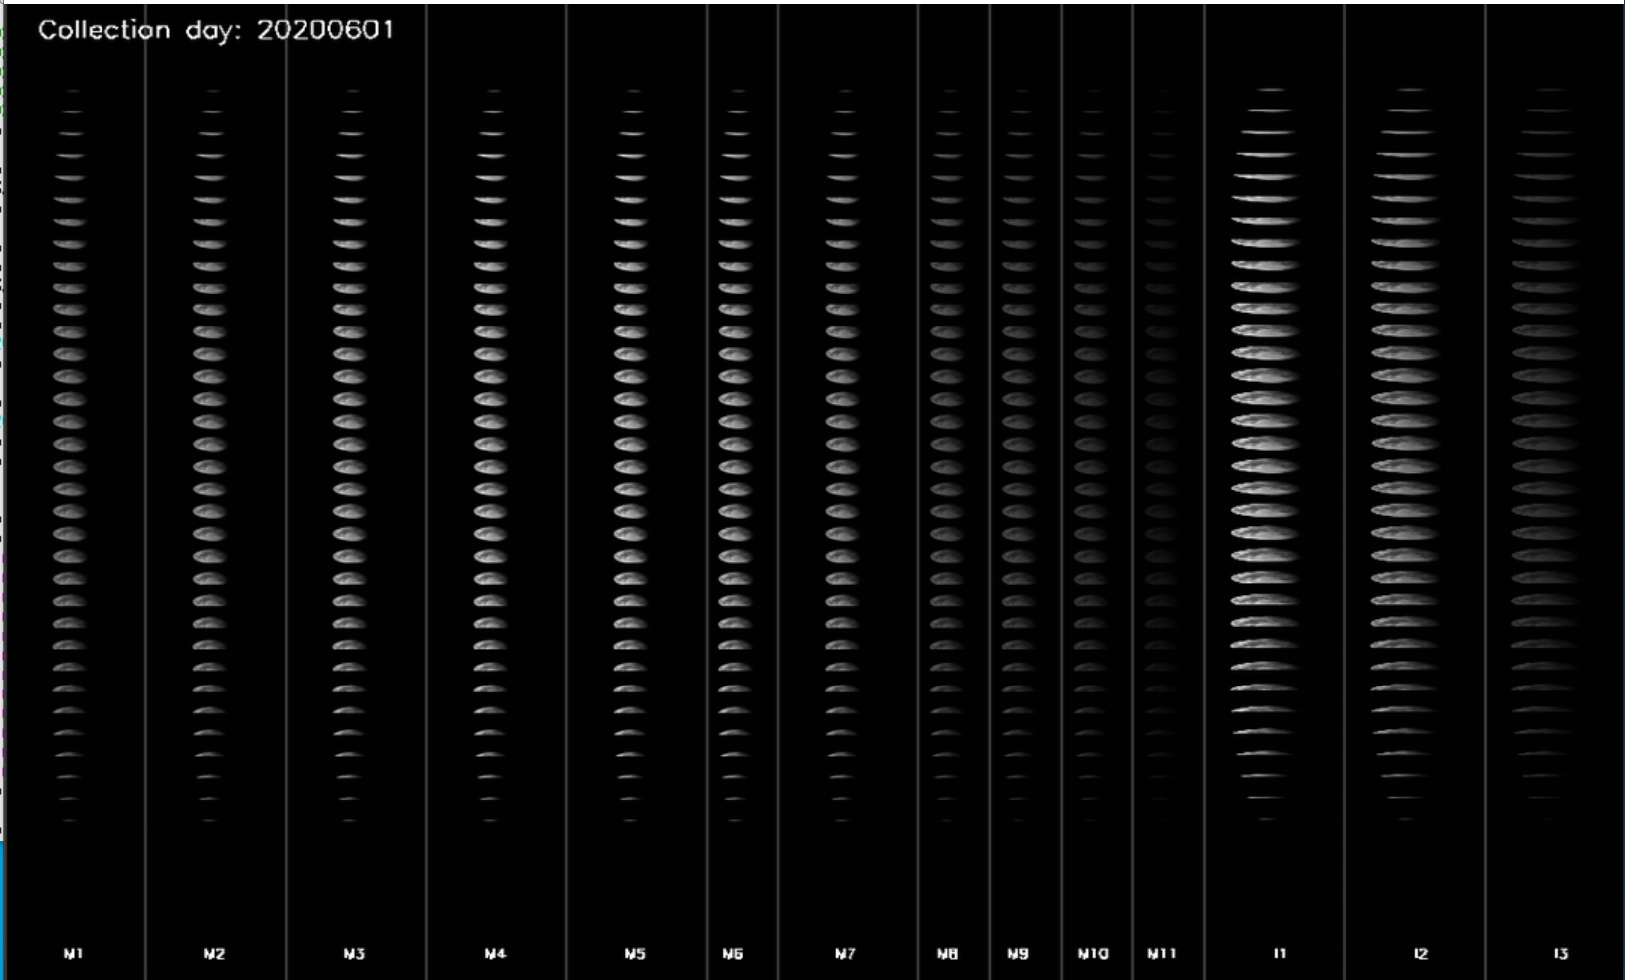
Alternative applications of lunar imagery
One talk by NOAA on VIIRS band-to-band registration + MTF (see T. Choi – 19.d)
5/25/2018 in band M7 - Image brightness adjusted to see the moon.

Slide 12
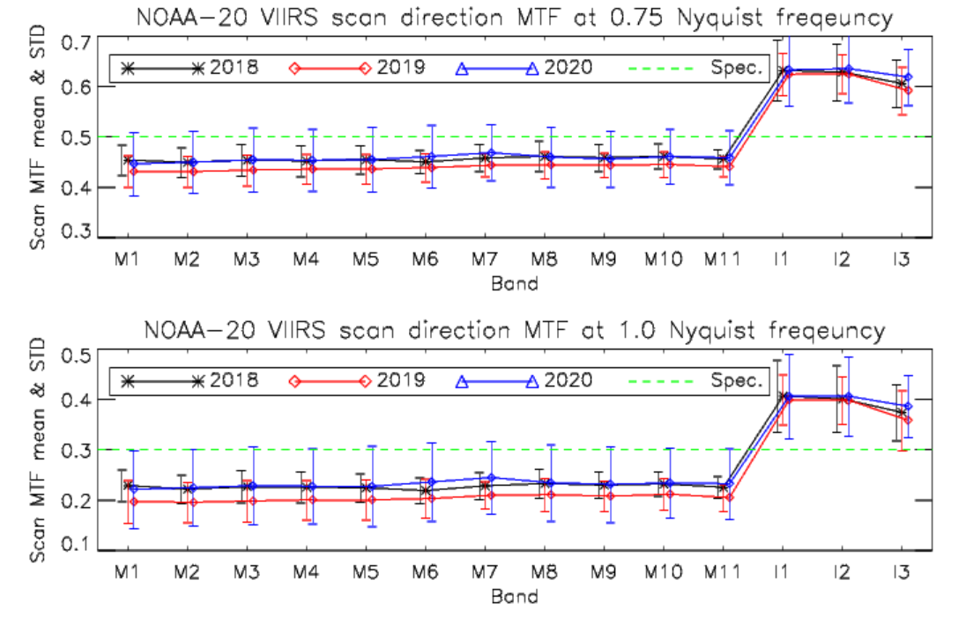
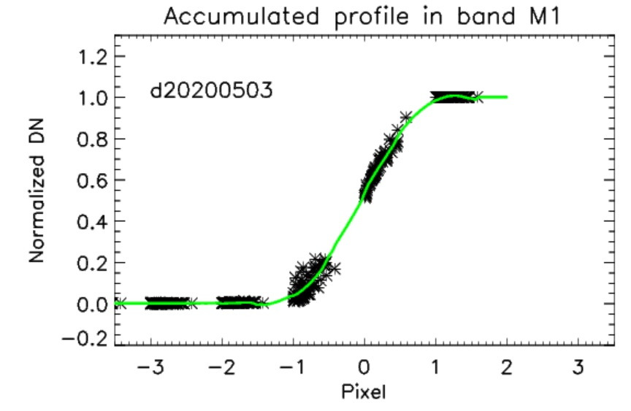
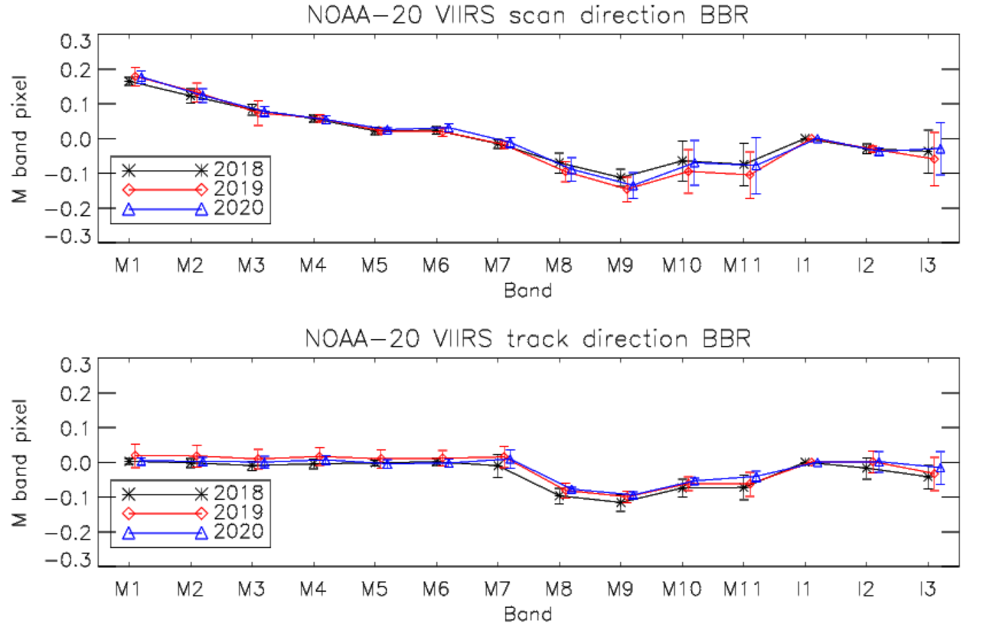
Alternative applications of lunar imagery
The prelaunch scan direction BBR results were very stable within 0.05 pixel.
Line
S/MWIR and VIR FPAs differences in the track are from prelaunch conditions
Frame

Slide 13
Alternative applications of lunar imagery
This topic could not be extensively covered ➔ hopefully at the next LCWS
In 2017, there was an idea to work with IVOS on MTF retrieval using the Moon, but did not materialise…
Recommendation (R.GVNIR.2020.19d.1) on NOAA to pursue their effort on coordinating the inter-comparison exercise on post-launch assessment of MTF using lunar imagery ➔ Idea = GSICS recommendation / white paper on best practices

Slide 14
Important points of focus
How to best integrate of observed irradiance ➔ possibility to prepare a GSICS white paper
Definition of an unambiguous terminology for "observed irradiance“ ➔ irradiance based on the same DN-to-radiance processing as science products BUT with mention of any time-based corrections included in this processing (on-board calibration / vicarious / lunar).
Solar irradiance model ➔ cross cutting discussion between VNIR and RS (ex-UV) subgroup
Need for including lunar data from geostationary instruments in lunar models ➔ question of the applicability range for selenographic coordinates
Separation of steps in lunar calibration, each of which should be separately accessible:
System-level relative spectral response to lunar effective wavelength
Time and location to angles and distance factor
Solar model and variations to solar irradiance (this may be challenging)
Geometric angles and effective wavelength to lunar disk-equivalent reflectance (using a named lunar model)
Output formatting ➔ already addressed by the standard GIRO output

Slide 15
Important points of focus
Agreed terminology to describe individual detector elements, arrays, focal planes, etc.
Model / software versioning and traceability ➔ definition of a convention
Need to include polarization in lunar models.
Estimate Earth-shine variation effect on lunar irradiance as a function of (absolute) phase angle.
Revise the benchmark proposed at the 2nd Joint GSICS/IVOS Lunar Calibration Workshop and propose a standard grid of angles to be used in lunar model comparisons ➔ initiated with the lunar model inter-comparison exercise (see T. Stone presentation)
Agreed terminology for describing accuracy, uncertainties, etc. in the context of lunar calibration and lunar modelling.

Slide 16
Main actions (out of 8)
A.GVNIR.2020.16f.1: EUMETSAT (S. Wagner) to liaise with USGS (T. Stone) to realign the GIRO with respect to the last version of the ROLO model ➔ initiated
A.GVNIR.2020.16f.2: EUMETSAT (S. Wagner) to propose letter of recommendation by GSICS to NASA to highlight the benefits to continue the Air-LUSI / campaigns and Mauna Loa-LUSI to improve lunar calibration ➔ will be addressed after annual meeting
A.GVNIR.2020.18g.1: UMD (Hu Tiger Yang) to coordinate with EUMETSAT (Vinia Mattioli) to draft a note outlining possible further collaborations on microwave and thermal infrared lunar calibration activities ➔ document provided to the GSICS subgroup chair to be discussed

Slide 17
Main recommendations (out of 8)
R.GVNIR.2020.16f.1: Model developers to consider how their models' inputs can be decoupled from the observations to allow inter-comparison and benchmarking on the various steps of lunar calibration ➔ immediately relevant for the on-going model inter-comparison exercise
R.GVNIR.2020.16f.2: EUMETSAT (S. Wagner) to investigate the possibility to revisit the mechanism to share the GIRO model, whilst respecting the existing license agreement ➔ being addressed
R.GVNIR.2020.17c.1: the solar irradiance spectrum used in the lunar irradiance models or for the instrument calibration should be documented and referenced when discussing lunar calibration results ➔ in line with VNIR subgroup discussions on reference solar irradiance spectral

Slide 18
Main recommendations (out of 8)
R.GVNIR.2020.18f.1: CMA is invited to share in upcoming GSICS and/or Lunar Calibration meetings its experience on the use of lunar observations acquired by their IR sounders ➔ IR is a new topic!
R.GVNIR.2020.18g.1 : the Microwave + Infrared group is encouraged to pursue current effort and report within the context of GSICS regular meetings ➔ need to keep the ball rolling within GSICS!
R.GVNIR.2020.19d.1: NOAA is encouraged to pursue its initiative on comparing approaches for post-launch assessment of MTF using lunar imagery. This initiative, in collaboration with other agencies would lead to the definition of best practices for MTF assessment using the Moon ➔ Idea = GSICS recommendation / white paper on best practices

Slide 19
Conclusion and future activities
Very successful meeting given the exceptional circumstances
High level of discussion and exchange!
Strong interest for improving the accuracy of the lunar models and work on SI-traceability:
Great effort on-going on the measurement side
Similar momentum on lunar modelling
New communities taken on-board with TIR and MW
Lunar model inter-comparison exercise will continue ➔ activity in 2021
Still to be discussed / decided = next LCWS date + location
Wiki page for the meeting + presentations: http://gsics.atmos.umd.edu/pub/Development/LunarCalibrationWS2020

Slide 20
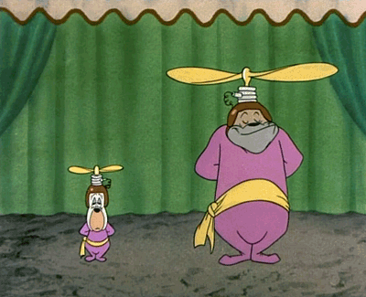
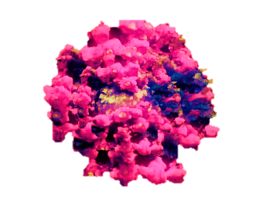
Thank you

