Slide 1
GSICS Lunar Model Comparison Exercise
Tom Stone – USGS
Sébastien Wagner – EUMETSAT
with contributions from
Marc Bouvet – ESA
Hugh Kieffer – Celestial Reasonings
Toru Kouyama – AIST
Matthijs Krijger – Earth Space Solutions
Steve Miller – CIRA, Colorado State University

Slide 2
Introduction
A GSICS activity
Lunar calibration uses models to generate reference values for comparing to measurements made by sensors.
Several new lunar models have been developed recently, some with the intent to provide the lunar calibration reference for various agencies.
The accuracy of the models needs to be tested, but no standard “ground truth” currently exists that can be used to evaluate them.
Objective of the exercise: to examine the performance of different lunar models relative to each other
Methodology: compare model results generated for a common set of inputs

Slide 3
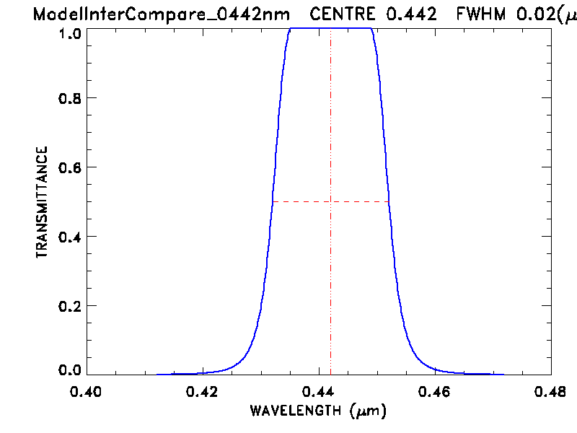
The common model inputs
The participating modelers agreed a set of test input parameters, to cover practical ranges of observation geometry (phase angles and librations) and spectral bands.
phase angle grid: 3°–10° at 1° spacing, 10°–20° at 2° spacing, 20°–50° at 5° spacing, 50°–90° at 10° spacing, both before and after Full Moon
libration grid: 0°, 4°, 8°, 12° in sub-observer longitude, 0°, 4°, 8° in latitude
All combinations gives 1610 total geometry points.
spectral bands: 8 typical remote sensing channels 442, 550, 670, 765, 870, 1380, 1640, 2350 nm
spectral response functions: 20 nm FWHM, flat-topped Gaussian

Slide 4
The models
Presented in roughly chronological order
Description slides contributed by the model PoCs as listed:
ROLO (2003), Tom Stone
CLIMES (Miller-Turner, 2009), Steve Miller
Spectral Profiler (SP, 2016), Toru Kouyama
GIRO (2018), Seb Wagner
SLIM (2019), Hugh Kieffer
LIME (2019), Marc Bouvet
LESSSR (2020), Seb Wagner

Slide 9
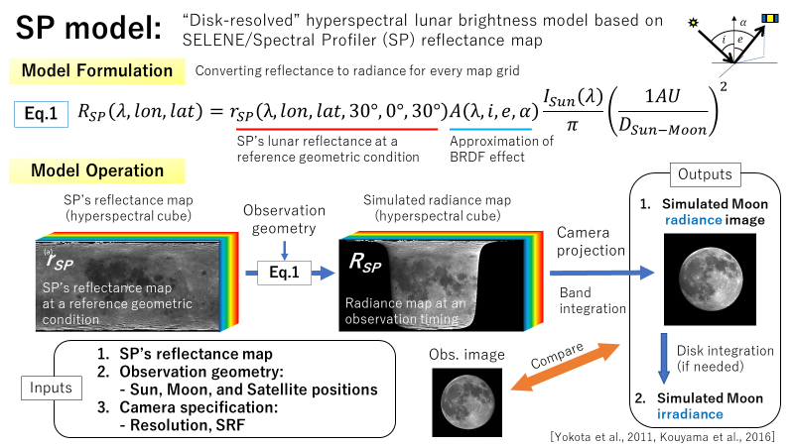

Slide 19
Summary and Conclusion
Status:
The test geometry grid and spectral response functions have been defined
specified as photometric parameters to eliminate potential errors due to conversion from geodetic or inertial coordinates
Model outputs are being generated by the participants
TBD: the format for comparing the results
Conclusion:
Reliable, high-accuracy absolute lunar radiometric measurements are needed to constrain the predictions of lunar models

Slide 20
Thank You!

