Slide 1
Comparison of spectral radiance for UV-VIS high-resolution spectrometers from
GF-5/EMI and S5p/TROPOMI
Qian Wang, Peng Zhang, Na Xu, and Lin Chen
National Satellite Meteorological Centre(NSMC), CMA
University Of Science And Technology Of China (USTC)

Slide 2
Outline of the presentation
1. GF-5/EMI and S5P/TROPOMI UV-VIS nadir satellite
2. Double difference technique
3. Selection of geometrically matched-up data
4. Factors affecting inter-comparison for UV-VIS hyperspectral instruments
5. Spectral radiance comparison results
6. Summary

Slide 3
1. GF-5/EMI and S5P/TROPOMI instruments
EMI is a payload on-board the Chinese high-resolution remote sensing satellite GaoFen-5(GF-5).
EMI and TROPOMI are two similar instruments that provide high resolution spectral radiance by grating spectrometers with a daily global coverage.
Take a well-calibrated TROPOMI as a reference.
To introduce a method of inter-comparison for UV-VIS high-resolution spectrometers, and present an initial radiometric difference between EMI and TROPOMI.
Instrument | GF-5/EMI | S5P/TROPOMI
Launch time | 2018 | 2017
Spatial resolution (km2) | 43(CT) * 13(AT) | 3.6(CL)*5.6(AL) / 3.5*7（before 2019/08）
Spectral resolution (nm) | 0.3-0.6 | 0.1-0.5
Local time | Ascending node of 13:30 | Ascending node of 13:30
Band(nm) | UV-1:240-315nm UV-2:311-403nm VIS-1:401-550nm VIS-2:545-710nm | UV:270-320nm UVIS:300-500nm NIR:675-775 nm SWIR:2305-2385 nm
Spectral Dimension (Column) | 1072 | 497
Spatial Dimension (Row) | 191 | 450
Objective | O3,SO2,NO2 | O3,SO2,NO2,aerosol,cloud
Swath(km) | 2600 | 2600
Orbital height（km） | 705 | 824
300-400nm

Slide 4
2. Double difference technique
Part 1
Part 1: EMI vs TROPOMI –
Geometric matching.
Part 2
Part 2: Factors affecting inter-comparison for UV-VIS band and hyperspectral instruments.
Part 3: Spectral radiance comparison results.
Part 3
Flowchart for computing inter-calibration double differences of EMI and TROPOMI

Slide 5
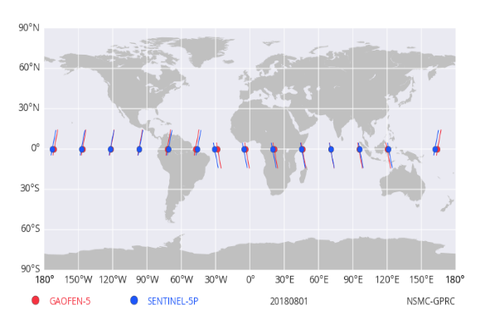

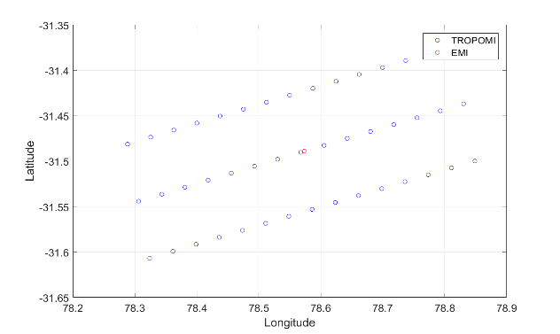

3. Selection of Geometrically Matched-Up Data
General procedures for inter-comparison
SNOx
Orbits calculation
To avoid biases due to ozone variations in polar regions
Pseudo-Invariant Ocean
Spatio-temporal matching
Spatial threshold：3km
Temporal threshold：240s
Alignment in Viewing Geometry
To avoid radiance biases due to VZA differences.
θ1 , θ2 are VZA for EMI and TROPOMI
Uniform scene filter
3 non-absorption channels (330.0, 359.9, 391.3nm）are selected to filter the uniform scene samples.
An array of 3 × 15 TROPOMI pixels to check spatial inhomogeneity for matched-up data
Cloud-free
Scene
Cloud-free scenes are selected by TROPOMI L2 Cloud products.

Slide 6
4. Factors affecting inter-comparison for UV-VIS hyperspectral instruments
1.Spectral Comparisons
2.Solar spectrum
3.Surface property
4.Polarization
Hyperspectral Instruments
Main Factors
Characteristics in UV-VIS band

Slide 7
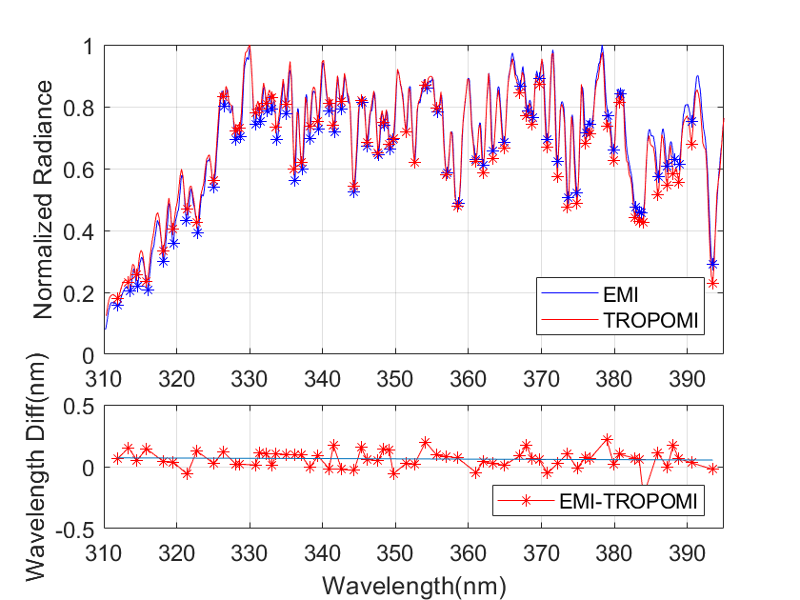
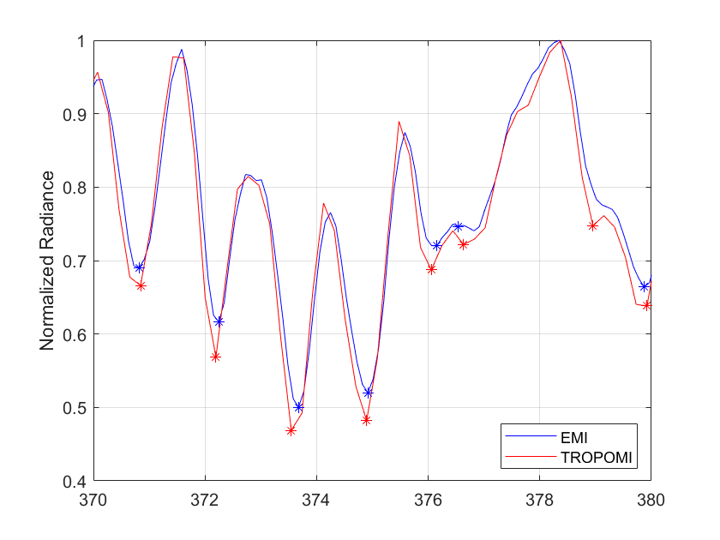
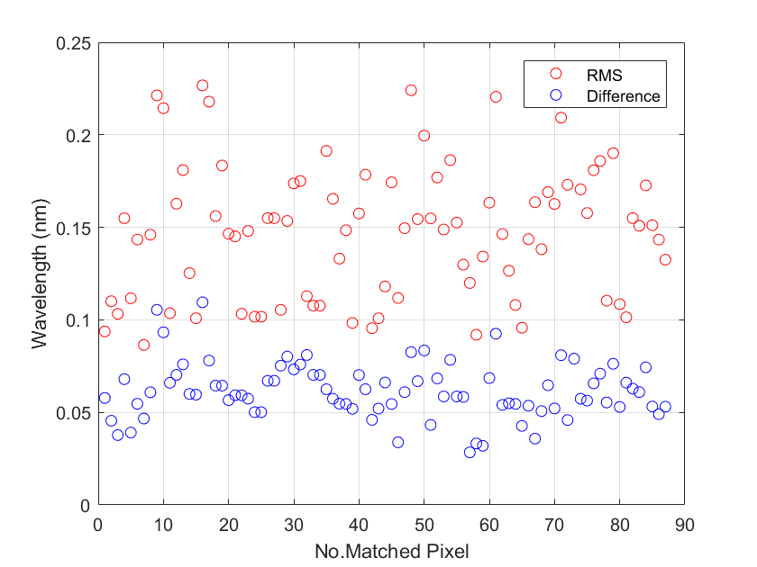
4. Factors——Spectral Comparisons
Spectral calibration is the basis of radiance comparisons for hyperspectral instruments.
Evaluate the accuracy of wavelength between EMI and TROPOMI by selected absorption channels in matched pixels.
EMI shows little positive wavelength shift. Average wavelength difference is about 0.06nm (<10% FWHM), RMSE value ranges from 0.1 to 0.22nm.
The wavelength difference is within 10% FWHM, radiance can be compared without any spectral correction.

Slide 8
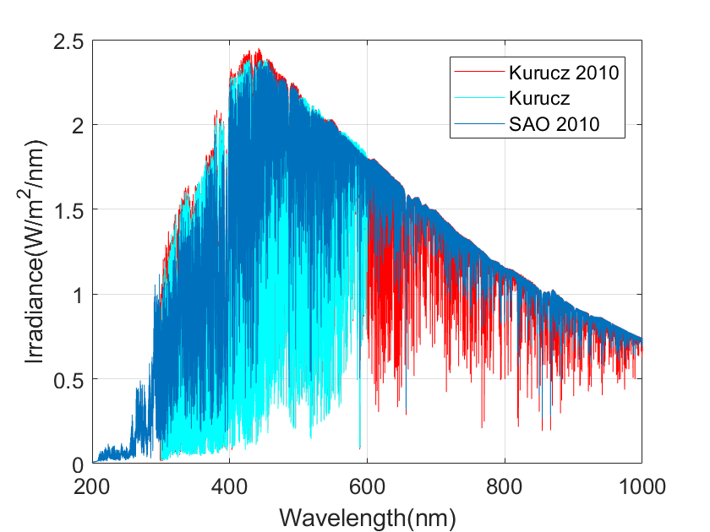
4. Factors——Solar spectrum
The solar reference spectrum is an essential input of radiative transfer model (RTM). It influences the simulated spectra on radiance, wavelength and the depth of absorption lines.
To determine the solar spectrum used to RTM calculation.
SAO2010 satisfies the requirements of UV-VIS calibration and radiative transfer calculation in spectral resolution, band coverage and integrated irradiance.
Table1 Spectral parameters of 3 kinds of reference spectra (unit: W/m2/nm）
Reference Spectrum | Band range | Spectral resolution
Kurucz (from SCIATRAN database) | 300-600nm | 0.01nm
Kurucz 2010 | 300-1000nm | 0.01nm
SAO 2010 | 200-1000nm | 0.04nm
Table 2 Difference of integrated irradiance ( Take SAO 2010 as a baseline)
Reference Spectrum | coverage | integrated irradiance | integrated irradiance difference %
Kurucz | 200-300 300-400 400-500 | - 91.787 186.717 | - -2.99% -2.19%
Kurucz 2010 | 200-300 300-400 400-500 | - 94.606 190.894 | - -0.074% 0.001%
Wavelength shift
Great consistency
The difference of band coverage and spectral resolution
Wavelength shift
Consistency in integrated irradiance
Kurucz spectrum (from SCIATRAN database) shows a large wavelength shift and integrated irradiance differences(2-3%) compared with SAO2010.
The spectral coverage of Kurucz2010 dose not extend to 200nm.
Set the SAO2010 as the solar spectrum in RTM simulation.

Slide 9
4. Factors——Surface property in UV-VIS band
Surface albedo is the one of the main factors affecting the simulated spectrum in sun-light reflected band in cloud-free scenes.
To investigate the typical surface albedo of different surfaces and identify the reasonable albedo in radiative transfer model.
Except for the snow, the reflectance in the UN-VIS band mainly changes from 0.03 to 0.12 in 300-400nm. The water is very dark with a reflectance of 0.03.
The radiance difference of non-absorption channels is about 20% with the albedo ranged from 0. 03 to 0.12, indicated that sunlight in 300-400nm can reach the surface after being absorbed by atmospheric gases.
Table. Average reflectance in 250-710nm for different surfaces
Surface | 250-300nm | 300-400nm | 400-500nm | 500-550nm | 550-710nm
Sand | 0.091 | 0.1218 | 0.1802 | 0.2202 | 0.2620
Soil | 0.0300 | 0.0403 | 0.0696 | 0.1082 | 0.1588
Snow | 0.9490 | 0.9533 | 0.9513 | 0.9427 | 0.9348
Vegetation | 0.0590 | 0.0590 | 0.0590 | 0.1058 | 0.1097
Water | 0.0250 | 0.0327 | 0.0502 | 0.0456 | 0.0308
The reflectance spectra property in UV-VIS band for typical surfaces
Set the albedo to 0.03 in RTM simulation.
Notes:
Sea Surface Reflectance

Slide 10
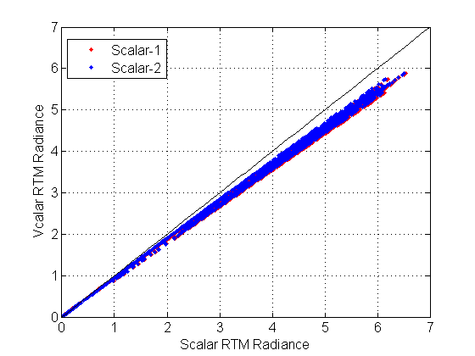
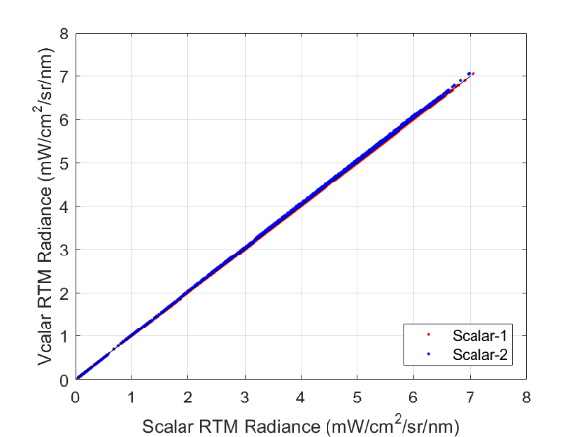
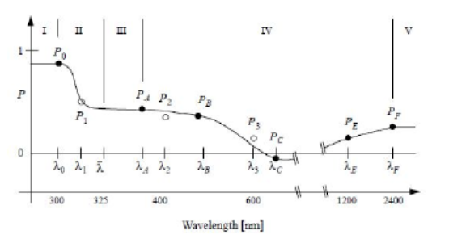
4. Factors——Polarization
Polarization is stronger in UV band than that of VIS and SWIR band.
Radiances calculated by Vector Radiative Transfer Model (VRTM) and Scalar Radiative Transfer Model (SRTM) show large differences in aerosol scenes. Scalar approximation of RTM in UV-VIS region can overestimate the radiance. But for aerosol-free scene, that shows very little difference.
How about the influences of vector RTM and scalar RTM calculation on radiance inter-comparison?
Aerosol-free Scene
Aerosol Scene
Earth’s polarization spectrum in 240-2400nm
(From Nick Schutgens et al.,2002 )
Simulated radiance by Vector RTM and Scalar RTM in aerosol scene (left) and aerosol-free scene (right)

Slide 11
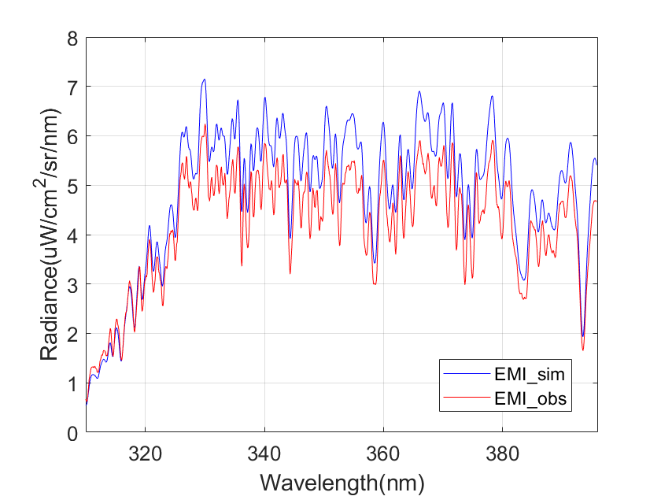
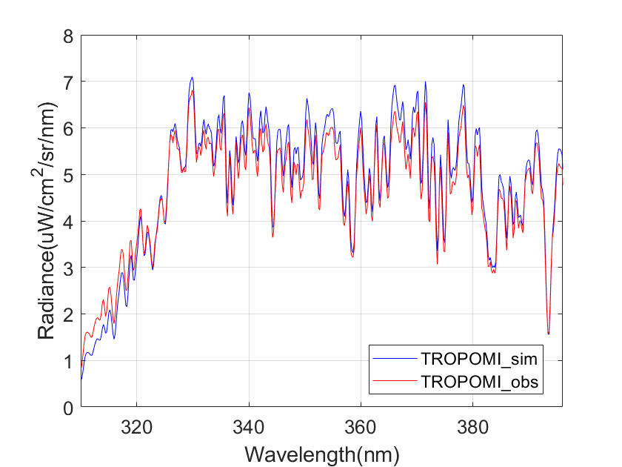
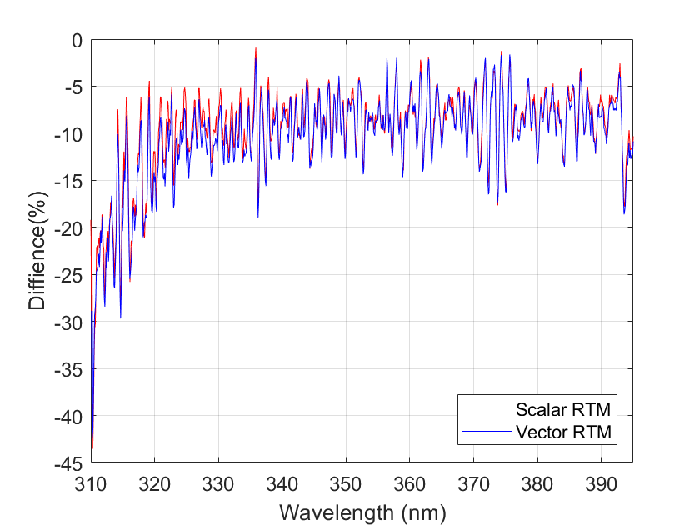
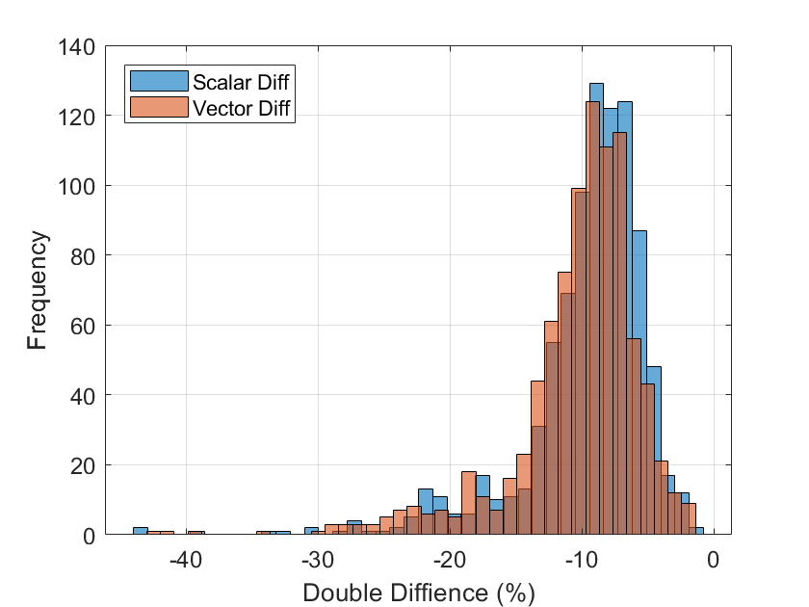
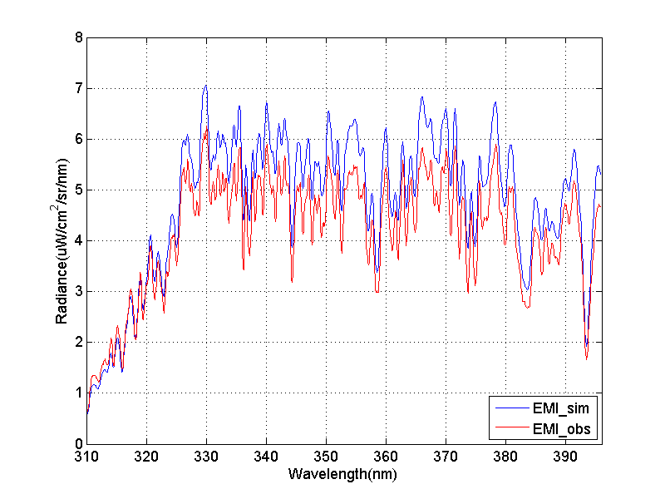
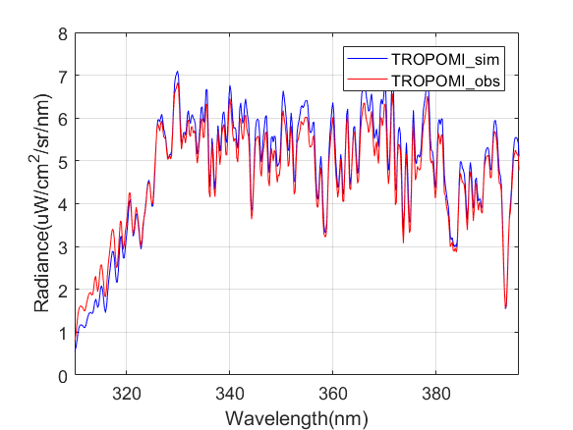
4. Factors——Polarization
To analyze the influences for vector and scalar RTM on radiance inter-comparison in aerosol scenes.
Spectral radiance for EMI and TROPOMI in a matched pixel are calculated by vector and scalar RTM.
Their influences on double difference are evaluated.
The distribution of double differences calculated by VRTM and SRTM shows a good consistency, the double difference calculated by SRTM fluctuates a little bigger than that of VRTM near the shortwave region. The difference calculated by VRTM and SRTM is about 0.3%.
Double difference for EMI calculated by vector RTM and scalar RTM
Difference is 0.3%
EMI/TROPOMI spectra calculated by scalar RTM
Spectra calculated by vector RTM
Double difference distribution
Double difference frequency
Calculate the spectra by scalar RTM simulation!

Slide 12
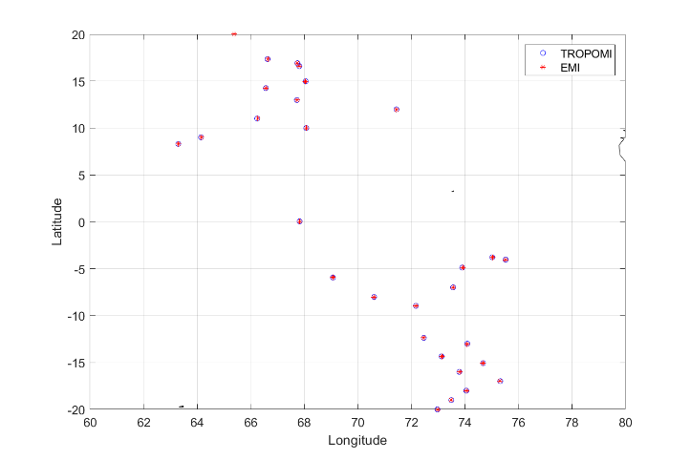
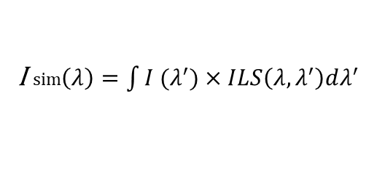
5. Spectral radiance comparison results
Table1 Parameters for EMI vs. TROPOMI matched orbits
Instrument | Date | Time | Latitude | Longitude | Distance | Time diff. | Matched pixel Num. | Sample Num. | Surface
EMI | 2018. 0801 | 08:51:11 | 0.03 | 70.59 | 2.36km | -194s | 3255 | 107 | Sea
TROPOMI |  | 08:47:57 | 0.01 | 70.57
Matched-up Pixels
Table2 Simulation conditions list of SCIATRAN
Parameters | EMI | TROPOMI | TROPOMI
Orbit height | 705km | 824km | 824km
Geometry | EMI L1B files | TROPOMI L1B files | TROPOMI L1B files
Sample step | 0.03
Spectra resolution | 0.1
Orbit height | 705km |  | 824km
Polarization | Scalar approximation |  | 17.69°
Background | climatological values
Mei | Default
Rayleigh | Default
Albedo | 0.03
ILS | Gaussian
Solar spectrum | SAO2010
Comparision based on Double difference (DD)
TROPOMI
I sim$\left(λ\right)=\int{I (λ^{′})×ILS\left(λ,λ^{′}\right)dλ^{′}}$
I is the radiance calculated by SCIATRAN, ILS is the Instrument Line Shape function. ILS is measured in the Lab for TROPOMI, is parameterized as Gaussian function for EMI.
SD_{EMI} = I_{obs,EMI}- I_{sim,EMI}
SD_{TROP}= I_{obs,TROP}-I_{sim,TROP}
DD=(I_{obs,EMI}- I_{sim,EMI} ) – (I_{obs,TROP}-I_{sim,TROP})
EMI
SD is the single difference for EMI and TROPOMI. DD refers to the double difference.

Slide 13
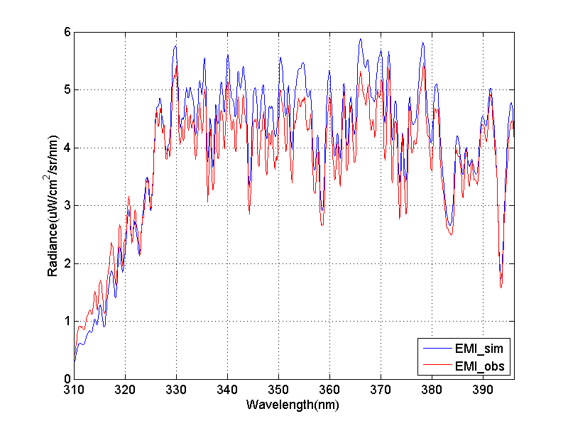
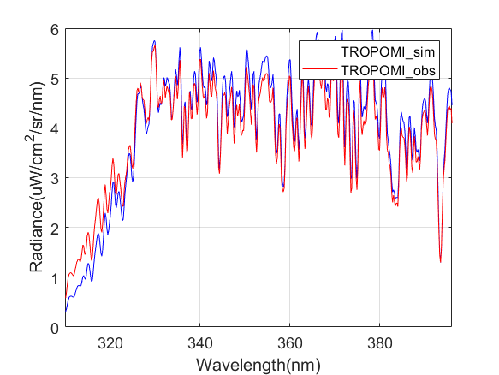
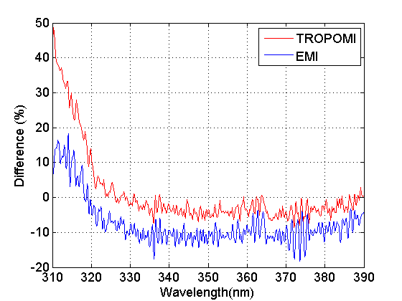
5. Spectral radiance comparison results
Average of Single Differences for EMI and TROPOMI for all the calculated matched-up pixels
Simulated and Observed Radiance for EMI(Left) and TROPOMI(Right) for one sample
Observed spectra radiance is lower than simulated spectral radiance in most of the band.
The averages of single differences for EMI and TROPOMI show similar trends with a systematic bias over the whole band.
The observed radiances are about 4.35% and 11.5% lower than the simulated radiance for TROPOMI and EMI, respectively.

Slide 14
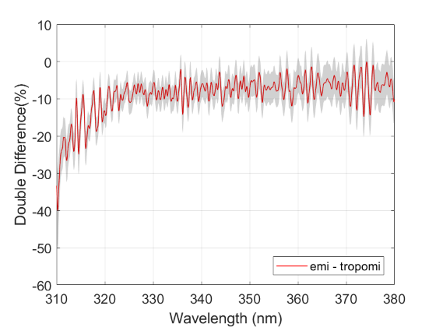
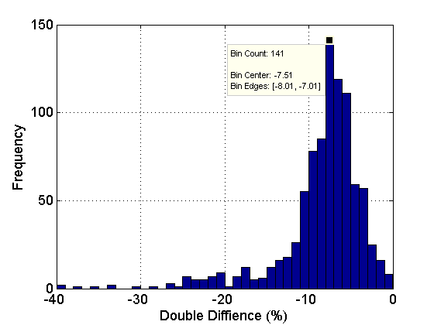
5. Spectral radiance comparison results
-7.5%
Double difference of EMI for all the calculated matched-up pixels.
Left: Average of double difference and the Standard deviation. Red line is the average of double difference, shadow is the standard deviation for those matched-up pixels. Right: Distribution of frequency for double differences
EMI radiance is lower than TROPOMI.
Frequency distribution of double difference shows that the radiometric difference is around -7.5%.

Slide 15
6. Summary
Inter-comparison for UV-VIS band and hyperspectral instruments
The extended SNO (SNOx) can be used for intercomparison of EMI with TROPOMI at low latitudes.
Spectral difference should be evaluated to reduce the radiance uncertainty.
Reference solar spectrum should be determined because of its severe effects on simulated spectral radiance.
Scalar approximation of radiative transfer calculation in UV-VIS band can be used for double difference technique.
Spectral radiance comparison results
Wavelength difference between EMI and TROPOMI is about 0.06nm.
Radiometric difference of EMI with TROPOMI is -7.5%.

Slide 16
Monitoring of NO₂ pollution from GF-5/EMI observations during 2020–nCoV outbreak over China
NO2 pollution during 2020 Spring Festival
(2020–nCoV outbreak)
NO2 pollution during 2019 Spring Festival
(From Huanhuan Yan)

Slide 17
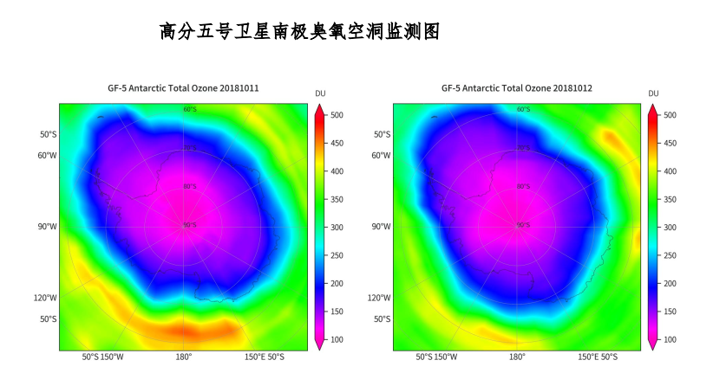
Monitoring of Antarctic ozone hole from GF-5/EMI observations in 2018.10.11 and 2018.10.12
(From Huanhuan Yan)

Slide 18
Monitoring of SO₂ pollution from GF-5/EMI and S5p/TROPOMI observations
2019.06.22
2019.06.22
(From Huanhuan Yan)

Slide 19
Thanks for your attention!

