Slide 1
Copernicus Climate Change Service:
Reanalysis and Satellite Data
Bill Bell,
Hans Hersbach, Cornel Soci, Paul Berrisford, Raluca Radu, Joaquin Munoz Sabater, Adrian Simmons, Andras Horanyi, Julien Nicholas, Dinand Schepers
&
C3S Contractors

Slide 2
Outline
The Copernicus Climate Change Service
The ERA5 reanalysis
  Specifications & performance
  Satellite observations
Satellite data reprocessing & data rescue
  Ongoing work
  Streamlining
Summary

Slide 3




















Copernicus Services
USERS
Policy Makers
&
Public
&
Private, Commercial
Different
Needs
Examples of
areas covered
Farming
Oil Spill Tracking
Air Quality
Flood
Surveillance
Arctic change
6 Information
Services
Land
Marine
Atmosphere
Emergency
Security
Climate
Space
Infrastructure
&
In Situ
Infrastructure
Sustainable
observation
capabilities
OBSERVATIONS
ECMWF operates the Copernicus Climate Change Service (C3S) and
Copernicus Atmosphere Monitoring Service (CAMS) on behalf of the European Commission.

Slide 4

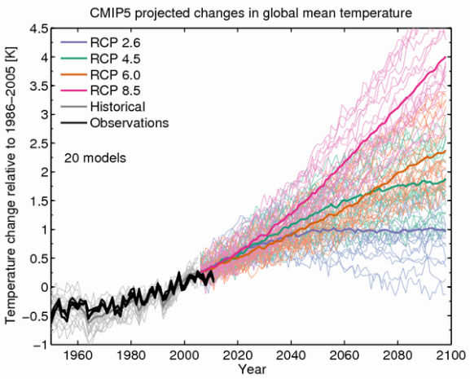
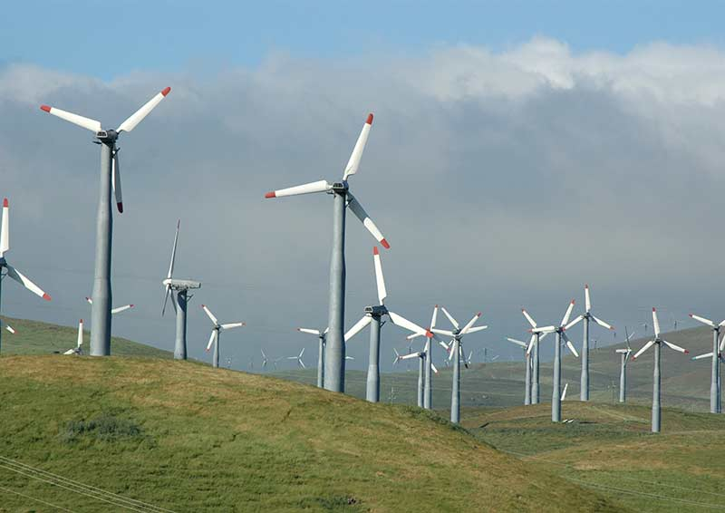
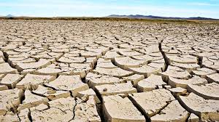
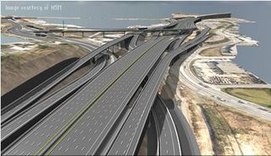
Climate Change Service: components
How is climate changing?
    Earth observations
    Reanalyses
Will climate change continue/accelerate?
    Predictions
    Projections
What are the societal impacts?
    Climate indicators
    Sectoral information

Slide 5
C3S - Development timeline
PoC + Pre-operational Phase
2013
2014
2015
2016
2017
2018
2019
2020
2021
Stage 0
Stage I
Stage II
Stage III
Operational Phase

Slide 6
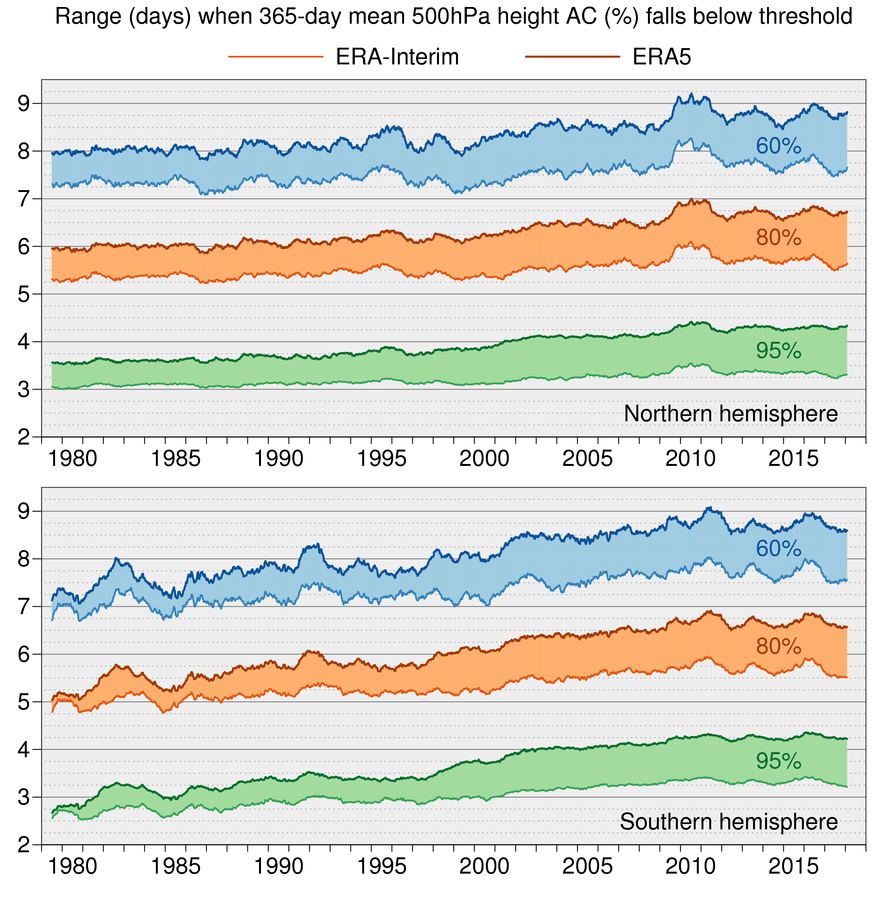
The ERA5 global reanalysis
ERA5 is in production at ECMWF for C3S
ERA5 will replace ERA-Interim
Improvements compared to ERA-Interim:
Benefit from 10 years model development
Much higher resolution; 31km versus 80km
More and better input data
Hourly output
Uncertainty estimate (at 62km)
Will reach further back in time (1950 versus 1979)
CDS public release plan:
Published to date: 1979–2018,
updates 2-months behind real time
Mid 2019: updates 2-5 days behind real time: ERA5T
End 2019: 1950-1978.
Production of ERA-Interim is no longer supported

Slide 7
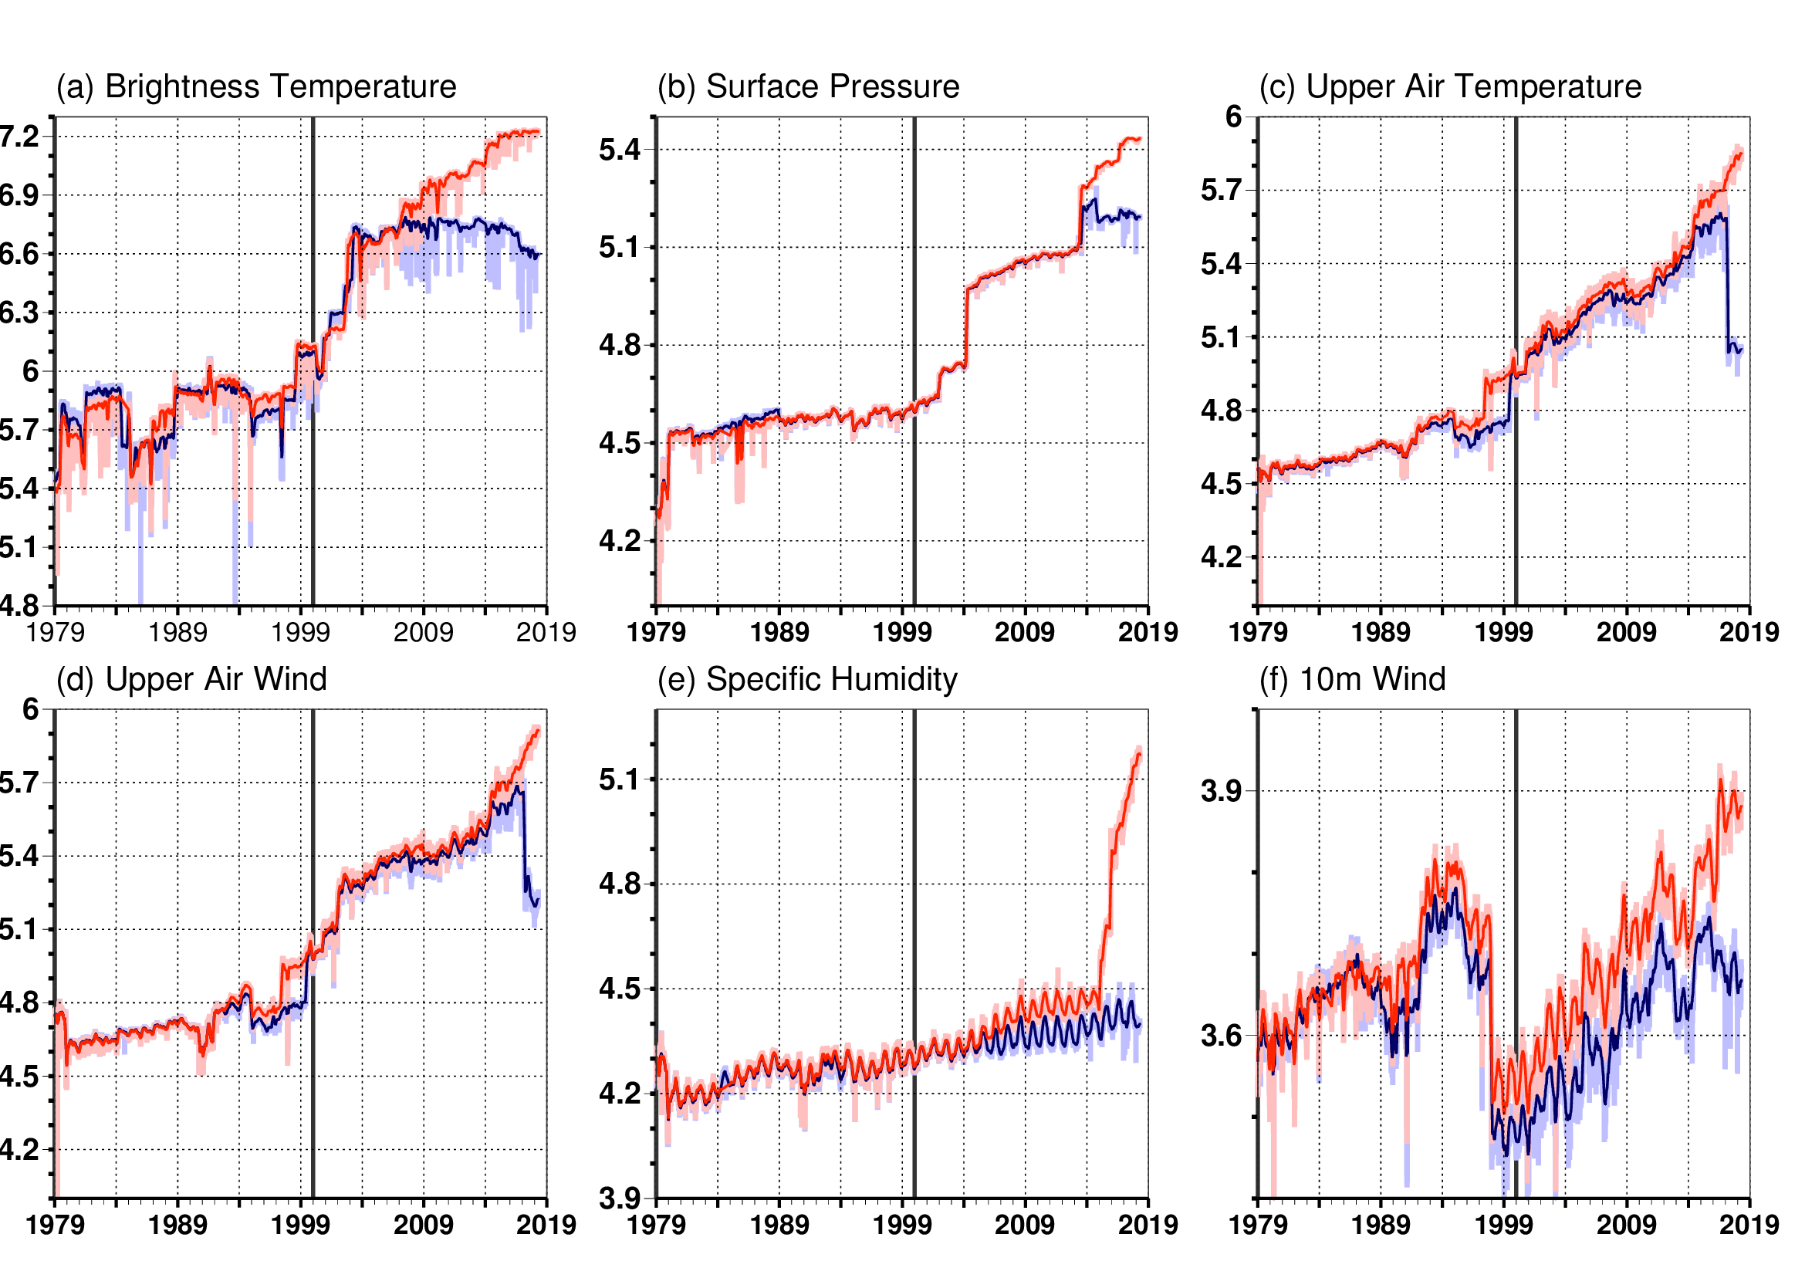
ERA5 data usage compared to ERA-Interim
Number of used observations per day (log10 scale) for ERA5 and ERA-Interim
ERA5 data usage has increased from
0.75 (1979) to 21 million/day (2018)
Over 200 types of reports:
Reprocessed data sets
Latest instruments
Improved data usage
ERA-Interim is progressively getting
outdated. It is not able to:
use the latest instruments
respond to changes in data format
(like the ongoing transition to BUFR
format for conventional data)

Slide 8
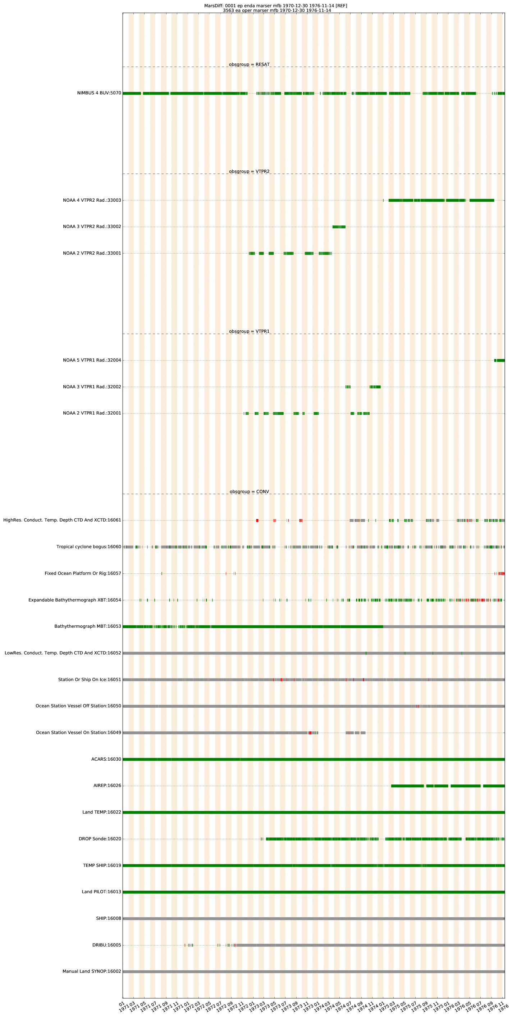
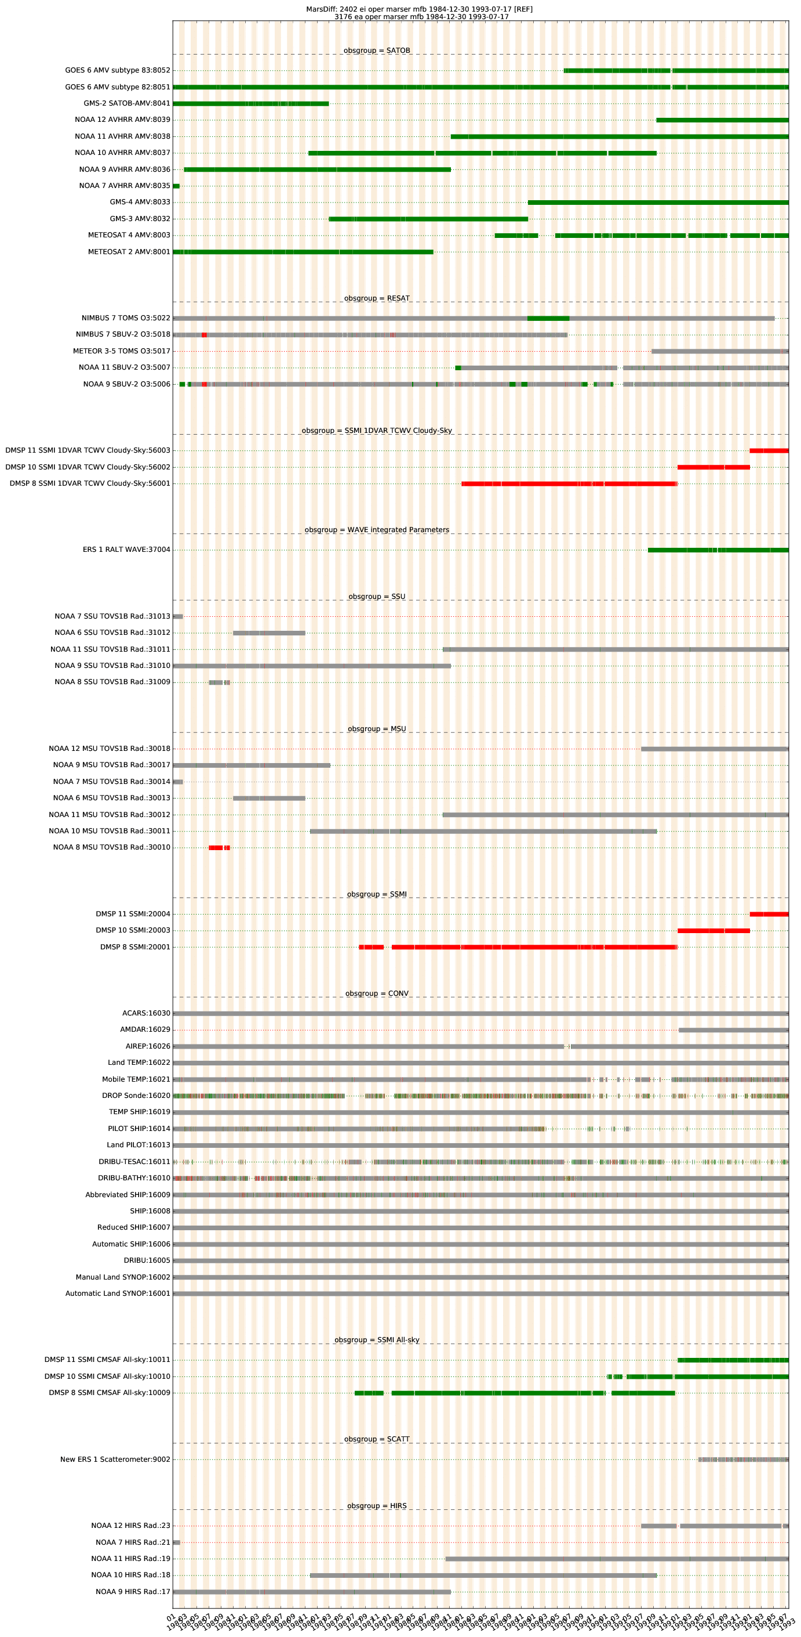
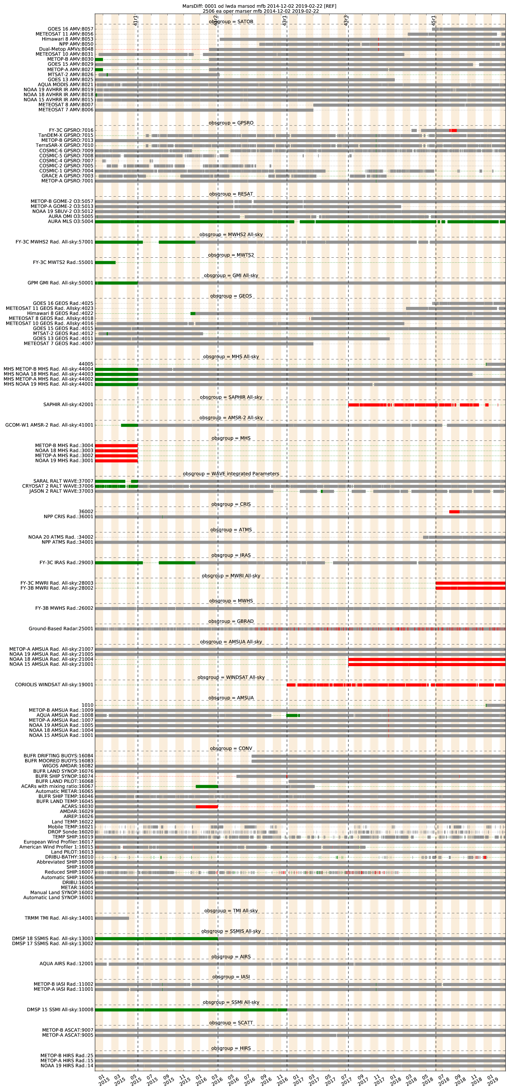
ERA5 : Monitoring observational input
1971-76
1985-93
2015-19
Used in ERA5 and
REFERENCE
( ERA-Int
or NWP operations)
Used in ERA5, but
not in REFERENCE
Not used in ERA5,
But used in
REFERENCE

Slide 9
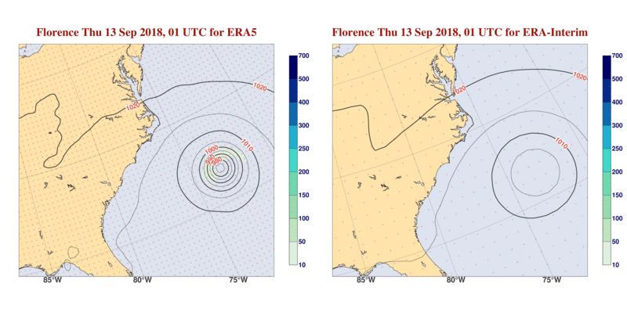
Much more accurate and detailed
Better model, better and more observations, higher resolution, hourly output
Accumulated precipitation (mm)
Mean sea level pressure (hPa)
ERA5
ERA-Interim

Slide 10
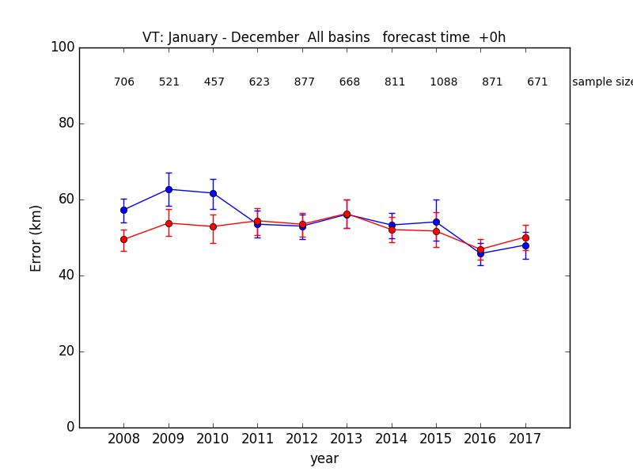
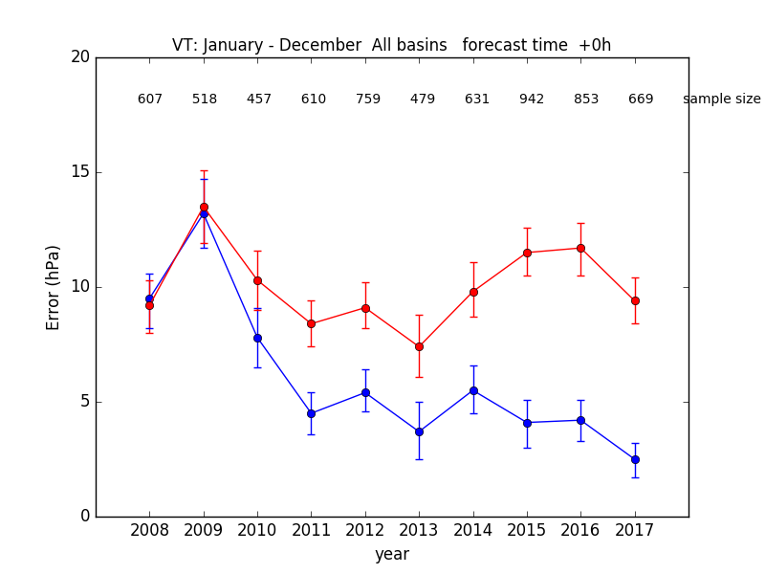
Performance: tropical cyclones
ERA5 versus ECMWF analysis from operational NWP
(bars: 95% C.I.)
Position
Central pressure
Courtesy: Fernando Prates
Notes:
Please note that these are statistics at analysis time; so no forecasts.
ERA5 is very stable over time; so provides more consistency.
Improvement of central pressure for OPER comes from e.g., resolution.

Slide 11
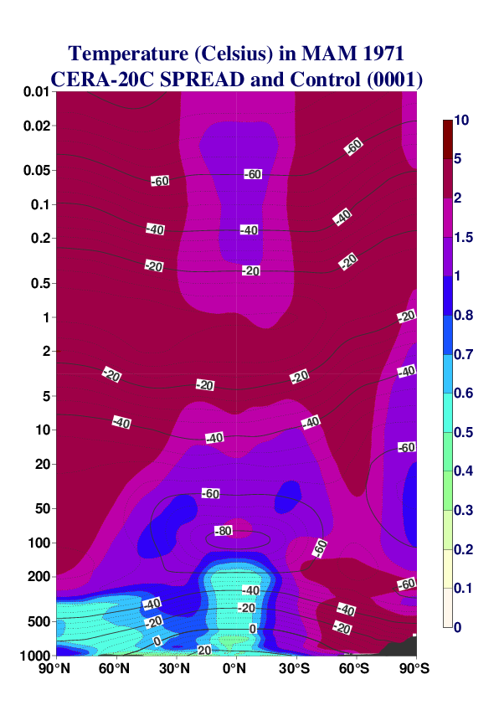
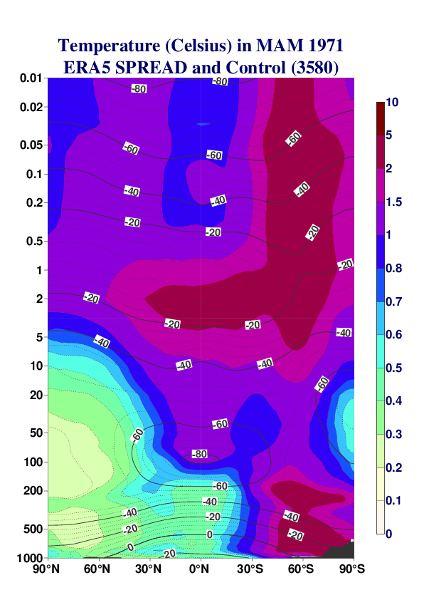
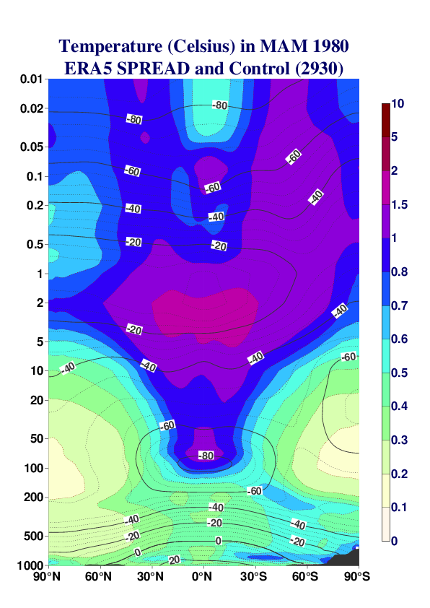
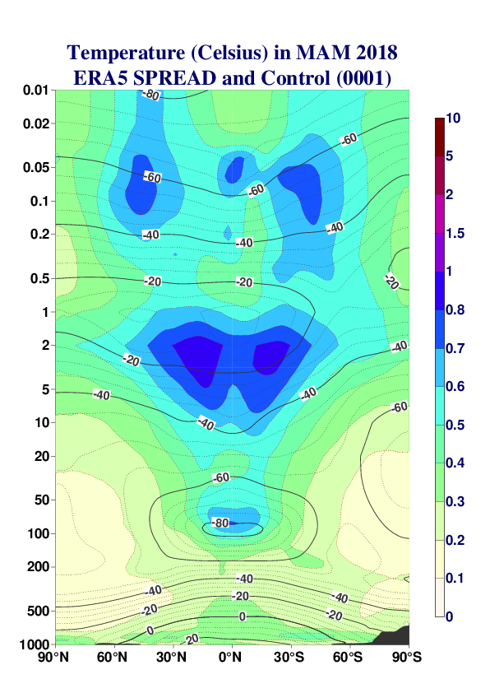
Ensemble spread & ERA5 uncertainty
1971 CERA-20C:
Surface pressure, marine wind, only
1971 ERA5:
Upper-air data
1980 ERA5:
Early-satellite era
2018 ERA5:
Current observing system
Notes:
Spread is related to the confidence on the synoptic actual weather.
Regarding low-frequency variability the ensemble spread expresses to what extent the reanalysis extracts information from direct observations and to what extent from the physical model.

Slide 12
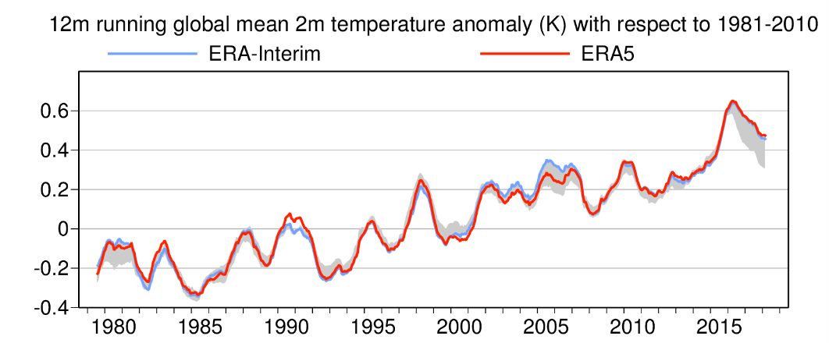
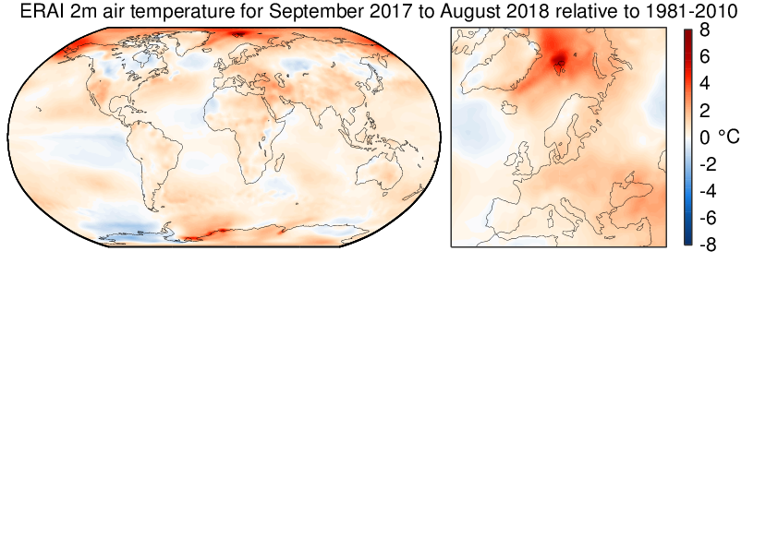
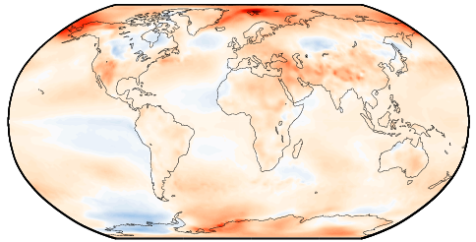
More refined monitoring of the climate
Better model, better and more consistent input data, higher resolution
ERA5
ERA-Interim
T2m, Sep 2017 - Aug 2018
relative to 1981-2010

Slide 13
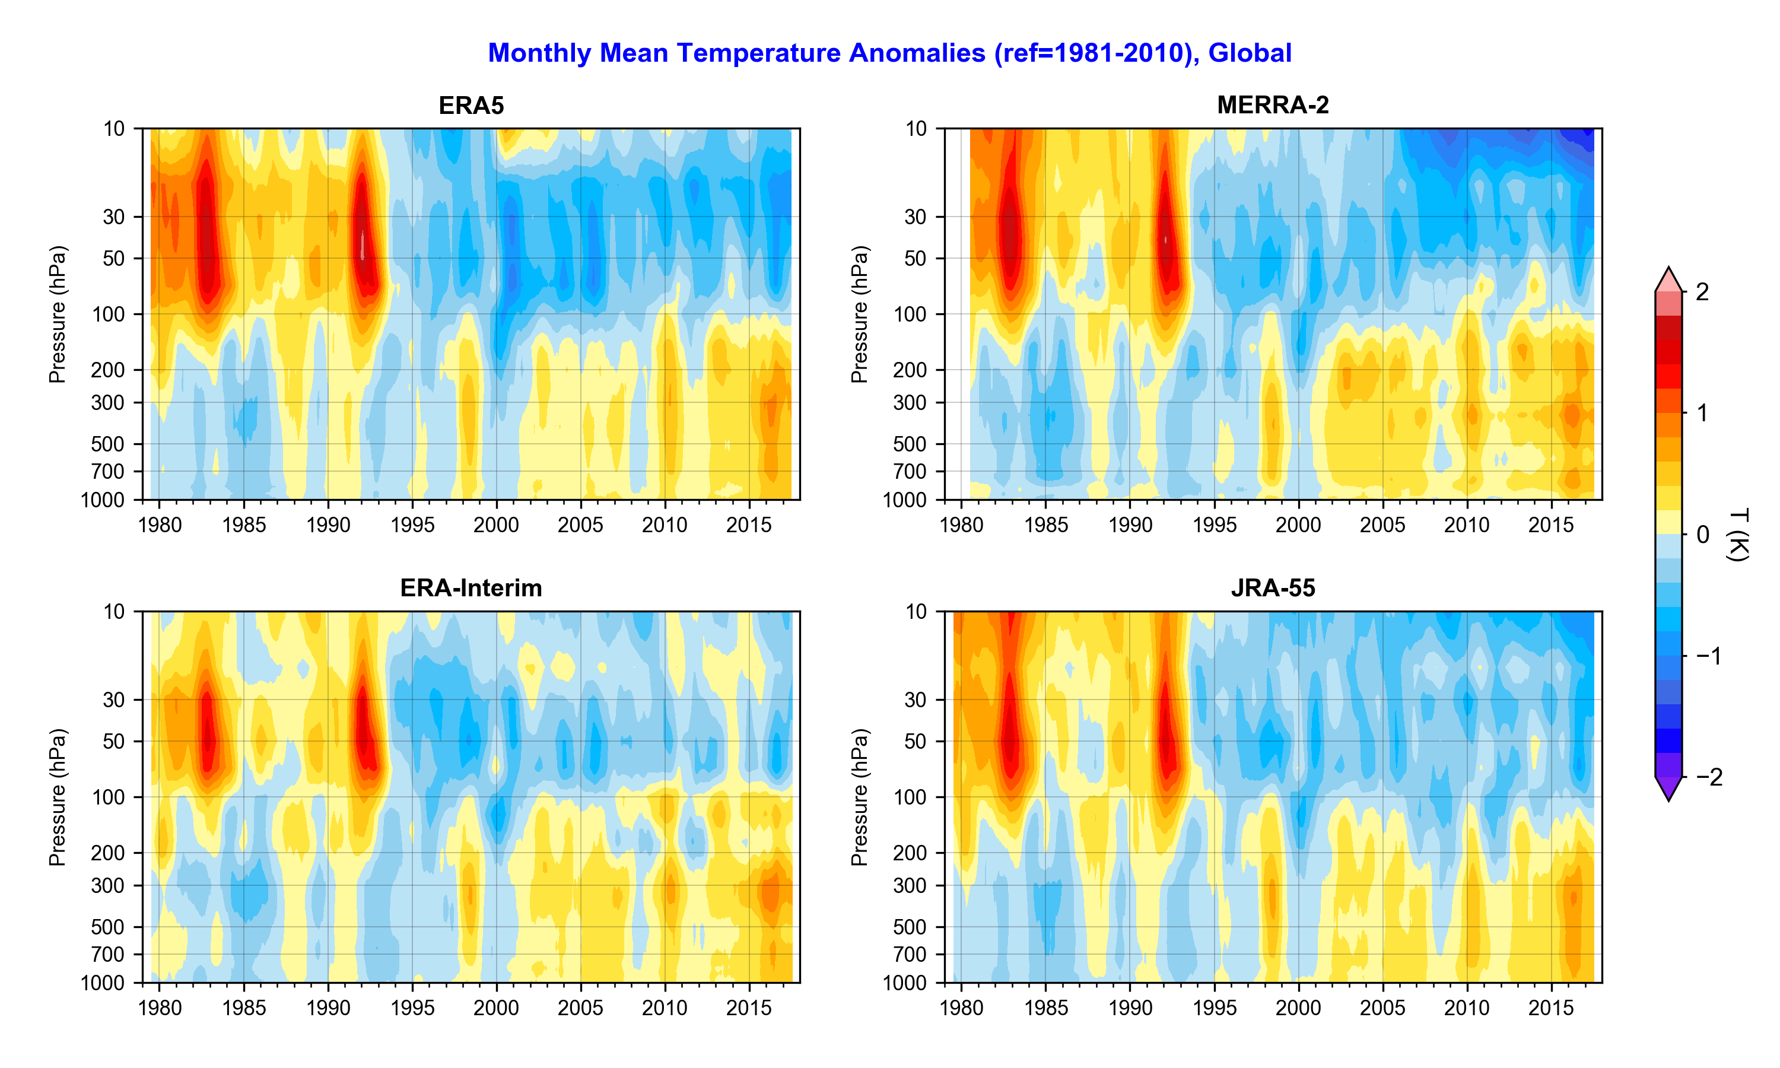
Upper Air temperature Anomalies in ERA5

Slide 14
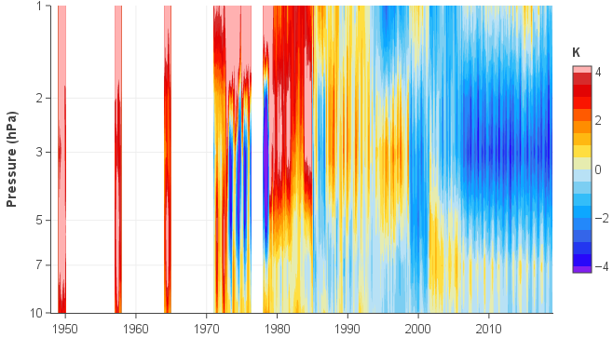
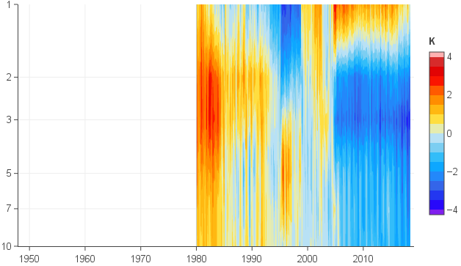
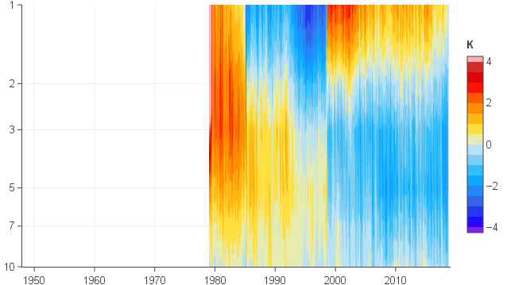
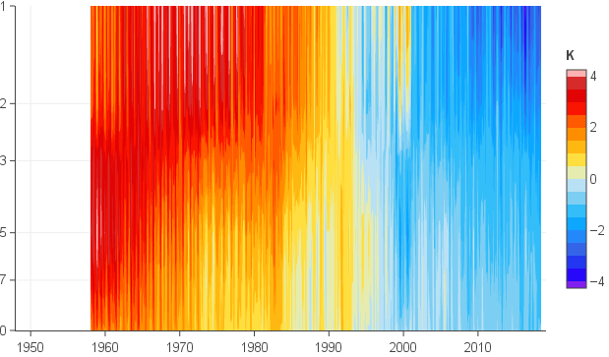
Temperature Anomalies :10 hPa – 1hPa
ERA5
MERRA2
ERA-Interim
JRA-55

Slide 15
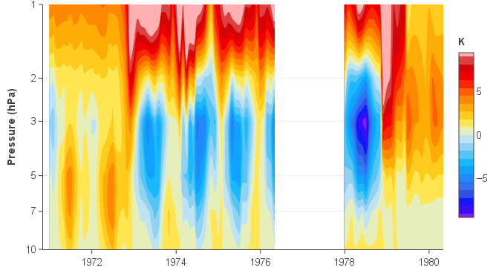
Upper stratospheric temperature anomalies
In low res
pre-production
runs of ERA5:
Anomalies at 2-10 hPa
NH summertime
Amplitude:
  ~5K 73-76
  ~9K 1978

Slide 16
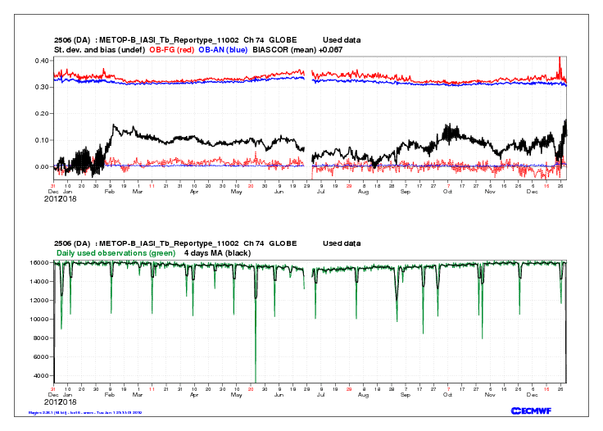
Monitoring satellite data in ERA5
Example: MetOp-B IASI (#74)
Processing change in late
June 2018 (well managed!)
Increase in STDEV(OB-FG)
(25/12/18) coincident with
SSW, not (initially) well
captured by ERA5
4 - 6 streams monitored
weekly by reanalysis team
(typically 3 – 90 satellite
instruments, with ?? chs
each)

Slide 17
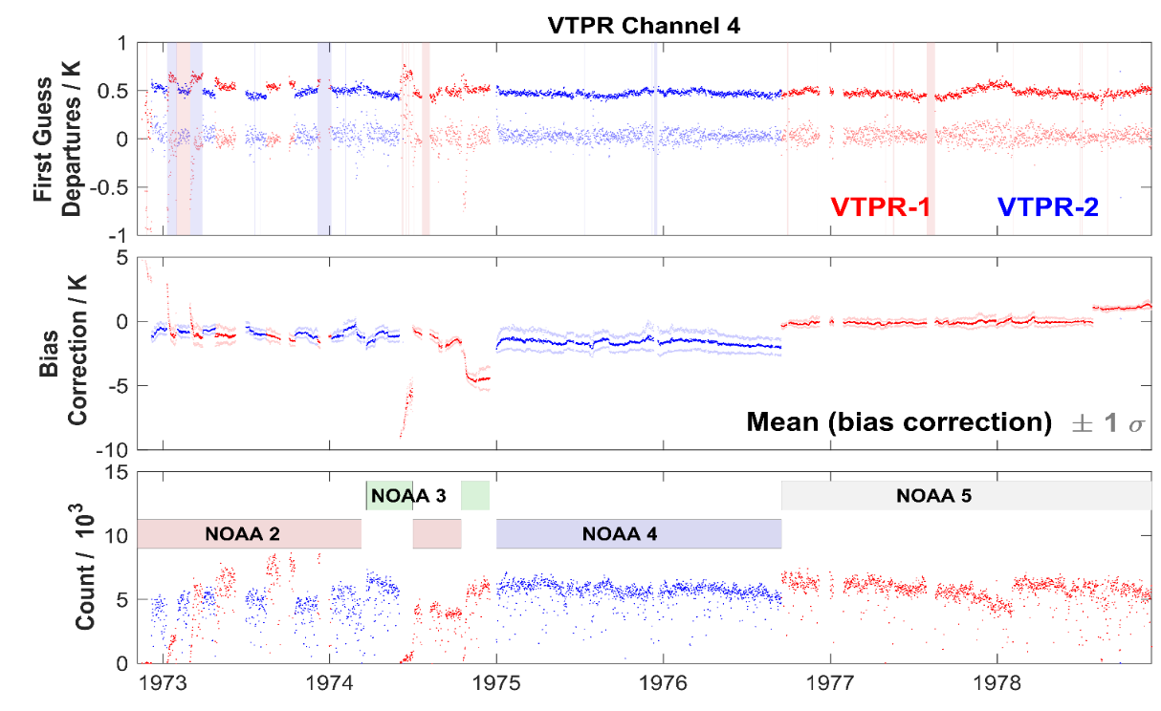
Preparing satellite data for ERA5(eg VTPR)
Example: VTPR (ch 4)
Reducing:
Inter-satellite biases &
Inter-instrument biases
Required bias correction (VarBC) &
Optimisation of the RT modelling

Slide 18
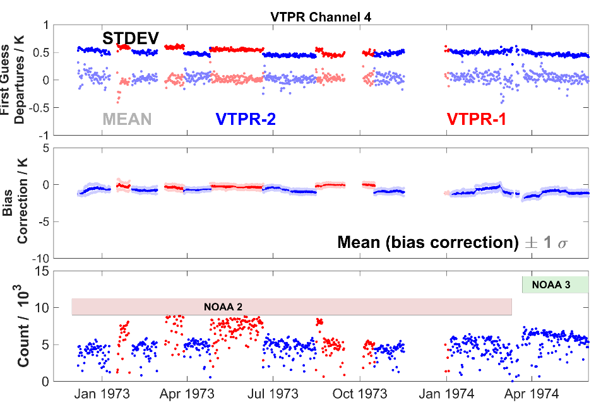
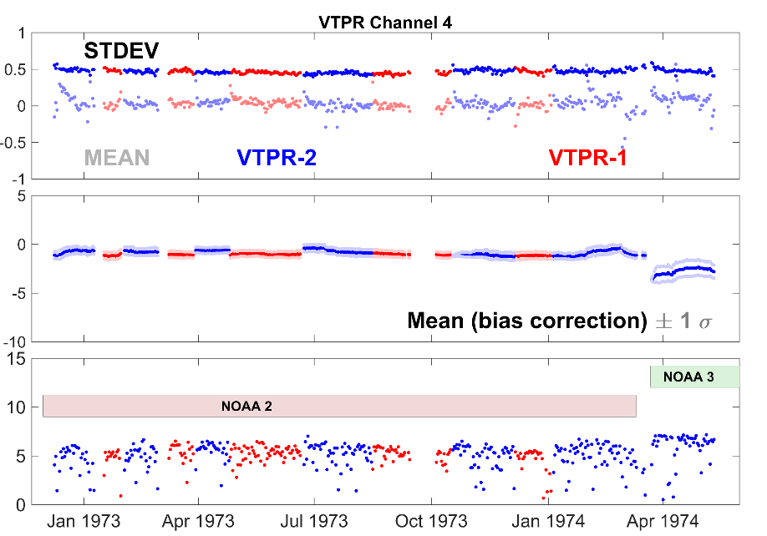
Preparing satellite data for ERA5(eg VTPR)
original tests final pre-production tests

Slide 19
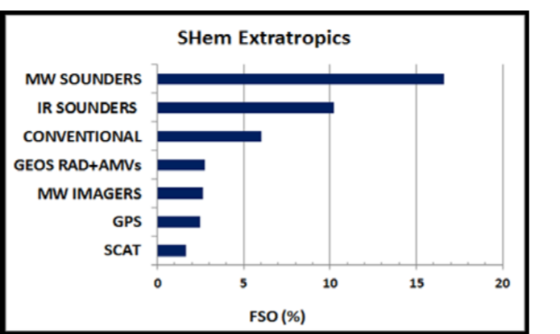
Satellite Data Records for ERA6
EUMETSAT provides high impact (F)CDRs for ERA6 back to the 1970s
Atmospheric Sounding Radiance (Microwave and Infrared)
Meteosat Radiance and Atmospheric Motion Vectors
Radio Occultation bending angle profile
Metop ASCAT backscatter
Meteorological CDRs:
  Metop global and polar Atmospheric Motion Vectors (LEO)
  Metop multi-sensor aerosol AOD product
Ranked contributions to forecast error reduction estimated by Adjoint Sensitivity Diagnostics averaged over the test period in the Southern Hemisphere. From McNally (2014).
Aims at going back in time as far as possible, best possible individual instrument correction, error flagging, advanced uncertainty estimates and harmonisation over the time series.

Slide 20
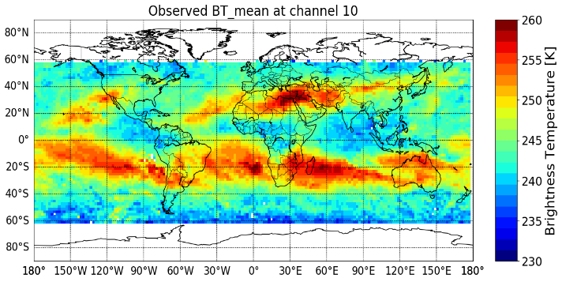
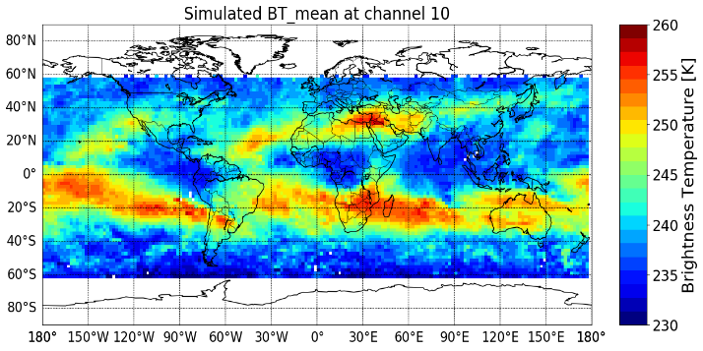
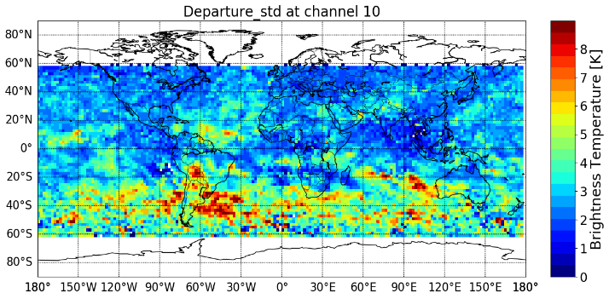
Analysis of NIMBUS-6 HIRS-1 Data
Nimbus-6 (Aug 1975)
ERA5 (Aug 1975)
Better models
Better
observations
Better
reanalysis
Standard Deviation
Nimbus-6 – ERA5 departures
Reanalysis provides a tool to analyse historical data in absence of satellite and ground-based references;
High standard deviations in SH may point to additional information from HIRS-1 if assimilated.

Slide 21
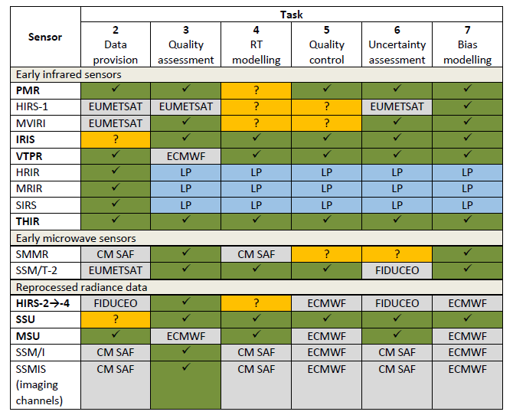

Satellite data rescue for climate reanalysis
Satellite data rescue services will be
delivered by: Spascia, ICARE, CNRM,
Univ. of Reading & Met Office.
(2019 - 2021)
Focus on early datasets
Range of activities: data provision → bias modelling and uncertainty assessment

Slide 22
Streamlining
‘Typical’ development cycle
reprocessing > reanalysis
EUMETSAT
ECMWF
acquisition
of data &
metadata
reprocessing, recalibration, QA
& harmonisation
re-formatting, documentation
& archiving
Internal re-formatting
& archiving
configuration
(R, b.list, RT, bias correction model )
final
pre-prodn.
QA checks
publication & post-production
production
Development cycle for C3S currently
acquisition
of data &
metadata
reprocessing, recalibration, QA
& harmonisation
re-formatting, documentation
& archiving
Internal re-formatting
& archiving
configuration
(R, b.list, RT, bias correction model )
final
pre-prodn.
QA checks
publication & post-production
production
ERA5 departure-based analysis of data quality
assessment & development of bias models

Slide 23
Streamlining: a possible future model
EUMETSAT
ECMWF
acquisition
of data &
metadata
reprocessing, recalibration, QA
& harmonisation
re-formatting, documentation
& archiving
configuration
(R, b.list, RT, bias correction model )
final
pre-prodn.
QA checks
publication & post-production
QA
production
Collaborative & iterative activity, including:
Data archived in common infrastructure
QA checks (‘scouts’) run by EUMETSAT, with ECMWF support
Bias models, blacklists, RT coefficients, obs error tuning developed jointly.

Slide 24
Summary
ECMWF operates the Copernicus Climate Change Service (C3S) and the Atmospheric Monitoring Service (CAM) on behalf of the European Commission. Both services have requirements for EO data (C3S L1 & L2, CAMS L2)
L1 data is critically important for C3S reanalyses (global & regional) & monitoring the quality of satellite EO data, over the entire satellite era (1972-present), is an important activity for the C3S reanalysis team(s).
C3S supports satellite data rescue and reprocessing activities, and is developing ways of streamlining the process of developing new FCDRs - > producing new reanalyses.
ERA5 is available from 1979-2018. 1950-1978 is expected by the end of 2019.
This includes analysis fields, but (soon) will include all observation feedback (incl. o - b and o – a for all observations assimilated) a potential resource for GSICS activities.

