Slide 1
GRWG IR Sub-Group Briefing Report
Likun Wang¹ and Tim Hewison²
Riverside @ NOAA/NESDIS.STAR; Likun.Wang@noaa.gov
EUMETSAT
2019 GSICS Annual meeting, Frascati, Italy; March 3- 9 2019

Slide 2
Outline
Scope of IR Subgroup
Activities of IR Group
Status of Action Items
IR Sessions
Emerging Issues & Future Direction

Slide 3
Review Scope of the IR Sub-Group
Counterpart of VIS/NIR, Microwave and UV Sub-Groups
  For satellite instrument channels in thermal infrared
  For Hyperspectral instruments
To establish user requirements for inter-calibration
Cooperate with instrument calibration groups
  To communicate relevant information to the users
  To help them understand the root cause of observed biases and develop fixes
Review existing, or develop new inter-calibration
  Algorithms, procedures, corrections, collocation, spectral-gap filling etc.
  Using NWP, ground-based, near-space measurements, etc.
To define and promote calibration standards, tools and datasets, and best practices
  Including selection of inter-calibration reference

Slide 4
Instruments and Measurements
Hyperspectral instruments
  AIRS
  IASI (A, B, C)
  CrIS (SNPP and N20)
  IRAS (FY3D, E)
  GIIRS (Geostationary FY4)
  IKFS-2
Narrow-band sounding instruments
  HIRS (1979 – current MetOp-B)
  GOES Sounders
IR channels of Broad- or narrow band imagers
  Geostationary imagers:
    GOES imager, ABI, AHI, AGRI, CMOS-MI, MVIRI/ SEVIRI, NSAT-3D
  Polar orbiting imagers:
    MODIS, VIIRS, AVHRR, SENTINEL-3 SLSTR, MERSI
NWP RTM simulations, Ground-based measurements, etc

Slide 5
Current Sub-Group activities
Instrument specification, pre-launch char., cal/val testing, Operational Calibration Support
Report on Reference Sensor Traceability and Uncertainty
  – Tim (EUMETSAT), Likun (NOAA), Dave T. (UW), Thomas (NASA), Larrabee (UW)
Hyperspectral instrument calibration and inter-comparison
  Likun & Yong (NOAA), Dave (UW), Larrabee (UMBC), Thomas (NASA), Denis (CNES), Chengli &Qiang (CMA)
Promote GEO-LEO IR products to Operational + Support & Further Development
  For IR channels of GEO imagers – Tim (EUMETSAT), Masaya (JMA), Dohyeong, Hyesook, Minju (CMA), Fangfang(NOAA), Na (CMA), Pradeep (ISRO)
Development of LEO-LEO Inter-calibration for imager and hyperspectral sounders
  Likun (Wang), Jack X (NASA)., Dave T. (UW), Hanlie (CMA)
Deployment of Prime GSICS Corrections
  Tim (EUMETSAT), Masaya (JMA), Fangfang (NOAA), Minju (KMA), Na (CMA)
Diurnal calibration variations
  – Masaya (JMA) , Fangfang(CMA), Dohyeong, Hyesook, Minju (KMA)

Slide 6
Current Sub-Group activities
Development of NWP inter-calibration method
  – Roger & Tim (EUMETSAT), Yong (NOAA), Larrabee (UMBC)
GEO-GEO comparisons
  Dave (NASA), Hidehiko (JMA), Dohyeong, Hyesook, Minju (KMA) , Fangfang, Fred (NOAA), Tim (EUMETSAT), Alexey Rublev (ROSCOSMOS)
Broadband Reference IR inter-calibration (e.g., reprocessing using HIRS )
  – Dave (NASA), Rob (EUMETSAT), Masaya (JMA)
Spectral Response Function retrieval – Manik (NOAA), Na(CMA)
Spectral gap and Coevolution Errors – Hu X (UMD)., Xu Liu (NASA), Tim (EUMETSAT)
Collocation Improvements – Likun (NOAA), Qiang (CMA)

Slide 7
GSICS GEO-LEO IR Product Status 2019-02
GPRC | Monitored Instrument | Reference Instrument | GSICS NRT Correction | GSICS Re-Analysis Correction | GSICS Bias Monitoring
EUMETSAT | Meteosat-8-11/SEVIRI | Metop-A/IASI Metop-B/IASI | Operational | Operational | RAC Plotting Tool
JMA | MTSAT-2 Imager Himawair-8-9/AHI | IASI + AIRS +CrIS | Operational | Operational | RAC Plotting Tool JMA Web
NOAA | GOES-11 & -12 Imager GOES-13 & -15 Imager GOES-16-17/ABI | IASI (+ AIRS) + CrIS | Development Pre-op Development | Demo Pre-op Development | Prototype Web RAC Plotting Tool
 | GOES Sounder | IASI (+ AIRS) | Development | Development | In development
CMA | FY2C,E,F,G/VISSR FY4 AGRI | IASI (+ AIRS) +CrIS | Development | Development | CMA Web CMA Web
KMA | COMS | IASI + CrIS + AIRS | Prototype | Prototype | KMA Web
ISRO | INSAT-3D/Imager INSAT-3D/Sounder | IASI-A | Demo | Demo | ISRO Web
Full GSICS Product Catalog available at http://www.star.nesdis.noaa.gov/smcd/GCC/ProductCatalog.php

Slide 8
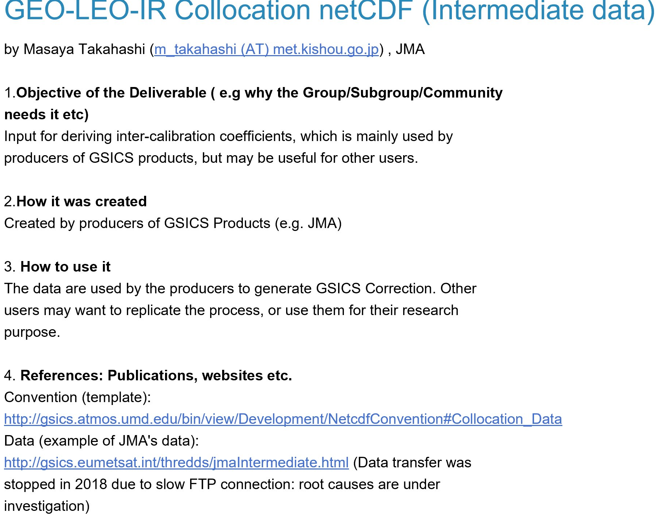
GEO-LEO-IR Collocation netCDF Data

Slide 9
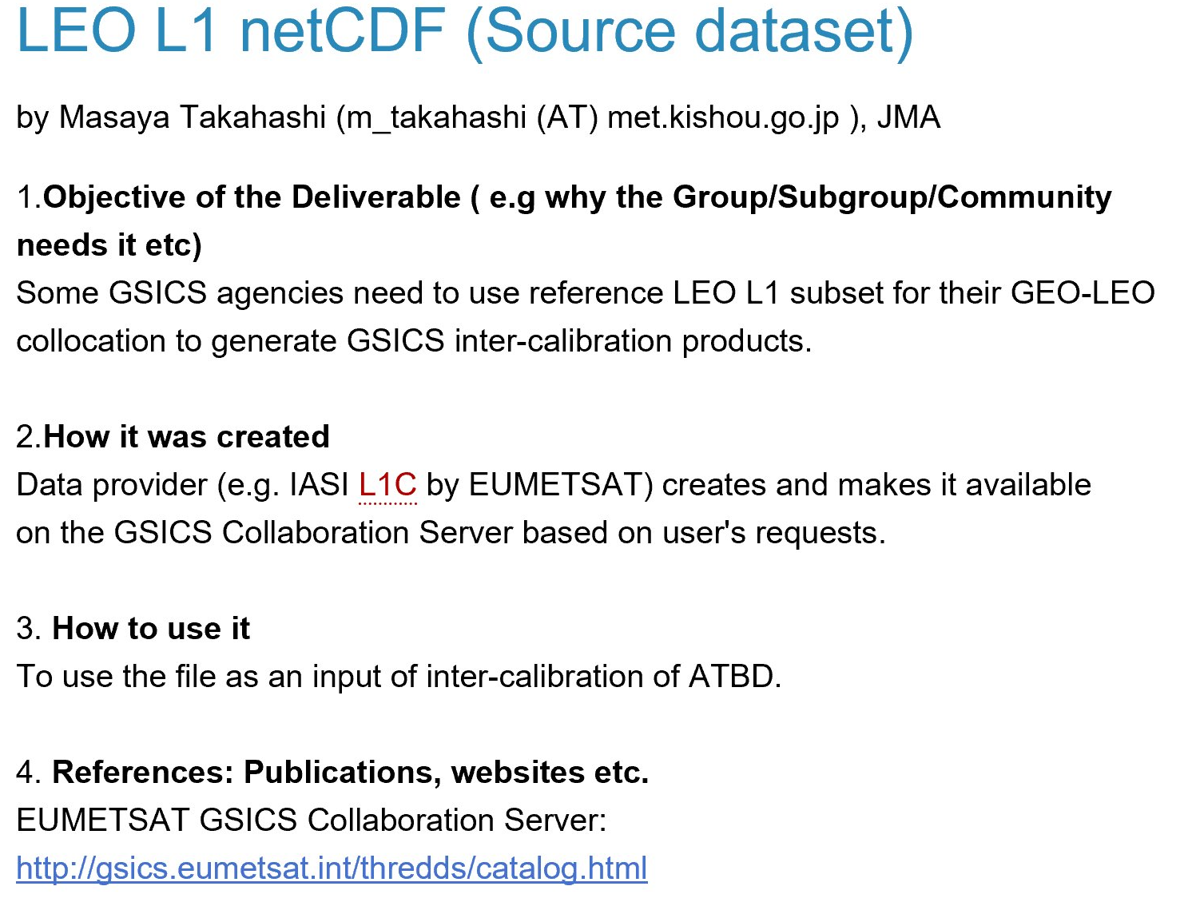
LEO L1 netCDF dataset

Slide 10
IR Related Web Meeting
Dohyeong Kim (KMA) - GEO-GEO comparison and contribution to IOGEO (May 05 2018)
Likun Wang (NOAA Affiliate) - Comparisons of gap-filling methods (Jun 06 2018)
Tim Hewison (EUMETSAT) - Planning a GSICS/CEOS-WGCV Workshop on SI-traceable reference instruments (Sep 13 2018)
Tim Hewison (EUMETSAT) - Reference Uncertainty and Traceability Report (IRRefUTable) (Nov 14 2018)
Tim Hewison (EUMETSAT) - Review different GEO-LEO IR inter-calibration algorithm evolutions (under plan)
Likun Wang (NOAA Affiliate) - Hyperspectral sounder inter-comparison (under plan)

Slide 11
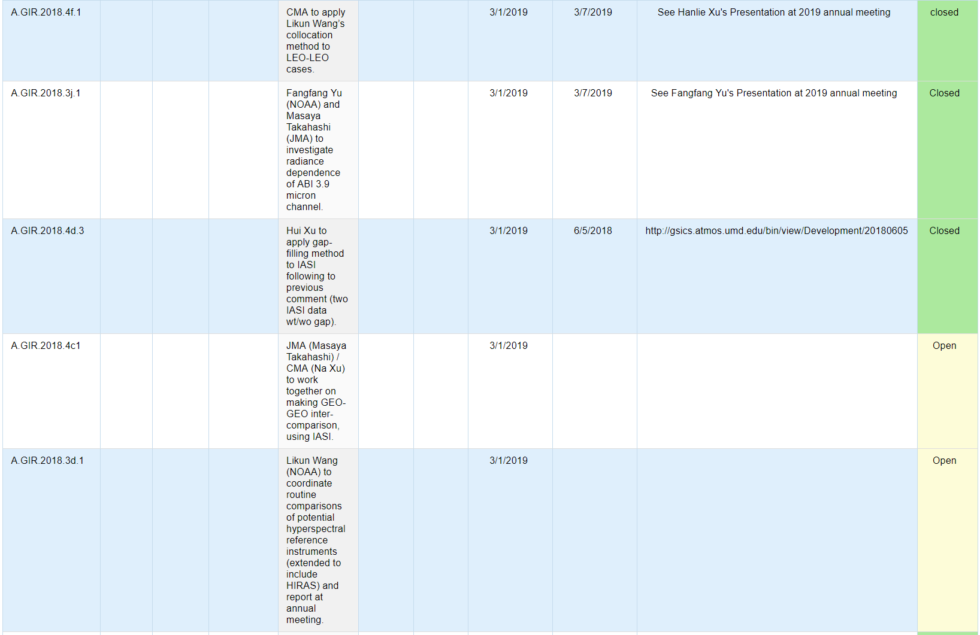
Action List (1)

Slide 12
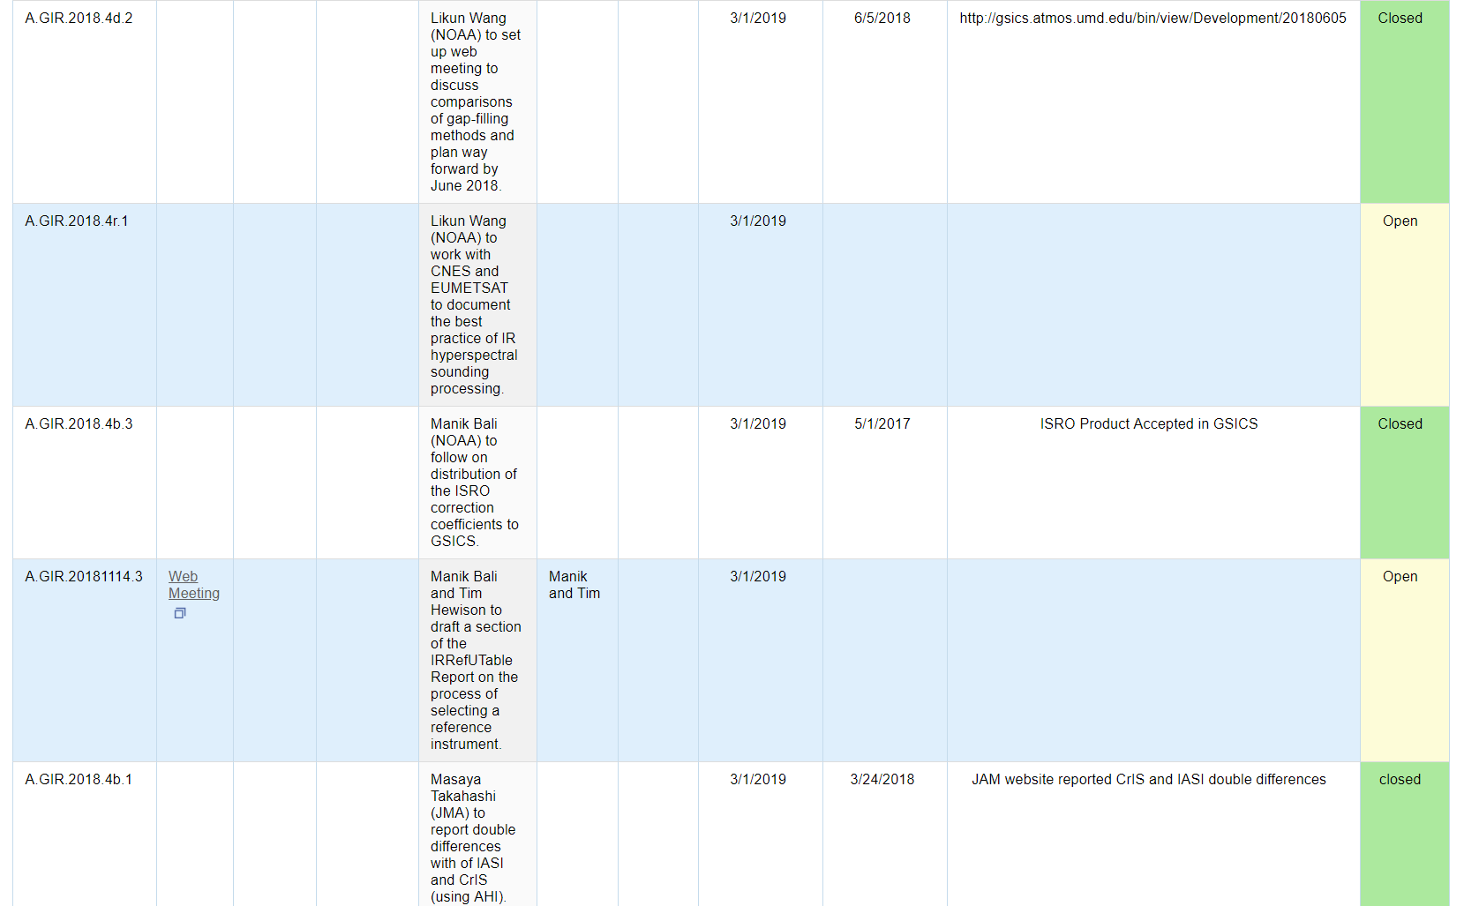
Action List (2)

Slide 13
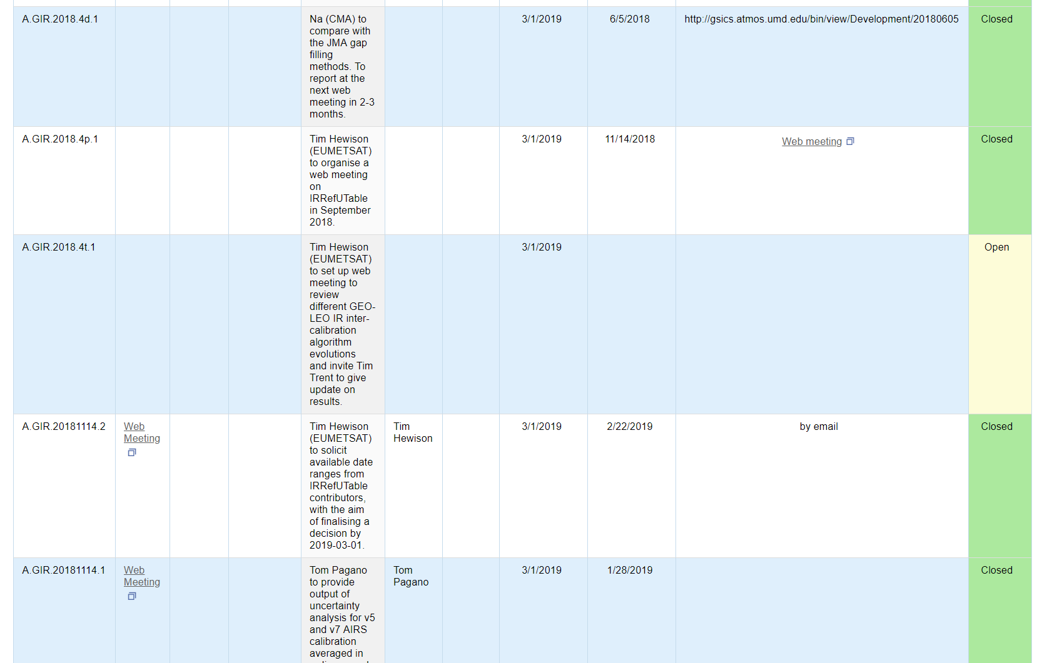
Action List (3)

Slide 14
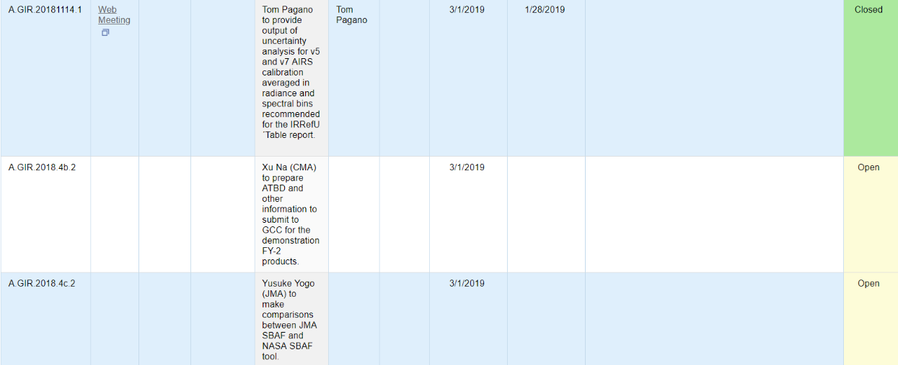
Action List (4)

Slide 15

IR Group Agenda (i)
Thurs am | GRWG: IR Sub-Group
 | Cal/Val status - Chair: Likun Wang, Minutes: Tim Hewison
8:30 | Likun Wang | NOAA Affiliate | Introduction to IR Sub-Group | 7a | 0:15
8:45 | Thomas Pagano | NASA/JPL | AIRS Calibration Update and Radiometric Uncertainty Estimates | 7b | 0:15
9:00 | Chengli Qi/ Chunqiang Wu | CMA | FY-3D HIRAS measurement validation and monitoring | 7c | 0:15
9:15 | Dorothee Coppens | EUMETSAT | Update on IASI-C Cal/Val activities | 7d | 0:15
9:30 | Qiang Guo | CMA | First Geostationary Infrared Hyper-spectral Measurements:In-orbit Validation Method for Radiometric Accuracy and its Preliminary Results | 7e | 0:15
9:45 | Xu Liu | NASA | Spectral gap-filling and Convolution Error Correction in Satellite Sensor Inter-calibrations | 7f | 0:15
10:00 |  |  | Coffee break |  | 0:30
 | Hyperspectral IR Inter-calibration - Chair: Likun Wang, Minutes: Tim Hewison
10:30 | Tim Hewison | EUMETSAT | IR Reference Uncertainty and Traceability Report (IRRefUTable) | 7g | 0:30
11:00 | Hanlie Xu | CMA | Mutual Evaluation between the imager and hyperspectral sounder at the same platform FY-3D and FY-4A | 7h | 0:15
11:15 | Dohy Kim | KMA | Double difference of inter-calibration comparison results of COMS/MI using before and after reprocessed CrIS data for one year data of 2015 | 7i | 0:15
11:30 | All | All | Discussion - way forward with Hyperspectral GSICS products | 7j | 0:30

Slide 16
IR Group Agenda (ii)
 | Multispectral IR Inter-calibration - Chair: Tim Hewison, Minutes: Likun Wang
13:00 | All | All | GEO-LEO IR Product Progress (5 min for each GEO operational agency) | 7k | 0:30
13:30 | Na Xu | CMA | IR inter-calibration update in CMA including GEO-LEO and LEO-LEO | 7l | 0:30
14:00 | Yusuke Yogo | JMA | Collaborative research of applying JMA's GSICS approach to FY-2G IR channels wrt IASI | 7m | 0:15
14:15 | Minju Gu | KMA | Inter-calibration results of COMS/MI using with and without MBCC March 2016 to August 2017 | 7n | 0:15
14:30 | Na Xu | CMA | SBAF requirements for GEO-GEO comparisons | 7o | 0:15
14:45 | Fangfang Yu | NOAA Affiliate | GEO-GEO inter-comparison for GOES-17 IR instrument performance monitoring and anomaly detection | 7p | 0:15
15:00 |  |  | Coffee break |  | 0:30
15:15 | Alessandro Burini | EUMETSAT | Monitoring SLSTR calibration using IASI | 7q | 0:15
15:30 | Dave Smith | RAL | S3 SLSTR IR channel calibration | 7r | 0:15
16:00 | All | All | Discussion Way Forward for Multispectral IR | 7s | 0:30
16:30 | Update on IR Research Topics - Chair: Likun Wang, Minutes: Tim Hewison
16:30 | Hanlie Xu | CMA | Application and evaluation of New NOAA gap filling for CMA IR hyperspectral instruments | 7t | 0:15
16:45 | Fangfang Yu | NOAA Affiliate | Investigation to the cold-scene bias at the ABI 3.9 micron channels | 7u | 0:15
17:00 | Hui Xu / Likun Wang | UMD | Sensitivity Test and Further Validation of Cross-track Infrared Sounder Spectral Gap Filling | 7t | 0:15
17:15 | Boming Sun | NOAA Affiliate | Progress with GRUAN observations in comparison with satellite measurements | 7v | 0:15
17:30 | Likun Wang | NOAA Affiliate | Near space platform for IR sensor validation | 7w | 0:15

Slide 17
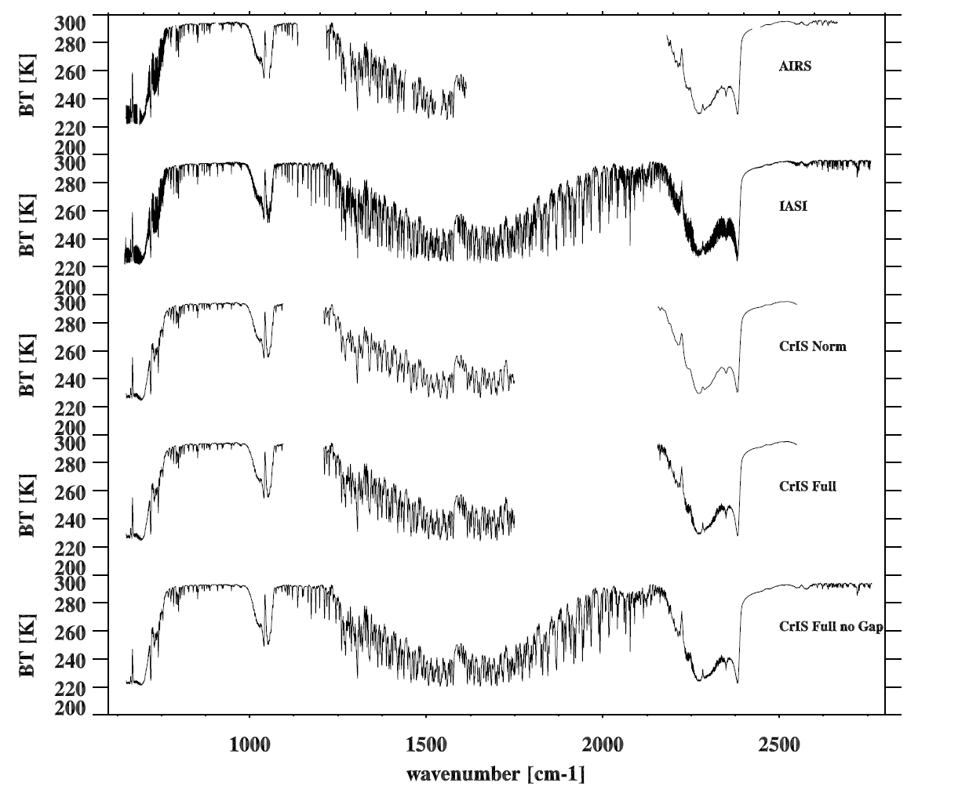
Emerging Issues and Future Direction:
Hyperspectral Measurements
More hyperspectral IR instruments
  Well documented
  Data access
Reference switch
  IASI-A => IASI-B
  SNPP CrIS => N20/CrIS
Inter-satellite bias well understood?
  Among the same type instruments?
  Among the different type instruments
  Reference Sensor Traceability and Uncertainty
Re-processing
  Consistent dataset

Slide 18
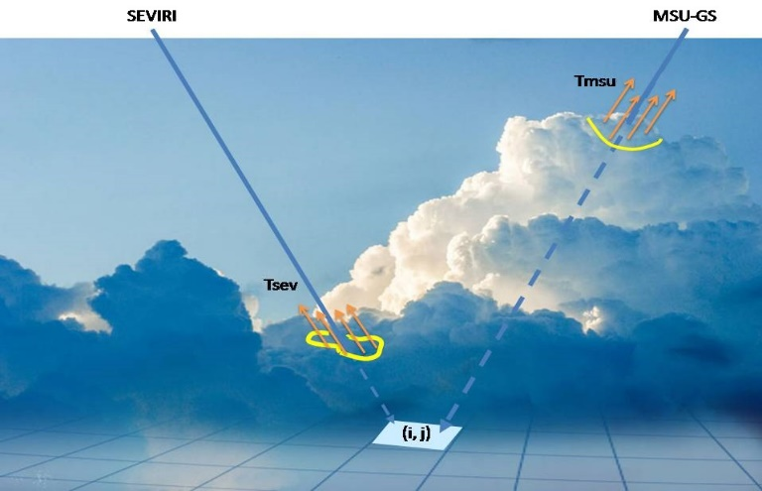
Emerging Issues and Future Direction:
GEO and GEO Inter-calibration
Benefit for GEO-GEO inter-calibration
Collocation
  Off-angle collocation
  Parallax Cloud Displacement
Scene selections
GSICS GEO-GEO inter-calibration algorithms
Spectral match (SBAF)
Instrument diurnal variation
Alexey Rublev (ROSHYDROMET)

Slide 19
Emerging Issues and Future Direction:
Gap Filling and Convolution Errors
Encouraging CrIS data users to validate CrIS gap filling (coef. released for public)
Potential convolution errors
Gap filling IR SW bands (3.9 µm )
PCRTM datasets
Validation work
From Xu’s Talk

Slide 20
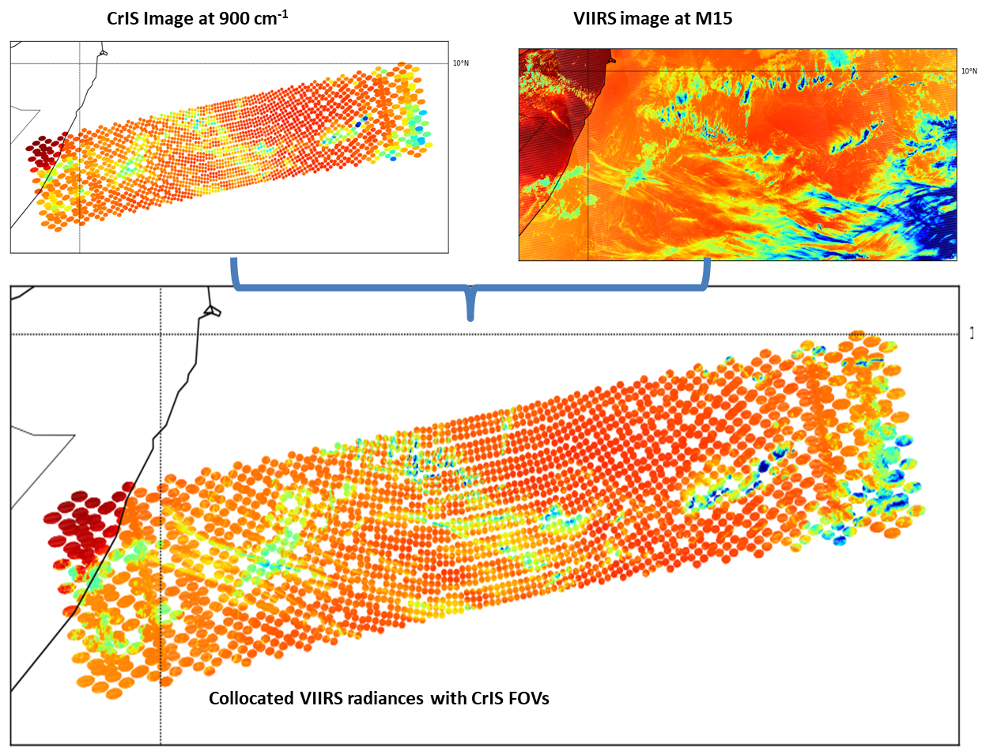
Emerging Issues and Future Direction:
Collocation
Common issues for all inter-calibration or inter-comparison
  Same or different platforms
  “look” at the same target
  Fast search
  Off-nadir distortion
  Detector (pixel) shapes
  Angle or ray matching (even for IR, Parallax Cloud Displacement)
If collocation is fast and accurate, filtering out collocation data with different need
Task forces for common collocation packages
  Benefit for community
  Considering different requirements for different applications (flexible conditions)
  Sounder vs Imager, imager vs Imager, sounder vs sounder, GEO vs GEO, GEO vs LEO

Slide 21
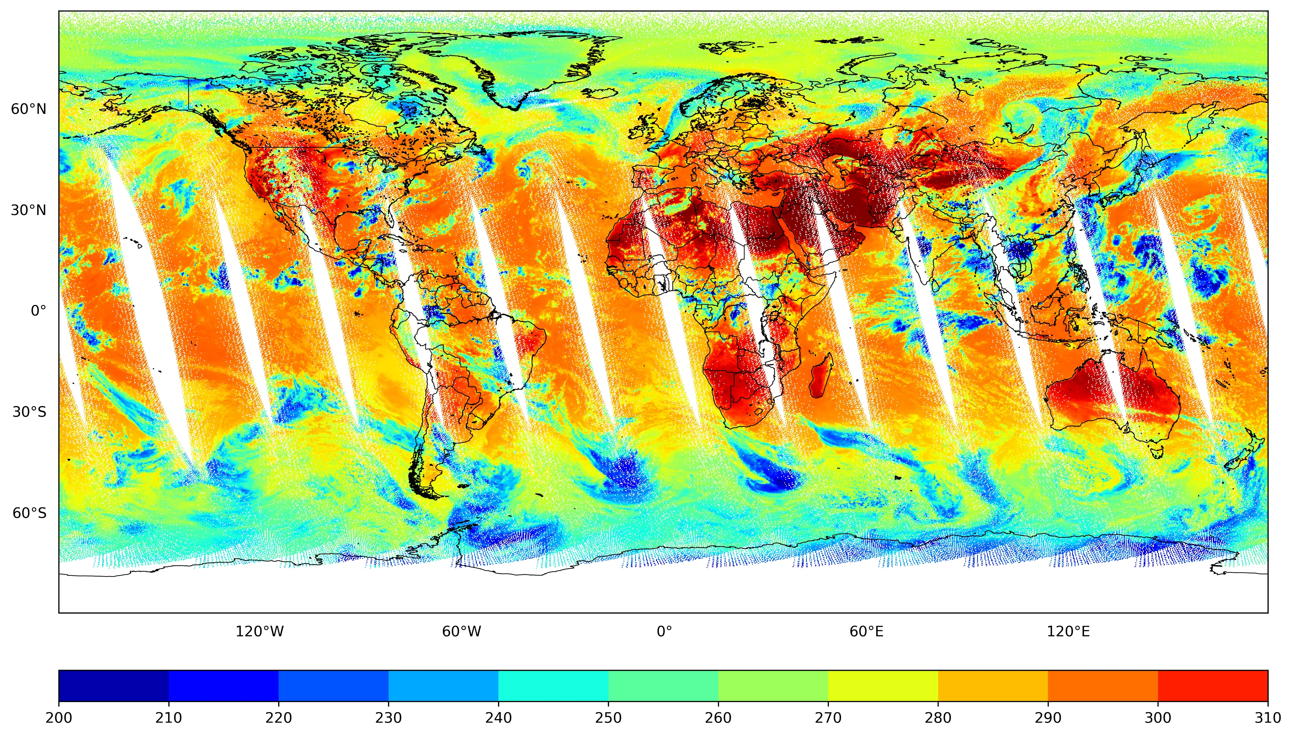
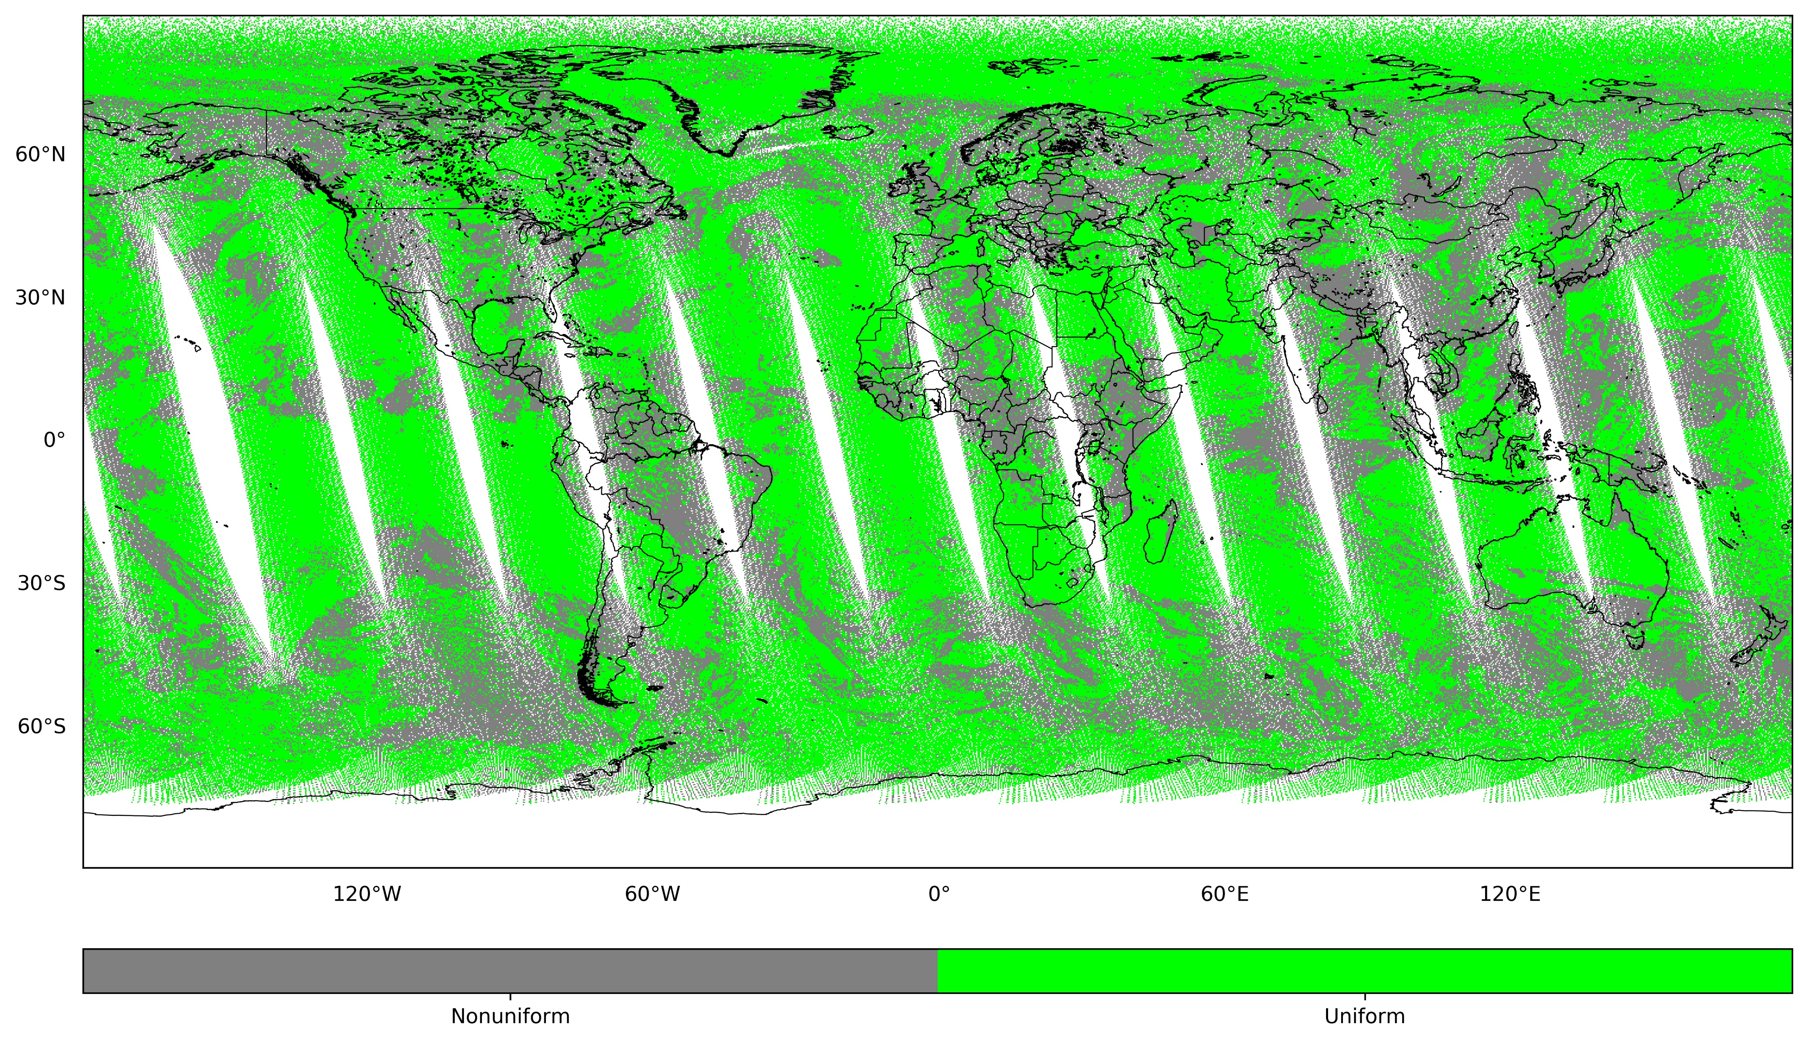
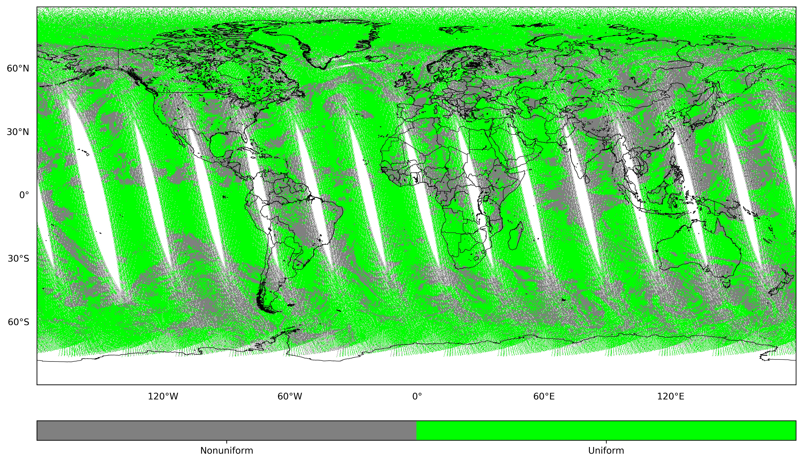
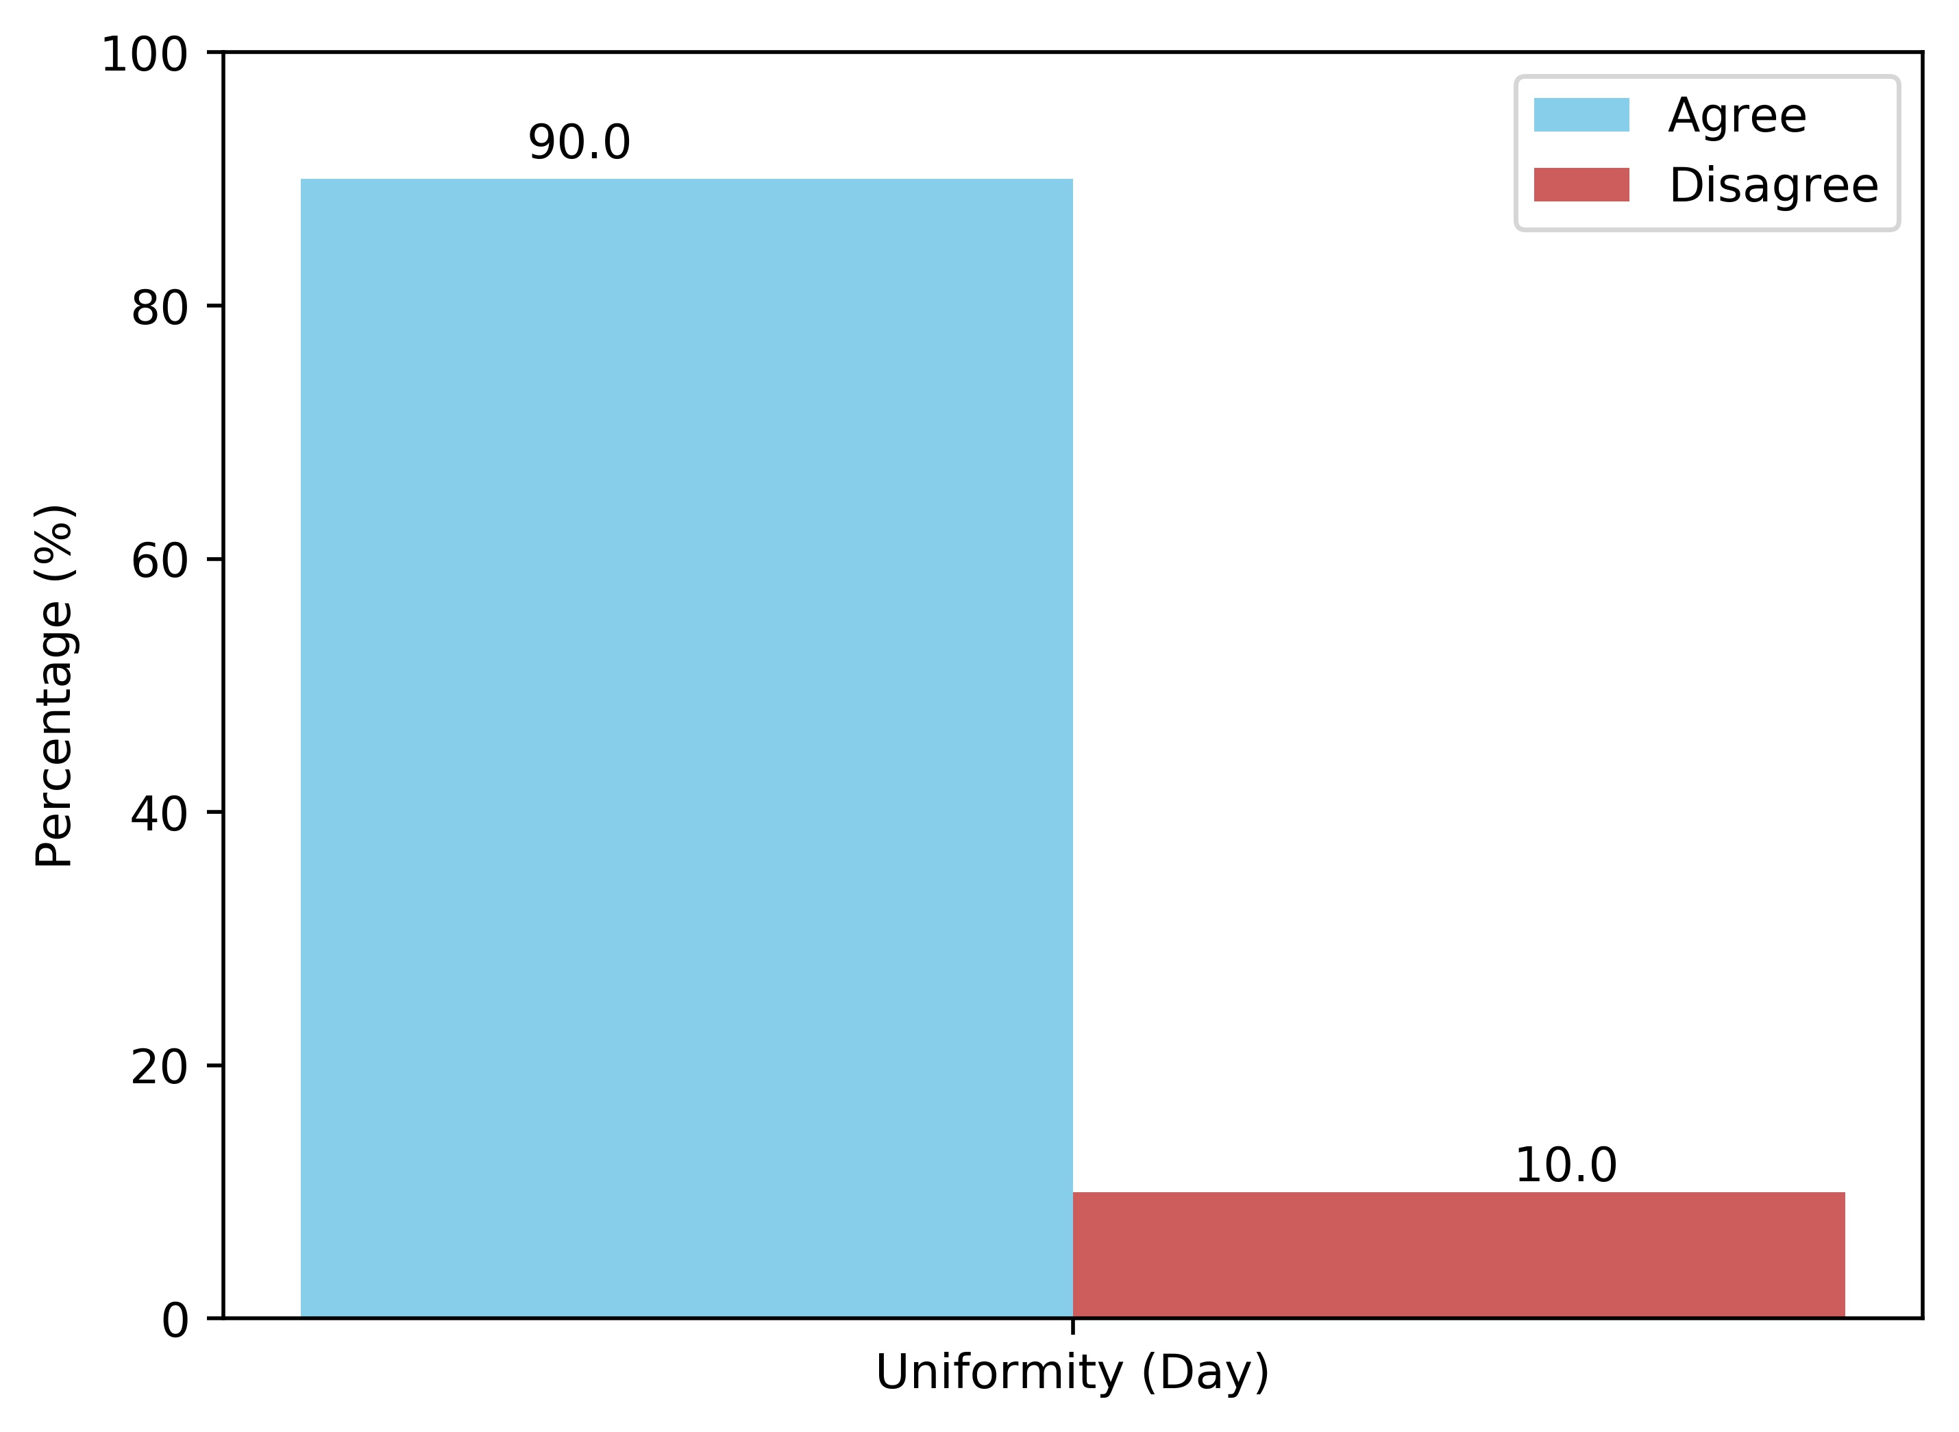
Emerging Issues and Future Direction:
AI &Machine Learning
AI Machining Learning and deep learning technique is emerging
Inter-calibration applications
  Scene detection
  Regression fitting
  IR ➔ MW
AL & DL learning tools
  Easy to use
  Open for public
NOAA workshops for AI applications (04/2019)
Case 1: Aug. 16, 2018 (Summer time)
VIIRS M15 BT
VIIRS M15 uniform scene mask
Predicted using ML
Accuracy
From Hui Xu/UMD

Slide 22
Summary
IR group is very active
Continued expansion of group
  From GEO/LEO inter-calibration to GEO/GEO, LEO/LEO, other datasets
  Imager/Sounder
  Hyperspectral Sounder inter-calibration
  Reprocessing, New Measurements, Gap Filling, Collocation
  More ideas, new collaborations, exploit other ongoing activities of relevance to GSICS
  Software, dataset, best practice, methods,
Sub-topical leads/formation
  Develop tasks, move forward with them
    References, Methods, Correction Tables, Tools …
  Taking a little longer than I had hoped…
Contributions to GSICS Newsletters

