Slide 1
Re-calibrating WV/IR channels of GMS/MTSAT imagers using HIRS/2, AIRS, and IASI
Tasuku Tabata¹, Viju John², Rob Roebeling², Tim Hewison², and Masaya Takahashi¹
1: Meteorological Satellite Center, Japan Meteorological Agency
2: EUMETSAT

Slide 2
Table of Contents
Motivation
Re-calibration algorithm
  Spectral band adjustment factor for HIRS/2
  Spectral gap-filling for AIRS
  How to bridge sensors’ gaps
Results
  TB biases and re-calibration uncertainties
  Impacts of re-calibration info on L1 data
Plans for collaboration with GSICS
Summary

Slide 3
Motivation
Operation of GEO satellites in Japan: since 1978
Re-calibration of GEO imagers at JMA
  VNIR: vicarious calibration using Terra/Aqua MODIS for GMS-5 (2000 ‒ ) in collaboration with Univ. of Tokyo and Chiba Univ.
  IR: no experience
 | Operation | VNIR | SWIR | WV | IR
GMS | 1978 – 1981 | 1 |  |  | 1
GMS-2 | 1981 – 1984 | 1 |  |  | 1
GMS-3 | 1984 – 1989 | 1 |  |  | 1
GMS-4 | 1989 – 1995 | 1 |  |  | 1
GMS-5 | 1995 – 2003 | 1 |  | 1 | 1
GOES-9 | 2003 – 2005 | 1 | 1 | 1 | 2
MTSAT-1R | 2005 – 2010 | 1 | 1 | 1 | 2
MTSAT-2 | 2010 – 2015 | 1 | 1 | 1 | 2
Himawari-8 | 2015 – | 6 | 1 | 3 | 7
Himawari-9 | (2022 –) | 6 | 1 | 3 | 7
Re-calibration of IR (11 μm) and WV channels for GMS ‒ MTSAT-2 under SCOPE-CM/IOGEO project
This study was done in collaboration w/ EUMETSAT during Tasuku Tabata’s stay as 1-year visiting scientist at EUMETSAT.

Slide 4

Re-calibration algorithm
Inter-calibration based on JMA GSICS GEO-LEO-IR algorithm
Reference sensors
  HIRS/2, AIRS, and IASI-A,B
Reference sensors
Sensor | Satellite | Period
HIRS/2 | TIROS-N NOAA-6-14 | 1978 – 2006
HIRS/3 | NOAA-15, 16,17 | 1998 – 2013
HIRS/4 | NOAA-18,19 Metop-1,2 | 2005 -
AIRS | Aqua | 2002-
IASI | Metop-A/B | 2007-
Differences from JMA-GSICS algorithm
  Spectral band adjustment factor for HIRS/2
  Spectral gap-filling for AIRS
  Regression equation for calculating inter-calibration coefficients
$$LEO=slope GEO+offset$$
    Weights for X and Y are taken into account (i.e. FIEXY in IDL)
    X: Stdv. of GEO radiance over averaged pixels
    Y: SBAF unc. and LEO NeDT

Slide 5
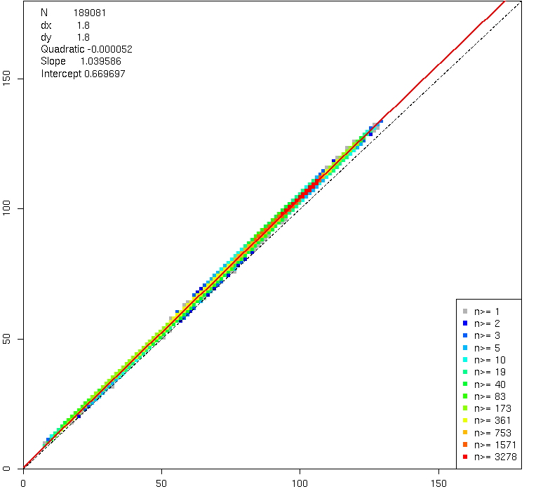
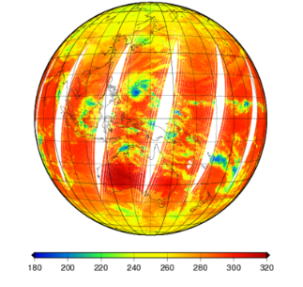


SBAF for HIRS/2
Linear regression of simulated pseudo GEO/HIRS radiances using IASI-A L1C data
Various scenes (~200,000) of IASI-A spectra are used
  $$GEO^{HIRS}=A × HIRS^{OBS} +B$$
Pseudo MTSAT-1R/JAMI 10.8 μm by IASI-A
$$Radiance of GEO^{IASI}$$
[K]
$$Radiance of HIR{S2}^{IASI}$$

Slide 6
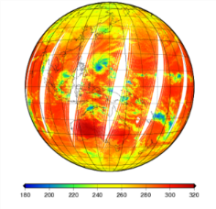






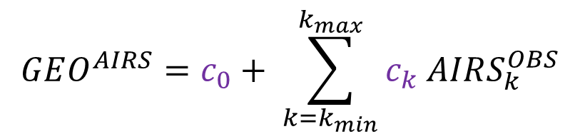

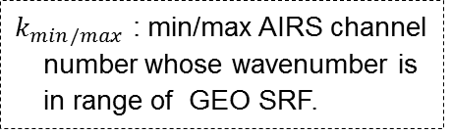
Spectral Gap-filling for AIRS
  $$GEO^{AIRS}=c_{0}+ \sum_{k=k_{min}}^{k_{max}}{c_{k} AIRS_{k}^{OBS}}$$
$k_{min/max}$ : min/max AIRS channel number whose wavenumber is in range of GEO SRF.
Calculation of c₀ and c_{k}
  $$GEO^{IASI}=c_{0}+ \sum_{k=k_{min}}^{k_{max}}{c_{k} AIRS_{k}^{IASI}}$$
~10,000 IASI obs.
$$GEO^{IASI}$$
  ( where $c_{k}$= 0 for $AIRS_{k}^{OBS}$ w/ bad-flag )
Pseudo AIRS radiances
…
$$AIRS_{k_{min}}^{IASI}$$
$$AIRS_{k_{min}+1}^{IASI}$$
$$AIRS_{k_{min}+2}^{IASI}$$
$$AIRS_{k_{max}}^{IASI}$$

Slide 7
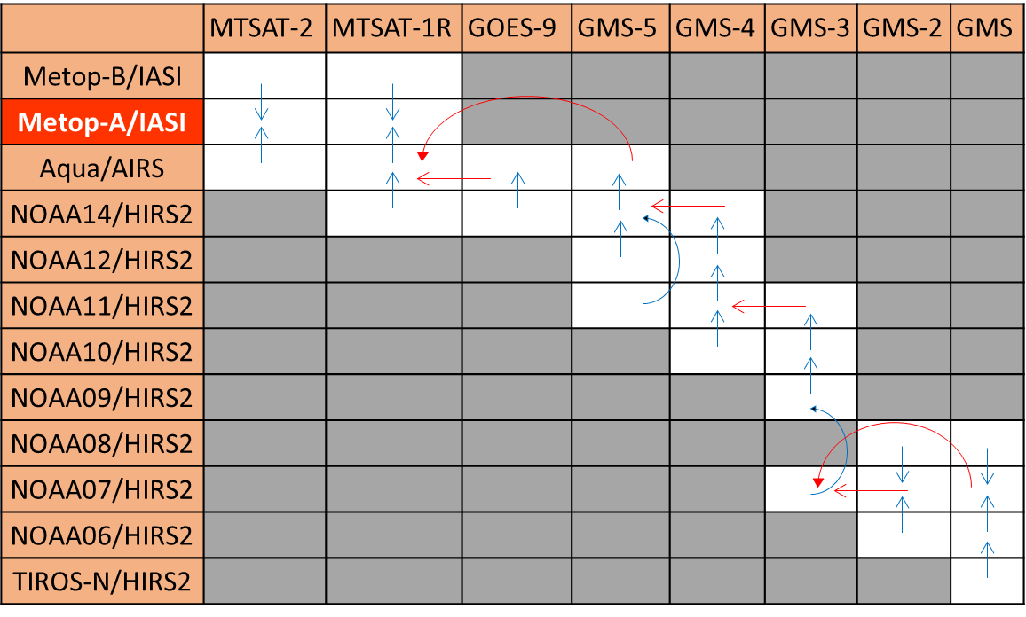
How to BRIDGE Reference Sensors
IASI-A: prime reference in this study
Tying sensors’ gaps by double-difference (DD) approach
  Uncertainties in SBAF/DD considered
SBAF
Filling reference biases by DD

Slide 8
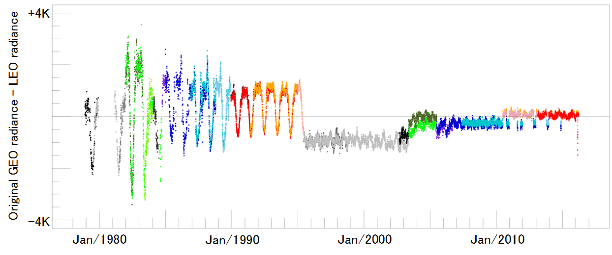
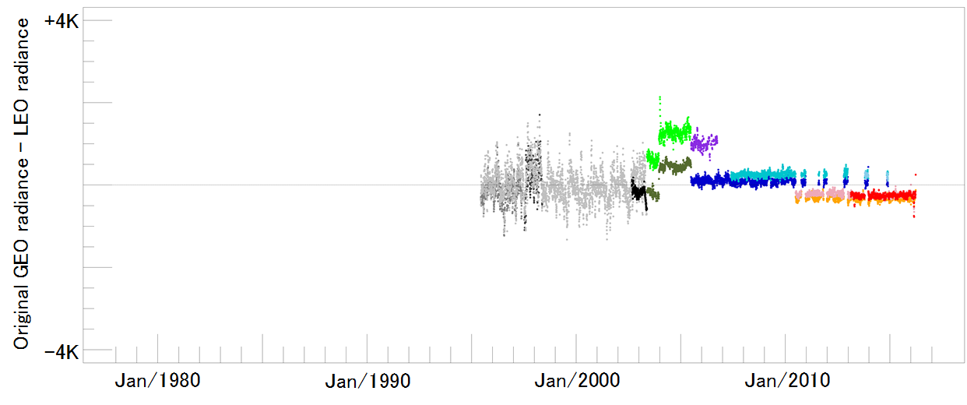
Results: TB bias in original L1 data
TB biases at standard scenes
Inter-calibration for each pair of one monitored / one reference sensor
Example:
MTSAT-1R vs. NOAA-14/HIRS/2
MTSAT-1R vs. Aqua/AIRS
MTSAT-1R vs. Metop-A/IASI
Same as GSICS Correction for individual reference
+4K
IR
0K
MTSAT-1R
GMS
GMS-2
GMS-3
GMS-4
GMS-5
GOES-9
MTSAT-2
-4K
+4K
0K
WV
-4K
1980
1990
2000
2010

Slide 9
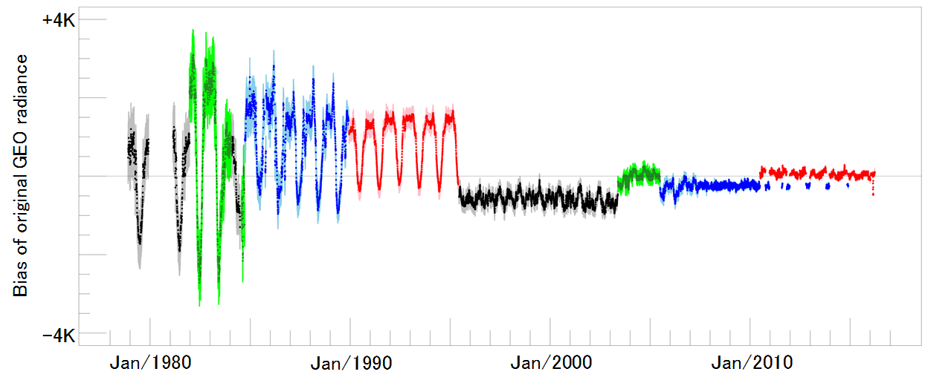
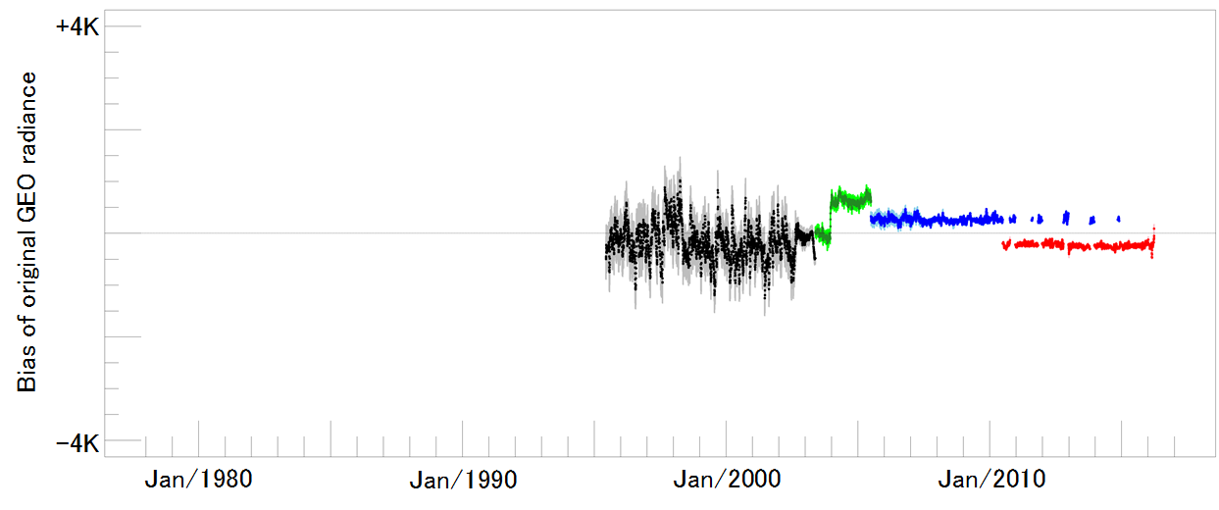
Results: TB bias in original L1 data
Inter-calibration of all monitored sensors vs. IASI-A
Sensor Equivalent Calibration
Same as GSICS Prime Correction
IR
Seasonal variations until GMS-4
  Seems to be related to sun and thermometer positions
  The latter was improved in GMS-5
WV
Seasonal variations (~1 K) w/ big unc. in GMS-5: caused by spectral gap with HIRS/2
  Big jump in Dec 2003: caused by updates of ground processing system
TB biases at standard scenes
+4K
IR
0K
MTSAT-1R
GMS
GMS-2
GMS-3
GMS-4
GMS-5
GOES-9
MTSAT-2
-4K
+4K
0K
WV
-4K
1980
1990
2000
2010

Slide 10
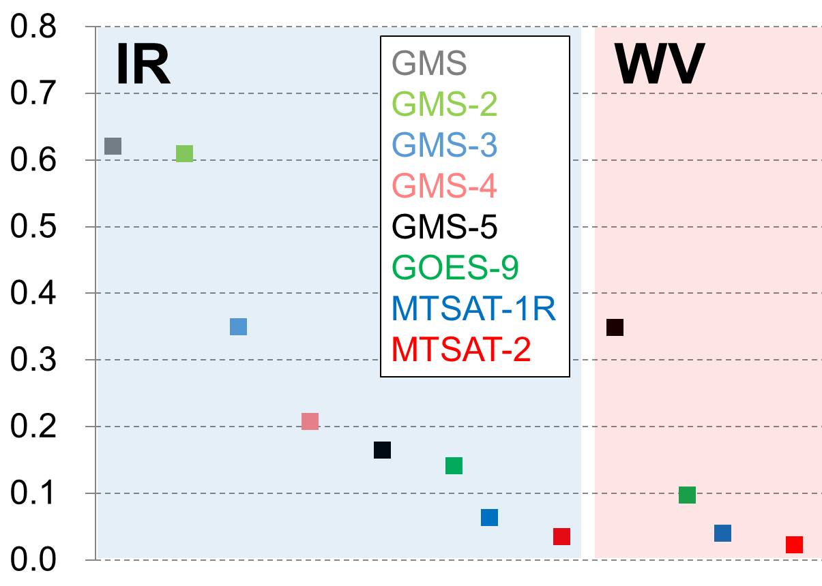
Re-calibration uncertainties
Long chains to prime reference (IASI-A) results in large uncertainties (e.g., ~0.6 K in GMS/GMS-2 IR channels)
Re-calibration unc. vs. IASI-A [K]

Slide 11
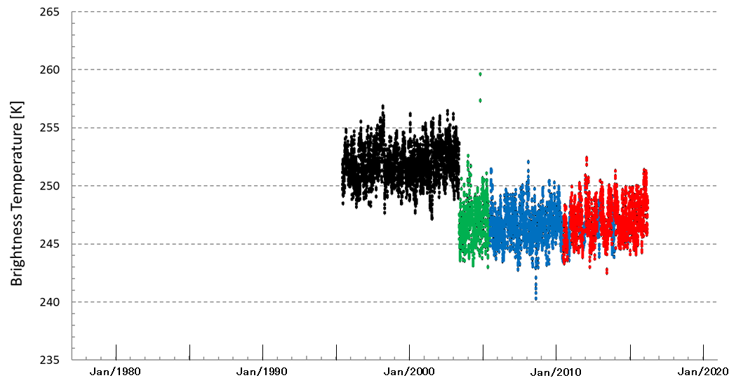
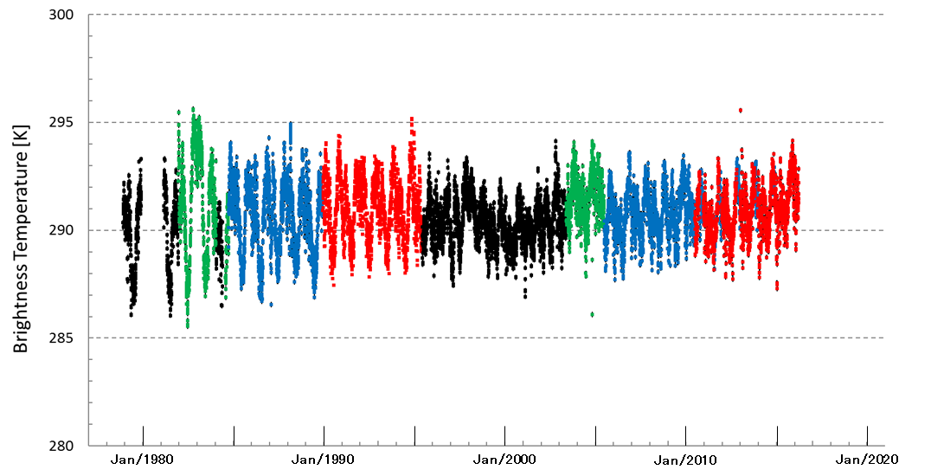
Impacts of Recalibration on L1 data
(This slide: before re-calibration)
Time series of TBs averaged over ± 30 deg. of SSP
Original L1 data w/ operational calibration info.
[K]
[K]
300
255
IR WV
290
MTSAT-1R
245
MTSAT-1R
GMS
GMS-2
GMS-3
GMS-4
GMS-5
GOES-9
MTSAT-2
GMS-5
GOES-9
MTSAT-2
280
235
1980
1990
2000
2010
1980
1990
2000
2010

Slide 12
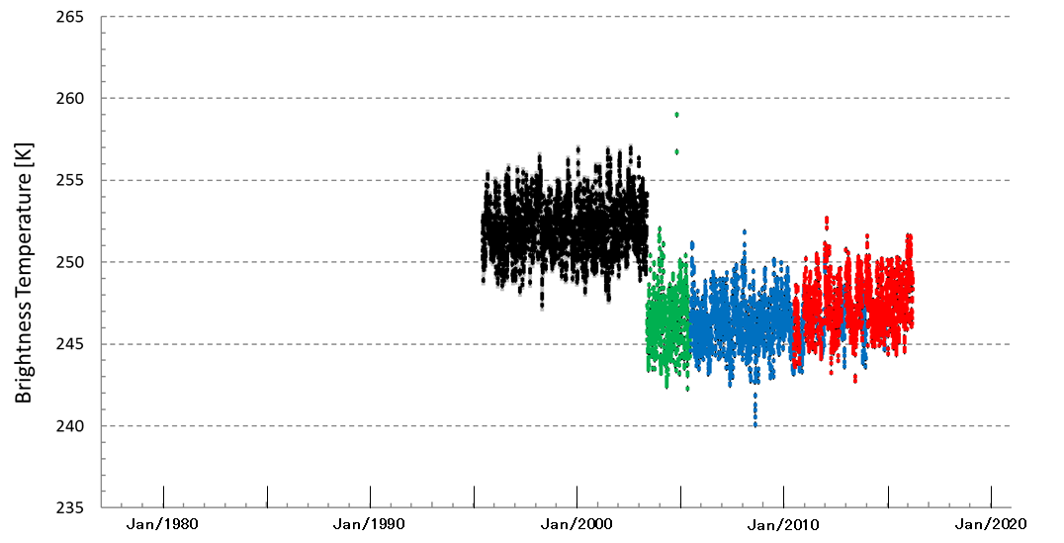
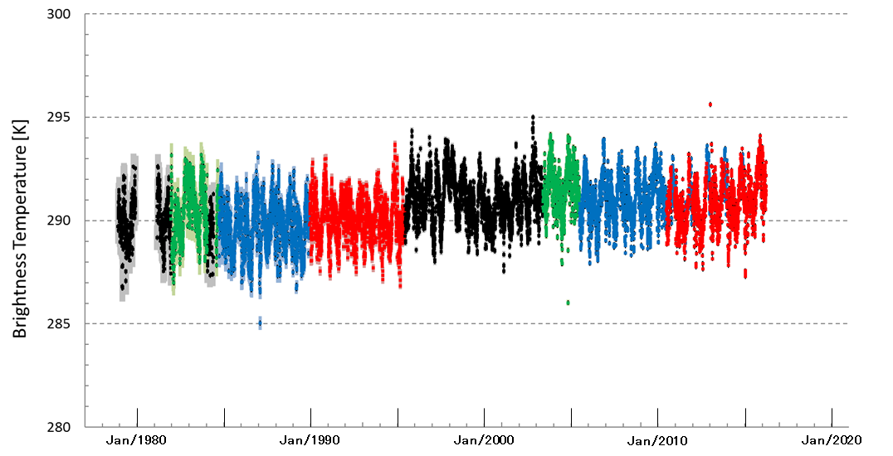
Impacts of Sensor Equivalent Calibration (~GSICS Prime Correction) on L1 data
Sensor Equivalent Calibration (all recalibrations tied to IASI-A as a prime reference) is applied.
TB differences due to GEO spectral gaps remains.
[K]
[K]
300
255
IR WV
290
MTSAT-1R
245
MTSAT-1R
GMS
GMS-2
GMS-3
GMS-4
GMS-5
GOES-9
MTSAT-2
GMS-5
GOES-9
MTSAT-2
280
235
1980
1990
2000
2010
1980
1990
2000
2010

Slide 13
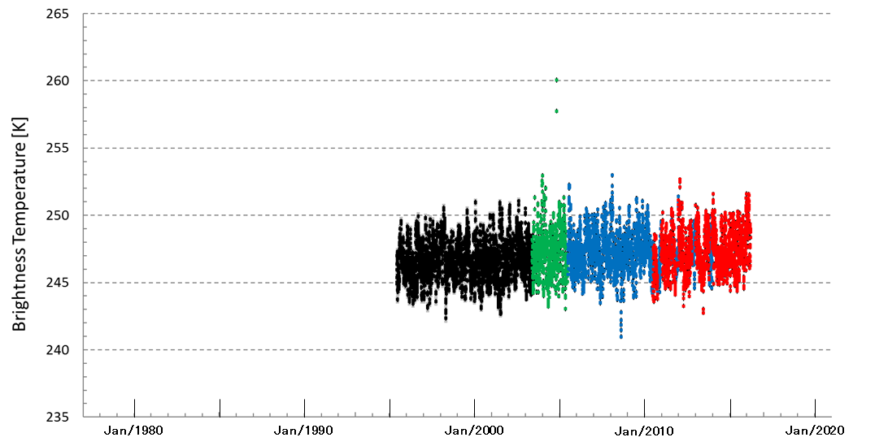
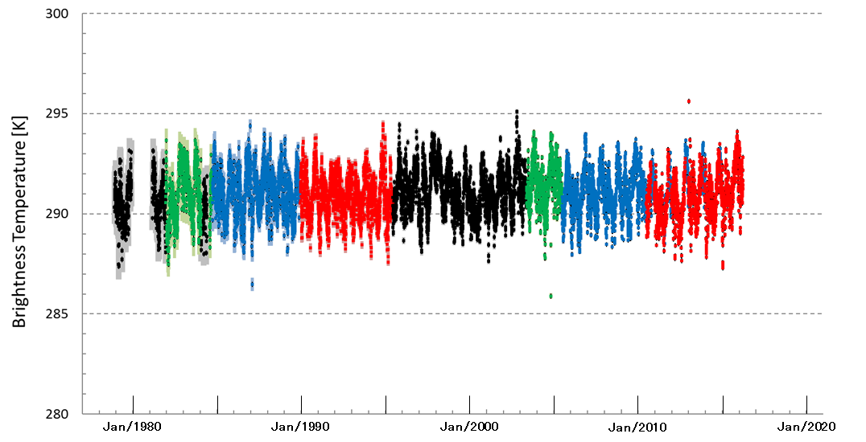
Impacts of Sensor Normalized Calibration on L1 data
All re-calibration info: normalized to MTSAT-2
Observation gaps among sensors are significantly reduced
[K]
[K]
300
255
IR WV
290
MTSAT-1R
245
MTSAT-1R
GMS
GMS-2
GMS-3
GMS-4
GMS-5
GOES-9
MTSAT-2
GMS-5
GOES-9
MTSAT-2
280
235
1980
1990
2000
2010
1980
1990
2000
2010

Slide 14
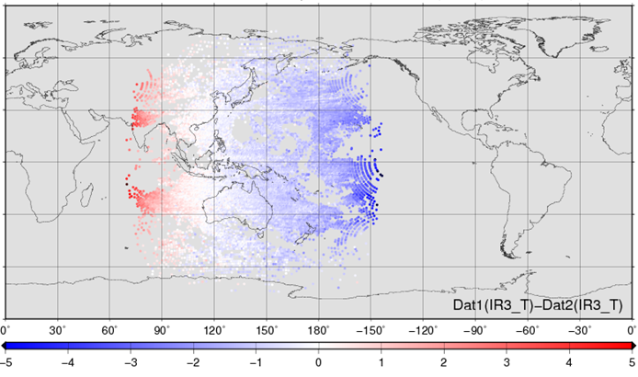
Plans for collaboration with GSICS
Comparison of re-calibrated L1 data at overwrapping region of Meteosat and GMS/MTSAT satellites
Comparison of re-calibration (this study) with GSICS GEO-LEO-IR
GSICS GEO-GEO comparison:
WV channels between MTSAT-1R (140E) and MTSAT-2 (145E)
6 days
Stdv. Mean Median
Murata and Tabata (2015)

Slide 15
Summary
Re-calibration algorithm for GMS/MTSAT and Meteosat imagers was jointly developed by EUMETSAT/JMA under SCOPE-CM/IOGEO project.
  HIRS/2, AIRS and IASI cover whole period of the GEO obs.
  SBAF from IASI-A and new spectral gap-filling method were applied to generate pseudo GEO radiances from HIRS/2 and AIRS.
  Double Difference approach was used for tying re-calibration bias/unc. among sensors.
  Two papers on this collaboration (Tabata et al. and John et al.) are in preparation.
Re-calibration revealed ~3 K seasonal variations in IR (10.8 μm) channels of GMS to GMS-4, ~ 1 K seasonal variations in GMS-5 WV due to spectral gaps w/ HIRS/2
Collaborative activities w/ GSICS (e.g. comparison of re-/inter- calibration results) are under planning.

Slide 16
Backup Slides

Slide 17
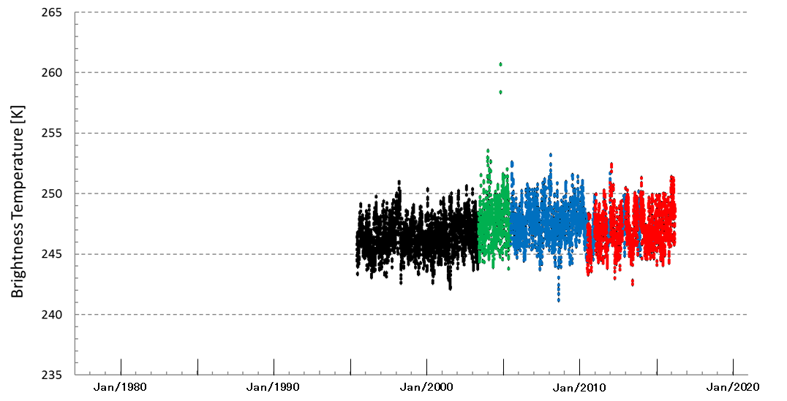
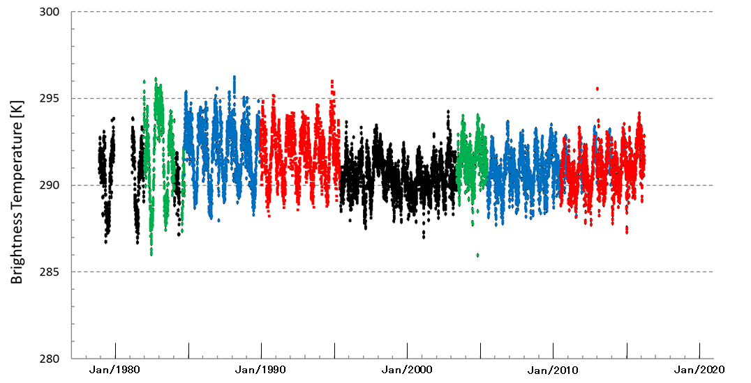
Impacts of Monitored Sensor Normalization on L1 data
Sensor Normalization to MTSAT-2 is only applied.
No changes in calibration (use of operational calibration informatoin in all GEO radiances)
[K]
[K]
300
255
IR WV
290
MTSAT-1R
245
MTSAT-1R
GMS
GMS-2
GMS-3
GMS-4
GMS-5
GOES-9
MTSAT-2
GMS-5
GOES-9
MTSAT-2
280
235
1980
1990
2000
2010
1980
1990
2000
2010

Slide 18
Sensor equivalent calibration
Sensor equivalent calibration [GSICS definition]
refers to the calibration where each sensor is calibrated in such a way that the spectral characteristics of that individual sensor are maintained. As a result of this process, the calibrated radiances represent the unique nature (e.g., spectral response function) of the monitored sensor.
Sensor 1
Sensor X
Radiances
Calibration as it should be
Actual Calibration
Time
Note, sensor equivalent calibrations are supposed to differ
in their radiances (or counts) due to differences in
the spectral characteristics of the sensors
Roebeling (2018)
Notes:
NRTC/RAC/ARC
For example, I suggested he discussed with you the "Requirements for NRTC/RAC/ARC". As you know at present we generate Near-Real-Time-Corrections and Re-Analysis Corrections for GEO-LEO IR, based on single pairs of instruments (one monitored, one reference). I would like you to consider what the requirements could be a GSICS Archive Re-Calibration, which is the sort of thing you are doing in SCOPE-CM. E.g. Could these requirements be met by my proposed Prime GSICS Corrections? i.e. Merging together inter-calibration results from different reference instruments, after correcting them to a common datum (the "Primary Reference") using "delta Corrections" (the double-difference of their time series).
18

Slide 19
Reference Sensor Normalized Calibration
Reference sensor normalised calibration [GSICS definition]
refers to the calibration that provides the best match to spectral characteristics of a predefined “reference*” sensor. As a result of this process, the calibrated radiances represent the unique nature (e.g., spectral response function) of the “reference” sensor. The normalised calibration includes information on uncertainty associated with adjusting the characteristics of the monitored sensor to those of the predefined “reference” sensor.
Sensor 1
Reference Sensor used for normalization
One sensor from a series
or
a hypothetical sensor
Sensor X
Radiances
Sensor Equivalent Calibration
Reference Sensor Normalized Calibration
Time
Uncertainty due to differences between
the spectral characteristics of the reference sensor and
the spectral characteristics of other sensors in the series
Roebeling (2018)
Notes:
NRTC/RAC/ARC
For example, I suggested he discussed with you the "Requirements for NRTC/RAC/ARC". As you know at present we generate Near-Real-Time-Corrections and Re-Analysis Corrections for GEO-LEO IR, based on single pairs of instruments (one monitored, one reference). I would like you to consider what the requirements could be a GSICS Archive Re-Calibration, which is the sort of thing you are doing in SCOPE-CM. E.g. Could these requirements be met by my proposed Prime GSICS Corrections? i.e. Merging together inter-calibration results from different reference instruments, after correcting them to a common datum (the "Primary Reference") using "delta Corrections" (the double-difference of their time series).
19

