Slide 1
Review of atmospheric radiative transfer models suitable for vicarious calibration
2019 GSICS Data and Research Working Groups Annual Meeting
Yves Govaerts & Vincent Leroy
Rayference
ESRIN, Frascati, 4 – 8 March 2019

Slide 2
Overview
Radiative transfer models play a critical role for vicarious calibration;
Instruments like S2/MSI have proven to have a radiometric accuracy close to 2-3%;
What is the expected simulation accuracy with current 1D RTMs over CEOS calibration sites: 1%, 3% or 5%?
RTM numerical accuracy
Input parameter accuracy
Notes:
Target of choice: water – appears dark in all 8 bands Sentinel 2 doesn’t make observations over open waters Open waters may appear too dark Coastal waters may appear brighter due to the presence of suspended matter
2

Slide 3
Concept
Physics is based on two fundamental pillars
OBSERVATION
THEORY

Slide 4
Concept
Physics is based on two fundamental pillars
OBSERVATION
THEORY
MEASUREMENT DEVICE
MATHEMATICAL MODEL

Slide 5
Concept
Physics is based on two fundamental pillars
OBSERVATION
THEORY
RADIATIVE TRANSFER MODEL
SATELLITE RADIOMETER

Slide 6
Experimental Setup
Acquisition of TOA BRF over Libya-4 acquired by (PICSCAR)
Envisat/MERIS
AQUA/MODIS
S2A/MSI
L8/OLI
Simulation of these TOA BRFs with 3 different RTMs fed with the same surface and aerosol properties (Govaerts et al., 2004, 2013)
Estimation of the mean bias between observation and simulation
Code | RTE solver | Gas | Surface | Aerosol
6S-V | Successive order | Hitran96 | RPV 4P | Customised
LibradtranV2 | Monte Carlo | Hitran2012 | RPV 4P | Customised
RTMOM | Matrix Operator | Hitran96 | RPV 4P | Customised

Slide 7
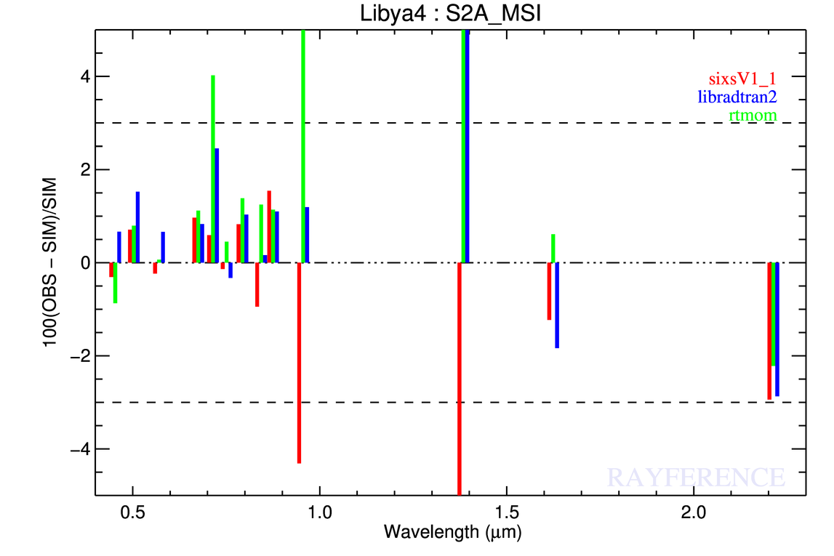
S2A/MSI
All SZA values

Slide 8
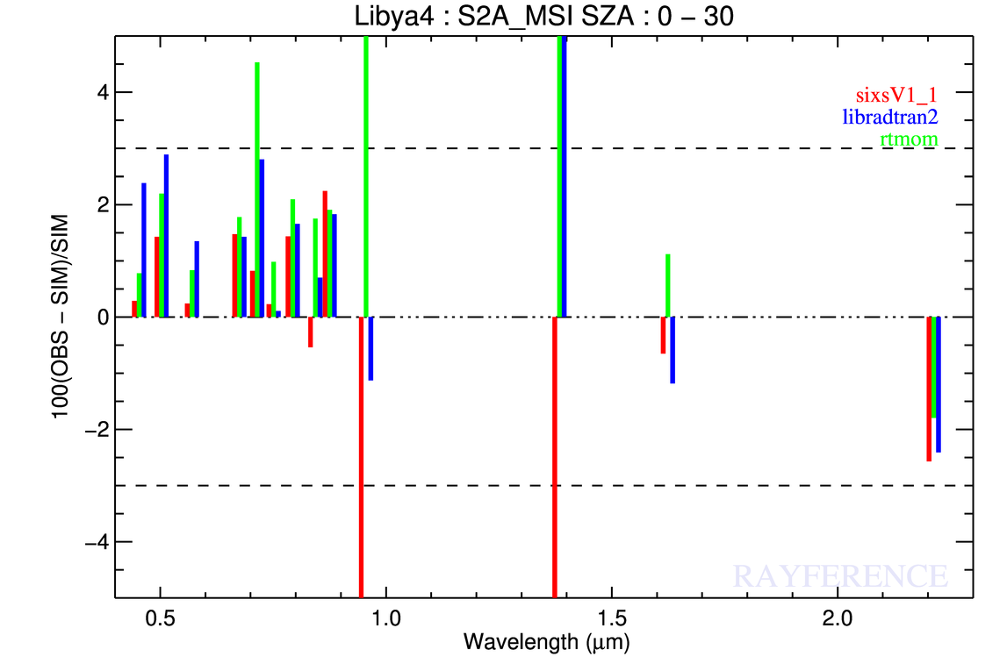
S2A/MSI

Slide 9
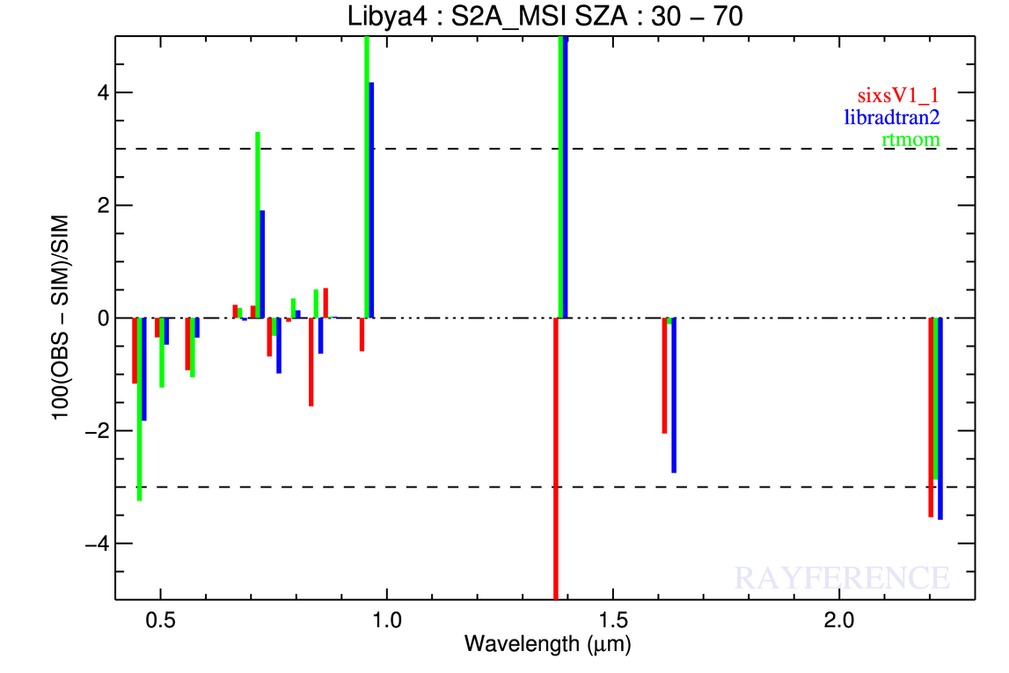
S2A/MSI

Slide 10
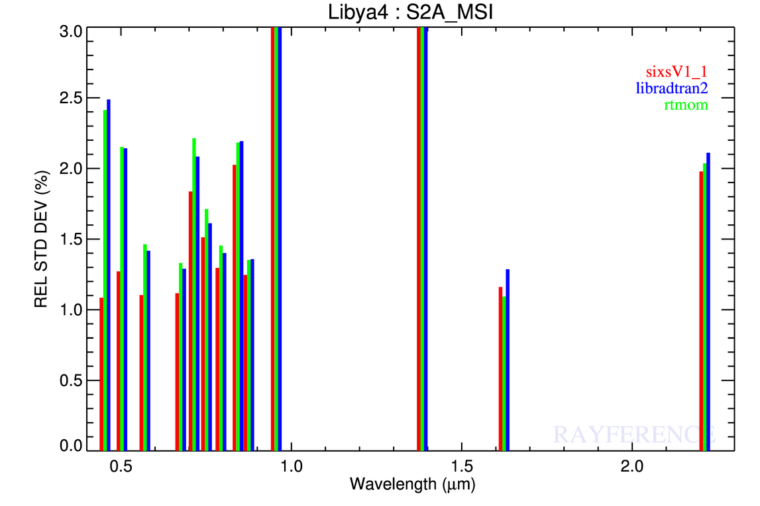
S2A/MSI
All SZA values

Slide 11
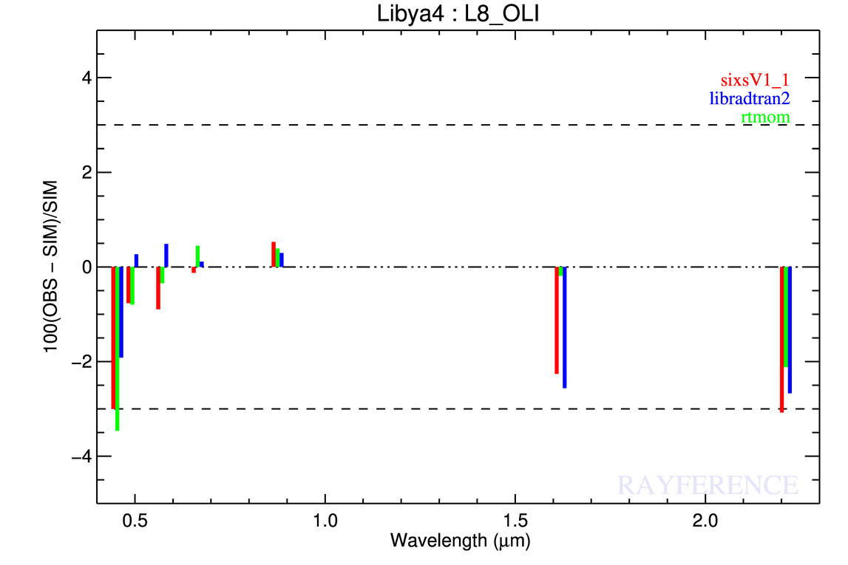
L8/OLI
All SZA values

Slide 12
S2A/MSI
All SZA values

Slide 13
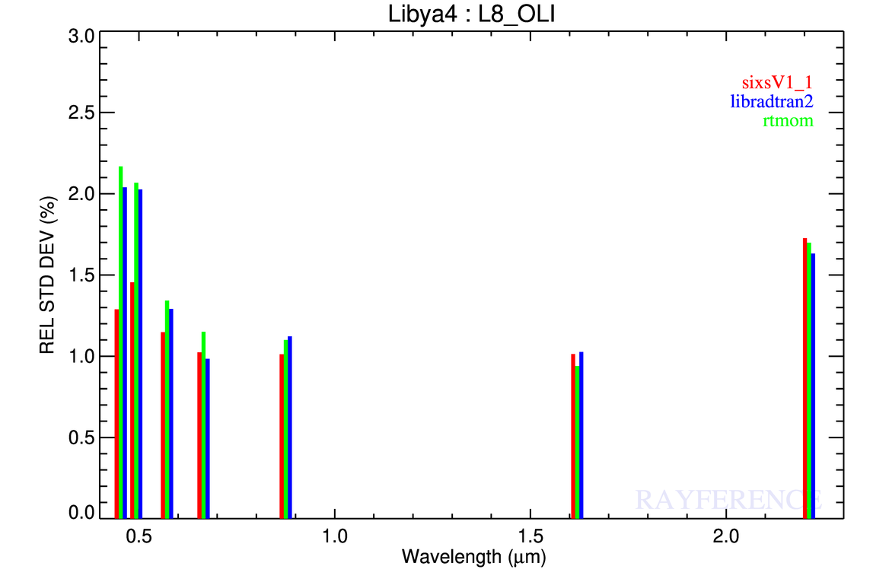
L8/OLI

Slide 14
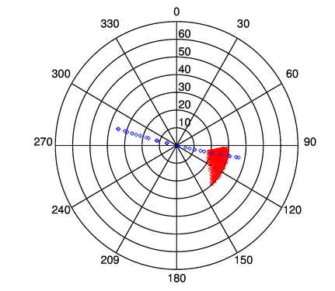
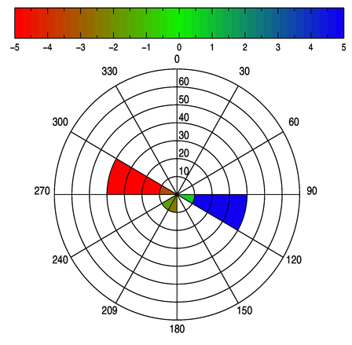
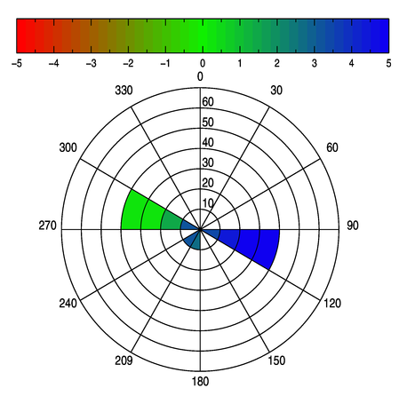
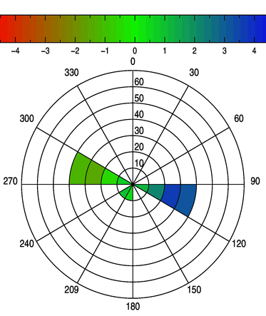
MERIS 412 band
ZSA < 30
SIXS-V
Libradtran
RTMOM

Slide 15
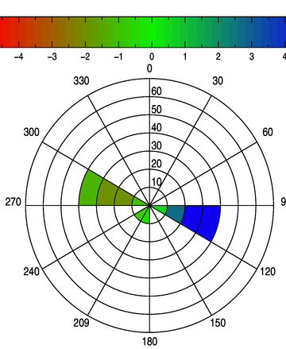
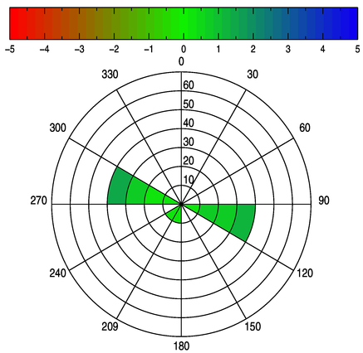
MERIS 885 band
ZSA < 30
SIXS-V
Libradtran
RTMOM

Slide 16
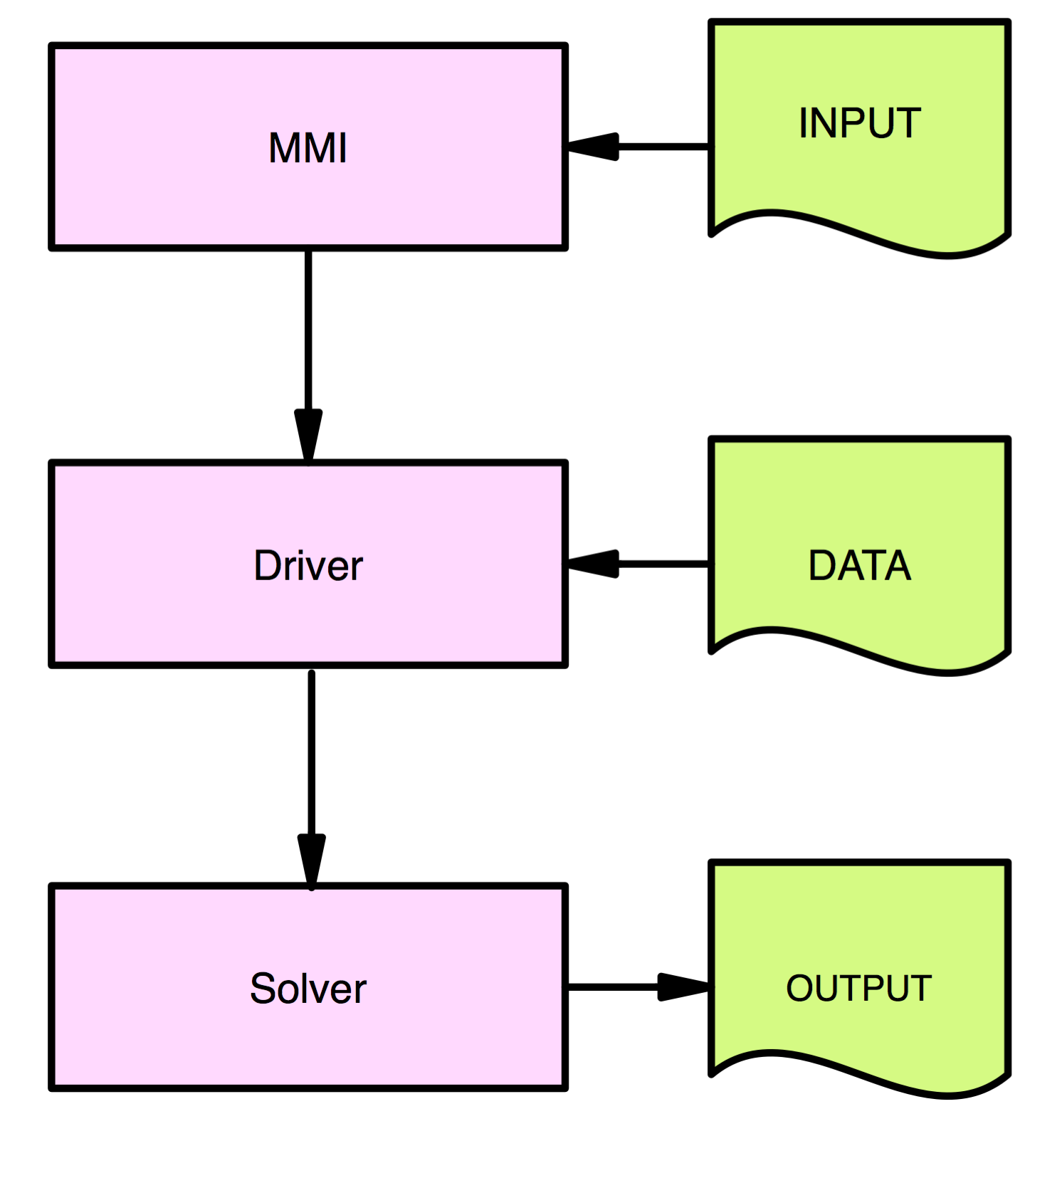
Typical RTM functionalities
Man-Machine Interface
Collects the input information concerning the
Spectral range and resolution;
Atmospheric vertical composition;
Cloud and aerosol concentration;
Surface properties;
Type of “measurements”
Up/down
Flux, radiance reflectance transmittance
Elevation

Slide 17
Typical RTM functionalities
Driver
Converts the input information into data that can be understood by the RTE solver at a given wavelength, i.e. for each atmospheric layer:
The phase function
The single scattering albedo
The molecular transmittances
It provides the lower boundary conditions.
It also performs the vertical rescaling of molecular concentration if needed.

Slide 18
Typical RTM functionalities
Driver
Converts the input information into data that can be understood by the RTE solver at a given wavelength, i.e. for each atmospheric layer:
The phase function
The single scattering albedo
The molecular transmittances
The lower boundary conditions (if needed)
It also performs the vertical rescaling of molecular concentration if needed.
RTMs without a versatile Driver should not be considered for operational vicarious calibration because there are too cumbersome to operate.

Slide 19
Typical RTM functionalities
RTE Solver
Solves the radiative transfer equation in each scattering element (e.g. atmospheric layers) with a specific numerical methods:
Successive Order of Scattering
Discrete ordinate
Adding/doubling
Matrix Operator
Spherical harmonic
Monte Carlo

Slide 20
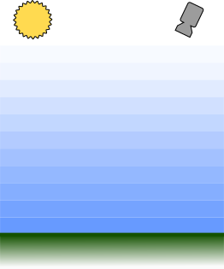
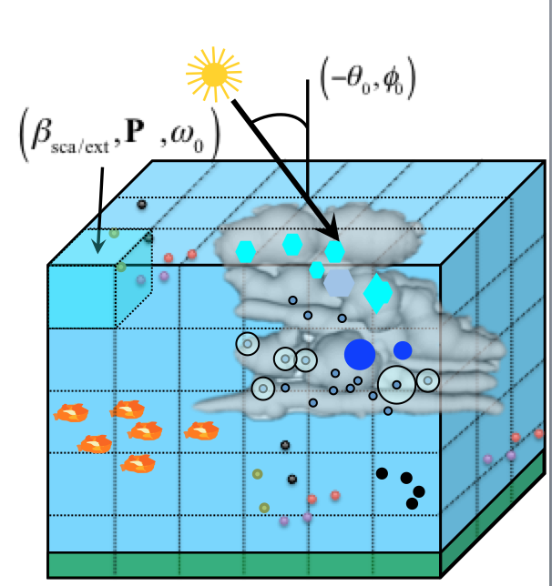
Review of existing models
1D plane parallel atmosphere
Vertical structure of the atmosphere
No 3D cloud effects (e.g. for DCC)
Only flat surface
Not accurate for large sun and viewing angles because of the plane parallel approximation.
3D plane parallel atmosphere
The atmosphere is divided into regular voxels
Each voxel might have different optical properties
RTE solver : discrete ordinate or Monte Carlo

Slide 21
Toward a 1% RTM accuracy
Surface BRF : accounting for topography (e.g., oriented sand dunes);
Molecular absorption: account for species like O₄;
Rigorous calculation of the coupling between:
Surface reflectance and atmosphere scattering;
Aerosol scattering and molecular absorption;
Polarization, non flat earth for large zenith angles;
Improvement of the surface and atmospheric property characterization;

Slide 22
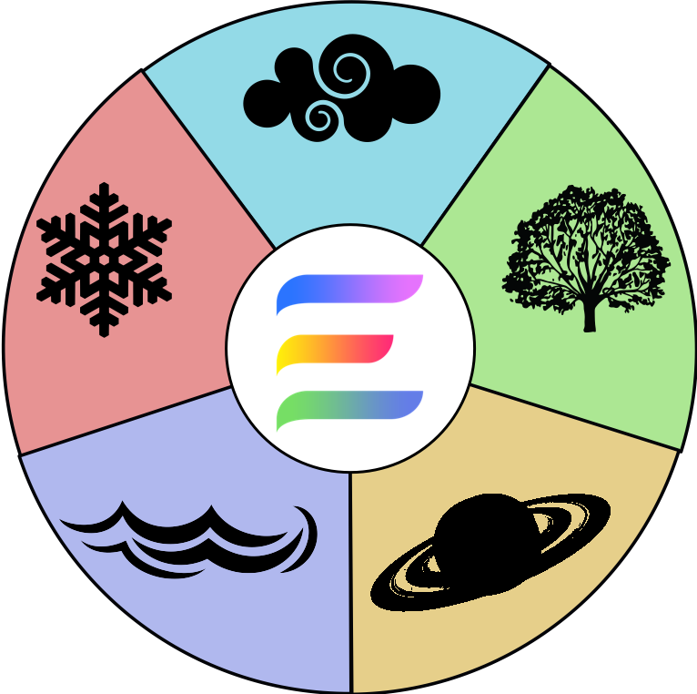
The Eradiate RTM
New open source 3D RTM specifically dedicated to Cal/Val activities;
Based on most advanced 3D Monte Carlo Ray Tracing rendering techniques;
Not limited to only one (atmospheric) community;
Will include 3D representation of land / ocean / atmospheric / cryosphere in a single framework;
Will allow the simulation of
BRF field at the infinity;
Satellite images;
Ground observations.

Slide 23
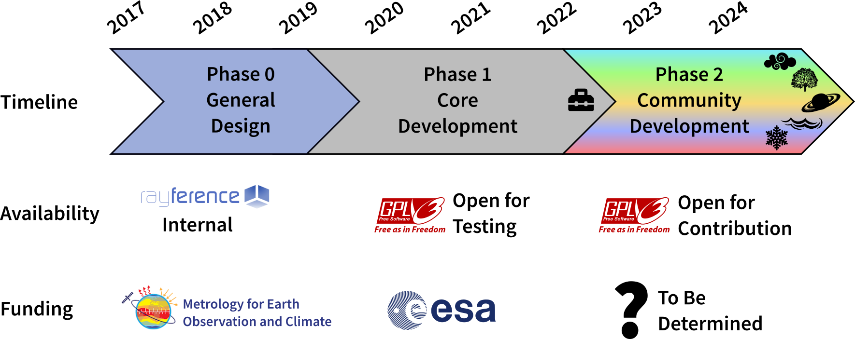
Development Phases

Slide 24
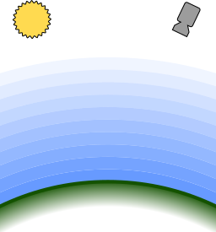
Phase 1 : Planned Scene Elements
1D Atmosphere
Plane-parallel (“flat-Earth”)
Layered spheroids (“round-Earth”)
Surface
Standard empirical BRF models (e.g. RPV, Ross-Li, Hapke)
Microfacet models (e.g. semi-discrete, Oren-Nayar, Torrance-Sparrow, Cox-Munk)
Including parameter texturing
3D scenes with detailed typography and objects (e.g. Libya-4, RadCalNet, Dome-C, …)
Illumination
Infinitely distant collimated
Finite-size solar disc (uncollimated)
Sensors
Flux & radiance meters
Ideal detector (pinhole camera)
BRF at finite or infinite distance

Slide 25
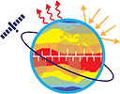
The Eradiate RTM
www.eradiate.eu
Please register to the Eradiate newsletter (under contact) to be updated on Eradiate latest developments.
Yearly Eradiate workshops are organised at the JRC, Ispra site (IT). The next (third) one will take place on Nov 26^{th -} 27th 2019 (save the date!).
Our sponsors (for this presentation)

