Slide 1
VIS/NIR sub-group discussion
GSICS annual meeting, Shanghai, China, March 19-23, 2018

Slide 2
VIS/NIR discussion topics
CLARREO Pathfinder objectives
NOAA NPP-VIIRS V2 reference calibration
GSICS multi-GPRC VIS/NIR DCC calibration paper
Rayleigh scattering calibration approach next steps
GPRC VIS/NIR upcoming priorities to determine future VIS/NIR calibration methods
Web meeting agenda

Slide 3
CLARREO PATHFINDER funded objectives
The CLARREO PATHFINDER instrument will fly on the international space shuttle (ISS) during 2023
Instrument to be operationally for at least one year
No climate benchmarking
Funded to inter-calibrate VIIRS imager and CERES broadband instruments
The ISS is in a precessionary orbit is ~63 days with an inclination of ~51°
When the ISS is in the 1:30PM local time it will be dedicated to calibrate VIIRS and MODIS
The remainder of the time it can inter-calibrate with GEOs using the PATHFINDER pointing capability
Ground target characterize is not being funded

Slide 4
NOAA NPP-VIIRS calibration reference
NOAA is the official archive agency for VIIRS
I or M band, decision from the last meeting is to use the band with the most similar spectral response function
NOAA NPP-VIIRS V2 at the University of Maryland dataset
With Kalmen filter?
With scaling factor for ocean color?
M5 scaled to I1, M5 is 1.5% brighter than I1, I1 calibration is closer to Aqua-MODIS?

Slide 5
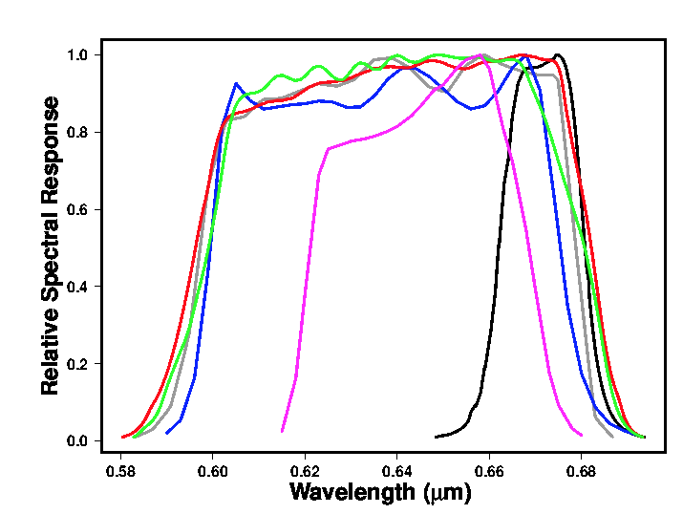
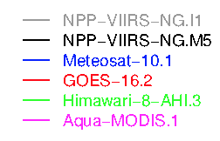
VIIRS 0.65µm reference channel, M5 or I1
VIIRS I bands have a higher spatial resolution, than M bands. But analyzed at the same resolution as M5 or collectively, would that matter?
The M5 band has a very narrow spectral band response function (SRF) and the I1 band has a SRF very similar to many 3rd generation GEOs
The calibration difference between M5 and I1 bands is about 1.5%
0.65µm

Slide 6
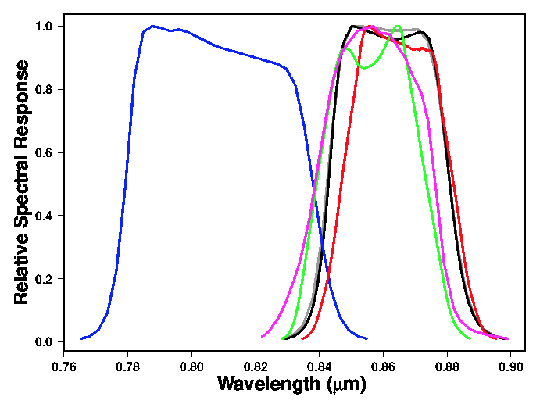
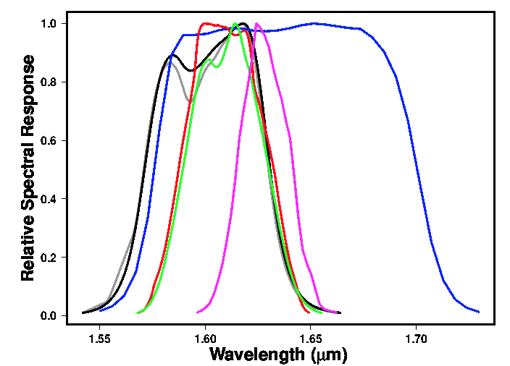
VIIRS 0.86 or1.6µm reference channel, M or I
The 0.86 µm I2 and M7 bands have very similar SRFs
The 1.61µm I2 and M10 bands have very similar SRFs.
0.86 µm
1.6 µm

Slide 7
GSICS DCC GEO calibration paper
Follow the GSICS IR paper approach
To document the GSICS DCC GEO calibration approach and to provide a reference for the calibration community
The paper would describe the baseline calibration approach
Each agency can then provide their optimization and the performance of their sensor to provide specific GEO DCC calibration uncertainties
We would want input from all agencies, a very long author list
I will write the baseline approach and distribute for comments
Then have DCC web meeting, where each agency can present their proposed contribution

Slide 8
GSICS Rayleigh scattering calibration approach
This will be a joint effort with the UV subgroup
Rayleigh scattering lead.
Do we have a volunteer to lead this effort?
If not, we can see if Bertrand Fougnie could lead the effort
Set up web meeting for all agencies to present their Rayleigh scattering approach
Hopefully find common ground among approaches and determine best practices
Do we have Rayleigh scattering calibration experts that are not part of GSICS?

Slide 9
GPRC VIS/NIR priorities discussion
Is there time to begin a new calibration approach
Current VIS/NIR approaches
Lunar
Lunar MTF
DCC
Rayleigh scattering
Other VIS/NIR approaches
Ray-matching with VIIRS
Deserts/PICS

Slide 10
VIS/NIR 2018 web meeting agenda
GSICS DCC paper web meeting
Rayleigh scattering approach/with UV group
Solar spectra/with UV group
Implementation of the DCC method for SWIR bands

