Slide 1
Review of White Paper Outline –CGMS Baseline
(Sustained contributions to the Global Observing System)
Manik Bali/Ralph Ferraro
GSICS Coordination Center, NOAA

Slide 2
TABLE OF CONTENT
Introduction
  Structure of White Paper outline- CGMS Baseline
  GSICS a component of WIGOS
  Goals of this session
Review CGMS Baseline: Sustained Contributions to the Global Observing System
  Contingency Plan
  HLPP
  Gap Analysis( Time and Spectral )
  GSICS as WIGOS Component
  Vision 2040
Summary

Slide 3
Introduction- Baseline Document
CGMS Baseline Sustained contributions to the Global Observing System
The CGMS Baseline document was initiated in the CGMS-46 in Bangalore, India. The ‘Baseline’ constitutes the commitments and plans of CGMS members to provide particular observations, measurements, and services.
1. Introduction ................................................................................................................................... 3
1.1 Document purpose ........................................................................................................................................ 3
1.2 Reference documents .................................................................................................................................... 3
1.3 Scope of the baseline ..................................................................................................................................... 3
1.4 Evolution of the baseline ............................................................................................................................... 4
1.5 Additional aspirational response to the WIGOS Vision ............................................................................... 4
2. Observations, measurements, and orbits ....................................................................................... 4
2.1 Observations and measurements ................................................................................................................. 4
3. Services .......................................................................................................................................... 8
3.1 Data sharing services ..................................................................................................................................... 8
4. Ensuring data and services ............................................................................................................. 8
4.1 Calibration and validation .............................................................................................................................. 8
4.2 Contingency planning to ensure continuity ................................................................................................. 9
4.3 Monitoring implementation of the baseline ................................................................................................ 9
4.4 Research to operations and employing research missions ......................................................................... 9
4.5 System compatibility and interoperability ................................................................................................... 9
APPENDIX A: CGMS baseline process ............................................................................................................... 10
GSICS contribution to it and how we would sustain/improve the calibration for MW sensors.

Slide 4
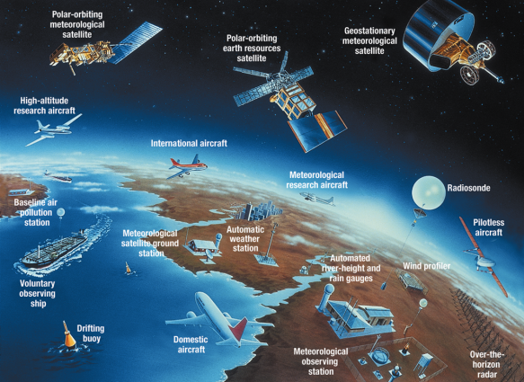
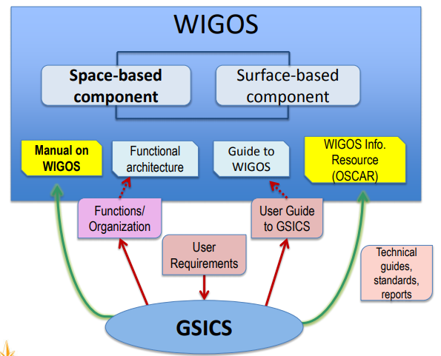
Introduction: GSICS a WIGOS component
WMO Integrated Global Observing System provides a framework for the integration and sharing of observational data from National Meteorological and Hydrological Services (NMHSs) and other sources, while WMO Information System (WIS) connects all National Meteorological and Hydrological Services and regions together for data exchange, management and processing.

Slide 5
Passive Microwave Missions
Introduction: Passive Microwave Missions
Satellites | Usage from | Usage to
Nimbus-5 | 1972 | 1983
Nimbus-5 | 1972 | 1983
Nimbus-6 | 1975 | 1983
Nimbus-6 | 1975 | 1983
NOAA-6-14 | 1978 | 2007
Nimbus-7 SeaSat | 1978 | 1994
DMSP-F Series | 1979 | 2019
Okean-O1-1 Okean-O1-2 Okean-O1-3 Okean-O1-4 Okean-O1-5 Okean-O1-6 Okean-O1-7 SICH-1 | 1986 | 2001
Okean-Series | 1986 | 2006
MOS-1 MOS-1B | 1987 | 1996
DMSP-F Series | 1987 | 2019
DMSP-F11 DMSP-F12 DMSP-F14 DMSP-F15 | 1991 | 2019
TOPEX-Poseidon | 1992 | 2005
TRMM | 1997 | 2015
Meteor-3M | 2001 | 2006
Aqua Metop-A Metop-B Metop-C NOAA-15 NOAA-16 NOAA-17 NOAA-18 NOAA-19 | 1998 | 2024
NOAA-15 NOAA-16 NOAA-17 | 1998 | 2019
Okean-O-1 | 1999 | 2000
OceanSat-1 (IRS-P4) | 1999 | 2010
Okean-O-1 | 1999 | 2000
Okean-O-1 | 1999 | 2000
JASON-1 | 2001 | 2013
Meteor-3M | 2001 | 2006
Meteor-3M | 2001 | 2006
JASON-2 JASON-3 | 2008 | 2021
SMOS | 2009 | 2019
Meteor-M N1 Meteor-M N2 Meteor-M N2-1 Meteor-M N2-2 Meteor-M N2-3 Meteor-M N2-4 Meteor-M N2-5 Meteor-M N2-6 | 2009 | 2028
JPSS-2 JPSS-3 JPSS-4 NOAA-20 SNPP | 2011 | 2038
Megha-Tropiques | 2011 | 2019
HY-2A HY-2B | 2011 | 2023
GCOM-W | 2012 | 2019
GPM Core Observatory | 2014 | 2019
JASON-CS-A JASON-CS-B | 2020 | 2032
TROPICS | 2020 | 2025
Meteor-MP N1 Meteor-MP N2 | 2021 | 2030
SWOT | 2021 | 2024
There is a need to harmonize and (if possible) integrate and complement the Microwave observations made by CGMS satellite agencies.
It is envisaged that such a process would be able to directly impact the ability to monitor climate/weather and improve the adaptation and mitigation plans on a global scale.
The WMO Integrated Meteorological Observing System (WIGOS) has taken crucial steps to facilitate this process. Some of these are
Develop Data Harmonization plans via the WIGOS TTDQM
Develop Vision and Baseline documents , to be revised every four years
Develop contingency plan ( situation emerging due to loss of a mission)
Further develop the overall vision for the Global Observing System ( GOS/GCOS)
ADEOS-2 | 2002 | 2003
Aqua | 2002 | 2019
DMSP-F16 DMSP-F17 DMSP-F18 DMSP-F19 | 2003 | 2019
SICH-1M | 2004 | 2006
Metop-A Metop-B Metop-C NOAA-18 NOAA-19 | 2005 | 2024
Goals of this Session
GSICS is requested to organize an expert meeting on the inter-calibration of operational PMW sensors to meet the WIGOS 2040 targets for a coordinated effort to share information on current and future PMW instruments and report to CGMS-47. (CGMS-46-EUM-WP-14)
In the WIGOS session review of the white paper outline would be presented and discussed. Various topics such as spectral gap would be discussed along with WMO perspective on WIGOS
Over 118 Passive Microwave Missions launched since the early seventies by CGMS members
( Ref: http://www.wmo-sat.info/oscar/instruments)

Slide 6
Review
1.1 DOCUMENT PURPOSE
The ‘Baseline’ constitutes the commitments and plans of CGMS members to provide particular observations, measurements, and services. CGMS members plan to maintain the capabilities and services described below to support the WMO Global Observing System (GOS). This document will remain consistent with the principles of the WMO Integrated Global Observing System (WIGOS) 2040 Vision and the WIGOS Vision serves as important input in the development of CGMS members’ plans.
Excepts from the WIGOS Vision 2040 (Vision 2040)
The WIGOS Vision document attempts to address the evolving interests of WMO Members beyond the traditional WMO focus on observations for weather and climate by taking on more of an Earth system viewpoint which includes other applications.
re both satellite and surface-based data are required, and for measurements that cannot be achieved from space.
The space segment must be complemented by the surface-based components of WIGOS, for example to provide surface-based reference measurements using a multi-tiered approach (i.e., a smaller number of high quality ground sites that are part of a much larger network of stations that provide significant geographical coverage). This applies to the many applications where both satellite and surface-based data are required, and for measurements that cannot be achieved from space.
The Baseline document should be looked at in the backdrop of the top level WIGOS 2040 document and the downstream documents that detail plans for contingency and gap filling

Slide 7
Inputs for Base Line Document
Title | Purpose and Revision Cycle | Link to Current Version
CGMS Contingency Plan | Defines guidance and the process for identifying, mitigating, and coping with risks to the continuity of the CGMS Baseline. | CGMS-46-CGMS-WP-28
CGMS High-Level Priority Plan (HLPP) | 4-year rolling plan containing high-level priorities for CGMS activities. Aspirational targets for enhancing the CGMS response to the WIGOS Vision are included in the HLPP. Revised annually. | CGMS HLPP 2018-2022
WMO Gap Analysis |  | CGMS-46-WMO-WP-14
WIGOS Vision | Contains the overall vision for the complete observing system, based on WMO requirements. Document is updated by WMO every 4 years. | CGMS-46-WMO-WP-01

Slide 8
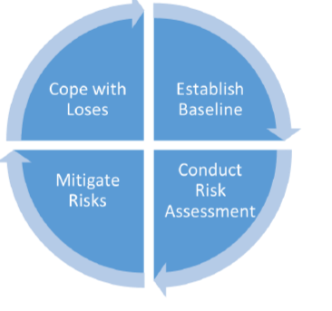
PMW Sensor Contingency Plan
CGMS encourages complementarity, compatibility, and possible mutual backup in the event of a system failure through cooperative mission planning, compatible meteorological data products and services, and the coordination of space and data related activities, thus complementing the work of other international satellite coordinating mechanisms.” (Ref: CGMS-46-CGMS-WP-28 )
Translated to PMW Sensors Specific Details that can build inter-agency collaboration within the Scope of GSICS
1. Risk Analysis ( slips in launches , funding, fuel resources to accurate assessment of mission life)
2. Mission Planning
  Long-term planning of satellite missions allowing on-orbit redundancy and launch schedule flexibility to quickly recover from a launch or on-orbit failure.
  Designing a resilient space segment architecture, including disaggregation as appropriate.
  Securing financial resources to implement these plans.
  Securing the availability of the required expertise for the whole lifecycle.
  Monitoring the implementation of the plans through project management practices.
  Addressing technological risk through adequate feasibility studies, tests, and demonstrations.
  Identifying the risk areas in: the overall system design; the space segment; space ground interfaces and ground systems, including telecommunications, network and computer security; and mitigating these risks through adequate measures such as redundancy or alternative means.
  Monitoring the risk over the whole life cycle, including maintenance aspects and subsystems becoming obsolete.
3. The CGMS risk management process to help ensure continuity
4.Operational Management
  Ensuring availability of in-orbit backup satellites to assume primary responsibilities as required.
  Considering the relocation of a satellite, which could include the possibility of merging two missions with reduced coverage.
  Splitting a mission over two satellites (e.g., primary and secondary) in case of partial payload failure.

Slide 9
CGMS High-Level Priority Plan (HLPP)
It is the policy of CGMS to coordinate satellite systems of its members in an end-to-end perspective, including protection of in orbit assets and support to users - e.g. through appropriate training - as required to facilitate and develop shared access to and use of satellite data and products in various applications.
This policy reflects in the structure of this 4-year High Level Priority Plan, which covers:
  Operational Continuity and Contingency Planning
  Coordination of Satellite Systems and Operations
  Coordination of Data Access and End User Support
  Enhancement of the quality of satellite-derived data and Products
  Outreach and training activities
  Cross-cutting issues and new challenges
Application of HLPP onto PMW Sensors:
Coordination of in-orbit PMW sensors via the GSICS Microwave Subgroup can support the CGMS goal of coordinating in the WIGOS framework.
These goals can be directly applied to PMW sensors. This would enhance not only the availability of PMW sensor data sets but ensure that high quality satellite data and products reach the users.
Platforms such as AOMSUC could be used to provide training in data usage.
GSICS Products and Deliverables accompany User Manual of Inter-calibration algorithms and data sets which can help users in monitoring and improving Microwave measurements.

Slide 10
GAP Analysis
Gaps in Satellite Observations can break the continuity of observations overtime thereby limiting our understanding of climate and enhancing risk in mitigation and adaptation. In order to minimize such observation gaps, WIGOS aims at ensuring stronger coordination within and among agencies.
Passive microwave imaging (PMW)
It is recommended that
CMA/CNSA and NASA report on progress with development of MW sounders in GEO.
NASA/DoD report on progress with development of MIS to provide large-antenna measurements in the early morning.
CMA confirms the FY-3RM programme and its long-term continuation.
ESA and NASA give consideration to follow-on missions for L-band radiometry for sea-surface salinity and volumetric soil moisture.
http://www.wmo-sat.info/oscar/gapanalyses?mission=7
Spectral gaps on future hyperspectral sounders
It is recommended that:
WMO and GSICS to continue the interaction on the subject of spectral gaps.
GSICS to continue reporting on the instruments used for inter-calibration exercises
GSICS has taken steps towards inter-calibration of instruments across the full range of PMW sensors
http://gsics.atmos.umd.edu/bin/view/Development/MicrowaveSubGroup

Slide 11
WIGOS Vision
Emerging user requirements from new applications that are not, or only partly captured in the current Vision for 2025. Today, these are mainly related to atmospheric composition, cryosphere, hydrology and space weather.
An increased need for a resilient observing system, with more and enhanced applications and services routinely utilizing satellite data; this applies not only to weather but also for example to climate
applications where the impact of potential gaps in the observing system on the continuity of climate time series is particularly severe;.
Recent or anticipated advances in remote sensing technology, satellite system design and satellite applications, which will enable to meet currently unfulfilled performance requirements, implementation of currently experimental or newly demonstrated techniques, and possibly alternative, more cost-effective approaches;
Changes in the satellite providers’ community that will involve more space-faring nations, an increased maturity and potential of satellite industry; there will be increasing pressure to demonstrate the benefit to societies of public investments into satellite programmes; the latter includes due considerations of commercial satellite initiatives. - An increased number of satellites from different space-faring nations will lead to larger diversity of data sources and therefore require new ways to document, process and apply satellite data , including a near-real time delivery of the data to users.
Passive microwave imaging (PMW) specific vision
higher resolution observations, better temporal and spatial sampling/coverage,
Improved data quality and consistent uncertainty characterization of the observations,
Novel data types, allowing insight into Earth system processes hitherto poorly understood,
Efficient and interoperable data representation, given the exponential growth of data volumes
Microwave Hyperspectral Imagery
Combination of active and passive measurements with formation flying spacecraft
Additional frequencies for radio- occultation ( Beyond L1,L2 and L5 GPS)

Slide 12
Observations, Measurements and Orbits
PMW Sensors Specific
PMW Sensors can be on GEO Stationary or LEO or even (HEO) Highly Elliptical orbits (ensure more coverage to poles) platforms.
The observations and measurements are a combination of active and passive remotely-sensed observations, and in-situ measurements.
Sensor Type | Orbit | Observation | Attributes
Microwave Imager | LEO | Sea surface temperature, Ocean surface winds, Precipitable water, Soil moisture, Snow and ice properties, Sea ice properties | LEO - 3 sun-synchronous orbits, nominally early morning, mid-morning and afternoon
Microwave Sounder | LEO | Atmospheric temperature, humidity and precipitation | 3 Sun-synchronous orbits, nominally early morning, mid morning and afternoon

Slide 13
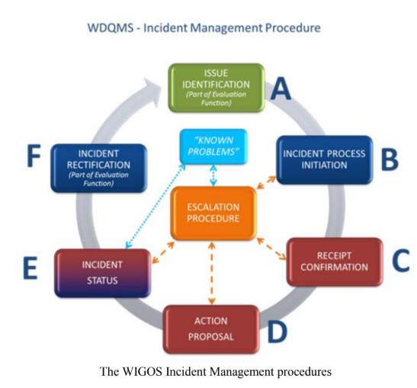
Data Sharing( Classical Vs WIGOS –DQMS)
The purpose of the WDQMS is to monitor, evaluate and trigger corrective actions relating to departures of actual WIGOS data quality from expected WIGOS data quality
Classical CGMS Data Sharing paradigm
The White paper suggests that CGMS members will establish and operate terrestrial and space-based dissemination services in order to exchange observations and measurement directly among members, and to make them available to National Hydrological and Meteorological Services and to the broader international user community in a timely and cost-effective manner. This data exchange should follow CGMS best practices.
New WIGOS-DQM data Sharing paradigm
However with the establishment of the WIGOS-DQMS agencies can use state of the art data networks to compliment the existing data sharing infrastructure and achieve a high level of data interoperability. This would reduce data latency and further aid in implementing checks and balances to ensure data quality. (GSICS 2020 Document: https://gsics.wmo.int/documents/GSICS_Vision-for-GSICS-in-2020s.pdf)
GSICS and PMW Specific
GSICS MW Deliverables and workspace provided to community.
Suggested in-orbit reference records
GRUAN-GSICS-GPSRO collaboration provides new opportunities to monitor MW instruments

Slide 14
Summa
Summary and Way forward
Initiated a review of the white paper on WIGOS CGMS Baseline
Sustained contributions to the Global Observing System
Over 118 PMW missions launched since early 70’s with the goal of observing the earth in 1-200 GHz wavelength.
Majority of the Microwave instruments observe in the 53-183 GHz range.
Within the WIGOS framework effort has been made to achieve integration of observing sources and data inter-operability.
WIGOS-DQM aims to facilitate GSICS style monitoring of Microwave instruments as well.
GSICS MW as a component of WIGOS system aims to monitor PMW sensors by comparing them with stable FCDR records, GRUAN sounds and GPSRO ( with RTMs).
It is envisaged that WIGOS/CGMS would provide coordination support to the member agencies to help them bring in newer, higher spatial/spectral resolution, higher repeat cycle PMW sensors to achieve global observations.

Slide 15
Summary and Way forward
Way Forward
From a GSICS Standpoint way forward can be to ensure sustained monitoring of PMW sensors. Our contribution this document can center around Monitoring
WIGOS2040 Dedicated calibration reference missions will provide intercalibration standards with good spatial and temporal coverage.
Inter-calibration sensors, records, data sets and Algorithms that GSICS can propose to monitor PMW sensors.
To achieve this we would create a subsection on inter-calibration in the document
Proposed Action:
Each GSICS member agency to create table of PMW sensor and reference used to monitor it to support white paper
PMW Sensor | Agency | Inter-Cal Method | Reference record/data

Slide 16


Slide 17
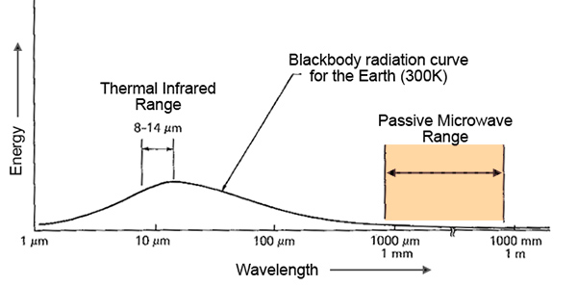
Introduction- Remote Sensing
Passive Microwave Sensors (PMW)
Passive microwave sensors (PMW) are also referred to as microwave radiometers. Typically operate in 1-200 GHz range
Advantages
A major advantages of passive microwave remote sensing is that microwave radiation can penetrate through cloud cover, rain and dust. It can also acquired during the day or the night.
Applications
Microwave radiometers can be used for many climate application
Water Vapor
Salinity water vapor
Sea Ice Monitoring
Soil Moisture
Rainfall Estimation
Sea Surface Temperature and many more

