Slide 1
ESA Collaborative Environment for Cal/Val
Andrea Della Vecchia, Damiano Guerrucci (ESA)
Simone Mantovani (MEEO)
GSICS Annual Meeting 2019, 6 March 2019, ESRIN-ESA

Slide 2
Introduction
EO Collaborative Environment
Example of current Collaborative Environments
Thematic Exploitation Platform
Mission Exploitation Platform
Joint ESA-NASA Multi-Mission Analysis Platform
ESA Collaborative Environment

Slide 3
Introduction
Collaborative Environment
Example of current Collaborative Environments
Thematic Exploitation Platform
Mission Exploitation Platform
Joint ESA-NASA Multi-Mission Analysis Platform
ESA Collaborative Environment

Slide 4
Collaborative Environment
EO collaborative environment is a virtual working environment providing access to EO data and analysis tools, processors, information and Communication Technology resources required to work with them, through one coherent interface.
A collaborative environment aims to change the paradigm from
“data to user“ to “user to data”

Slide 5
Introduction
Collaborative Environment
Example of current Collaborative Environments
Thematic Exploitation Platform
Mission Exploitation Platform
Joint ESA-NASA Multi-Mission Analysis Platform
ESA Collaborative Environment

Slide 6
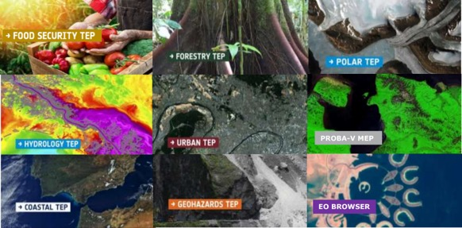
Thematic Exploitation Platform - TEP
https://tep.eo.esa.int/
In this context ESA has started in 2014 the EO Exploitation Platforms (EPs) initiative, a set of R&D activities that in the first phase (up to 2017) aims to create an ecosystem of interconnected Thematic Exploitation Platforms (TEPs) on European footing, addressing:
Coastal
Forestry
Hydrology
Geohazards
Polar
Urban themes
Food Security (under definition)
TEP presentation at CEOS WGISS#44

Slide 7
Mission Exploitation Platform (Proba-V)
The PROBA-V Mission Exploitation Platform (PV-MEP) is an ESA pathfinder project aiming to:
Build and operational Exploitation Platform
Give full access to PROBA-V data repository (@VITO PDF)
Integrate, correlative data and derived products addressing the wider vegetation user community with the final aim to ease and foster the use of PROBA-V data.

Slide 8

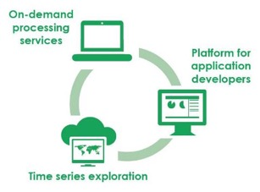
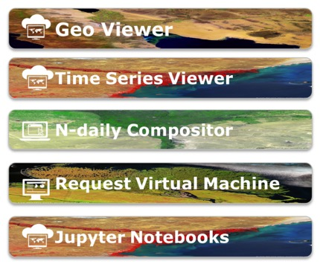
Proba-V MEP – Tools
https://proba-v-mep.esa.int/
(*) only operations & EC funded – limited to viewers
(**) http://viewer.globalland.vgt.vito.be/viewer/
http://viewer.globalland.vgt.vito.be/tsviewer/
Copernicus Global Land (*) (**)
SPOT-VEGETATION
Proba-V

Slide 9






Joint ESA-NASA
Multi-Mission Analysis Platform (MAP)

Slide 10



Joint Biomass-NISAR-GEDI MAP
Transparent access to the content of both platforms
ESA NASA MEP
NASA Mission
Data
NASA Mission
Tools&Visu
ESA-NASA
Missions
Community
ESA Mission
Data
ESA Mission
Tools&Visu
NASA Mission
Processing
resources
ESA Mission
Processing
resources
Up to date data and algorithms
Cohesive community

Slide 11
Joint ESA-NASA MAP Objectives
To provide to the users a common virtual working environment
Federation of two (or more) platforms to allow to both US and European users a transparent access to the content of both platforms, CEOS WGISS guidelines shall be considered
To allow end-users to access up-to-date data and algorithms for biomass estimation and to increase the cohesion of the P/L-band SAR and biosphere communities
The capabilities envisioned for the MAP will enable for the first time efficient and tailorable intercomparison, cross-calibration, and fusion of data from these missions for a broad class of scientists and other users (notably with respective ground segments and cal/val activities)

Slide 12
Introduction
Collaborative Environment
Example of current Collaborative Environments
Thematic Exploitation Platform
Mission Exploitation Platform
Joint ESA-NASA Multi-Mission Analysis Platform
ESA PDGS Collaborative Environment

Slide 13
ESA PDGS Collaborative Environment
To provide the ESA PDGS with a set of interoperable and federated services permitting the users to:
Access to missions/platforms information supported by a common ontology
Discovery and, if possible, direct download of EO and in-situ data:
  Copernicus Missions (e.g., Sentinels)
  Third Party Missions - TPMs (e.g. SPOT, Landsat …)
  Heritage Missions - HMs (e.g., ERS-1/2, ENVISAT instruments …)
  Earth Explorer – EEs (e.g., SMOS, Cryosat, SWARM, …)
  International repositories (e.g., NASA CMR, CEOS IDN)
Discovery and access to basic services (e.g., datacube):
  Browse/visualization tools and time series extraction
  EO data extraction, resampling and reprojection
Hosted Processing for authorised users/communities (e.g., CAL/VAL)

Slide 14


Operational interface
ESA
User Community
Query and service requests
External
Conceptual Model
Data access interface
Operational Data Access
Web User Interface for pixel-based access, analysis and processing
Web User Interface for granule-based discovery and/or retrieval
……….
International EO Information Page:
- CEOS IDN
Mission oriented GUI
  - SWARM
  - SMOS
  - Cryosat
  - External
External catalogue application
……….
ESA PDGS Data Cube GUI, VIRES GUI, etc…
ESA EO Information Page:
- ESA EO Gateway
Multi Mission GUI:
– ESA EOCAT
OpenSearch
(collections and granules)
Knowledge-Base Facility
Standard services request Interfaces (e.g., restful API)
OpenSearch
(collections
and granules)
Standardised Interoperable Interfaces
Thesauri Repository
Metadata management
ESA Operational Service
Protocol for data access
(e.g., OGC, Open Datacube)
EO Data & Service Metadata Repository
Products Access Interface
Data Repositories
Copernicus Data Repositories
ESA Missions Data Repositories
External Web Interface
Standardised Interoperable Services Interfaces
External Web Interfaces
Data management
IT Resources provided as services (IaaS, PaaS, SaaS)
TPMs
HMs
EEs
S-1
S-2
S-3
S-5
User Applications
ESA User Applications
Temporary
VM – Processors
Storage
VM – Browse Images Generation
VM – DataCube Engine/API

Slide 15





Operational interface
ESA
User Community
Query and service requests
External
Data access interface
UC1: EO Data Discovery and Access
Operational Data Access
Web User Interface for pixel-based access, analysis and processing
Web User Interface for granule-based discovery and/or retrieval
……….
International EO Information Page:
- CEOS IDN
Mission oriented GUI
  - SWARM
  - SMOS
  - Cryosat
  - External
External catalogue application
……….
ESA PDGS Data Cube GUI, VIRES GUI, etc…
ESA EO Information Page:
- ESA EO Gateway
Multi Mission GUI:
– ESA EOCAT
OpenSearch
(collections and granules)
Knowledge-Base Facility
Standard services request Interfaces (e.g., restful API)
OpenSearch
(collections
and granules)
Standardised Interoperable Interfaces
Thesauri Repository
Metadata management
ESA Operational Service
Protocol for data access
(e.g., OGC, Open Datacube)
EO Data & Service Metadata Repository
Products Access Interface
Data Repositories
Copernicus Data Repositories
ESA Missions Data Repositories
External Web Interface
Standardised Interoperable Services Interfaces
External Web Interfaces
Data management
IT Resources provided as services (IaaS, PaaS, SaaS)
TPMs
HMs
EEs
S-1
S-2
S-3
S-5
User Applications
ESA User Applications
Temporary
VM – Processors
Storage
VM – Browse Images Generation
VM – DataCube Engine/API

Slide 16
Operational interface
ESA
User Community
Query and service requests
External
Data access interface
UC2: EO Data Discovery, Visualization and Pixel Access
Operational Data Access
Web User Interface for pixel-based access, analysis and processing
Web User Interface for granule-based discovery and/or retrieval
……….
International EO Information Page:
- CEOS IDN
Mission oriented GUI
  - SWARM
  - SMOS
  - Cryosat
  - External
External catalogue application
……….
ESA PDGS Data Cube GUI, VIRES GUI, etc…
ESA EO Information Page:
- ESA EO Gateway
Multi Mission GUI:
– ESA EOCAT
OpenSearch
(collections and granules)
Knowledge-Base Facility
Standard services request Interfaces (e.g., restful API)
OpenSearch
(collections
and granules)
Standardised Interoperable Interfaces
Thesauri Repository
Metadata management
ESA Operational Service
Protocol for data access
(e.g., OGC, Open Datacube)
EO Data & Service Metadata Repository
Products Access Interface
Data Repositories
Copernicus Data Repositories
ESA Missions Data Repositories
External Web Interface
Standardised Interoperable Services Interfaces
External Web Interfaces
Data management
IT Resources provided as services (IaaS, PaaS, SaaS)
TPMs
HMs
EEs
S-1
S-2
S-3
S-5
User Applications
ESA User Applications
Temporary
VM – Processors
Storage
VM – Browse Images Generation
VM – DataCube Engine/API

Slide 17
Operational interface
ESA
User Community
Query and service requests
External
Data access interface
UC3: EO Service Discovery
and Processing
Operational Data Access
Web User Interface for pixel-based access, analysis and processing
Web User Interface for granule-based discovery and/or retrieval
……….
International EO Information Page:
- CEOS IDN
Mission oriented GUI
  - SWARM
  - SMOS
  - Cryosat
  - External
External catalogue application
……….
ESA PDGS Data Cube GUI, VIRES GUI, etc…
ESA EO Information Page:
- ESA EO Gateway
Multi Mission GUI:
– ESA EOCAT
OpenSearch
(collections and granules)
Knowledge-Base Facility
Standard services request Interfaces (e.g., restful API)
OpenSearch
(collections
and granules)
Standardised Interoperable Interfaces
Thesauri Repository
Metadata management
ESA Operational Service
Protocol for data access
(e.g., OGC, Open Datacube)
EO Data & Service Metadata Repository
Products Access Interface
Data Repositories
Copernicus Data Repositories
ESA Missions Data Repositories
External Web Interface
Standardised Interoperable Services Interfaces
External Web Interfaces
Data management
IT Resources provided as services (IaaS, PaaS, SaaS)
TPMs
HMs
EEs
S-1
S-2
S-3
S-5
User Applications
ESA User Applications
Temporary
VM – Processors
Storage
VM – Browse Images Generation
VM – DataCube Engine/API

Slide 18
UC2: EO Data Discovery, Visualization and Pixel Access
UC3: EO Service Discovery and Processing

Slide 19




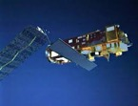
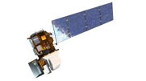
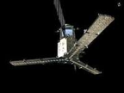
Web based GUI
Jupyter Notebook
CLI / REST API
Visualization layer
Standardised data access interfaces allow connecting a wide range of user interfaces
Datacube Engine/API VMs
The deployment of DAS in front of each data source enables effective access services
DAS
ESA
Third Party Missions
ESA
Heritage Missions
ESA
Earth Explorer
Data layer
Data remain at their own location (multiple data centers) with the original data format

Slide 20
TPMs online data storage @ESA
Mission | Product (~ 0.6 PB) | Collection Description | Data format | Online data storage https://tpm-ds.eo.esa.int/collections/ | Hosted processing
Landsat-5 | Level 1 (L1G, L1Gt, GEO_1P, GTC_1P) (Storage: 355 TB) | TOI: 04/1984 – 11/2011 (link) | EO-SIP (ZIP): - single band TIF | @ESA | @ESA (WCS link; GUI link)
Landsat- 7 | Level 1 (TC_1P) (Storage: 64 TB) | TOI:07/1999 – 12/2003 (link) | EO-SIP (ZIP): - single band TIF | @ESA | @ESA (WCS link; GUI link)
Tropforest | Multiple (Storage: 8TB) | TOI: 07/2006 – 04/2011 (link) | EO-SIP (ZIP): - ZIP - CEOS format | @ESA | @ESA (under registration)
SPOT-1-5_ESA | Level 1 Level 2 (Storage: 6TB) | TOI: 04/1986 – 11/2015 (link) | EO-SIP (ZIP): - ZIP - CEOS format | @ESA | @ESA (to be registered)
IKONOS-2 | Level 1 (Storage: 1TB) | TOI: 12/2000 – 12/2008 (link) | EO-SIP (ZIP): - ZIP - TIFF | @ESA | @ESA (to be registered)
OceanSat2 | Level 0 Level 1 Level 2 (Storage: 126TB) | TOI: 10/2015 – 07/2018 (link) | EO-SIP (ZIP): - ZIP - HDF | @ESA | HDF inside a ZIP currently not supported
Seasat | Level 1 (Storage: 1TB) | TOI: 07/1978 – 10/1978 (link) | EO-SIP (ZIP): - TAR - CEOS format | @ESA | @ESA (to be registered)

Slide 21
HMs online data storage (L0 @ESA → L1+ @LocalInventory)
Mission | Product (~ 1.6 PB) | Collection Description | Data format | Online data storage https://esar-ds.eo.esa.int/oads/access/collection | Hosted processing
ENVISAT | ASAR collectiona (Storage L1 ~600TB) ASA_GM1_1P, ASA_IMM_1P, ASA_WSM_1P, ASA_IMS_1P, ASA_IMP_1P, ASA_APS_1P, ASA_APP_1P, ASA_WSS_1P | TOI:2002 – 2012 (link) (link) (link) (link) (link) (link) (link) (link) | Level 1: ENVISAT (N1) | Level 0 @ ESA Level 1 @MEEO | @MEEO (to be registered) (under registration) (to be registered) (to be registered) (to be registered) (to be registered) (to be registered) (to be registered) (to be registered)
ERS | SAR collectiona (Storage L1 ~1PB) SAR_IMS_1P, SAR_IMP_1P | TOI: 07/1991 – 07/2011 (link) (link) | Level 1: ERS (E1) | Level 0 @ ESA Level 1 @MEEO | @MEEO (to be registered)

Slide 22
EEs online data storage
Mission | Product (~ 1.5 TB) | Collection Description | Data format | Online data storage https://smos-diss.eo.esa.int/oads/access | Hosted processing
SMOS | Collection (Storage L2 ~1.5TB) MIR_SMUDP2 MIR_OSUDP2 | TOI:2010 – (link) | DBL / GeoTIFF | Level 2 @ ESA Level 2 @MEEO | @MEEO (GUI link) (GUI link)
SMOS | MIR_BWSF1C MIR_BWSD1C MIR_BWLF1C MIR_BWLD1C | (link) | DBL / GeoTIFF | Level 1 @ ESA | @MEEO (to be registered)
SMOS | MIR_SCSF1C MIR_SCSD1C MIR_SCLF1C MIR_SCLD1C | (link) | DBL / GeoTIFF | Level 1 @ ESA | @MEEO (to be registered)
SMOS | MIR_SC_F1B MIR_SC_D1B | (link) | DBL / GeoTIFF | Level 1 @ ESA | @MEEO (to be registered)

Slide 23
UC2: EO Data Discovery, Visualization and Pixel Access
The users:
connect to the GUI (https://adam.eodataservice.org/)
  select the collection(s)
  define AOI/TOI
connect to the central jupyter hub
  use/edit/create notebooks to manage the full data cycle (discover, access, process, visualize)
Open his/her own terminal
  use API / CLI to code and send the access / processing query
The GUI:
connects to datacube @ESA
sends the access / processing query to the DAS component
The DAS:
retrieves the data from the online storage
sends back the GUI
Notes:
To update the screenshot with ESA correct one. Keeping the current animation

Slide 24
UC3: EO Service Discovery and Processing
The users:
connect to the GUI (https://adam.eodataservice.org/)
  select the collection(s)
  define AOI/TOI
connect to the central jupyter hub
  use/edit/create notebooks to manage the full data cycle (discover, access, process, visualize)
Open his/her own terminal
  use API / CLI to code and send the access / processing query
The jupyter hub provides (https://jupyter.eodataservice.org/user/demo/tree) :
notebooks with examples of access / processing query to the DAS component @ESA
interactive interface for live coding to discover, access, process, visualize the datacube(s)

Slide 25
F E D E R A T I O N

Slide 26




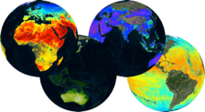
Web based GUI
Jupyter Notebook
CLI / REST API
Visualization layer
Standardised data access interfaces allow connecting a wide range of user interfaces
Datacube Engine/API VMs
The deployment of DAS in front of each data source enables effective access services
DAS
DAS
DAS
DAS
DAS
DAS
DAS
Data layer
Data remain at their own location (multiple data centers) with the original data format
Mission-specific data
Thematic data
Other geospatial data

Slide 27
Federated Infrastructure
Available Collections (~ overall storage +5PB)
High Resolution optical satellite data (Level 1)
Sentinel 2 (10m, global, since 2015)
Landsat 8 (30m, Europe, since 2013)
Land Products (Level 2+)
Vegetation Indexes (250m - 10m, 2000)
Land Surface Temperature (1Km, 2000)
Soil Moisture (100Km - 10km, 1978)
Land Cover type (1km, 2000)
Atmospheric Products (Level 2+ Numerical Model)
Air Temperature (12.5 - 1km, 1979)
Precipitation (100km - 4.5km, 1979)
Aerosol Optical Thickness (1km, 2000)
Ocean products (Level 2+ Numerical Model)
Sea Surface TEMPERATURE (5km, Global, 2017)
OCEAN Salinity (10Km, Global, 2010)
Chlorophyll data (5km, Europe, 2010 – 2013)
Sea Surface Height (12km, Europe, 1993 – 2017)
Sea Surface Velocity (12km, Europe, 1993 – 2017)
ESA TPMs/ HMs/ EEs
Landsat 4/7 (30m, Europe, since 1984)
SPOT (1986 – 2015)
ERS-1/-2 (1991 – 2011, on demand)
ENVISAT (2002 – 2012, on demand)
SMOS (10km, since 2010)
In BLUE external repositories

Slide 28
UC2: EO Data Discovery, Visualization and Pixel Access
The users:
connect to the GUI (https://eodataservice.org/)
  select the collection(s)
  define AOI/TOI
connect to the central jupyter hub
  use/edit/create notebooks to manage the full data cycle (discover, access, process, visualize)
Open his/her own terminal
  use API / CLI to code and send the access / processing query
The GUI:
connects to the selected datacube(s)
sends the access / processing query to the DAS component
The DAS:
retrieves the data from the online storage
sends back the GUI

Slide 29
UC3: EO Service Discovery and Processing
The users:
connect to the GUI (https://adam.eodataservice.org/)
  select the collection(s)
  define AOI/TOI
connect to the central jupyter hub
  use/edit/create notebooks to manage the full data cycle (discover, access, process, visualize)
Open his/her own terminal
  use API / CLI to code and send the access / processing query
The jupyter hub provides (https://jupyter.eodataservice.org/user/demo/tree):
notebooks with examples of access / processing query to the DAS component
interactive interface for live coding to discover, access, process, visualize the datacube(s)

Slide 30
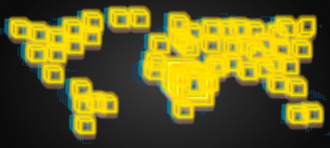
Effective Data Access
Let’s assume we want to correlate pollution and temperature over Ferrara (Italy).
We want to use time series of Land Surface Temperature (LST) and Aerosol Optical Thickness (AOT) from MODIS.
LST timeseries 3 years
Global: ~120GB
Italy: ~245MB
Ferrara: ~17KB
Data transfer rate
500x
10⁶x
AOT timeseries 3 years
Global: ~300MB
Italy: ~1MB
Ferrara: ~17KB
Data transfer rate
300x
10⁴x
Notes:
To be replaced with time series

Slide 31
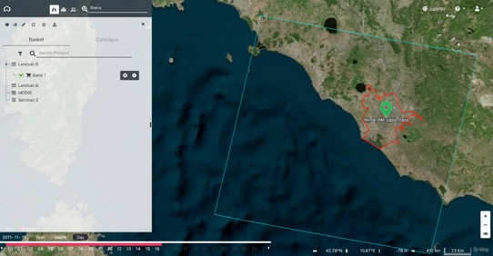
Effective Data Access
Let’s assume we want to monitor the urban area of Rome in Italy.
We want to use time series of Landsat True Color (RGB) and Vegetation Index (NDVI).
Landsat-5 (path/row = 191/31)
26 years (1985 - 2011)
~160GB (~400MB/product)
RGB timeseries 26 years
RGB full tile (blue line): ~22GB
RGB over Rome (red line): ~4GB
RGB over Rome (green marker): ~1KB
Data transfer optimization 7x - 40x - 10⁸x
NDVI timeseries 26 years
NDVI full tile (blue line): ~25GB
NDVI over Rome (red line): ~5GB
NDVI over Rome (green marker): ~2KB
Notes:
To be replaced with time series

Slide 32
UC2.1: In-situ / EO Data Discovery, Visualization and Pixel Access
  - Atmospheric Correction Inter-Comparison Exercise (ACIX)
  - Radiometric Calibration Network (RadCalNet)
UC3.1: In-situ / EO Service Discovery and Processing (next step)

Slide 33
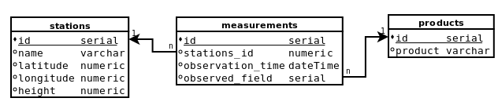
EO and In-situ Data Management
EO and In-situ data management
SQL
In-situ
ingestion
rasterization
EO
Pre-processing:
Re-projection
Re-sampling
Format conversion
WCS
OpenSearch

Slide 34
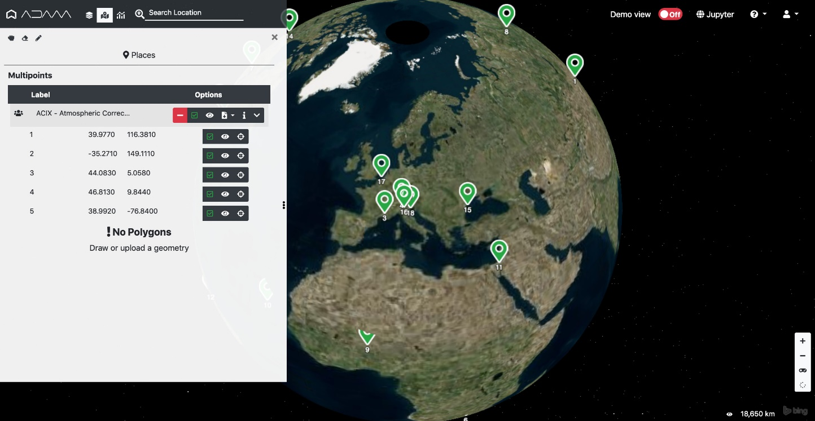
UC2.1: In-situ / EO Data Discovery, Visualization and Pixel Access
  - Atmospheric Correction Inter-Comparison Exercise (ACIX)
Pre-configured list of 19 sites

Slide 35
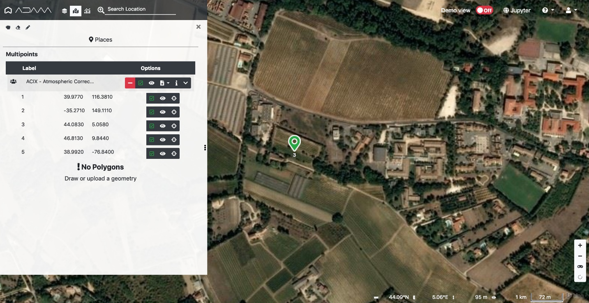
UC2.1: In-situ / EO Data Discovery, Visualization and Pixel Access
  - Atmospheric Correction Inter-Comparison Exercise (ACIX)
Direct access to the selected site

Slide 36
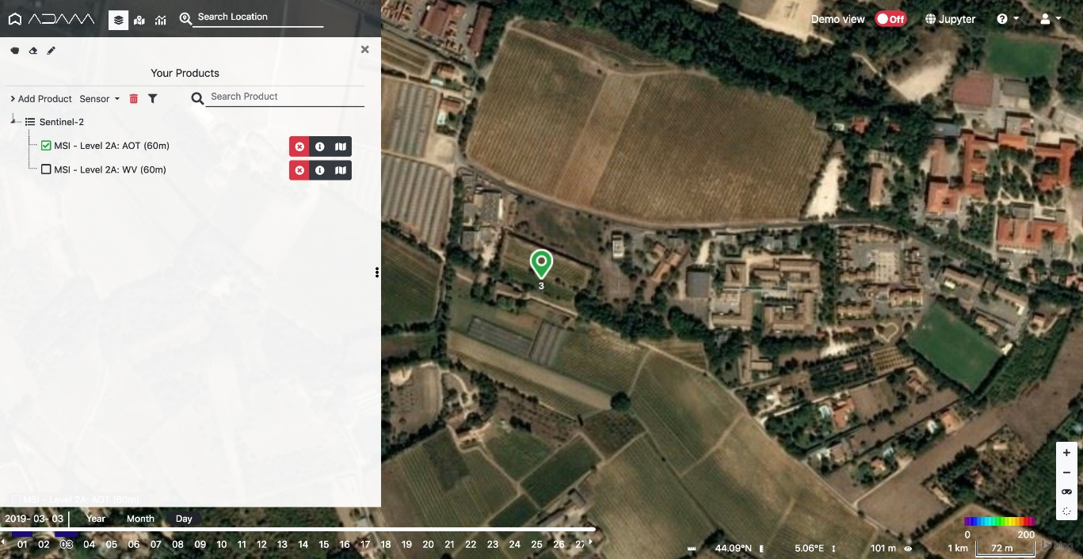
UC2.1: In-situ / EO Data Discovery, Visualization and Pixel Access
  - Atmospheric Correction Inter-Comparison Exercise (ACIX)
Data discovery
Data | Status
In-situ AERONET (AOT, WV, SR) | Data collection: completed Data ingestion: in progress
EO Data Landsat-8 (AOT, SR) | Data collection: in progress
EO Data Sentinel-2 (AOT, WV, SR) | On-line

Slide 37
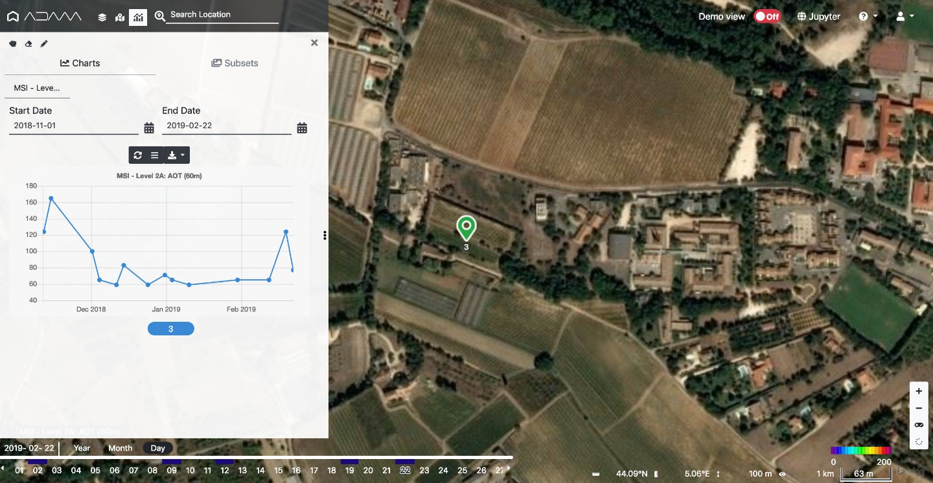
UC2.1: In-situ / EO Data Discovery, Visualization and Pixel Access
  - Atmospheric Correction Inter-Comparison Exercise (ACIX)
In-situ/EO Data Visualization
and pixel access

Slide 38
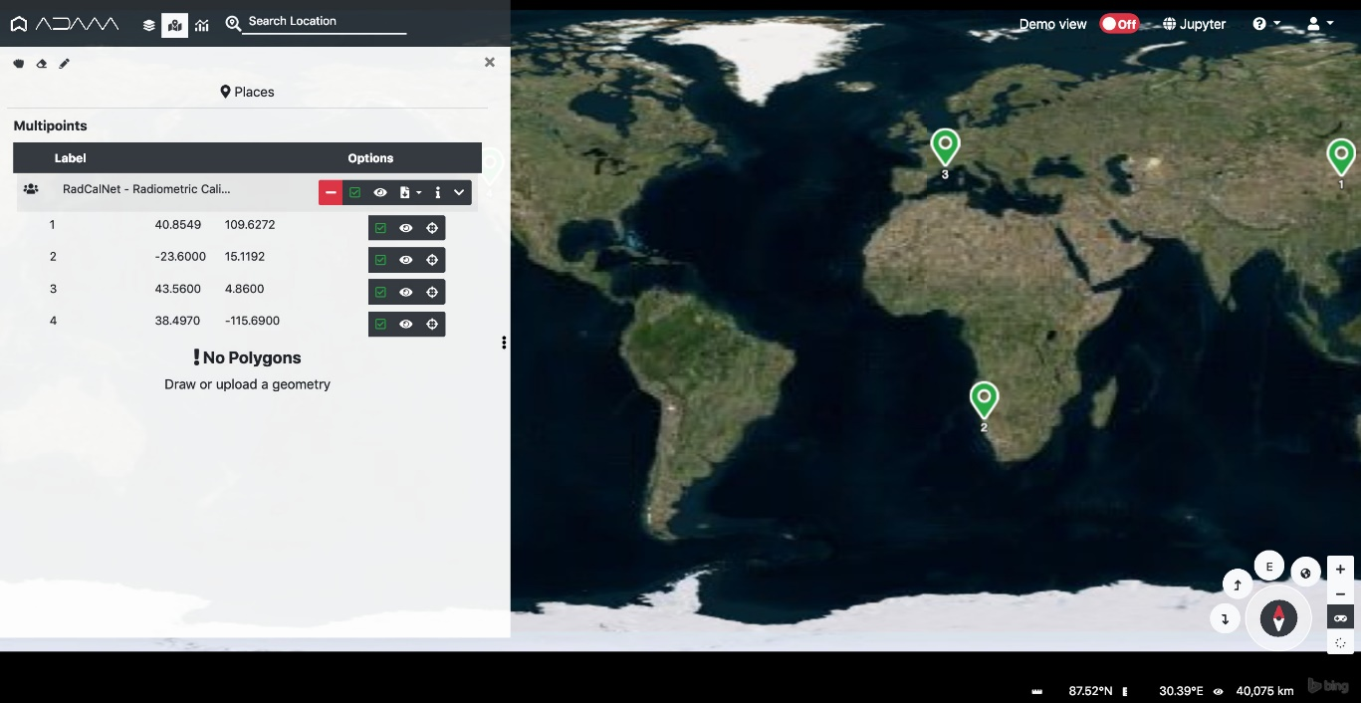
UC2.1: In-situ Data Discovery, Visualization and Pixel Access
  - Radiometric Calibration Network (RadCalNet)
Pre-configured list of 4 sites

Slide 39
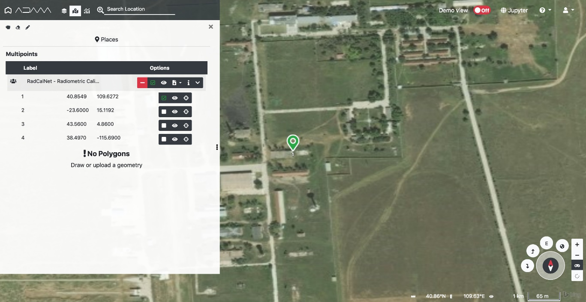
UC2.1: In-situ Data Discovery, Visualization and Pixel Access
  - Radiometric Calibration Network (RadCalNet)
Direct access to the selected site

Slide 40
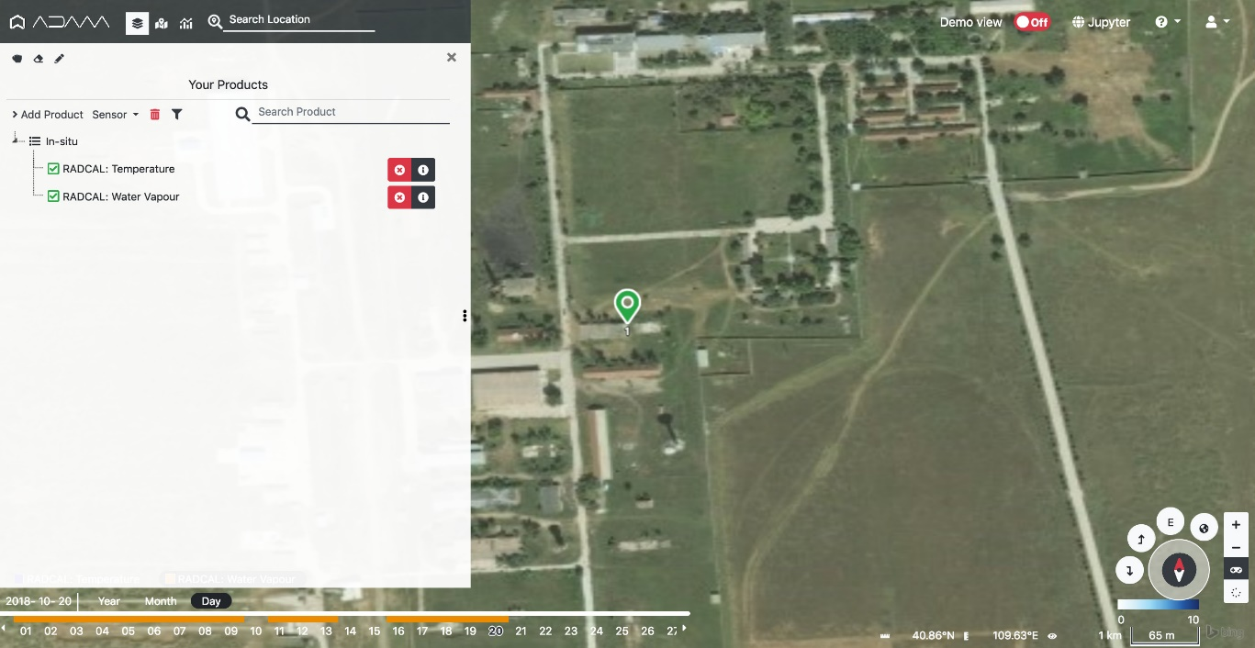
UC2.1: In-situ Data Discovery, Visualization and Pixel Access
  - Radiometric Calibration Network (RadCalNet)
Data discovery (only in-situ)
Data | Status
Temperature | On-line
Water Vapour | On-line
Pressure | Data registration: in progess
Ozone | Data registration: in progess
Aerosol optical properties | Data registration: in progess
Surface reflectance | Data registration: in progess

Slide 41
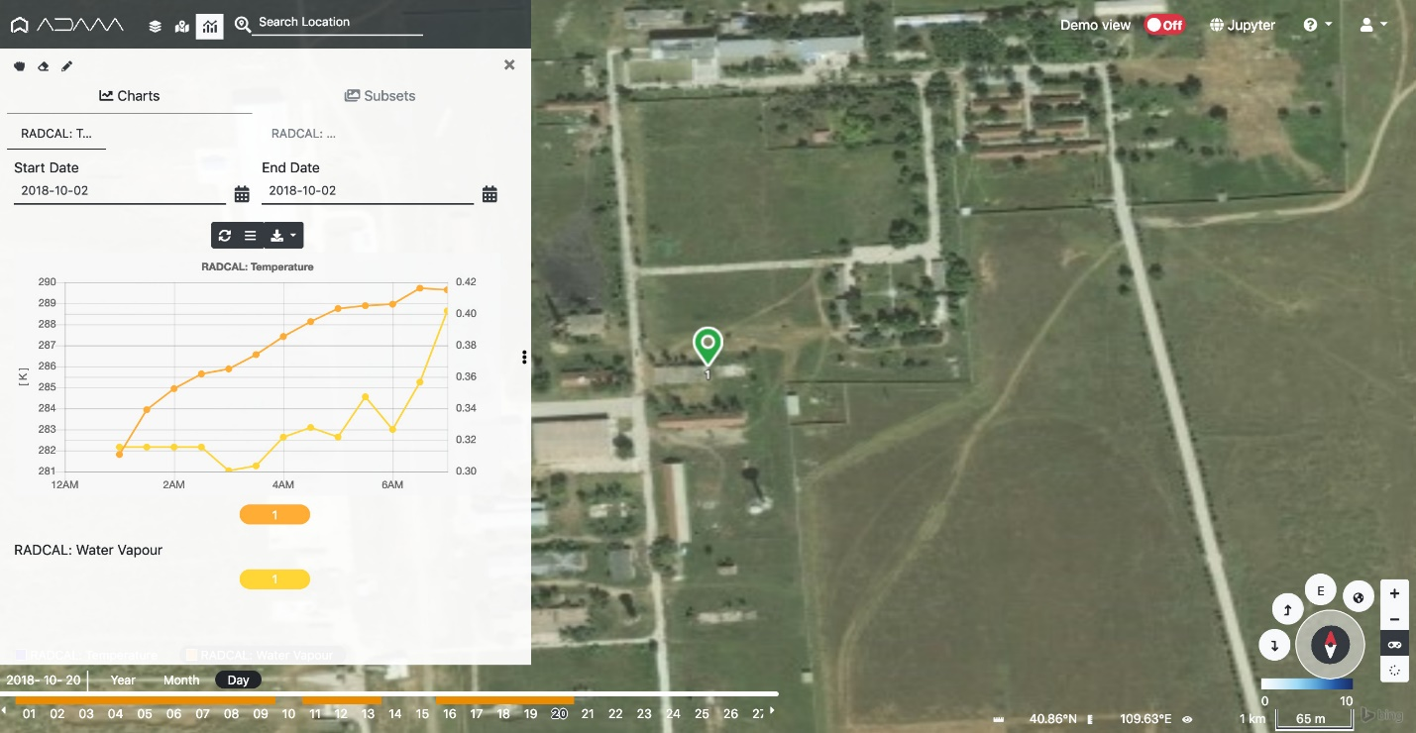
UC2.1: In-situ Data Discovery, Visualization and Pixel Access
  - Radiometric Calibration Network (RadCalNet)
In-situ Data Visualization
and pixel access

Slide 42
UC2.1: In-situ / EO Data Discovery, Visualization and Pixel Access
  - Atmospheric Correction Inter-Comparison Exercise (ACIX)
  - Radiometric Calibration Network (RadCalNet)
UC3.1: In-situ / EO Service Discovery and Processing (next step)
  - Atmospheric Correction Inter-Comparison Exercise (ACIX)
  - Customized UI to support AOT/WV/SR inter-comparison
  - Jupyter notebook to support live coding / sharing

Slide 43
Next Step – 2019
TTO ESA Catalogue Q2 2019
Q1 ’19
Most of ESA TPM/HM/EE collections available (pre-operational phase)
Preliminary support of CEOS WGCV and ESA Cal/Val use cases:
  ACIX http://calvalportal.ceos.org/projects/acix
  RadcalNet https://www.radcalnet.org/#!/
Q2 ’19
Software refactoring to boost performance and manage concurrent users
Internal OpenSearch interface aligned with CEOS OS BP 1.2
All ESA TPM/HM/EE collections available
Full support to ESA Cal/Val initiatives
Q4 ‘19
CEOS WGISS(/WGCV) international cooperation
Evolution about interoperability (e.g., connection with several Open Data Cube instances)

