Slide 1
GOES Calibration Event Log
X. Wu
NOAA/NESDIS/STAR and GOES-R CWG
2019-03-06

Slide 2
Scope of the Calibration Event Log
Calibration:
Actual impact on calibration, e.g., “incorrect gain for G16 VNIR bands from when to when”.
Potential impact on calibration, e.g., “Scan mode changed from which to which”. Frequency of star looks may change, which may impact on geometric calibration.
Only calibration, e.g., data gap will not be logged.
In a sense, concerned with data quality but not quantity.
Event:
Include anomalies, which often have no ending date and sometimes no clear onsite date.
More than anomaly, i.e., those that may not have known impact on calibration.
Log:
Online for easy access, throughout the mission life.
Intended for ABI L1b users, calibration specialists, operators, managers, vendors, international partners, and other members of the public interested in ABI calibration.
Maintained by the GOES-R Calibration Working Group (CWG) who has the discretion of what to log. Can be amended long after the fact.

Slide 3
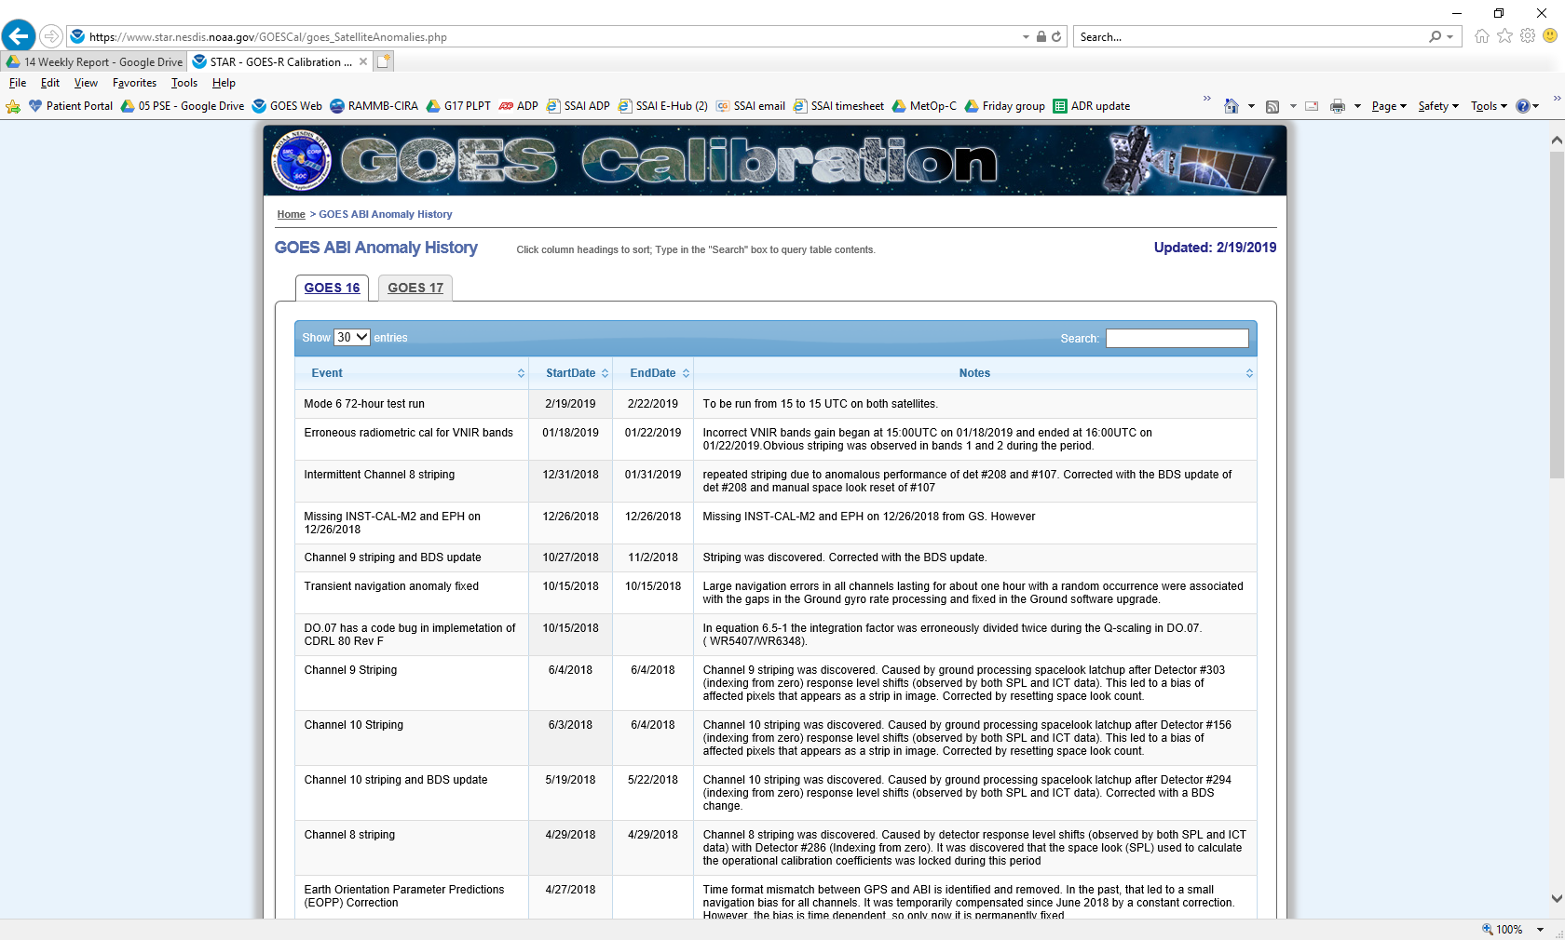
G16/17 Calibration Event Log (CEL)
https://www.star.nesdis.noaa.gov/GOESCal/goes_SatelliteAnomalies.php

Slide 4
Updates of G16/G17 CEL
 | Event | Start date | End date | Notes
GOES-17 | Mode 6M 72-hour test run | 2/19/2019 | 2/22/2019 | To be run from 15 to 15 UTC on both satellites.
 | Mode 6M 72-hour test run | 2/25/2019 | 2/28/2019 | To be run in the period of the highest thermal stress.
 | Event | Start date | End date | Notes
GOES-16 | Mode 6 72-hour test run | 2/19/2019 | 2/22/2019 | To be run from 15 to 15 UTC on both satellites.

Slide 5
Highlights of G16/G17 CEL Examples
 | Event | Start date | End date | Notes
GOES-17 | GOES-17 operational declaration as GOES-West | 02/12/2019 |  | GOES-17 is officially declared as the GOES-West satellite at 137.2 degrees west.
 | VNIR bands incorrect gain | 01/18/2019 | 01/19/2019 | Incorrect VNIR bands gain began at 15:00UTC on 01/18/2019 and ended at 3:00UTC on 01/19/2019 after the solar calibration on 01/19/2019.
 | Gainset 3 turned on | 1/18/2019 |  | Gainset 1->3: 0830UTC and gainset 3->1: 1930UTC.
 | Mode 6M 48-hour test run | 1/28/2019 | 1/30/2019 | Run from 13 to 13 UTC; CWG evaluation of radiometric and geometric calibration is positive.
 | Event | Start date | End date | Notes
GOES-16 | DO.07 has a code bug in implemetation of CDRL 80 Rev F | 10/15/2018 |  | In equation 6.5-1 the integration factor was erroneously divided twice during the Q-scaling in DO.07.( WR5407/WR6348).
 | Channel 9 striping and BDS update | 10/27/2018 | 11/2/2018 | Striping was discovered. Corrected with the BDS update.
 | Erroneous radiometric cal for VNIR bands | 01/18/2019 | 01/22/2019 | Incorrect VNIR bands gain began at 15:00UTC on 01/18/2019 and ended at 16:00UTC on 01/22/2019.Obvious striping was observed in bands 1 and 2 during the period.
 | ABI Band02 is ~7% brighter than VIIRS | 6/1/2017 |  | G16 ABI Band2 (0.64um) is brighter than VIIR I1band by ~6-8%, depending on time.
https://www.star.nesdis.noaa.gov/GOESCal/goes_SatelliteAnomalies.php

Slide 6
Summary
Relatively new. Work in progress.
Positive feedback from users.
Comments on any aspect, especially those from GSICS, would be most valuable.

