Slide 1
Near Space Platform for
Satellite Sensor Validation
Likun Wang¹, Ling Liu², Kevin Garrett³, Kayo Ide⁴, Sid Boukabara³
Riverside @ NOAA/NESDIS.STAR; Likun.Wang@noaa.gov
ARE@ NOAA/MESDIS/STAR
NOAA/NESDIS/STAR
Univ. of Maryland
Acknowledgements to Max Kamenetsky (Google Loon), Lawrence Coy (SSAI), Mark R Schoeberl (STC), Katherine Lukens (UMD)
2019 GSICS Annual meeting, Frascati, Italy; March 7 2019

Slide 2
Background
One of NOAA Technology Maturity Evaluation (TME) project
Explore possibility of near-space measurements for NOAA observation system
  Can these measurements potentially improve the NOAA NWP?
  Can these serve as a high-altitude "pesudo-satellite" platform to host instruments and sensors?
Google Loon platform: Example
  Characteristics
  Inter-comparison between GOES16 ABI and IR thermometer
  Potentials as sensor validation platforms

Slide 3
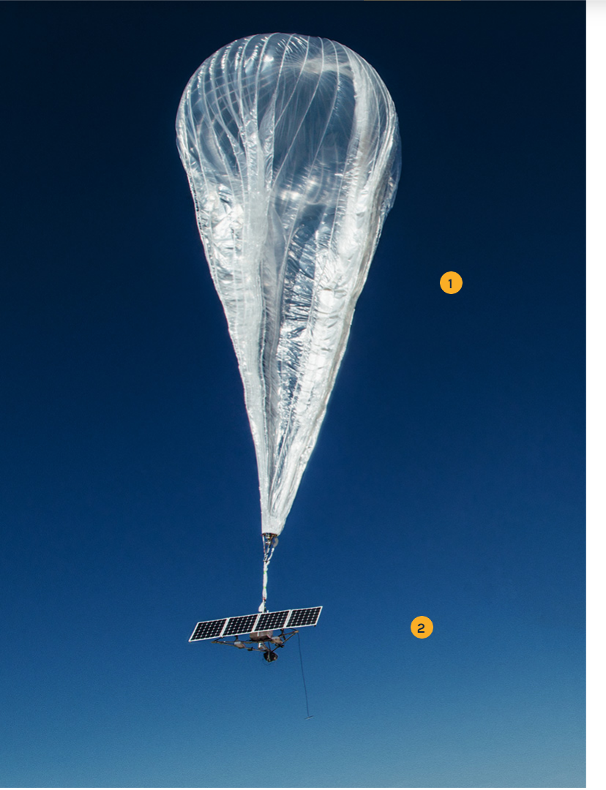
Google Loon Review
Project Loon is a network of stratospheric balloons, designed to extend Internet connectivity to people in rural and remote areas worldwide
Auto launchers: capable of safely and consistently launching a new balloon every 30 minutes.
Status: over 25 million km of test flights since the project began. Duration: up to 190 days in the stratosphere.
Made from sheets of polyethylene, each tennis court-sized balloon is built to last for well over 100 days before landing back on Earth in a controlled descent. Standing 15 m (49 ft) across and 12 m (39 ft)
Flight equipment's: Solar panel system, antenna, flight
capsule, parachute
from https://loon.co/

Slide 4
Loon Design – Detailed View
https://www.icao.int/SAM/Documents/2016-CRPP4/Peru%20GREPECAS%20PPRC-4%20brief%20Jul%2016.pdf

Slide 5
Potential Payload
Payload for In-situ measurements
  Stratosphere winds from Loon position
  Stratosphere temperature
  Stratosphere Trace gas concentration (e.g., Ozone)
Payload for Remote Sensing
  Loon-based IR thermometers
  Loon-based GPS RO
  Loon-based cube satellite instrument

Slide 6
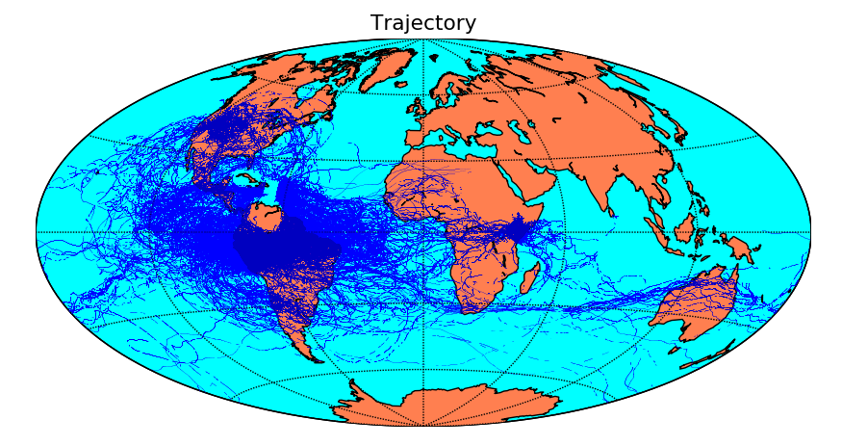
Google Loon Trajectory
(2016 -2017)

Slide 7
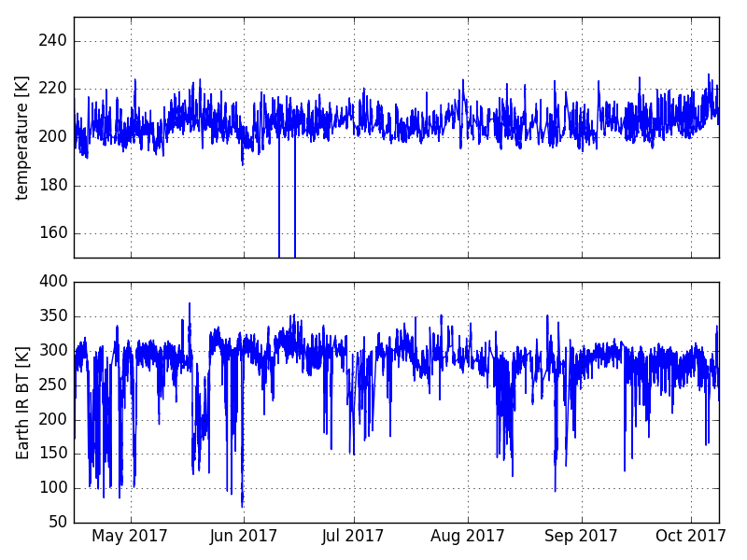
Example of the Data
(longest flight)
Ambient Temperature Sensor
Deep convective clouds
IR Thermometer

Slide 8
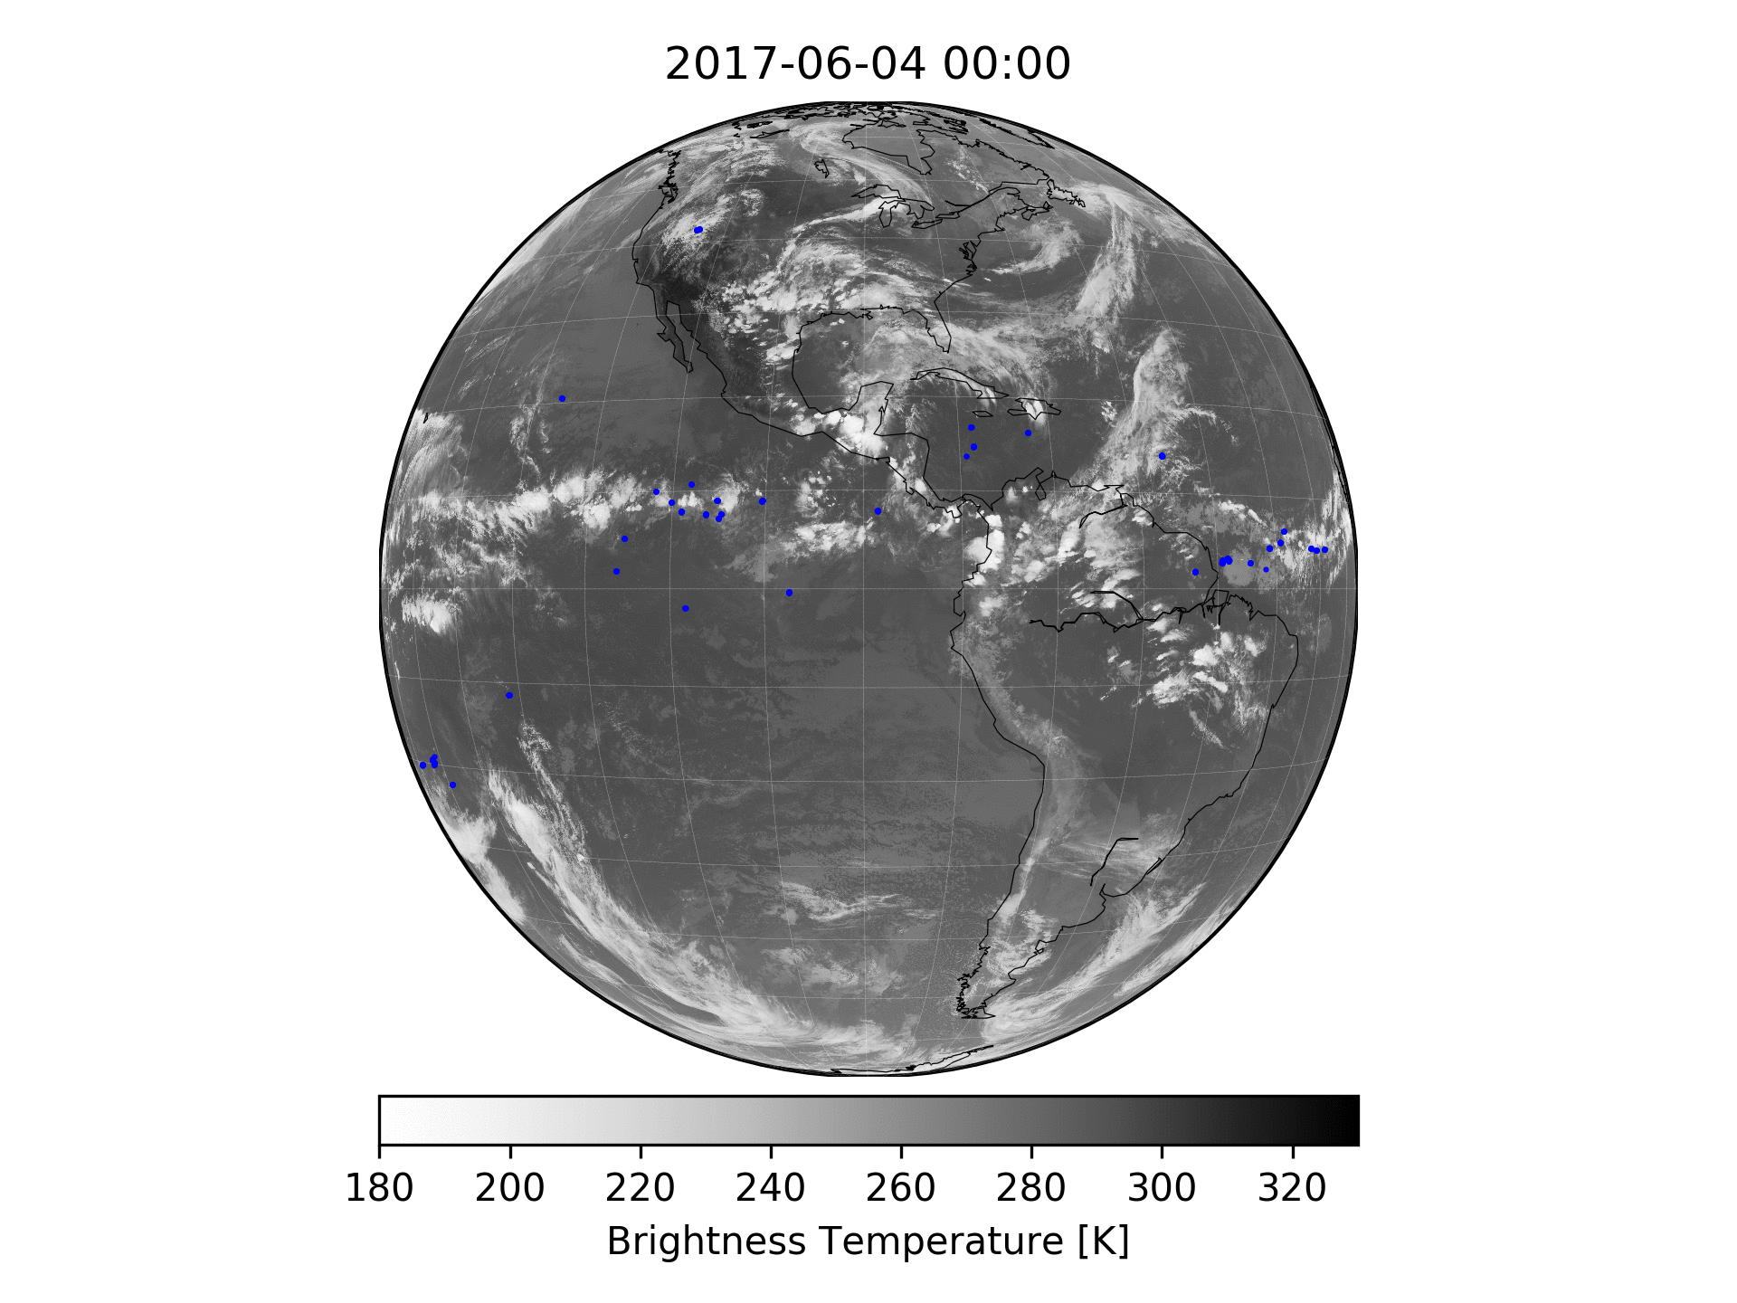
GOES-R ABI vs Loon IR thermometer

Slide 9
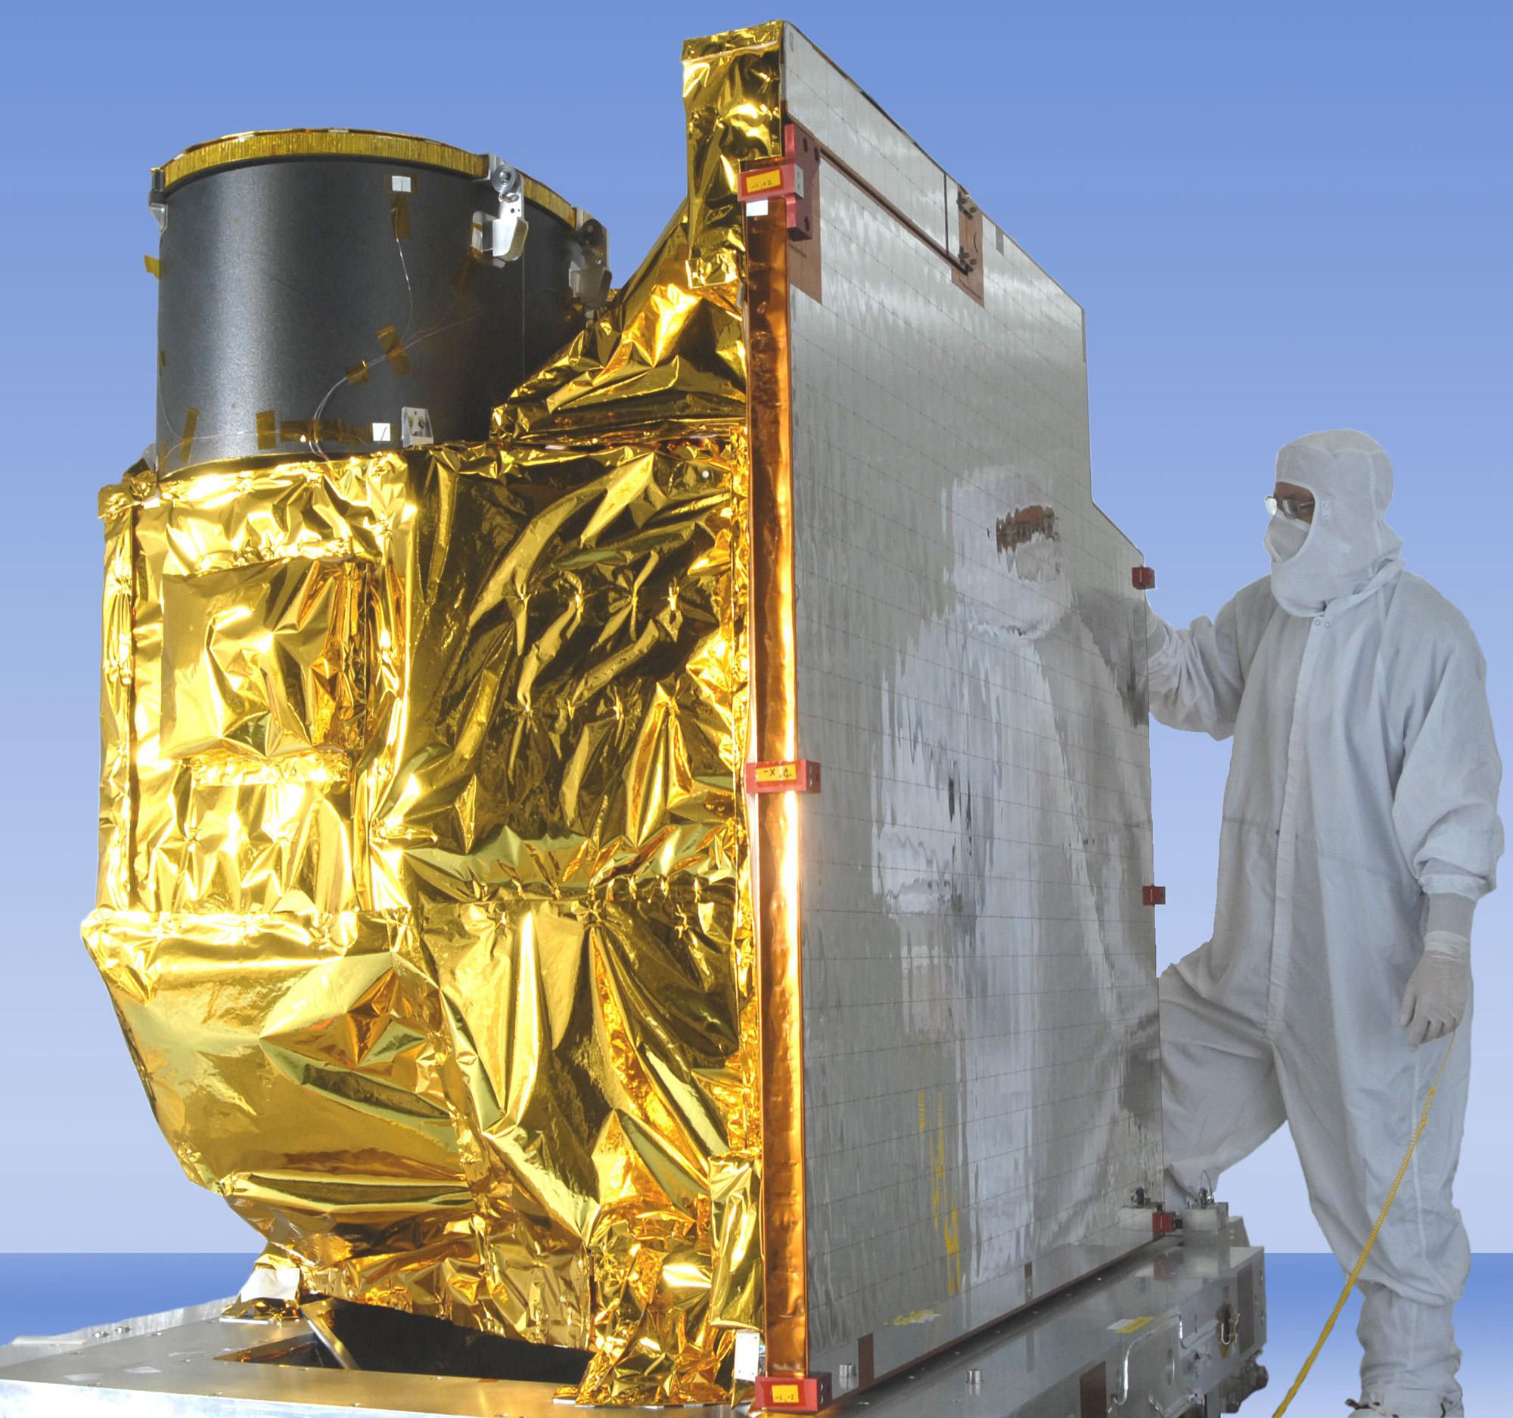
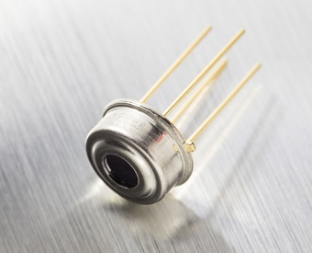
ABI vs Infrared Thermometer
Advanced Baseline Imager (ABI)
On GOES16
Melexis MLX90614 IR Thermometer
On Google Loon
Top Features
Small size and low cost
Easy to integrate
Factory calibrated in wide temperature range: -40 to 125°C for sensor temperature and -70 to 380°C for object temperature
Thermopile detector chip
https://www.harris.com/content/goes-r-advanced-baseline-imager
https://www.melexis.com/en/product/MLX90614/Digital-Plug-Play-Infrared-Thermometer-TO-Can

Slide 10
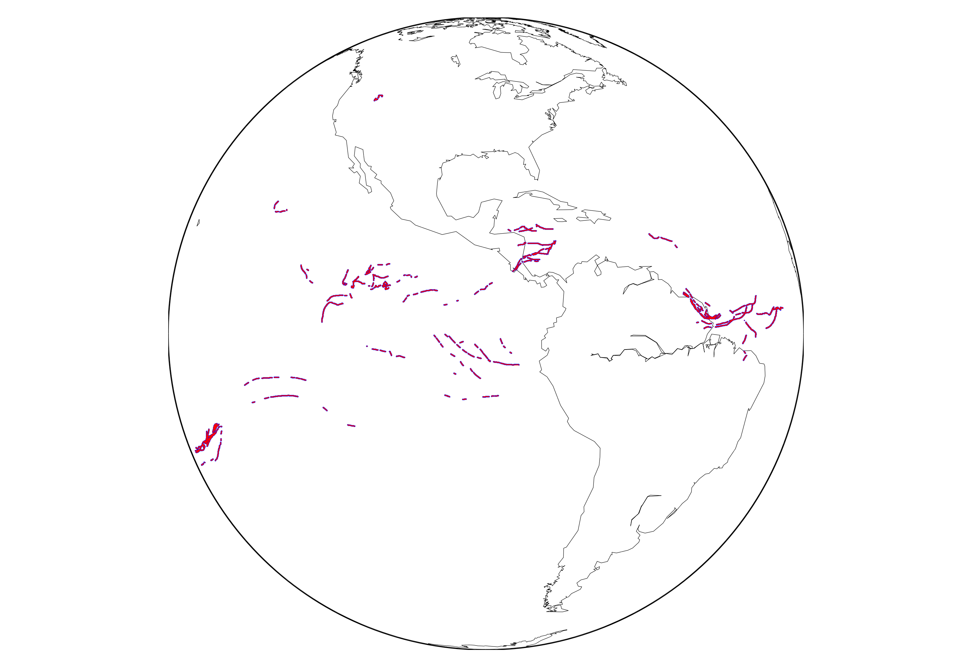
Collocating Two Dataset Together
Samples: 37322
Solar zenith angle: -88.85 - 84.53
Zenith Angle Range: 2.74 – 85.5 Degree (Loon are most at nadir)
Time Difference : within 10 minutes (ABI Scan)

Slide 11
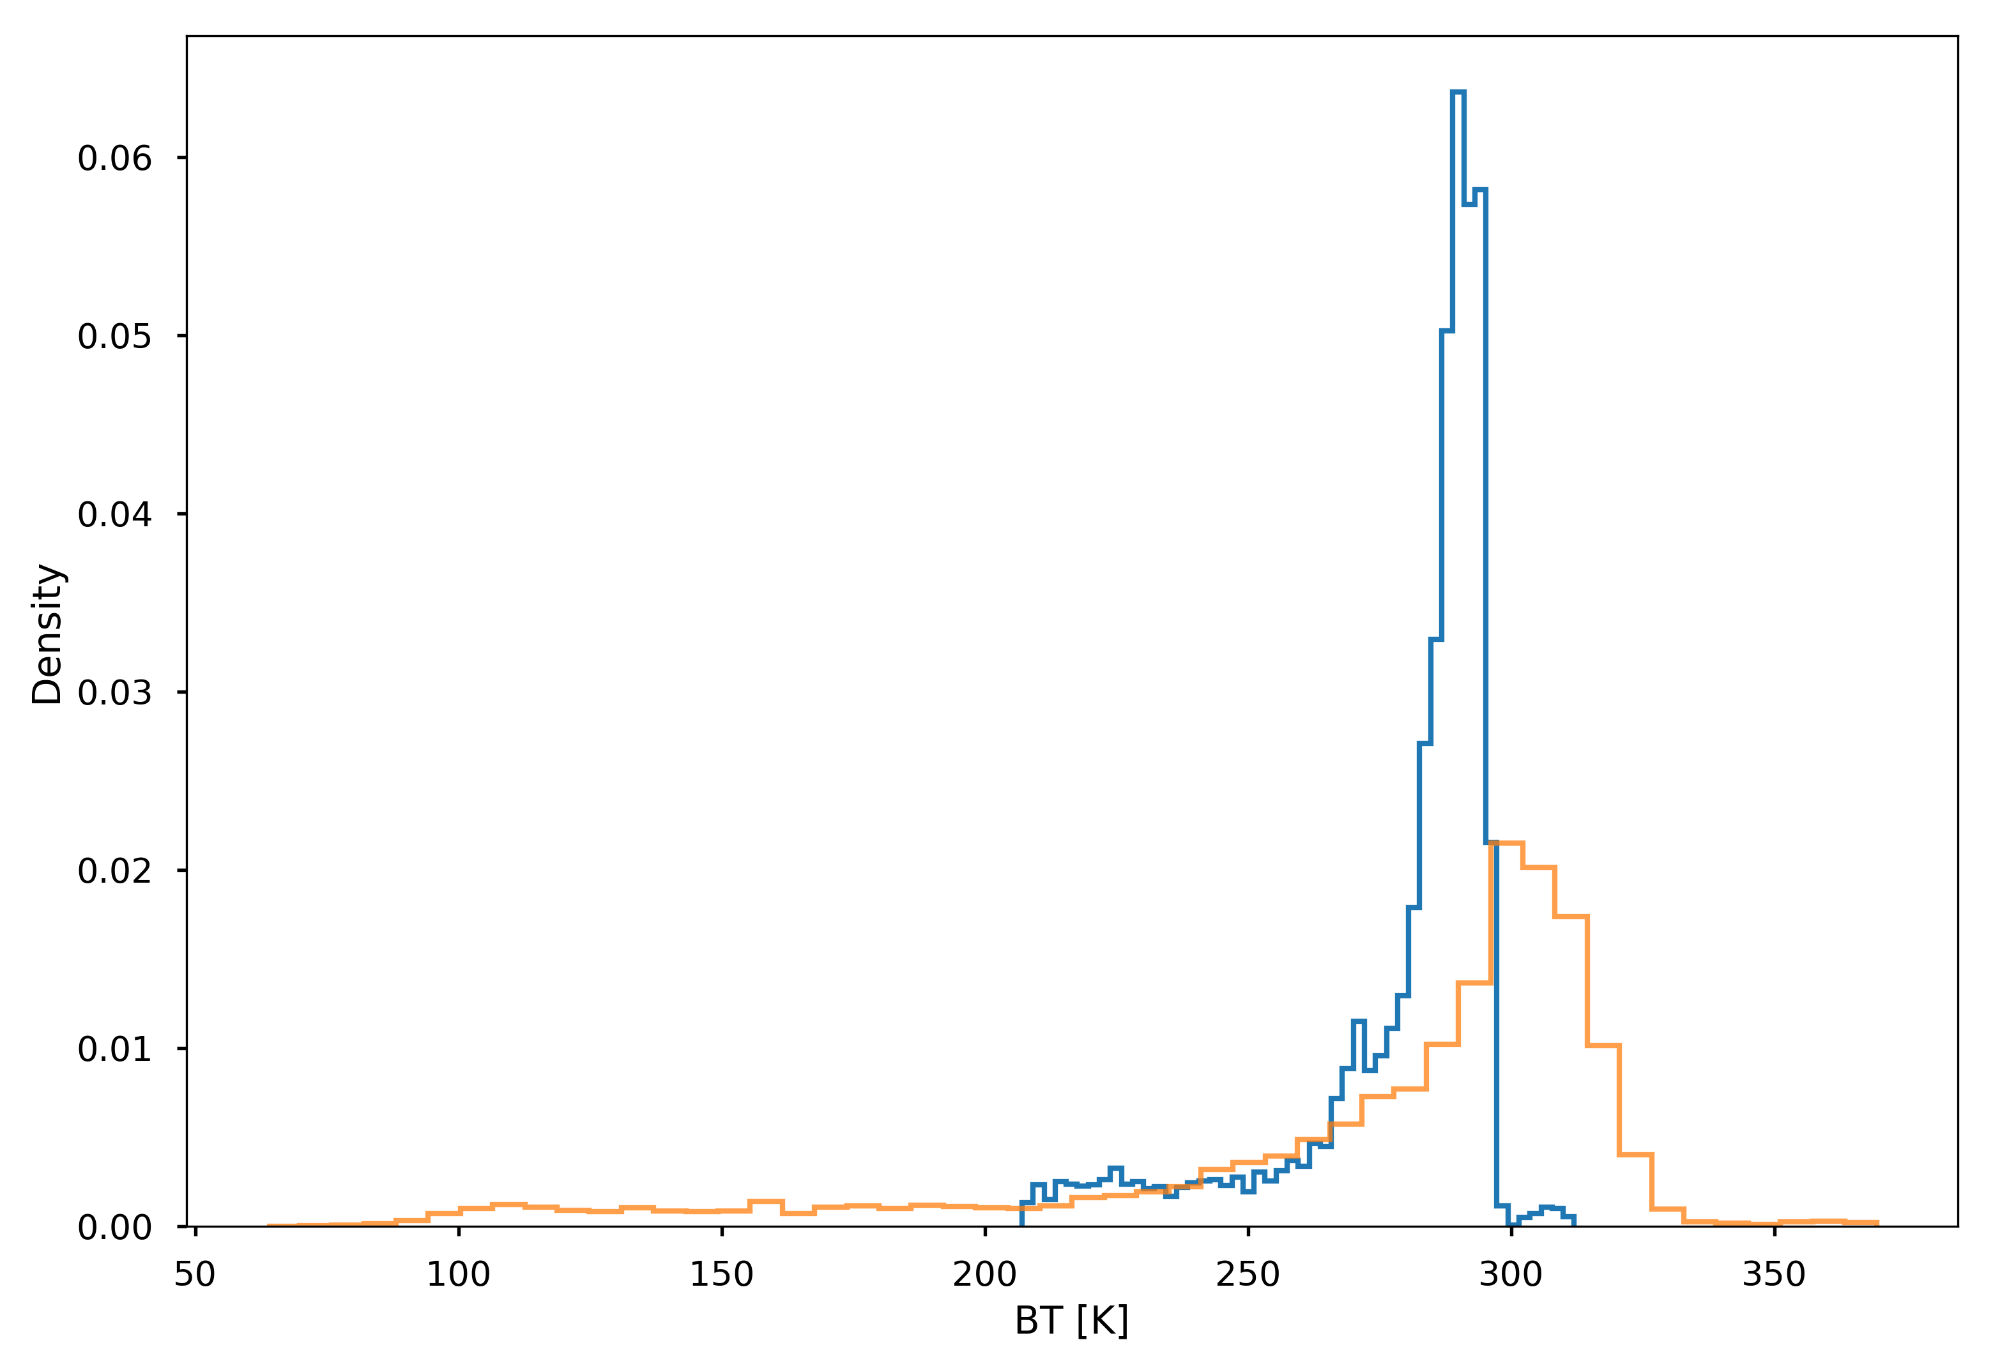
Histogram of Collocated BTs
All Data
GOES BT
LOON BT

Slide 12
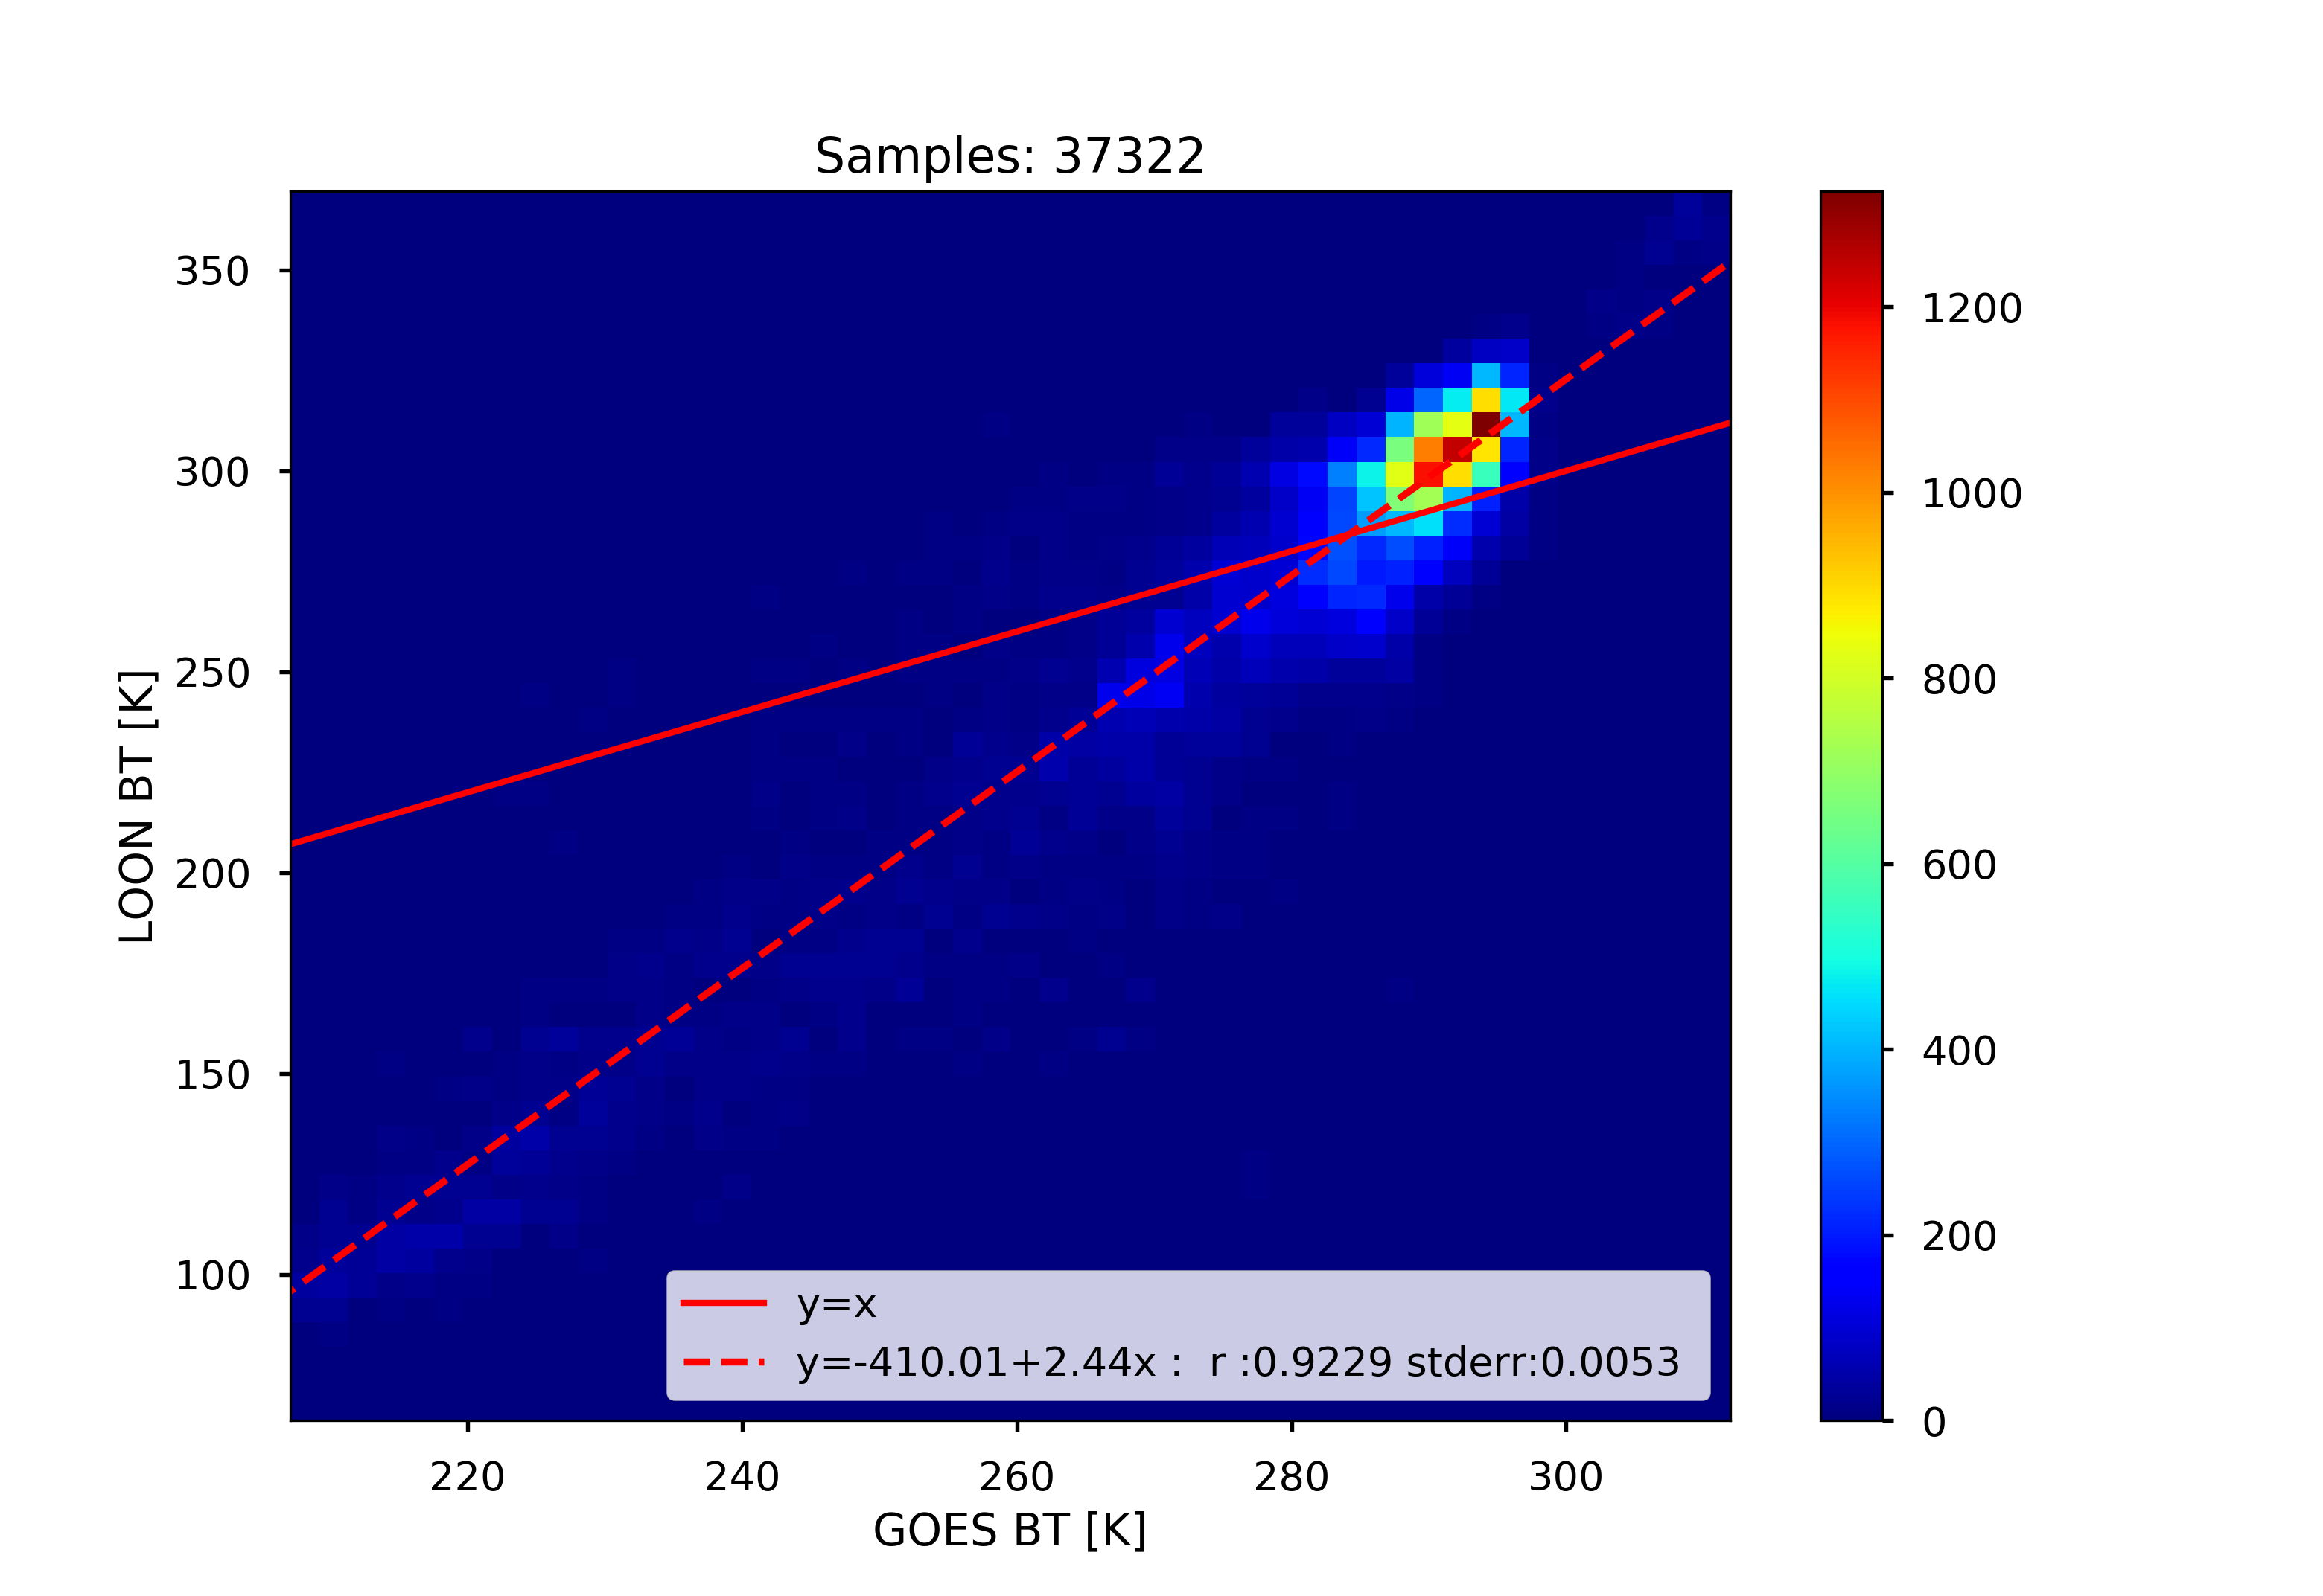
2-D histogram and Linear Fitting
(All data)

Slide 13
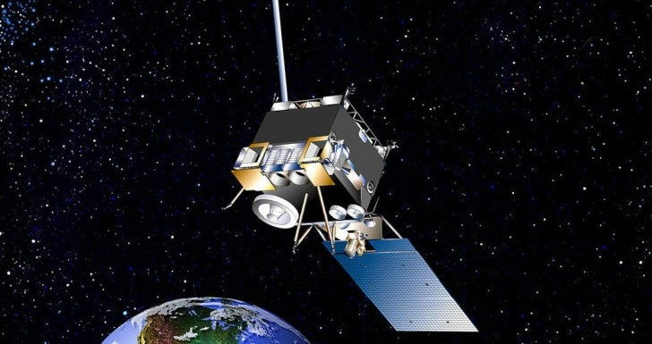
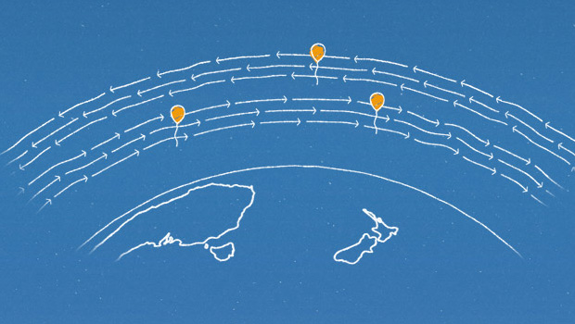
Zenith Angle Play a Role
Google Loon mostly down looking only; But geostationary satellite stays far way and mostly “watches” the Earth with large zenith angle

Slide 14
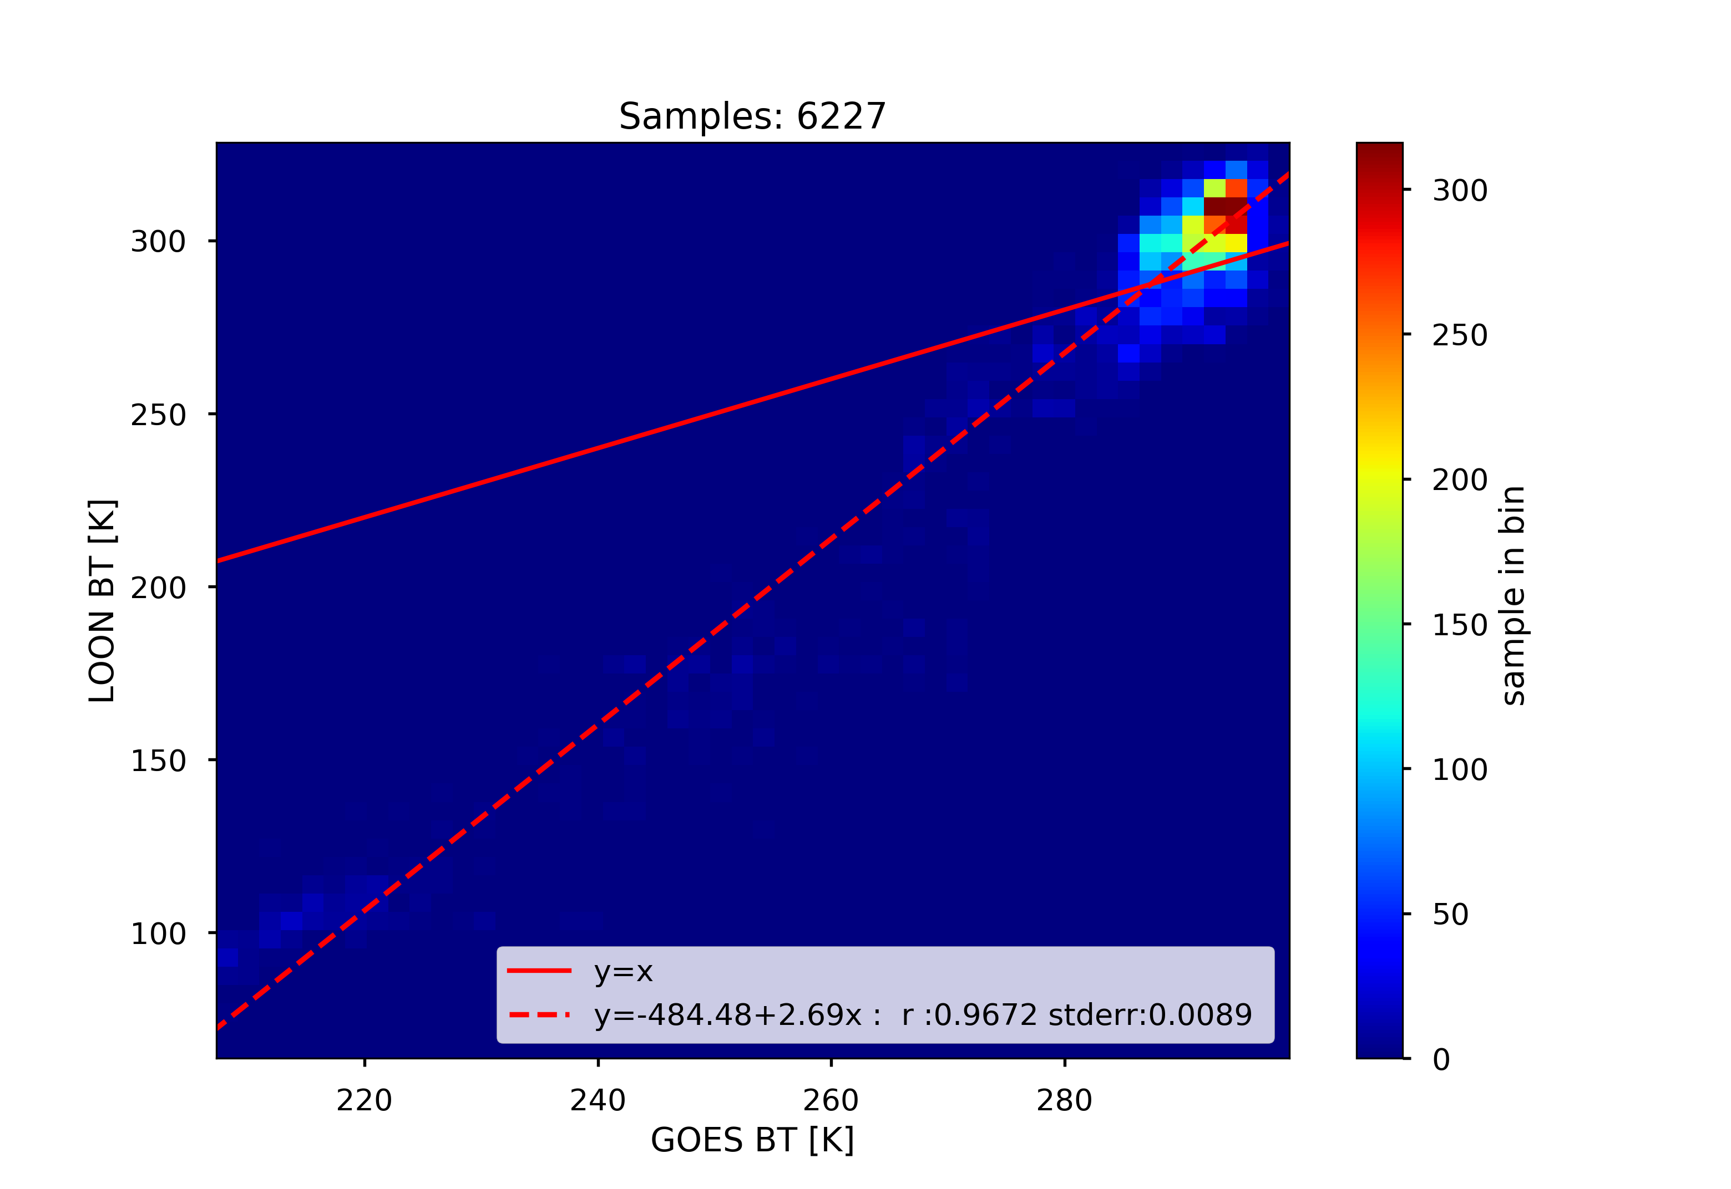
2-D histogram and Linear Fitting
(Zenith angle < 20.0)
Correlation is in creasing after constraining zenith angle

Slide 15
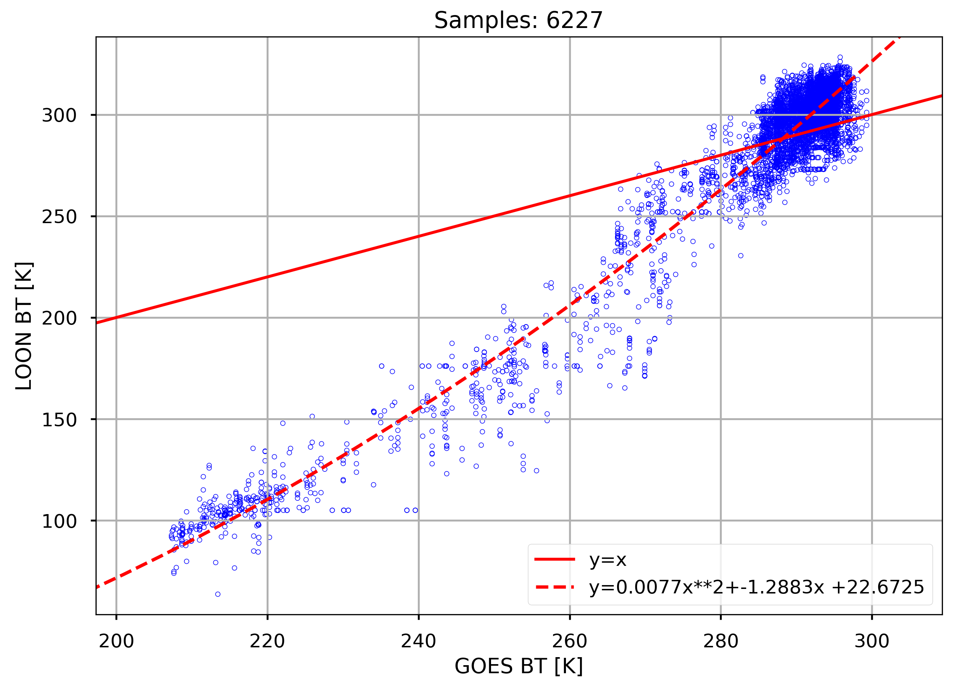
Scatter plot
(Zenith angle < 20.0)
The dynamic range probably
has issues. The sensor is not well calibrated
The relationship is encouraging

Slide 16
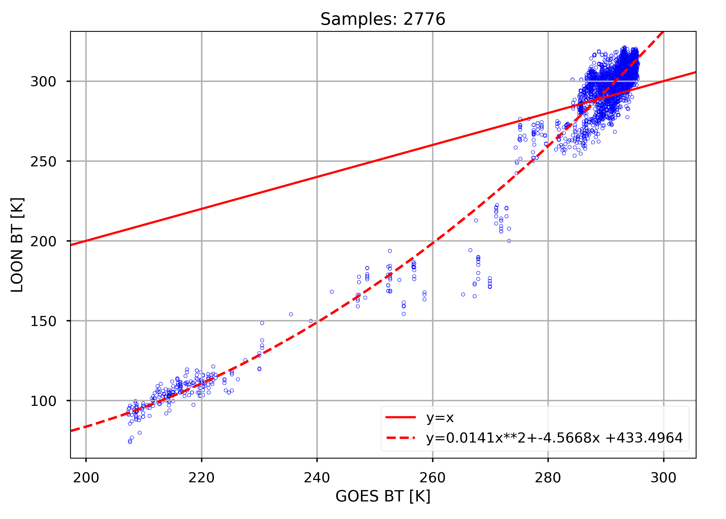
Scatter Plot
(Zenith angle < 20.0 and Night Only)
The uncertainties is reduced. But need more data to fill the gap.

Slide 17
Preliminary Remarks
The results are encouraging,
  without knowledge of spectral coverage
  without knowledge of view geometry
  without calibration source
  with large uncertainties: ± 6 K
Future Google Loon can potentially serve as a satellite sensor validation platform
  Low cost
  can fly anywhere and hover over specific regions
  can maintain the instruments
  Improved sensor

