Slide 1
Current Status and Update of CMA GSICS Collaboration Server
XU Zhe
CMA GDWG
2019.3.4-8 Frascati, Italy

Slide 2
Agenda
Current Status of CMA GSICS Collaboration Server
Progress in CMA on GSICS Collaboration Servers Synchronisation
FY4A GIIRS Data Introduction
L1 IR Data Released since 2019-1-24
Notes:
GSICS Processing and Research Centres (GPRC)

Slide 3
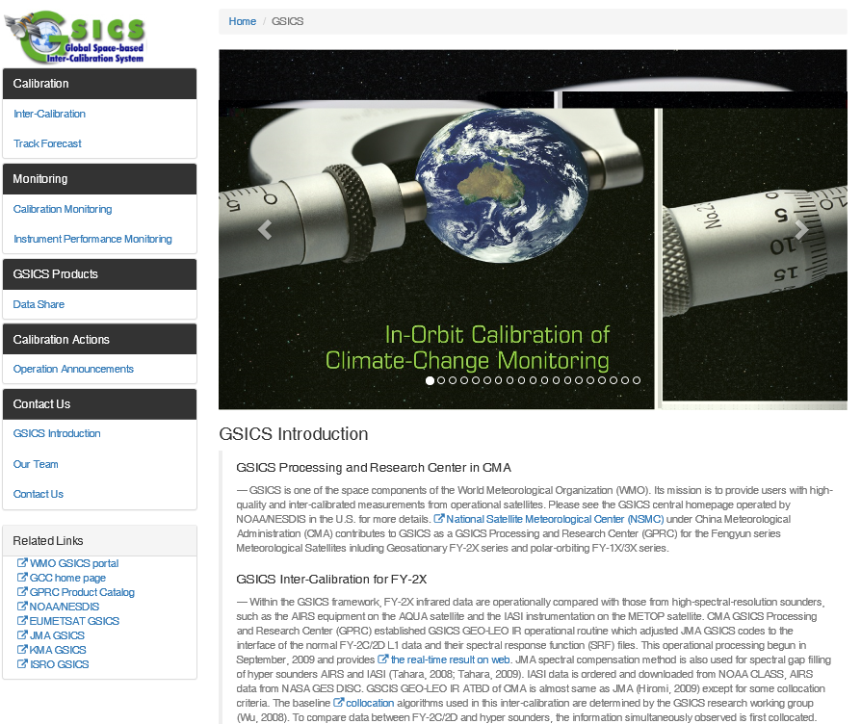
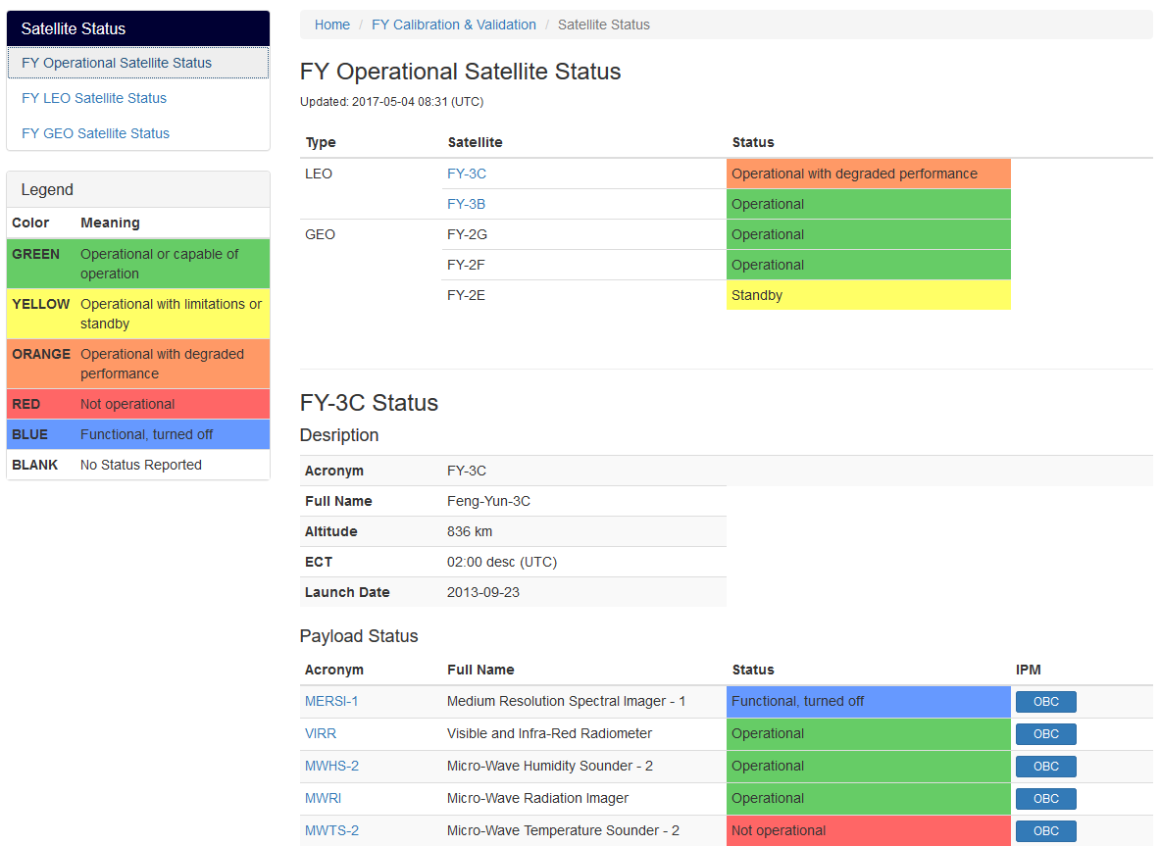
CMA GPRC Website Operation
Content: GPRC Information, CMA GSICS product sharing, Instrument Operation Status
CMA GRWG: Content provider
CMA GDWG: Website construction and maintain
Integrated into NSMC Web Portal, Servers operated by NSMC IT Dep.
Notes:
GSICS Processing and Research Centres (GPRC)

Slide 4
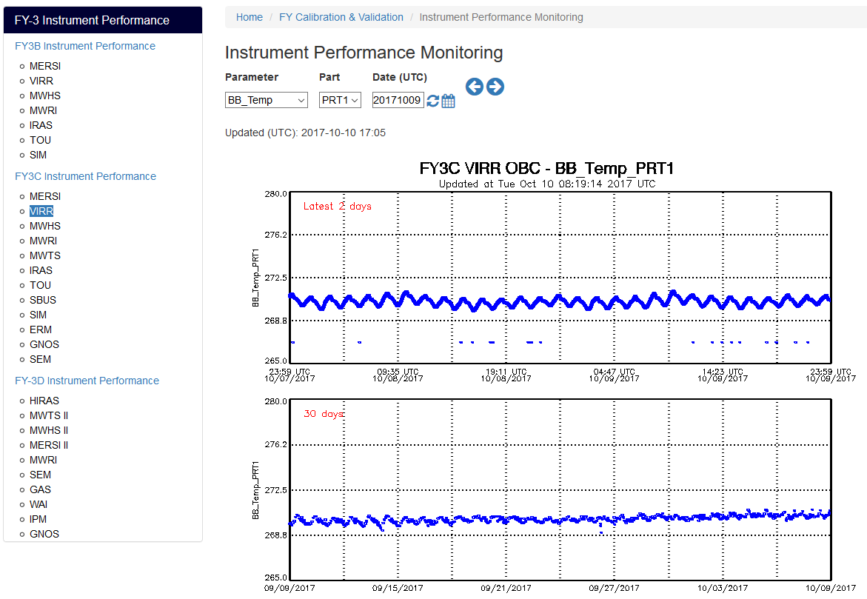
CMA GPRC Website Update
Instrument Performance Monitoring

Slide 5
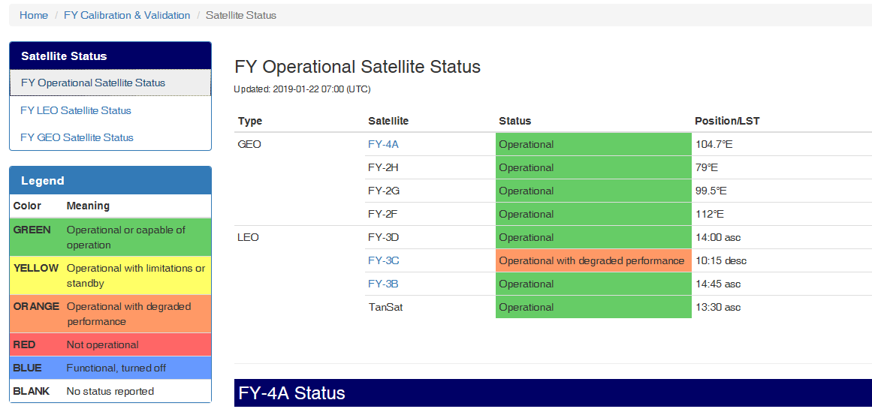
CMA GPRC Website Update
Instrument Status （FY4A/FY3D new）

Slide 6
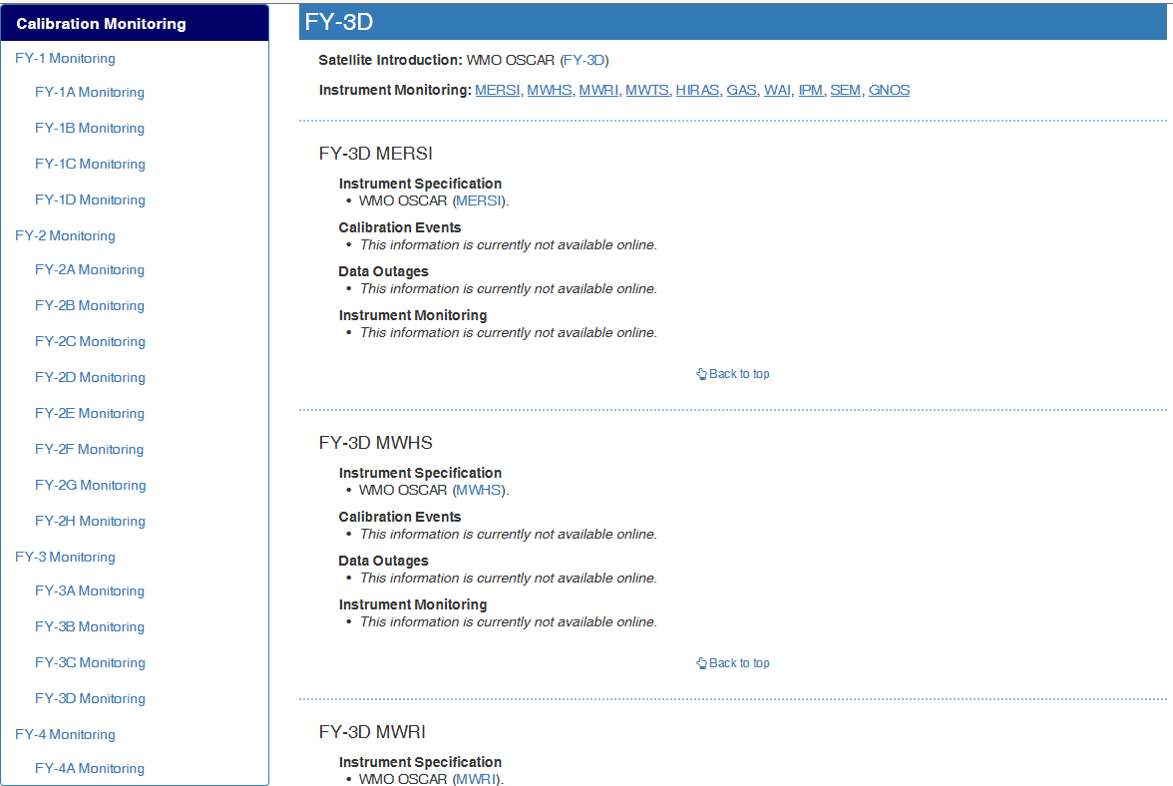
CMA GPRC Website Update
Landing Page (Li Yuan) （FY4A/FY3D new）

Slide 7
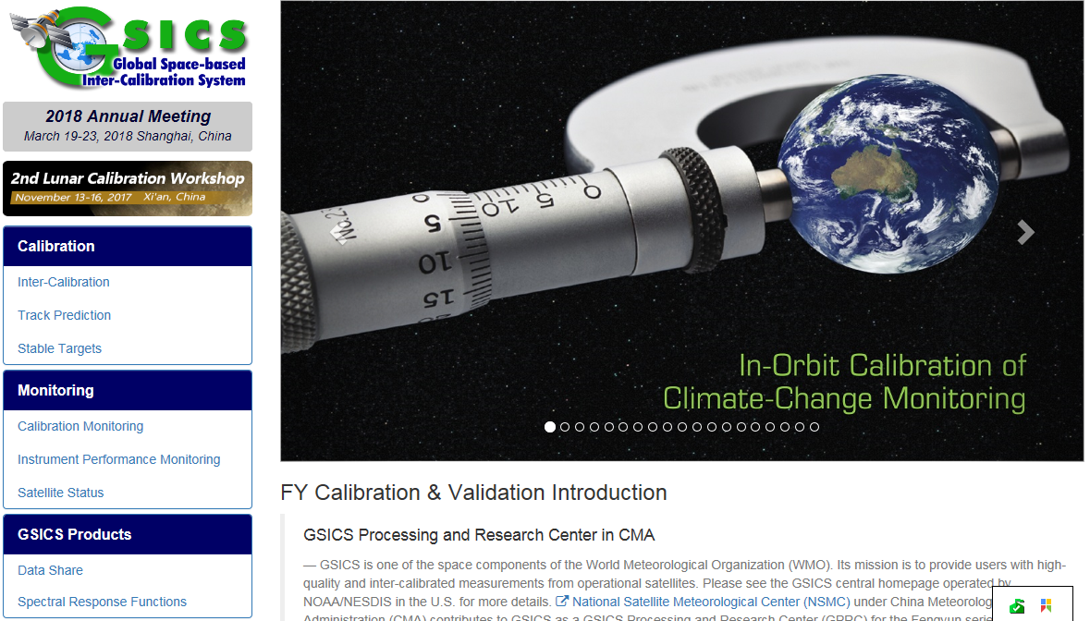
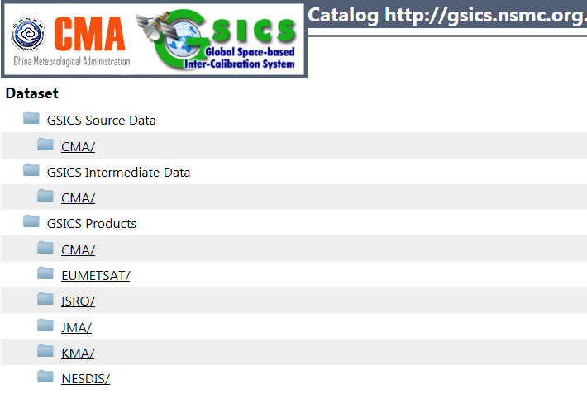
CMA GSICS Collaboration Server
FY2 GEOLEO Products
NRTC/RAC
EUMETSAT RAC Products

Slide 8
Agenda
Current Status of CMA GSICS Collaboration Server
Progress in CMA on GSICS Collaboration Servers Synchronisation
EUMETSAT Sync code test in CMA
CMA Sync EUMETSAT RAC product status
Suggestions
FY4A GIIRS Data Introduction
Notes:
GSICS Processing and Research Centres (GPRC)

Slide 9
EUM Sync Code Test
Version 1:
2018-05-17, CMA received Sync code and document from Peter. Miu(EUM);
Re-engineered the CMA script for downloading all RAC oper products.
Test result:
8 EUM RAC product can be downloaded: MSG1（2,3,4）+SEVIRI-MetOpA(B)+IASI_C_EUMG
Error exist: http response：500
Notes:
GSICS Processing and Research Centres (GPRC)

Slide 10
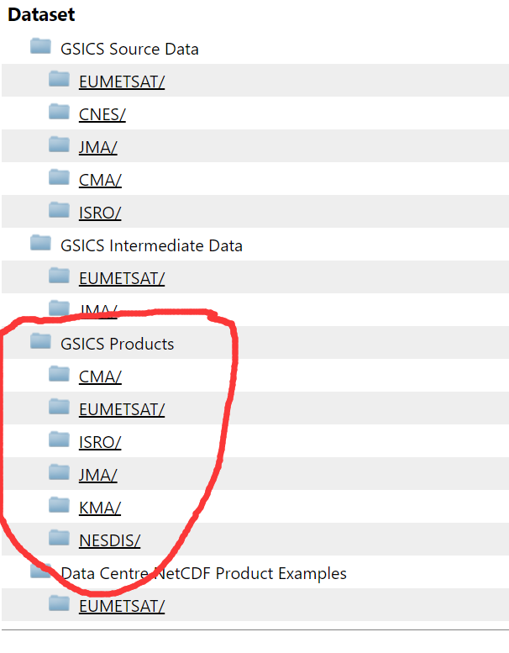
EUM Sync Code Test
Version 2:
2018-06-29, CMA received update Sync code and XML configuration file;
Include:
Code: gsicsSyncDaemon.pl
Configuration file: gsicsServers2Sync.xml
Run: perl gsicsSyncDaemon.pl gsicsServers2Sync.xml
Test result:
Run smoothly on CMA server without error report
Download file from GSICS Products
Notes:
GSICS Processing and Research Centres (GPRC)

Slide 11
CMA Status
CMA replicate EUMETSAT RAC product
Continue using our Shell script
Get and Put
Why?
Replicated remote file has already integrated in CMA GSICS data preparation software in operation mode
Routine job, runs 1 daily
Download catalogue can be configured on demand.
CMA will use EUM’s sync script after annual meeting

Slide 12
Suggestion
EUMETSAT Sync code +XML configuration file is convenient to users, easy to learn ,deploy, and integrated in local application;
CMA recommend for other GDWG members to use it in GPRC for sync RAC product;
Thanks Peter.Miu (EUMETSAT)’s contribution on Sync code development.

Slide 13
Agenda
Current Status of CMA GSICS Collaboration Server
Progress in CMA on GSICS Collaboration Servers Synchronisation
FY4A GIIRS Data Introduction
Notes:
GSICS Processing and Research Centres (GPRC)

Slide 14
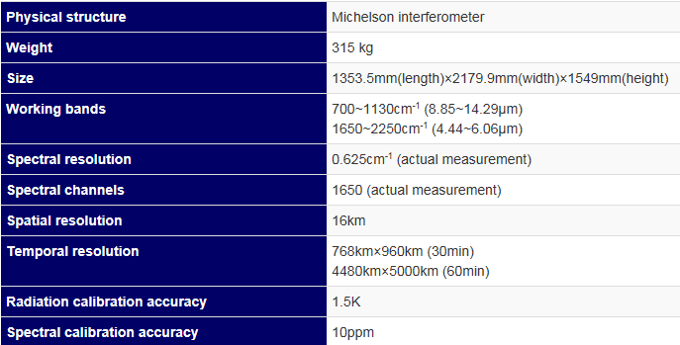
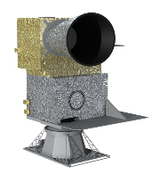
FY4A GIIRS
Geostationary Interferometric Infrared Sounder (GIIRS)
An infrared hyper-spectral vertical sounder, also the first space-borne interferometer that flies in geostationary
Take measurements of three dimensional atmospheric structure

Slide 15
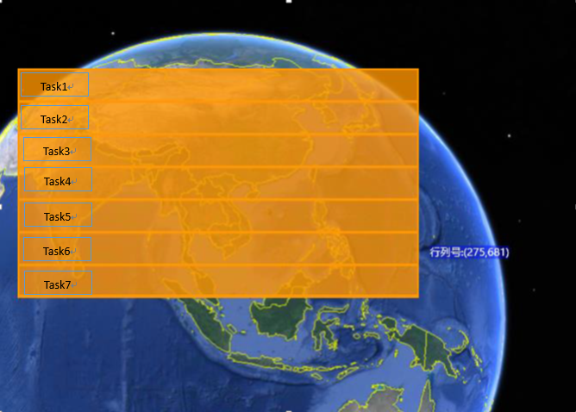
FY4A GIIRS
Daily Schedule:
Every 2 hour: Full Observation region, will be scheduled to 7 tasks
Every task costs 10 minutes. One task contains ca 60 dwells.
16—18UTC: Maintenance, data unavailable
Observation region (REGX) :
3N-55N, 66E-144E

Slide 16
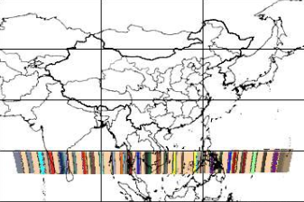
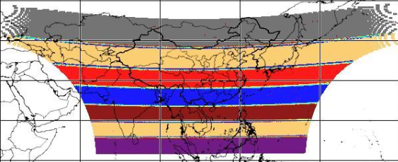
L1 Data Volume:
1 IR dwell file volume is ca 4MB.
The daily L1 data volume is random, average is:：12GB/Day 4380 files/Day
Dwell
10 Mins Task: 60Dwell
2 Hours Regional Scan, 7 tasks

Slide 17
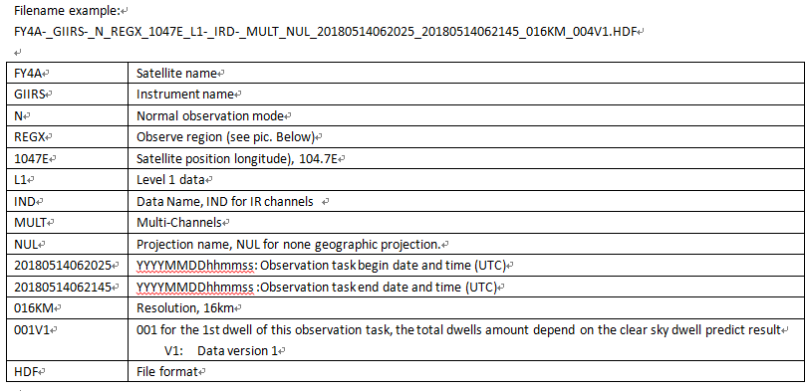
FY4A GIIRS L1 File Name

Slide 18
Data Service Web Portal
http://fy4.nsmc.org.cn/portal/en/theme/FY4A.html
AGRI Animation
Data Search: Archive FY-4A data order
Data Download: NRT FY-4A data FTP service

Slide 19
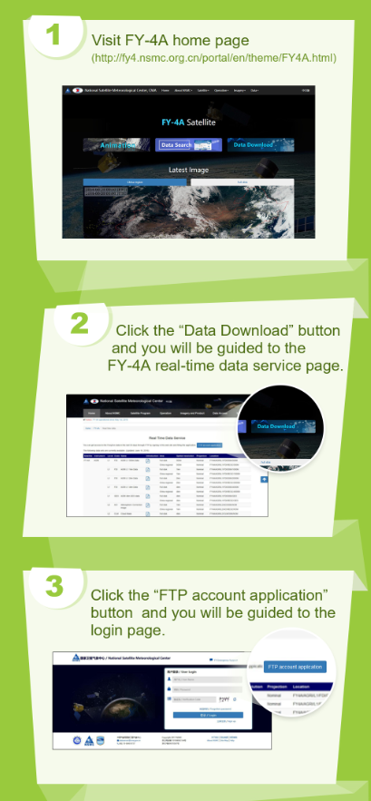
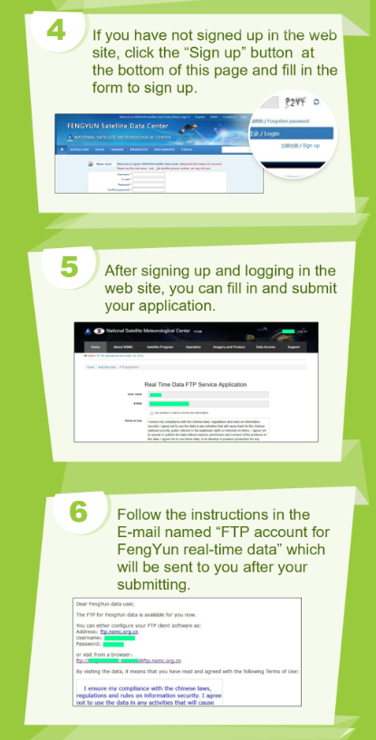
NRT FY-4A data FTP service

Slide 20
Thank you for your attention
WMO GSICS Portal
http://gsics.wmo.int
GSICS Coordination Centre http://www.star.nesdis.noaa.gov/smcd/GCC/index.php
GSICS Product Catalog https://www.star.nesdis.noaa.gov/smcd/GCC/ProductCatalog.php
GSICS Wiki
http://gsics.atmos.umd.edu/wiki/Home

