Slide 1
OMI collection 4 calibration and instrument performance
David Haffner^{1,2}, Quintus Kleipool³, Nico Rozemeijer³, Antje Ludewig³, Glen Jaross², Jonatan Leloux³, Erwin Loots³, Mirna van Hoek³, Emiel van der Plas³, Matthew Bandel^{1,2}, Zachary Fasnacht^{1,2}
¹SSAI, ²NASA GSFC, ³KNMI
GSICS Annual Meeting UVNS Breakout Session
10 March 2022

Slide 2
Outline
OMI Instrument
OMI Collection 4
Radiance and Irradiance Calibration
Other important calibration/performance changes
Feedback from Science Team

Slide 3
Ozone Monitoring Instrument (OMI)
2D CCD spectrometer operating since 2004 on EOS Aura (LTAN 13:45)
2600 km swath; ground pixel size at nadir 13x24 km²
Three hyperspectral bands:

Slide 4
Motivation for OMI Collection 4
Importance of OMI data in global AC/AQ observing system
Calibration and data issues to address
Prepare for Exit from A-Train
Consolidate institutional knowledge
Much more data available since start of Collection 3 (2007)
Responsibility for OMI has been transferred KNMI to NASA

Slide 5
Collection 4 and NASA Transition Activities
Processing Algorithms and Software
Entirely new L0-1b processor
L2 Science algorithm updates
Operations and Monitoring
Thermal Stabilization
Operations Baseline
Preparations for A-Train Exit
Calibration trending overhaul
Instrument Calibration
Degradation corrections
Fundamentally revised calibration
Full reconstruction of cal. chain
Major coordination effort between NASA & KNMI, L1B & L2 teams, Science & Support Teams

Slide 6
OMI Collection 3 vs. Collection 4
Calibration registration basis
wavelength
pixel

Slide 7
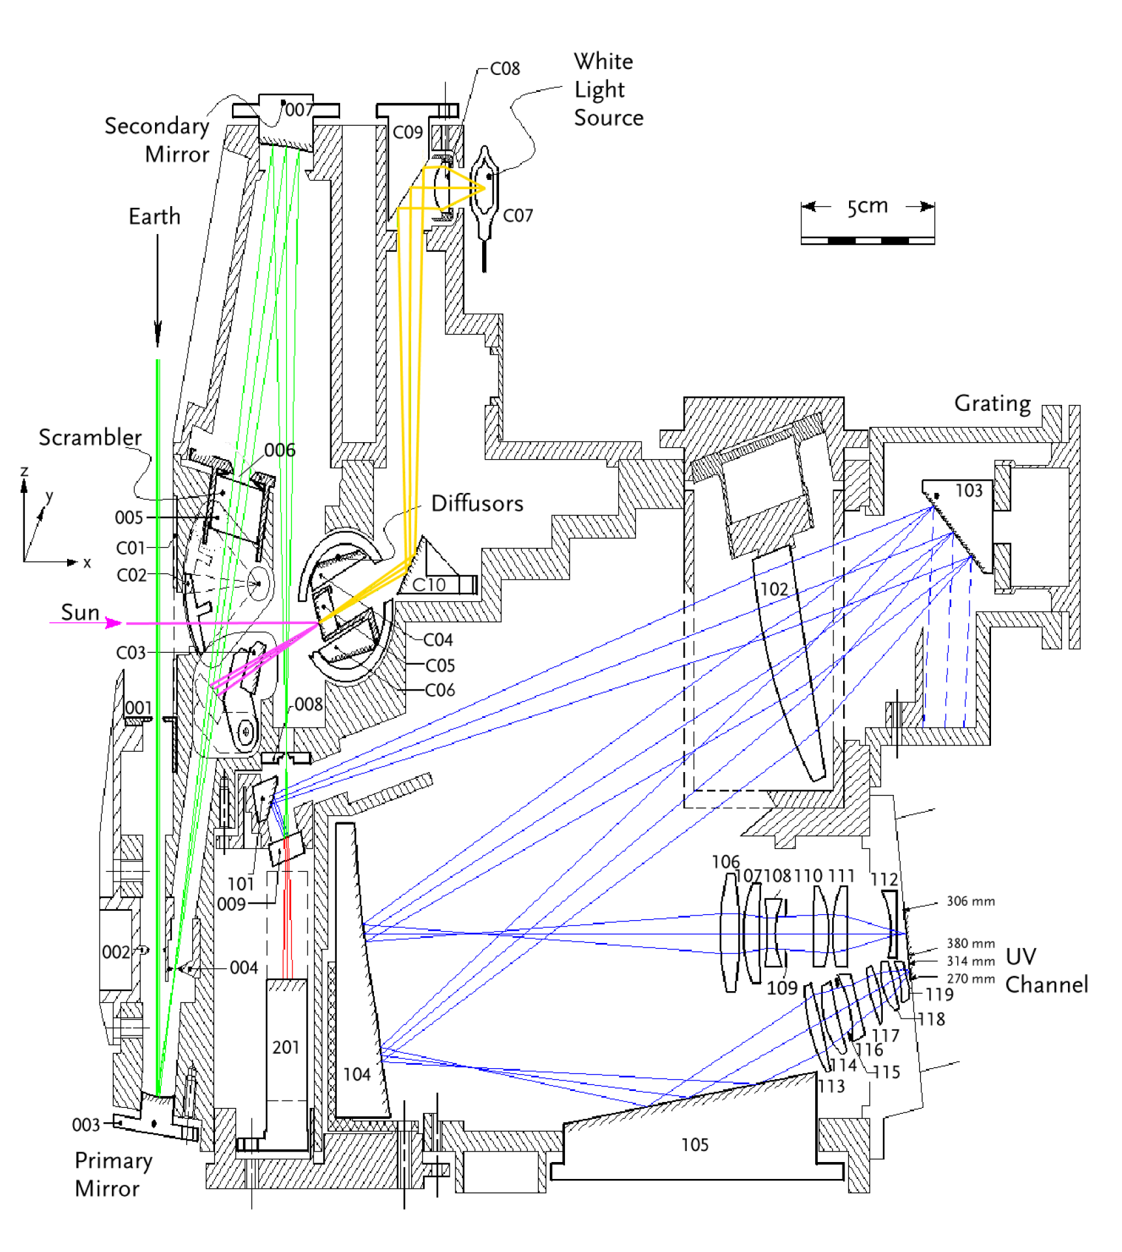
OMI Instrument Design
M2
FM
Radiance: M1*M2*S*E
Irradiance: D*FM*M2*S*E
D
S
M1. Primary Mirror
M2. Secondary Mirror
D. Diffuser
S. Spectrometer
E. Electronics
M1

Slide 8
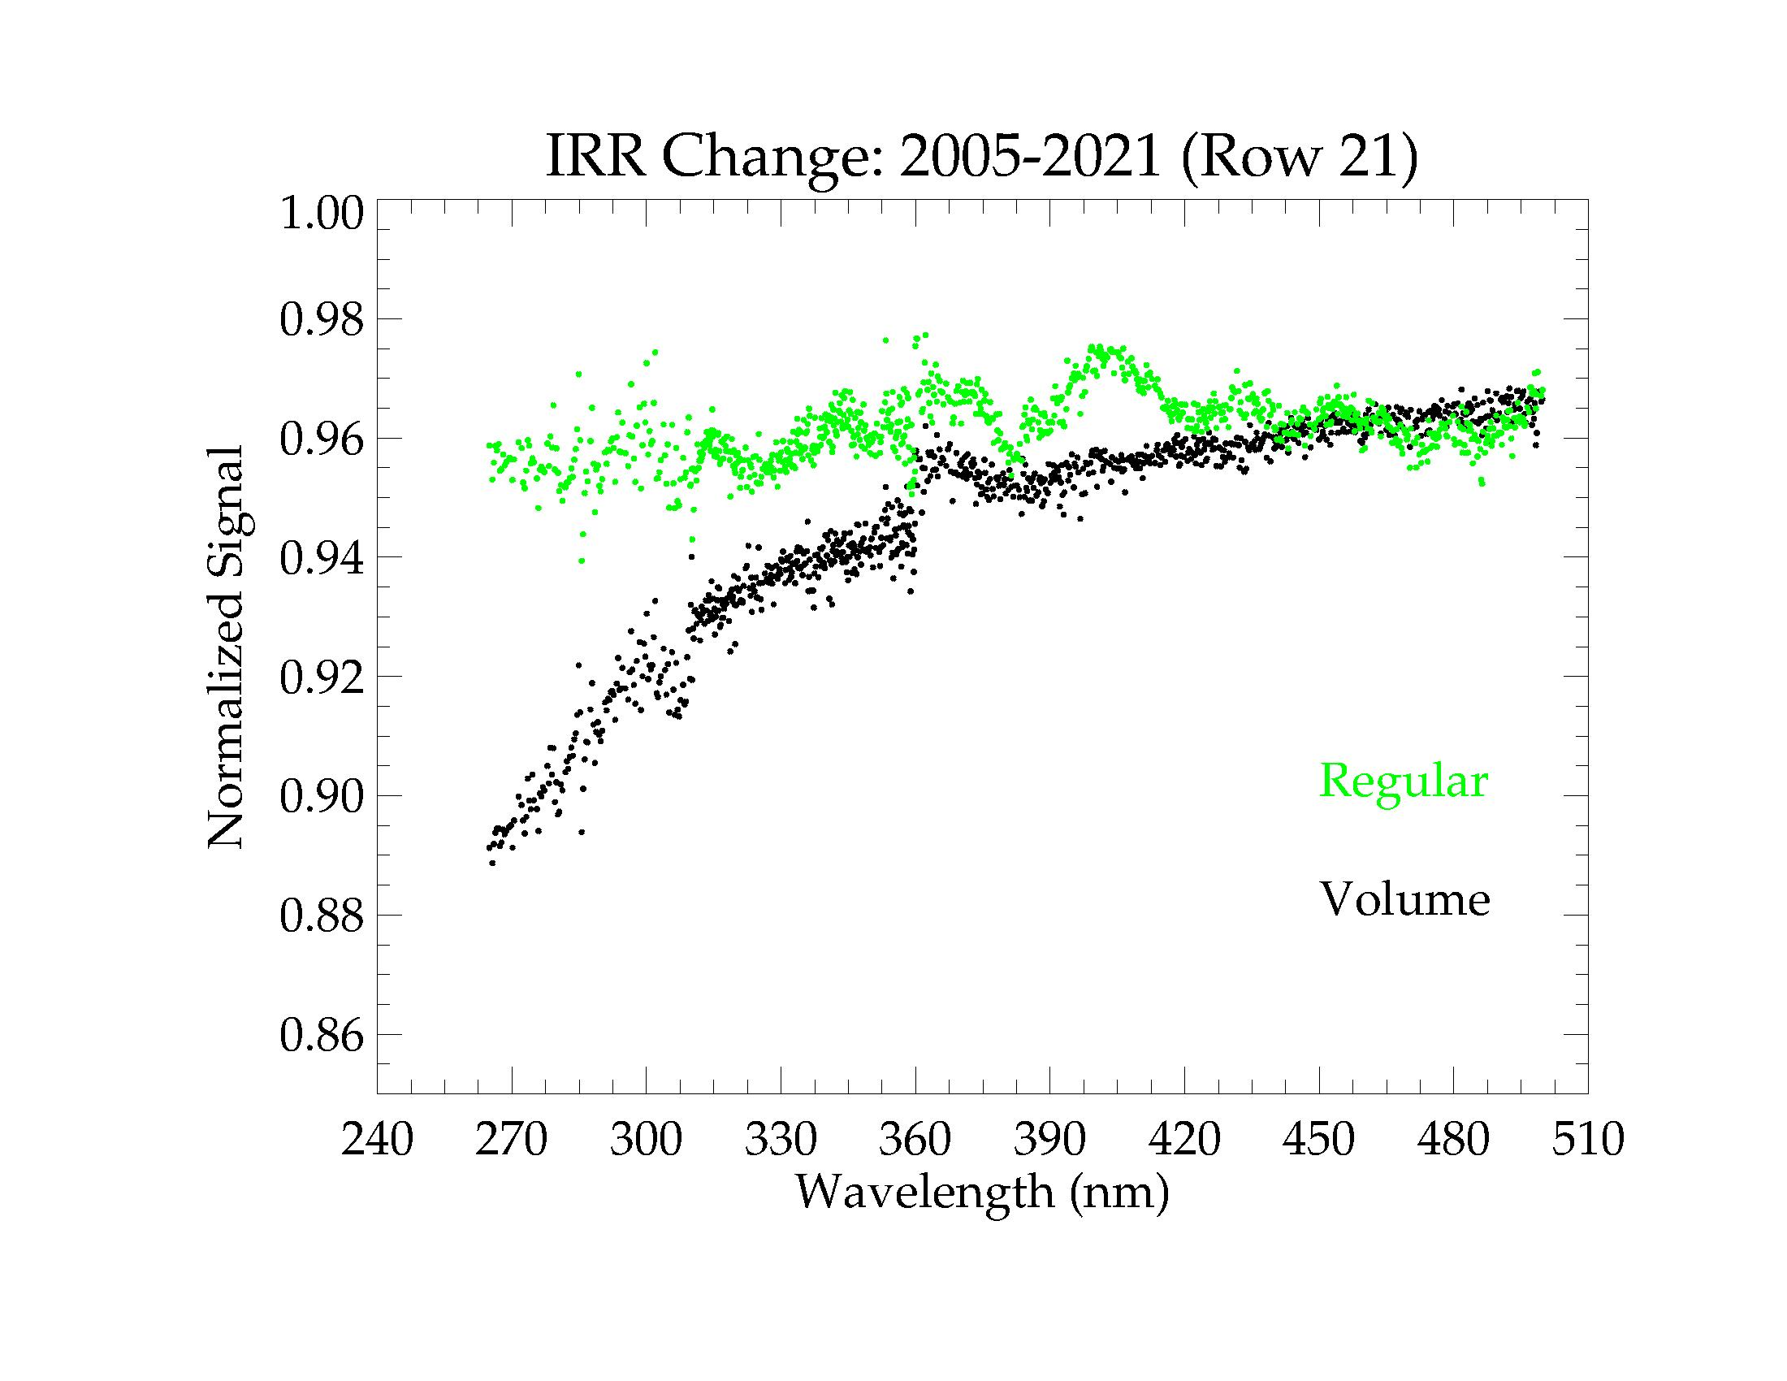
Changes in Irradiance Signal

Slide 9
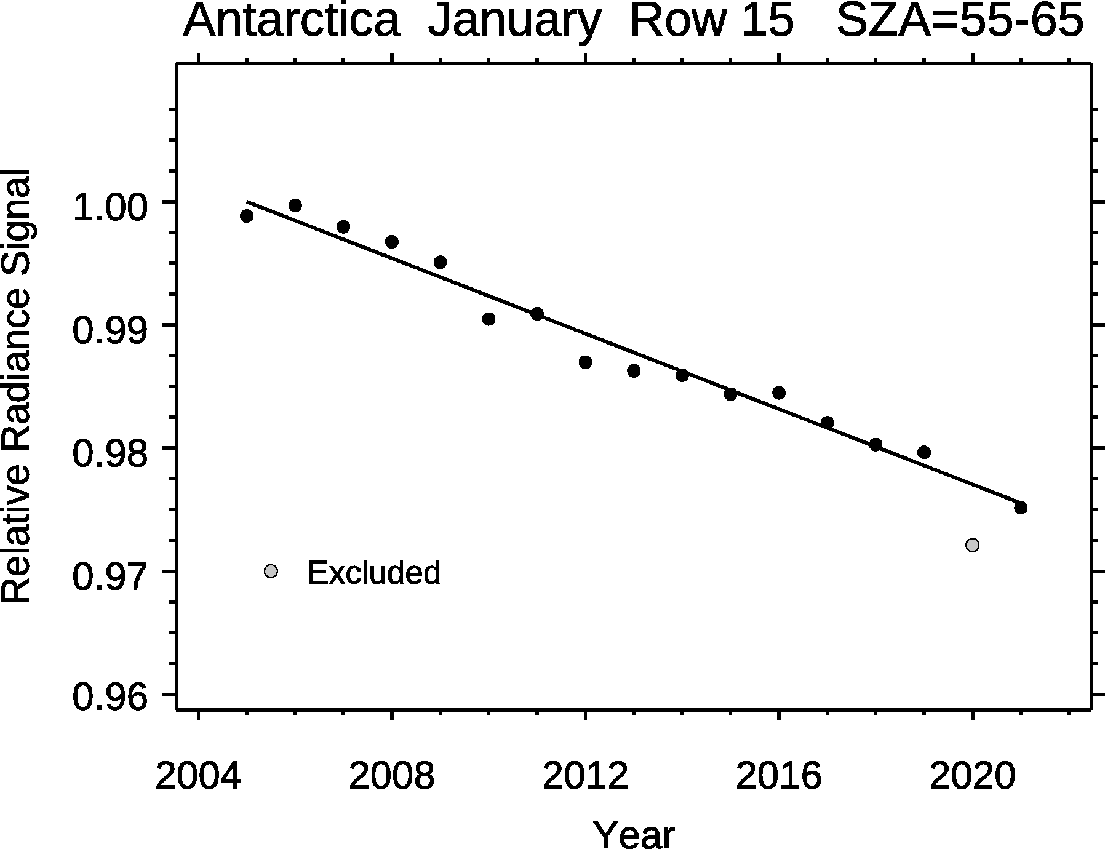
340 nm Ice Radiance Trends

Slide 10
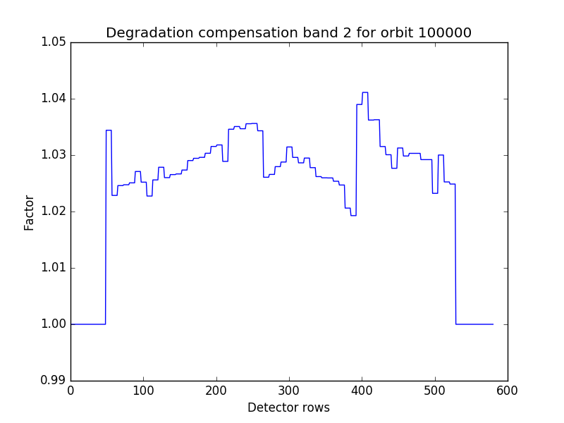
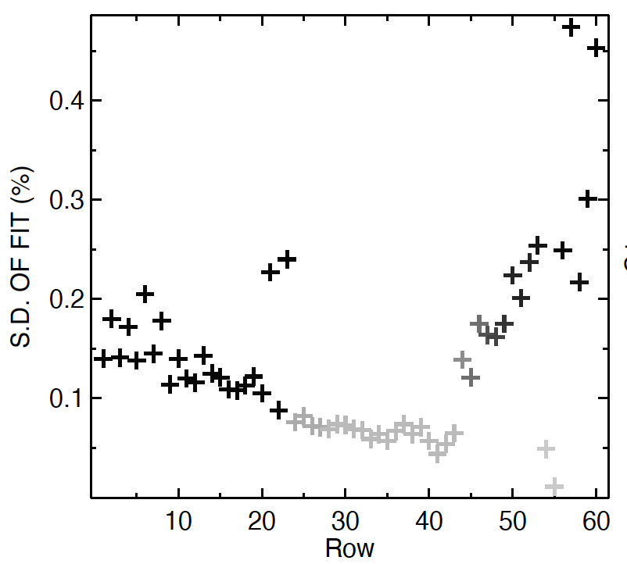
Radiance Degradation Correction

Slide 11
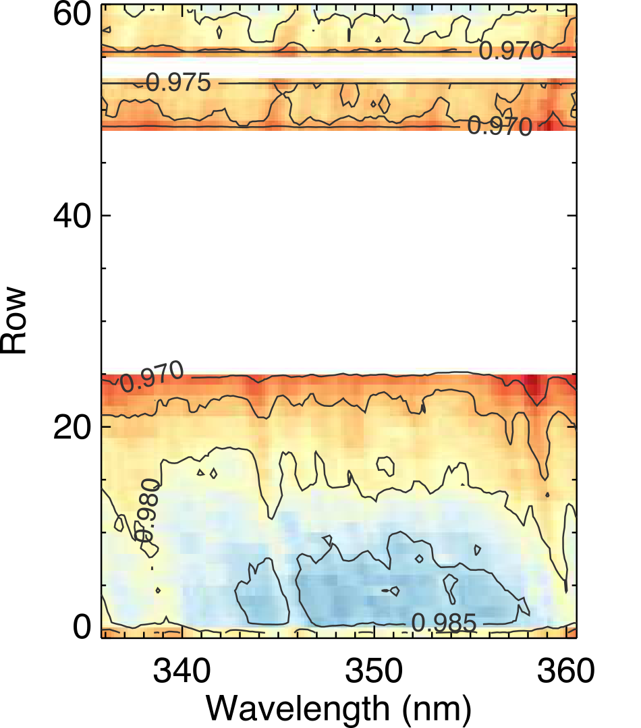
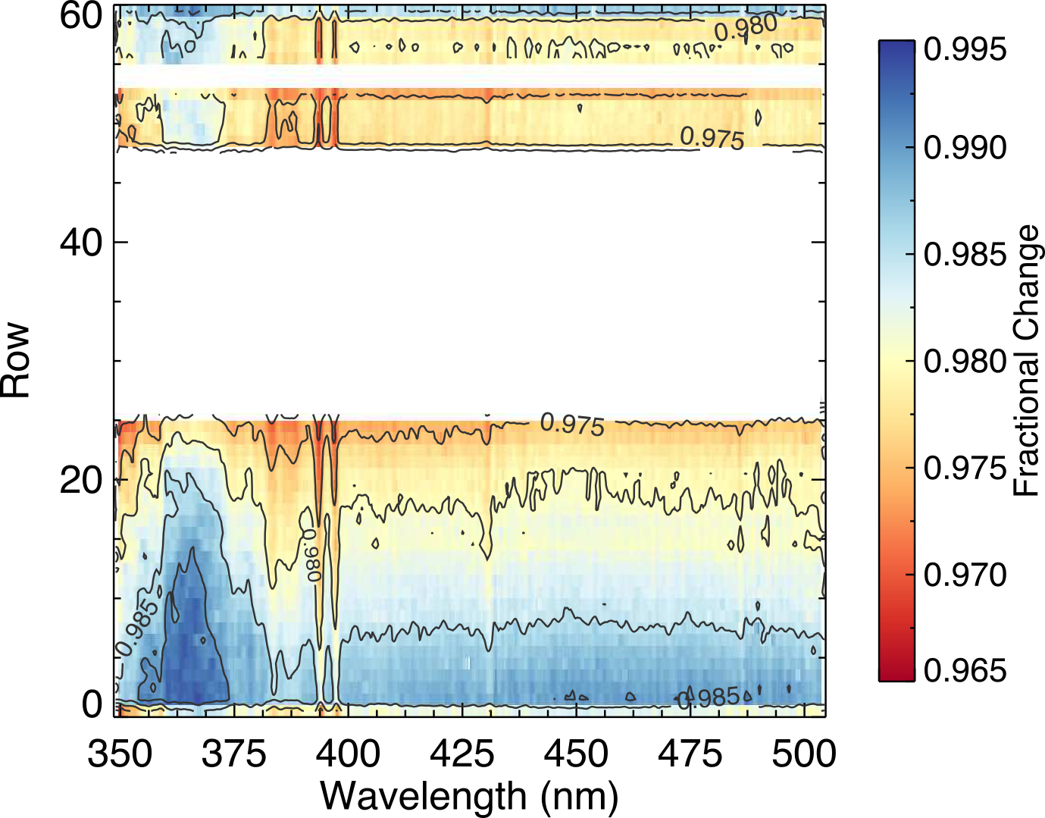
Changes in Band 2 & 3 Radiance Channels

Slide 12
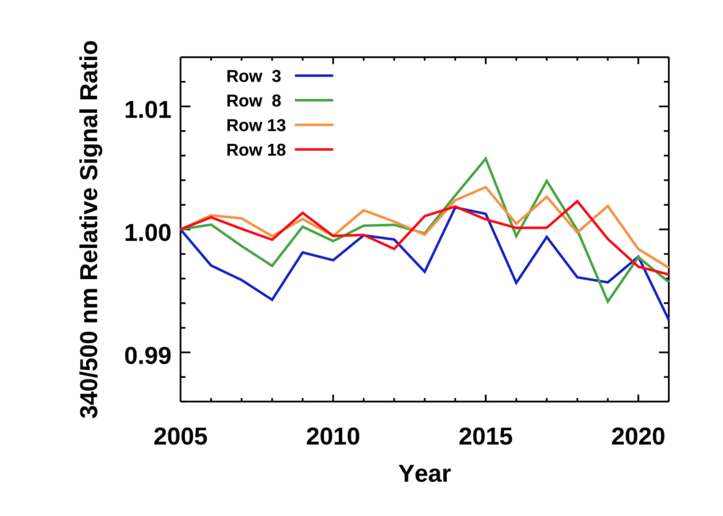
340/500 nm Spectral Dependence

Slide 13
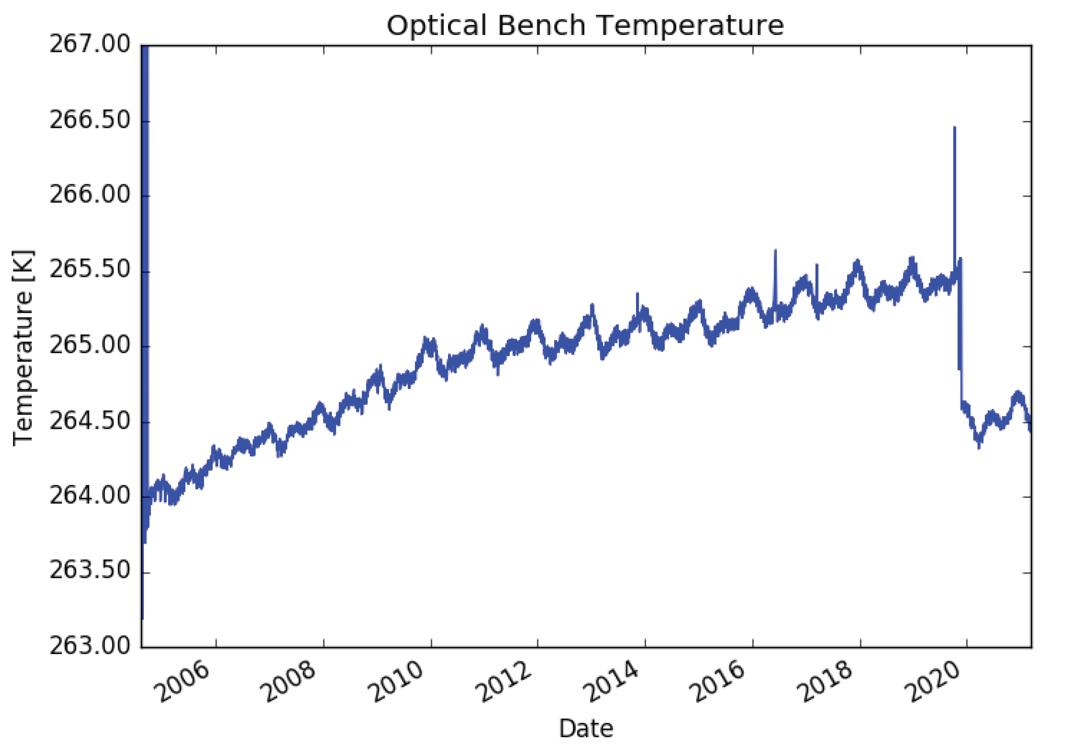
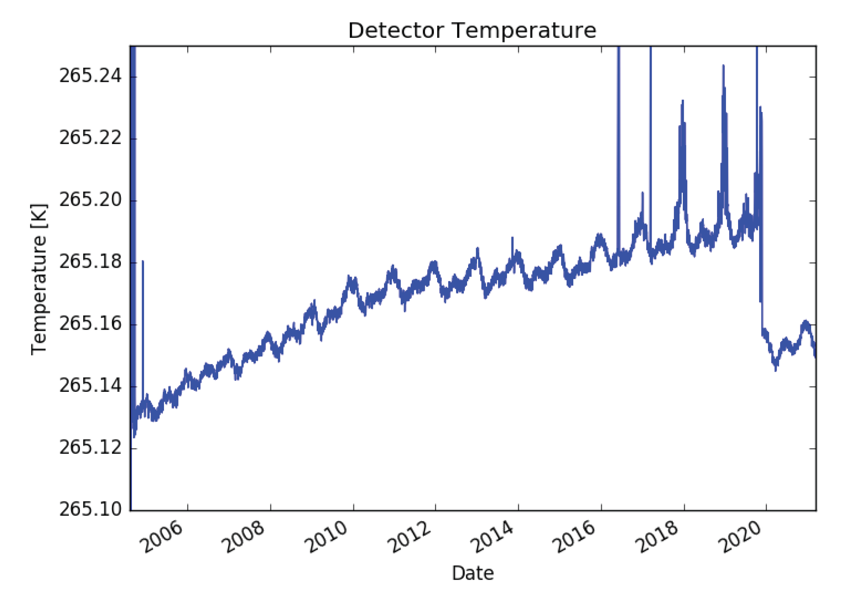
Recent thermal stabilization of OPB and detector

Slide 14
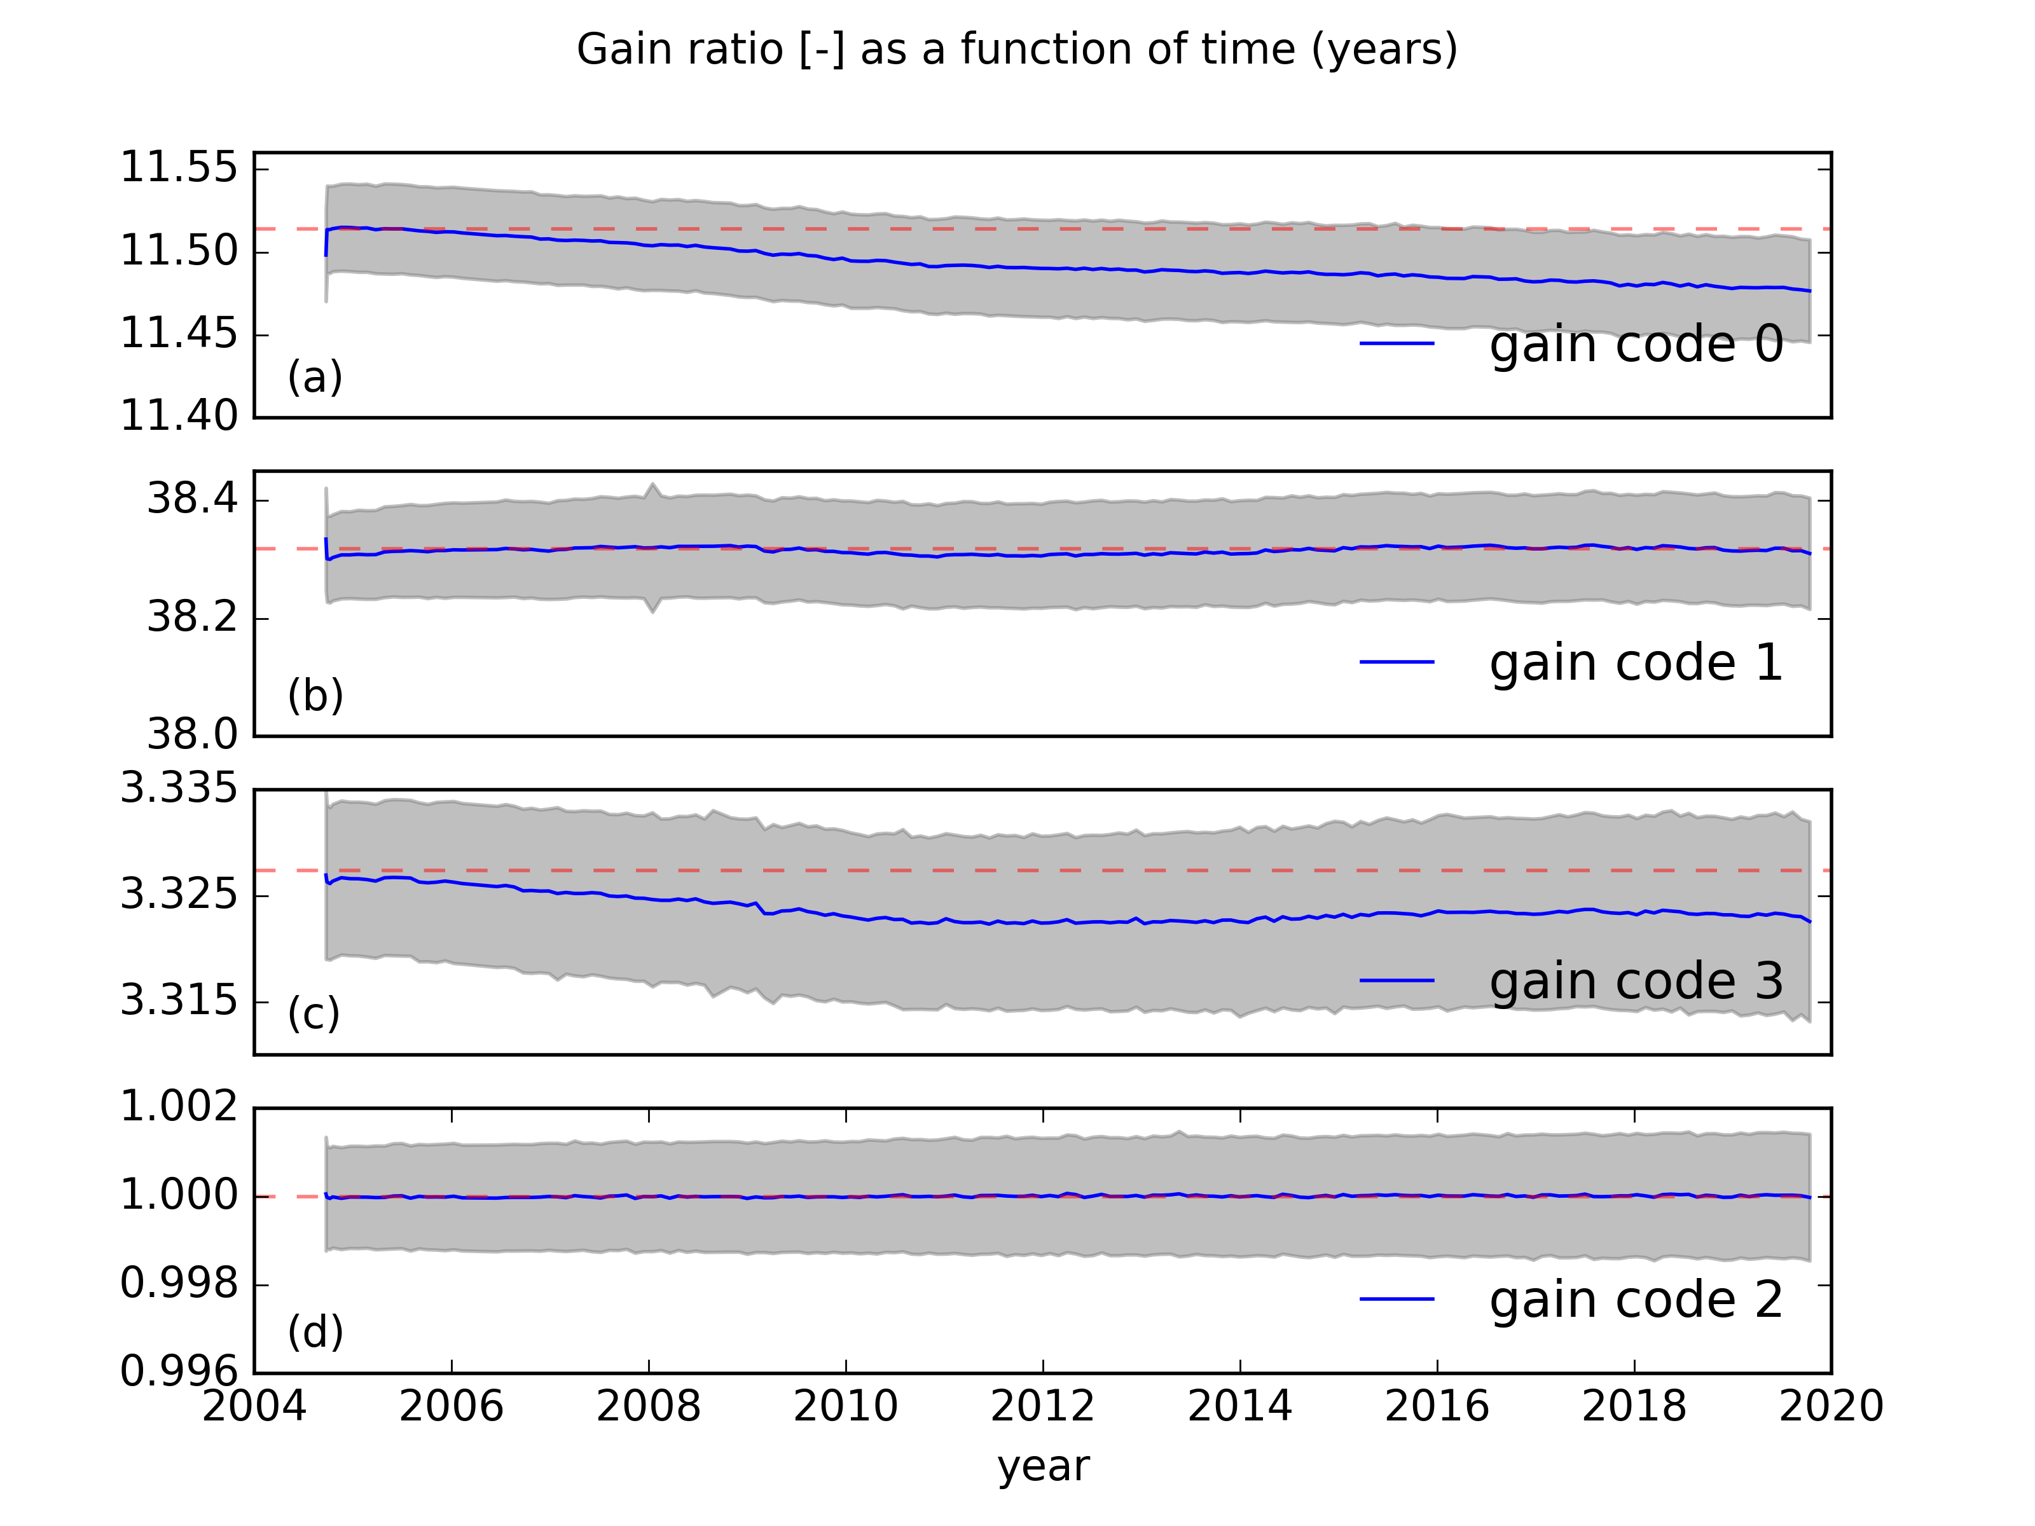
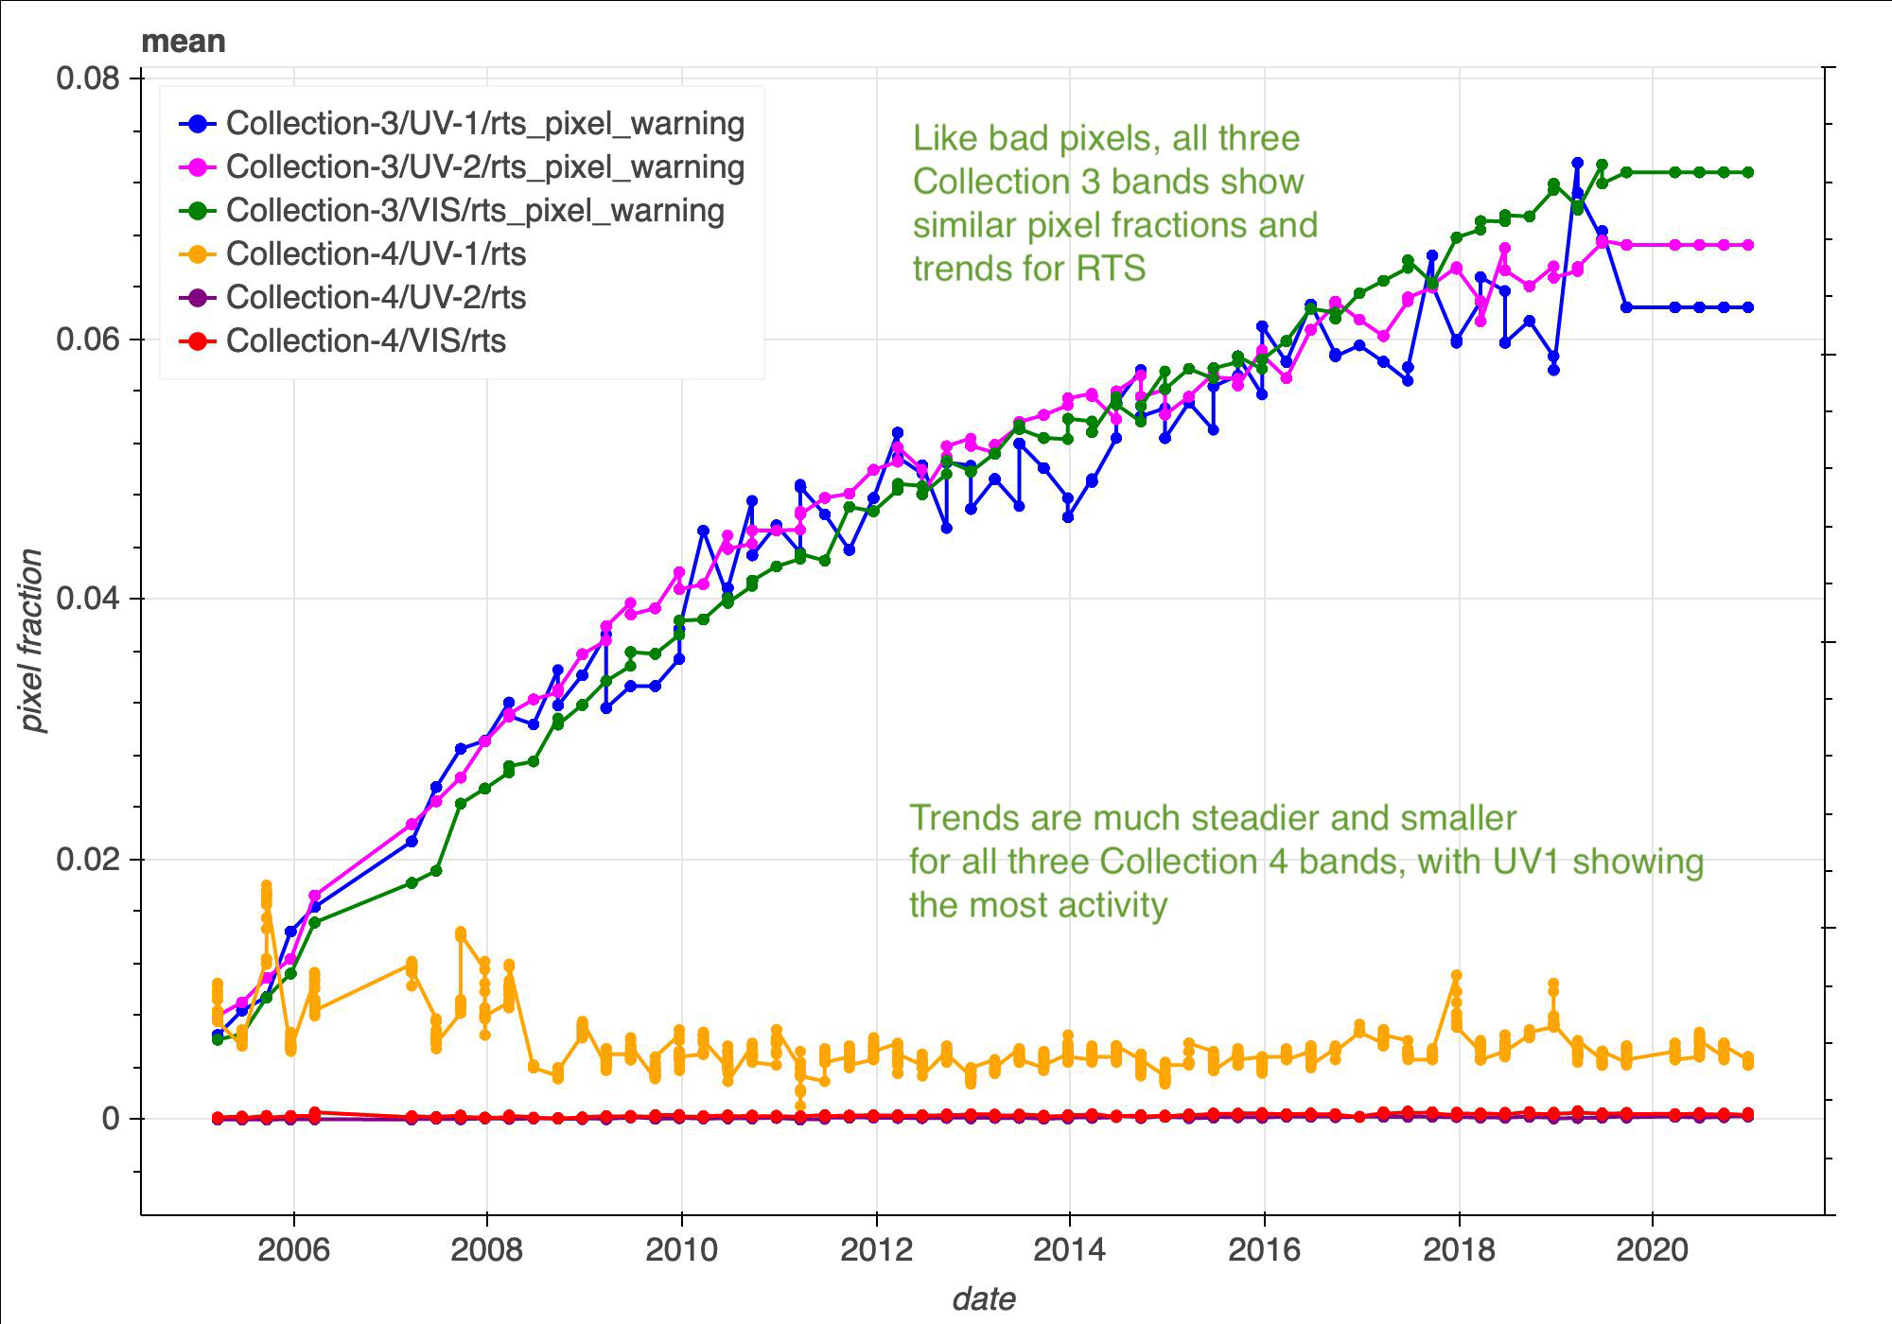
RTS over-flagging issues now resolved
Gain ratio drift corrected
Collection 4 gain ratios address a 0.4% drift

Slide 15
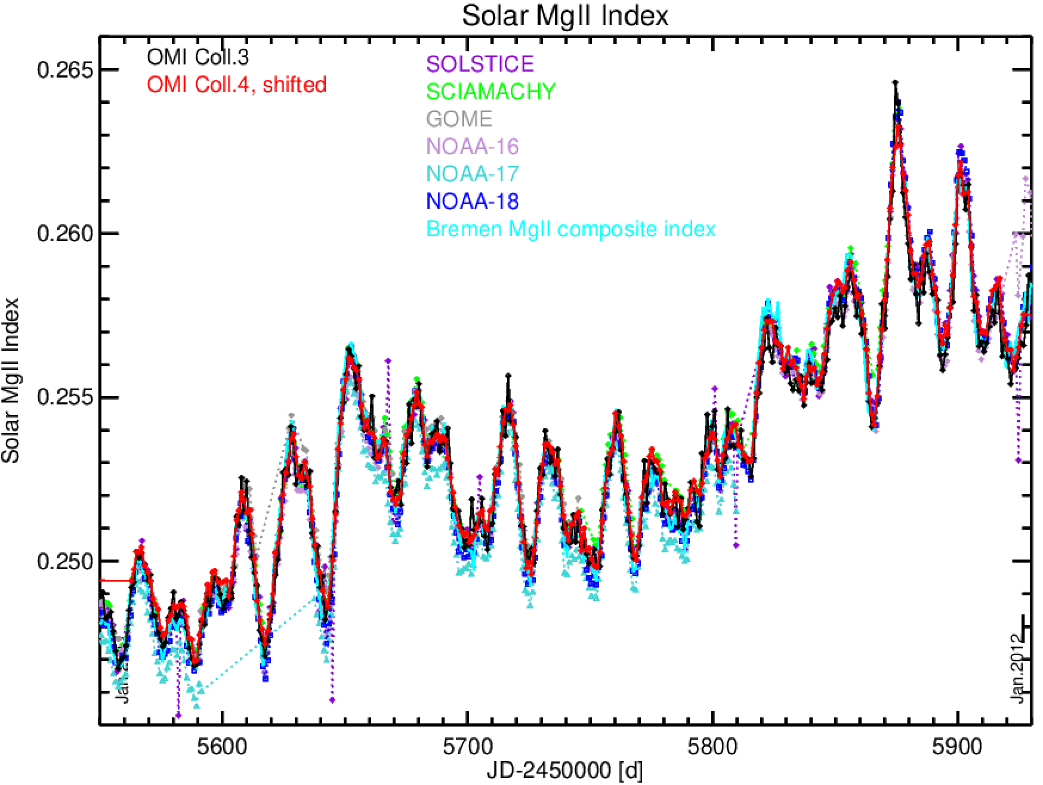
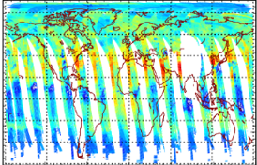
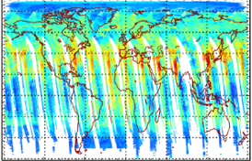
Feedback from the Science Team on Collection 4 L1B Data
Daily OMI Tropospheric Column ozone maps
Collection 4
June 21 2020
Collection 3
Sergey Marchenko (SSAI/NASA)
2005
Solar Activity
“(the Collection 4) solar indices are less noisy than the Collection 3 … in 2019 the data come to better agreement with the benchmark Bremen composite index. Both things are quite important.”
Juseon Bak (PNU), Xiong Liu (SAO)
Profile/Tropospheric Ozone
“In both UV1 and UV2 bands, the fitting accuracies are improved with Collection 4, especially for UV2.”
Glyoxal
“Retrievals using Collection 4 look more stable than those using Collection 3 and low and high biases disappear.”

Slide 16
Backup Slides

Slide 17
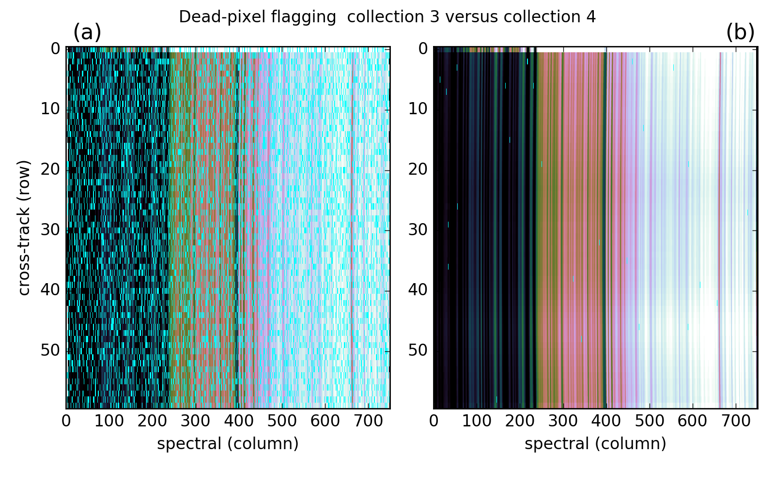
Improved Pixel Flagging

Slide 18
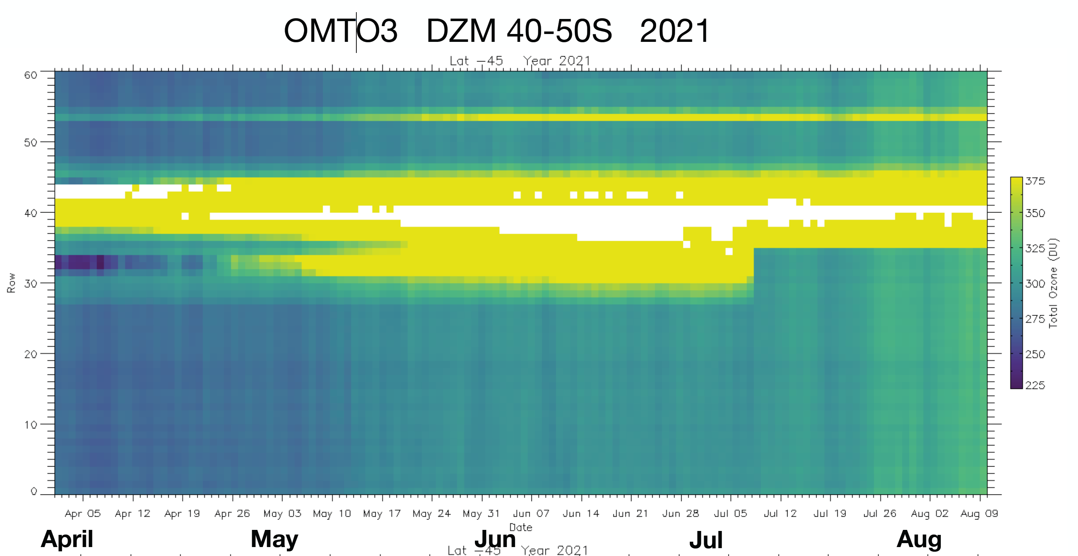
Recent Row Anomaly Shift

