Slide 1
JMA Agency Report for GDWG 2022
OKUYAMA Arata
Meteorological Satellite Center of JMA

Slide 2
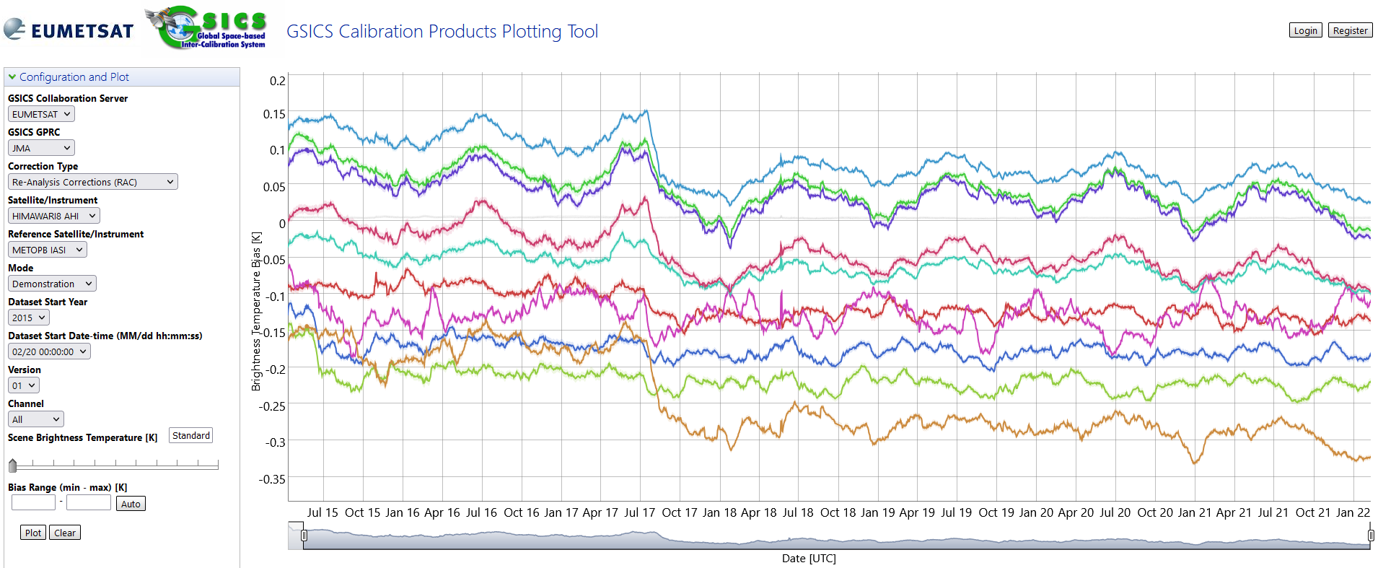
JMA GSICS Corrections
Status of GSICS Correction by JMA
The following Corrections are available from the GSICS server in EUMETSAT
Near-Real Time Correction
Himawari-8 / AHI / IR with reference to IASI-A/-B, AIRS: Demo. phase
MTSAT-2 / IMAGER / IR with reference to AIRS, IASI-A: Demo. phase
Re-analysis Correction
Himawari-8 / AHI / IR with reference to IASI-A/-B, AIRS: Demo. phase
MTSAT-2 / IMAGER / IR with reference to AIRS, IASI-A: Demo. phase
IASI-A had been supported until Oct. 2021. Implementation of IASI-C and CrIS is ongoing.

Slide 3
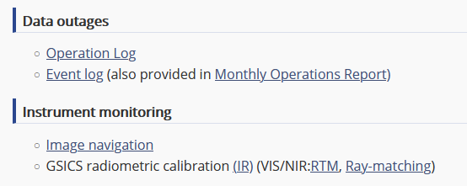
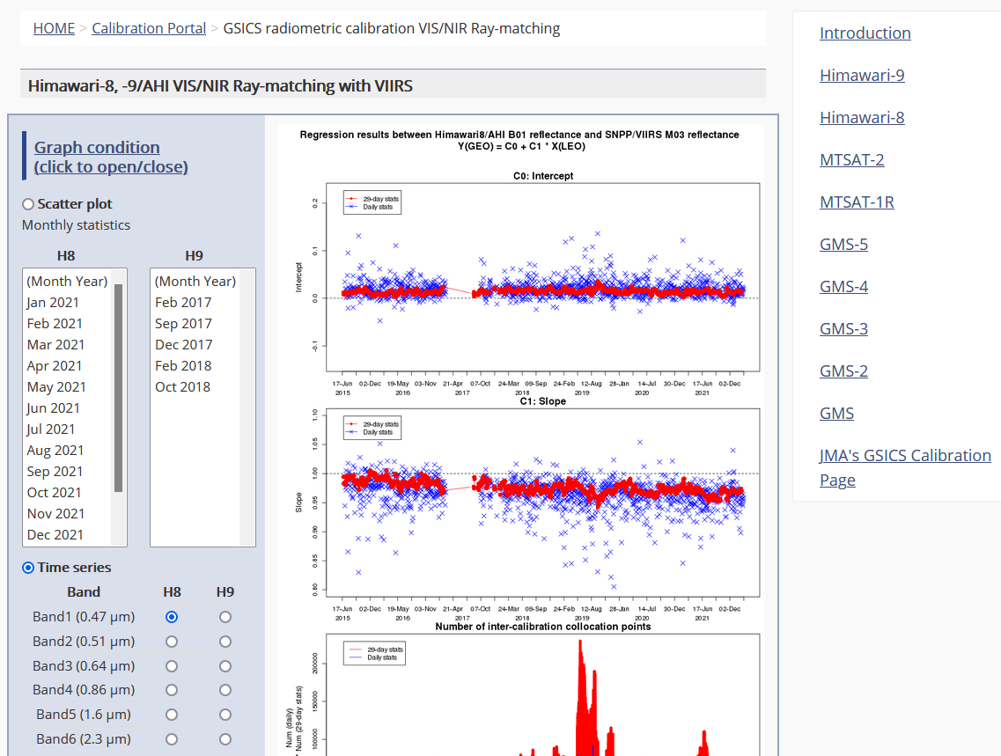
JMA GPRC web pages
Landing page (cal. portal)
Calibration monitoring
A Monitoring web page based on the ray-matching approach started in Jun. 2021. NOAA20/VIIRS will be added in Q2 2022.
Navigation monitoring
Event logging
Instrument information
Event logging
Information of incomplete imagery
Processing Events
Data Outage
Landing page:
https://www.data.jma.go.jp/mscweb/en/oper/calibration/calibration_portal.html
Event logging:
https://www.data.jma.go.jp/mscweb/en/oper/event_H8.html

Slide 4
Other topics
Switchover of the operational satellite
Switchover of the operational satellite from Himawari-8 to Himawari-9 is planned around December 2022. The switchover date will be announced as it is determined.
Calibration monitoring web on the Landing page already contains information about Himawari-9 past observation data.
Navigation monitoring page will support Himawari-9 when its observation start.

