Slide 1
2022 GSICS State of Observing System Report
For NOAA, by Xiangqian Wu and Likun Wang
With contributions from NOAA STAR Colleagues
Disclaimer: The scientific results and conclusions, as well as any views or opinions expressed herein, are those of the author(s) and do not necessarily reflect those of NOAA or the Department of Commerce.

Slide 2
Outline
Seven Instruments
  JPSS
    ATMS – Liu
    CrIS – Iturbide
    OMPS – Yan
    VIIRS – Cao
  GOES
    ABI – Wu
    GLM – Rudlosky
    Space Weather – Talaat
Eight Activities
  GSICS WG & Subgroup
    GDWG – Bali
    IR – Wang
    Microwave – Liu
    VNIR – Wu
    UNVS – Flynn
  GSICS Related:
    GRUAN – Reale
    ICVS – Yan
    Reprocessing – Zou
Old Template
  1-2 slides per instrument / activities
    Accuracy, Uncertainty, Events, Trend, …
  And Agency Report
    Launch schedule; action items; personnel; etc.
  And Special Issue:
    Reprocessing/Climate in 2021
    Space Weather in 2022
New Constraints
  Five slides maximum
New Format: One slide each for
  Reference instruments
  Monitored instruments
  Research

Slide 3
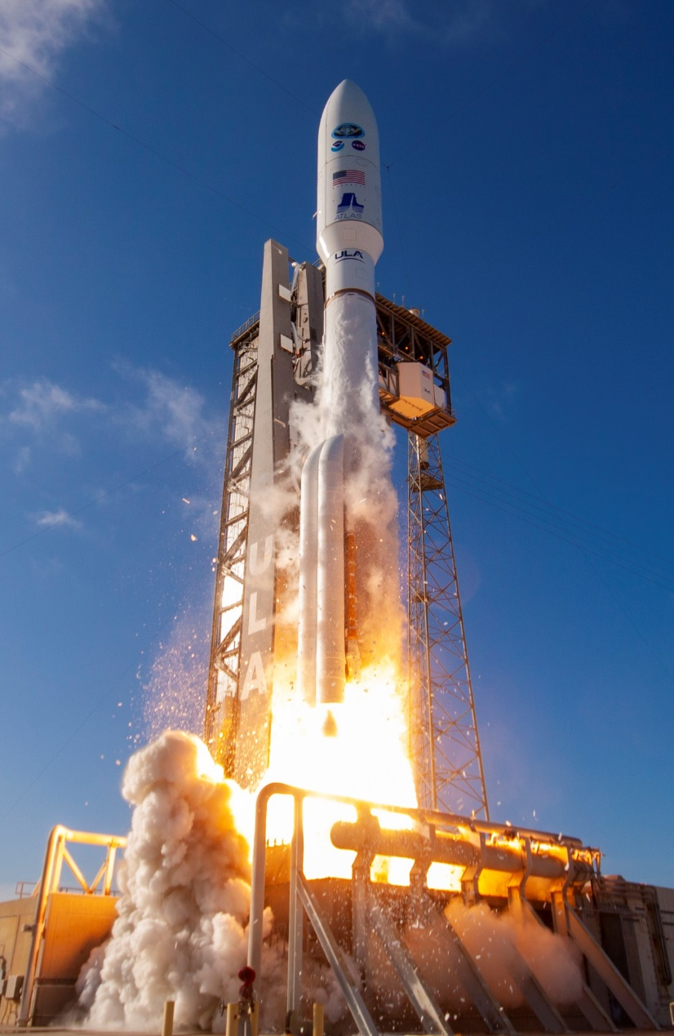
GOES-T on March 1, 2022

Slide 4
Reference Instrument Status
S-NPP and NOAA-20 VIIRS are in nominal status.
  DCC, SNO, global 20+ calibration sites, and lunar time series indicate that there is no significant drift in VIS bands.
  NOAA-20 VIIRS operational calibration updated (based on moon and DCC) for reflective solar bands; maximum correction for I1 will be about 0.24% per year for next two years.
  S-NPP safe-mode sun-pointing anomaly on 8/3/2021: VIIRS SDR data quality recovered back to normal after two days.
  NASA vs. NOAA NOAA-20 VIIRS RSB products are very stable and radiometrically consistent within 0.2% to 0.4% levels.
CrIS has provided high quality and stable calibrated observations for more than 10 years.
  The S-NPP CrIS successfully recalibrated on July 13 2021 after switching back to Side-1 electronics, with two functional bands (LWIR and SWIR).
  The S-NPP CrIS recovered from the Sun-Point Safe-Mode anomaly (August 3, 2021) and reached the full sensor stability on August 6, 2021.
  Intensive calibration/validation activities showed that the quality of the S-NPP CrIS observations was not impacted by the Sun-Point anomaly.
  The excellence performance of the CrIS instruments on S-NPP and NOAA-20 will continue with the J2 CrIS instrument, planned to be deployed into space in September 2022.
Notes:
No IR bands cal – not reference.

Slide 5
Monitored Instrument Status
ATMS SDRs are monitored by the NOAA Microwave Satellite Data Quality Monitoring System based on using GPS RO.
OMPS NM and NP
  The OMPS SDR products are monitored at: https://www.star.nesdis.noaa.gov/icvs/status_NPP_OMPS_NP.php
  The OMPS Nadir Mapper and Nadir Profiler instrument degradations are well-characterized by the annual reference solar measurements.
  The V8TOz and V8Pro ozone products for OMPS, SBUV/2 and GOME-2 are monitored at: https://www.star.nesdis.noaa.gov/smcd/spb/OMPSDemo/proOMPSbeta.php
ABI
  IR channels are monitored using two CrIS and three IASI (two after Sept 2021).
  VNIR channels are monitored using two VIIRS, augmented by lunar, desert, and DCC calibration.
  Setpoint for GOES-17 ABI IR channels was raised from 81 K to 84 K in October 2021 (and much higher briefly in February 2022). That altered the bias by up to 0.1 K for some channels, likely via SRF.
  Solar calibration frequency for GOES-16/17 ABI was increased from quarterly to bi-weekly since June 2021.

Slide 6
GSICS-Related Research
Investigated COSMIC-2 wetPrf Soundings Impacts on a RO-based NOAA Microwave Satellite Data Quality Monitoring System.
New method for MW Sounder Radiometric Noise Estimation to quantify instrument thermal noise and 1/f noise separately.
A new 32-Day Averaged Difference (32D-AD) method for calculating inter-sensor radiometric biases between S-NPP and NOAA-20 Instruments (ATMS, CrIS, OMPS NP, and VIIRS) within the ICVS framework
Improved the long-term monitoring stability within ICVS for S-NPP and NOAA-20 CrIS radiance differences by using a temporal interpolation-based SNO method via an ABI sensor.
NPROVS provides access and analysis of globally available collocated satellite and reference (GRUAN) radiosonde observations. These data can be used to evaluate satellite data quality.
  Datasets include SDR for selected collocations within 2-hours of satellite overpass (NOAA or MetOp) since 2018; over 5000 stored, and counting

Slide 7
Reprocessing (Climate)
Transition of reprocessed S-NPP SDRs (1.7 Pb) from NOAA/STAR to NOAA/CLASS for permanent archiving and operational distribution;
  ATMS V1 and V2 SDRs: Completed
  CrIS and OMPS V1 and V2 SDRs: Will complete in March 2022
  VIIRS SDRs: Will complete in October 2023
NOAA-20 reprocessing
  ATMS, CrIS, and OMPS completed
  VIIRS is being planned
To support AVHRR GAC based climate study and facilitate long term EDR (aerosol, cloud, polar wind) development, production of VIIRS Global Area Coverage (VGAC) Data is ongoing at NOAA/STAR in collaboration with NCEI.
A new reprocessing has been conducted to generate science-quality consistent lifetime S-NPP OMPS NM and NP SDR datasets until 06/30/2021, by using all validated calibration tables (including dynamic solar wavelength tables) and new improvements such as the updated stray light correction table, geolocation error correction table, and dark correction code error.

Slide 8
Backup slides

Slide 9
Support GSICS activities
EP: M. Goldberg.
GCC: L. Flynn, M. Bali.
GPRC: X. Wu, L. Wang.
  GDWG: M. Bali.
    ICVS: B. Yan, N. Sun.
  GRWG:
    UVNS: L. Flynn, B. Yan, C. Pan.
    VNIR: X. Wu, C. Cao, S. Uprety.
    IR: L. Wang, F. Yu.
    MW: Q. Liu, R. Iacovazzi.
    GRUAN: T. Reale.
    Reprocessing: C.-Z. Zou.
Instrument Leads
  JPSS
    ATMS – Liu
    CrIS – Iturbide
    OMPS – Yan
    VIIRS – Cao
  GOES
    ABI – Wu
    GLM – Rudlosky
    Space Weather – Talaat

Slide 10
NOAA VIIRS Update
S-NPP and NOAA-20 VIIRS are in nominal status.
  DCC, SNO, global 20+ calibration sites, and lunar time series indicate that there is no significant drift in VIS bands.
  NOAA-20 VIIRS operational calibration updated (based on moon and DCC) for reflective solar bands; maximum correction for I1 will be about 0.24% per year for next two years.
  Suomi NPP safe-mode/sun-pointing anomaly on 8/3/2021: VIIRS SDR data quality recovered back to normal after 2 days
NASA vs. NOAA NOAA-20 VIIRS RSB products are very stable and radiometrically consistent within 0.2% to 0.4% levels.
Archiving of Version 2 reprocessed SNPP VIIRS data is currently undergoing at NOAA CLASS.
NOAA-20 VIIRS reprocessing under NOAA COVID-19 project is complete.
To support AVHRR GAC based climate study and facilitate long term EDR (aerosol, cloud, polar wind) development, production of VIIRS Global Area Coverage (VGAC) Data is ongoing at NOAA/STAR in collaboration with NCEI.
JPSS-2 satellite integration completed: testing in progress for launch readiness in September 2022.
JPSS-3 VIIRS instrument testing to be completed in 2022, for launch readiness in 2027.

Slide 11
Successful Continuation of CrIS Observations and Recovery of SNPP CrIS Anomalies
The CrIS Program has provided high quality and stable calibrated observations for more than 10 years.
The SNPP CrIS successfully recalibrated on July 13, 2021 after switching back to Side-1 electronics, with two functional bands (LWIR and SWIR).
The SNPP CrIS recovered from the Sun-Point Safe-Mode anomaly (August 3, 2021) and reached the full sensor stability on August 6, 2021.
Intensive calibration/validation activities showed that the quality of the SNPP CrIS observations was not impacted by the Sun-Point anomaly.
The excellence performance of the CrIS instruments on SNPP and NOAA-20 will continue with the J2 CrIS instrument, planned to be deployed into space in September 2022.
POC: Flavio Iturbide-Sanchez (NOAA/NESDIS/STAR; Flavio.Iturbide@noaa.gov and Kun Zhang (GST Inc. at NOAA/NESDIS/STAR; Kun.Zhang@noaa.gov)

Slide 12
General Achievements and Progress
Investigated COSMIC-2 wetPrf Soundings Impacts on a RO-based NOAA Microwave Satellite Data Quality Monitoring System
  Sample number increases by ~10X, and distribution shifts to the tropics and subtropics
  Individual sensor changes in long-term mean observed minus CRTM-simulated (O-B) Ta bias
    Most instruments and monitored channels (< 0.2K shift)
    ATMS Ch 2-3 has 0.5 K shift due to antenna emissivity correction in October 2019
    ATMS(AMSU-A) Ch 15(14) has -0.5 K shift and 1.5 K semi-annual variability, due to COSMIC-2 replacement of ECMWF NWP gap-filler data between 40-60km.
  Inter-sensor double differences show very robust extensions for all monitored sensor pair groups
  S-NPP comparisons with UCAR-generated dry atmospheric temperature soundings

Slide 13
General Achievements and Progress
Microwave FCDR Development
  Reference mean layer mid-tropospheric temperature time series (2002 to present) created using AMSU-A and ATMS observations onboard satellites only in stable orbits to minimize diurnal sampling drifting errors.
  With high radiometric stability for individual satellite observations, the merged time series achieved an accuracy of 0.01K/Decade in trend detection, exceeding the GCOS requirement of 0.02K/Decade.
  The time series can be used as reference for trend detection and verifying other observations and climate model simulations.
MW Sounder Radiometric Noise Estimation
  New method to quantify instrument thermal noise and 1/f noise separately
  Separate PRT variation from calibrated warm load Tb to reduce the impact of orbit oscillation
  Split warm counts for independent calibration gain calculation and variance calculation to avoid pseudo f/2 noise
  Currently being tested before implementation into operations

Slide 14
NOAA UVN Spectrometer Subgroup Activities
OMPS NM and NP Monitoring and Stability
  The OMPS SDR (Level 1) products are monitored at: https://www.star.nesdis.noaa.gov/icvs/status_NPP_OMPS_NP.php
  The OMPS Nadir Mapper and Nadir Profiler instrument degradations are well-characterized by the annual reference solar measurements.
  The V8TOz and V8Pro ozone products for OMPS, SBUV/2 and GOME-2 are monitored at: https://www.star.nesdis.noaa.gov/smcd/spb/OMPSDemo/proOMPSbeta.php
  The full S-NPP and NOAA-20 OMPS SDR (Level 1) records have been reprocessed. We are developing soft calibration adjustments to force agreement between SBUV/2 and OMPS ozone records.
  The JPSS-02 (NOAA-21) launch with the third OMPS will take place later this year.
An Enterprise V8TOz algorithm has been applied to OMPS, GOME-2 and Tropomi, and it will be applied to GEMS, EPIC and TEMPO. Relative calibration offset are identified for the three main channels (318, 331 and 360 nm) and can be tracked over time.
NOAA is developing plans for the next GEO missions, GEO-XO. It will include Atmospheric Composition sensors. (Search on GEO XO NOAA for details.)

Slide 15
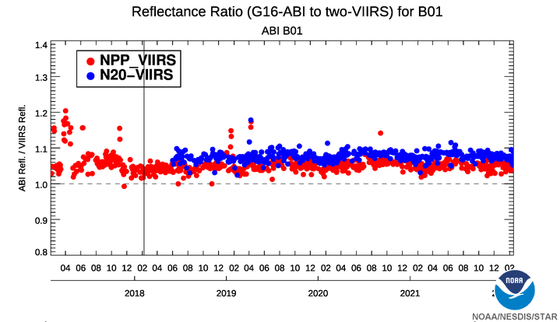
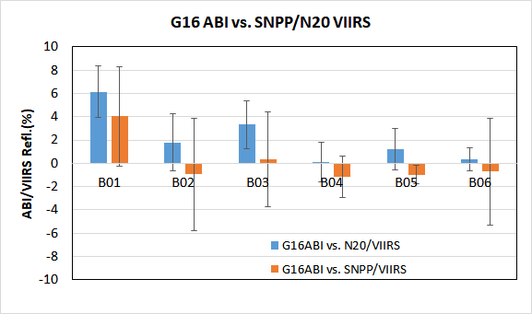
GOES-16 ABI VNIR Channels
Major Calibration Event in 2021
  Higher frequency of solar calibration cadence from quarterly to bi-weekly since late June 2021
Stable radiometric calibration for all six VNIR spectral channels in 2021
Figure 1: Time-series of daily mean reflectance ratio between G16 ABI and VIIRS onboard SNPP and NOAA-20 since the first light in Jan 2017. G16 ABI VNIR calibration has been in general stable since April 2019. Vertical gray line stands for the G16 operational time.
Figure 2: The mean and standard deviation values of the reflectance difference between G16 ABI and NOAA20 (N20) and SNPP VIIRS in 2021

Slide 16
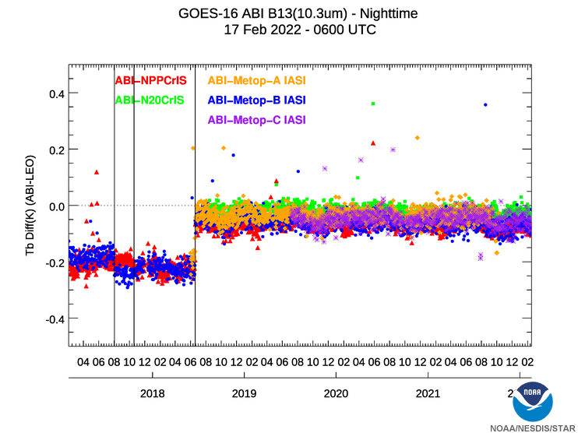
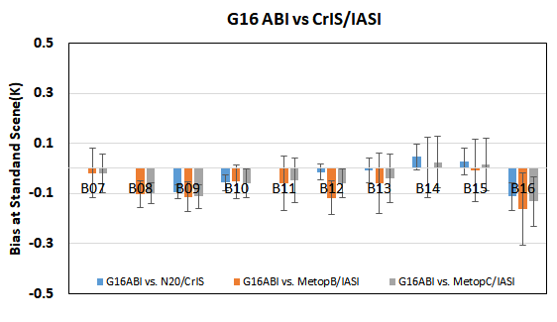
GOES-16 ABI IR Channels
Stable radiometric calibration for all the ten IR channels in 2021
Figure 2: GEO-LEO bias and uncertainty at the standard scene temperature values in 2021 for the 10 G16 ABI IR channels.
Figure 1: Time-series of daily mean Tb difference between G16 ABI and a series of hyperspectral radiometers onboard LEO satellites since the first light in Jan 2017. G16 ABI IR calibration has been stable since June 2018. Vertical lines stands for two G16 ABI IR Ground System (GS) updates in Oct. 2019 and June 2018, and one Metop-B GS update in August 2017.

Slide 17
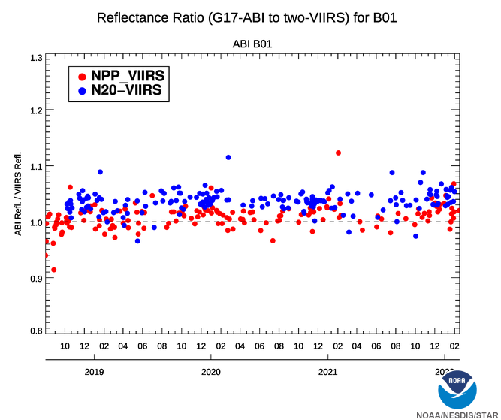
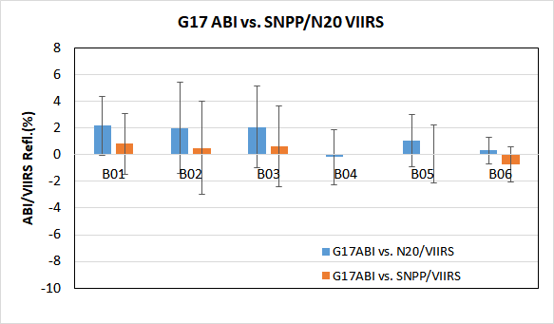
GOES-17 ABI VNIR Channels
Major Calibration Event in 2021
  Solar Calibration Candance was changed from quarterly to bi-weekly since late June 2021
G17 VNIR Calibration was stable in 2021
Figure 2: The mean and standard deviation values of the reflectance difference between G17 ABI and N20 and SNPP VIIRS in 2021..
Figure 1: Time-series of daily mean reflectance ratio between G17 ABI and VIIRS onboard SNPP and NOAA-20 (N20) since August 2018. G17 ABI VNIR calibration has been in general stable since April 2019.

Slide 18
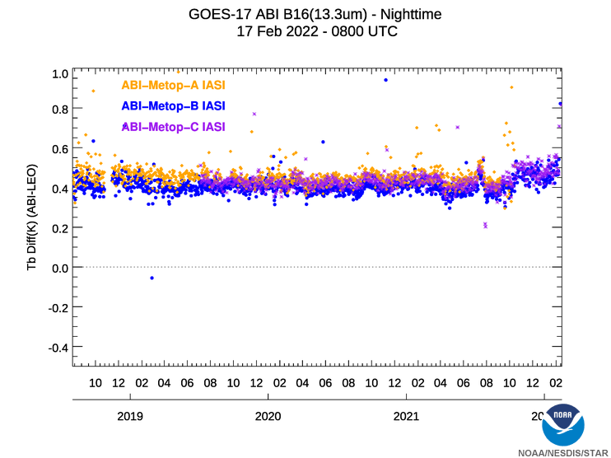
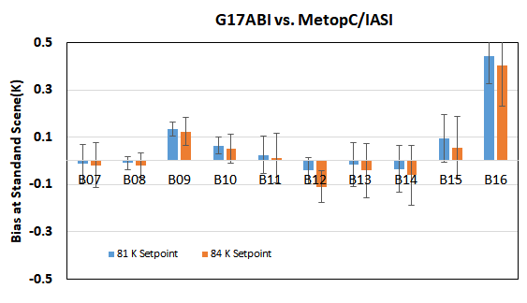
GOES-17 ABI IR Channels
Major Calibration Event in 2021
  The nominal cryocooler setpoint temperature was raised from 81 K to 84 K on in early October 2021 after several earlier tests.
  Impact on the IR nominal radiometric calibration accuracy was small (<0.1K) as shown in Figures below
Figure 1: G17 IR radiometric calibration accuracy is relatively stable during in the nominal calibration period, as shown the daily mean GEO-LEO bias monitoring. Slight change of bias can be observed at B16 in early Oct after the setpoint change.
Figure 2: Impact of the setpoint temperature change on the G17 IR nominal calibration accuracy as referred to Metop-C/IASI

Slide 19
ICVS – Yan
In Remote Sensing, published a new 32-Day Averaged Difference (32D-AD) method for calculating inter-sensor radiometric biases between SNPP and NOAA-20 Instruments (ATMS, CrIS, OMPS NP, and VIIRS) within the ICVS framework (B. Yan et al., 2021).
Initialized an ICVS web-based monitoring tool to provide long-term performance of inter-sensor radiance differences for SNPP and NOAA-20 using multiple methods (e.g., https://www.star.nesdis.noaa.gov/icvs-beta/comparison_ATMS.php)
Improved the long-term monitoring stability within ICVS for SNPP and NOAA-20 CrIS radiance differences by using a temporal interpolation-based SNO method via an ABI sensor (X. Jin et al., 2022)
A new statistical method for SNPP and NOAA-20 SDR Inter-Sensor Radiance Difference Analysis: 32D-AD method: Comparison with other 2 DD methods
Figure Comparisons of SNPP and NOAA-20 ATMS inter-sensor calibration radiometric biases by using three different methods, with the data spanning on Nov. 1 2020 through Dec. 2, 2020. Here, the 32D-AD method is applied to 22 channels while other two methods (CRTM-DD and AMSU-A-DD) are applied to part of the 22 channels. The inter-sensor calibration biases are within 0.5 K demonstrating that the ATMS TDR data from SNPP and NOAA-20 agree well. The new method also exhibits the good agreement with other two existing DD methods for the available channels in the DD methods.
Notes:
New 32-Day Averaged Difference (32D-AD) Method for Calculating Inter-Sensor Radiometric Biases between SNPP and NOAA-20 Instruments (ATMS, CrIS, OMPS NP, and VIIRS) within ICVS Framework (B. Yan et. al., 2020 IGRASS Virtual Conference)
Assessed the difference between SNPP and NOAA-20 CrIS using ABI as transfer (X. Jin et al., 2021 101st AMS annual virtual meeting).
Developed a new NEDT algorithm development for onboard MW instrument (B. Yan and S. V. Kireev, ITGRS 2021)

Slide 20
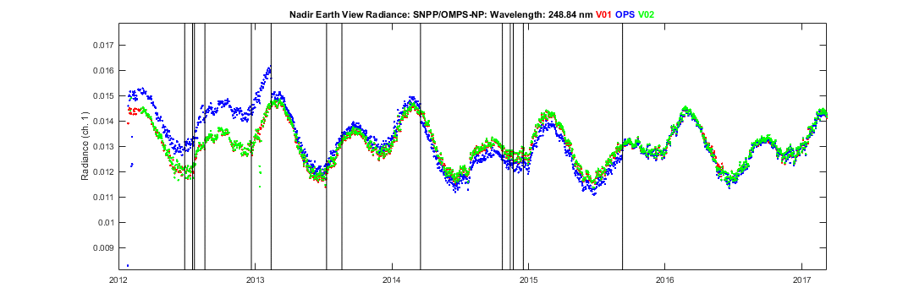
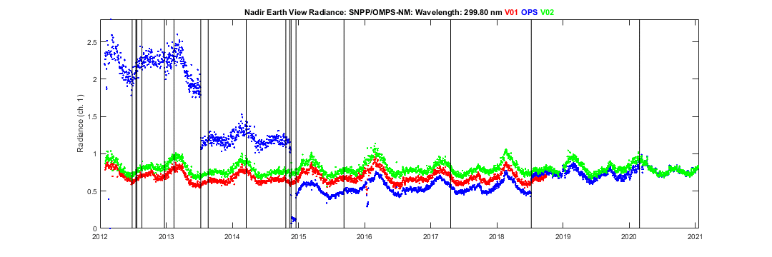
OMPS SDR (Yan)
A new reprocessing has been conducted to generate science-quality consistent lifetime SNPP OMPS NM and NP SDR datasets until 06/30/2021, by using all validated calibration tables (including dynamic solar wavelength tables) and new improvements such as the updated stray light correction table, geolocation error correction table, and dark correction code error (referring to B. Yan et. al., 102nd AMS Virtual Conference).
The new reprocessing (v02) demonstrates life-time quality-consistent sensor data records (SDR), having a much better performance than both the operational and previously reprocessed SDR data sets.
The newly reprocessed SNPP OMPS NM/NP SDR datasets will be archived in the NOAA CLASS that is accessible to public users.
(a) LT Performance of SNPP OMPS NP Nadir Radiance at 147 Channels
(Tropical Region; Animated Time Series)
The newly (v02) (green) reprocessed data demonstrate a quality-consistent LT performance for all OMPS NM and NP channels.
Ops data exhibit large fluctuations due to non-validated calibration LUTs prior to 09/09/2015
(b) LT Performance of SNPP OMPS NM Nadir Radiance at 196 Channels
(Tropical Region; Animated Time Series)

Slide 21
Reprocessing – Zou
Transition of reprocessed S-NPP SDRs from NOAA/STAR to NOAA/CLASS for permanent archiving and operational distribution; Total data volume 1.7Pb
Transition of reprocessed ATMS V1 and V2 SDRs completed
Transition of reprocessed CrIS and OMPS V1 and V2 SDRs will be completed in March 2022
Transition of reprocessed VIIRS SDRs will be completed in October 2023
NOAA-20 reprocessing
ATMS, CrIS, and OMPS completed
VIIRS is being planned

Slide 22
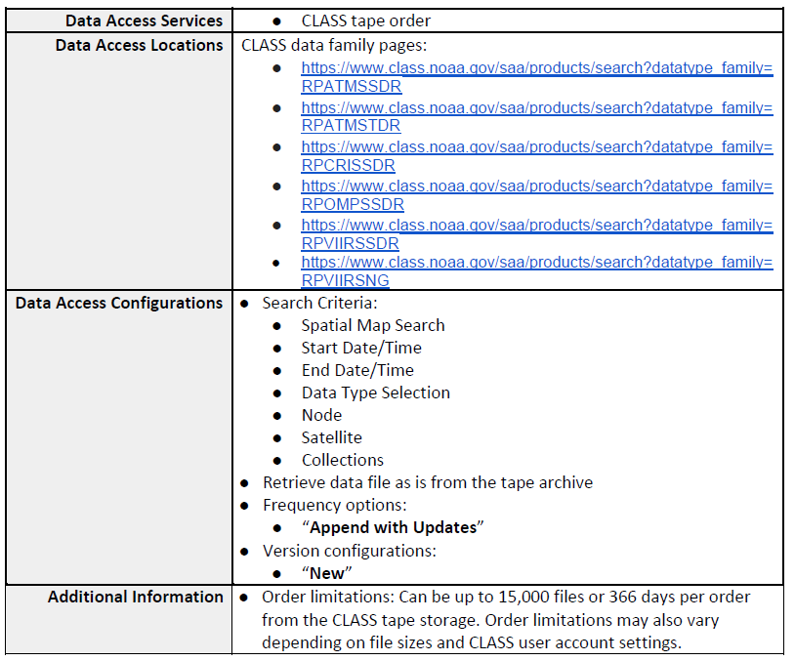
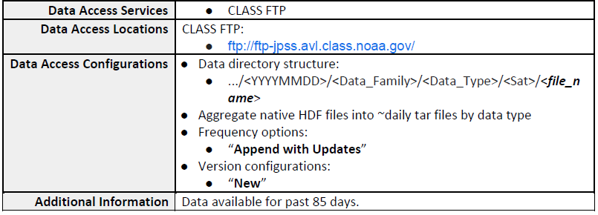
Reprocessing – Zou
Two options to get the reprocessed S-NPP SDR data from NCEI/CLASS
Archive Tape Search and Order
B. Recent Tar File FTP Download
ftp://ftp-jpss.avl.class.noaa.gov/STAR/

Slide 23
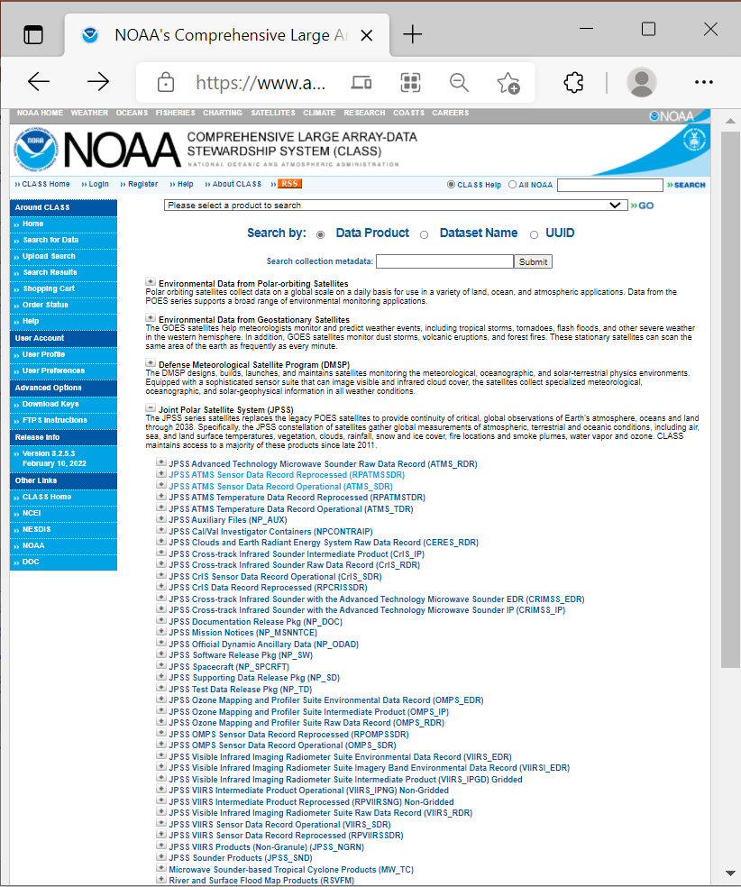
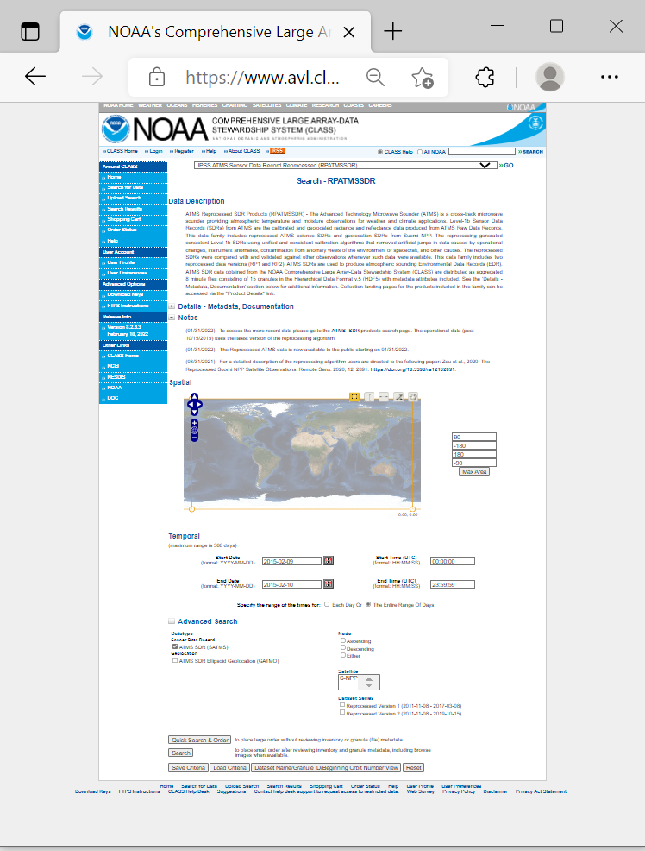
Reprocessing – Zou
https://www.avl.class.noaa.gov/saa/products/catSearch
JPSS ATMS Sensor Data Record Reprocessed (RPATMSSDR)
CLASS Archive Search and Order Interface
JPSS ATMS Sensor Data Record Reprocessed (RPATMSSDR)
JPSS ATMS Temperature Data Record Reprocessed (RPATMSTDR)
JPSS CrIS Sensor Data Record Reprocessed (RPCRISSDR)
JPSS OMPS Sensor Data Record Reprocessed (RPOMPSSDR)
JPSS VIIRS Intermediate Product Reprocessed (RPVIIRSNG) Non-Gridded
JPSS VIIRS Sensor Data Record Reprocessed (RPVIIRSSDR)
The reprocessed SNPP ATMS data is available now!

Slide 24
Activities & Achievements – GDWG
THREDDS server to integrate NOAA with the GSICS collaboration server.
Alert System to update on status of product creation.
Notebook that combines Processors, Code, and GSICS products.
Wiki as a platform to exchange ideas.
Inter-Calibration Platform, a python platform with readers of satellite data, collocation algorithm, and radiative transfer model that can compare wide range of observing systems.
Action Tracker on Google Cloud to extract and publish actions, recommendations, and decisions.
New Colab Platforms
  Produce State of Observing System Charts
  Visualize and Analyze GEMS data at all available resolutions
New features added in the GSICS Product monitoring System

Slide 25
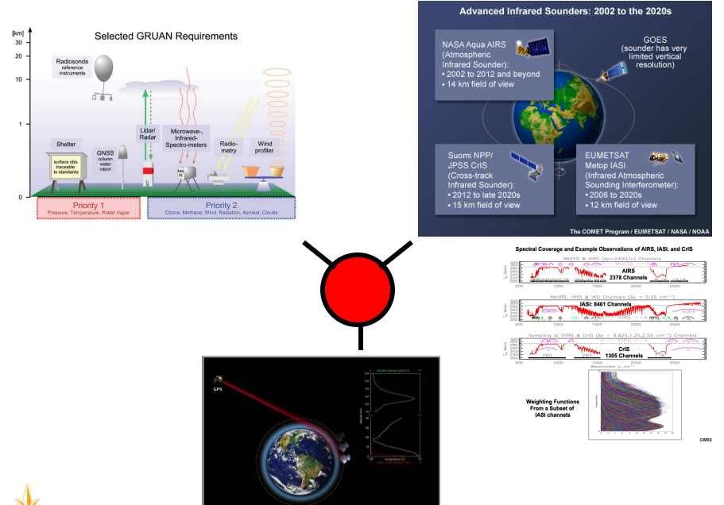
GRUAN for Inter-Calibration
In-situ
Data
Monitoring
Satellite
Sensor
Monitoring
GRUAN-GSICS Interaction
GRUAN-GNSS Interaction
STAR/SMCD - NPROVS supports GSICS Research and Data Management Working Groups by providing access/analysis of collocated satellite and reference (GRUAN) in-situ observations … 0.1 FTE
GNSS-GSICS Interaction
Sun et al. 2021 (see note page).
Global Space-based Inter-Calibration System (GSICS),
GNSS and GRUAN Framework (3G)
Notes:
Sun, B.; Calbet, X.; Reale, A.; Schroeder, S.; Bali, M.; Smith, R.; Pettey, M. Accuracy of Vaisala RS41 and RS92 Upper Tropospheric Humidity Compared to Satellite Hyperspectral Infrared Measurements. Remote Sens. 2021, 13, 173. https://doi.org/10.3390/ rs13020173

Slide 26
Activities & Achievements – GRUAN
NPROVS provides access and analysis of globally available collocated satellite and reference (GRUAN) radiosonde observations
Datasets include SDR for selected collocations within 2-hours of satellite overpass (NOAA or MetOp) since 2018; over 5000 stored, and counting
GRUAN Data Product (GDP) is now available (as of February 2022) for the technically advanced Vaisala RS41 radiosonde which replaced RS92 beginning 2016 (see next slide); these are being integrated into NPROVS
Notes:
NPROVS: NOAA Product Validation System.
GCOS: Global Climate Observing System.
GRUAN: GCOS Reference Upper Air Network.

Slide 27
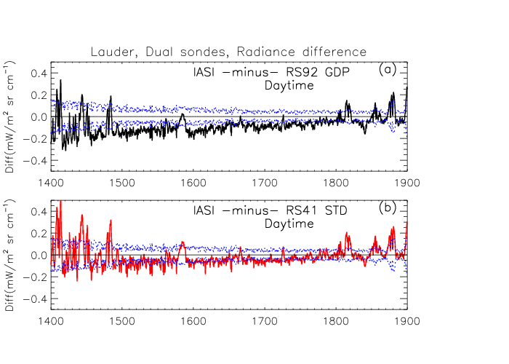
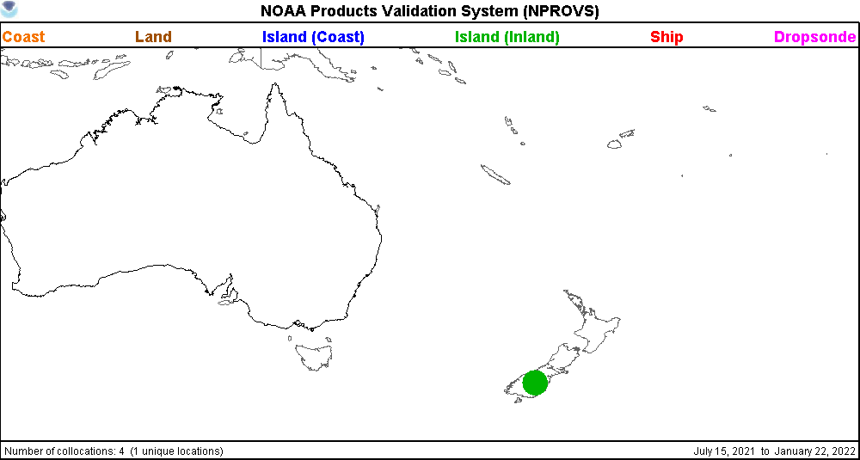
Lauder, NZ
Duals (RS92 GDP & RS41 STD) vs Satellite Sensor
RS92 GDP:
-0.1291 (0.085) mW m⁻² sr cm⁻¹
2.8% dry bias in RH
RS41 STD:
-0.0705 (0.081) mW m⁻² sr cm⁻¹
1.4% dry bias in RH
Preliminary comparisons between RS92 (GRUAN (GDP) processed, top) and Vaisala RS41 (standard (STD) vendor processed, bottom)
show reduced bias in UTLS RH for RS41 vs RS92 baselined to IASI spectral data sensitive to upper troposphetc moisture
(blue dotted curves: 2 x (IASI, RAOB and collocation uncertainty); RS41 within blue curves. Future results versus RS41 GDP planned
Sun, Calbet, Reale, Schroeder, Bali, Smith, and Pettey, 2021: “Accuracy of Vaisala RS41 and RS92 upper tropospheric humidity compared to satellite hyperspectral infrared measurements”. Remote Sens. 2021, 13, 173. https://doi.org/10.3390/rs13020173.
27

Slide 28
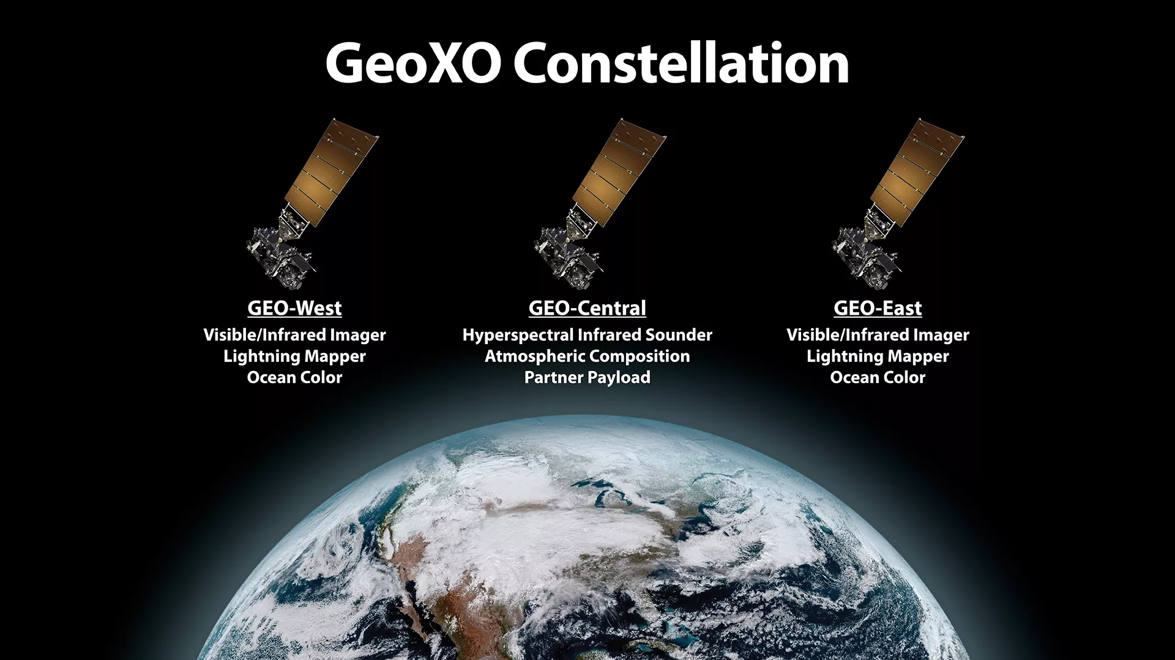
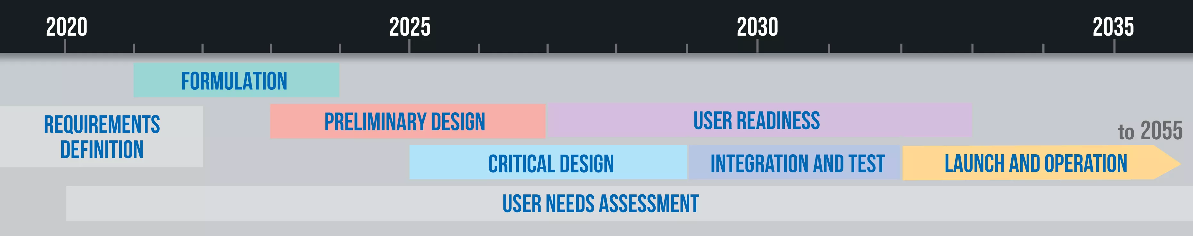
GeoXO Update – Wu
3-sat constellation
Partner payload
Cloud-based distribution
Imager & Lightning
IR Sounder
Nighttime imagery
Ocean color
Atmospheric composition
Notes:
https://www.nesdis.noaa.gov/next-generation/geostationary-extended-observations-geoxo

