Slide 1
GRWG Report Fangfang Yu and Xiuqing Hu 03/18/2022
Special Issue of the IEEE TGRS on “Inter-Calibration of Satellite Instruments”:
Special Issue of the IEEE TGRS on “Inter-Calibration of Satellite Instruments”:

Slide 2
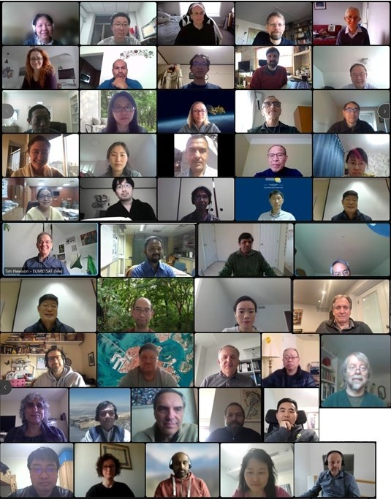
2022 GSICS Annual Meeting
First mini-conference in the pandemic period, after two-year gap.
More than 65 people from international space and operational agencies, research institutes, universities, and private sectors attended meeting this year.
Thirteen agencies made the annual agency reports
Thanks for the helps from EP, GCC, GDWG and GRWG members

Slide 3
2022 Annual Meeting (Virtual)
10 March |  | 14 March | 15 March | 16 March |  | 17 March |  | 18 March
break-out session |  | Plenary | Plenary | Break-out | Break-out | Break-out | Breakout | Plenary
UVNS Subgroup |  | Mini Conference | Agent Report | IR subgroup | GDWG | VNIR subgroup | MW subgroup | Cross-cutting
http://gsics.atmos.umd.edu/bin/view/Development/Annualmeeting2022

Slide 4
Overview
GRWG Chairing
GSICS Calibration Activities
Collaboration and Outreach
Advances in GSICS
GRWG Actions Review

Slide 5
GRWG Chairing
GSICS Research Working Group
Chair: Fangfang Yu
Outgoing-Chair: Xiuqing “Scott” Hu
incoming-Chair: XXXX
UVN Spectrometer Sub-Group
Chair: Rose Munro
Acting: Larry Flynn
IR Sub-Group
Chair: Likun Wang
VIS/NIR Sub-Group
Chair: Dave Doelling
Microwave Sub-Group
Chair: Qifeng Lu
Fangfang Yu became the presiding Chair in November 2021.
Scott Hu acts as the vice (outgoing) Chair
We Need a new GRWG vice (incoming) Chair.
WMO Secretariat: Heikki Pohjola

Slide 6
A New Deliverable on Horizon
NOAA’s Microwave Instrument Calibration Processing System (MICalPS)
Currently under NOAA software release process
To be available to GSICS members through Github
Details in the MW Subgroup Report
http://gsics.atmos.umd.edu/bin/view/Development/2022_MWSG_TechnicalWorkshop

Slide 7
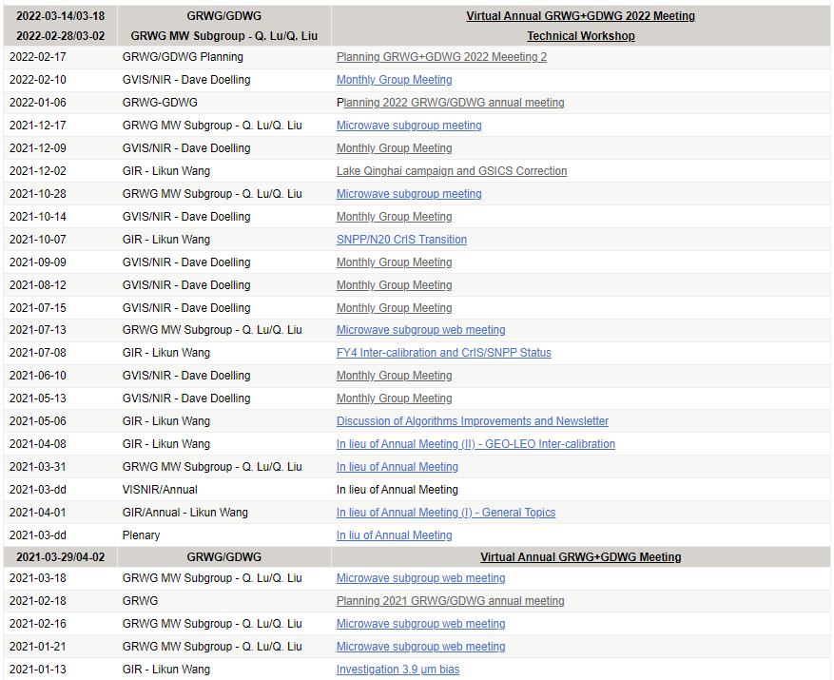
GRWG Subgroup Activities
Very Active and Productive GRWG Subgroups
Monthly/bi-monthly web-meetings for IR/VNIR/MW subgroups through out the year
One technical workshop hosted by Microwave subgroup
Feb 28 – Mar 2, 2022
Details in the GRWG subgroup reports.

Slide 8
State of Observing System Report
Continue to collect the state of observing system report from the state and operational agencies
Some agencies already submitted inside the agency report package
Current due date: 03/25/2022
Discussion:
Acronym?
How to archive the report? Is it a GSICS product/deliverable?

Slide 9
Collaboration and Outreach
Enhance the collaboration with NWP/RTM community
Continuing the well known mutually beneficial collaboration in the WM and IR spectral ranges
New collaboration field in the VNIR wavelengths
Continue the active collaboration with ISCCP-NS
Extend the influence of calibration activities in commercial space missions

Slide 10
Advances in GSICS
First early-morning orbit meteorological satellite (FY-3E)
To help improve NWP accuracy and time efficiency
Implementation of GSICS harmonization products
More discussions across the subgroups and GDWG will follow up
Others?

Slide 11
Topics/Actions in Min-Conf Minutes
Proposal discussion on SRF retrievals for web meeting
CMA(Xu Na) recently published a nice paper on SRF retrievals
Recommendation: CMA to compare with FY-4A/AGRI and GIIRS and report the results in IR subgroup.
Lunar calibration of Planet labs satellites will be presented in monthly meeting
Action: Tim Hewison (EUMETSAT) to provide Tech Note providing guidance on how to apply GSICS correction (harmonization) for GEO imagers to Andy Heidinger to request feedback
Action: Andy Heidinger to put the link to the ISCCP-NG in the minutes.

Slide 12
Webmeeting Topics in Agency Report Minutes
Seasonal cycle in ABI/AHI/AMI VNIR calibration
IASI lunar calibration and SUMULU (CNES)
INSAT-3R bias during eclipse season.
Recommendation to ISRO: to include CrIS and/or HIRAS in GEO-LEO IR to investigate diurnal variations
ESA proposed several web meeting topics – GEO microwave, SLSTR calibration, Sentinel 2A-2B inter-calibration, SMOS and SWARM contribution to space weather
Fangfang to give a talk on G16/17 ABI IR calibration at an IR web meeting

Slide 13
GRWG Actions Reviews (2021)
Action ID | Summary | Lead | Exp. Date | Status
None in 2021

Slide 14
GRWG Actions Reviews (2020)
Action ID | Summary | Lead | Exp. Date | Status
D.GRWG.20200812.1 | Dedicated meetings on specific topics. ISCCP and GSICS to participate in each other’s meetings. |  | 3/1/2021 | Open
A.GWG.20200519.6 | Heidinger (NOAA) to coordinate with GRWG to take VIS and IR to discuss next steps for the GSICS – ISCCP/NG collaboration |  | 5/1/2021 | Open
A.GWG.20200416.1 | Dorothee Coppens (EUMETSAT) to circulate plans for Metop-A End Of Life testing, which is expected for 2021Q3/Q4 for IASI |  | 3/1/2021 | Closed
A.GWG.2020.1f.1 | GSICS will hold a web meeting in June to establish a Task Force from GSICS and ISCCP-NG to identify requirements and set up pilot programs before a meeting at EUMETSAT in September |  | 3/1/2021 | Closed
A.GWG.2020.1e.1 | Create a GSICS Meeting to discuss GSICS input and what we would like to learn to guide participation in the ECMWF/EUMETSAT Workshop on characterizing random and systematic errors in satellite data assimilation for NWP. The meeting needs to occur before 30 September 2020. Assigned to Tim Hewison. (Note relationship to Action: A.GCC.2020.1b.1 ) |  | 3/1/2021 | Closed
A.GWG.2020.1a.2 | All agencies to compile reports on calibration of instruments monitored by GSICS, following the template - to include IASI double-differences. Reports due by the end of April. A web meeting will be organized and held in early May to review the submitted reports. Assigned to all agencies. |  | 3/1/2021 | Open
A.GRWG.20201020.4 | GRWG to provide inputs to GDWG as to what convention changes needed for new/revised products | T. Hewison | 3/1/2021 | Open
A.GRWG.20200812.4 | Ken Knapp (NOAA) to solicit ISSCP-NG comments on GEO imager calibration accuracy capabilities and requirements based on Table 1 of Hewison et al. 2020 |  | 3/1/2021 | Open
A.GRWG.20200812.3 | GRWG to investigate 3.8 micron daytime calibration |  | 3/1/2021 | Open

Slide 15
GRWG Actions Reviews (2019)
Action ID | Summary | Lead | Exp. Date | Status
A.GRWG.2019.10b.1 | Scott Hu (CMA) to add one more objective in the lunar workshop that new measure (e.g. air-LUSI) can constrain the uncertainty of the lunar irradiance models. |  | 3/1/2020 | Open
A.GRWG.2019.10b.3 | Scott Hu (CMA) to incorporate the comments and suggestions from the annual meeting in the report of the potential re-calibration/re-processing workshop to the EP. |  | 3/1/2020 | Open
A.GRWG.2019.2e.1 | CNES to report on progress with Lunar thermal infrared model study by 2020 meeting. |  | 3/1/2020 | Open
A.GRWG.2019.3b.1 | Scott Hu (CMA) to ensure that POC for SPIT from each agency be nominated. |  | 3/1/2020 | Open
A.GRWG.2019.4i.1 | Present a request to LASP to provide a reference solar irradiance spectrum based on the TSIS project (a static and high resolution solar spectrum scaled to TSIS). |  | 3/1/2020 | Open
A.GRWG.2019.4i.2 | Dave Doelling (NASA) to organise a web meeting and invite LASP to discuss on the progress for establishing a high resolution solar spectrum based on TSIS, with an estimate of the associated uncertainties. This spectrum is to be used in the VNIR activities. |  | 3/1/2020 | Open
A.GRWG.2019.4v.1 | Tom Stone (USGS) to organise a web meeting in conjunction with Seb Wagner in preparation of the next Lunar Cal workshop by the end of 2019 |  | 3/1/2020 | Open
A.GRWG.2019.4v.2 | D. Doelling (NASA) to organise a web meeting on the DCC and the preparation of a paper. |  | 3/1/2020 | Open

Slide 16
GRWG Actions Reviews (2019)
Action ID | Summary | Lead | Exp. Date | Status
A.GRWG.2019.8e.1 | Rose Munro, EUMETSAT, to circulate additional ideas for new subgroup names. |  | 3/1/2020 | Closed
A.GRWG.2019.8e.2 | GRWG Chair to raise the proposal to rename the UVSG to the EP. |  | 3/1/2020 | Open -> Closed
A.GRWG.2019.9e.1 | Lin Chen (CMA) and Sebastien Wagner (EUMETSAT) to specify user requirements and use cases on Level-1 data subsets over PICS and SNO prediction, and present it to GRWG in order to see if this is useful for the supporting GPRC organisations. |  | 3/1/2020 | Open
A.GRWG.2019.9p.3 | GRWG Chair to consider improving the GSICS inter-calibration coefficients because they are difficult for the user to apply these corrections. |  | 3/1/2020 | Open
A.GRWG.20190516.2 | GRWG to prepare the State of Observing System report. |  | EP-21 | Open
A.GRWG.20190516.3 | GRWG to organize the mini-conference on MW inter- calibration in 2020 GSICS annual meeting. |  | EP-21 | Open
A.GRWG.20190516.3 | GRWG to develop Terms of References for GRWG sub- groups. |  | EP-21 | Open
A.GRWG2019.3m.1 | Sirish Uprety (NOAA) to report back on outcome of comparison of VIIRS v2 versus NASA SIPS dataset. |  | 3/1/2020 | Open
A.GRWG2019.3n.1 | Bill Bell (ECMWF) to clarify time scale with the partner agencies for input data needed for ERA-6 activities. |  | 3/1/2020 | Open
A.GRWG2019.3p.1 | Fangfang Yu (NOAA) to set-up a web meeting to initiate a discussion on establishing a strawman algorithm for GEO-GEO inter-comparisons |  | 3/1/2020 | Closed

Slide 17
Thank you!

