Slide 1
KMA GSICS Agency Report 2022
Jiyoung Kim,
Eunkyu Kim, and Minju Gu
KMA/NMSC

Slide 2
Presentation Overview
Summary of Agency’s GSICS Activities, Actions, and Achievements
Agency’s Support to GDWG Activities
Agency’s Support to GRWG Activities
Agency’s Calibration Stand-up Items

Slide 3
Summary of KMA’s GSICS Activities, Actions, and Achievements
Current Status of KMA activities
Generation of GSICS product for IR
Demonstration phase of GK2A/AMI IR channel with IASI/CrIS for NRTC and RAC
GK2A AMI lunar calibration for 6 VIS/NIR channel
Achievements Summary
Develop the additional satellite (NOAA-20/VIIRS) for ray matching method and DCC based NASA algorithm in VNIR calibration

Slide 4
Support to GDWG Activities
Summary of the tasks of KMA’s supports in the GDWG
Set up and operate a GitHub project for GDWG activities
Building a plotting tool development environments in KMA
Review GPRC websites
Overview of the resources and time taken for this support
Eunkyu Kim

Slide 5
Support to GRWG Activities
Summary of the tasks of KMA’s supports in the GRWG
Monitoring of GEO-LEO using MetOp-B, -C/IASI, SNPP and NOAA20/CrIS for IR
Application of gap-filling method to inter-calibrate with CrIS
Demonstration phase for NRTC and RAC data (MetOp-B, -C/IASI, SNPP and NOAA20/CrIS)
Develop GEO-GEO direct comparison for both IR and visible channel
Long-term analysis AMI vs AHI (application of SBAF)
Develop and update calibration approaches
Lunar calibration
Ray matching method and GSICS DCC with NOAA-20/VIIRS
Overview of the resources and time taken for this support
Jiyoung Kim, Eunkyu Kim(VNIR), Minju Gu*(IR)
* leave of absence
Issues
GK2A AMI VNIR channels seasonal variation

Slide 6
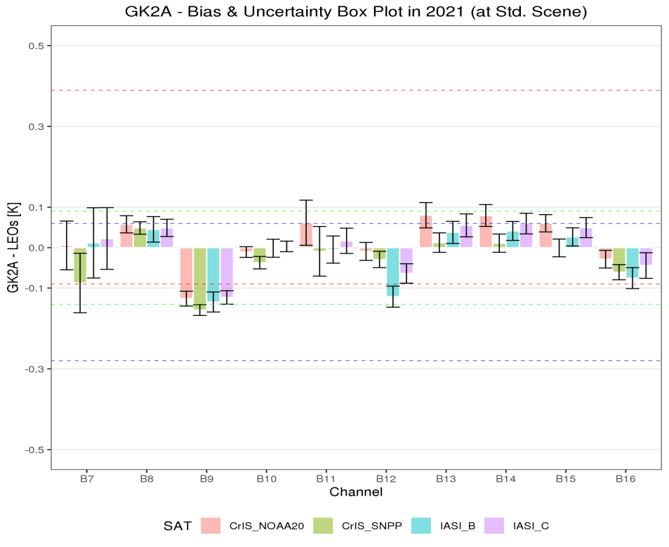
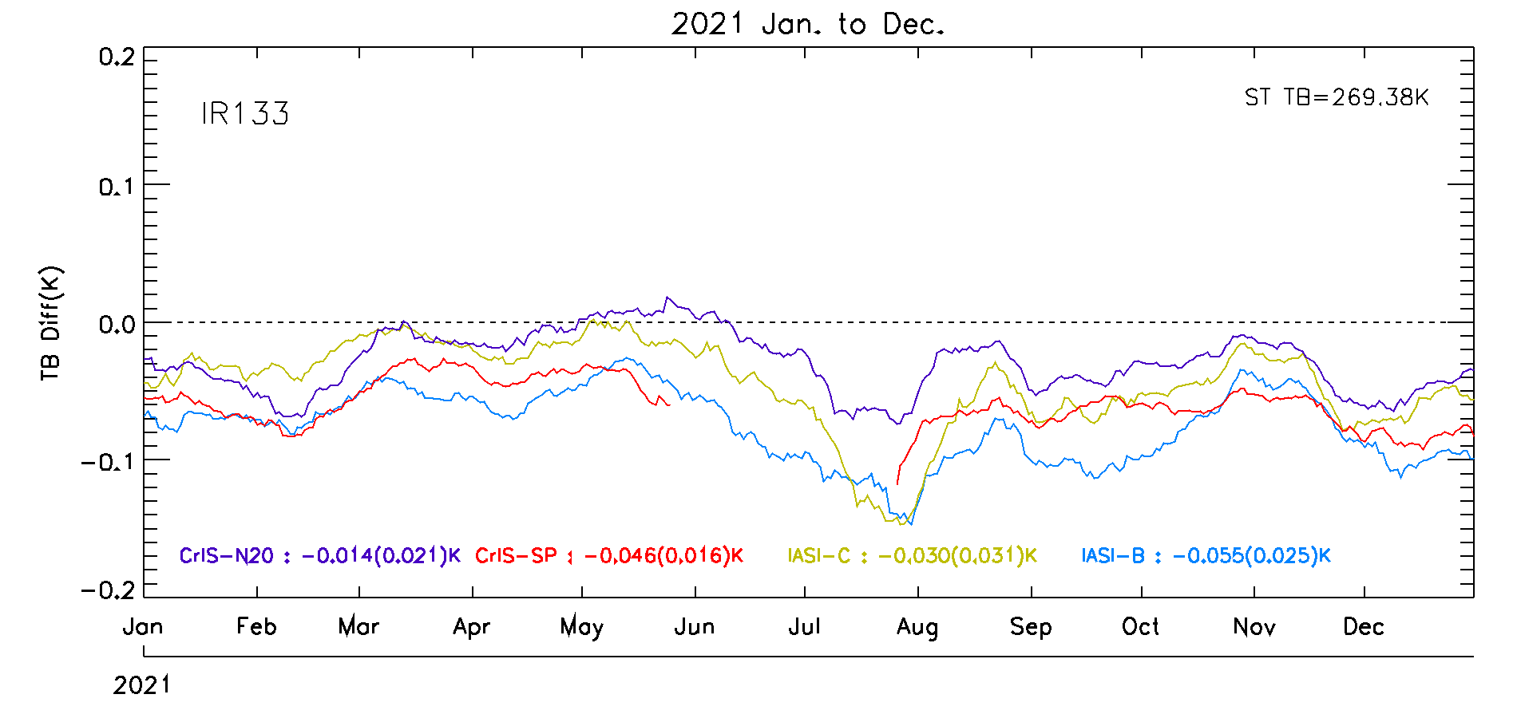
KMA’s Calibration Stand-up Items (IR)
January - December 2021
IR133
Reference Satellite |  | Bias (Uncertainty)
 |  | SW038 (3.8㎛) | WV063 (6.3㎛) | WV069 (6.9㎛) | WV073 (7.3㎛) | IR087 (8.7㎛) | IR096 (9.6㎛) | IR105 (10.5㎛) | IR112 (11.2㎛) | IR123 (12.3㎛) | IR133 (13.3㎛)
CrIS | NOAA-20 | 0.01 (±0.06) | 0.06 (±0.02) | -0.13 (±0.02) | -0.01 (±0.01) | 0.06 (±0.06) | -0.01 (±0.02) | 0.08 (±0.03) | 0.08 (±0.03) | 0.06 (±0.02) | -0.03 (±0.02)
 | S-NPP | -0.09 (±0.07) | 0.05 (±0.02) | -0.15 (±0.01) | -0.04 (±0.02) | -0.01 (±0.06) | -0.03 (±0.02) | 0.01 (±0.02) | 0.01 (±0.02) | -0.00 (±0.02) | -0.06 (±0.02)
IASI | Metop-B | 0.01 (±0.09) | 0.05 (±0.03) | -0.13 (±0.02) | -0.00 (±0.02) | -0.00 (±0.03) | -0.12 (±0.03) | 0.04 (±0.03) | 0.04 (±0.02) | 0.03 (±0.02) | -0.08 (±0.03)
 | Metop-C | 0.02 (±0.08) | 0.05 (±0.02) | -0.12 (±0.02) | 0.00 (±0.01) | 0.02 (±0.03) | -0.06 (±0.02) | 0.06 (±0.03) | 0.06 (±0.03) | 0.05 (±0.02) | -0.04 (±0.03)
Standard Temp.(K) |  | 285.9 | 234.9 | 244.1 | 254.5 | 283.7 | 259.1 | 286.1 | 286.0 | 283.8 | 269.4

Slide 7
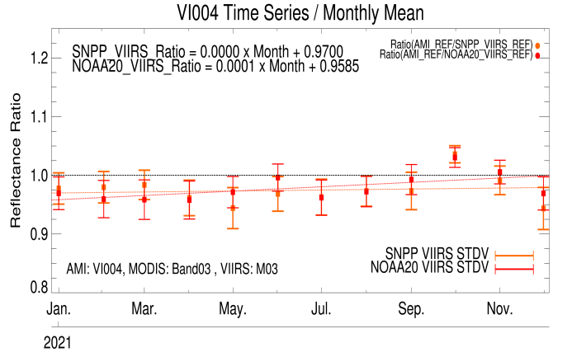
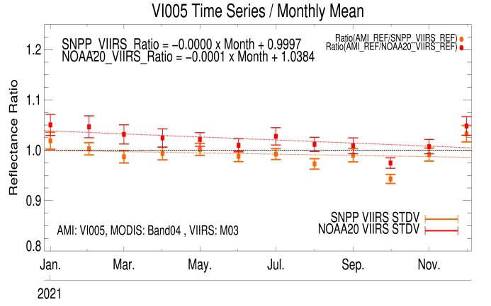
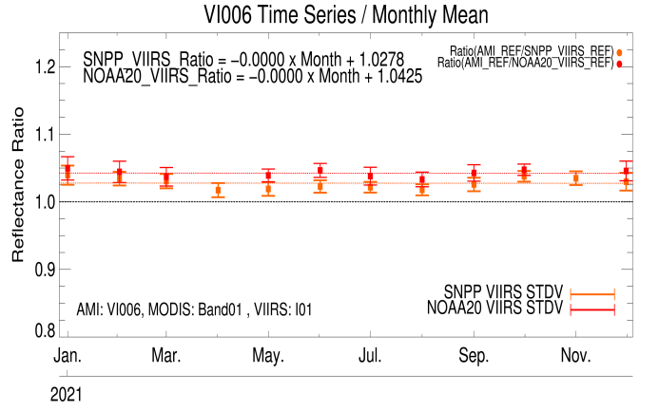
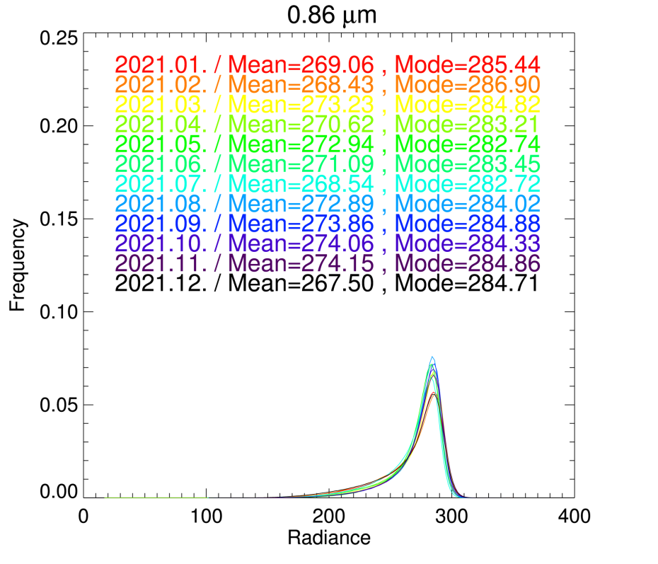
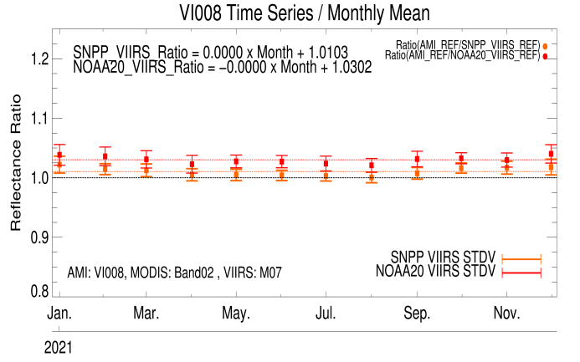
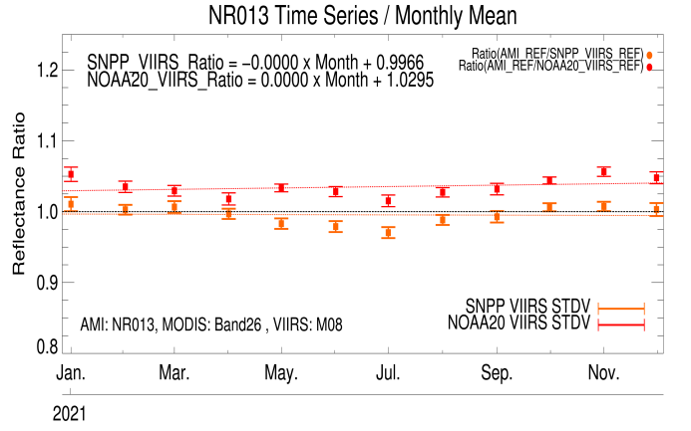
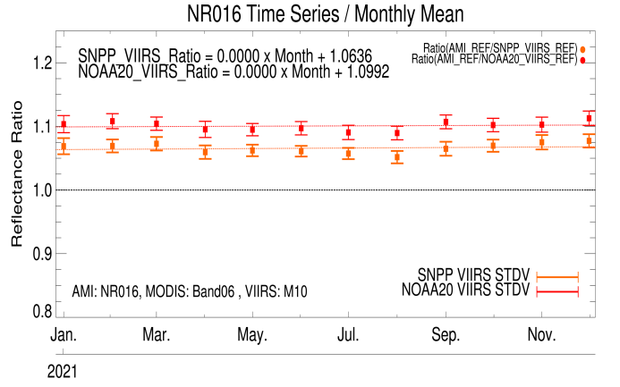
KMA’s Calibration Stand-up Items (VNIR)
January - December 2021
Stable radiance histogram over DCC
Reference Satellite | Mean Bias (Uncertainty)
 | VI004 (0.47 μm) | VI005 (0.51 μm) | VI006 (0.64 μm) | VI008 (0.86 μm) | NR013 (1.37 μm) | NR016 (1.61 μm)
NOAA-20/ VIIRS | -2.23 (±1.91) | 2.17 (±1.21) | 4.17 (±1.07) | 2.53 (±1.16) | 2.11 (±0.66) | 9.15 (±0.98)
S-NPP/ VIIRS | -3.59 (±2.11) | -0.39 (±1.06) | 2.13 (±0.95) | 0.62 (±1.00) | -2.26 (±0.69) | 5.39 (±0.93)

Slide 8
Additional Slides Not Presented
Introduce/Confirm the Agency’s Personnel Supporting GSICS
GRWG members/GDWG members
Other Key Agency Personal
Agency’s GSICS activities to be discussed in this joint meeting
GSICS agenda items that are especially of interest to the agency
Agency’s activities that may be of interest to the GSICS community

Slide 9
Introduce the KMA’s Personnel supporting GSICS
EP
Dohyeong Kim
GRWG
Jiyoung Kim, Eunkyu Kim, and Minju Gu*
(*leave of absence)
GDWG
Eunkyu Kim
Member | GRWG | GDWG | GEO-LEO | DCC RTM | Moon | GEO-GEO
Jiyoung Kim (Mr.) | Y |  | Y | Y | Y | Y
Minju Gu (Ms.) | Y |  | Y |  |  | Y
Eunkyu Kim (Mr.) | Y | Y |  | Y | Y

Slide 10
KMA’s GSICS activities to be discussed in this joint meeting
GRWG
VIS Sub-Group
GK2A AMI visible calibration results (Eunkyu Kim)

