Slide 1
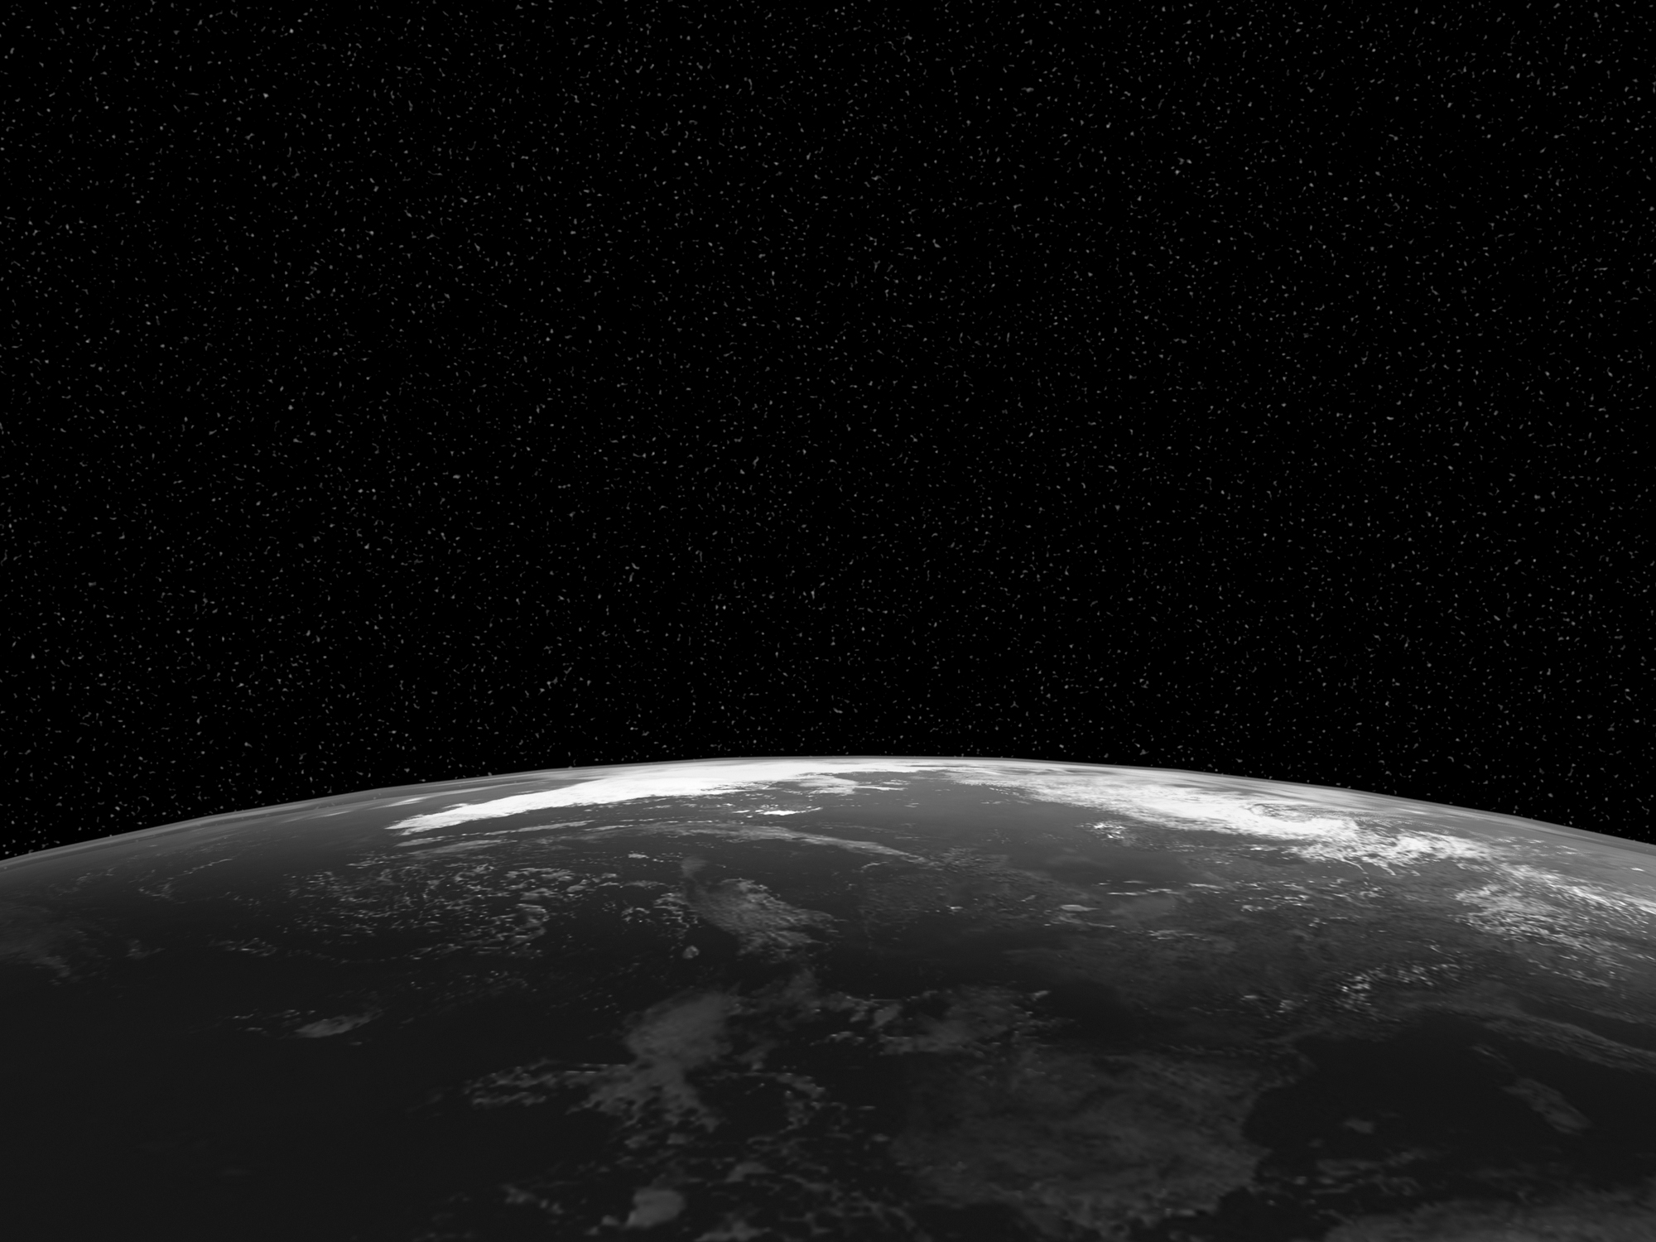
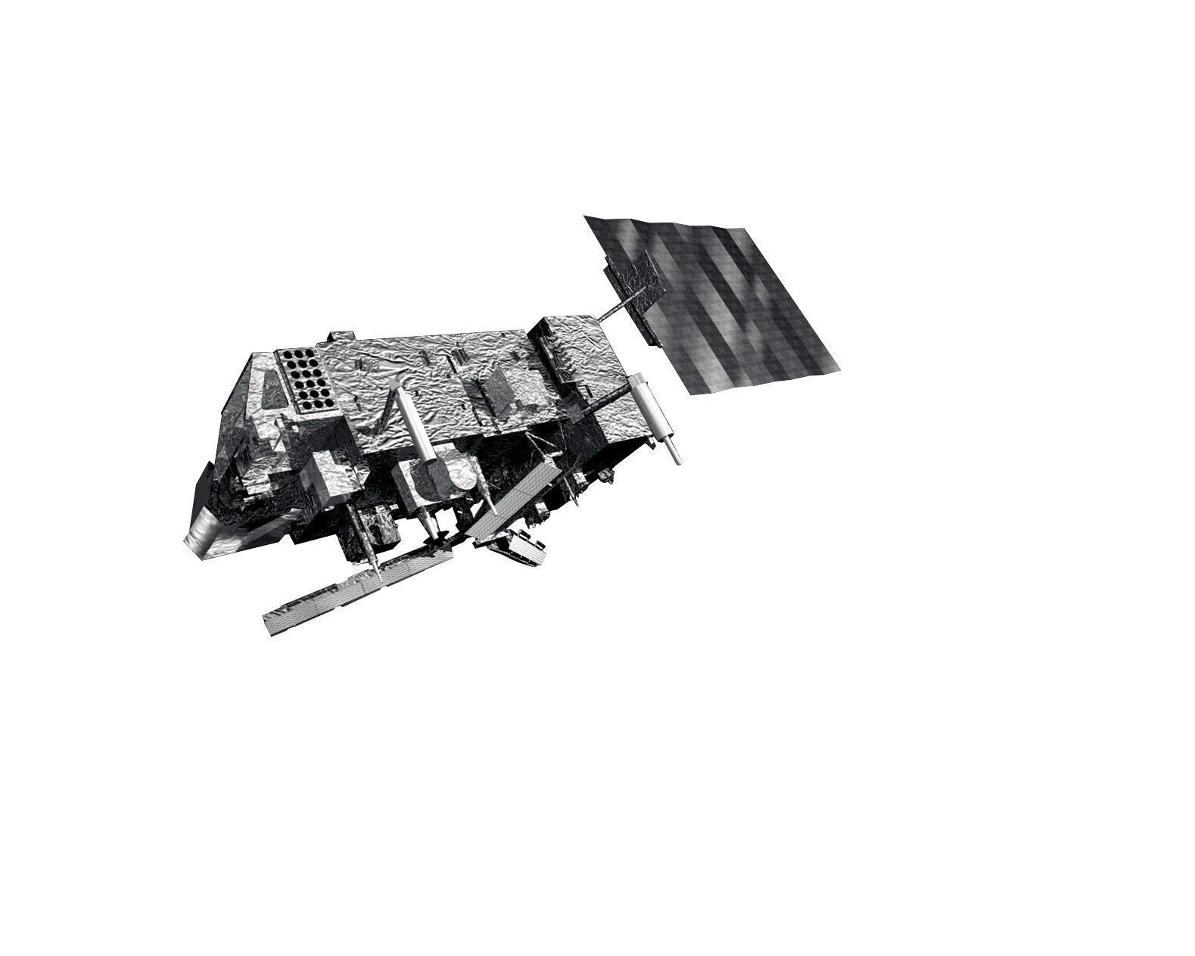
Long term monitoring of satellite
radiances using the Met Office NWP model
R. Saunders, T. Blackmore, B. Candy, P. Francis & T. Hewison
Acknowledgements to EUMETSAT for part-funding

Slide 2
Rationale
It is crucial for climate and very desirable for NWP that we determine the characteristics of satellite radiance biases and try to understand their cause
Simultaneous Nadir Overpasses (SNOs) have a limited time and space sampling.
By comparing measured radiances against those simulated from a NWP model more can be learnt about the nature of the biases as the space and time matchup window can be relaxed using double differences with the NWP model as a transfer standard.
The Met Office NWP model 6hr forecast background fields are used for this study which assimilate many satellite and in situ observations.

Slide 3
Why are there radiance biases?
Uncertainties in the calibration of the sensor (e.g. solar intrusion, sudden heating/cooling, poor BB, non-linearity in detector response, etc)
Lack of knowledge or changes in spectral response of channels (much less of an issue for IASI,AIRS,CrIS)
Biases can vary with time, scan position, orbital, diurnal and seasonal timescales.
Fast (and LbL) RT model uncertainties (generally small but some effects can be important)

Slide 4
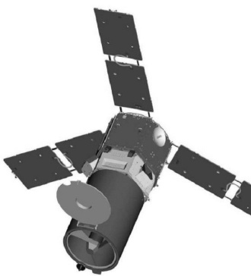
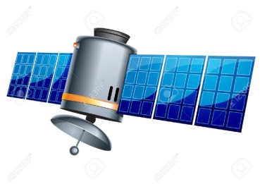
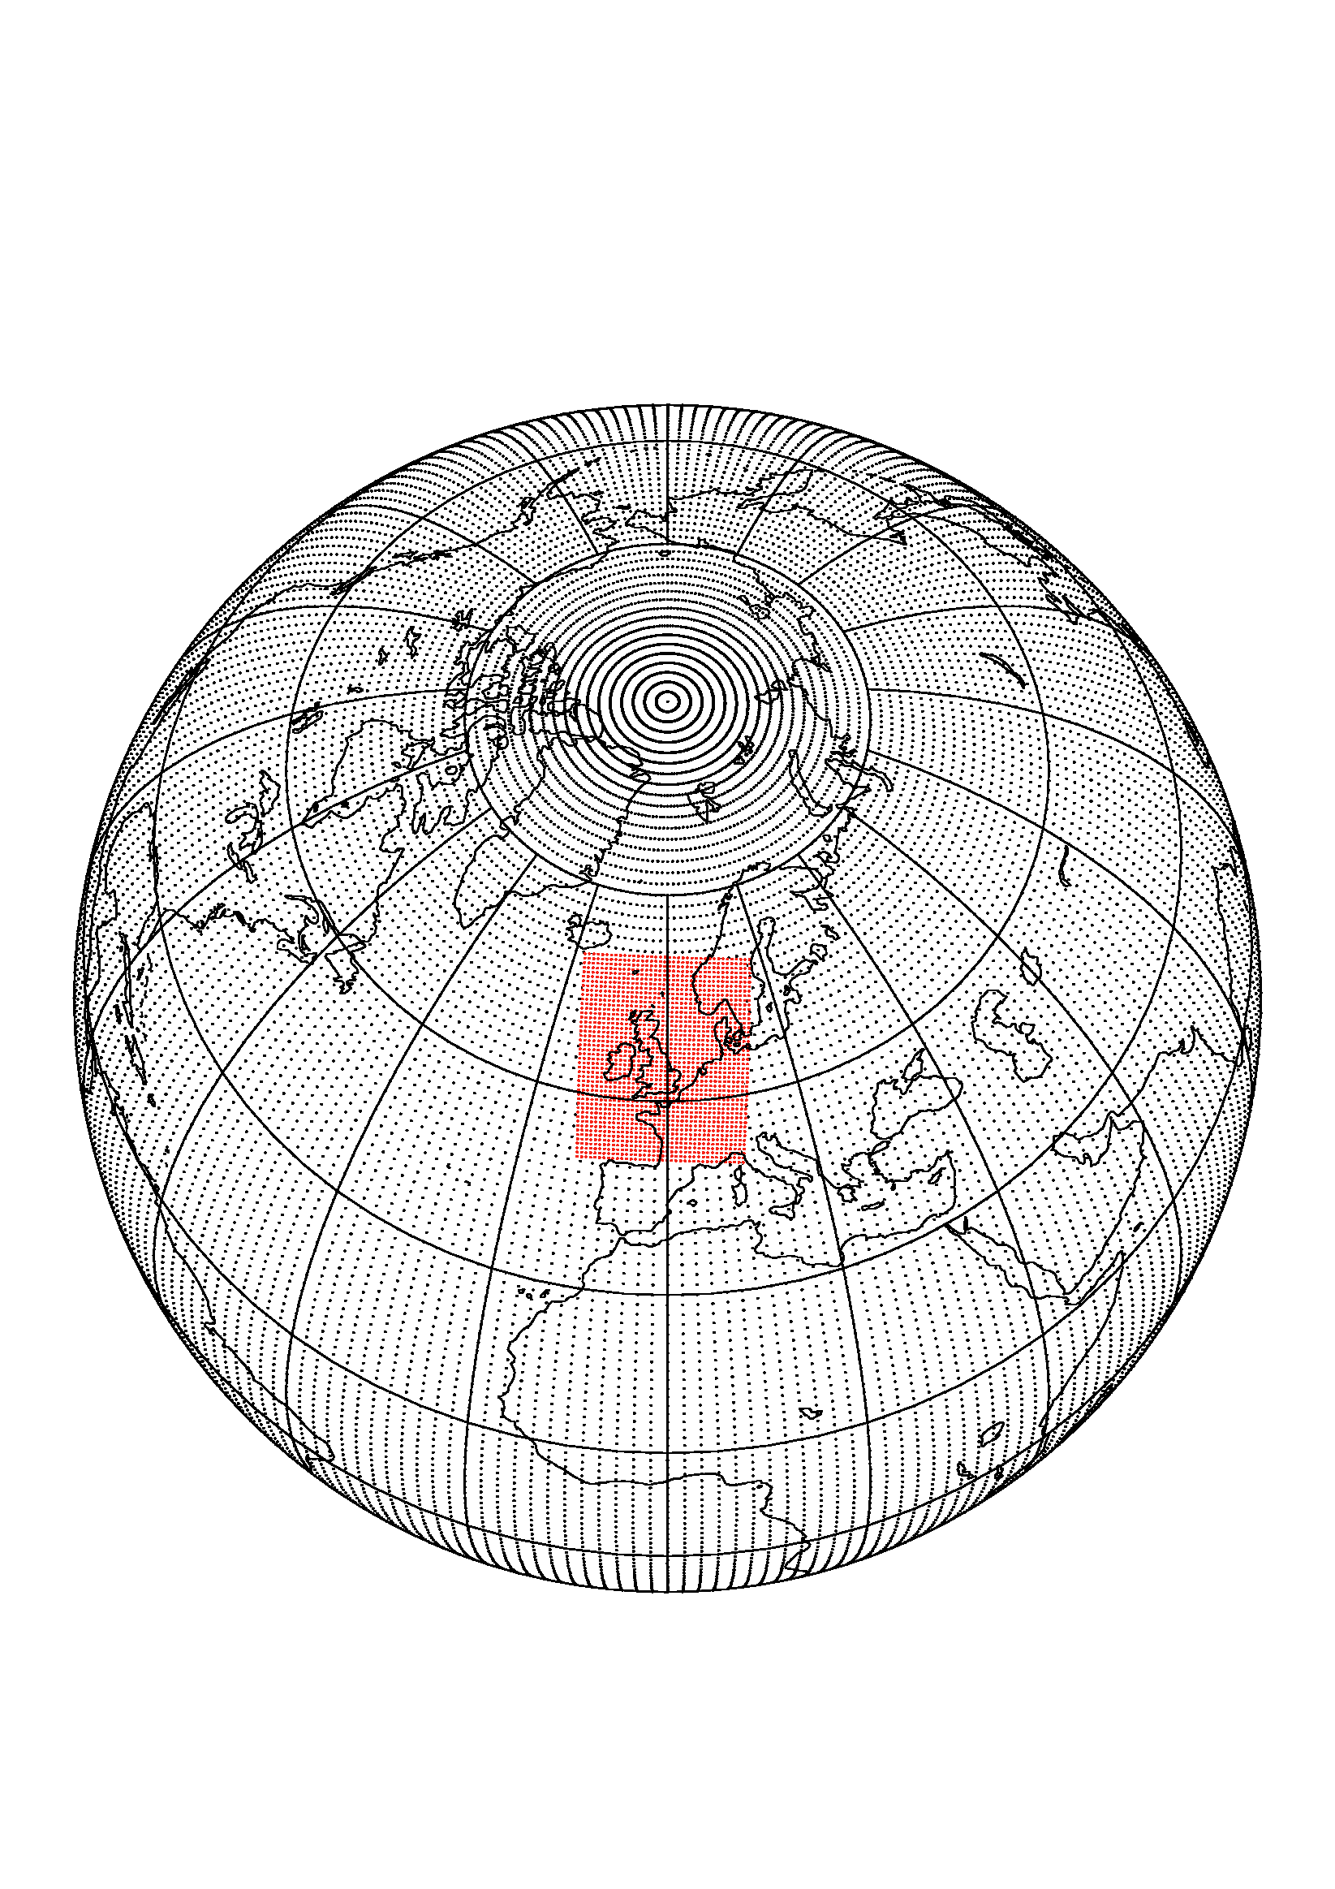
Calculation of radiance biases NWP as transfer standard
For channel n
Sensor 1: DBT(n) = mean{y_{n} - H_{n}(x_{i})}
i=1 to k obs
For channel m
Sensor 2: DBT(m) = mean{y_{m} - H_{m}(x_{i})}
i=1 to k obs
1
2
Assume same model bias?
x_{i} atmospheric state vector for observation i
H_{n} is radiative transfer model
y_{n} is the observed radiance
Compare DBT(n) with DBT(m) (double difference)

Slide 5
Calculation of model radiances
H_{n}(x_{i})
RTTOV used for Radiative Transfer calculation with:
ISEM model assumed for surface emissivity over ocean for all IR sensors
Temperature and water vapour profiles from Met Office model background (6hr forecast)
Climatologically varying ozone profile used
All other gases assumed fixed, no cloud or aerosol
CO₂ concentration assumed different for AIRS & IASI

Slide 6
Sensors included
Geostationary Satellites | Instruments | Channels | Source | Period
Meteosat-9 | SEVIRI | 8 IR | EUMETCAST | 19 Nov 2008-21 Jan 2013
Meteosat-10 | SEVIRI | 8 IR | EUMETCAST | 21 Jan 2013-20 Feb 2018
Meteosat-11 | SEVIRI | 8 IR | EUMETCAST | 20 Feb 2018-31 Dec 2019
Polar-orbit Satellites | Instruments | Channels | Source | Period
Metop-A | IASI HIRS | See next slide 19 IR | EUMETCAST EUMETCAST | 19 Nov 2008 – 31 Dec 2019 19 Nov 2008 – 31 Dec 2019
 | AMSU-A/MHS | 20 MW | EUMETCAST | Aug 2010 – Apr 2012
Metop-B | IASI | See next slide | EUMETCAST | 15 Sep 2013 – 31 Dec 2019
 | HIRS | 19 IR | EUMETCAST | 1 Jan 2016 – 16 Feb 2017
Metop-C | IASI | See next slide | EUMETCAST | 1 May 2019 – 31 Dec 2019
Aqua | AIRS | See next slide | NESDIS | 19 Nov 2008 – 31 Dec 2019
NOAA-17 | HIRS | 19 IR | NESDIS | 19 Nov 2008 –30 Jan 2013
NOAA-19 | HIRS AMSU-A/MHS | 19 IR 20 MW | NESDIS NESDIS | 14 July 2009 – 31 Dec 2019 Aug 2010 – Apr 2012
ENVISAT | AATSR | 3 IR Nadir 3 IR Fwd | FTP ESRIN | 1 Sep 2010 – 8 April 2012

Slide 7
IASI | IASI | AIRS | AIRS | HIRS | SEVIRI | AATSR
Channel | Wavenumber | Channel | Wavenumber | Channel | Channel | Channel
92 | 667.75 | 75 | 667.78 | 1
141 | 680 | 123 | 680.14 | 2
179 | 689.5 | 138 | 689.49 | 3
212 | 697.75 | 168 | 697.71
242 | 705.25 | 193 | 704.72 | 4
246 | 706.25 | 198 | 706.14
280 | 714.75 | 227 | 714.48 | 5
345 | 731 | 295 | 734.15
381 | 740 | 318 | 741.29
434 | 753.25 | 355 | 753.06 | 7 | 11
457 | 759 | 375 | 759.57
546 | 781.25 | 475 | 801.1
756 | 833.75 | 528 | 820.83 |  | 10 | 1
1121 | 925 | 787 | 917.31
1133 | 928 | 791 | 918.75 | 8 | 9 | 2
1579 | 1039.5 | 1088 | 1039.23 | 9 | 8
1991 | 1142.5 | 1260 | 1135.57
2019 | 1149.5 |  |  |  | 7
2245 | 1206 | 1263 | 1216.97
2741 | 1330 | 1449 | 1330.98 | 11 | 6
3029 | 1402 | 1583 | 1402.15
3339 | 1479.5 | 1681 | 1476.25 |  | 5
3522 | 1525.25 | 1756 | 1524.35 | 12 | 5
3540 | 1529.75 |  |  | 12 | 5 | 0.00
3653 | 1558 | 1783 | 1556.1 |  | 5 | 0.00
3943 | 1630.5 |  |  |  | 5 | 0.00
5130 | 1927.25 |  |  |  |  | 0.00
 |  | 1873 | 2188.76 | 13 |  | 0.00
 |  | 1897 | 2210.85 | 14 |  | 0.00
6350 | 2232.25 | 1924 | 2236.23 | 15 |  | 0.00
 |  | 1937 | 2248.65 | 16 |  | 0.00
6463 | 2260.5 | 1948 | 2259.26 |  |  | 0.00
6601 | 2295 | 1988 | 2298.71 |  |  | 0.00
6962 | 2385.25 | 2106 | 2385.23 |  |  | 0.00
6980 | 2389.75 | 2111 | 2390.11 |  |  | 0.00
6997 | 2394 | 2115 | 2394.03 | 17 | 1 | 0.00
7424 | 2500.75 | 2189 | 2492.08 | 18 | 1 | 0.00
8007 | 2646.5 | 2363 | 2648.75 |  | 1 | 0.00
 |  | 2377 | 2664.14 | 19 | 1 | 0.00
Values in red may have high instrumental noise
IR Channel
list for sensors
in this study
Wavenumber
=
1/wavelength (cm)
1000cm⁻¹=0.001cm
=10µm

Slide 8
Analysis
Over 10 years of data collected 20 Nov 08 to 31 Dec 2019 (except AATSR and MW sensors)
Generally only global or “full disk” mean plots shown which may “hide” things
Only clear radiances over ocean included in analysis
Comparisons with SEVIRI are only over a limited area
Radiances are not bias corrected of course and no GSICS correction applied

Slide 9
Model and observation changes
Date | Model/Observation change | Date | Model/Observation change
20 Aug 2009 | Start assimilation of NOAA-19 HIRS and AMSU radiances | 28 March 2012 | Hybrid DA updated to use MOGREPS-G
10 Nov 2009 | Change of model levels from 50 to 70 and model top raised from 0.1hPa to 0.01hPa | 17 Sept 2012 | Upgrade to RTTOV-9 in data assimilation
10 Nov 2009 | Change in bias correction of radiosonde relative humidity | 23 Jan 2013 | Moved to RTTOV-9 for bias stats presented here
17 Dec 2009 to 9 Feb 2010 | NOAA-17 HIRS not assimilated | 30 April 2013 | CrIS and ATMS assimilated
9 Mar 2010 | DMSP F-16 SSMIS window channels assimilated operationally – clear scenes only over ocean | 15 July 2014 | Increase in model resolution 25 km to 17 km. ENDGAME implemented.
2 Nov 2010 | Modify AIRS channel selection and assumed observation errors | 1 Jan 2016 | Change to IASI cloud detection thresholds
2 Nov 2010 | SSMIS channels 23,24 introduced to improve mesospheric/upper stratospheric analysis | 15 Mar 2016 | VarBC introduced for all radiances. Aircraft Relative Humidity assimilated.
2 Nov 2010 | Introduce Meteosat-9 clear sky window and water vapour channel radiances | 8 Nov 2016 | More IR radiances assimilated over land. Added FY-3B MWHS radiances.
20 July 2011 | Introduce GOES-E+W clear sky window and water vapour channel radiances | 11 July 2017 | Upgraded to RTTOV-11. Increased model horizontal resolution to 10km.
20 July 2011 | Use more IASI channels over land | 13 Feb 2018 | Assimilated GMI radiances. IASI and ATOVS thinning changed.
20 July 2011 | Change in humidity control variable from relative humidity to normalised pseudo relative humidity (Ingleby et. al . 2011) | 25 Sep 2018 | Upgraded to RTTOV-12. Cloud affected AMSU-A assimilated.

Slide 10
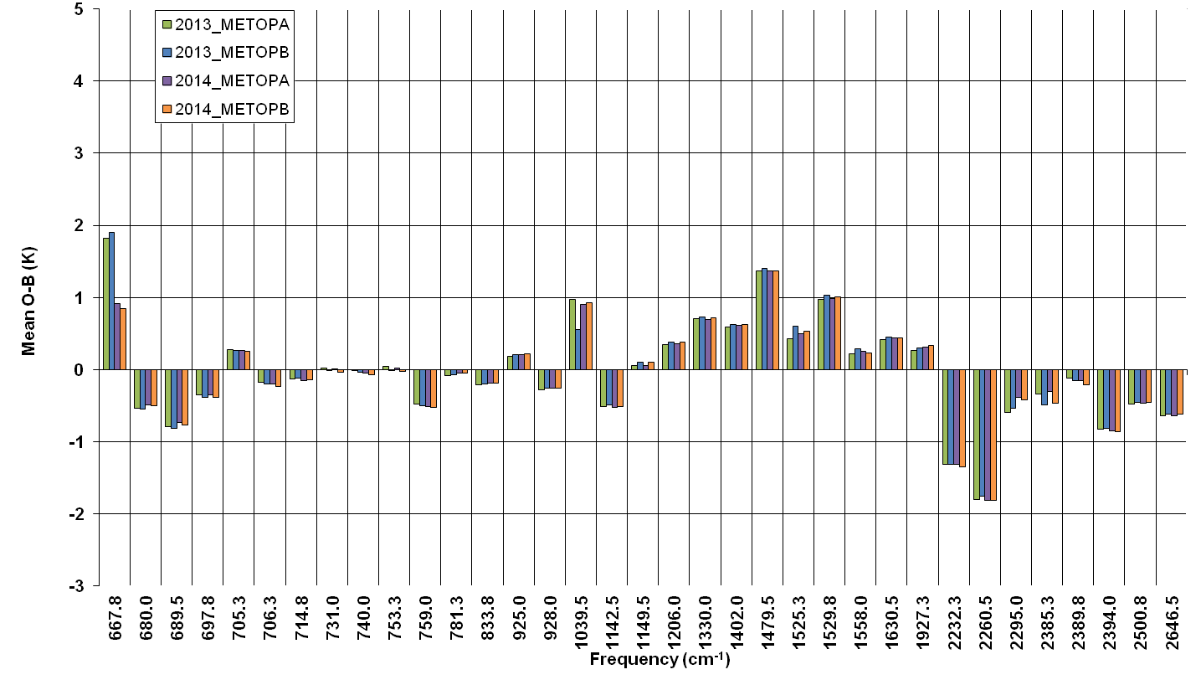
IASI-A vs IASI-B biases

Slide 11
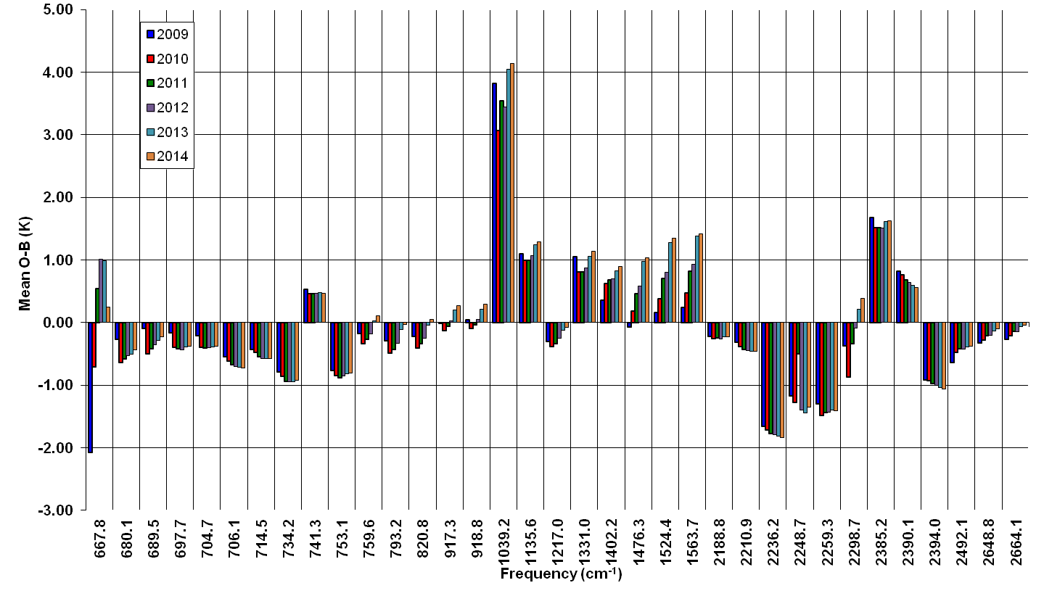
AIRS biases

Slide 12
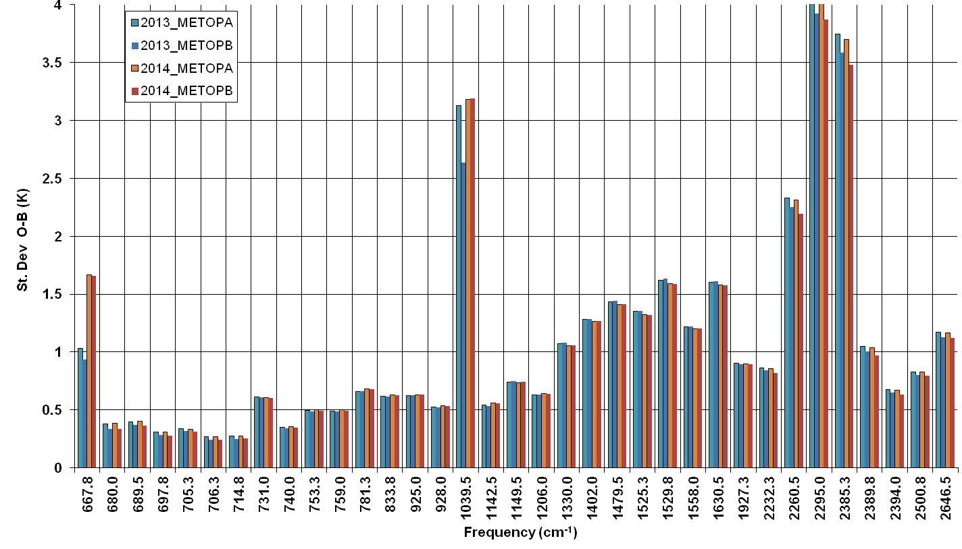
IASI-A vs IASI-B St Devs

Slide 13
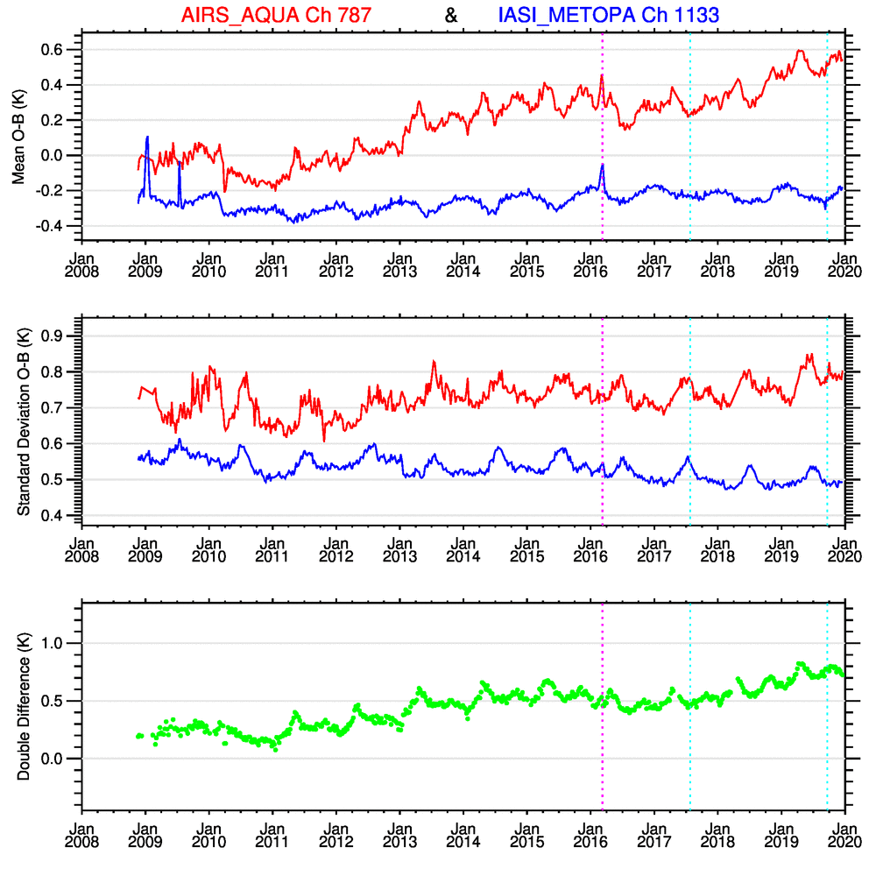
Metop-A IASI 918 cm⁻¹ channel and AIRS 917 cm⁻¹ channels have a relative drift of 0.06 degK/year. Annual cycle seen in double difference.

Slide 14
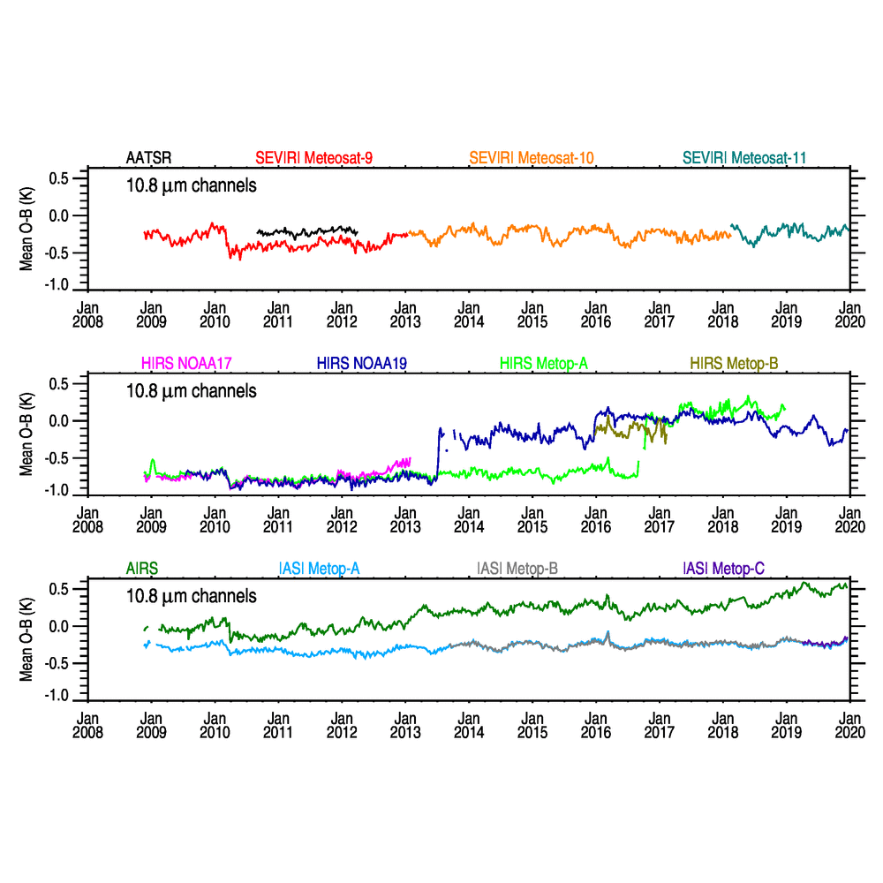
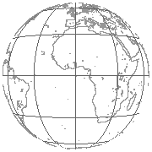
Meteosat disk
area
Ocean
Day + Night
HIRS filter wheel

Slide 15
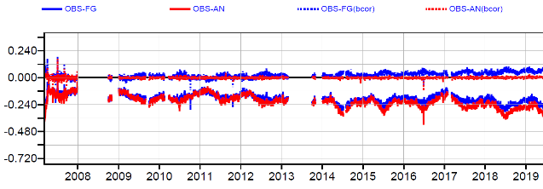
ERA-5 Monitoring
Metop-A IASI chan 921 11.4um
Meteosat disk
area
Ocean
Day + Night

Slide 16
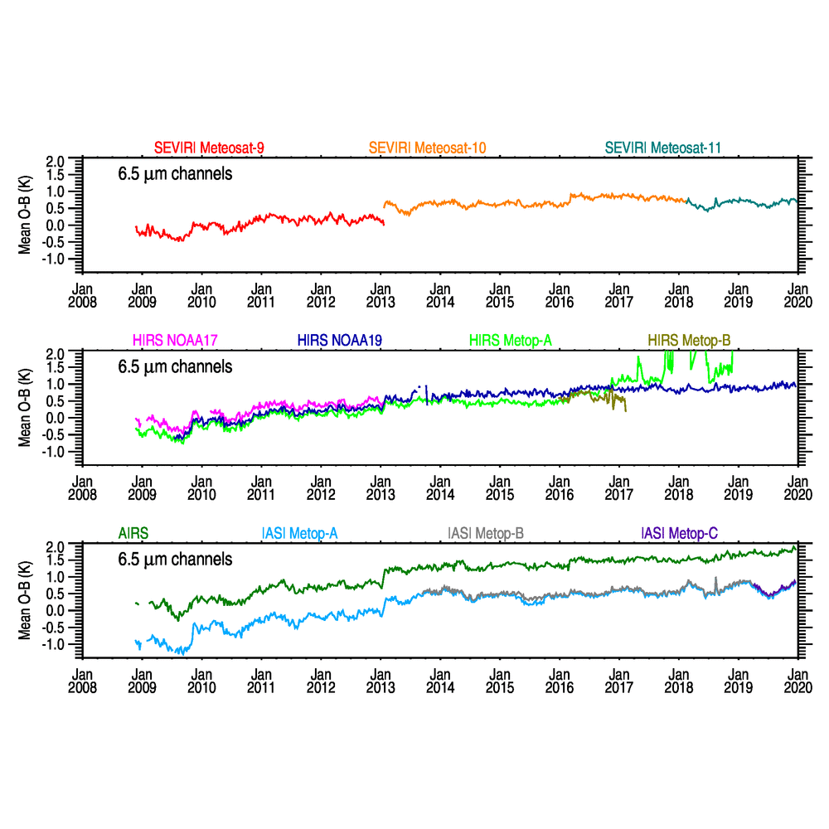
Meteosat disk
area
Ocean
Day + Night
Gradual moistening of UTH in model
Change RTTOV version

Slide 17
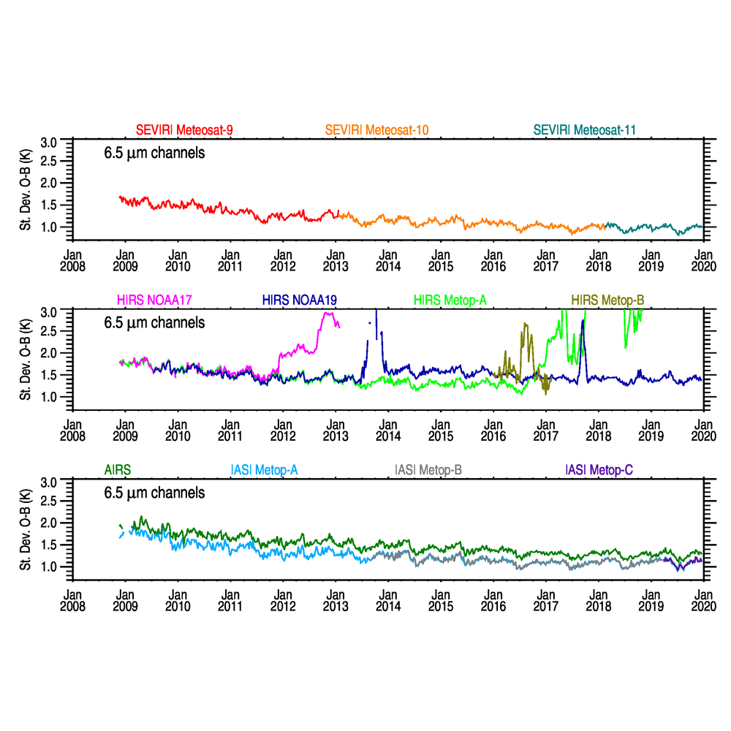
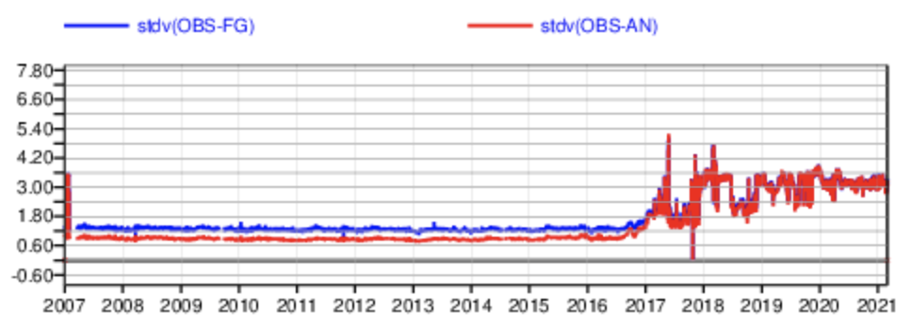
Meteosat disk
area
Ocean
Day + Night
ERA-5 - HIRS-METOP-A
Improving UTH in model

Slide 18
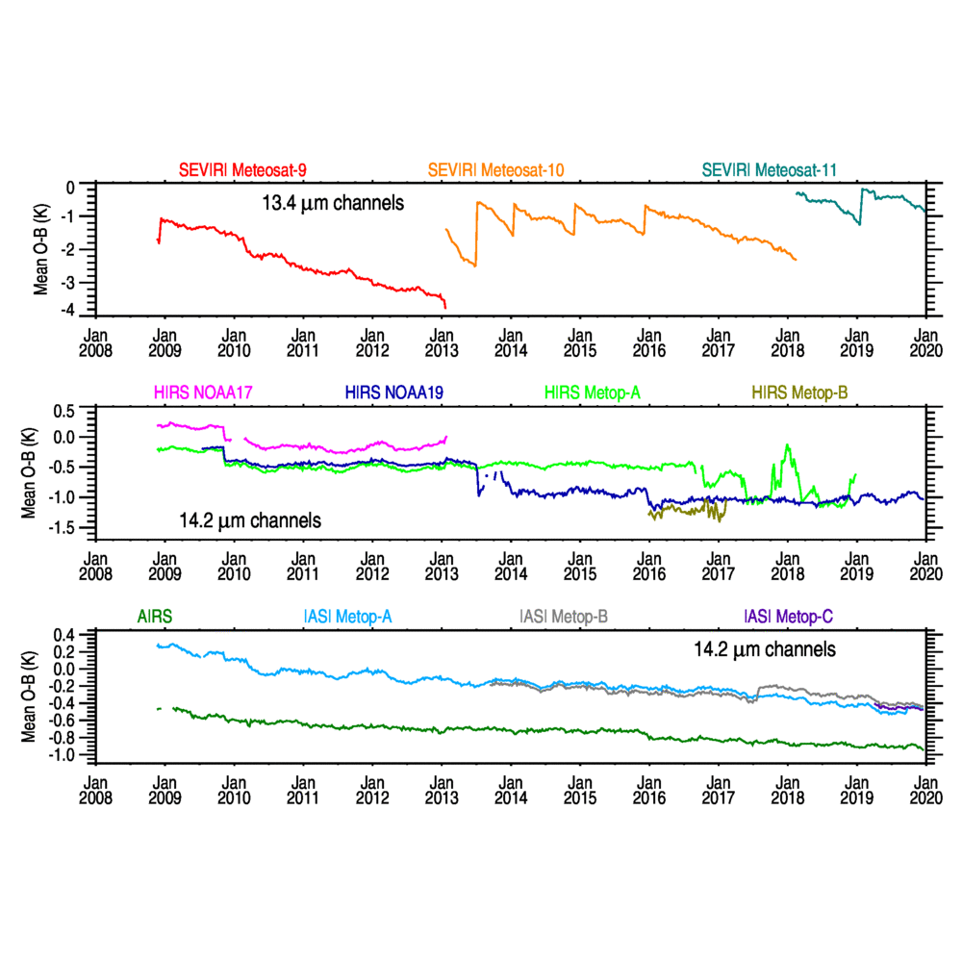
SEVIRI Decontamination
Meteosat disk
area
Ocean
Day + Night
Increasing CO₂
Nonlinearity corrn

Slide 19
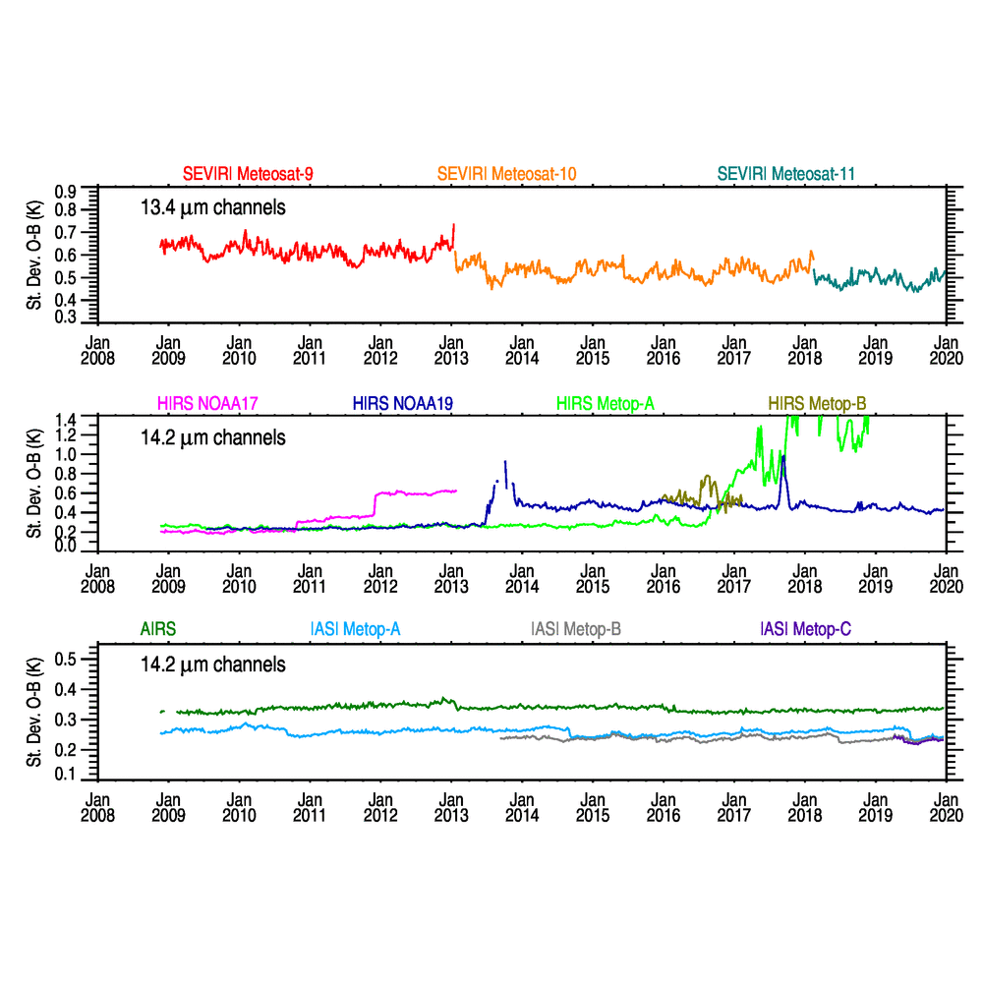
Meteosat disk
area
Ocean
Day + Night
?

Slide 20
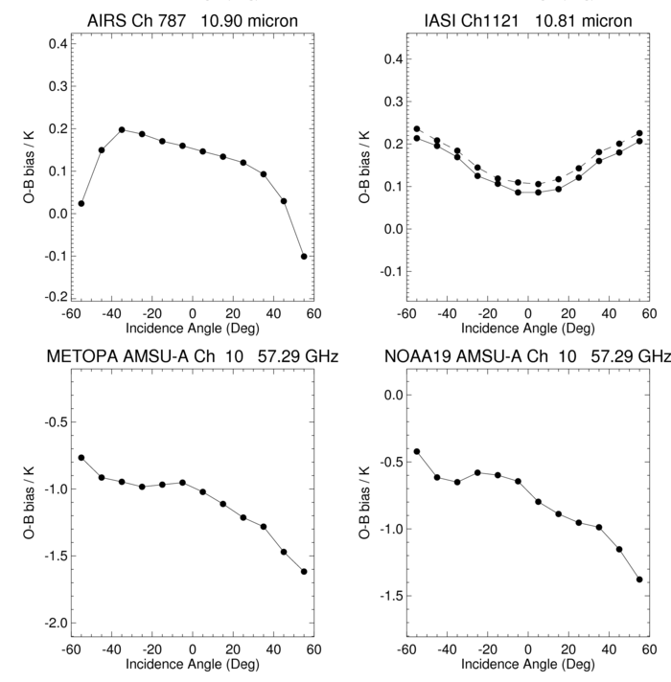
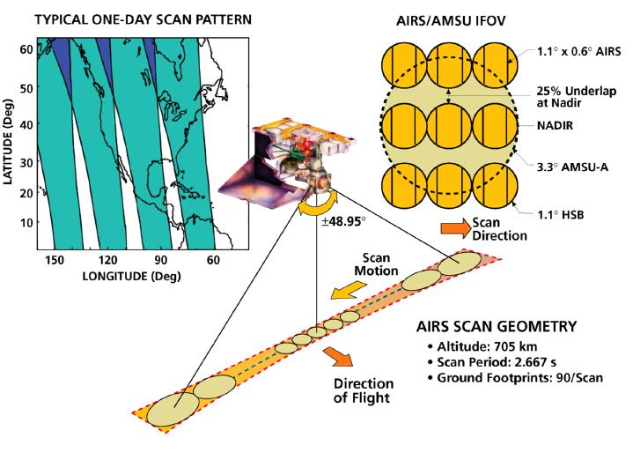
Scan biases for different sensors
Averages for 2013
B
IR sensors
A
AMSU-A

Slide 21
Scene Dependence
Averages for 2013
IASI-A
identical to
IASI-B
N.B. 2 black bodies
Nadir & Forward views.

Slide 22
Summary 1
Monitoring satellite radiances using an NWP model is a useful tool to monitor an instruments health. Changes in the NWP system can introduce changes in the bias (e.g. upper level moisture, upper stratosphere) but the double difference is insensitive to these.
The biases for IASI-A and IASI-B are very similar and stable and in general close to zero compared to the model. The scan dependence and scene dependence are identical. The non-linearity corrections applied in Aug 2017 and Sep 2019 are more evident for the CO₂ channels and now all 3 IASIs in better agreement. It is clear IASI radiances will make a good Fundamental Climate Data Record.
The bias of the CO₂ channels on SEVIRI, IASI and AIRS/HIRS (on METOP) are all significantly different from each other (instrument related). For the 6.2µm water vapour channel the biases are different due to different ISRFs but they all vary the same way (model related).

Slide 23
Summary 2
The changes in bias of the Meteosat SEVIRI CO₂ channel is evident and the impact of decontamination on the bias.
The big changes in bias and st deviation of the HIRS radiances over the past 10 years will require care when creating FCDRs.
The O-B bias becomes more positive with increasing scene temperature for all instruments except AATSR which uses 2 internal black bodies for its calibration. The change in bias with scene temperature shows the limitation of the polar SNO method.
Improvements in UTH in the Met Office model demonstrated.
Reanalyses are new resource for historical O-B studies.

Slide 24
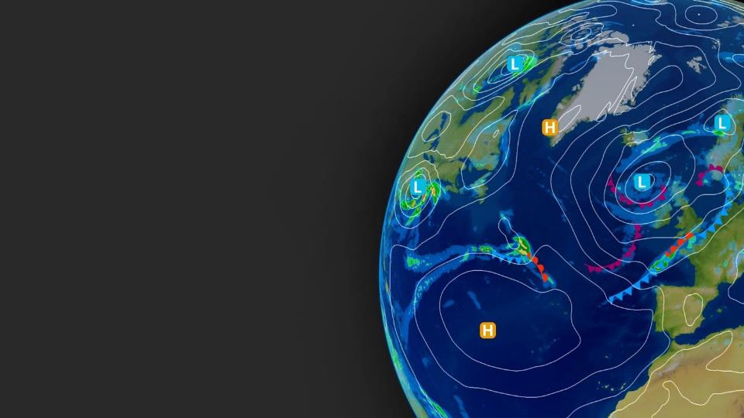
This work is published:
Ten Years of Satellite Infrared Radiance
Monitoring With the Met Office NWP
Model, in IEEE Transactions on
Geoscience and Remote Sensing
DOI 10.1109/TGRS.2020.3015257.
Any Questions?

