Slide 1
GSICS Coordination Centre (GCC) Report for 2021-2022
Larry Flynn & Manik Bali
May 10, 2022
2022 GSICS Executive Panel Meeting (EP-22)

Slide 2
Disclaimer
"The contents of this presentation are those of the authors and do not necessarily reflect any position of the US Government or the National Oceanic and Atmospheric Administration."

Slide 3
Outline
Introduction
GCC Activities
Global participation in GSICS activities
GSICS Quarterly Newsletter
Meeting Support
GSICS Product Status
New products accepted in past year
GSICS Action Tracker
GSICS Notebooks
GSICS Product Status System
Near Term Goals
Summary

Slide 4
GCC Activities – Participation in GSICS Activities
Interest in GSICS activities continues to grow

Slide 5
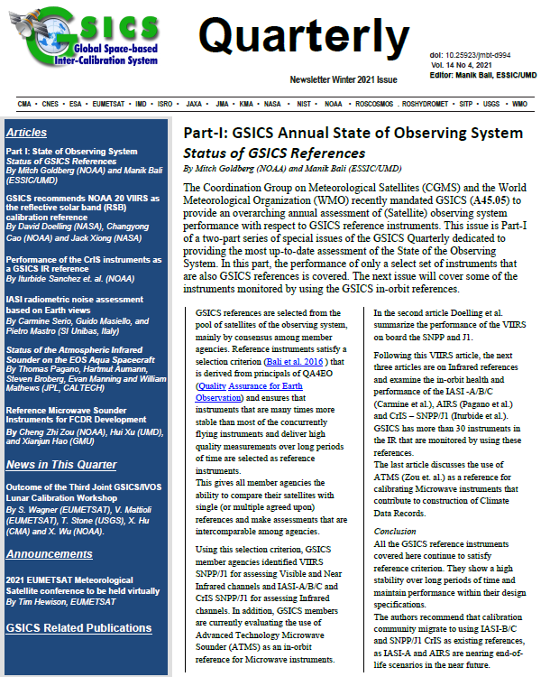
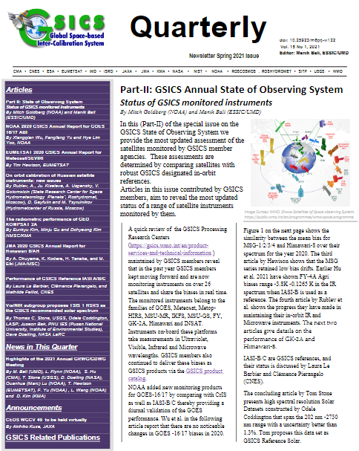
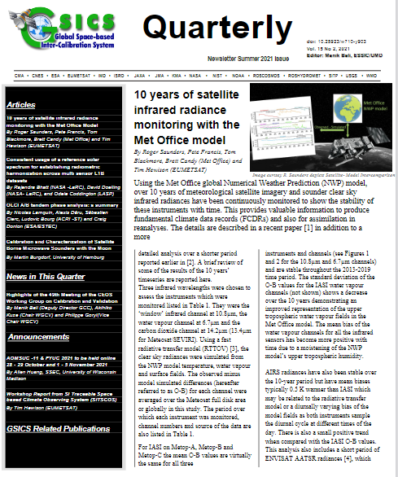
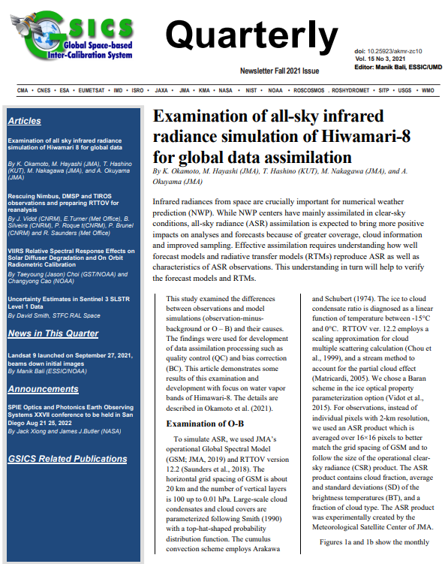
GSICS Activities-GSICS Newsletter https://www.star.nesdis.noaa.gov/smcd/GCC/newsletters.php
Over the last year, we published four Issues of the GSICS Newsletter
19 Research Articles and seven Topics of News to which
Approximately 70 Scientists contributed as Authors & Co-Authors.
Special Issue on State of Observing System
Next Special issue is on State of Observing System
https://www.star.nesdis.noaa.gov/smcd/GCC/newsletters.php
GSICS Newsletter Editorial Board
Manik Bali, Editor
Lawrence E. Flynn, Reviewer
Lori K. Brown, Tech Support
Fangfang Yu, US Correspondent.
Tim Hewison, European Correspondent
Yuan Li, Asian Correspondent
Reviewers in the past year
Lawrence E. Flynn, NOAA
Tim Hewison, EUMETSAT
Sri Harshara Madhavan, SSAI/NASA
Tony Reale, NOAA
Fangfang Yu, NOAA

Slide 6
Meeting Support
GSICS Coordination Center supported the GSICS Annual Meeting 2022.
Meeting Minutes /Agenda can be accessed from GSICS Wiki http://gsics.atmos.umd.edu/bin/view/Development/Annualmeeting2022
Meeting Actions can be viewed at https://www.star.nesdis.noaa.gov/smcd/GCC/MeetingActions.php

Slide 7
GSICS Products Status
A total of 72 Products presently delivered via the GSICS Product Catalog
Operational 12 product [12 EUMETSAT]
Preoperational 10 products [10 NOAA]
Demonstration 44 products [12 EUMETSAT, 13 NOAA, 12 JMA, 1 KMA, 2 ISRO]
Prototype 6 products [ 6 EUMETSAT]
Would like to thank the GRWG/GDWG Subgroup Chairs, the product developers and the GPAT and non GPAT experts for their extensive support of the GPPA process.
Notes:
Four demonstration products (NOAA) have ended production.
There are two prototype products.

Slide 8
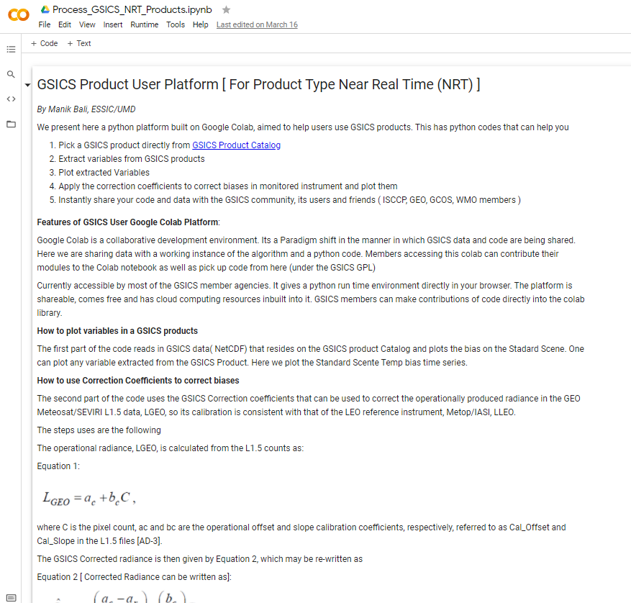
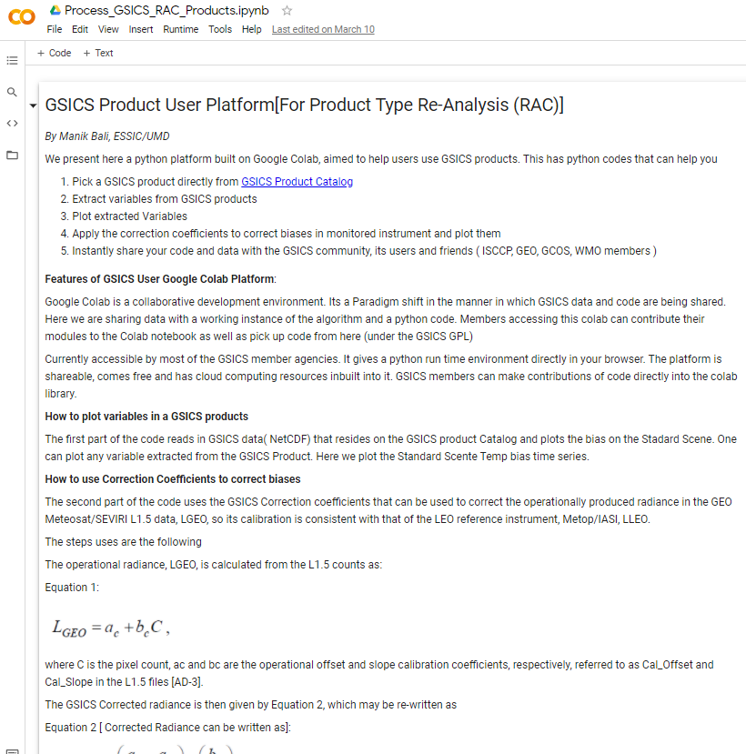
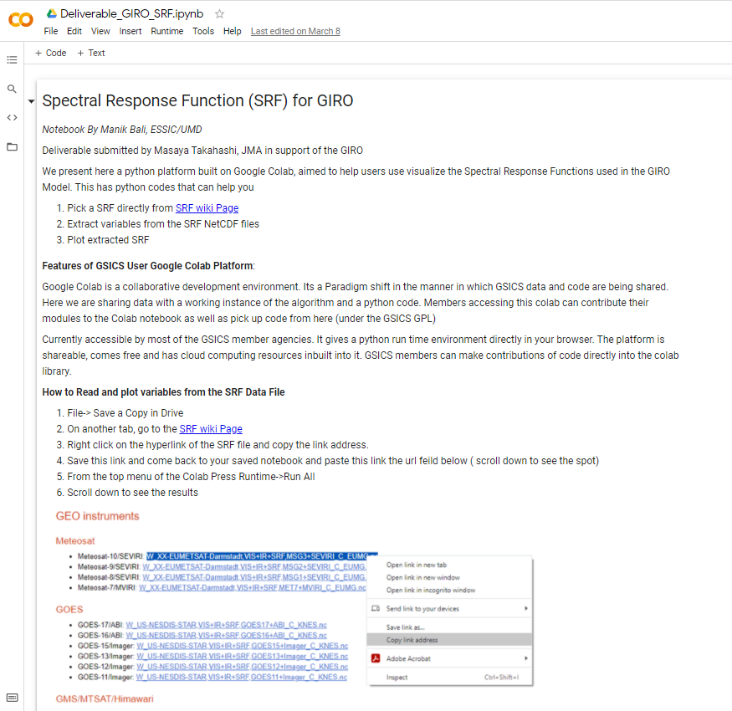
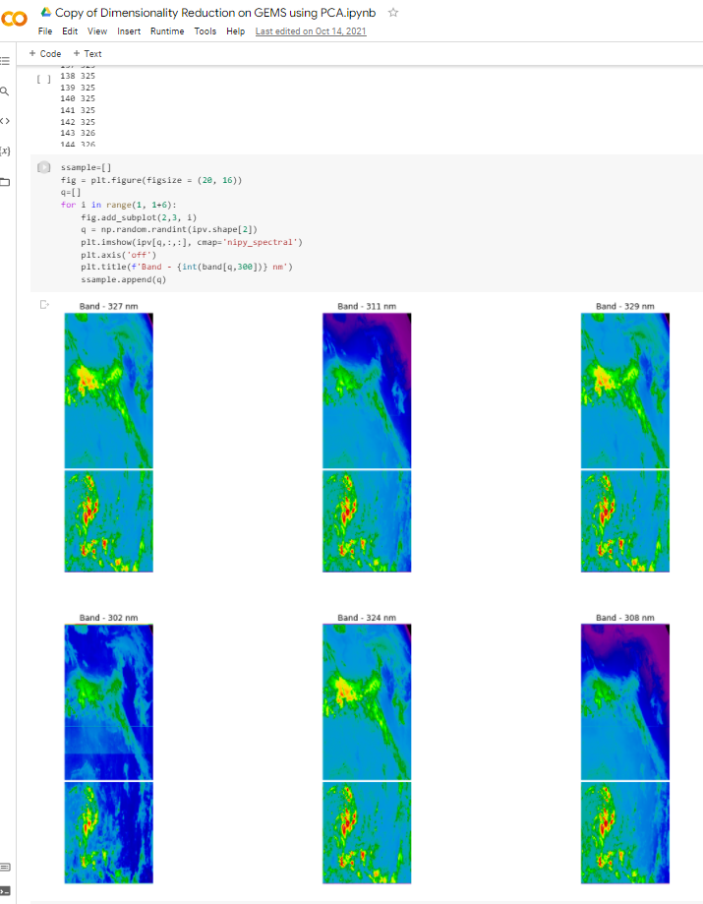
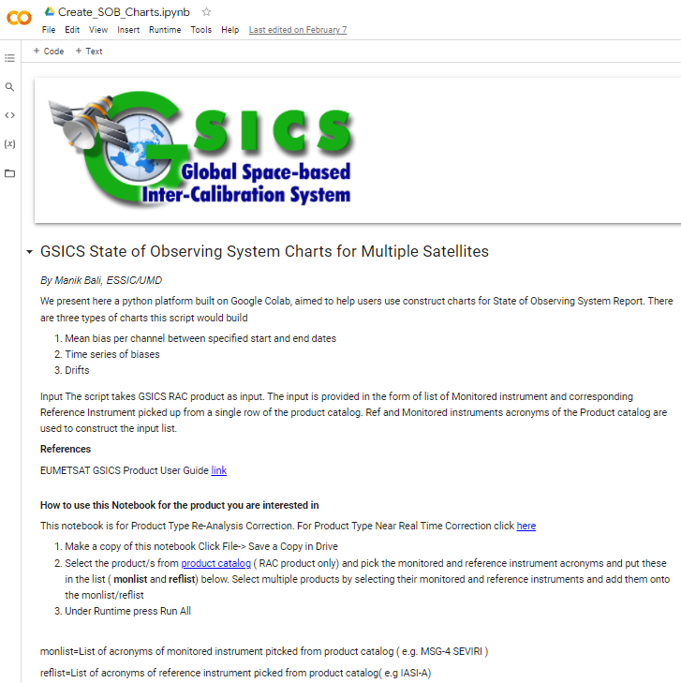
New GSICS Google Colab Notebook
New Colab files were created and previous maintained and supported.
The Python Script can read and use GSICS Products/Deliverables. It can be run directly from the browser.
Connects Users directly with product producers which helps in collaborative development.
Can be shared instantly. Click on hyperlinks below and start using GSICS Products/Deliverables
Seek EP/GRWG approval to designate Notebooks GSICS Deliverables
GSICS RAC Product
GSICS NRT Product
GSICS Deliverables SRF/Cal Tables
GEMS Data Processing
Generate State of Observing System Charts

Slide 9
GSICS Notebooks
Google Notebooks for Deliverables
Spectral Response Function (SRF) netCDF: SRFs used in GIRO in NetCDF format (Author: Masaya Takahashi, JMA) Note
GEO-LEO-IR Collocation netCDF: Intermediate Collocation data Himaware, METSAT 1R/2 Vs AIRS/IASI/MODIS (Author: Masaya Takahashi, JMA) [ Above Notebook can be tuned ]
LEO L1 netCDF: IASI Reference Radiances (Author: Masaya Takahashi, JMA) [Above Notebook can be tuned]
Level 1C inter calibration tables: Inter-Cal tables for Microwave Radiometers, e.g., SSMI series TRMM Constellation and GPM Radiometers (Author: Wes Berg, CSU)

Slide 10
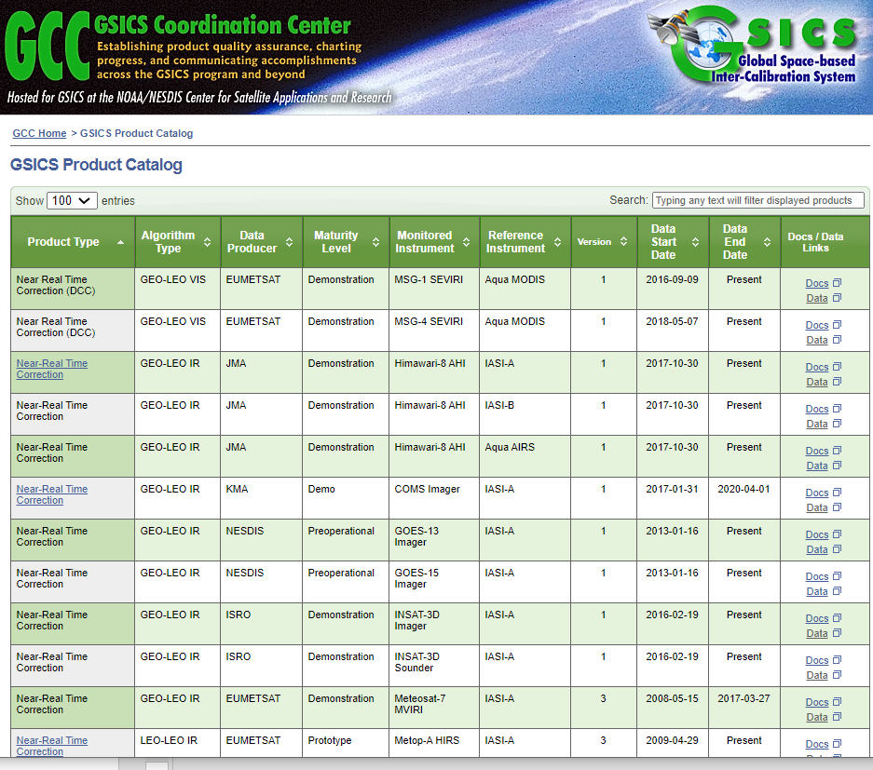
GSICS Product Status System: Background
The Global Space Based Inter-Calibration System ( GSICS ) maintains 72 inter-calibration products. These products are produced each day and disseminated via the THREDDS server or via the ftp servers on the https://www.star.nesdis.noaa.gov/smcd/GCC/ProductCatalog.php
The goal of status system is to inform the producers about the status of their GSICS product via an Email sent by the Alert System. The emails provide a list of un-updated products in a format similar to that on the GSICS Product Catalog.
For a Demo Click here
Relays the following information to the subscriber:
When was the last time the product upload took place on the THREDDS server
Whether or not the URL is active.
**System was updated to allow multiple users to access emails.

Slide 11
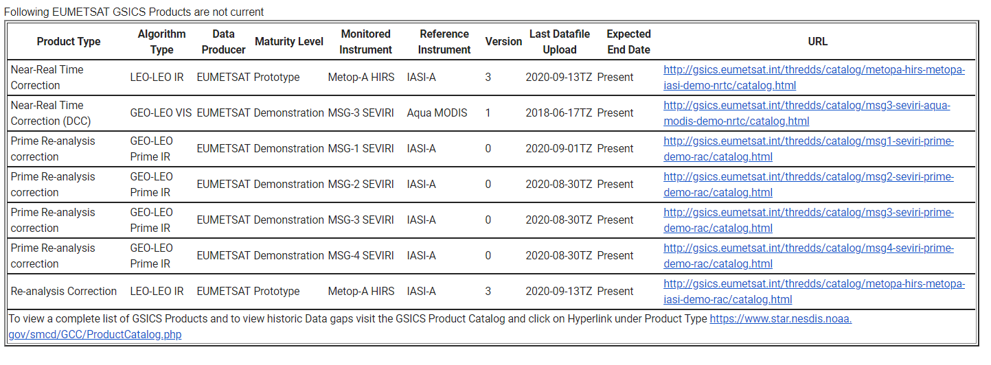
Sample Status Emails

Slide 12
GCC Action Status [2020+2022]
A.GCC.20200519.7 |  | GCC to publish a special issue on State of Observing Systems in the GSICS quarterly special issue on the state of the observing system | 5/1/2021 | ( Special issue split into two: first issue in April and next issue in three months) | Closed
A.GIR.20200319.7 | http://gsics.atmos.umd.edu/bin/view/Development/20200319 | Manik Bali (NOAA) to review guidance in the definition of time_coverage_start and end variables in the GSICS netCDF convention, | 3/1/2021 | Needs reformulation | Open
A.GCC.20220318.1 |  | GCC to edit an article on Notebooks, wiki and pages GSICS Tools |  |  | Open

Slide 13
Actions Webpage https://www.star.nesdis.noaa.gov/smcd/GCC/MeetingActions.php
Action tracker was maintained given the new restrictions at UMD.

Slide 14
Bias Plots of GSICS Products available on the Catalog
Following Actions to improve GSICS Product Catalog in 2018 Annual Meeting, GCC-NOAA-GDWG has added new features to the Catalog
https://www.star.nesdis.noaa.gov/smcd/GCC/ProductCatalogImages.php
Product Type | Algorithm Type | Data Producer | Maturity Level | Monitored Instrument | Reference Instrument | Version | Data Start Date | Data End Date | Docs / Data Links
Prime Re-analysis correction | GEO-LEO Prime IR | EUMETSAT | Demonstration | MSG-1 SEVIRI | IASI-A | 0 | 6/1/2008 | Present | Docs Data
Prime Re-analysis correction | GEO-LEO Prime IR | EUMETSAT | Demonstration | MSG-2 SEVIRI | IASI-A | 0 | 6/1/2008 | Present | Docs Data
Prime Re-analysis correction | GEO-LEO Prime IR | EUMETSAT | Demonstration | MSG-3 SEVIRI | IASI-A | 0 | 8/12/2012 | Present | Docs Data
Prime Re-analysis correction | GEO-LEO Prime IR | EUMETSAT | Demonstration | MSG-4 SEVIRI | IASI-A | 0 | 9/8/2015 | Present | Docs Data
Re-analysis Correction | GEO-LEO IR | EUMETSAT | Demonstration | MSG-1 SEVIRI | IASI-A | 3 | 6/1/2008 | Present | Docs Data

Slide 15
Near-term 2021-2022 Goals
Coordination
Continue to work with the GPRCs, GRWG and GDWG to expand and formalize the content in the Annual Instrument Reports.
Continue to coordinate efforts to establish the GSICS baseline algorithms, especially those for the GEO solar reflective channels, and increase the number of GSICS products for visible sensor measurements,
Continue to provide communication between the research group and users
GSICS Quarterly
Continue to compile, edit and distribute this important link to the GSICS community.
Support the inclusion of new products in the GPPA, and conduct reviews of GSICS Products, Deliverables and Resources
Meeting Support (additional proposed meetings in the Note Pages)
GSICS Annual Meeting for 2022
Continue collaborative development of the Action Tracker.
[ added sharepoint for updating actions]
Develop tools to help users
Develop User Guide and Google Notebook
Develop Product Status system
Improve outreach to potential Users of GSICS Products
Notes:
2020-01GDWGProgress Meeting
2019-??GVNIR - D.DoellingSolar Spectra
2019-??GVNIR - S.WagnerPICS data extraction and sharing
2019-??GVNIR - D.DoellingExtension of DCC method to NIR
2019-??GVNIR - D.DoellingSolicit inputs from all GPRCs on preferred sites to be characterized by CLARREO Pathfinder
2019-??GVNIR - D.DoellingPlan journal paper on DCC method
2019-??GVNIR - B.FougnieRayleigh scattering calibration
2019-??GUV - R.MunroUltraviolet Sub-Group web meeting
2019-??GIR - T.HewisonReview different GEO-LEO IR inter-calibration algorithm evolutions
2019-??GRWG - R.Roebeling/T.HewisonReprocessing/recalibration Workshop planning
2019-??GRWG - X.WuMTF characterization on the moon2019-??GDWGTHREDDS + Plotting Tool
2020-06-18GRWGECMWF Workshop on Error treatment

Slide 16
Guidance from Executive Panel
It is constant Endeavor of GCC to meet the expectations of the members
To this end we seek guidance
When should we plan the next GSICS Users Workshop
What should be the venue of the upcoming GSICS meetings
Should we make Planet-X and Australia Space Agency as members of GSICS

Slide 17
Summary
The GSICS Coordination Center continues to support and coordinate exchanges of ideas within GSICS.
GCC continues to play its role in reaching out to potential future members
GCC continues to publish the Newsletter.
GCC continues to support the collaboration and planning of GSICS research and other activities with complementary groups such as GRUAN, GNSS and WIGOS.
Established inter- comparison platform that has the capability to inter-compare any two platforms being established at UMD.
Suggestions, Feedback are welcome

Slide 18
Thank You

Slide 19
Future GSICS Annual Research Meetings
RoshydroMet (Planeta) and ROSCOSMOS would like to host a GSICS annual meeting. They would need a letter from the WMO very soon this year to begin arrangements to host in two years (March / April 2023).
We had discussed a possible meeting in Boulder CO USA hosted by LASP at some point but have not pursued the details.
Others venues and hosts?

Slide 20
Backup

Slide 21
Action item report from 2020

Slide 22
GCC Action Status
Action Id | Summary | What to Do | Expected Completion | Actual Completion | Status
A.GCC.20191017.1 | GCC to notify the GRWG Chair and the POCs of GSICS GEO satellite agencies for the coming ISCCP-NG workshop |  | 10/11/2019 |  | Closed
A.GCC.2019.3s.1 | GCC ( Manik Bali) to provide a detailed list of entities that can be classified as potential deliverables to the GSICS community. |  | 3/1/2020 |  | Open

Slide 23
NOAA-GDWD- Actions Status
Show entries
Search:
Action Id | Summary | Expected Completion | Deliverable Usage | Status
A.GWG.2019.3t.1 | Toshiyuki Kurino (WMO) to provide account access to update WMO GSICS website to GCC, GDWG and GRWG. | 3/1/2020 |  | Open
A.GDWG.2019.9p.5 | GCC to confirm with the GRWG to release the next version of the product catalogue to address table concern from Ken. | 3/1/2020 | New Product Catalog with Quicklooks now operational | Closed
A.GDWG.2019.9p.4 | GCC to contact Ken Knapp to what website he is referring to regarding his comment on its for contributors and not users, and report this to the working group. | 3/1/2020 |  | Closed
A.GDWG.2019.9p.2 | GCC to provide EUMETSAT the download script for review to see if this can be provided to users to improve the downloading of GSICS products. | 3/1/2020 | Script provided for review and place on wiki | Closed
A.GDWG.2019.9l.1 | GDWG Chair to provide GCC the updates for GSICS Action Tracker which was agreed at GDWG Web meeting in January 2019. | 3/1/2020 |  | Open
A.GDWG.2019.9k.1 | GCC to present the options available for the Wiki migration to the GDWG members, and coordinate a way forward to present to the GSICS EP. | 3/1/2020 |  | Closed
Action Id | Summary | Expected Completion | Deliverable Usage | Status
A.GWG.2019.3t.1 | Toshiyuki Kurino (WMO) to provide account access to update WMO GSICS website to GCC, GDWG and GRWG. | 3/1/2020 |  | Open
A.GDWG.2019.9p.5 | GCC to confirm with the GRWG to release the next version of the product catalogue to address table concern from Ken. | 3/1/2020 | New Product Catalog with Quicklooks now operational | Closed
A.GDWG.2019.9p.4 | GCC to contact Ken Knapp to what website he is referring to regarding his comment on its for contributors and not users, and report this to the working group. | 3/1/2020 |  | Closed
A.GDWG.2019.9p.2 | GCC to provide EUMETSAT the download script for review to see if this can be provided to users to improve the downloading of GSICS products. | 3/1/2020 | Script provided for review and place on wiki | Closed
A.GDWG.2019.9l.1 | GDWG Chair to provide GCC the updates for GSICS Action Tracker which was agreed at GDWG Web meeting in January 2019. | 3/1/2020 |  | Open
A.GDWG.2019.9k.1 | GCC to present the options available for the Wiki migration to the GDWG members, and coordinate a way forward to present to the GSICS EP. | 3/1/2020 |  | Closed

Slide 24
Recent Actions on GCC and NOAA/GDWG
Action Id | Summary | Expected Completion | Deliverable Usage | Status
A.GCC.2020.1b.1 | GCC to organize a web meeting to bring GSCIS Developers and users together. We need to learn how we can make the products better and more accessible. | 3/1/2021 |  | Open
A.GDWG.20200416.1 | Manik Bali (NOAA) to coordinate GDWG to investigate developing scripts to generate contents of Annual Calibration Reports from GSICS Corrections. | 3/1/2021 |  | Open
Actions Aim to:
Develop consensus on producing class of GSICS products that are user friendly.
To simplify creation of State of Observing report / Calibration reports by agencies and harmonize the tables and plot

Slide 25
EP Actions on GCC ( Status)
Action Id | Summary | Expected Completion | Deliverable Usage | Status
A.GCC.20190516.1 | GCC to relax User Guide requirement and uncertainty for GSICS Products, if measurements come from operational maturity. | 5/1/2020 |  | Ongoing
A.GCC.20190516.2 | GCC with GRWG to demonstrate the QA4EO nature of selection criterion of reference Instrument to EP members. | 5/1/2020 |  | Ongoing
A.GCC.2019016.3 | GCC to draft the QA4EO based selection criterion of GSICS Deliverables for the endorsement by EP. | 5/1/2020 | E-Mail from N. Fox confirms the QA4EO nature | Closed
A.GCC.2019516.4 | GCC to share the recommendations of EP-5 on applying QA4EO processes in GSICS ( e.g. GPPA) with GSICS EP. | 5/1/2020 | Would present in EP-21 | Closed
A.WMO.20190516.1 | WMO to address the letter to ISRO for nominating the GDWG Chair | 3/1/2020 | WMO sent the letter: | Closed

