Slide 1
GSICS Data Working Group Plenary Cross Cutting 03/18/2022
Kamaljit Ray (MOES)
Manik Bali (NOAA)
Contributions from
CMA, Paolo Castracane (ESA), R. K Giri(IMD),
Nitant Dube(ISRO) and Arata Okuyma(JMA)

Slide 2
GDWG in the GSICS Framework
GDWG actively supports all aspects of GSICS activities
e.g . systems/metadata/products/wiki/GPPA
Detailed TOR here
Slide curtesy Tim Hewison (EUMETSAT)

Slide 3
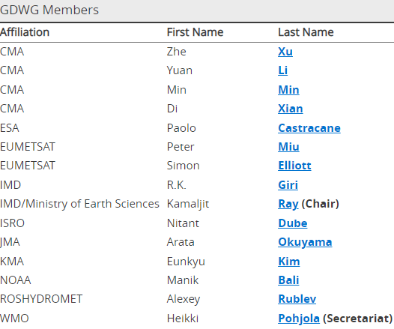
GDWG Membership
GDWG Members as of March 2021
Recent GDWG activities
Websites
GSICS webpage at each agency
Updating new WMO GSICS Portal
GSICS Collaboration Servers
Defining GSICS Conventions for new GSICS Deliverables
Instrument Event Logging
Annual Calibration Report (GRWG/GDWG Chair)
Updating GSICS Plotting Tool
Use of GitHub for collaborative work
Action Tracking Tool (GCC+GDWG)
Product Status Tool
Google Colab Notebook
https://gsics.wmo.int/en/focal-points
Welcome Eunkyu Kim to GDWG

Slide 4
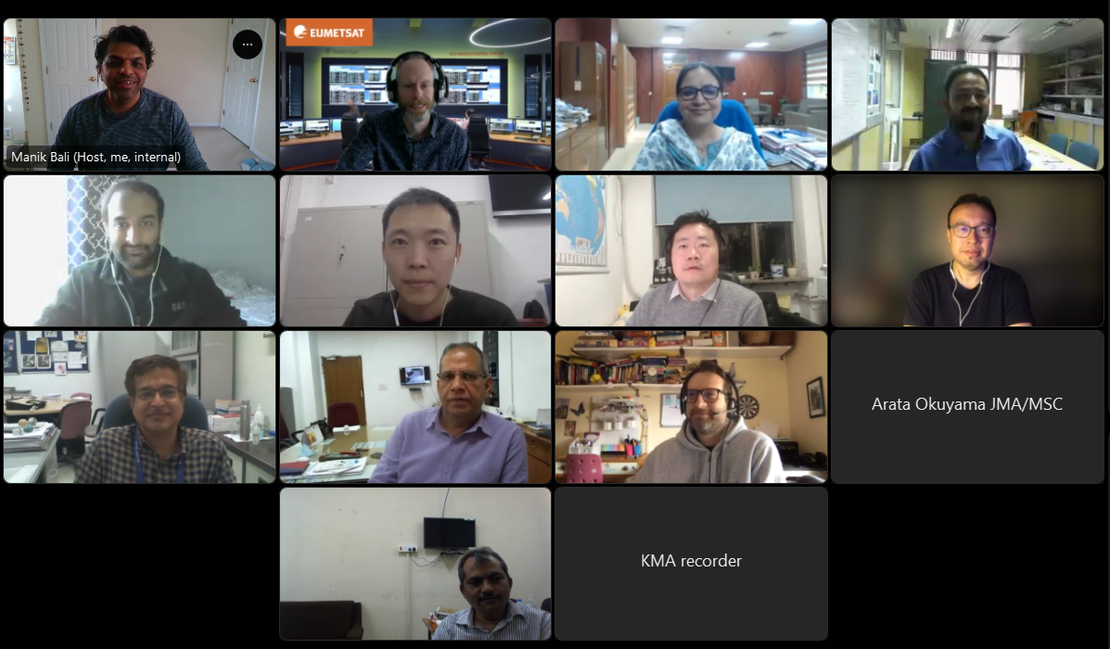
Group Photo: Top Left-Bottom Right: Manik Bali(NOAA), Simon Elliot(EUMETSAT), Kamaljit Ray ( Chair GDWG), Ashim Mitra(IMD), CMA, CMA, CMA, Nitant Dubey(ISRO), S. C Bhan(IMD), Paolo Castracane(ESA), Arata Okuyama(JMA), R. K Giri (IMD), Eunkyu Kim (KMA)
13 Participants represented Six GSICS Member agencies

Slide 5
GDWG Breakout session
GDWG- Breakout Session Planned Agenda 16 March 2022 12:00-14:00 GMT
Chair: Kamaljit Ray Minutes: Manik Bali
All
Time | Agency | Title
12:00 | Chair | GDWG Introduction | Kamal jit Ray
12:15 | IMD | IMD GDWG Report | R. K Giri
12:30 | JMA | JMA GDWG Report | Arata Okuyama
12:45 | CMA | CMA GDWG Report | Tian Lin
13:00 | ISRO | ISRO GDWG Annual report | Nitant Dube
13:15 | NOAA | NOAA Annual Report | Manik Bali
13:30 | ESA | Cal/Val Data web portals | Paolo Castracane
13:45 | ROSHYDROMET | ROSHYDROMET Annual Report | Rublev
 | KMA | KMA Annual Report (N/A) | Eunkyu Kim

Slide 6
Actions Status ( 2020)
Show entries
Search:
Action Id | Item | Summary | Lead | Expected Completion | Actual Completion | Status
A.GDWG.20202010.1 |  | KMA to provide the members the process to get account and use the KMA GSICS github. | Hysook (KMA) | 3/1/20201 | KMA provided contact info | Closed
A.GDWG.20201020.3: |  | IMD to update to update GSICS on receiving of JPSS data at IMD | IMD | 3/1/2021 |  | open
A.GDWG.20201020.2 |  | R.K Giri (IMD) to provide updates on landing page to GDWG | R.K Giri | 3/1/2021 |  | open
A.GDWG.202010.20.5 |  | GDWG to review GRWG proposed product convention changes (A.GDWG.20201020.4) and revise convention accordingly | GDWG | 3/1/2021 |  | Open
A.GDWG.20200812.1: | http://gsics.atmos.umd.edu/bin/view/Development/20200812 | GDWG to review existing product THREDDS directory structure to make it easier for ISCCP-NG users to access products |  | 3/1/2021 |  | Open
A.GDWG.20200519.9 |  | GDWG Chair to Organizeing a kick off in next few weeks for GDWG Groupfor GDWG chair. |  | 5/1/2021 | Web Meeting held on 2020/10/20 | Closed
A.GDWG.20200416.1 | http://gsics.atmos.umd.edu/bin/view/Development/20200416 | Manik Bali (NOAA) to coordinate GDWG to investigate developing scripts to generate contents of Annual Calibration Reports from GSICS Corrections. |  | 3/1/2021 | https://colab.research.google.com/drive/1-nMyJ4z-D2vTqfyI6wqQj1DgRCRfQW-h | Closed

Slide 7
Actions Status ( 2021)
A.GMW.20210330.3 | Get the GDWG presentation so that the group has the links to the GRWG software tools | Robbie Iacovazzi | 4/9/2021 | 4/21/2021 | Link available from GSICS Wiki page for 2021 Annual Meeting | Closed

Slide 8
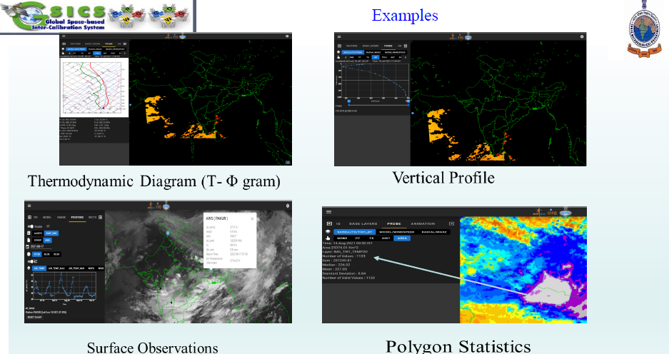
Discussions
India Meteorology Department (IMD)
Informed about RAPID Plotting tool (https://rapid.imd.gov.in/r2v/: ). The tool has the ability to plot satellite data on the IMD disk.
IMD will explore if it can be extended to plot GSICS data and deliverables.
Japanese Meteorology Agency (JMA)
Maintained GPRC and helped members inherit the design
Progressing towards migrating from IASI-A to IASI-B/C and H-8 to H-9

Slide 9
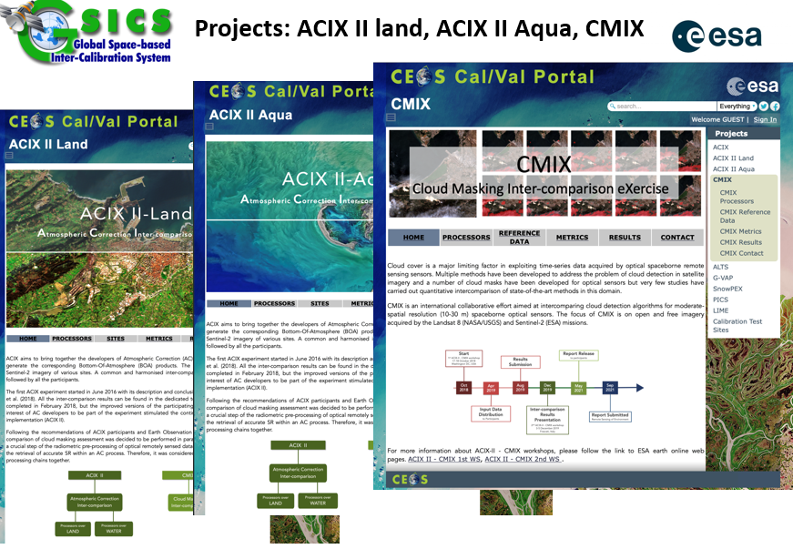
Chinese Meteorological Administration (CMA)
Maintained GPRC , THREDDS and GSICS website
Progressing towards building Landing pages for FY series
Supported RICH-CEOS program on Retrospective Processing
Indian Space Research Organization (ISRO)
Maintained GPRC , THREDDS and GSICS website
Retrospectively processes GSICS products
Supported Plotting tool
European Space Agency (ESA)
Reported on CEOS Cal/VAL portal
Reported on ESA Atmospheric Validation Data Center
ESA Calibration Landing Pages

Slide 10
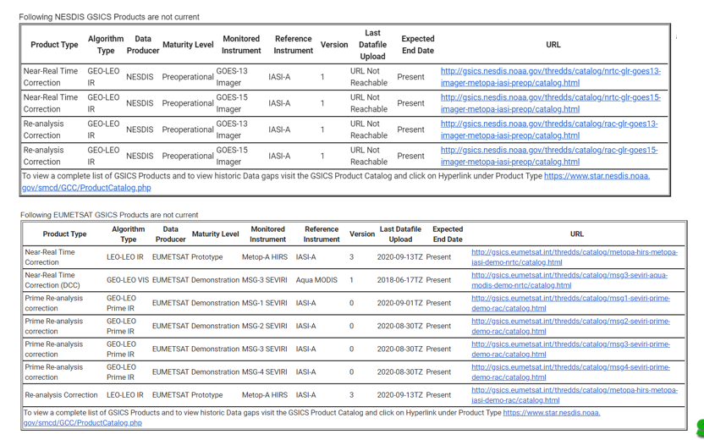
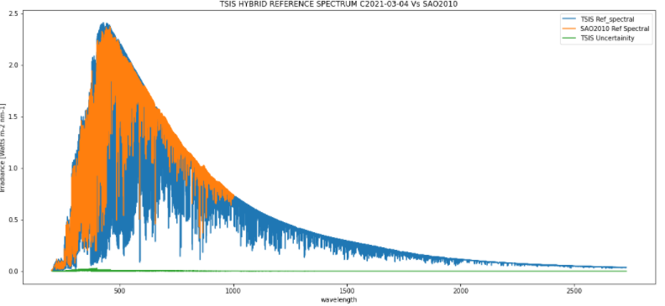
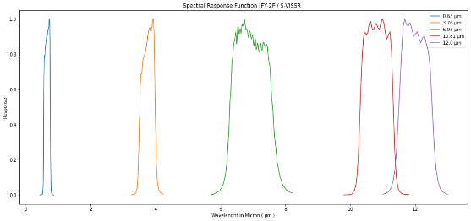
National Oceanic and Atmospheric Administration (NOAA)
New Notebooks
Generate SOS Report
Compare Solar Data Sets
GIRO SRF
Process GEMS data**
DCC Product notebook
This notebook reads DCC products and plots and lists them
GIRO SRF notebook
GSICS Product RAC notebook and NRT notebook

Slide 11
New Actions from GDWG Breakout Session
R.GDWG.20220316.1: Agencies to share their reprocessing best practices
A.GDWG.20220316.1: GDWG to discuss if reprocessed data be designated as a GSICS deliverable
R.GDWG.20220316.2: GDWG members to inform GCC about the latest membership
A.GDWG.20220316.3: CMA to present use of GSICS coefficients in NWP processing
A.GDWG.20220316.4: GSICS members to contact Paolo (ESA) and provide feedback to EVDC
A.GDWG.20220316.5: IMD/ISRO Cal/Val portal link to be provided to ESA to be included in the CEOS Cal/Val portal
A.GDWG.20220316.6: GSICS-GDWG(Manik) to work closely with ESA ( Paolo) to integrate GSICS notebooks into the ESA metrology notebooks.
A.GDWG.20220316.7: GDWG to contact GRWG to gather requirements for combined product
A.GDWG.20220316.7: Provide guidelines for UV SRF and help with readers and writers
A.20210331.1 To have a meeting on building the best practices for plotting tool. ISRO and CMA, KMA on plotting tool
A.20210331.2.: ESA to explore providing link of product catalog on EVDC and other ESA websites
Suggestions are welcome

Slide 12
Summary of links to GSICS tools
Bash script to download GSICS Data http://gsics.atmos.umd.edu/bin/view/Development/DownloadGSICSProducts
Series of notebooks to read, view and process GSICS Data and Deliverables from the browser in a collaborative ecosystem
DCC Product notebook
This notebook reads DCC products and plots and lists them
GIRO SRF notebook
GSICS Product RAC notebook and NRT notebook
Compare Solar Data Sets
3. Plotting Tool http://gsics.tools.eumetsat.int/plotter
4. GSICS Product Catalog: https://www.star.nesdis.noaa.gov/smcd/GCC/ProductCatalog.php
5. GSICS Product Status registration: Register here

Slide 13
Conclusion
Data Working Group continues to support the GSICS CAL/VAL activities
By building tools and best practices for the community.
New actions have been picked up to support collaborative ecosystem of development

Slide 14
THANK YOU

