Slide 1
GSICS Coordination Center & NOAA/GDWG GDWG Kickoff 10/19/2020
Manik Bali * Larry Flynn
GSICS Coordination Center, NOAA
NOAA GDWG

Slide 2
TABLE OF CONTENT
Introduction
NOAA/GDWG Action Status and new actions
Action Tracker
Alert System
Product Catalog
Moving on to next year

Slide 3
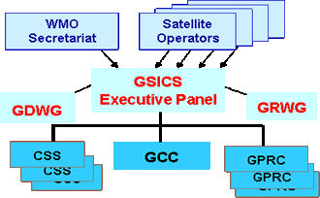
Introduction
GCC
NOAA/GDWG
GCC and NOAA/GDWG activities overlap
e.g Product Catalog, Action Tracker

Slide 4
NOAA-GDWD- Actions Status
Show entries
Search:
Action Id | Summary | Expected Completion | Deliverable Usage | Status
A.GWG.2019.3t.1 | Toshiyuki Kurino (WMO) to provide account access to update WMO GSICS website to GCC, GDWG and GRWG. | 3/1/2020 |  | Open
A.GDWG.2019.9p.5 | GCC to confirm with the GRWG to release the next version of the product catalogue to address table concern from Ken. | 3/1/2020 | New Product Catalog with Quicklooks now operational | Closed
A.GDWG.2019.9p.4 | GCC to contact Ken Knapp to what website he is referring to regarding his comment on its for contributors and not users, and report this to the working group. | 3/1/2020 |  | Closed
A.GDWG.2019.9p.2 | GCC to provide EUMETSAT the download script for review to see if this can be provided to users to improve the downloading of GSICS products. | 3/1/2020 | Script provided for review and place on wiki | Closed
A.GDWG.2019.9l.1 | GDWG Chair to provide GCC the updates for GSICS Action Tracker which was agreed at GDWG Web meeting in January 2019. | 3/1/2020 |  | Open
A.GDWG.2019.9k.1 | GCC to present the options available for the Wiki migration to the GDWG members, and coordinate a way forward to present to the GSICS EP. | 3/1/2020 |  | Closed
Action Id | Summary | Expected Completion | Deliverable Usage | Status
A.GWG.2019.3t.1 | Toshiyuki Kurino (WMO) to provide account access to update WMO GSICS website to GCC, GDWG and GRWG. | 3/1/2020 |  | Open
A.GDWG.2019.9p.5 | GCC to confirm with the GRWG to release the next version of the product catalogue to address table concern from Ken. | 3/1/2020 | New Product Catalog with Quicklooks now operational | Closed
A.GDWG.2019.9p.4 | GCC to contact Ken Knapp to what website he is referring to regarding his comment on its for contributors and not users, and report this to the working group. | 3/1/2020 |  | Closed
A.GDWG.2019.9p.2 | GCC to provide EUMETSAT the download script for review to see if this can be provided to users to improve the downloading of GSICS products. | 3/1/2020 | Script provided for review and place on wiki | Closed
A.GDWG.2019.9l.1 | GDWG Chair to provide GCC the updates for GSICS Action Tracker which was agreed at GDWG Web meeting in January 2019. | 3/1/2020 |  | Open
A.GDWG.2019.9k.1 | GCC to present the options available for the Wiki migration to the GDWG members, and coordinate a way forward to present to the GSICS EP. | 3/1/2020 |  | Closed

Slide 5
Recent Actions on GCC and NOAA/GDWG
Action Id | Summary | Expected Completion | Deliverable Usage | Status
A.GCC.2020.1b.1 | GCC to organize a web meeting to bring GSCIS Developers and users together. We need to learn how we can make the products better and more accessible. | 3/1/2021 |  | Open
A.GDWG.20200416.1 | Manik Bali (NOAA) to coordinate GDWG to investigate developing scripts to generate contents of Annual Calibration Reports from GSICS Corrections. | 3/1/2021 |  | Open
Actions Aim to:
Develop consensus on producing class of GSICS products that are user friendly.
To simplify creation of State of Observing report / Calibration reports by agencies and harmonize the tables and plot

Slide 6
Product Alert System

Slide 7
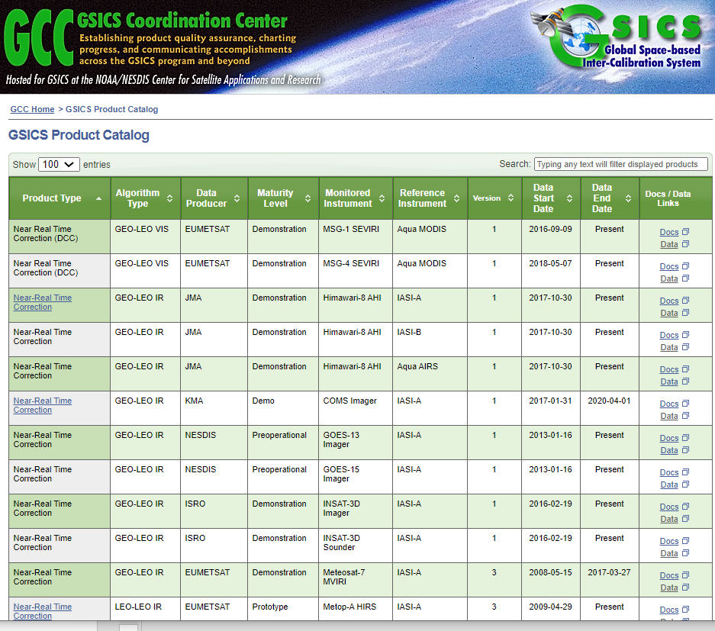
Background
The Global Space Based Inter-Calibration System ( GSICS ) maintains over 63 inter-calibration products. These products are produced each day and disseminated via the THREDDS server or via the ftp servers on the https://www.star.nesdis.noaa.gov/smcd/GCC/ProductCatalog.php
The goal of this alert system is to inform the producers about the status of their GSICS product via an Email sent by the Alert System. The email consist a list of un-updated products in a format similar to that on the GSICS Product Catalog.
For Demo Click here
Relays the following information to the subscriber
When did the last time product uploaded take place on the THREDDS server
If the URL is active

Slide 8
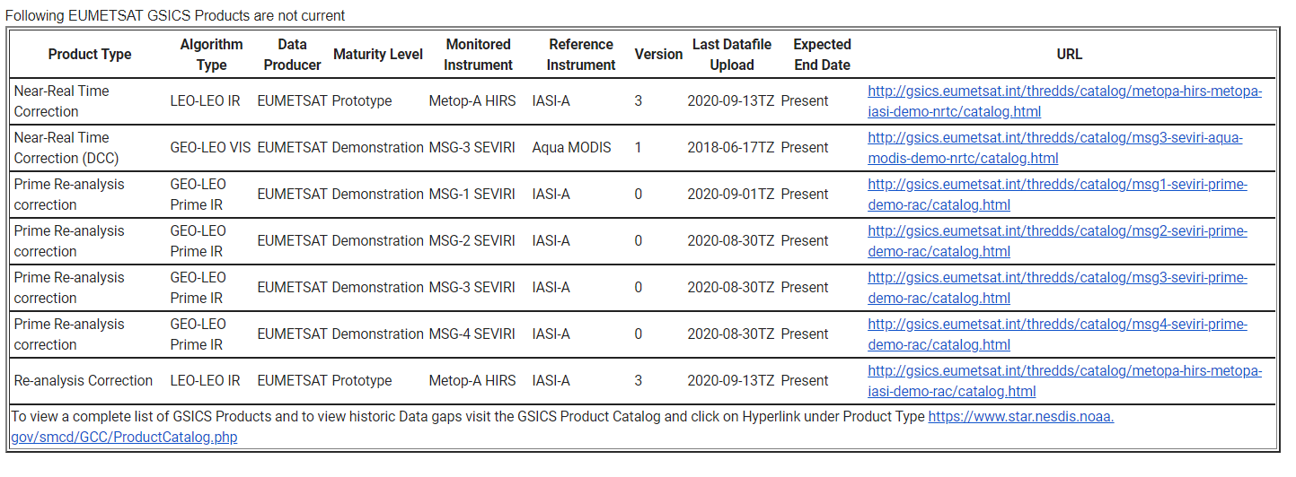
Alert Emails

Slide 9
Why Action Tracker
Each year actions are generated in GSICS community.
These actions were previously monitored on the GSICS Wiki Page
Over the years activity in GSICS has increased as has the number of Actions generated in GSICS Annual, EP, UW and group and subgroup meetings.
GRWG placed a request to GCC-NOAA-GDWG to provide an alternative to the wiki actions page. Features that were requested.
Fast search.
Easy Action writing.
Easy updating.
Easy to understand layout.
New Category of actions ( For example, Lunar, Recommendation, Decision)
Some level of automation.
Big Thank you to Tim Hewison and Masaya Takahashi for posting requirements and testing the existing tool

Slide 10
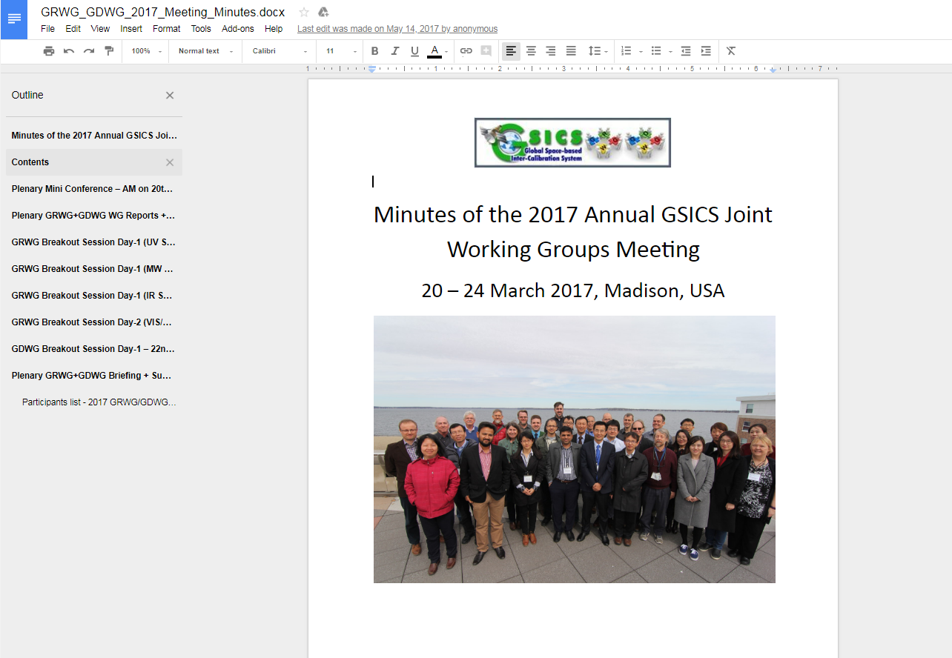
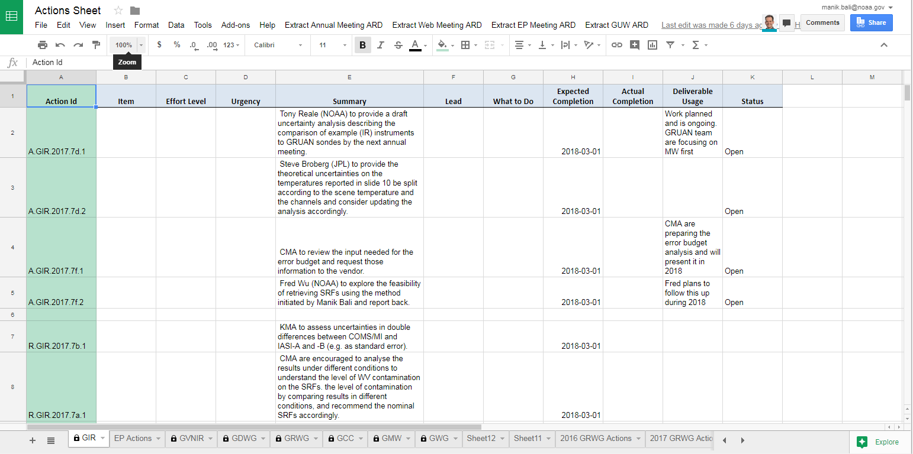
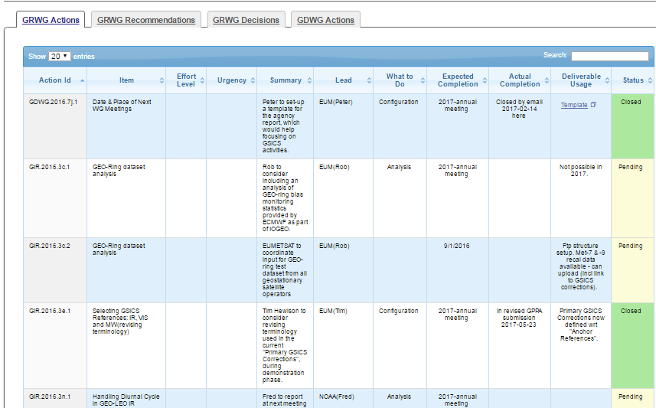
Approach - Google Cloud + Web

Slide 11
Au
How to Use the Action Tracker
Automatically reads the Annual Meeting report Goodle Doc and extracts Actions/Recommendations/Decisions and puts them onto Google Sheet ( Direct Reduction of Overhead by 50% as compared to Wiki)

Slide 12
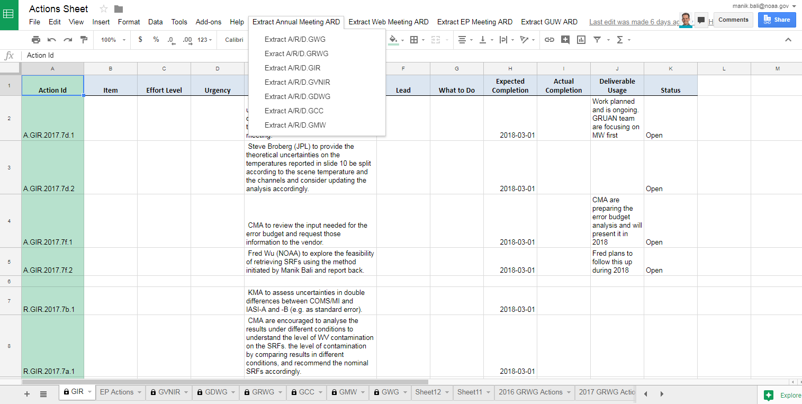
New Features
Dropdown Menu extracts Actions/Recommendations and Decisions from Annual GUW and EP meeting

Slide 13
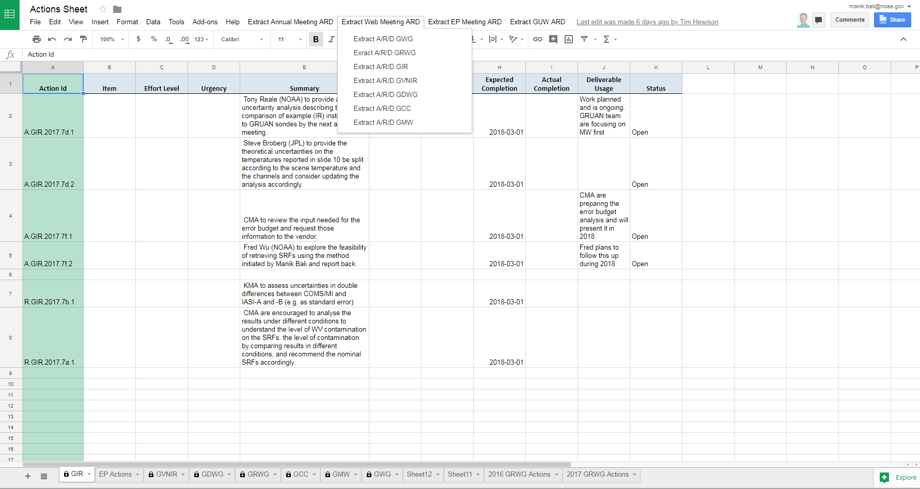
New Features
Dropdown Menu extracts Actions/Recommendations and Decisions from Annual GUW and EP meeting

Slide 14
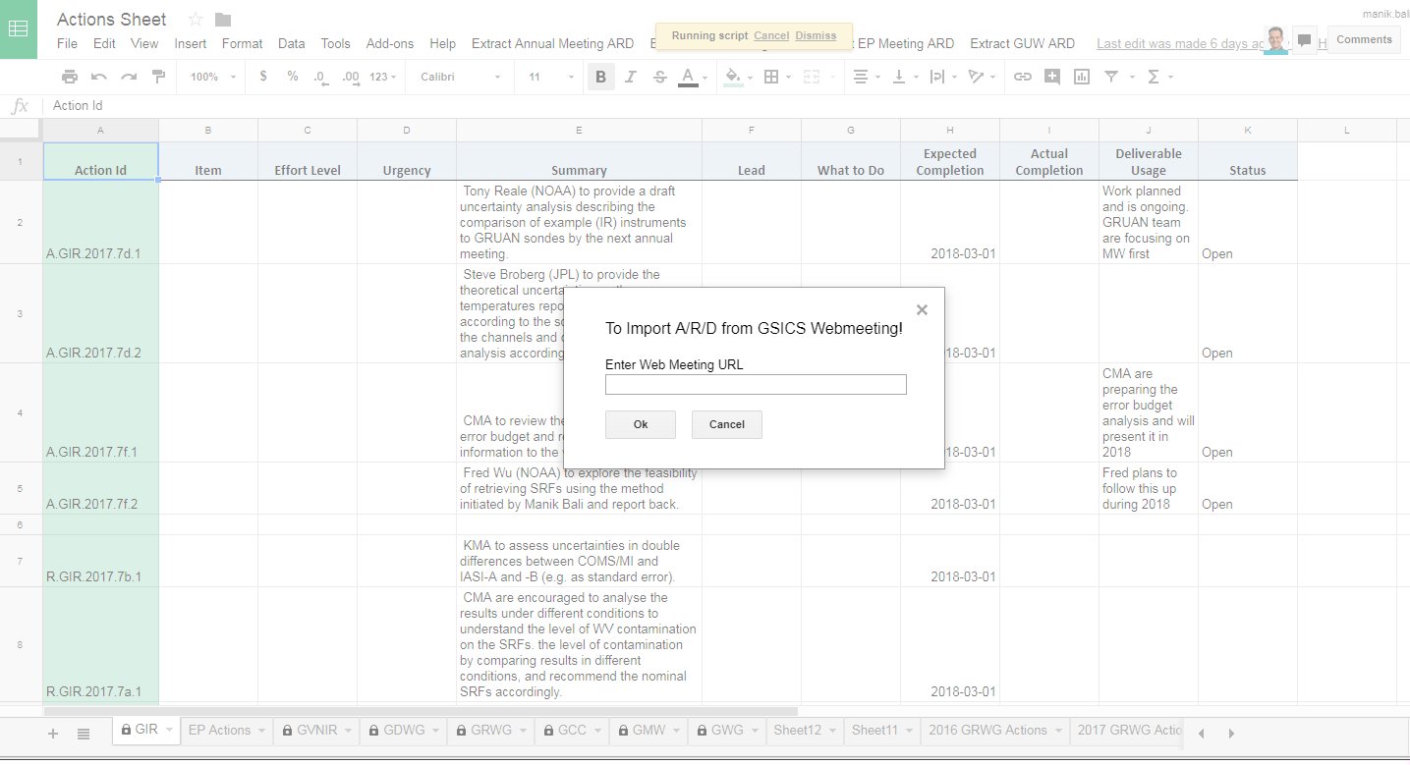
New Features
A new feature to extract Actions from Wiki page has been added and tested successfully.

Slide 15
How to Use the Action Tracker
GCC creates a google Sheet for each type of action being tracked. The Sheet link is shared among GSICS members.
The actions are grouped into pages by year, each different type viewable on a separate tab. The content of the tables on the tabs are sortable and searchable.
If users need to add hyperlinks to any action sheet, users should use the ‘Activate Hyperlink’ button to activate on the google sheet to activate ithe hyperlink on the GCC Action Tracker website.
When users’ changes are saved, they are dynamically updated onto the correct Action Tracker page.
A.GroupID.YYYY.sessionID.Action number (Actions )
D.GroupID.YYYY.sessionID.Decision number (Decisions )
R.GroupID.YYYY. sessionID.Reccomendation number (Recommendations )
Always Use Actions/Recommendations/Decisions ID’s correctly (Eg A.GDWG.2017.5a.8 )

Slide 16
Summary of New Additions
Added new buttons. Each GSICS Meeting has a button
Direct extraction of Actions/Recommendations and Decisions from from google document without any human intervention
Added new Tabs on the Excel Sheet
Added the ability to import actions from Wiki Page and Webpages
New Parser has been developed to extract actions from GSICS EP meeting
Activtehyperlink button has been re-integrated into the new Tracker Sheet to add hyperlink( To n extent this has reduced the column width)
Done tests with reducing columns , should be operational coming yer
Demo: Google is not Available in China however import from Zoho to google sheet has been successfully tested.
https://docs.google.com/spreadsheets/d/11-U2XDE7J5cHYjksRsZ5WGFVXMyw_hgEz5XG1RG4BoY/edit#gid=1779096712
Update 2020 Actions

Slide 17
Discussion
Do we need a web page for GSICS Deliverables ?
Discussion on developing scripts for SOB report

Slide 18
Moving forward
Past year supported
Migration of wiki to new location ( power back up)
Development of Alert System
Update the Action Tracker
Updated the product catalog
Support landing of new NOAA products
Planned activities next year
Develop script for generating State of Observing System Content
Design the State of Observing System presentation
Add new Analytical features to Alert system
Machine Learning technique for Landing Pages
Support landing of new NOAA products
Sync GSICS Wiki to GitHub/New H/W

Slide 19
THANK YOU

