Slide 1

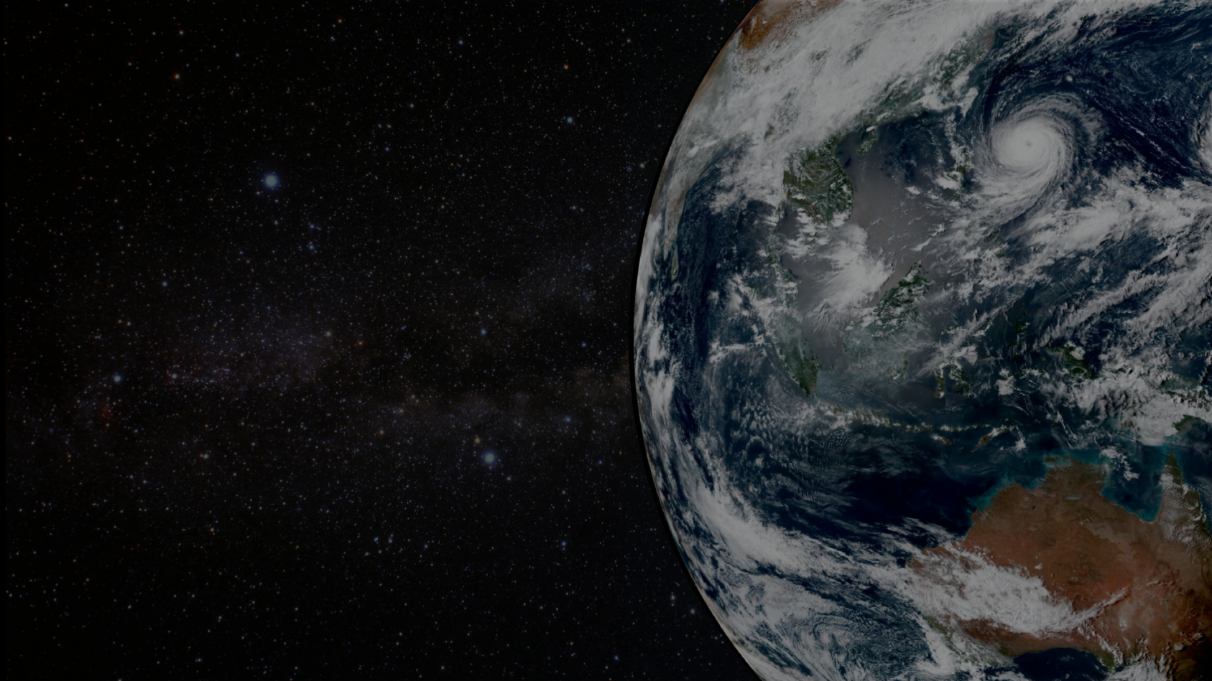
The Community Radiative Transfer Model
Benjamin T. Johnson and Quanhua (Mark) Liu
Patrick Stegmann (UCAR / JCSDA) | Andrew Tangborn (EMC)
Cheng Dang (UCAR/JCSDA) | Isaac Moradi (GMAO)
Ming Chen (STAR) | Youlong Xia
Yingtao Ma (STAR) | Bryan Karpowicz (GMAO)
Igor Polonsky (AER) | Nick Nalli (STAR)
GSICS Annual Meeting, FEB 27, 2023, College Park, Maryland

Slide 2
What is Community Radiative Transfer Model
(CRTM)? --- Radiance Interpreter
Satellite Observation
Radiative Transfer (CRTM)
forward
adjoint
Sensor monitoring
Physical retrieved satellite products
Radiance assimilation
Reanalysis
Geophysical Parameters

Slide 3

CRTM Development
OPTRAN (Mcmillin and Fleming,1976) for CO2 absorption channels
CRTM (Weng and Liu,2003)
CRTM V1 Operational (2005)
Current CRTM V2.4.0
Next major release CRTM V3.0 (Liu and Cao, 2019)

Slide 4

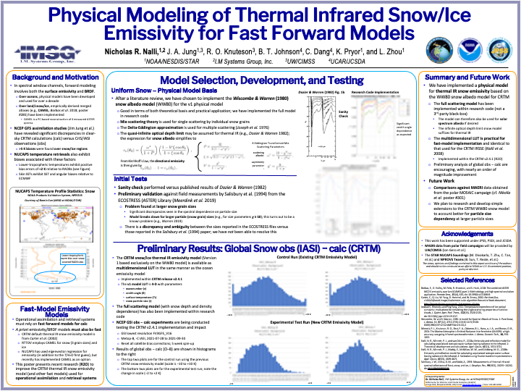
Improved snow emissivity T-IR (N. Nalli)
Nick’s AMS-22 Poster
Publication in preparation
SIMOBS-38

Slide 5
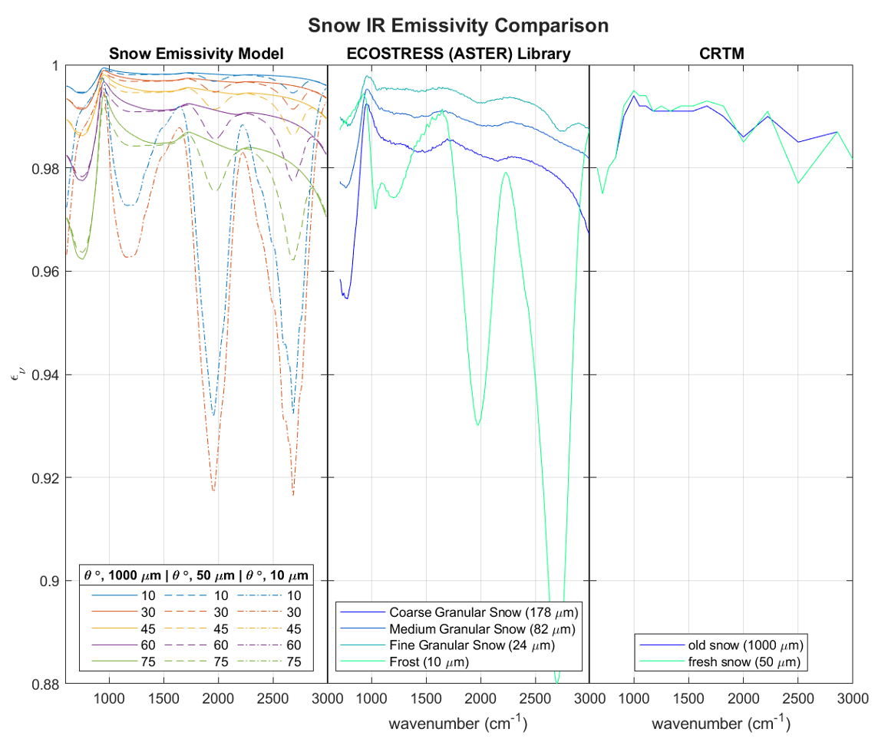
Snow Covered Surfaces
Infrared (Nalli)
Reference Library
New Model
Current Model
SIMOBS-38
Simplified model
  Quasi-infinite optical depth assumption
  Warren & Brandt (2008) optical constants for ice
Significant zenith angle dependence as expected
However, significant differences were seen in the spectral dependence on particle size from those observed in ECOSTRESS spectral library

Slide 6
Space-based radar in CRTM (Moradi/Johnson/Yingtao)
SIMOBS-22, 36
CRTM radar simulator as well as its adjoint and tangent linear are implemented and tested
The radar module takes advantage of different CRTM atmospheric absorption and cloud scattering modules
The radar simulator uses the backscattering coefficients included in the new DDA lookup tables
The radar module can be used for the assimilation of observations from instruments such as CloudSat CPR, GPM DPR, and EarthCare CPR.
Work is in progress to evaluate the active module especially within the JEDI DA system

Slide 7
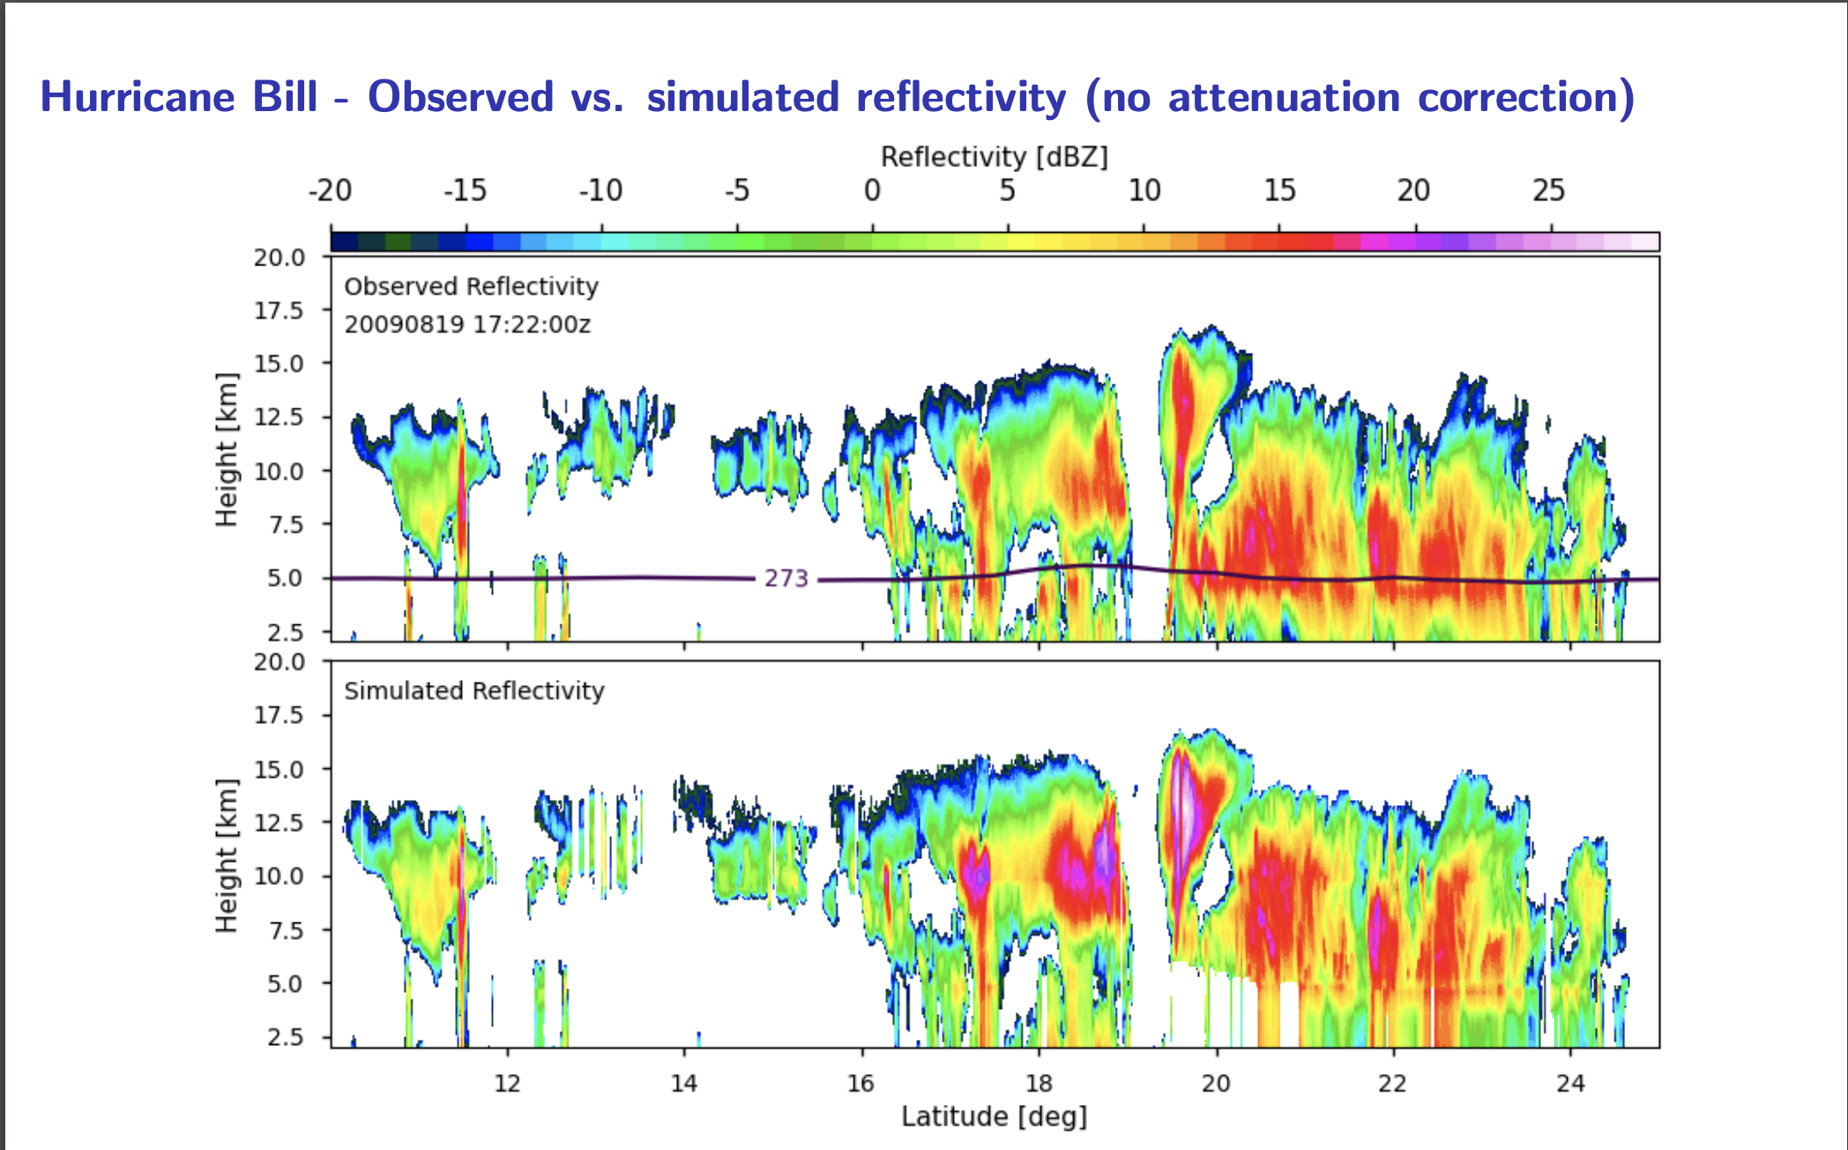
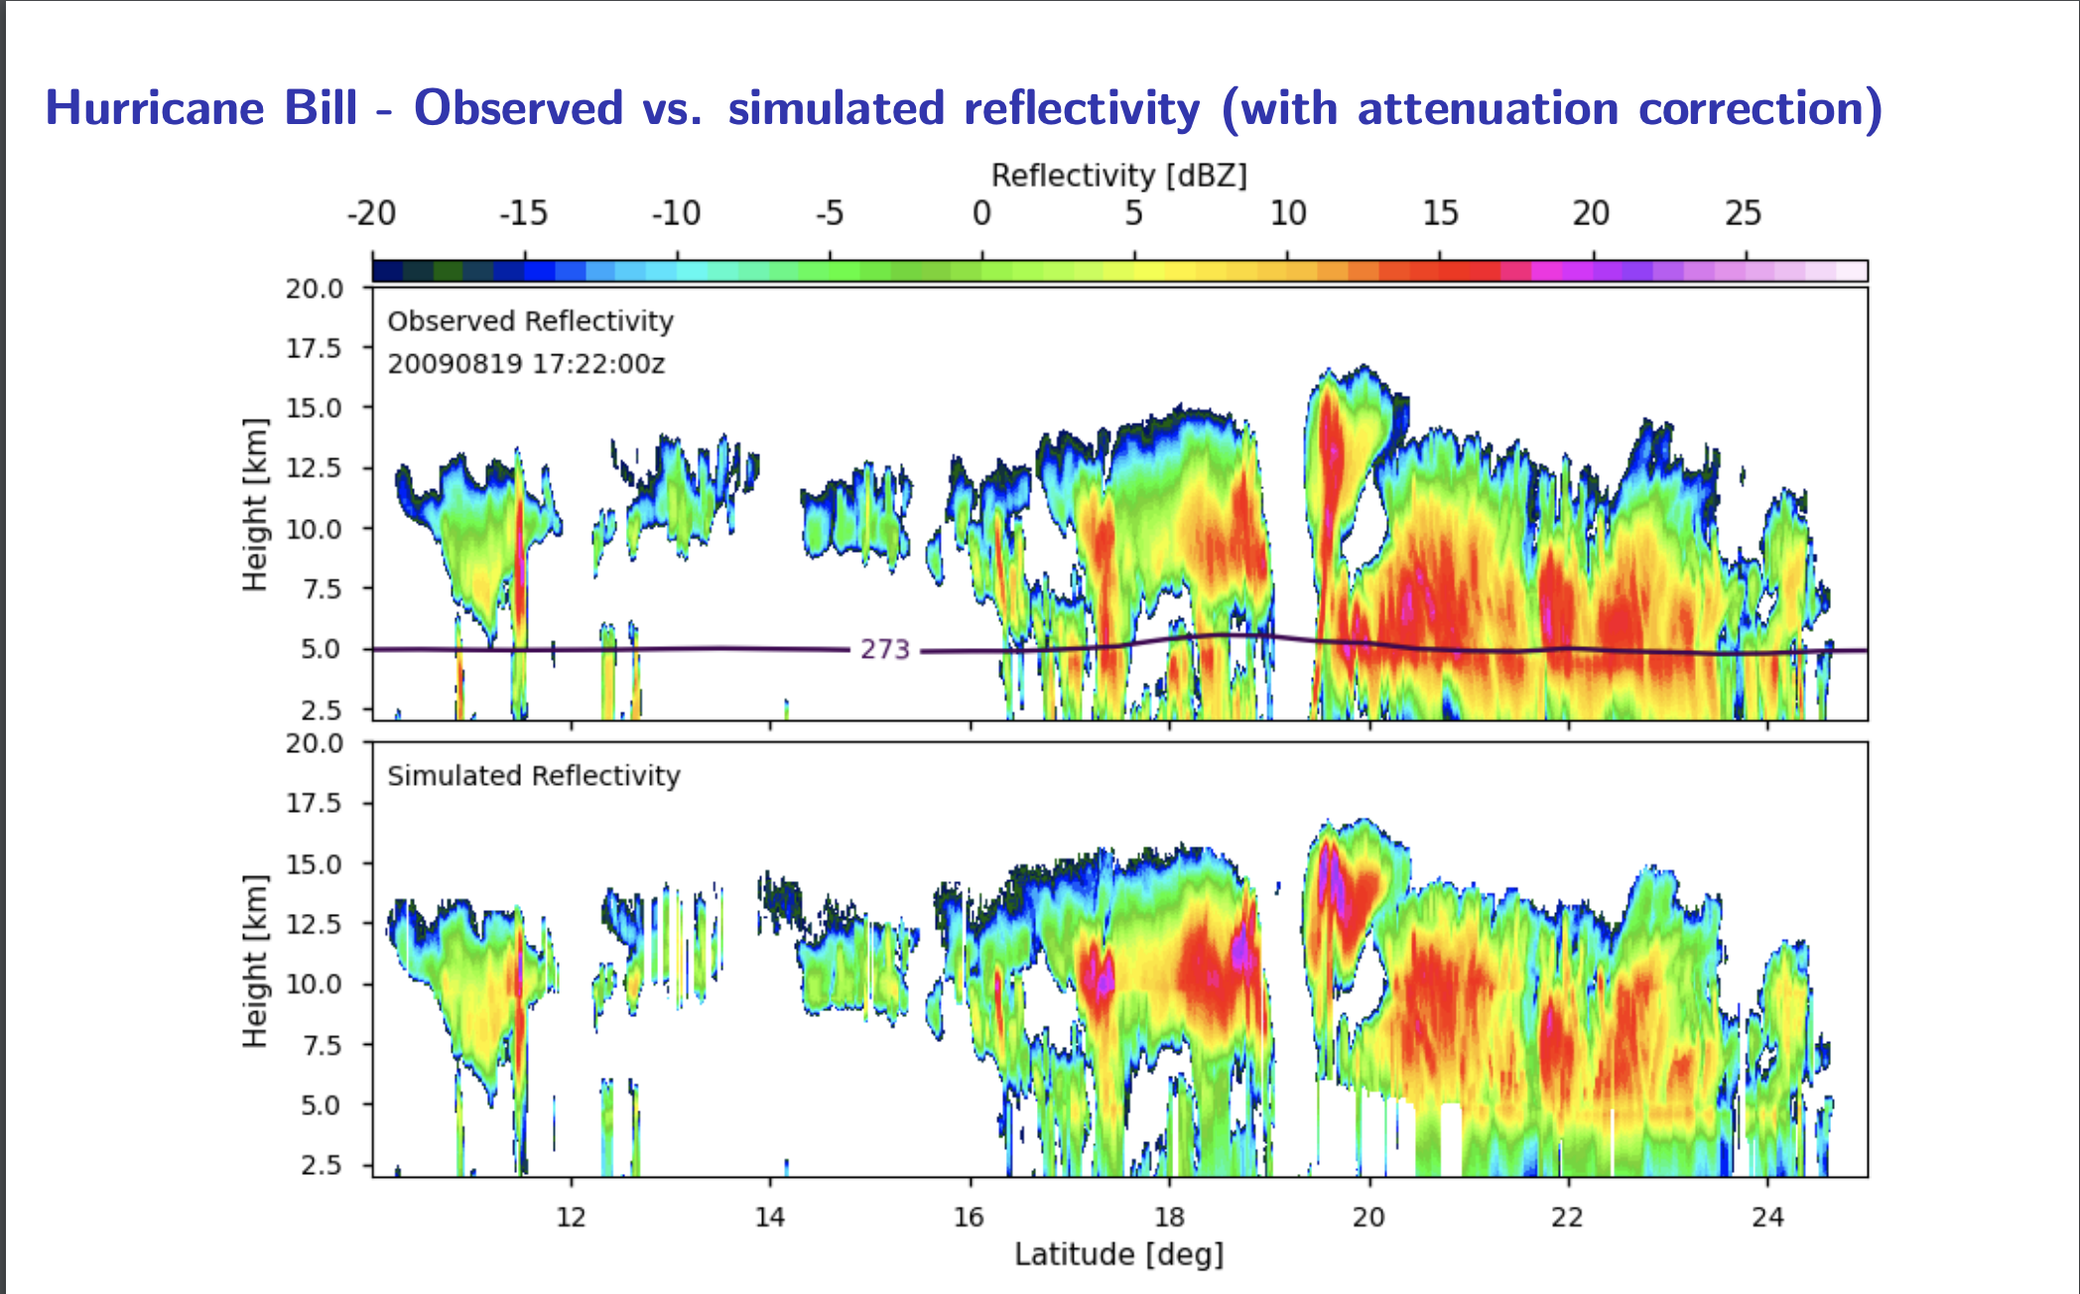
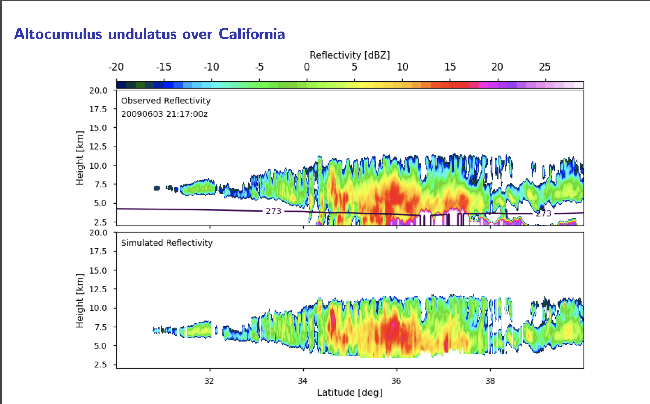
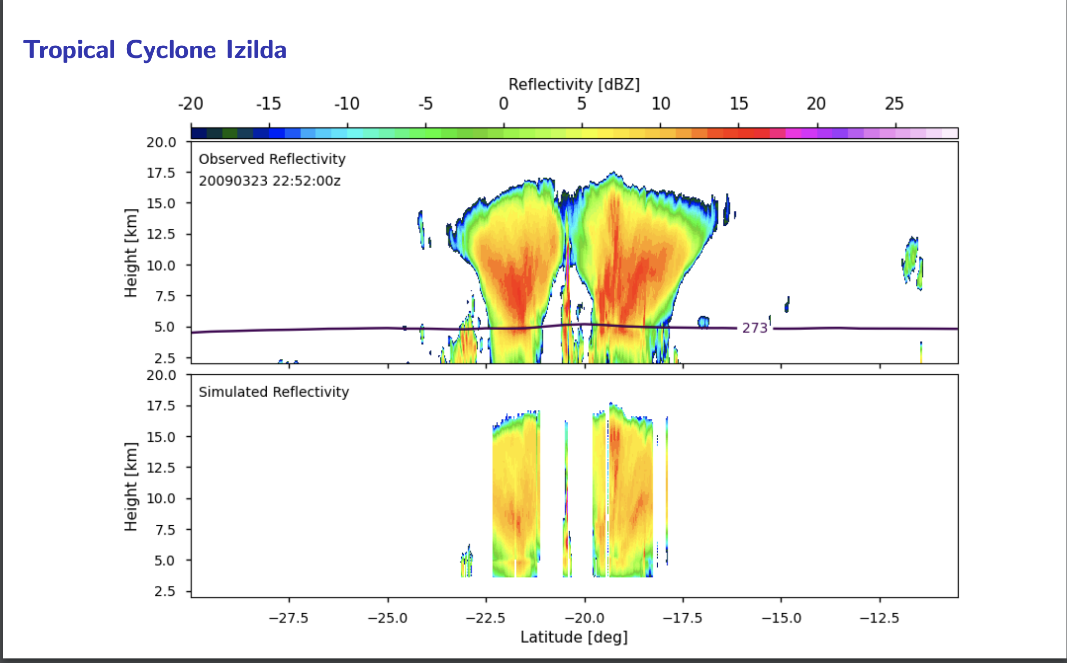
Space-based radar in CRTM (Moradi)
SIMOBS-22, 36

Slide 8
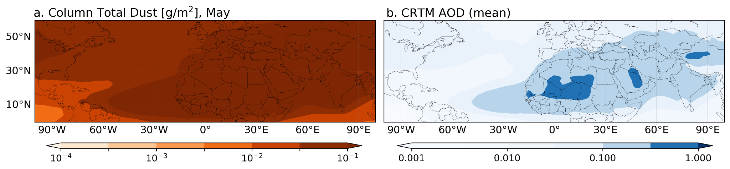
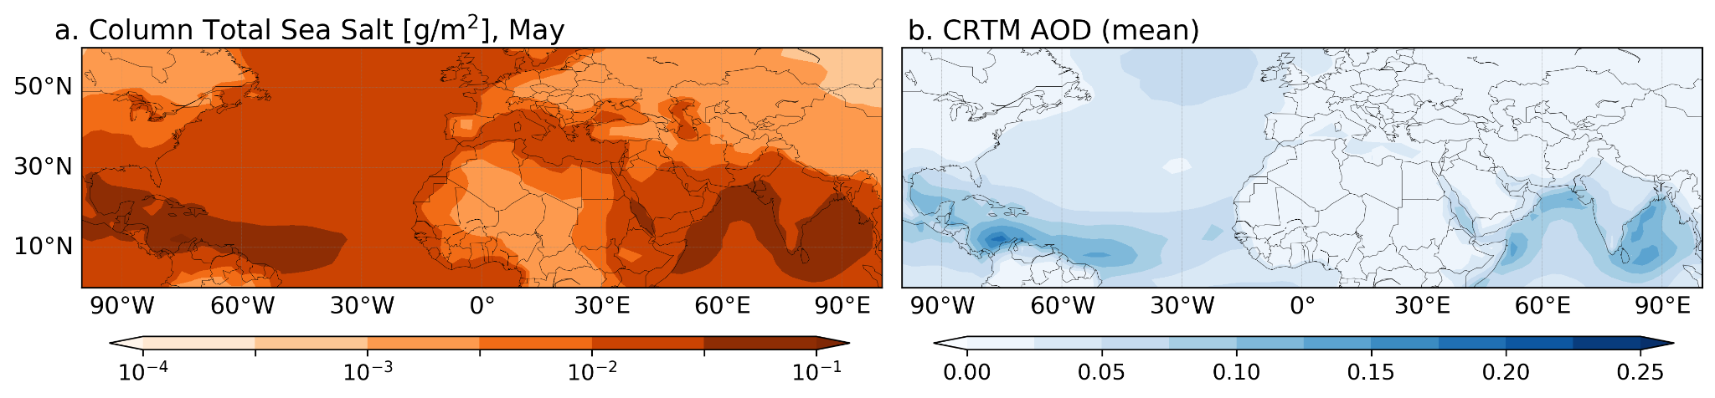
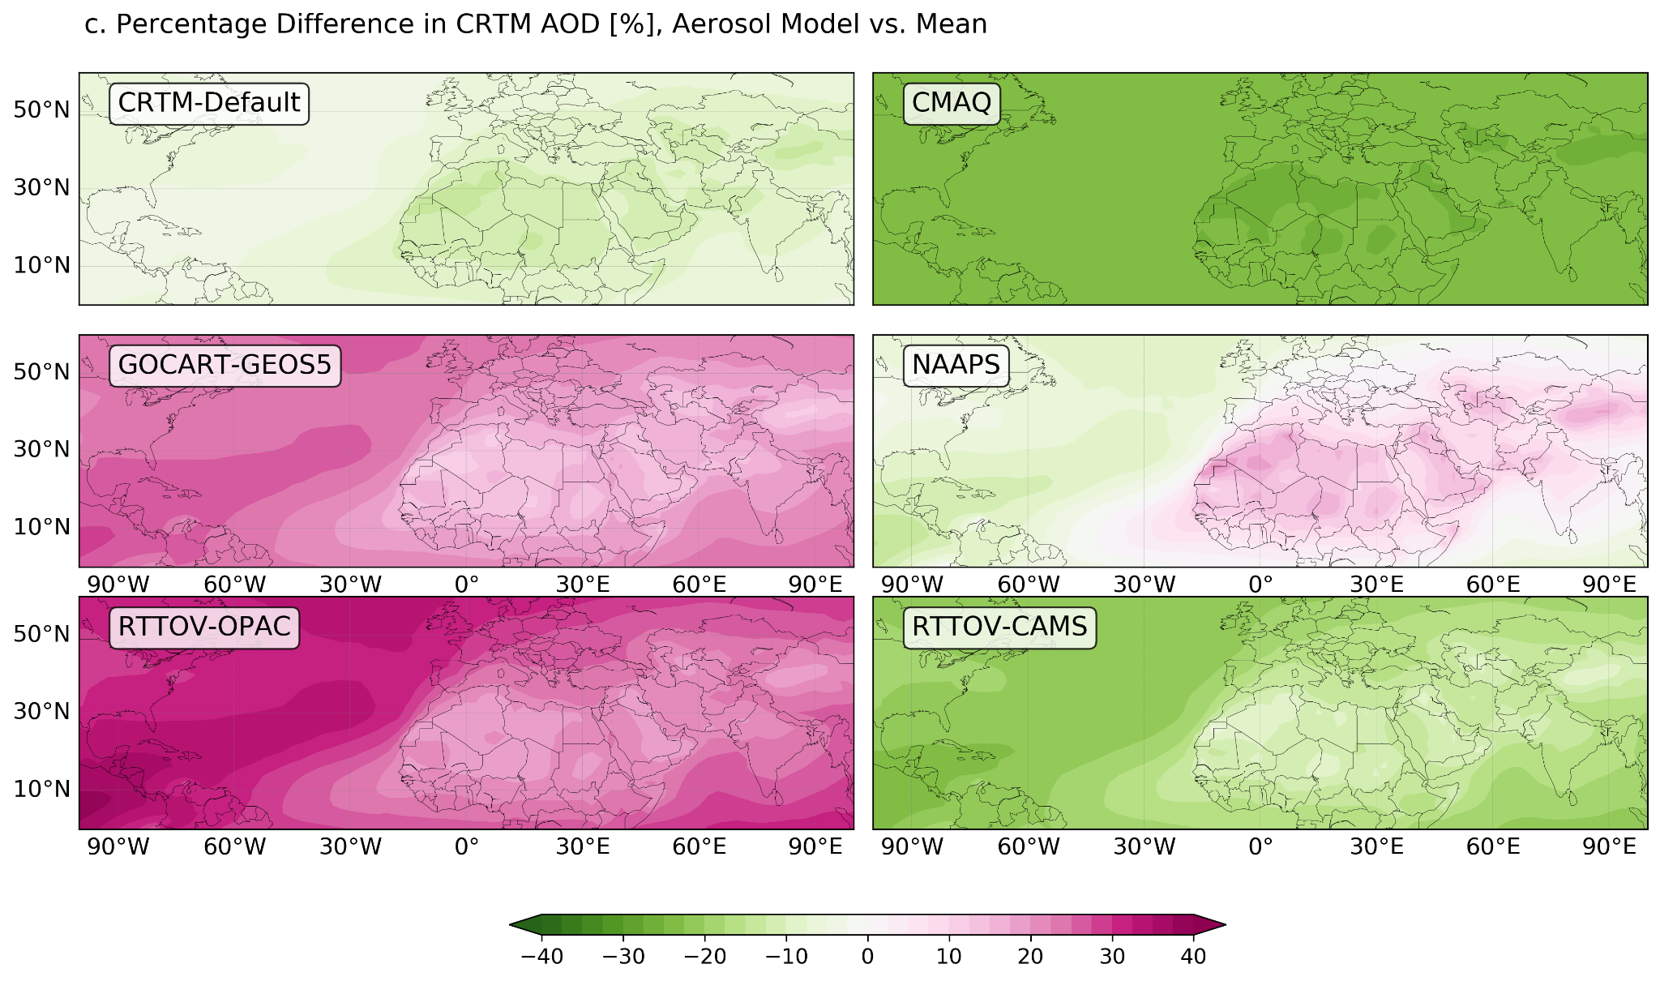
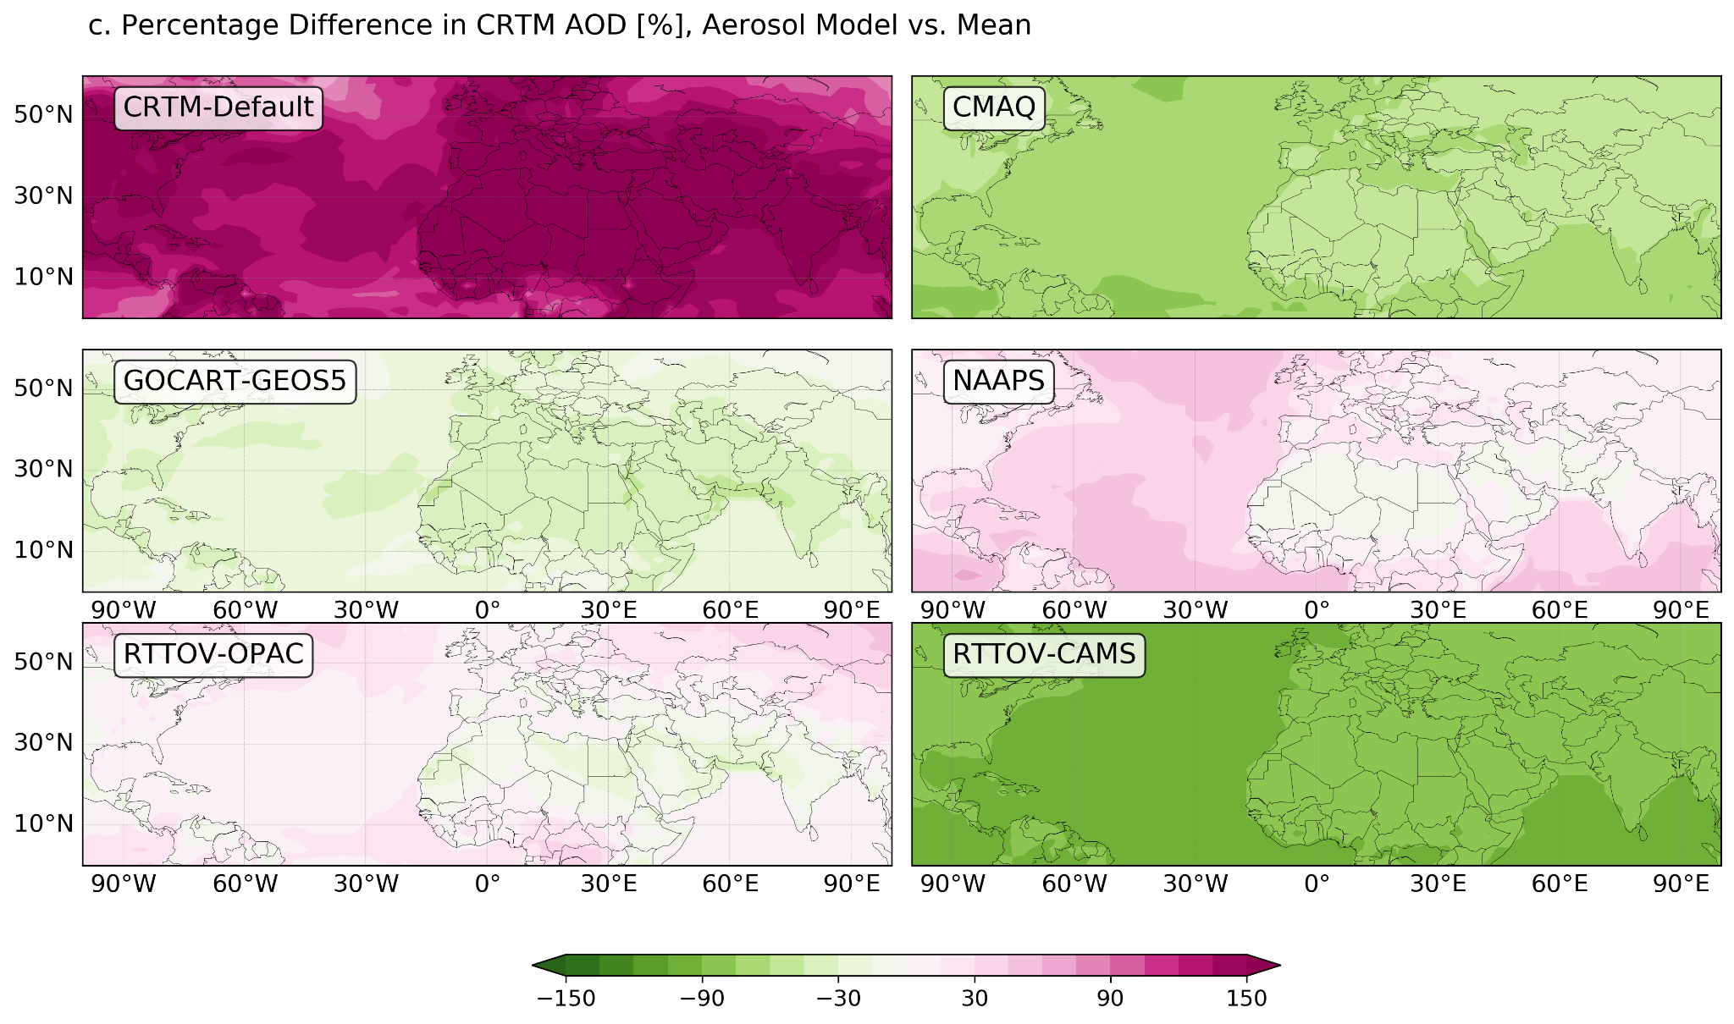
Additional Research Activities (C. Dang)
CRTM aerosols schemes (updated AOD test results with two RTTOV tables)
SIMOBS-37
Dust
Sea Salt
Figures, a. Column total aerosol concentration of May (MERRA-2 climatology) and b. the corresponding AOD simulated using CRTM, averaged over six aerosol schemes. c. percentage differences in AOD computed using each aerosol scheme.

Slide 9
CRTM v3 Development
https://github.com/JCSDA/CRTMv3 (public repository)
Authoritative development and release repository
Aiming for DevOps style of development
  small, frequent updates
  “microservices architecture” decouples large, complex systems into simple, independent projects
  Frequent team releases, with critical tagged releases for partners and support
  Versioning will remain the same, but minor version number will have more increments
netCDF Coefficient versioning, full deprecation of Big Endian / Little Endian binary formats –coefficient versioning will be associated with a given release, but not necessarily tied to a specific release.
Build process will check out coefficients and verify compatibility – procedure will be developed with operational partners to ensure operational requirements are met
Updated OMPS coefficient file to support off-nadir beams, each having a different wavelength.

Slide 10
CRTM v3.0 (under heavy development)
https://github.com/JCSDA/CRTMv3
Status: Code merged with v2.4.1, v3.0.0 -- Feb. 14th 💖 for initial/structural testing in UFO.
Full Polarization Solver Capability
  ▣ UV capable solver + polarization support under evaluation (CRTM v3.0-beta) [Thanks Q. Liu]
Aerosols
  ▣ Improved aerosol indices of refraction (P. Yang/TAMU, P. Stegmann, D. Turner, J. Gasteiger, C. Dang)
  ▣ Update of CRTM using initial CMAQ specifications (C. Dang, Y. Ma)
  ▣ Improve Lidar backscattering and attenuation calculations (Pagowski, Scherllin-Pirscher)
Cloud / Precipitation
  ▣ Backscattering coefficients for CRTM active sensor capability (Moradi, Johnson, Stegmann)
  ▣ Produce (Polarized) CRTM Scattering Coefficients from BHMIE and T-Matrix spheroids in binary and NetCDF
  ▣ Start systematic investigation of “optimal” single-scattering properties for CRTM applications
  ▣ Update of CHYM for microphysical consistency with NWP (B. Johnson, G. Thompson, Y. Lu, E. Clothiaux)
Surface
  ▣ Test CRTM-CSEM in GFS/GSI, focusing on the comparisons among model options. (M. Chen)
  ▣ Initial implementation of MW ocean surface BRDF model (M. Chen)
  ▣ Ocean Surface Emissivity improvements IR (IRSSE, N. Nalli), and Microwave (Team)
  ▣ Improved snow cover / ice emissivity in IR (Nall), and Microwave (Team)
SW / IR improvements in CRTM
  ▣ Cloud, surface, and aerosol impacts on visible channels (C. Dang)

Slide 11
CRTM v2 -> v3 Development
Active Sensor Forward Module (Ma, Moradi, Johnson) (SIMOBS-22)
  Active: GPM DPR, CloudSat CPR (Moradi) sensors added to repository
Community Surface Emissivity Model (Nalli, Chen) (SIMOBS-38)
  Snow-covered land for IR
  Sea-Ice (?)
Cloud Optical Look-up Table (Ma, Moradi, C. Dang) (SIMOBS-36)
AI-based Radiative Transfer Model Development (Liu) (related to SIMOBS-24)
JEDI/UFO integration (SIMOBS-55+)

Slide 12
Challenges for future radiative transfer model
Current CRTM efficiency and accuracy need to be significantly improved because of
rapidly increasing observations with higher accuracy, high accuracy in data assimilation and retrievals.
CRTM is band (or channel) based fast radiative transfer model. The polychromatic optical depths are approximately used as ‘monochromatic’ for cloud/aerosol scatterings, which causes some errors.
The spectral resolution of hyperspectral sensor such as CrIS can be important. How CRTM can simulate unapodized CrIS radiance?
The difference between using ATMS measured and box-cart approximate spectral response data is about 0.2 K. Very accurate RT model is required to have the benefit using ATMS measured SRF.

Slide 13
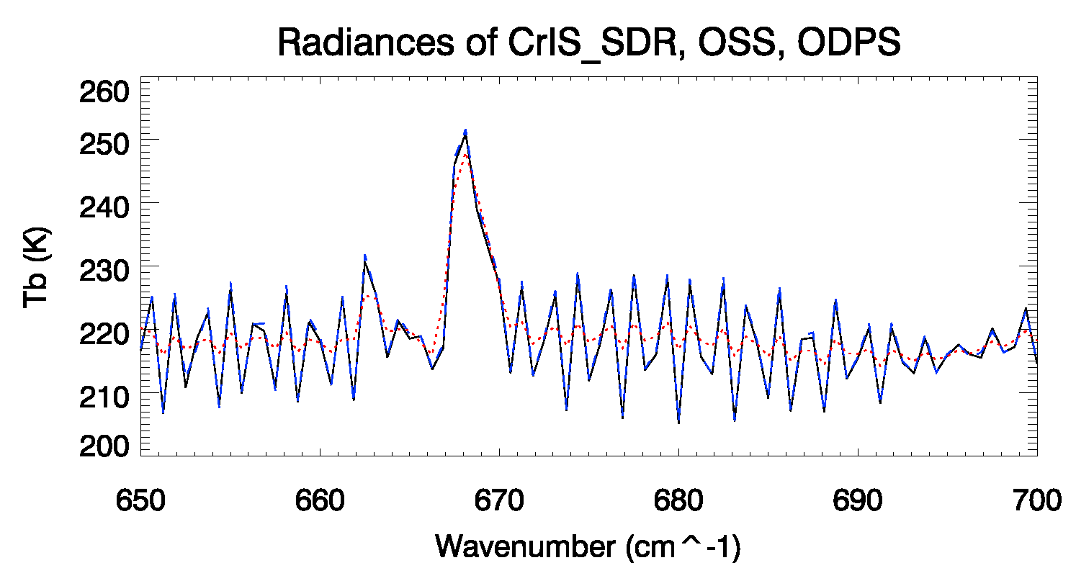
CrIS Unapodized Radiance Calculations
Individual unapodized channel radiance displays better spectral information than
apodized channel radiance. However, with two guard channels, the apodized radiance
can be analytically converted to unapodized radiance, see the equation (29) from
https://www.sciencedirect.com/science/article/pii/B9780124095489103914
_____ Measured unapodized
- - - - - CRTM_OSS unapodized
. . . . . . CRTM ODPS apodized
Comparison of SNPP CrIS SDR unapodized radiance observation with CRTM-OSS unapodized simulation and CRTM-ODPS apodized simulation for one profile under clear sky condition over ocean at 0600 UTC, March 29, 2016.

Slide 14
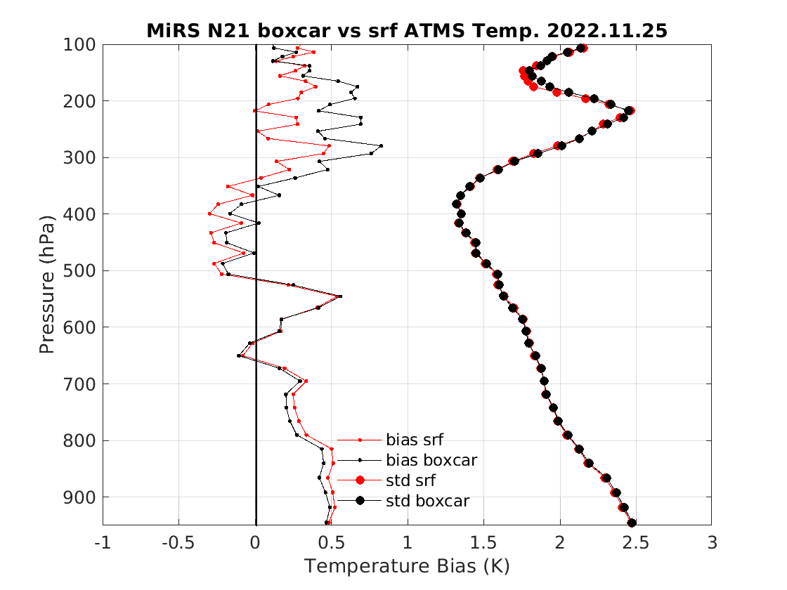
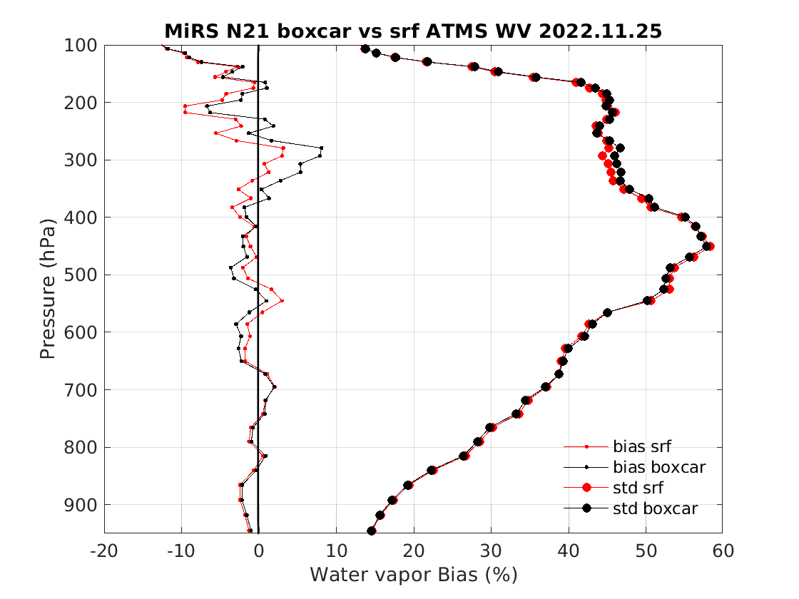
NOAA-21 MiRS ATMS Retrieval, using measured vs box-vart SRF
MiRS retrieval results showed using measured SRF data is slightly better above 400 hPa,
but slightly worse below 400 hPa, which may suggest the issue in simulating radiance
affected by surface emissivity.

Slide 15
Physics-based Constraint for AI Model Training
Physics in the radiative transfer model refers to macrophysics for example the
radiance sensitivity (or jacobian) on water vapor in the atmosphere, although the
macrophysics foundation is microphysics such as molecular emission and absorption
described by quantum mechanics.
Add root mean square errors of jacobian radiance into loss function and a module
for minimizing the jacobian error term in training process without changing
original AI RTM. I use my training tool (AI_phy) and will try to add to keras or
Tensorflow if it isn’t difficult to do.
The AI model has 22 outputs for ATMS 22 channels brightness temperatures.
Adding the physics constraint helps the training, not affect computational
efficiency in applications.

Slide 16
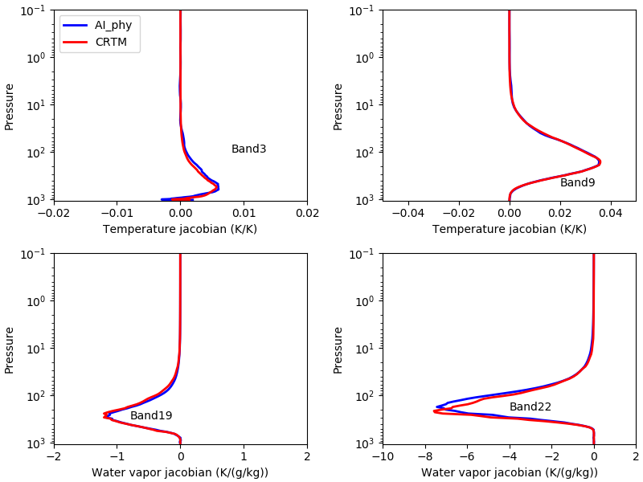
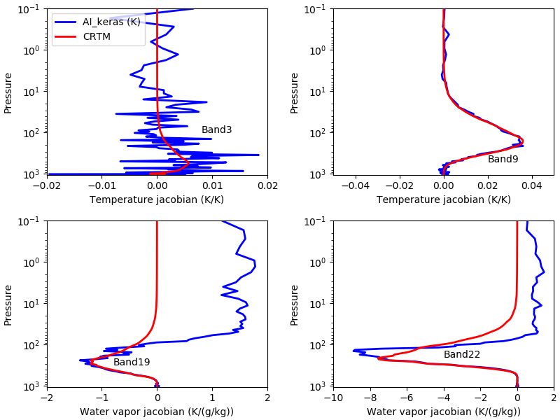
Radiance Jacobian Comparisons
AI_phy RT AI_keras RT
AI_phy_rt and AI_keras_rt use the same AI model configuration. AI_phy_rt is trained with physics constraint and its forward model accuracy is comparable to AI_keras, better than ATMS instrumental noise. AI_phy_rt jacobian agrees with the CRTM, much better than AI_keras_rt.

Slide 17
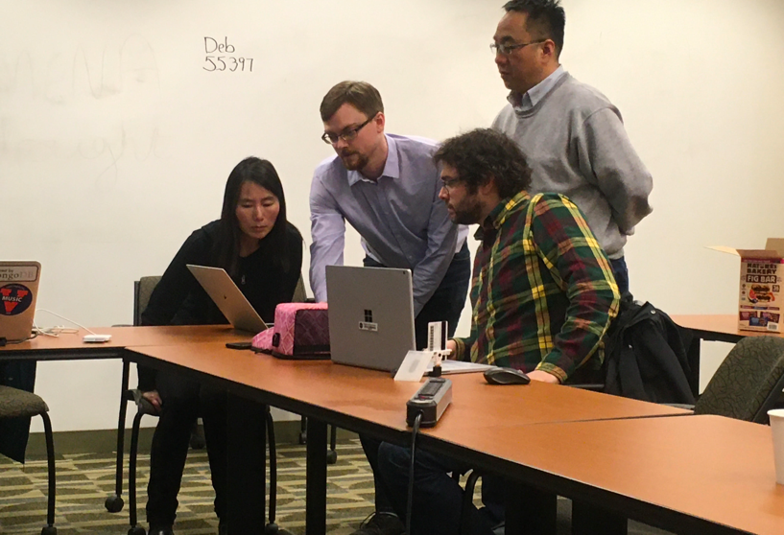
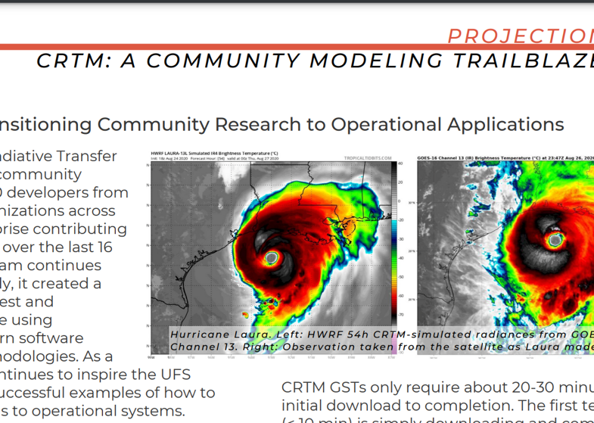
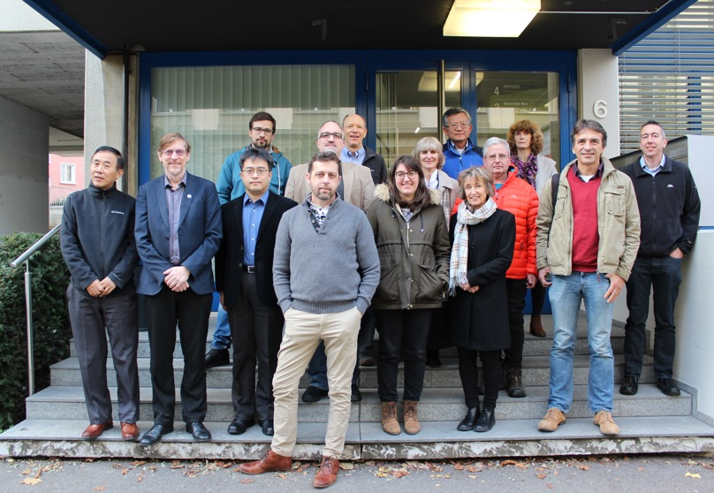
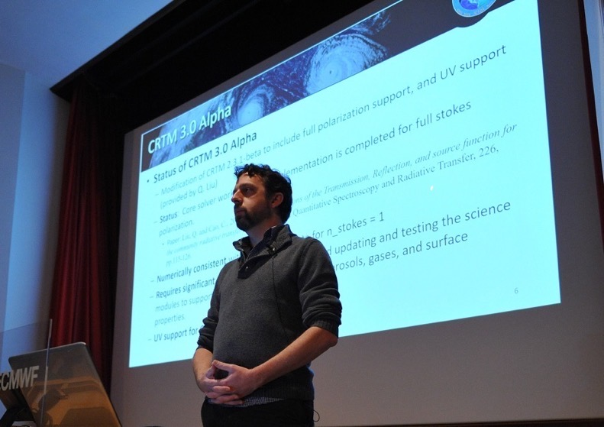
Community Engagement
  CRTM User/Developer Workshop
  JCSDA Summer Colloquium
    Summer 2023 (TBD)
  Code Sprints
    ~2 per year (post covid)
  Seminars / Colloquia
    ITWG/IPWG/ICAP/ISDA
  ISSI VIS/Near-IR Group
  JCSDA.org website
  STEM outreach
    Middle school / high school mentorship in STEM

Slide 18

Support / Contact
Website: https://www.jcsda.org/jcsda-project-community-radiative-transfer-model
Support:
https://groups.google.com/forum/#!forum/crtm-support
Support email:
crtm-support@googlegroups.com
Email: Benjamin.T.Johnson@noaa.gov for direct support, questions, and comments

