Slide 1
Image Navigation and Registration Assessment for ABI at NOAA STAR
Vladimir KONDRATOVICH¹
¹ UMD CISESS, College Park, MD, USA
Presentation at GSICS Meeting, College Park, MD. February 27, 2023

Slide 2
Acknowledgements
This work was funded in part by GOES-R Program.
CWG appreciates collaboration and help by the other participants of the GOES-R Program from NOAA, NASA, L3Harris Corp, Aerospace Corp, and Program Office.
CWG appreciates the contribution to ideas and data from our international collaborators from JMA, KMA and EUMETSAT.
Current CENRAIS team members are Song Guo and Vladimir Kondratovich, who are privileged to use the intellectual resources of Fred Wu, Fangfang Yu, and other current and former members of the STAR CWG.
Disclaimer: The presentation contents are solely the opinions of the authors and do not constitute a statement of policy, decision, or position on behalf of NOAA or the U.S. government.

Slide 3
INR Assessment Goals
Quantify the geolocation accuracy of ABI images in terms of Navigation Error (NAV), Channel-to-Channel Registration (CCR), Frame-to-Frame Registration (FFR), Within Frame registration (WIFR), and Swath-to-Swath Registration (SSR).
Demonstrate the compliance with the Mission Requirements Document (MRD).
The navigation algorithm of ABI uses a pioneering concept of star observations to maintain a high precision of INR.
Our goal at NOAA is the validation of ABI INR, so we use an independent approach – the image-landmark comparison and SNO with JPSS VIIRS sensor. Extensive use of landmarks allowed us to build a system CENRAIS (CWG Extended Navigation & Registration Analysis and Improvement System) for 24x7 near-real time ABI INR assessment.

Slide 4
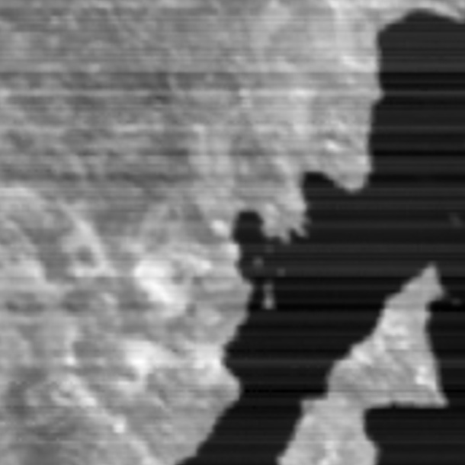
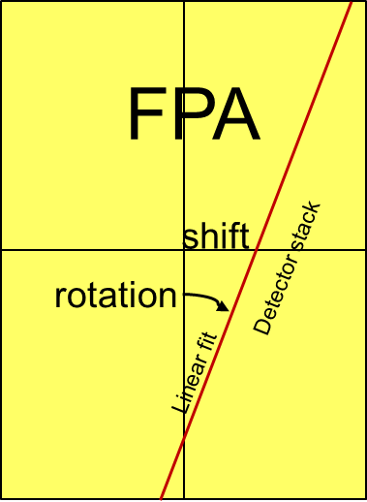
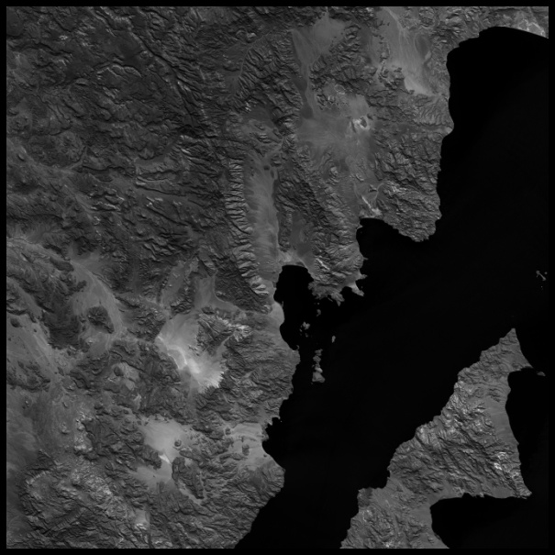
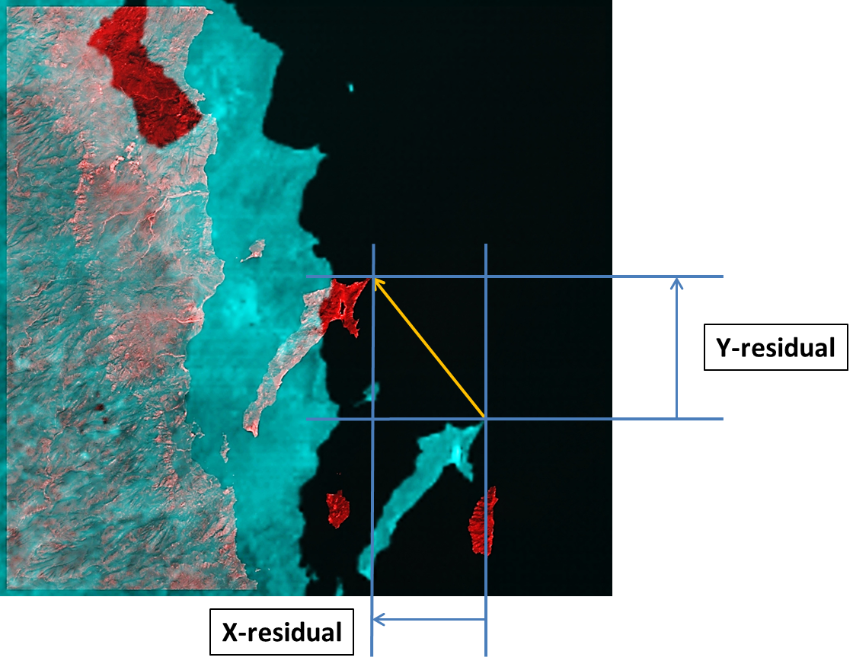
The Use of Landmarks
Compare a landmark with corresponding fragment of ABI image.
The leading parameters of difference are usually East-West (X) and North-South (Y) shifts. For illustration, see the bottom plot, where a landmark (red) is superimposed on the ABI image (blue).
The same way, we can compare the fragments of ABI images from different channels taken at the same moment. That provides us with the Channel-to-Channel Registration (CCR) error estimate.
By associating these shifts with detectors used to observe the ABI image(s), we can extract the information about the shape of detector column on the focal plane (yellow insert).
ABI Image
Landmark

Slide 5
INR Parameters 1 - 4
CENRAIS provides the estimates for the INR parameters listed below. MRD sets the limits for these quantities for the full daily error – abs(bias)+3*stdev in each direction – East-West (x) and North-South (y).
Image shifts NAVx and NAVy.
Frame-to-Frame Registration, FFRx and FFRy. This parameter gives displacements between consecutive images of the same channel and the same domain.
Channel-to-Channel Registration, CCRx and CCRy. This parameter gives displacements between the images in different channels collected at the same time.
Within-Frame Registration, WIFRx and WIFRy, describes how homogenious is the image deformation across the image. If WIFR is close to zero, the image deformation has no warp and is just a displacement, so the NAV parameters are sufficient to describe it.

Slide 6
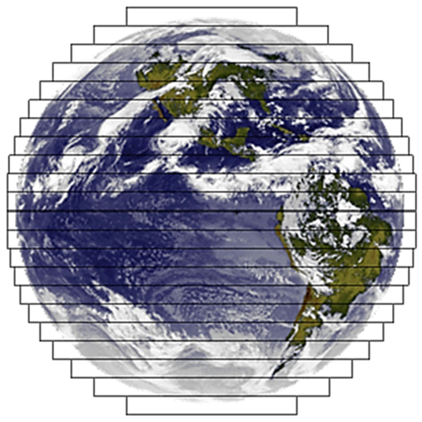
INR Parameter 5
The fifth INR parameter estimated by CENRAIS is Swath-to-Swath Registration, SSRx and SSRy. It is considered because the ABI images are composed by swaths. These parameters describe how the image navigation error (in x and y direction) changes across the swath boundary.
SSR error may appear due to two factors:
The shift of one swath with respect to the neighbor.
The tilt (left black lines) or stretch (right black lines) of detector column used to create the swath.

Slide 7
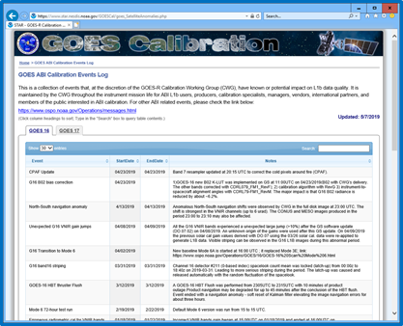
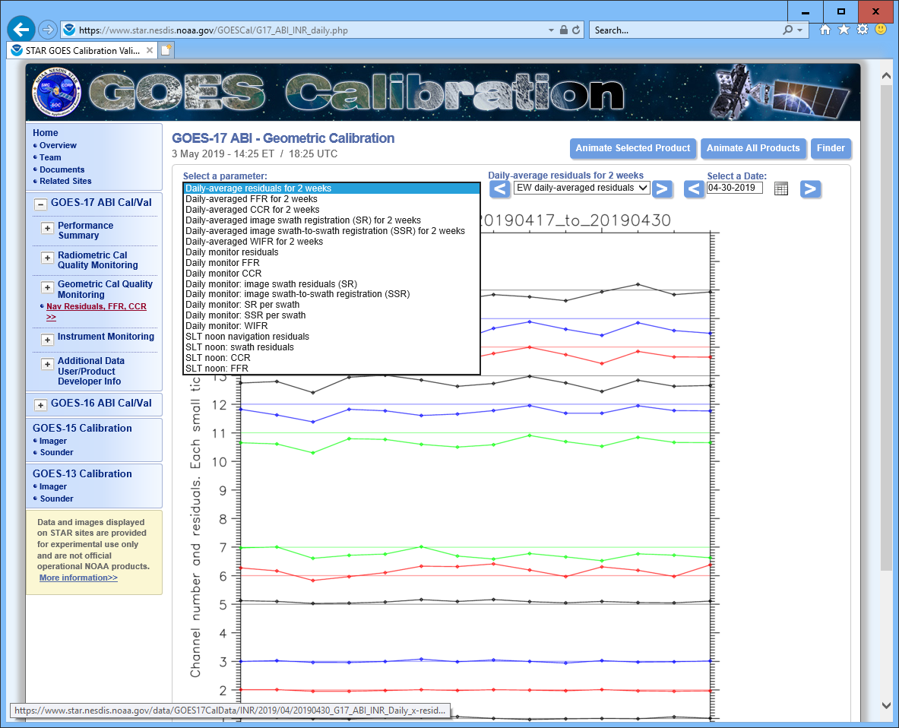
CENRAIS (CWG Extended Navigation & Registration Analysis and Improvement System)
CENRAIS goals:
Assess quality of geometric calibration of ABI L1b images
Detect navigation anomalies and provide detailed diagnostic information
Trend navigation of ABI L1b images and provide de-trending estimates
ABI Image
NRT output web site: https://www.star.nesdis.noaa.gov/GOESCal/index.php
Pearson correlation
ABI
L1b
Landmark
Correlation filters
ADP
Image statistics
Calibration
Event Log
Week&Mos
Monitor: NAV,CCR,FFR SR,SSR,WIFR,
ANOMALY FLAGS
Long-
Term
Storage:
All image
and daily
metrics
0.5 TB per
year-sat
LANDSAT landmark
DB
Image navigation:
NAV,CCR,SR,SSR,WIFR
GOESCal
web
Navigation inversion:
ADP, swath shear & stretch,
Full SSR. FFR.
Daily Monitor:
NAV,CCR,FFR,SR,SSR,WIFR
Correction coefficients
Long-term
trending

Slide 8
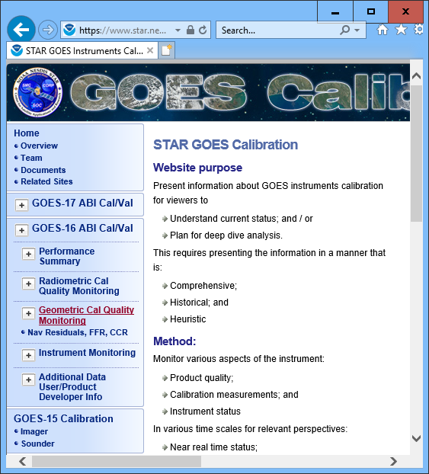
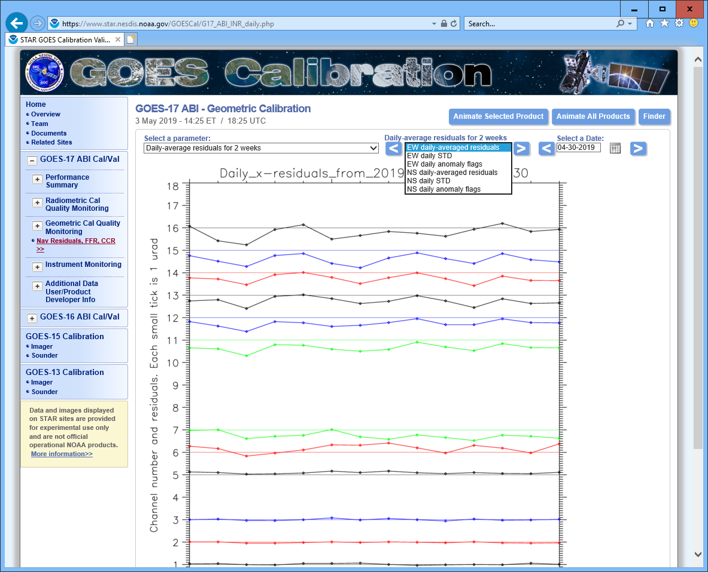
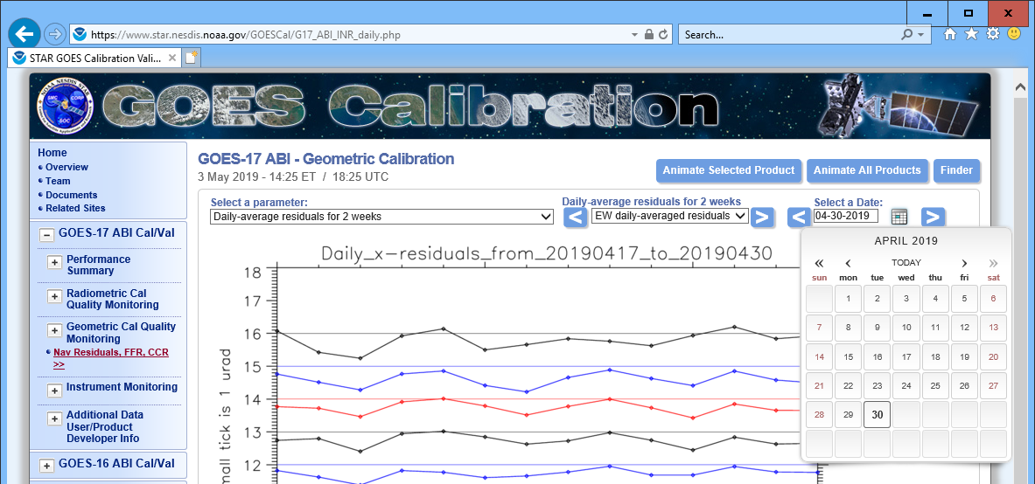
CENRAIS on the Web
https://www.star.nesdis.noaa.gov/GOESCal/
Pull-Down Menu (PDM) leads to the ABI geometric calibration monitoring web page for each satellite.
First PDM on the page lists the monitored parameters.
Second PDM lists the plots for selected parameter, including anomaly flags for weekly and monthly trending.
Third PDM shows the calendar.

Slide 9
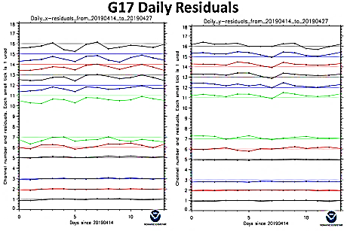
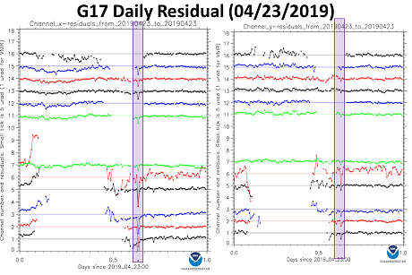
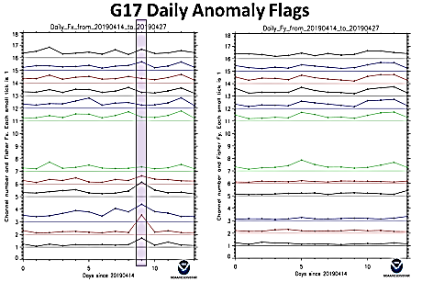
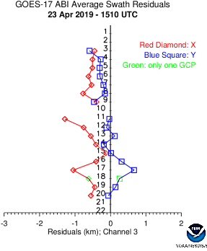
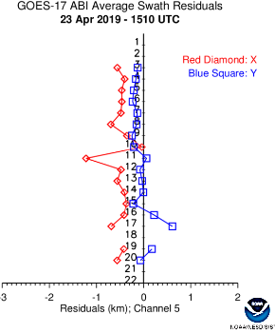
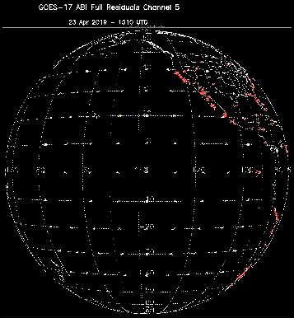
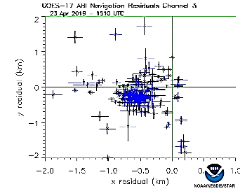
Navigation Anomaly Monitoring
weekly trending plots
That day monitor
Residual map
Swath residuals
Swath residuals
Dispersion
Anomaly detected
Gyro rate gap anomaly discovered by CWG.

Slide 10
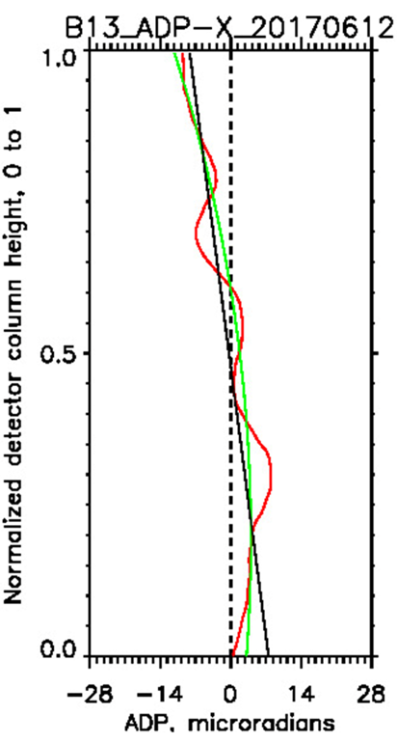
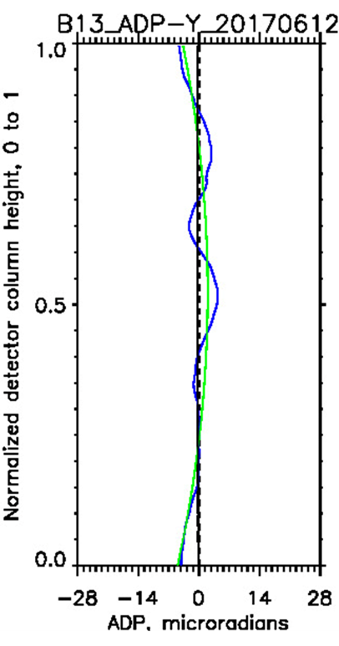
CENRAIS Applications
Excellent record of INR anomaly detection and analysis. No false alarms.
Diagnostic on-demand output allows to analyze the “out-of-the-wall” cases.
Eclipse error analysis. During penumbral period (about 2 minutes), ABI LOS experiences sharp changes. If a VIS star look is performed at that time, the Kalman filter of ABI is not fast enough to take a proper account of changes, so the image gets navigation errors. The fix is in work.
Detector map verification. Average navigation residuals are plotted on the horizontal axis in microradians against the normalized detector location across the scan direction (vertical axis, 0.5 is the middle of the detector stack). East-West (X) residuals are plotted on the left panel (red curve), and North-South (Y) are on the right panel (blue curve). In each panel, the black and green lines are linear and quadratic regressions to all noise-filtered residuals. The vertical dashed lines represent an ideal image with zero residuals.

Slide 11
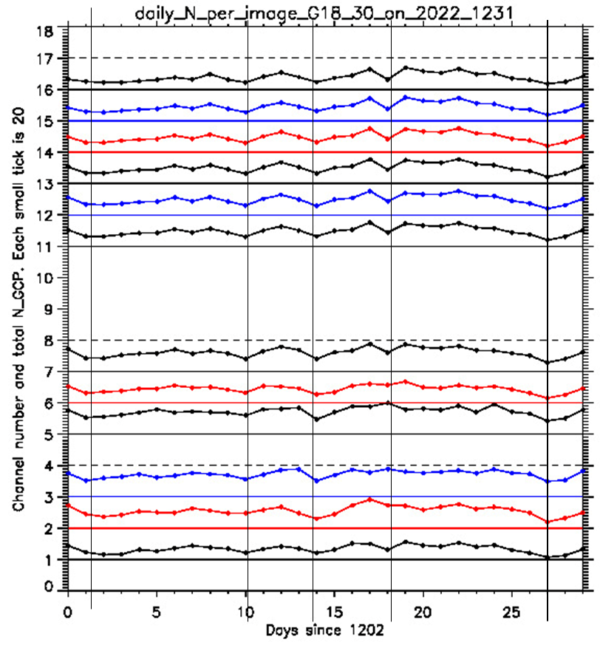
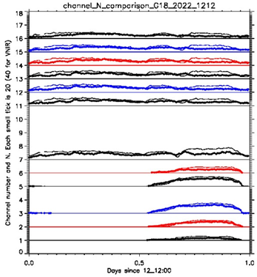
CENRAIS Applications
Long-Term Trending. Left: 2-year (1/1/2018 – 12/31/2019) GOES-16 image x-navigation residual plot with FFT harmonic lines plotted in red.
Right: same for 1-year (1/28/2019 – 1/27/2020) GOES-17 image navigation x-residuals. Linear trend is negligible in comparison with periodic (seasonal) variations.
Image Quality Trending. Left plot legend: Channel N - number of active GCP for FD image averaged for the day of observation – is plotted on the level of the channel number. Color varies to distinguish the neighboring plots. Zero level is plotted in the same color. Vertical lines show the days of interest.
Right plot legend: Channel N - number of active GCP for FD image – is plotted on the level of the channel number. Color varies to distinguish the neighboring plots. Zero level is plotted in the same color. Diamonds are for the current day, the smooth line with dots show the N for the previous day.

Slide 12
Summary
CWG responded to the challenges of validation and verification of the ABI INR by creating the CENRAIS system.
CENRAIS navigates all ABI images produced in the Full Disk and CONUS L1b formats in the Near-Real Time (NRT). INR validation results are published on the web in NRT. MESO images are navigated upon request.
Navigation accuracy was verified by comparison with the operational image navigation systems IPATS and PM.
The main use of CENRAIS is the geometric calibration validation of the L1b images and anomaly detection. INR parameter plots are published on the web in NRT.
CENRAIS has proven its capability of anomaly detection and analysis ability in process of commissioning three ABI sensors onboard the GOES-16, 17, and 18 satellites.

