Slide 1

Flight Model pre-launch calibration and L1 product processing of CMA OMS
OMS-Limb: Yuan Li¹, Guanyu Lin², Zhanfeng Li², Yu Huang²
OMS-Nadir: Qian Wang¹, Yongmei Wang³, Entao Shi³, Jinghua Mao³
¹National Satellite Meteorological Center, CMA
²Changchun Institute of Optics, Fine Mechanicsand Physics, CAS
³Center for Space Science and Applied Research, CAS
UVN Spectrometer Subgroup for GSICS Annual Meeting Week of February 27th, 2023
Notes:
大家好。很高兴代表CMA的紫外高光谱团队在GSICS年会UVN光谱仪小组中介绍CMA OMS正样发射前定标和L1产品处理的最新进展。
Hello, everyone. It's my pleasure to representing ultraviolet hyperspectral team of CMA to introduce the Flight Model pre-launch calibration and L1 product processing of CMA OMS in this UVN Spectrometer Subgroup for GSICS Annual Meeting.

Slide 2
Outline
Instrument specifications and measurement of OMS Limb.
L1 product processing of OMS Limb.
L1 data introduction of OMS Limb.
Instrument specifications and measurement of OMS Nadir.
L1 product processing of OMS Nadir.
L1 data introduction of OMS Nadir.
Notes:
CMA OMS由两台独立的仪器 OMS-Limb 与 OMS-Nadir组成。我将用六个部分来介绍这两台仪器的工作。
CMA OMS consists[kənˈsɪsts] of two independent[ˌɪndɪˈpendənt] instruments[ˈɪnstrəmənts], OMS-Limb and OMS-Nadir. I will introduce[ˌɪntrəˈduːs] the work of these two instruments in six parts.

Slide 3
Instrument specifications and measurement of OMS Limb
OMS Limb specifications
Pre-launch calibration
No. | Test items | Technical requirement
1 | Spectral range / nm | 290-500
2 | Spectral resolution / nm | 0.6
3 | Spectral sampling interval | Continuous sampling pixel by pixel
4 | Wavelength calibration accuracy / nm | 0.01
5 | Spatial resolution / km | 3 (vertical, i.e. the height direction of the Limb of the earth)
6 | Instantaneous field of view / ° | 2.3 (horizontal) × 0.045 (vertical)
7 | Dynamic range | 10⁵
8 | Relative radiometric calibration accuracy | Better than 2%
9 | Calibration accuracy of diffuse reflector | Better than 3%
10 | Absolute radiometric calibration accuracy | Better than 3%
11 | Signal to noise ratio | > 300@0.1mw /cm² × sr × nm (radiance)
  Band1：
    286.8-402.1nm,FWHM0.4-0.44nm
  Band2：
    390.1-504.1nm, FWHM0.44-0.48nm
  Band3 (polarization):
    289.8-503.9nm, FWHM5.60-30.43nm
  Vertical FOV: 0.038 °, 2.24km at Limb point
  Horizontal crossing FOV: 1.8 °, 108.79km at Limb point
  Along the track: 8.92km at 1.2s (determined by the detector integration time)
  Limb detection height: 15-60km
Secondary dispersion technology: Brewster prism plus grating
Detector: cooled two-dimensional CMOS detector * 3
Notes:
临边仪器采用了布鲁斯特棱镜加光栅的二级色散技术，使用3个带制冷的二维CMOS探测器分别记录大气散射与偏振信息。2个探测波段可以覆盖286.8-504.1nm光谱范围。二者中间有12nm的光谱重合，出于信噪比的考虑推荐重叠部分以波段2的观测为准。光谱分辨率从设计时0.6nm提高至优于0.5nm,视场角从设计的2.3*0.045提高至1.8*0.038度。
The Limb instrument[ˈɪnstrəmənt] realize[ˈriːəlaɪz] the secondary dispersion[dɪˈspɜːrʒn] technology[tekˈnɑːlədʒi] with Brewster prism and grating, and uses three two-dimensional[daɪˈmenʃənl] CMOS detectors with refrigeration[rɪˌfrɪdʒə'reɪʃ(ə)n] to record[ˈrekərd] the atmospheric[ˌætməsˈferɪk] scattering and polarization[ˌpoʊlərəˈzeɪʃn] information[ˌɪnfərˈmeɪʃn] respectively[rɪˈspektɪvli]. Two detection bands can cover the spectral range of 286.8-504.1 nm. There is 12 nm spectral overlap[ˌoʊvərˈlæp] between the two detection bands. For the sake of SNR, the overlapping part is recommended to be based on the observation of band 2. The spectral resolution changed from 0.6 nm to better than 0.5 nm, and the field of view increased from 2.3 * 0.045 to 1.8 * 0.038 degrees.

Slide 4
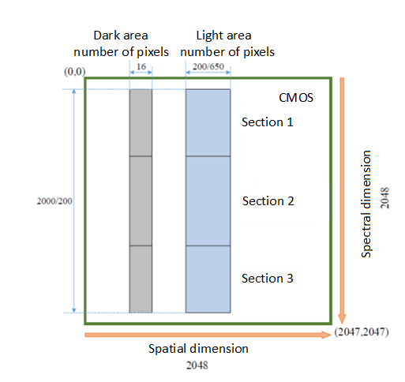
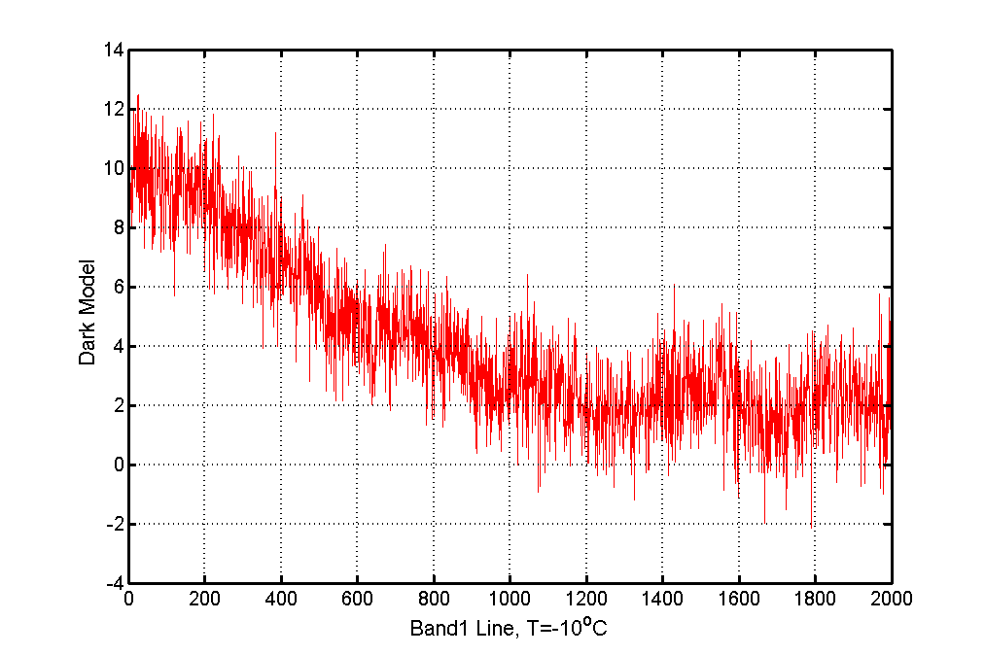
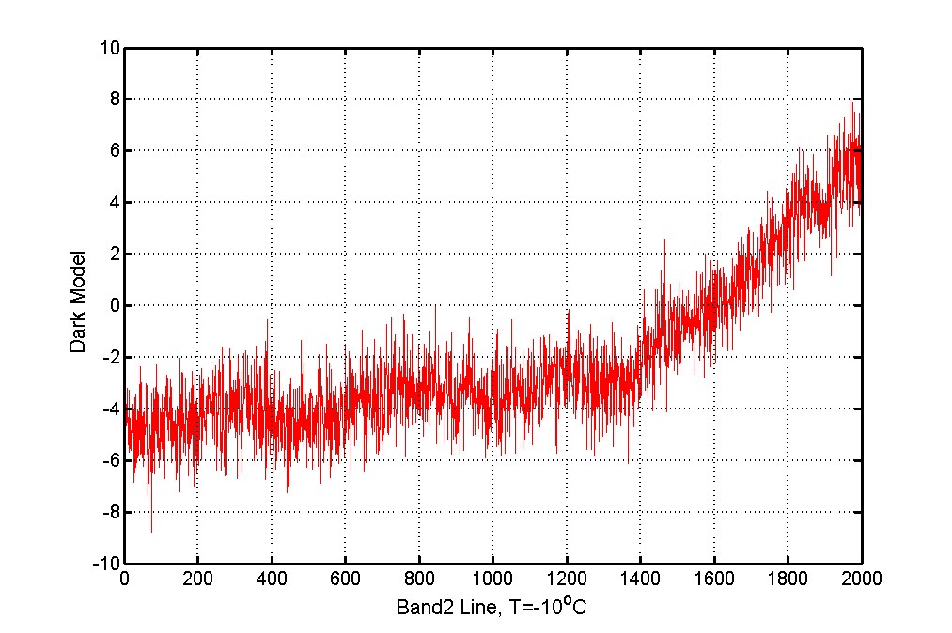
L1 product processing of OMS Limb
L1 product processing flow
L0
Decoding
Bad pixel detection
Dark current processing
Spectral calibration
Radiometric calibration
Polarization correction
Quality Control
L1
Geographic positioning
Dark current processing
  Obtain the dark current of light area (DN_Dark) by the dark area (DN0_Dark) based on the dark current model(DDN): DN_Dark=DDN+DN0_Dark
  The model could be updated once a month by observing the blind board of reference board.
Diagram of detector
Band 1 dark current model
Band 2 dark current model
Notes:
L1产品处理流程如上图所示。L0数据经过解码、地理定位、坏像元检测、暗电流处理、光谱定标、辐射定标、偏振订正、质量控制等处理生成L1数据。其中暗电流处理过程是指基于暗电流模型，用暗参考列的输出来表征光照区亮像元的暗电流水平。左图展示了暗像元与亮像元在CMOS面阵上的分布，右图是发射前测量的暗电流模型。在轨后每月在阴影区会执行一次漫反射板的盲板观测以实现暗电流模型的更新。
L1 product processing flow was shown in the figure above. L1 data is generated from L0 data through decoding, geographic[ˌdʒiəˈgræfɪk] positioning, bad pixel detection, dark current processing, spectral calibration, radiometric calibration, polarization[ˌpoʊlərəˈzeɪʃn] correction, and quality[ˈkwɑːləti] control. Along them, the dark current processing aims to obtain[əbˈteɪn] the dark current of light area by the dark area based on the dark current model[ˈmɑːdl]. The left figure shows the distribution of dark and bright pixels on the CMOS array[əˈreɪ], the right figure is the dark current model measured before launch. The model could be updated once a month by observing the blind reference board in-orbit.

Slide 5
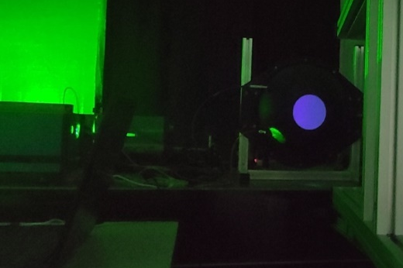
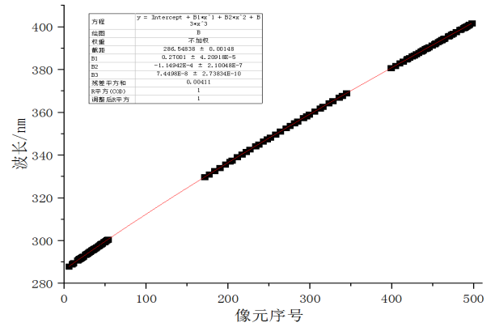
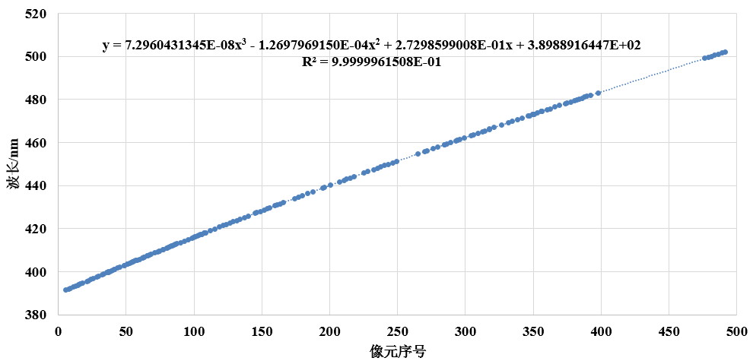
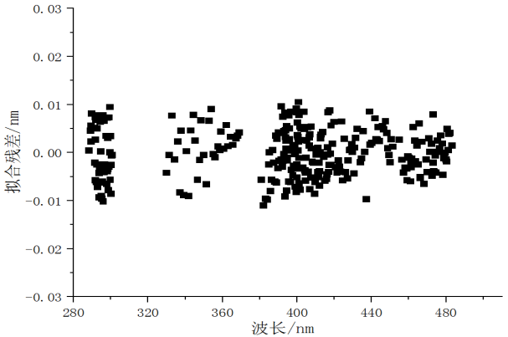
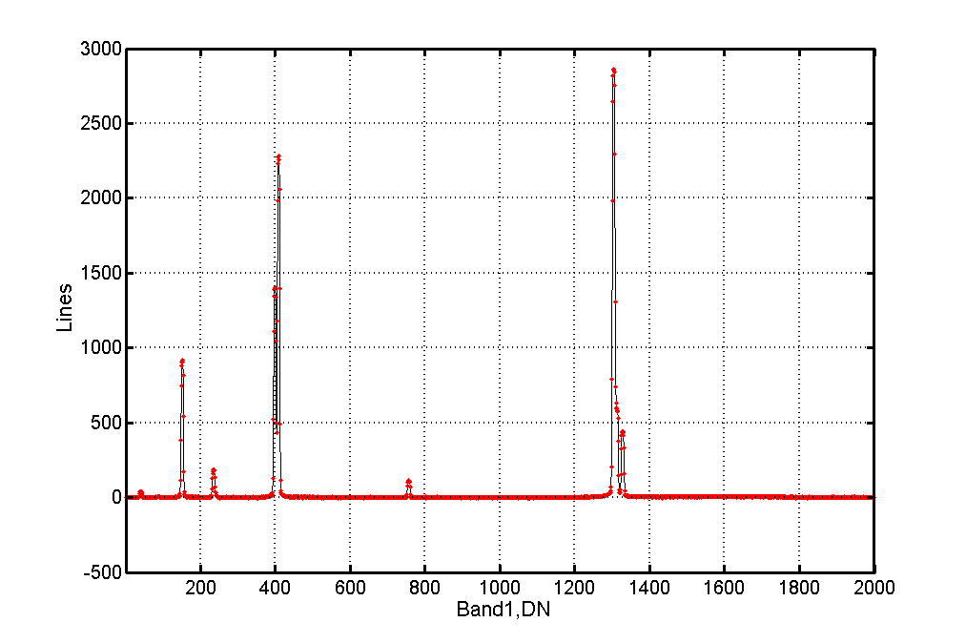
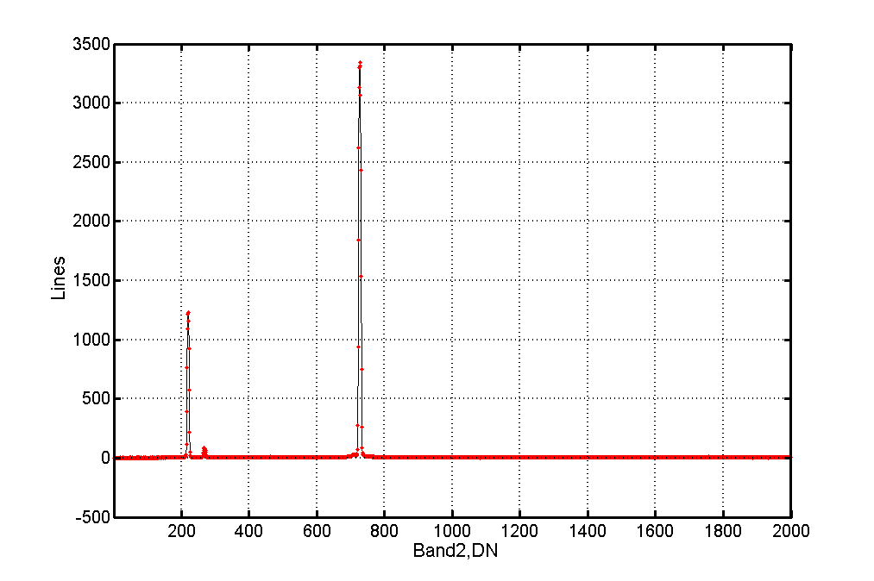
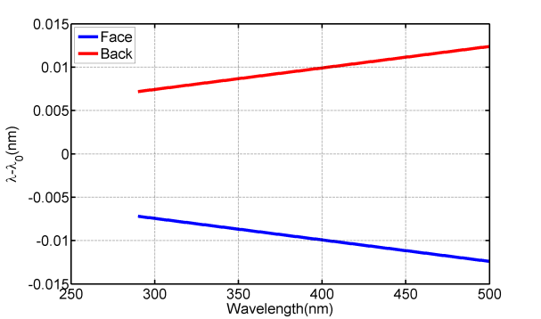
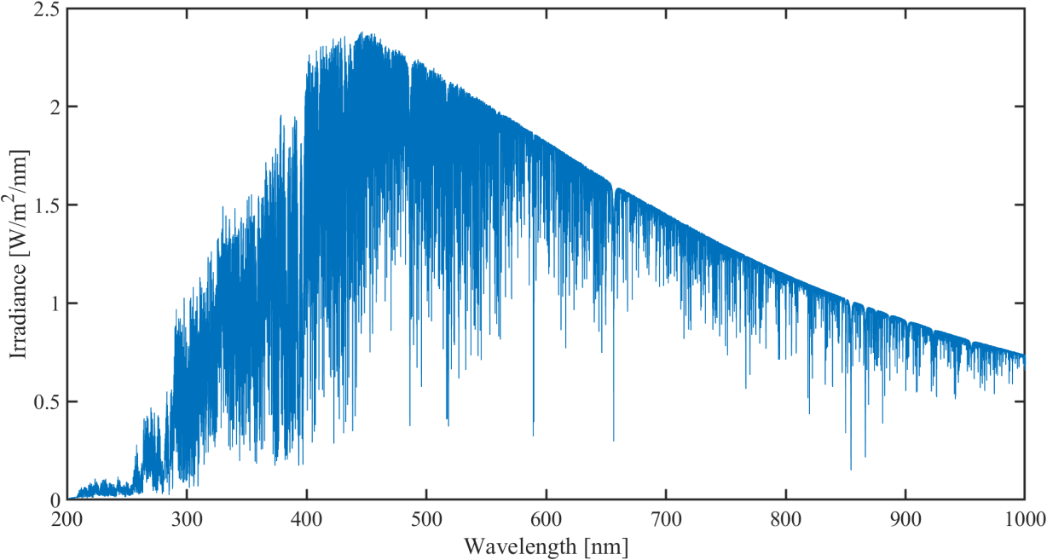
Spectral calibration
Spectral calibration correspondence has been accurately determined using a tunable laser before launch.
After launch, the observation of mercury lamp on the satellite will be carried out once a month in the shadow area to correct this correspondence.
At the same time, the solar spectrum observation will be carried out once a month in the sunshine area to check the calibration.
Spectral calibration using tunable lasers
Spectral calibration curve of Band 1
Spectral calibration curve of Band 2
The fitting residual is less than 0.01 nm
Spectral line of in-orbit mercury lamp observed by band 1
Spectral line of in-orbit mercury lamp observed by band 2
On-orbit Doppler shift correction (0.007-0.012nm)
On-orbit spectral calibration check using TSIS-1 HSRS solar spectral
Notes:
发射前已经使用可调谐激光器精确确定了探测器像元位置与波长之间对应关系,光谱定标拟合残差小于0.01nm。在轨后每月在阴影区会执行一次星上汞灯的观测，对这一对应关系进行修正。同时每月在阳照区会执行一次太阳光谱的观测，太阳观测数据经过多普勒频移修正后与TSIS-1 HSRS的理论太阳光谱进行比较，用来对汞灯光谱定标结果进行检验。
Spectral calibration correspondence [ˌkɔːrəˈspɑːndəns] has been accurately[ˈækjərətli] determined using a tunable laser before launch, and the spectral calibration fitting residual[rɪˈzɪdʒuəl] is less than 0.01 nm. After launch, the observation of mercury[ˈmɜːrkjəri] lamp on the satellite will be carried out once a month in the shadow area to correct this correspondence[ˌkɔːrəˈspɑːndəns] . At the same time, the solar spectrum observation[ˌɑːbzərˈveɪʃn] will be carried out once a month in the sunshine area. The solar observation data are compared with the theoretical solar spectrum of TSIS-1 HSRS after Doppler frequency[ˈfriːkwənsi] shift correction. It is used to test the spectrum calibration results of mercury[ˈmɜːrkjəri] lamp.

Slide 6
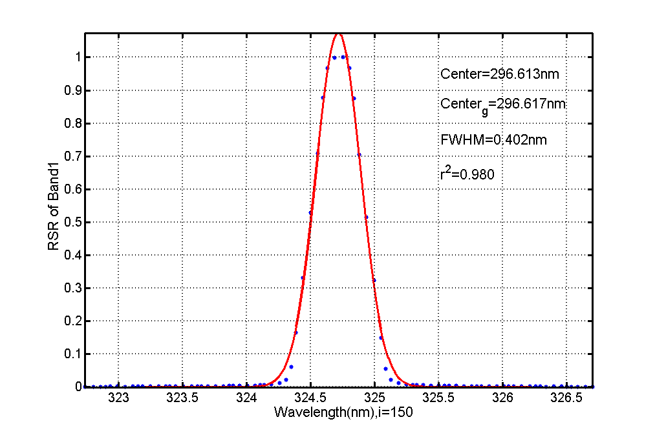
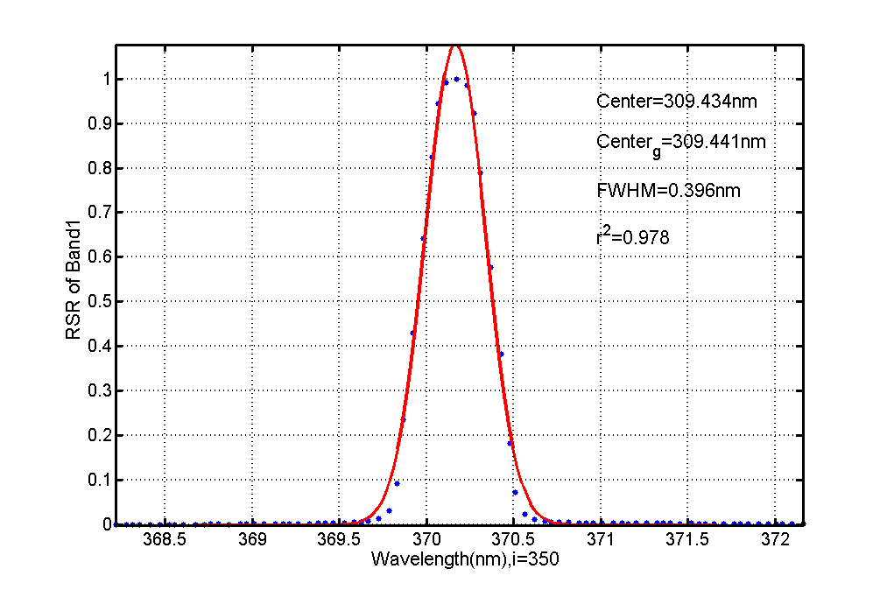
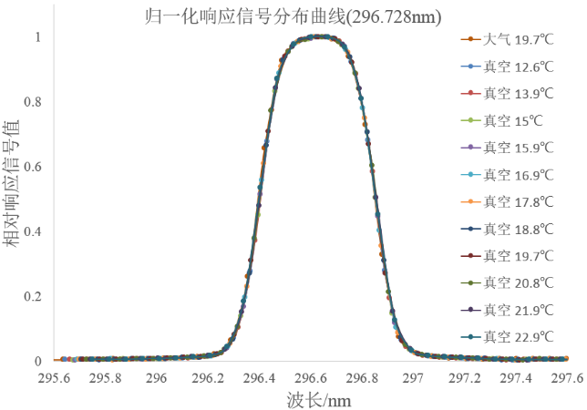
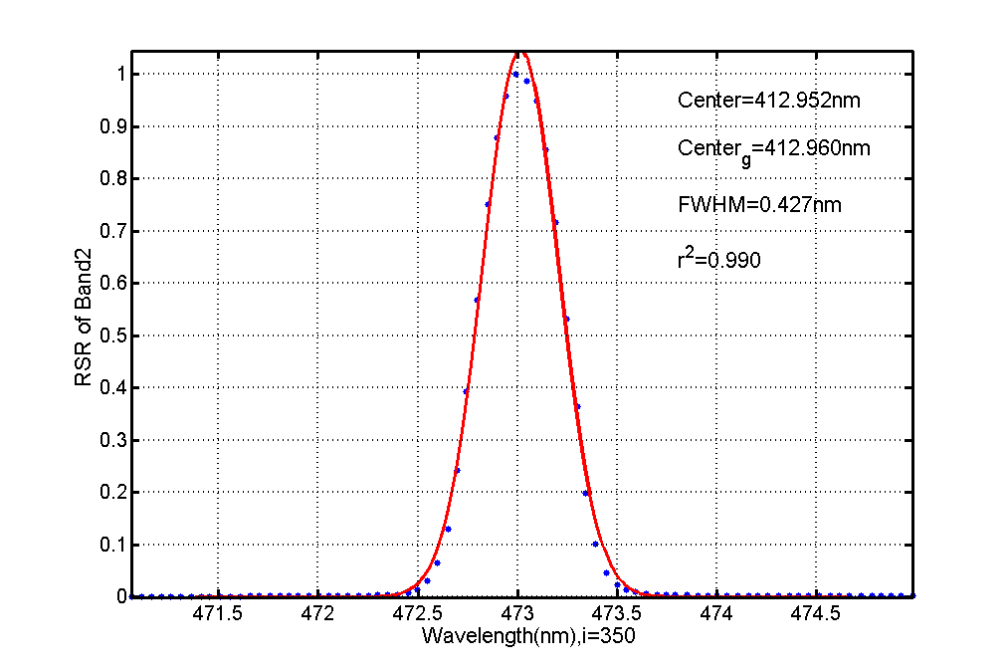
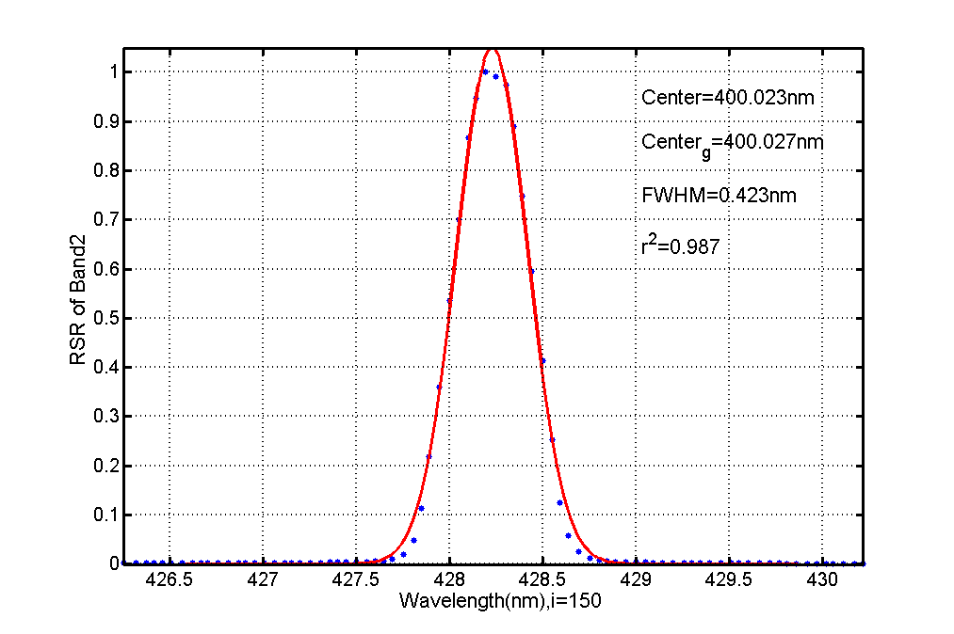
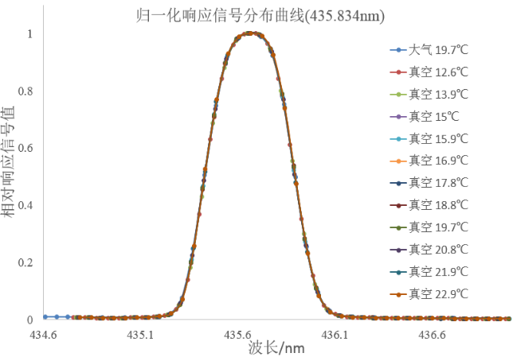
Relative spectral response function (RSR)
OMSL do not have device to monitor the change of the RSR in orbit, and the environmental difference has no effect on the RSR basically. Therefore, the RSR measured by the continuously scanning tunable laser before launch will always be used.
Band 1 RSR at 150 pixel
Band 1 RSR at 350 pixel
Band 1 RSR at 296.728nm does not change with the environment
Band 2 RSR at 150 pixel
Band 1 RSR at 350 pixel
Band 2 RSR at 435.834nm does not change with the environment
Notes:
OMSL在轨没有监测光谱响应函数变化的装置，同时环境差异对光谱响应函数基本无影响，因此将一直沿用发射前利用可连续扫描的可调激光器测量的数据。
OMSL do not have device to monitor the change of the spectral response function in orbit, and the environmental difference has no effect on the spectral response function basically. Therefore, the data measured by the continuously scanning tunable laser before launch will always be used.

Slide 7
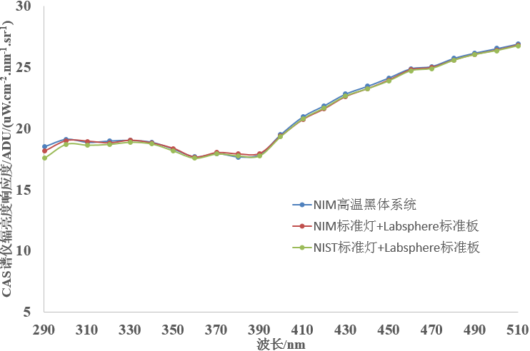
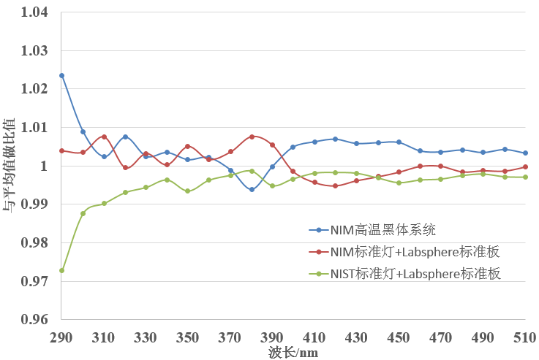
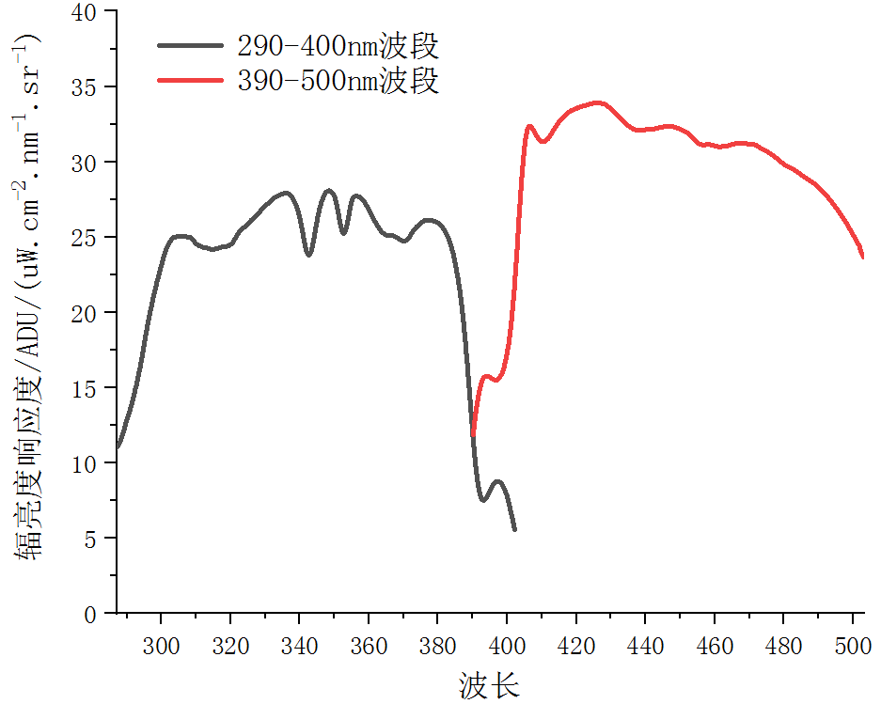
Radiance calibration
The radiance calibration is realized by using the monthly observation of the tungsten lamp in orbit. After nonlinear correction, the look-up table of the ground calibration before launch is corrected through linear relationship.
NIST Lamp
NIM Lamp
NIM High-temperature blackbody
Transfer spectrum radiometer
Tungsten + xenon lamp UV integrating sphere
Integrating sphere monitoring spectrometer
Three different tracing methods were used before launch (NIST Lamp, NIM Lamp, Blackbody)
The difference between the responsivity is less than 3%
Item | Lamp | Blackbody
Lamp irradiance uncertainty | 1.60% | 1.40%
Uncertainty of diffuse board | 1.30%
Distance error between lamp and board | 0.20%
OMS-Limb radiance response curve (Normalized integral time)
Comparison of uncertainty of different traceability chains
Notes:
在轨使用每月一次星上钨灯观测实现辐亮度定标，经非线性订正后通过线性比例关系对发射前地面定标查找表进行修正。发射前分别使用了三种不同的溯源方式，直接溯源至NIM高温黑体的方式，实现了最高的精度水平。
The radiance calibration is realized by using the monthly observation of the tungsten lamp in orbit. After nonlinear correction, the look-up table of the ground calibration before launch is corrected through linear relationship. Three different tracing methods were used before launch, directly tracing to NIM high-temperature blackbody, achieving the highest accuracy level.

Slide 8
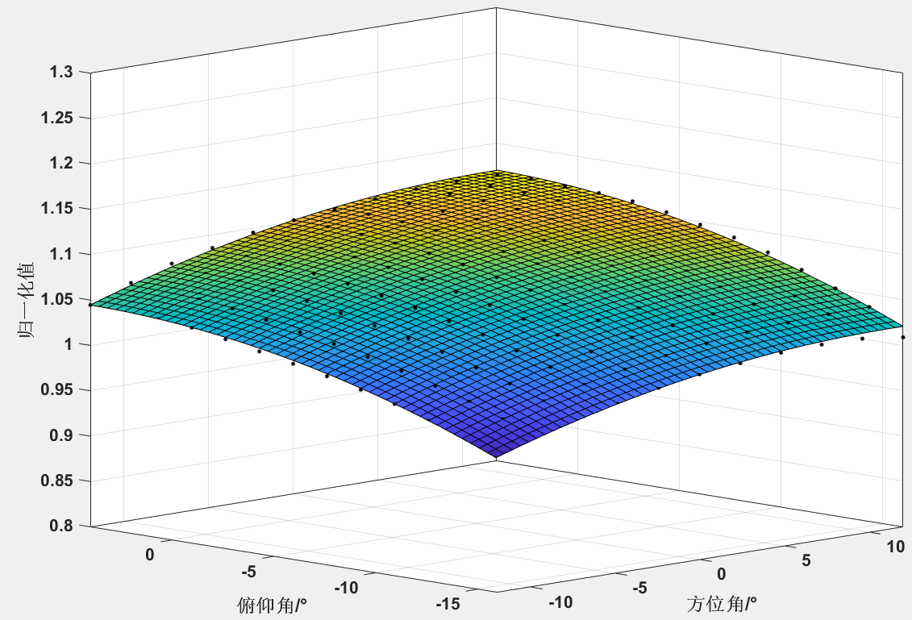
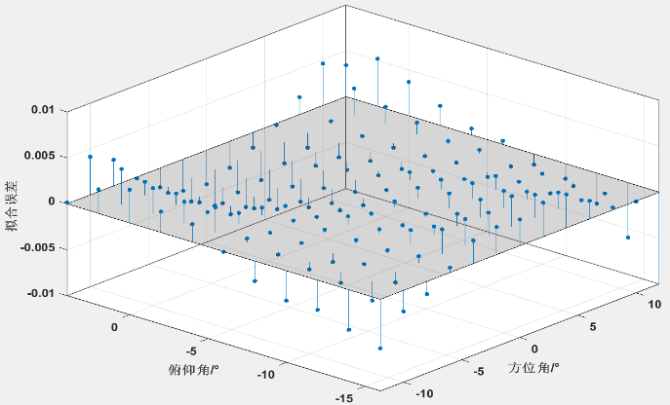
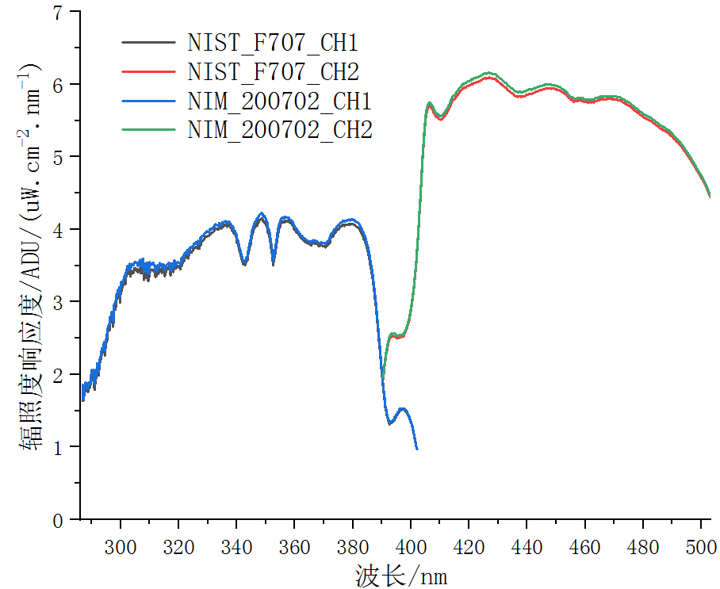
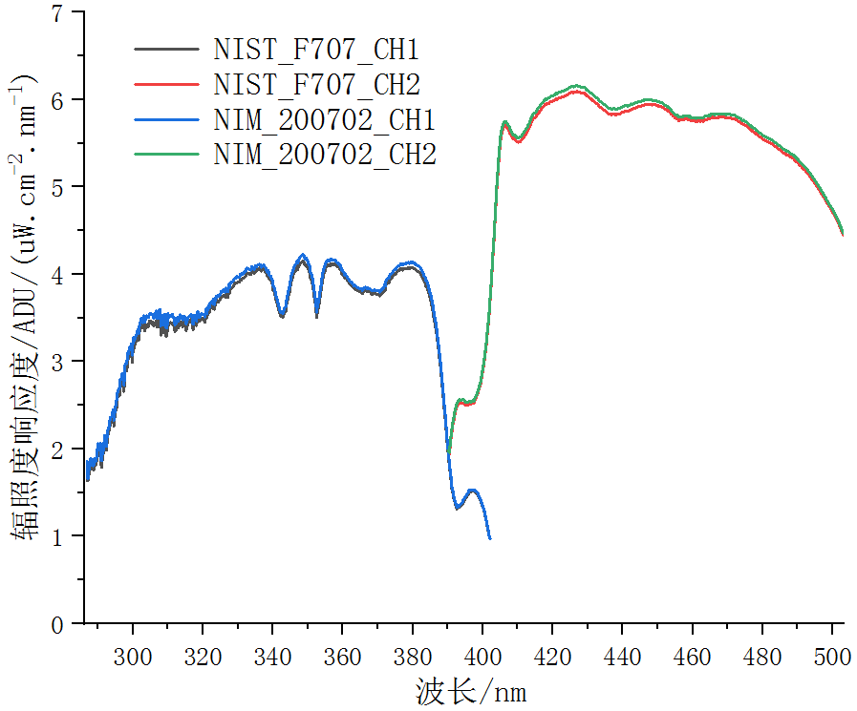
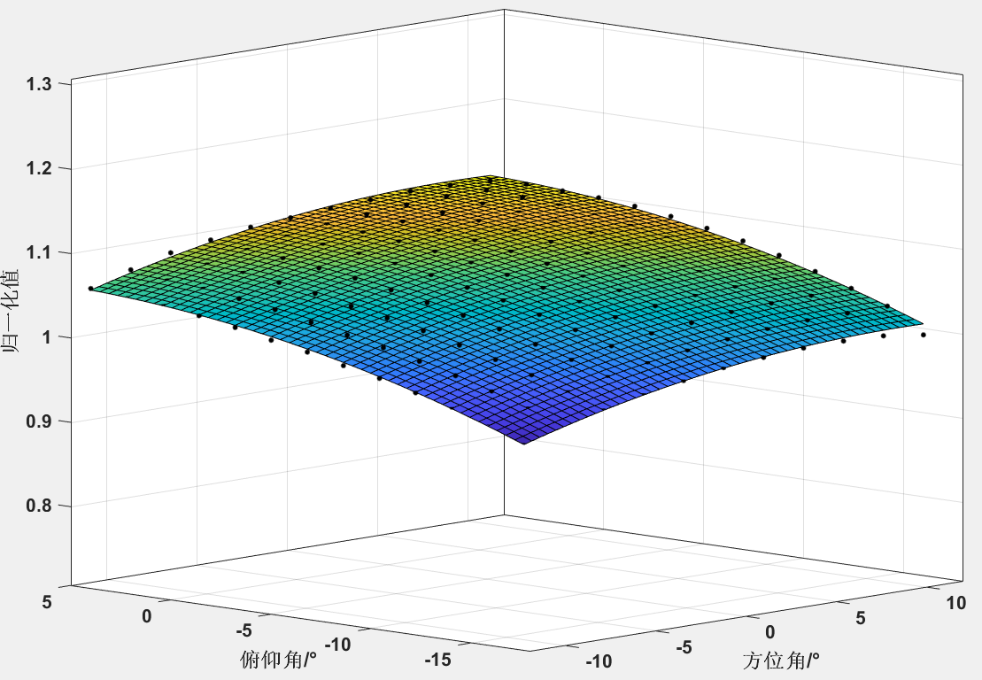
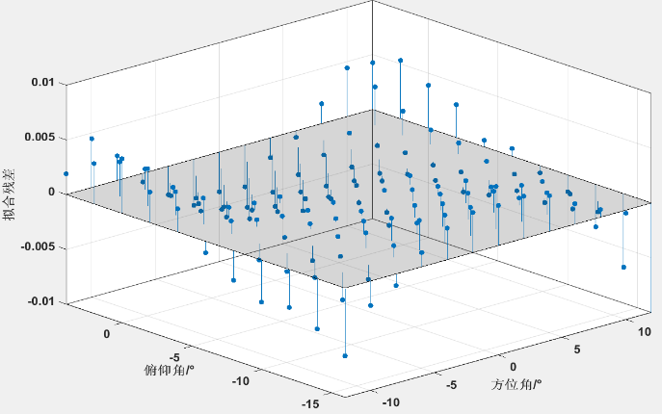
Irradiance calibration
The in-orbit irradiance calibration is achieved by the monthly observation of the solar spectrum. After the correction of nonlinear and diffuse board directivity, the pre-launch ground calibration lookup table is corrected by linear proportional relationship.
Directional correction coefficient of main board 345nm
Fitting error of 345nm directional correction of main diffuse board is less than 1%
Irradiance responsivity of main diffuse board
Irradiance responsivity of back-up diffuse board
Directional correction coefficient of main board 450nm
Fitting error of 450nm directional correction of main diffuse board is less than 1%
Notes:
在轨辐照度定标由每月执行的对太阳光谱的观测完成。经非线性与漫反板方向性订正后通过线性比例关系对发射前地面定标查找表进行修正。左图为发射前测量的辐照度定标查找表，右图为漫反板方向性订正系数。
The in-orbit irradiance calibration is achieved by the monthly observation of the solar spectrum. After the correction of nonlinear and diffuse board directivity, the pre-launch ground calibration lookup table is corrected by linear proportional relationship. The left figure shows the irradiance calibration lookup table measured before launch, and the right figure shows the directional correction coefficient of the diffuse board.

Slide 9
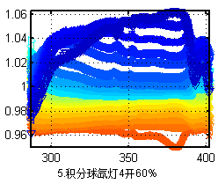
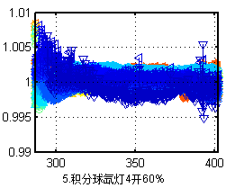
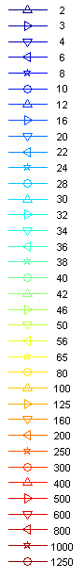
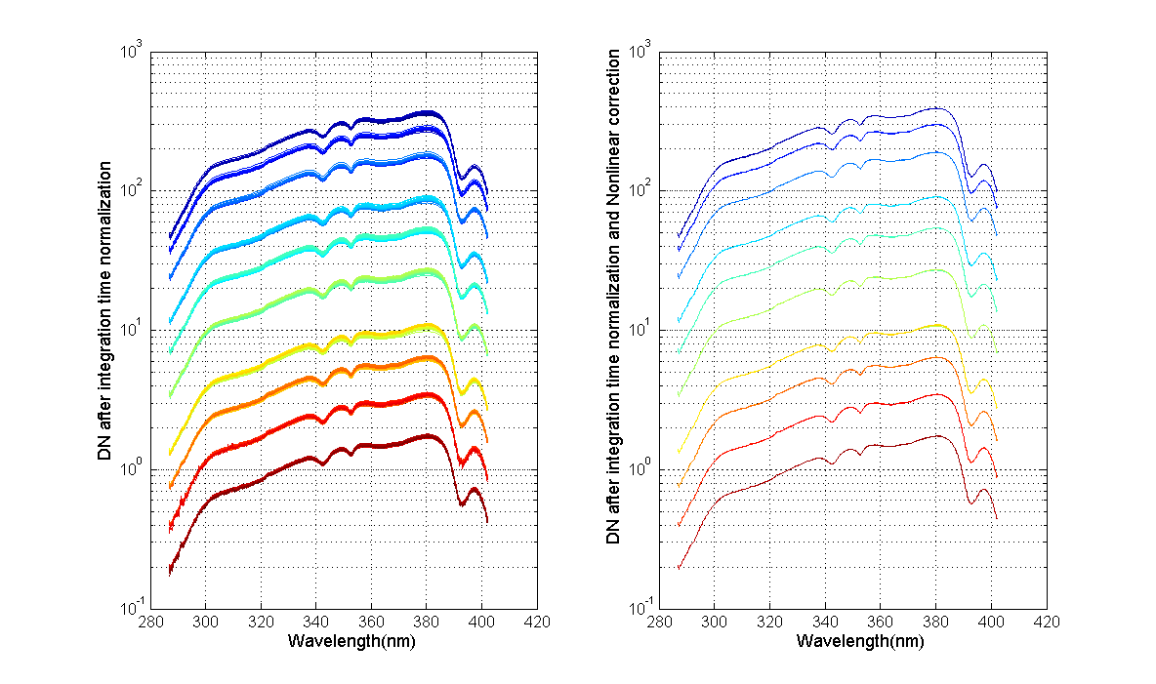
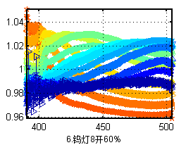
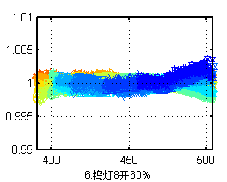
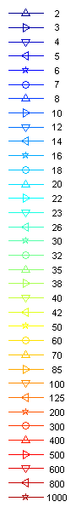
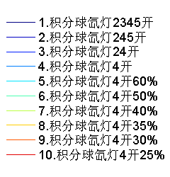
Nonlinear correction
The nonlinear correction coefficient uses the value before launch.
  Noise and saturation screening: screening DN<50 or>13000
  Effective reset operation coefficients: Band1,2 : 1.01 at less than 32 of the integration time , band 3 :1.007 at less than 13
  Different signal correction: take signal 220 as the boundary, use two to four different Gaussian functions
  Band 1 the relative difference of IDN before correction is less than 6%
  Band 1 the relative difference of IDN after correction is less than 1%
  Band 2 the relative difference of IDN before correction is less than 5%
  Band 2 the relative difference of IDN after correction is less than 1%
  The comparison of normalized integrated time DN(IDN) before and after nonlinear correction
The algorithm is provided by Zhanfeng Li
Notes:
在轨后非线性修正拟合系数使用发射前测量值。左图是非线性修正前后积分时间归一化DN (IDN) 对比，不同颜色代表不同输入能量。经非线性修正后,改进了IDN值不能重叠在一起的问题。右图显示非线性修正前后DN值的相对差异从6%降低到1%。
The nonlinear correction coefficient uses the value before launch. Left figure shows the comparison of normalized integrated time DN(IDN) before and after nonlinear correction. Different colors represent different input energies. The problem that IDN values cannot overlap is improved after nonlinear correction. The figure on the right shows that the relative difference of IDN reduced from 6% to 1% after nonlinear correction.

Slide 10
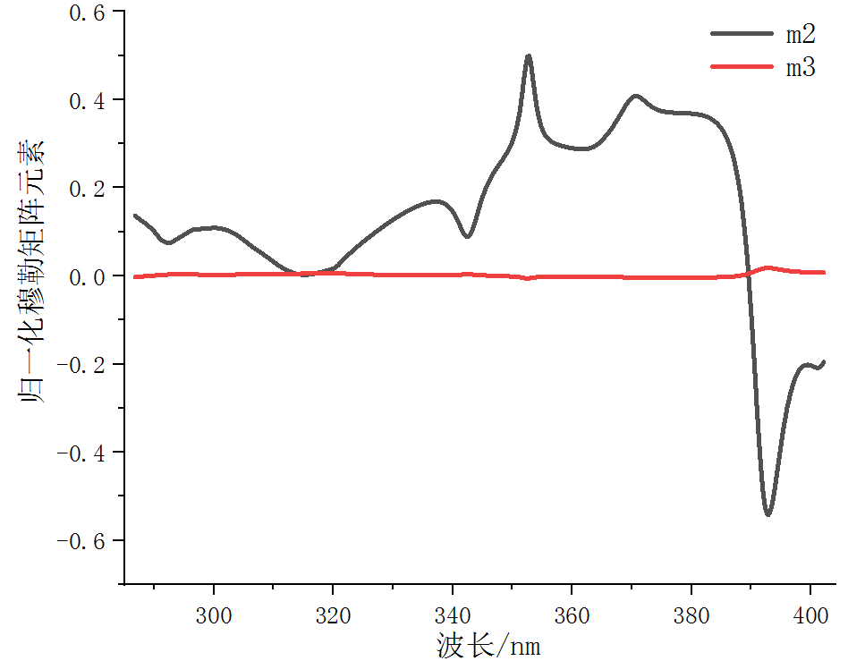
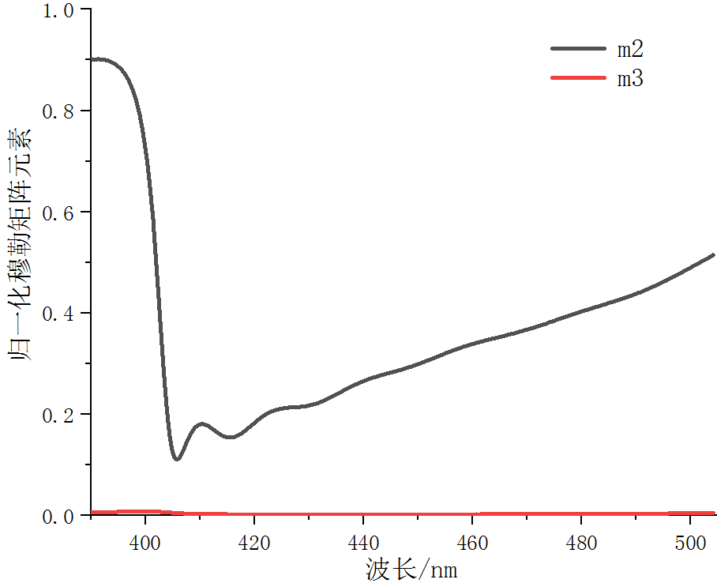
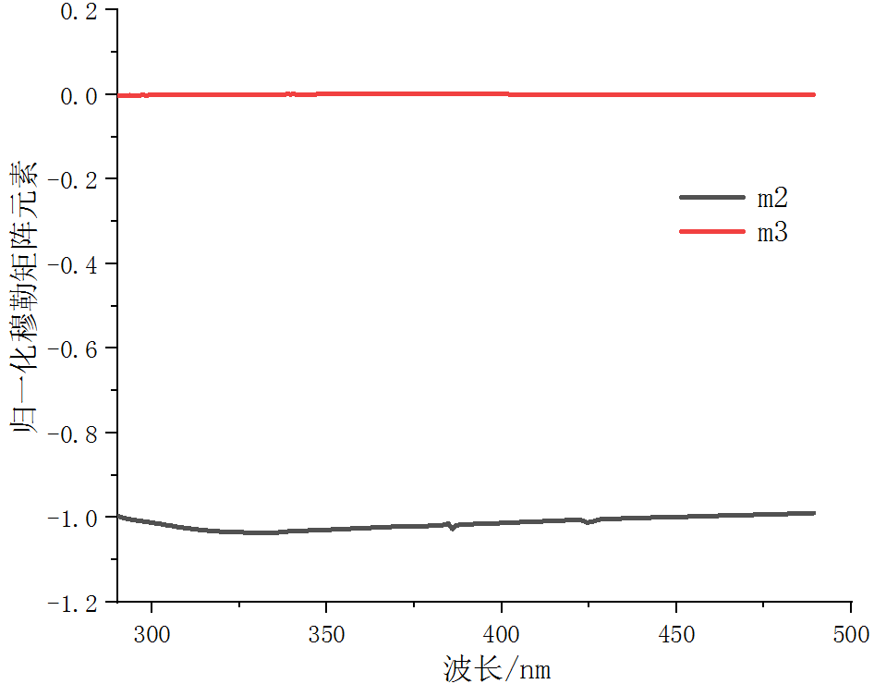
Polarization correction
The polarization correction is to calculate the normalized Stokes vector parameters of the incident light based on the radiance ratio of the observation and polarization band and the normalized Muller matrix elements. After correction, radiance of band 1 and band 2 in L1 product only related to the incident intensity.
Band 1 normalized Muller matrix elements m2 and m3
Band 2 normalized Muller matrix elements m2 and m3
Band 3 normalized Muller matrix elements m2 and m3
Notes:
偏振订正是基于观测/偏振波段辐亮度与归一化穆勒矩阵元素在线计算入射光波的归一化斯托克斯矢量参数，生成只与入射光强有关的波段1、2亮度光谱。归一化穆勒矩阵元素由发射前测量得到，如下图所示。
The polarization correction is to calculate the normalized Stokes vector parameters of the incident light based on the radiance ratio of the observation and polarization band and the normalized Muller matrix elements. After correction, radiance of band 1 and band 2 in L1 product only related to the incident intensity. The normalized Muller matrix elements measured before launch were shown in the figure below.

Slide 11
OMS-L L1 data set
OMS-L L1 data set consists of radiation data, location information, quality code and observation time. One OMS-L L1 product file is generated for each track, and 14 files are generated every day.
Group | No. | Name of data set
Data | SDS 1. | Band1_wavelength
Data | SDS 2. | Band2_wavelength
Data | SDS 3. | Band3_wavelength
Data | SDS 4. | Band1_radiance
Data | SDS 5. | Band2_radiance
Data | SDS 6. | Band3_radiance
Data | SDS 7. | Band1_irradiance
Data | SDS 8. | Band2_irradiance
Data | SDS 9. | Band3_irradiance
QA | SDS 27. | QA_observation
QA | SDS 28. | QA_telemetry
QA | SDS 29. | QA_data_processing
QA | SDS 30. | QA_verification
QA | SDS 31. | Data_quality_score
Time | SDS 32. | Detect_end_time_day_count
Time | SDS 33. | Detect_start_time_day_count
Time | SDS 34. | Detect_end_time_millisecond_count
Time | SDS 35. | Detect_start_time_millisecond_count
Group | No. | Name of data set
Geo | SDS 10. | Tangent_height
Geo | SDS 11. | Tangent_height_earth_radius
Geo | SDS 12. | Tangent_longitude
Geo | SDS 13. | Tangent_latitude
Geo | SDS 14. | Sensor_zenith_angle_tangent
Geo | SDS 15. | Sensor_azimuth_angle_tangent
Geo | SDS 16. | Solar_zenith_angle_tangent
Geo | SDS 17. | Solar_azimuth_angle_tangent
Geo | SDS 18. | Longitude
Geo | SDS 19. | Latitude
Geo | SDS 20. | Tangent_altitude
Geo | SDS 21. | Satellite_altitude
Geo | SDS 22. | Solar_zenith_angle
Geo | SDS 23. | Solar_azimuth_angle
Geo | SDS 24. | Solar_rotation_angle
Geo | SDS 25. | Land_sea_mask
Geo | SDS 26. | Land_cover
Notes:
OMS-L L1数据集由辐射数据、定位信息、质检码、观测时间四部分组成。每轨生成一个OMS-L L1产品文件，每天生成14个文件。
OMS-L L1 data set consists of radiation data, location information, quality code and observation time. One OMS-L L1 product file is generated for each track, and 14 files are generated every day.

Slide 12
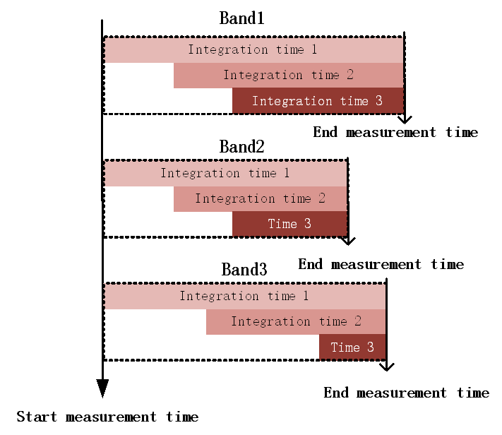
Pixel merging and measurement timing
The spectrum and spatial dimensions of bands 1,2 and 3 were shown in the table below.
After the data is acquired the spatial dimensions of the three bands are combined before downloading.
In order to improve the spectral dimension of signal to noise ratio, a 4-in-1 pixel merging process is also carried out of bands 1 and 2 during L1 data generating.
OMS-L spectrum and spatial dimensions
 | Original |  | Before downloading |  | Create data products
Dimensions | band 1,2 | band 3 | band 1,2 | band 3 | band 1,2 | band 3
Spectrum | 2000 | 200 | 2000 | 200 | 500 | 200
Bright pixel spatial | 200 | 650 | 2 | 2 | 1 | 1
Dark pixel spatial | 16 | 16 | 1 | 1 | 1 | 1
Measurement timing relationship diagram of three bands
The integration time of OMS-L detector is adjustable in three sections. The spectral intervals can also be adjusted as needed. When the bands start to observation, the three sections do not start the same time, but they ends at the same time, as shown in Figure above.
Notes:
虽然使用的是二维探测器，3个波段的空间维全部进行了合并，在产品中只表现出一个平均数。OMS-L探测器的积分时间可分为三个区间各自调整。还可以根据需要调整区间边界。开始观测时，三个区间不会同时开始观测，但会同时结束观测，如右图所示。L1数据中的观测时间为这三个区间的积分时间中间值。
Although the two-dimensional detector is used, the spatial dimensions of the three bands are all combined. The integration time of OMS-L detector is adjustable in three sections. The section boundary can also be adjusted as needed. When the observation begin, the three sections do not start measurement at the same time, but they ends at the same time, as shown in Figure on the right. The observation time in L1 data is the intermediate value of the integration time of these three sections.

Slide 13
Quality code in L1 data
The OMS-L L1 product contains five quality code data, namely QA_observation, QA telemetry, QA data processing, QA_verification and Data quality score. Primary users can judge whether the data is reliable according to the data quality score.
QA_observation
QA_data_processing
Position | Meaning
Bit0 | =1, time code has jumped and has been revised; =0, the time code is correct;
Bit1 | =1, component temperature is abnormal; =0, the component temperature is correct;
Bit2 | =1, abnormal cooling current; =0, the cooling current is correct;
Bit3 | =1, the scanning motor current is abnormal; =0, the scanning motor current is correct;
Bit4 | =1, the degree of scanning encoder is abnormal; =0, the degree of scanning encoder is correct;
Bit5 | =1, orbit instantaneous root fault; =0, the orbit instantaneous root normal;
Position | Meaning
Bit0 | =1, bad pixel filling failed; =0, bad pixel filling is successful;
Bit1 | =1, dark current correction failed; =0, dark current correction is successful;
Bit3 | =1, spectral calibration failed; =0, spectral calibration is successful;
Bit4 | =1, radiation calibration failed; =0, radiation calibration is successful;
Bit5 | =1, polarization correction failed; =0, polarization correction is successful;
Bit8 | =1, the tangent height point is located in the solar eclipse area; =0, the tangent height point is not located in the solar eclipse area;
Bit9 | =1, and the tangent height point is located in the lunar eclipse area; =0, the tangent height point is not located in the eclipse area;
Bit10 | =1, and the instrument is located in the south Atlantic region; =0, the instrument is not located in the south Atlantic region;
Bit16 | =1, positioning is successful, and IOE positioning is processed; =0, the positioning is successful. GPS positioning processing;
Bit17 | =1. other factors cause the positioning failure; =0, positioning failed due to time code error
QA_telemetry
QA_verification
  =1, inconsistent with the original satellite data;
  =0, consistent with the original satellite data
Position | Meaning
Bit0 | =1, component temperature and status are abnormal; =0, the temperature and status of components are correct;
Bit1 | =1, the initial position of limb observation is abnormal; =0, the starting position of limb observation is correct;
Bit2 | =1, the working mode of the scanning mirror is abnormal; =0, the working mode of the scanning mirror is correct;
Bit3 | =1, limb atmospheric observation time count is abnormal; =0, the time counting of limb atmospheric observation is correct;
Bit4 | =1, active thermal control power consumption is abnormal; =0, the active thermal control power consumption is correct;
Bit5 | =1, the detector works abnormally; =0, the detector works correctly;
Bit6 | =1, the lifting angle of limb observation is abnormal; =0, the lifting angle of limb observation is correct
Data_quality_score
  =0, unavailable data;
  =100, qualified data
Notes:
OMS-L L1产品包含5个质量码数据，分别是观测质量标识、遥测质量标识、数据处理质量标识、校验质量标识和数据质量评分。初级用户可以根据数据质量评分来判断数据是否可信。
The OMS-L L1 product contains five quality code data, namely QA_observation, QA telemetry, QA data processing, QA_verification and Data quality score. Primary users can judge whether the data is reliable according to the data quality score.

Slide 14
FY-3F OMS-nadir
Qian Wang, Yongmei Wang, Entao Shi, Jinghua Mao
Notes:
下面我会用几张幻灯片介绍OMS-nadir的研制进展。以下工作主要由王倩完成。
Next, I will introduce the development of OMS-nadir with a few slides. The following work is mainly completed by Qian Wang and Yongmei Wang.

Slide 15
The OMS-nadir specifications and update
Parameter | Instrument Specifications | Pre-launch measurement
Band coverage | UV1: 250-300nm UV2:300-320nm VIS: 310-493nm | UV1：249.8-300.1nm UV2：300.1-322.3nm VIS : 307-495nm
Total field of view | 112° | UV1&UV2:116.7° VIS:112.5°
Nadir ground pixel size (along track × across track) | UV1: 21 km × 28 km UV2: 7 km × 7 km VIS: 7 km × 7 km | ---
Spectral resolution | UV1: 1 nm UV2: 0.5 nm VIS: 0.6 nm | UV1：0.52-0.56nm UV2：0.4-0.45nm VIS : 0.45-0.49nm
Spectral accuracy | UV:0.05nm VIS:0.01nm | UV：0.031nm VIS : 0.01nm
Dynamic range | UV1：10⁵ UV2 & VIS ：10⁴ | ---
Relative radiometric calibration accuracy | Better than 2% | ---
Absolute radiometric | Better than 3% | ---
Notes:
Here is a table of the instrument’s specifications[ˌspɛsəfəˈkeɪʃənz], as well as some of the measured indicators[ˈɪndəˌkeɪtərz] from pre-launch measurement. We have completed the pre-launch experiment[ɪkˈsperɪmənt], the spectral calibration data have been processed. But the process of radiometric calibration data is on going.

Slide 16
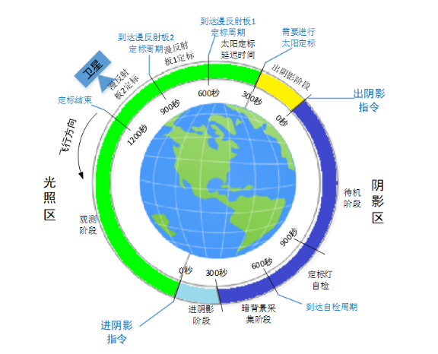
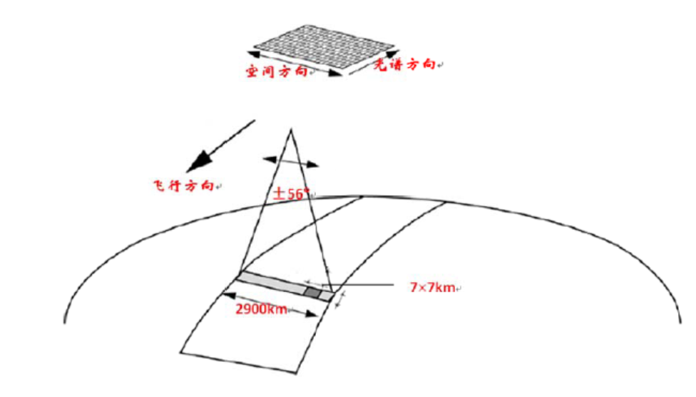
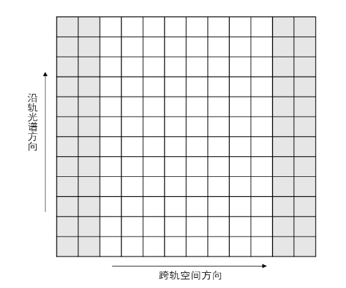
The OMS-nadir instrument design
Flight and measurement
configuration
Observing mode
Detector arrays
Spatial row 1024
swath
wavelength
Along track
Spectral column 1024
Flight direction
±56°
2900km
Across track
Dark pixels
Push broom
2D grating spectrometer + 2D detectors (CCD)
Wide cross flight IFOV(2900km）
Narrow along flight IFOV（7km/28km）
Earth observation (14 orbit/day)
Solar observation（1/10 days）
Calibration measurement
WLS measurements（1/10 days）
Dark background measurements( 1 /day)
2D array detector(1024×1024）
Spatial row binned
Bad pixels check
Broad dynamic range
Integration time is adjustable
AD gain is adjustable
Notes:
The OMS-nadir Instrument is a nadir viewing imaging spectrograph[ˈspɛktrəˌgræf] where the UV and visible range of the Earth spectrum is imaged onto two CCD detectors. One dimension of each CCD detector is used for the wavelength measurement, and the other dimension[daɪˈmenʃn] is used for spatial measurement of the cross-track field of view perpendicular[ˌpɜːrpənˈdɪkjələr] to the flight direction[dəˈrekʃn].
OMS-nadir is designed to possess scientific observation modes to collect the sunlight reflected by the Earth.
And will regularly perform four types of calibration modes, including background measurement, White light source, and solar viewing for spectral and radiometric calibration.
Dark pixels are designed at both ends of the spatial row of the detector to acquire the dark background. Also, to extend the dynamic[daɪˈnæmɪk] range, the integration time and AD gain are adjustable.

Slide 17
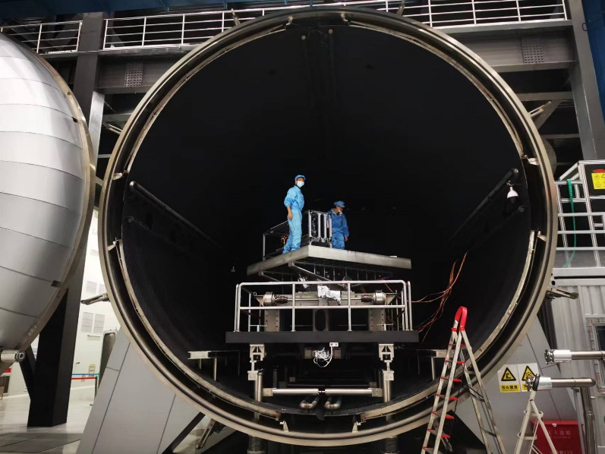
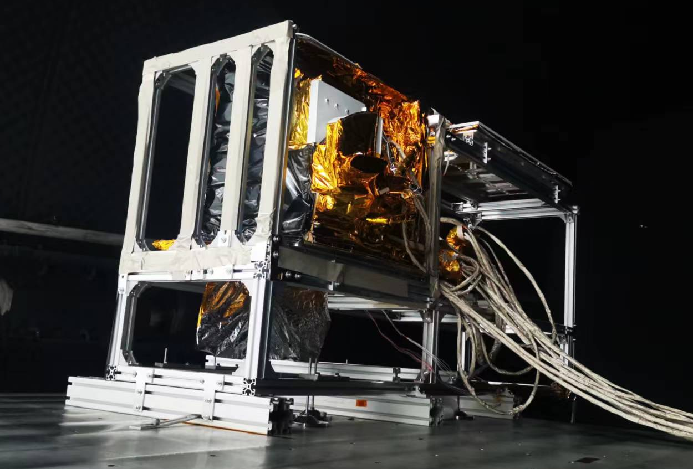
The OMS-nadir instrument prelaunch calibration
Calibration facility
Vacuum level：better than 6.65×10⁻³Pa
Spectrometer Temperature 20℃±2℃
Detectors Temperature：-35℃
Cleanliness Classification: 100,000
Thermal Vacuum tanks
The on-ground calibration test covers the full instrument swath， with more than 30 terms that all completed in a vacuum.
The on-ground calibration was split into two parts: the Earth port conﬁguration and the Sun port conﬁguration.
The OMS-nadir instrument mounted on the rotation stage.
Notes:
The on-ground calibration for OMS-nadir was performed in a thermal vacuum tank. The OMS-nadir instrument mounted on the rotation stage. This cradle[ˈkreɪdl] allowed us to calibrate the full instrument swath[swɑθ] (108 ◦ ) under operational conditions. The on-ground calibration test covers the full instrument swath， with more than 30 terms that all completed in a vacuum. The on-ground calibration was split into two parts: the Earth port and the Sun port configuration[kənˌfɪɡjəˈreɪʃn] .

Slide 18
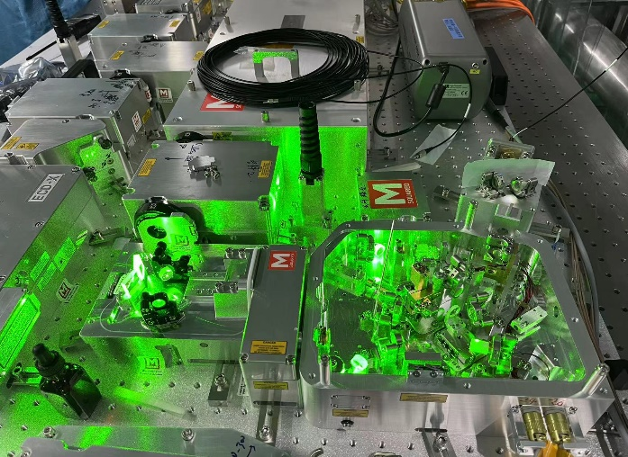
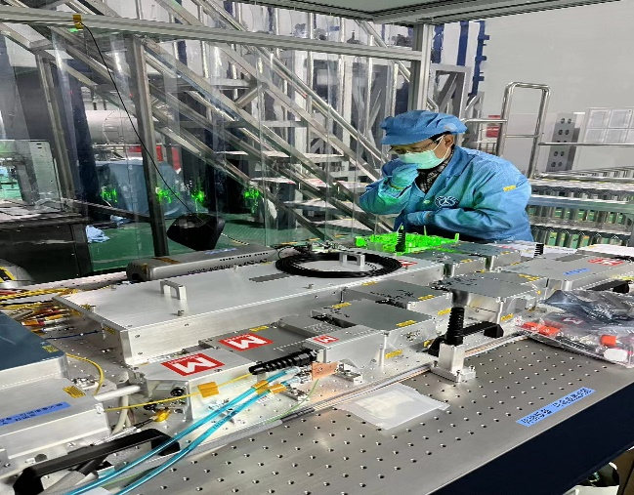
The OMS-nadir instrument prelaunch spectral calibration
Tunable Lasers : 250-300nm & 350-500nm
OPO Pulsed Lasers: 300-350nm
Hg spectral line lamps : Spectral accuracy validation
UV1 & UV2 ISRF
VIS ISRF
Tunable Lasers used for spectral calibration
Data and parametrized ISRFs for several pixels on the UV and VIS detectors
Notes:
The spectral calibration measurements were performed with two lasers. And the wavelength accuracy[ˈækjərəsi] is validated using a mercury[ˈmɜːrkjəri] spectral line lamps. Measurements were performed only for Sun port with an internal diffuser.
The pictures in the bottom are the tunable Lasers used for spectral calibration.
The right figures are the ISRFs for several pixels on the UV and VIS detectors.

Slide 19
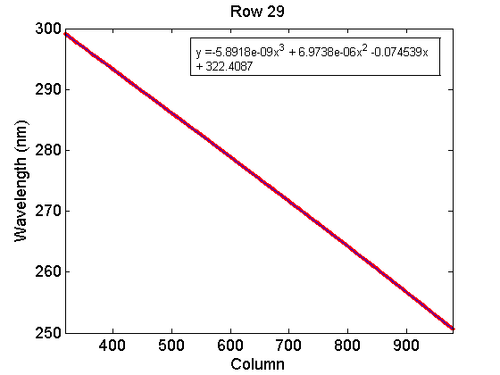
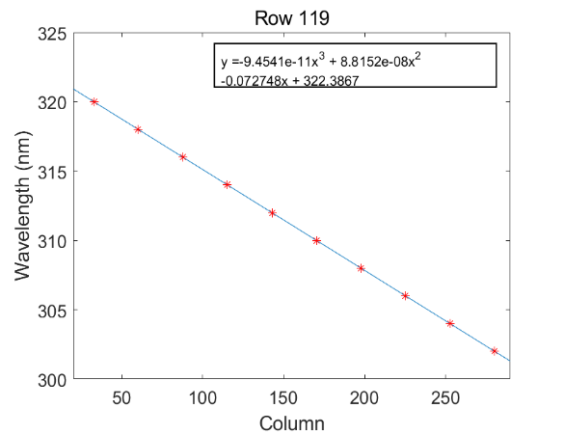
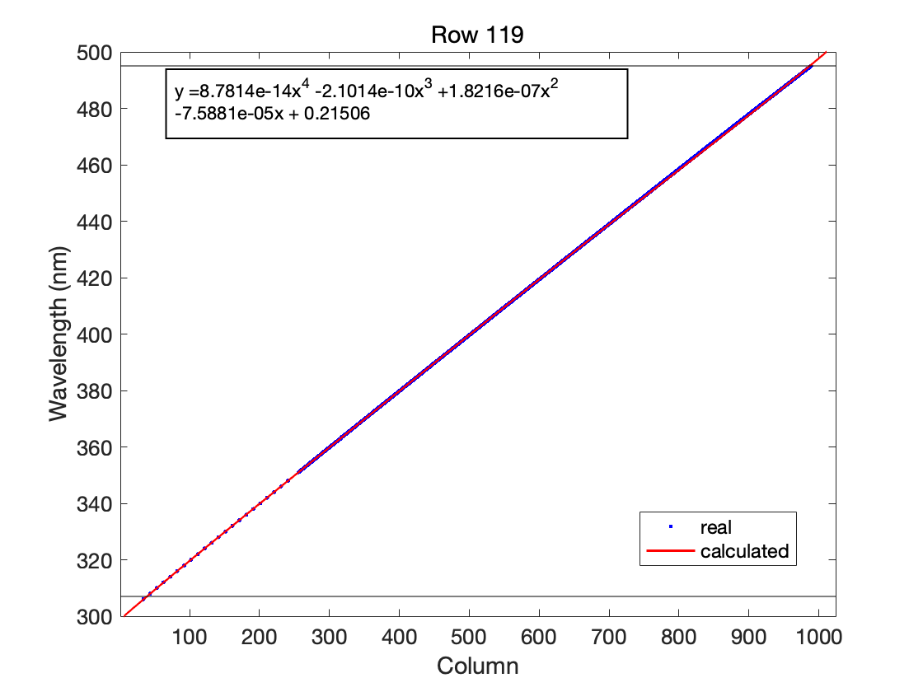
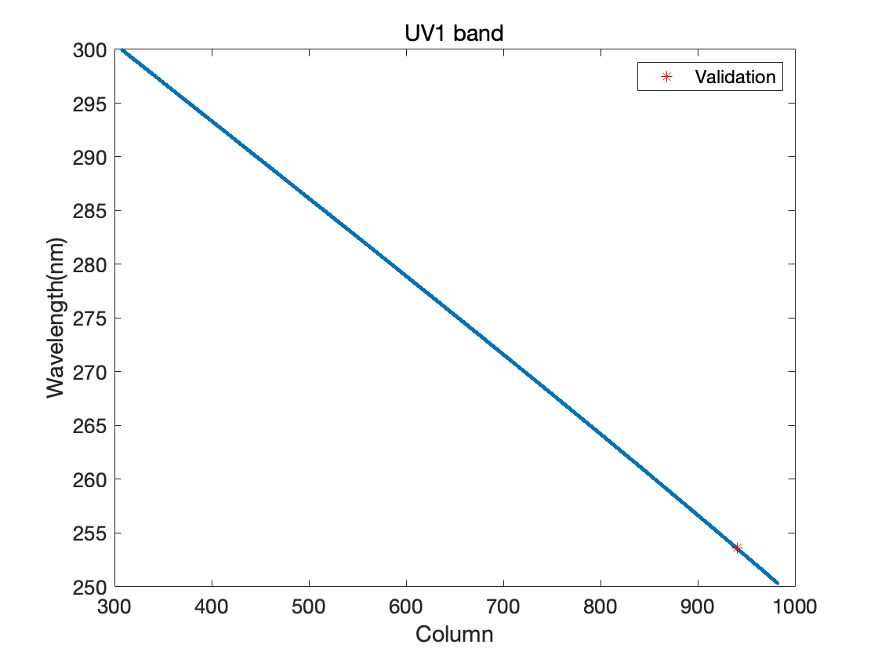
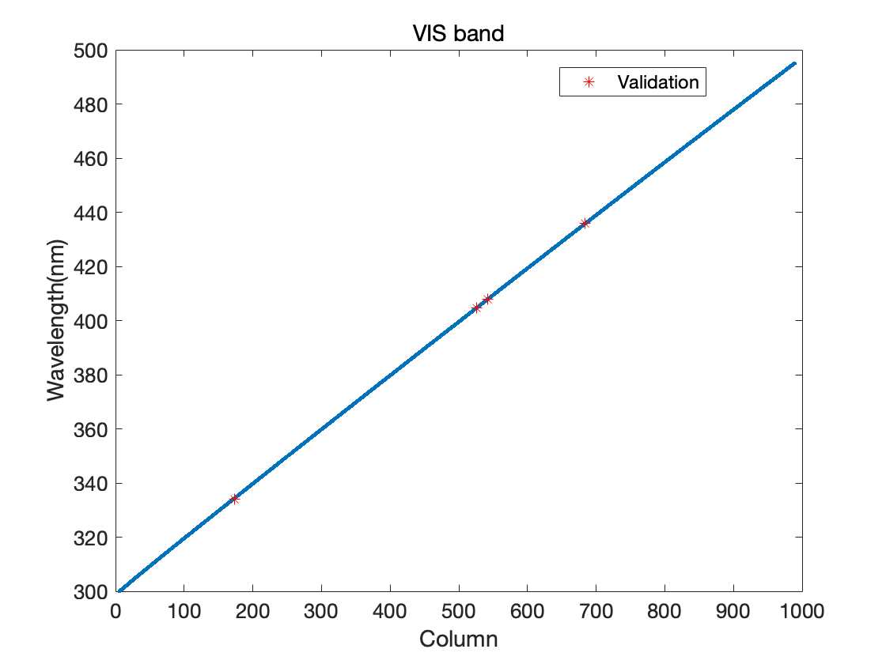
The OMS-nadir instrument prelaunch spectral calibration
Dispersion curves for UV1, UV2 and VIS at nadir
UV1
UV2
VIS
Wavelength accuracy validation using Hg spectral line lamps
band | Reference Wavelength | Tested wavelength | Wavelength accuracy
UV1 | 253.652nm | 253.621nm | -0.031nm
VIS | 334.1484nm | 334.1384nm | -0.01nm
 | 404.6570nm | 404.6556nm | -0.0014nm
 | 407.7837nm | 407.7895nm | 0.0058nm
 | 435.8340nm | 435.8279nm | -0.0061nm
UV1
VIS
Notes:
Dispersion [dɪˈspɜːrʒn] curves for UV1, UV2 and VIS at nadir are shown in the upper panel. The red spots are tested data, the blue lines are the fitted curves. It can be seen that the dispersion curves has a very good linearity[ˈlɪniəriti].
The bottom panels are the results of wavelength accuracy[ˈækjərəsi] validation using mercury[ˈmɜːrkjəri] spectral line lamps. The wavelength accuracies are better than 0.03nm and 0.01nm for UV and VIS band, respectively[rɪˈspektɪvli].

Slide 20
The OMS-nadir L01b forward processing flow
Level 1 product
Level 1b radiance
Level 1b irradiance
Level 1a OBC
Level 1a calibration
Level 1a OBC-DARK
Notes:
Here is an overall flowchart of OMS-nadir L01b forward processing, which consists of several on-line sections such as quality check, spectral and radiometric calibration, and off-line sections like in-orbit spectra, radiometric corrections and bad pixel matrix[ˈmeɪtrɪks] generation.
The raw data from the quality check goes into the spectral and radiometric calibration section, which generates the L1 radiance and irradiance product, as well as some L1A OBC data for calibration and monitoring[ˈmɑːnɪtərɪŋ]. In-orbit spectral radiometric correction section can be performed to calculate the wavelength shift and radiometric correction. Based on white light source observations[ˌɑbzərˈveɪʃənz], the in-orbit bad pixel matrix[ˈmeɪtrɪks] can be updated for quality checks.

Slide 21
The OMS-nadir L01b products
Radiance product
Irradiance product
Group | SDS | Description
Geolocation | Day_Count | Day_count for each measurement from 12:00 of 2000/01/01 UTC.
 | Millisec_Count | Millisecond count from 12:00 am of each day for the beginning time of earth observation in each scan line.
 | Latitude | Latitude of the center of each ground pixel
 | Longitude | Longitude of the center of each ground pixel
 | Altitude | Altitude of each pixel on earth topography with terrain correction
 | Satellite_Altitude | The altitude of the spacecraft
 | Satellite_Latitude | The latitude of the spacecraft
 | Satellite_Longitude | The longitude of the spacecraft
 | Solar_Azimuth | Solar azimuth angle at the ground pixel location
 | Solar_Zenith | Solar zenith angle at the ground pixel location
 | Sensor_Azimuth | Azimuth angle of the satellite at the ground pixel location
 | Sensor_Zenith | Zenith angle of the satellite at the ground pixel location
 | Land_Sea_Mask | Land sea mask
 | Land_Cover | Land cover
Data | Wavelength | Spectral channel wavelength
 | Radiance | Measured spectral radiance for each spectral pixel
 | Integration_Time | Integration time
 | Gain | Gain
QA | QA_Flag_Scnline | Scan line quality flag
 | QA_Flag_Process | Processing quality flag
 | QA_Score | Observation quality score
Group | SDS | Description
 | Day_Count | Day count for each measurement from 12:00 of 2000/01/01 UTC.
 | Millisec_Count | Millisecond count from 12:00 am of each day for the beginning time of earth observation in each scan line.
 | Wavelength_UV1 | Spectral channel wavelength at UV1 band
 | Wavelength_UV2 | Spectral channel wavelength at UV2 band
 | Wavelength_VIS | Spectral channel wavelength at VIS band
 | Irradiance_UV1 | Measured spectral irradiance at UV1 band for each spectral pixel
 | Irradiance_UV2 | Measured spectral irradiance at UV2 band for each spectral pixel
 | Irradiance_VIS | Measured spectral irradiance at VIS band for each spectral pixel
 | QA_Flag_Scnline | Scan line quality flag
 | QA_Flag_Process_UV1 | Processing quality flag for UV1
 | QA_Flag_Process_UV2 | Processing quality flag for UV2
 | QA_Flag_Process_VIS | Processing quality flag for VIS
 | QA_Score_UV1 | Observation quality score for UV1
 | QA_Score_UV2 | Observation quality score for UV2
 | QA_Score_VIS | Observation quality score for VIS
Notes:
Finally, the instrument's L1 radiance and irradiance product datasets are shown, including geolocation, observation data and quality flag, which can be used for product retrieval.

Slide 22
Thank you for the attention!
Email: liyuan@cma.gov.cn
Notes:
感谢大家的关注，也特别感谢Larry对会议的组织。如果您在本次会议后有任何意见，也欢迎通过电子邮件与我联系。
Thank you for the attention and special thanks to Larry for organizing the meeting. You are also welcome to contact me by email if there have any comments after this meeting.

