Slide 1
OMI (Collection 4) and TROPOMI (V2.01, Collection 3) Solar Spectral Irradiances s. Marchenko^{1,2,3}, M. DeLand^{1,2,3}, A. Ludewig⁴, P. Veefkind^{4,5}
¹ Science Systems and Applications, Inc., USA ² Goddard Space Flight Center, NASA, USA
³ Solar Irradiance Science Team, NASA, USA
⁴ Royal Netherlands Meteorological Institute, the Netherlands
⁵ University of Technology Delft, the Netherlands
GSICS, February 28, 2023
Notes:
3 WOW moments

Slide 2
Solar spectral irradiances (SSI)
Calibration
Climate studies
Solar physics Extremely challenging calibration!
Search for exo-planets
…
Sun is a variable star
Notes:
Solar irradiances: meant for calibration, however contributing to science, as long as the instruments perform accordingly

Slide 3
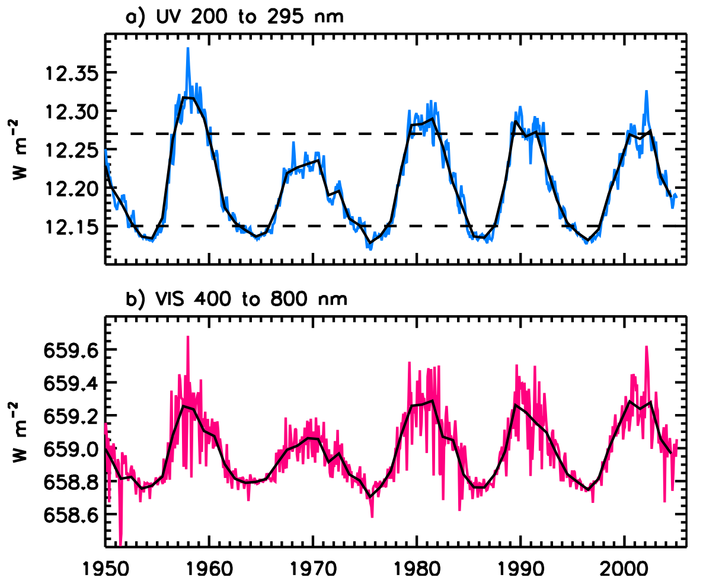
Solar cycle SSI signal is small and spectrally dependent
TOTAL: 1360.8 W m⁻²
1 %
SSI
0.1 %
YEAR
Repr. from: D. Rind et al., JGR-A 113, D24103 (2008)
Notes:
For illustration only: the shown VIS variability is ~3x higher than observed in our data
UV: low output, but high variability
VIS: very low variability, but high yield
I.e., While uncertainties of a few percent have been present for all satellite instruments,
solar cycle variations shortward of ~260 nm are large enough that reasonable estimates
have been available since the late 1980s. The longer wavelengths have been the challenge.

Slide 4
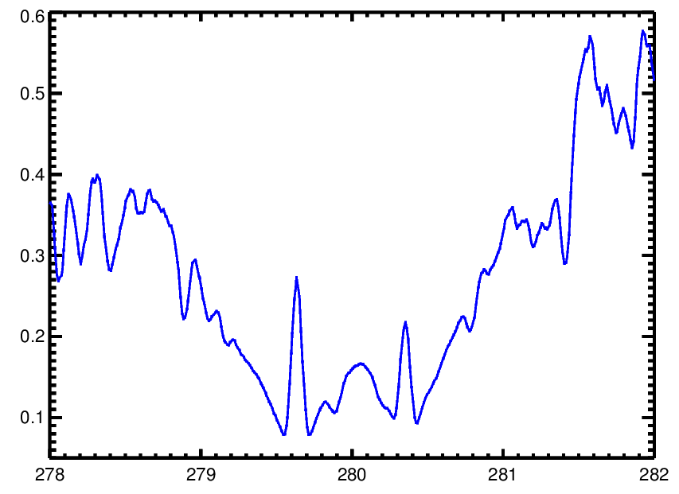
Solar line indices: a good proxy of the solar activity
Wing 2
MgII 280 nm doublet from
SOLSTICE, ∆λ ≈ 0.1 nm
Wing 1
Core
Norm. Flux
Wavelength, nm
Notes:
Potential of the line indices as a calibration tool:
Regarding the degradation, the approach effectively cancels out multiplicative components. Superb (down to 0.05%) additive-component sensitivity. Also sensitive to the wavelength registration glitches.

Slide 5
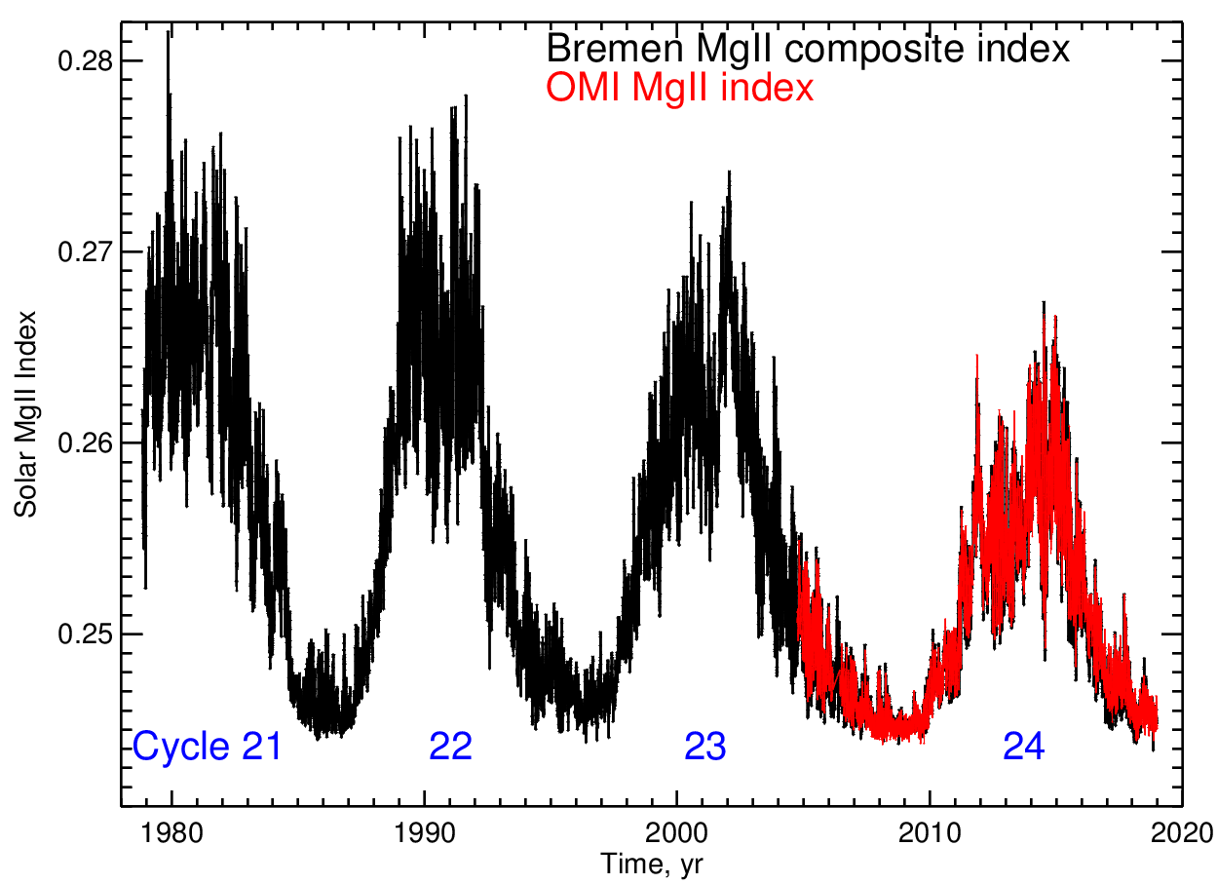
The validated and reliable OMI MgII and CaII indices
3σ
10 %
Notes:
OMI is appropriately re-scaled to account for the difference in sp. resolution. The shown 3-sigma uncertainties apply to cycle 24 and are VERY conservative.

Slide 6
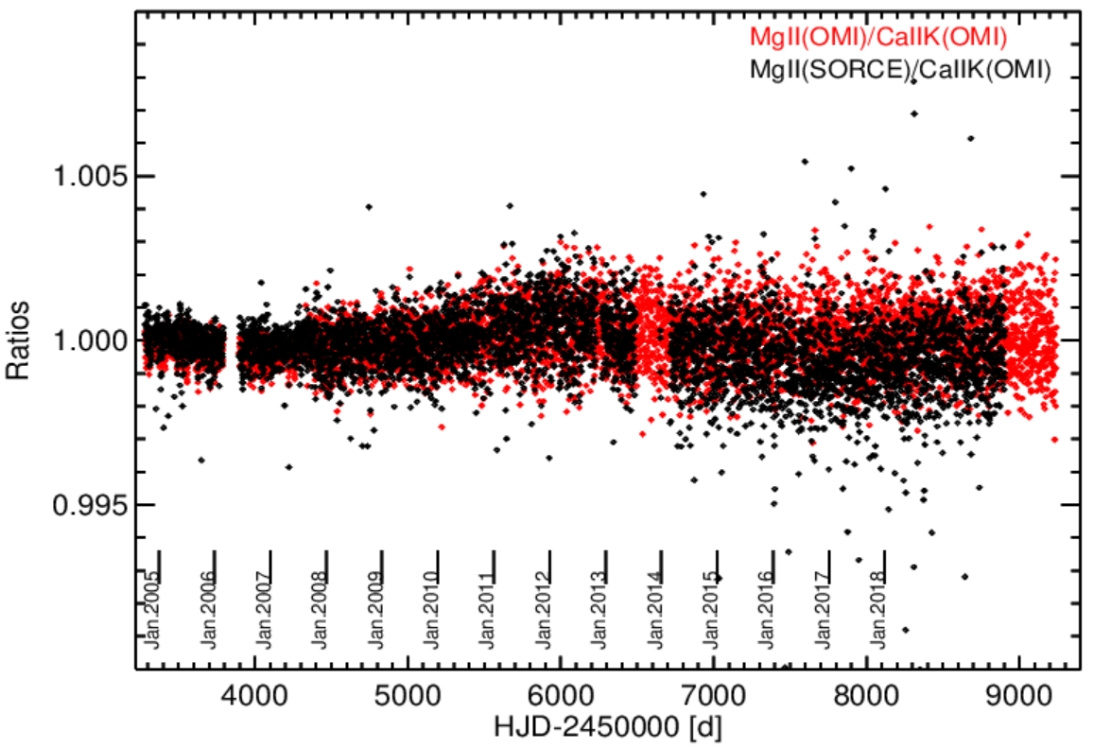
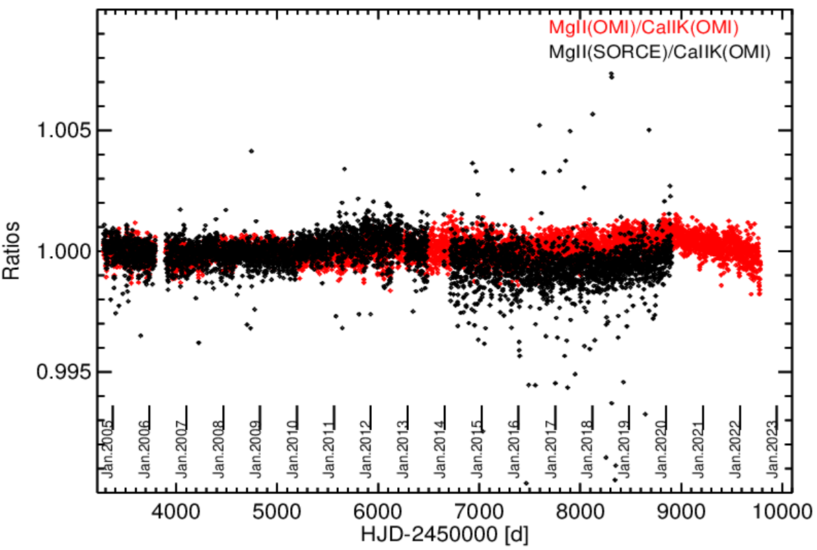
OMI MgII, CaII H&K indices
Collection 3 Collection 4: June-July 2022 release,
*CAL data
Coll. 4: Kleipool, Q., et al., Atmos. Meas. Tech., 15, 3527–3553 (2022)
Notes:
MgII/CaII correlation is ~99.5%, i.e., practically noise-limited. Hence, the MgII/CaII ratio efficiently removes the intrinsic solar variability. Note the increasing noise in the SOLSTICE data, and stable S/N in the OMI Coll. 4 indices

Slide 7
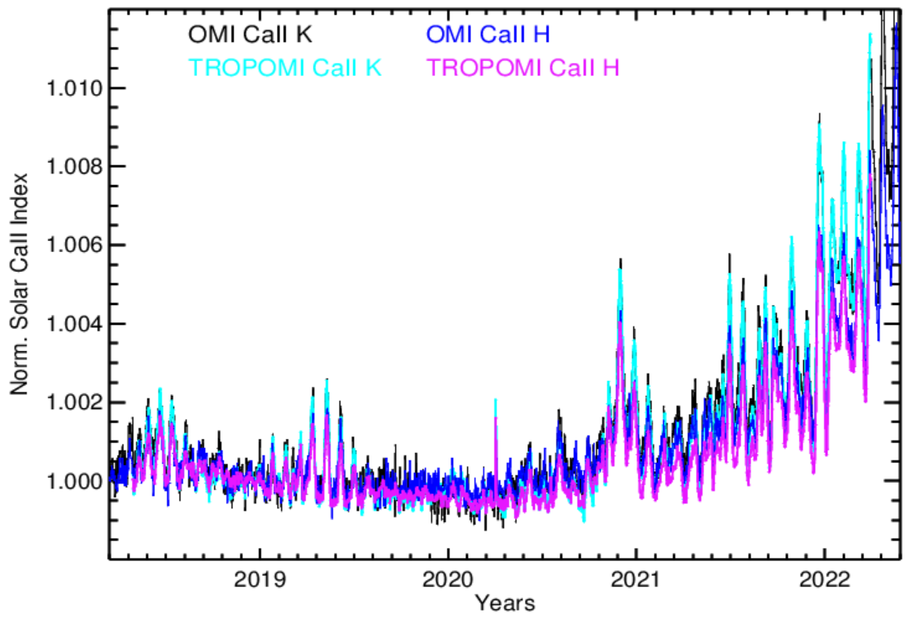
OMI Coll. 4 & TROPOMI (V2.01, Dec. 2022 release): a success story – both the solar rotation and the solar cycle variability are detected down to 0.1%
1 %

Slide 8
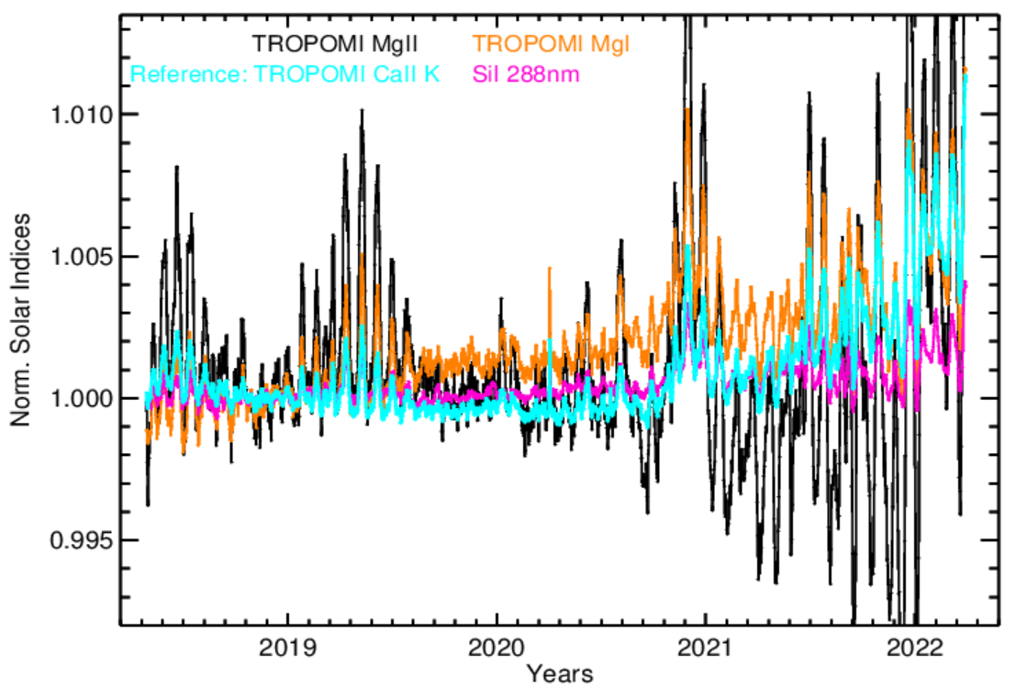
TROPOMI B1 (267-300 nm) line indices : spectral ageing
Instrument performance and calibration: Ludewig, A., et al., Atmos. Meas. Tech., 13, 3561–3580 (2020)

Slide 9
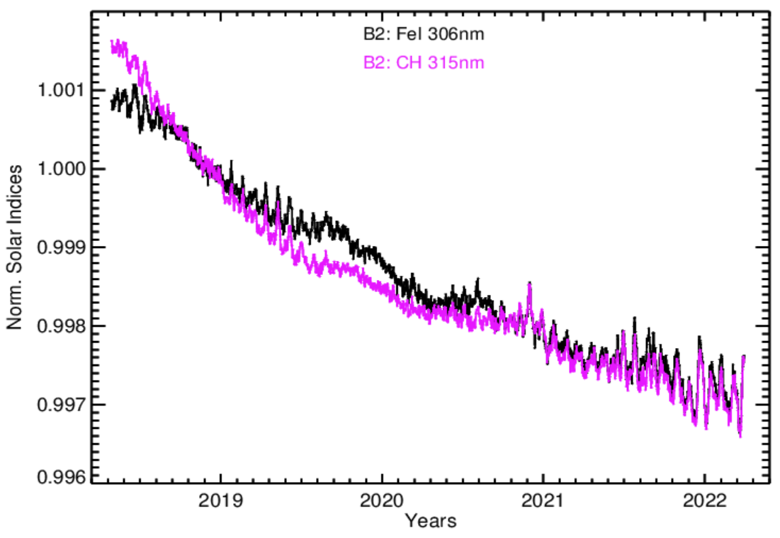
TROPOMI B2 (300-332 nm) indices: more likely, an evolving additive component or, less likely, changing spectral instrument transfer function
0.5 %

Slide 10
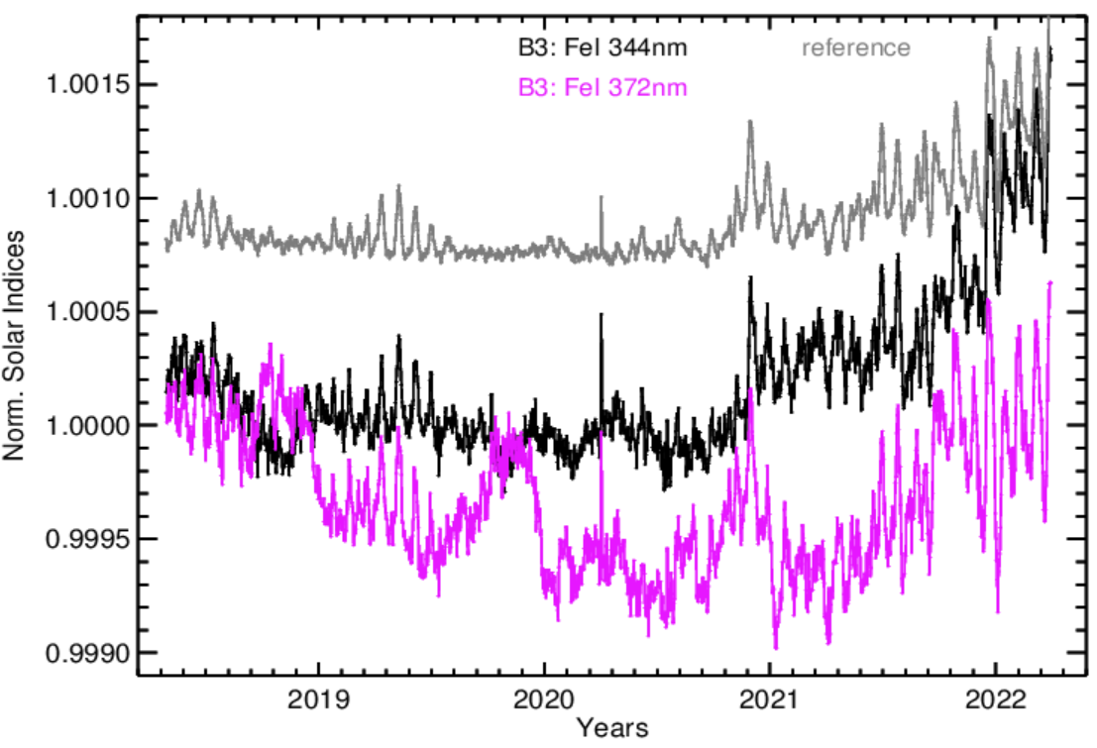
TROPOMI B3 (305-400 nm) indices: an additive component
0.2 %

Slide 11
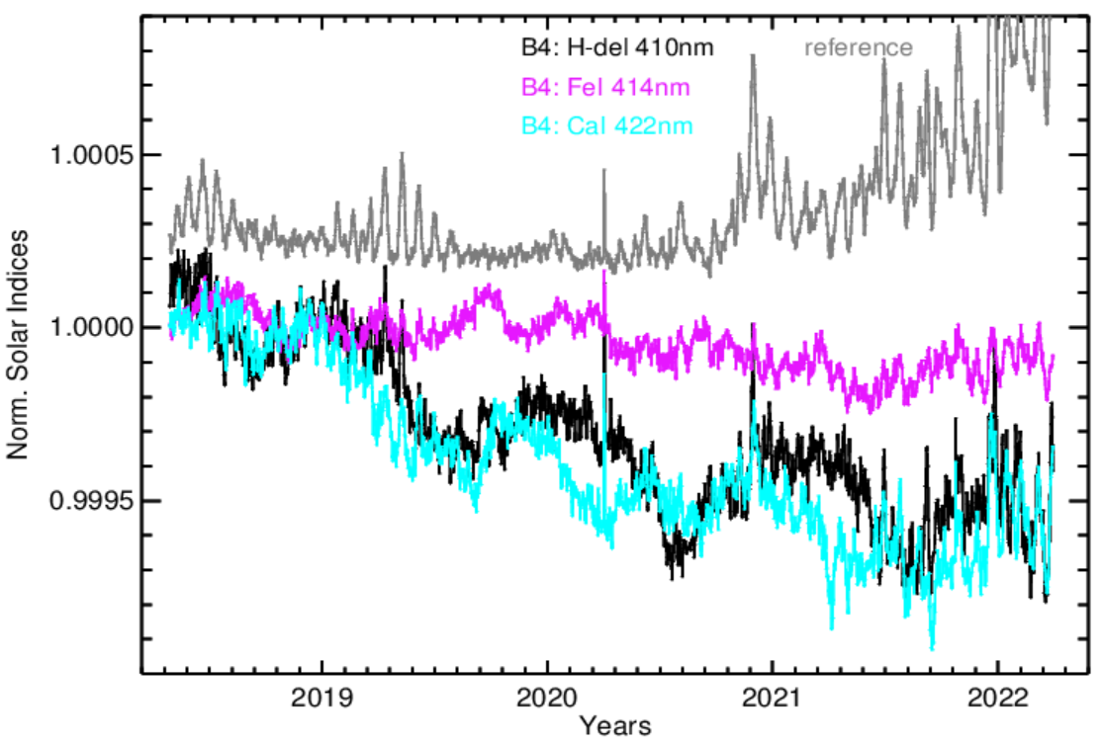
TROPOMI B4 (400-499 nm) indices: an additive component
0.1 %

Slide 12
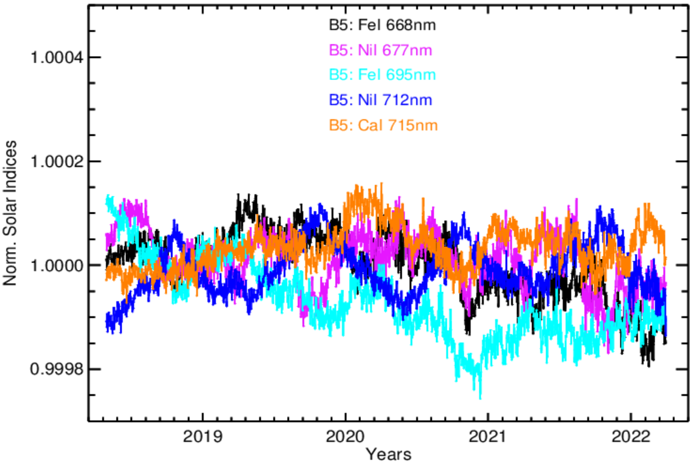
TROPOMI B5 indices (661-725 nm; no reference – a Terra incognita!)
0.04 %

Slide 13
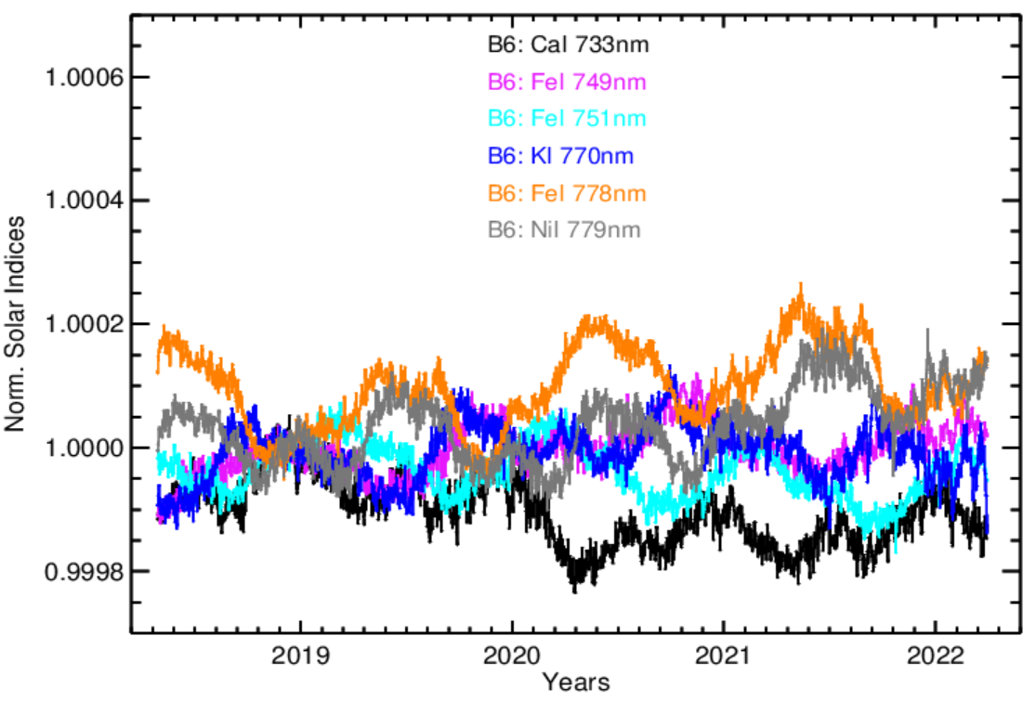
TROPOMI B6 indices (725-786 nm; no reference!)
0.04 %

Slide 14
Conclusions
The spectral line-indices may track instrument performance (additive components) down to ≈0.01-0.02%.
OMI:
- Collection 4 provides improved line indices;
- remains to be stable, predictable instrument.
TROPOMI:
- excellent-quality CaII H&K indices;
- Band 1 is affected by evolving spectral ageing artifacts;
- Bands 2-4 are affected by evolving additive component(s);
- Bands 5-6 are artifact-free down to ≈0.02% level.

