Slide 1
GEO-GEO analysis of
Himawari-8/9 parallel observation
OKUYAMA Arata and KODERA Kazuki
Meteorological satellite center of Japan meteorological agency

Slide 2
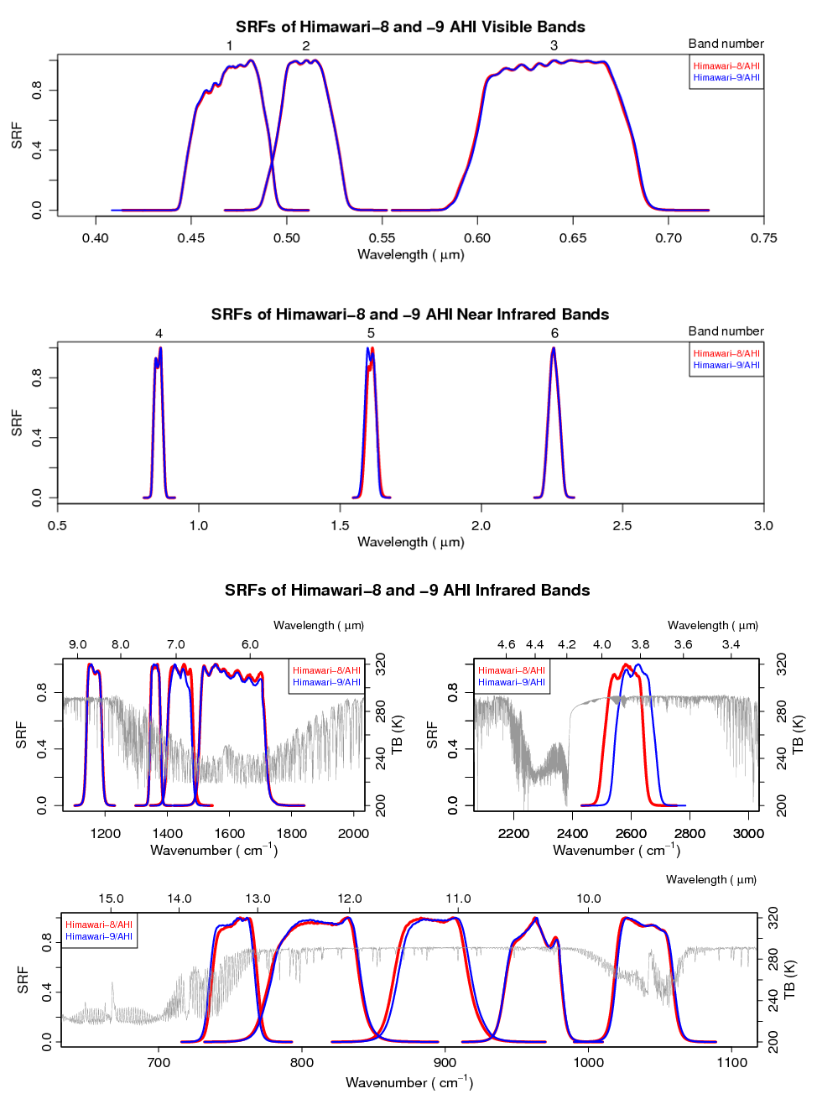
Introduction
Himawari-8/AHI
Himawari-9/AHI
01
02
03
Himawari-9
Himawari-8 is currently a back up satellite (no observation operation)
Specifications of H8 and 9 are same.
  140.7 deg. East
  Imager is AHI.
  16 bands, FD obs. every 10 mins. and area obs. every 2.5 mins.
Launch | 02 Nov. 2016
Back up operation start | 10 Mar. 2017
Parallel data dissemination start | 27 Sep. 2022
Full operation start | 13 Dec. 2022
04
05
06
07
11-08
16
15
14
13
12

Slide 3
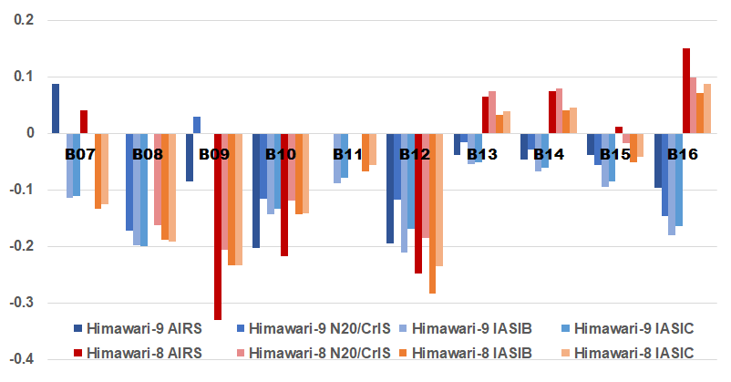
AHI9 calibration (IR bands, B07-B16)
AHI - reference [K]
2022/09/02 - 30
AHI9 | AIRS | N20/CrIS | IASI-B | IASI-C
B07 (3.9) | 0.09 | - | -0.12 | -0.11
B08 (6.2) | - | -0.17 | -0.20 | -0.20
B09 (6.9) | -0.09 | 0.03 | 0.00 | 0.00
B10 (7.3) | -0.20 | -0.12 | -0.15 | -0.14
B11 (8.6) | - | - | -0.09 | -0.08
B12 (9.6) | -0.20 | -0.12 | -0.21 | -0.17
B13 (10.4) | -0.04 | -0.02 | -0.06 | -0.05
B14 (11.2) | -0.05 | -0.03 | -0.07 | -0.06
B15 (12.4) | -0.04 | -0.06 | -0.10 | -0.09
B16 (13.3) | -0.10 | -0.15 | -0.18 | -0.17
The brightness temperature (Tb) biases for both AHI8 and AHI9 are stable and within 0.3K at the standard radiance corresponding to clear sky sea surface temperature.
There are some cases that have larger biases for lower Tb.
Tb bias at the standard radiance [K]
+0.2
+0.1
0.0
AHI8 | AIRS | N20/CrIS | IASI-B | IASI-C
B07 (3.9) | 0.04 | - | -0.13 | -0.13
B08 (6.2) | - | -0.16 | -0.19 | -0.19
B09 (6.9) | -0.33 | -0.21 | -0.24 | -0.23
B10 (7.3) | -0.22 | -0.12 | -0.14 | -0.14
B11 (8.6) | - | - | -0.07 | -0.06
B12 (9.6) | -0.25 | -0.19 | -0.28 | -0.24
B13 (10.4) | 0.06 | 0.07 | 0.03 | 0.04
B14 (11.2) | 0.07 | 0.08 | 0.04 | 0.05
B15 (12.4) | 0.01 | -0.02 | -0.05 | -0.04
B16 (13.3) | 0.15 | 0.10 | 0.07 | 0.09
-0.1
-0.2
-0.3
-0.4
The bias wrt. CrIS at B07, the bias wrt. AIRS at B08 and the bias wrt. AIRS and CrIS at B11 are omitted because of its large uncertainty.

Slide 4
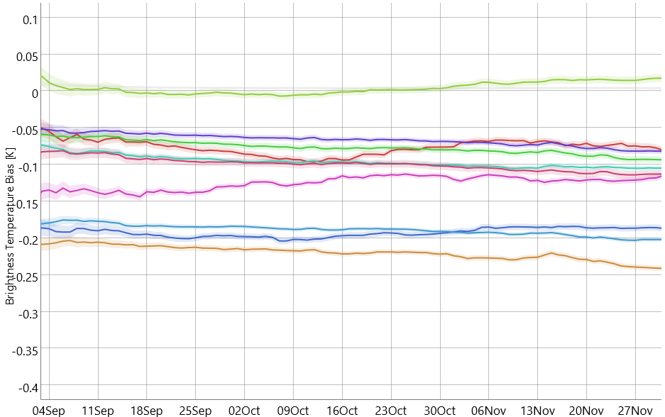
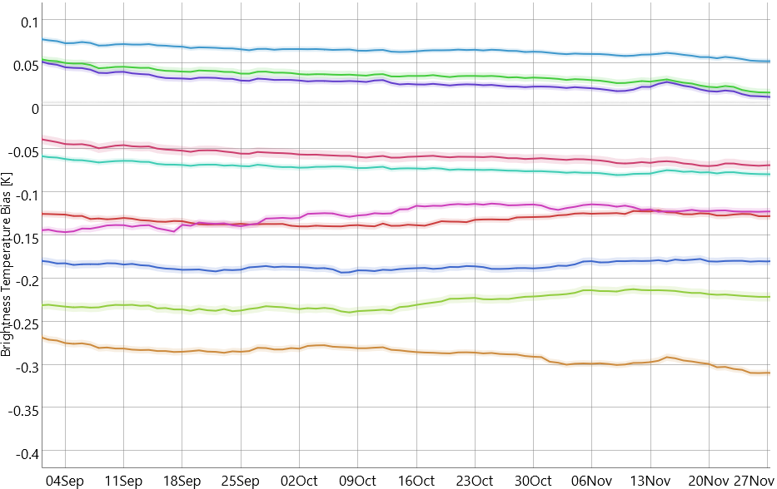
Tb bias stability at the std.rad.
The biases for AHI9 are as stable as AHI8, and their range is similar to the one for AHI8.
+0.1
+0.1
B07
B08
B09
B10
B11
B12
B13
B14
B15
B16
AHI9 Tb bias at std. rad.
10 weeks from 2022/09
wrt. Metop-B/IASI (Re-analysis)
AHI8 Tb bias at std. rad.
10 weeks from 2022/09
wrt. Metop-B/IASI (Re-analysis)
-0.4
2022/09
2022/12
-0.4
2022/09
2022/12
cf. GSICS Calibration Products Plotting Tool

Slide 5
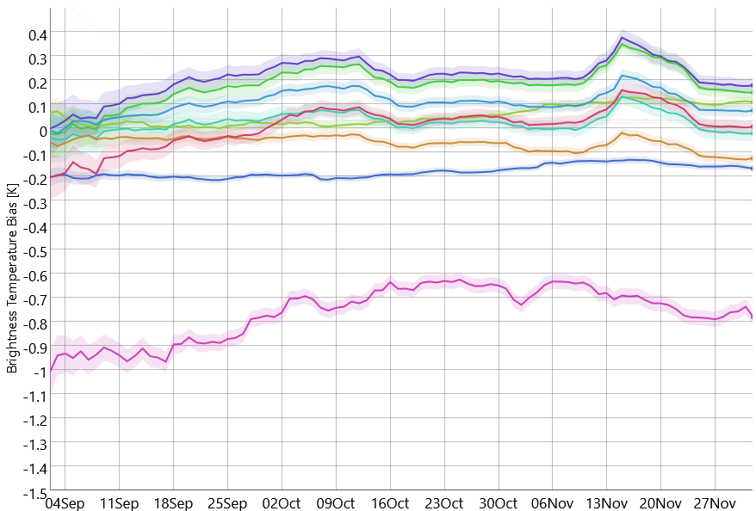
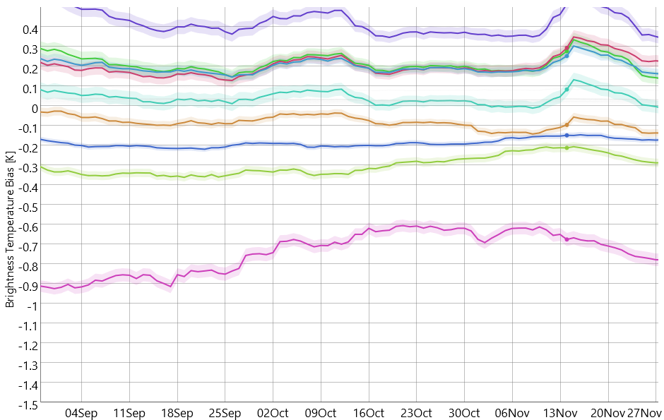
Tb bias stability at 220K
Their variation ranges are almost same for the both of AHI8 and 9, while there are some cases that have larger value.
+0.4
+0.4
B07
B08
B09
B10
B11
B12
B13
B14
B15
B16
AHI9 Tb bias at 220K
10 weeks from 2022/09
wrt. Metop-B/IASI (Re-analysis)
AHI8 Tb bias at 220K
10 weeks from 2022/09
wrt. Metop-B/IASI (Re-analysis)
-1.5
2022/09
2022/12
-1.5
2022/09
2022/12
cf. GSICS Calibration Products Plotting Tool

Slide 6
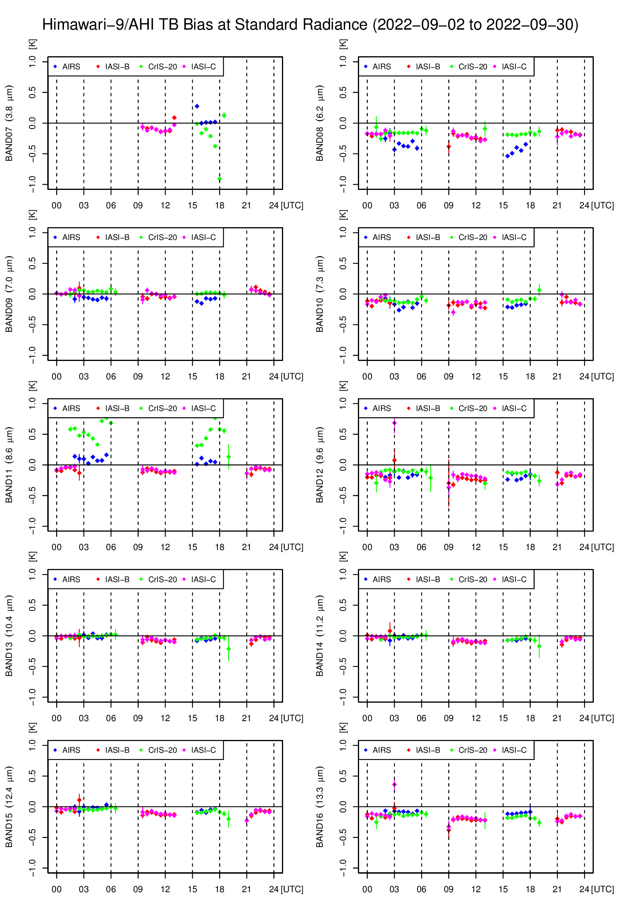
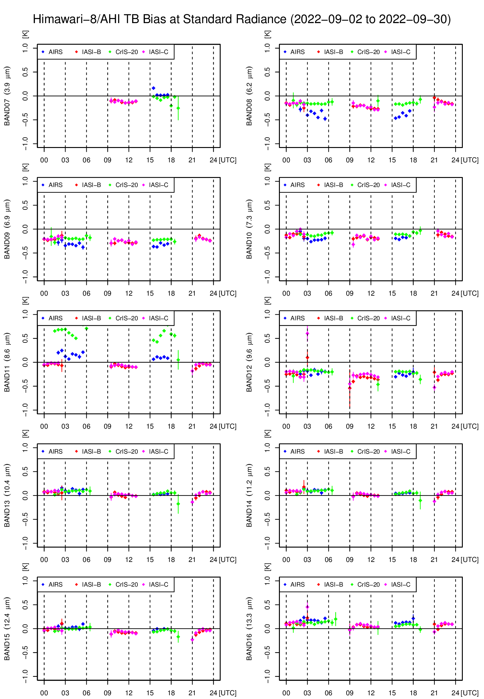
Tb bias (Diurnal variation ) at the std. rad.
1.0
B07
B08
B07
B08
AHI9
AHI8
There is no significant variation for the both imagers.
x-axes: Time in UTC
y-axes: Tb bias [K]
Note that the bias wrt. CrIS at B07, the bias wrt. AIRS at B08 and the bias wrt. AIRS and CrIS at B11 have large uncertainty due to their band gaps.
-1.0
1.0
B09
B10
B09
B10
-1.0
1.0
B11
B12
B11
B12
-1.0
1.0
B13
B14
B13
B14
-1.0
1.0
B15
B16
B15
B16
AIRS
CrIS-20
IASI-B
IASI-C
Data period:
2022/09/02 - 30
-1.0

Slide 7
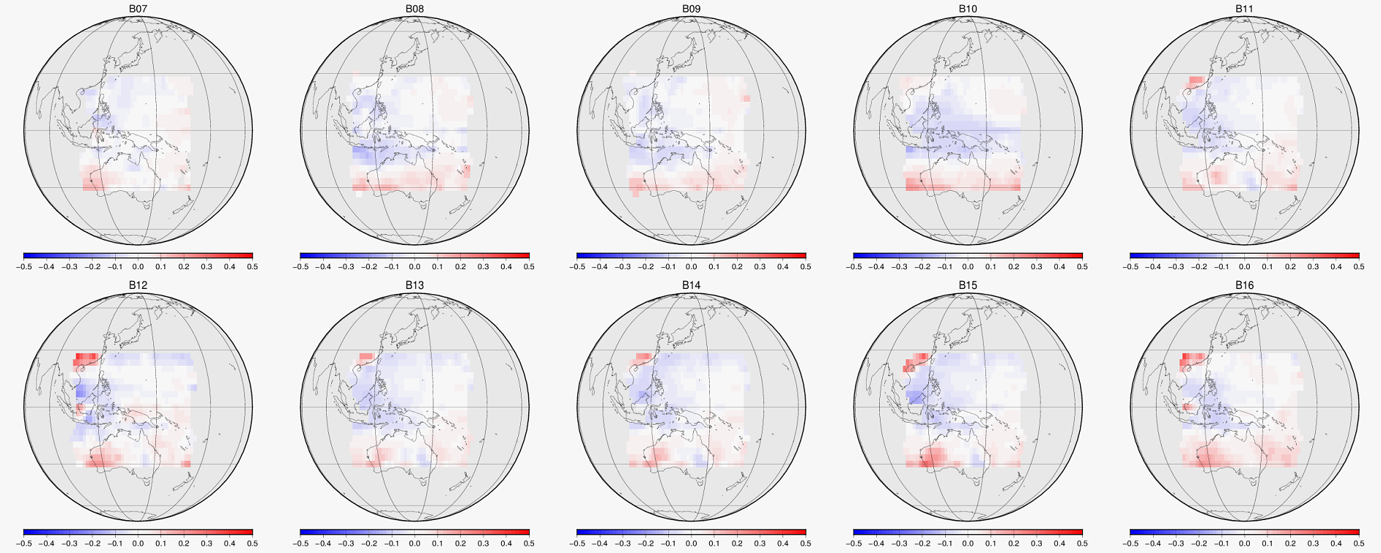
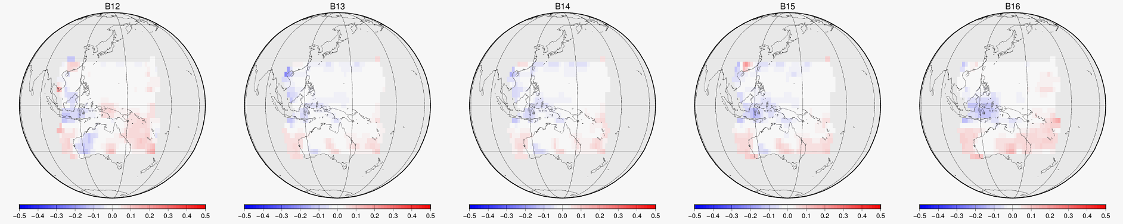
Tb bias (for scan position by GSICS approach)
Grid ave. Tb difference residual: GEO minus LEO [K]
vs.
Metop-B/IASI
Scan position dependent bias is not significant.
B07
B08
B09
B10
B11
-0.5 K
+0.5 K
2022/10 to 12
3 month average
AHI-9 vs. LEO
Only scenes with Tbs > Std.radiances are averaged.
B12
B13
B14
B15
B16
vs.
SNPP/CrIS
AHI9 - Hyper-sounder Tb
B12
B13
B14
B15
B16
Hyper-sounder Tb

Slide 8
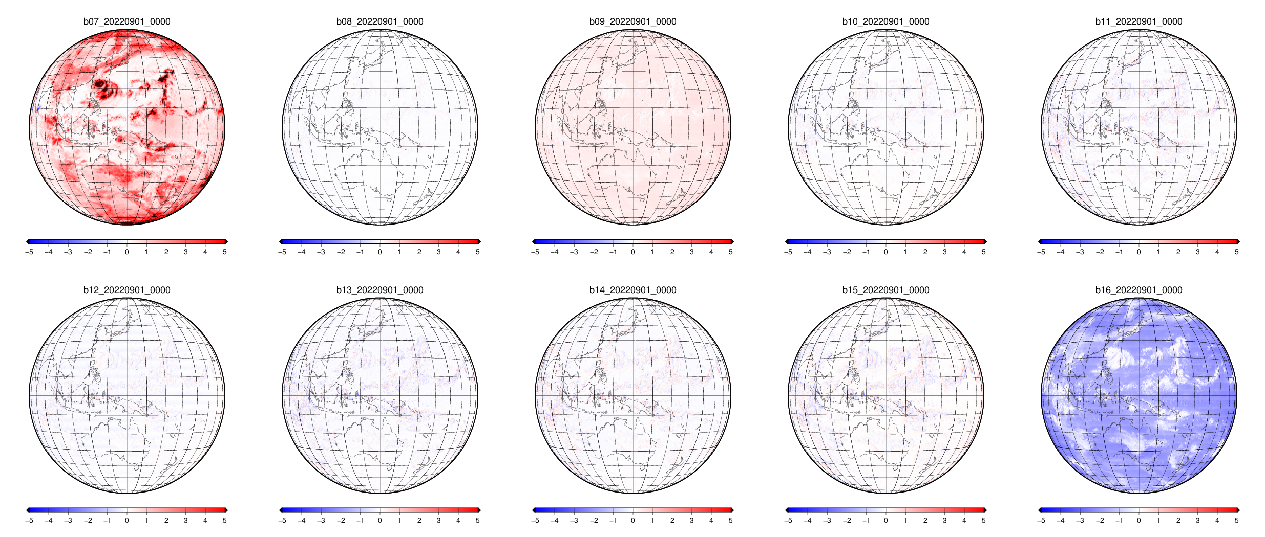
GEO-GEO: Himawari-8/9
Some bands show difference brought by the SRF difference between H8 and H9.
B07: Solar light reflection affects stronger for B07 (3.9um) of AHI9 than the one of AHI8, due to a difference of SRFs.
B16: Their SRFs doesn't look different comparing with B07's case, however, observed Tb is affected by the SRF difference, e.g. the standard radiances are 269.73K and 268.53K for AHI8 and AHI9, respectively.
Note that the GEO-GEO differences don't mean absolute error but just a relative comparison between AHI9 and AHI8.
Tb difference: snapshot (AHI9 - AHI8) [K]
AHI8
AHI9
B07
B07
B08
B09
B10
B11
-5 K
+5 K
AHI8
AHI9
B16
B12
B13
B14
B15
B16
SRF difference is not corrected. Images are compared by "as is".
2022/09/01 00:00 UTC

Slide 9
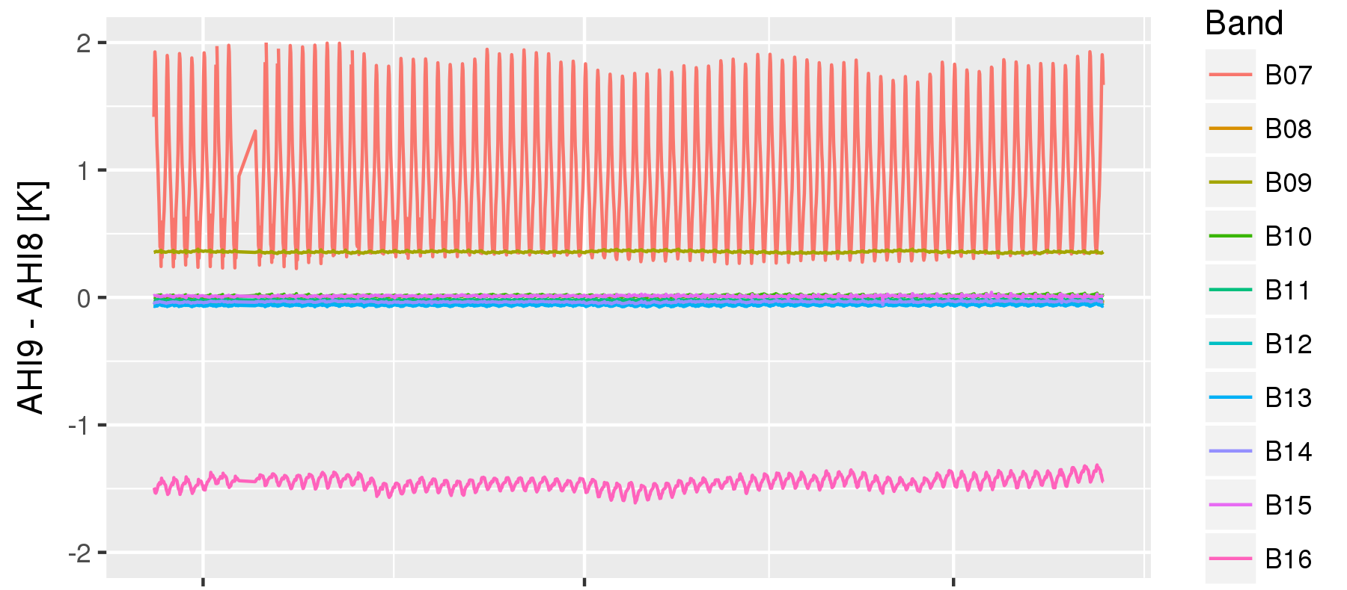
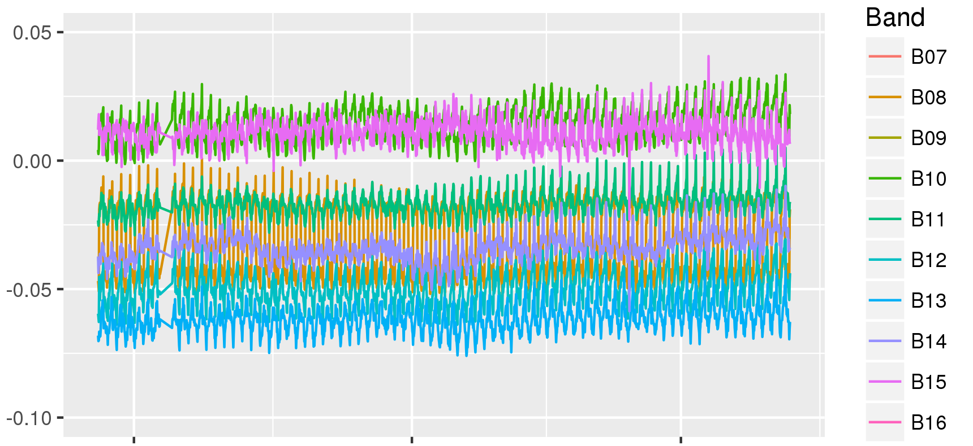
GEO-GEO (Trend)
Tb difference: AHI9 - AHI8 [K]
B07
B09
B16
2022/10
2022/11
2022/12
2022/10
2022/11
2022/12
Trend of the full disk average of the Tb difference is stable in the last a few month, while there is diurnal variation.
B07: diurnal variation due to the contribution by the solar light component.
B16: larger difference with around 1.5 K due to the SRF difference.
B09: relatively larger difference than other bands. GSICS approach revealed that Himwari-8 has around 0.3K of bias on this band.
In other bands, the difference between the both imagers are within less than 0.1K.

Slide 10
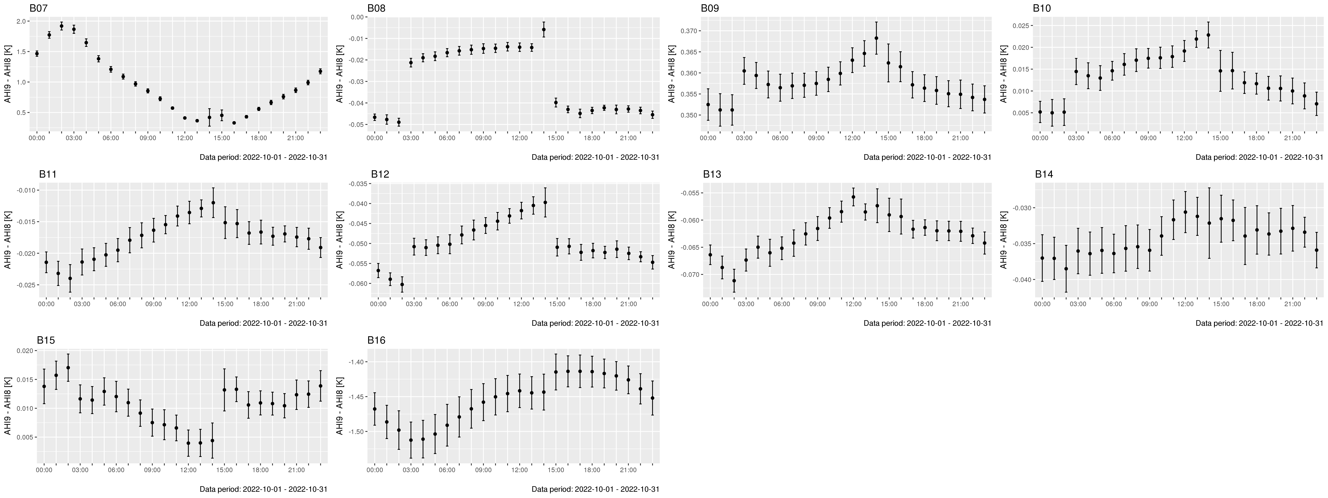
GEO-GEO (Diurnal variation)
Tb difference: AHI9 - AHI8 [K]: 00 to 23 UTC
B07 (3.9)
B08 (6.2)
B09 (6.9)
B10 (7.3)
2.0
0.37
-0.01
0.02
0.01
0.5
-0.05
0.35
B11 (8.6)
B12 (9.6)
B13 (10.4)
B14 (11.2)
-0.01
-0.04
-0.06
-0.03
-0.02
-0.06
-0.07
-0.04
B15 (12.4)
B16 (13.3)
0.02
-1.40
Amplitude of the diurnal variation wrt. AHI8 is around order of 10⁻² K except for B07 and B16.
AHI8 and AHI9 change a position of space-look for calibration reference before 03UTC and 15UTC.
-1.50
0.00

Slide 11
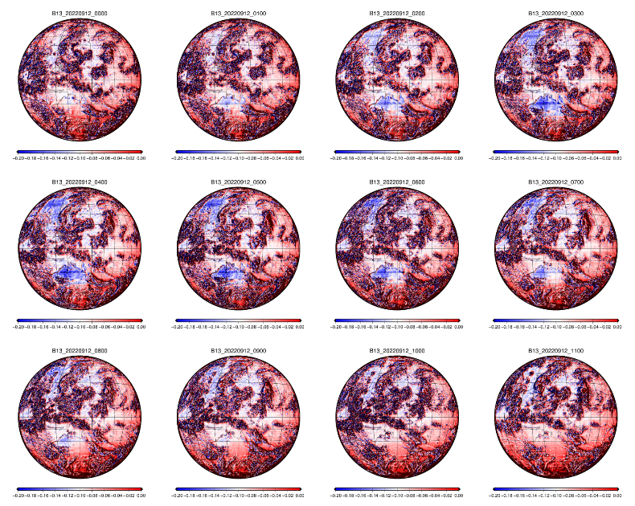
GEO-GEO (Diurnal variation)
00 UTC
01 UTC
02 UTC
03 UTC
B13 (10.4um)
AHI9 – AHI8 [K]
2022-09-12, 00 to 11 UTC
Local noon is around 03 UTC
SRF difference is not corrected.
Both satellites are located at “140.7 degrees East”.
-0.2
0.0
04 UTC
05 UTC
06 UTC
07 UTC
08 UTC
09 UTC
10 UTC
11 UTC

Slide 12
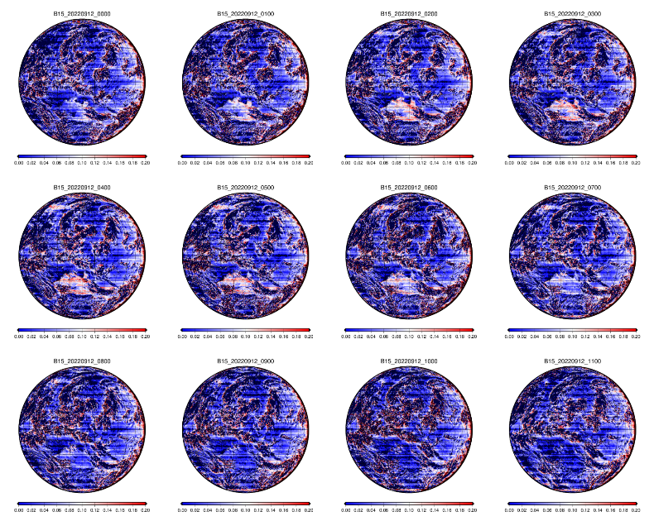
GEO-GEO (Diurnal variation)
00 UTC
01 UTC
02 UTC
03 UTC
B15 (12.4um)
AHI9 – AHI8 [K]
2022-09-12, 00 to 11 UTC
Local noon is around 03 UTC
SRF difference is not corrected.
Both satellites are located at “140.7 degrees East”.
0.0
+0.2
04 UTC
05 UTC
06 UTC
07 UTC
08 UTC
09 UTC
10 UTC
11 UTC

Slide 13
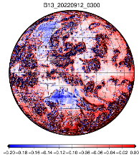
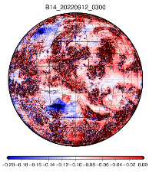
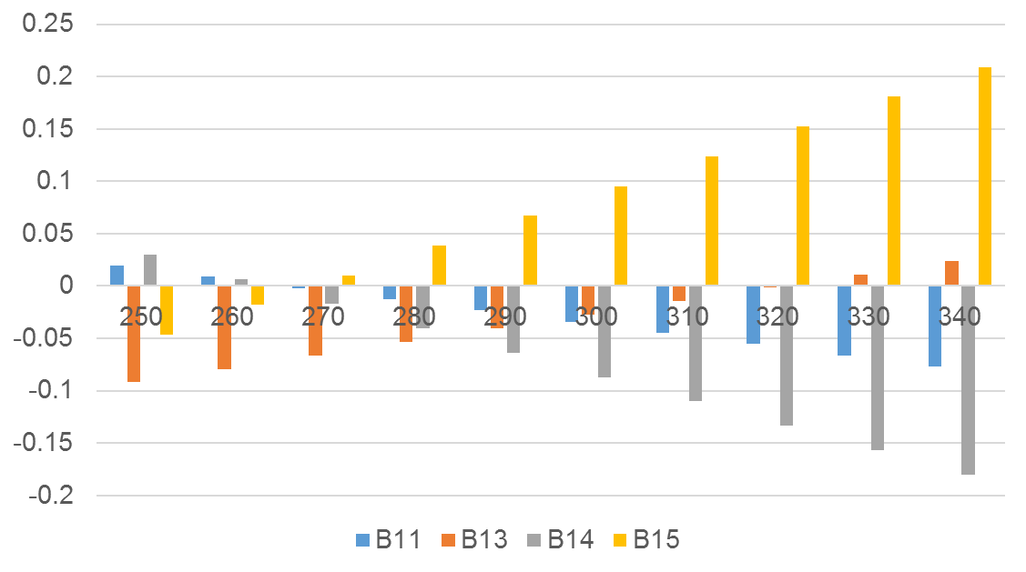
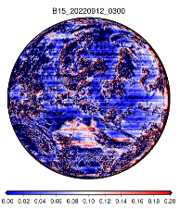
GEO-GEO (Diurnal variation)
B13
Larger Tb bias (positive or negative) around 0.2K are seen over land area in daytime afternoon in “window” bands (B13, 14, 15, and slightly B11).
According to GEO-GEO liner regression coefficients (AHI-9 vs. AHI-8), the Tb difference corresponding to observed Tb is estimated as the bottom figure.
The estimation can roughly express the Tb change, but further quantitative check will be necessary.
B14
Estimated Tb diff. (AHI9-AHI8) [K]
B15
Observed Tb [K]

Slide 14
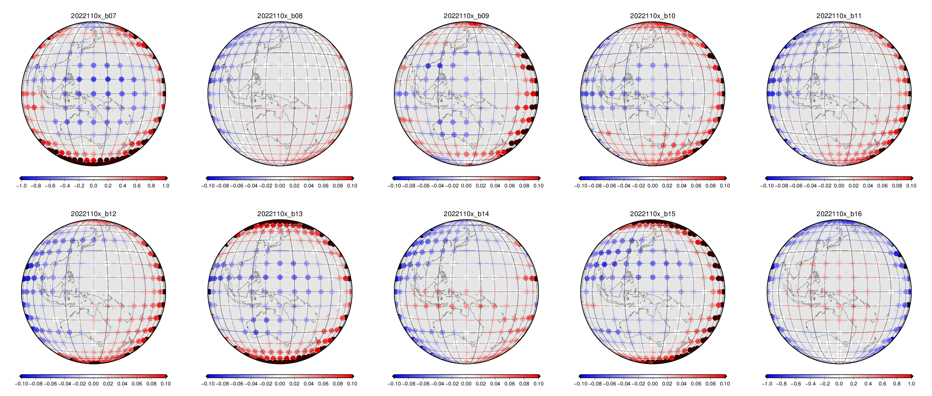
GEO-GEO (for scan position)
Faint systematic difference can be seen in East-West direction for B08, B11, B12 and in center-to-limb direction for B16.
Grid ave. Tb difference residual: AHI9 - AHI8 [K]
2022/11/01-10
10 days average
B07
B08
B09
B10
B11
-1 K
+1 K
-0.1 K
+0.1 K
-0.1 K
+0.1 K
-0.1 K
+0.1 K
-0.1 K
+0.1 K
B12
B13
B14
B15
B16
AHI9 - Hyper-sounder Tb
-0.1 K
+0.1 K
-0.1 K
+0.1 K
-0.1 K
+0.1 K
-0.1 K
+0.1 K
-1 K
+1 K
Hyper-sounder Tb

Slide 15
summary
Himawari-9 started full operational observation on 13 December 2022 at 140.7 deg. East. AHI9 specification is the same as that of AHI8.
Himawari-8 has been a back up satellite since 13 December 2022.
The Tb biases for both of AHI8 and AHI9 are within 0.3K at the standard radiance.
The Tb bias trend and diurnal variation for AHI9 are stable in similar order to the one of AHI8, and no significant scan position dependency.
GEO-GEO comparison with AHI8 shows diurnal variation, trend, and scan position dependency. B07 and B16 show relatively larger variation. Potential cause is the difference of SRFs.
Again, the “GEO-GEO” differences don't mean absolute bias but just a relative comparison between AHI9 and AHI8.

Slide 16
References
The Level-1 products comparison between H8 and 9
  https://www.data.jma.go.jp/mscweb/en/oper/healthcheck/[L1]Validation_H9_processing_forMSCWEB.pdf
Calibration portal
  https://www.data.jma.go.jp/mscweb/en/oper/calibration/calibration_portal.html
Event log
  https://www.data.jma.go.jp/mscweb/en/oper/event_H9.html

Slide 17
Back up…

Slide 18
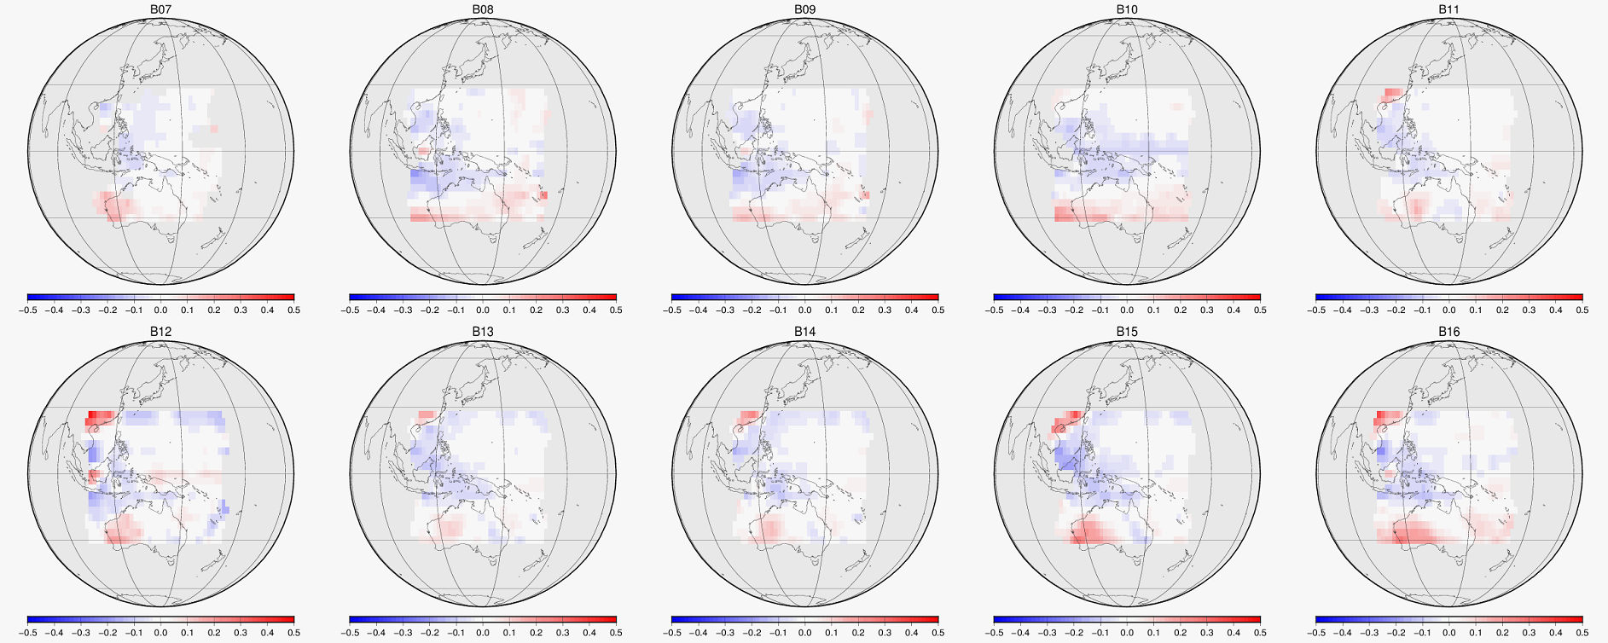
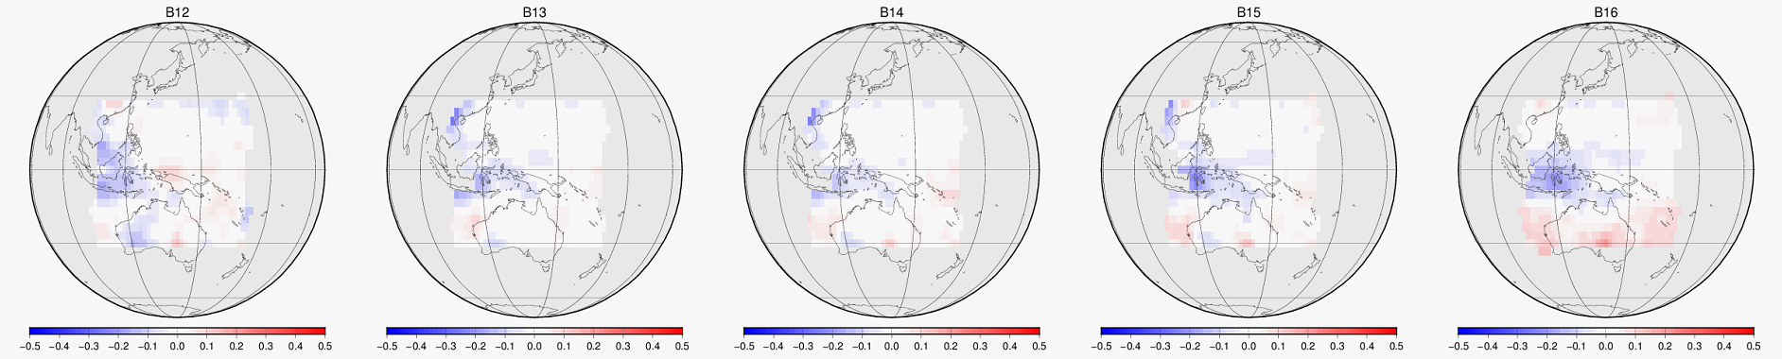
Tb bias (for scan position by GSICS approach)
Grid ave. Tb difference residual: GEO minus LEO [K]
vs.
Metop-B/IASI
Scan position dependent bias is not significant.
B07
B08
B09
B10
B11
AHI-8
-0.5 K
+0.5 K
2022/10 to 12
3 month average
AHI-9 vs. LEO
Only scenes with Tbs > Std.radiances are averaged.
B12
B13
B14
B15
B16
vs.
SNPP/CrIS
AHI9 - Hyper-sounder Tb
B12
B13
B14
B15
B16
Hyper-sounder Tb

Slide 19
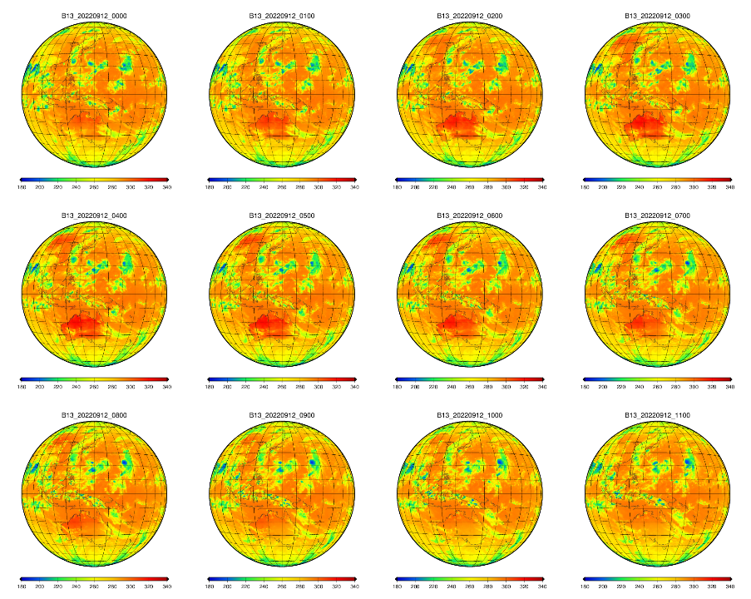
B13 (10.4um)
AHI9 [K]
(not a difference)
2022-09-12
00 to 11 UTC
Local noon is around 03 UTC
Tb over Australia varies from around 290 to 320K.

Slide 20
Linear regression (sorry, night time only)
Data period:
1st - 7th October 2022
Conditions:
10 – 13 UTC (Nighttime)
Sun zenith angle: larger than 110 deg.
Data from outside the Earth disk not included
Stable linear relationship since the start of AHI-9 observation in 2022
Brightness temperature [K]
AHI9
B07
B08
B09
B10
B11
AHI8
B12
B13
B14
B15
B16
https://www.data.jma.go.jp/mscweb/en/oper/healthcheck/[L1]Validation_H9_processing_forMSCWEB.pdf

Slide 21
Linear regression (sorry, night time only)
Linear regression coefficients
 | Slope | Offset
B01 | 1.04750 | -0.19260
B02 | 1.00594 | -0.03052
B03 | 0.97746 | -0.02018
B04 | 0.99698 | -0.00105
B05 | 0.94478 | -0.01444
B06 | 0.98394 | 0.00502
 | Slope | Offset | H9-H8 [K] @StdTb.* | H9-H8 [K] @220K | H9-H8 [K] @250K | H9-H8 [K] @290K
B07 | 0.99118 | 2.70964 | 0.19 @285.95K | 0.77 | 0.51 | 0.15
B08 | 0.99759 | 0.55558 | -0.01 @234.65K | 0.03 | -0.05 | -0.14
B09 | 1.00486 | -0.80853 | 0.38 @243.85K | 0.26 | 0.41 | 0.60
B10 | 0.99805 | 0.51075 | 0.02 @254.59K | 0.08 | 0.02 | -0.05
B11 | 0.99893 | 0.28697 | -0.02 @283.82K | 0.05 | 0.02 | -0.02
B12 | 0.99738 | 0.63064 | -0.05 @259.45K | 0.06 | -0.02 | -0.13
B13 | 1.00129 | -0.41459 | -0.05 @286.18K | -0.13 | -0.09 | -0.04
B14 | 0.99766 | 0.6151 | -0.05 @286.10K | 0.10 | 0.03 | -0.06
B15 | 1.00284 | -0.75661 | 0.05 @283.78K | -0.13 | -0.05 | 0.07
B16 | 0.97016 | 6.29606 | -1.75 @269.73K | -0.27 | -1.17 | -2.36
Std.Tb: Brightness temperature corresponding to clear-sky sea surface (band-dependent)
Data period: 1st – 7th October 2022, 00-06UTC (for B01-B06), 10-13UTC (forB07-B16)
https://www.data.jma.go.jp/mscweb/en/oper/healthcheck/[L1]Validation_H9_processing_forMSCWEB.pdf

