Slide 1
Improving GEO-GEO Inter-calibration with Parallax Correction
Likun Wang
ESSIC/University of Maryland. College Park MD; wlikun@umd.edu
2023 GSICS Annual Meeting on March 1 2023, College Park, MD, USA

Slide 2
Background
GEO-GEO intercomparison is another expanded area in the GSICS IR group.
A dedicated GSICS Web Meeting on GEO-GEO inter-comparison algorithm has been held on Oct 17 2019.
A session on GEO-GEO inter-calibration is organized in the annual meeting.
INSAT-3D vs MSG-SEVIRI; GOES16 vs GOES17 (-18); Himawari-8/9;
A key challenge for GEO-GEO inter-calibration is parallax effects.
To use them, accurate collocation to account for it.
To avoid them, flag them to reduce the uncertainties.

Slide 3
GEO-GEO Satellite Pairs ABI-like Instruments
GK-2A
Himawari-8
GOES17
GOES16

Slide 4
GOES16 vs GOES17
GOES17
GOES16
Same Location:
Same Time: Time Difference less than 3 minutes
Close Local zenith angles: ABS |cos(zenith_G16)/cos(zenith_G17)| < 0.05, but from different azimuth angles

Slide 5
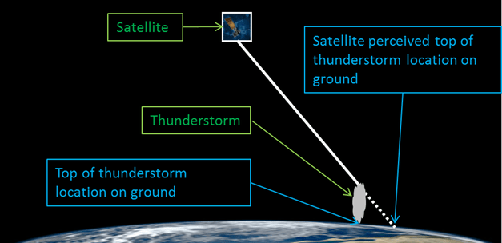
Parallax Effects
Parallax Displacement
https://satelliteliaisonblog.com/2017/04/19/why-is-my-goes-16-imagery-displaced-parallax/
For Example:
Zenith Angle: 60°, 10km cloud gives 17 km displacement

Slide 6
Shifted Pixels Due to Parallax Effects
Most GOES16 and GOES17 GEO and GEO Coverage

Slide 7
Parallax Effects will be Doubled for GEO-GEO Inter-Calibration
Both satellites view the targets off nadir
One will see the same target displacement when play two images due to perspective change
The displacement is determined by the view zenith angle (known) and target altitude (unknow?)
Wrong collocation if only use latitude and longitude collocation, especially at cloud edge: one see cloud target and another see surface target
Merucci, L.; Zakšek, K.; Carboni, E.; Corradini, S. Stereoscopic Estimation of Volcanic Ash Cloud-Top Height from Two Geostationary Satellites. Remote Sens. 2016, 8, 206.

Slide 8
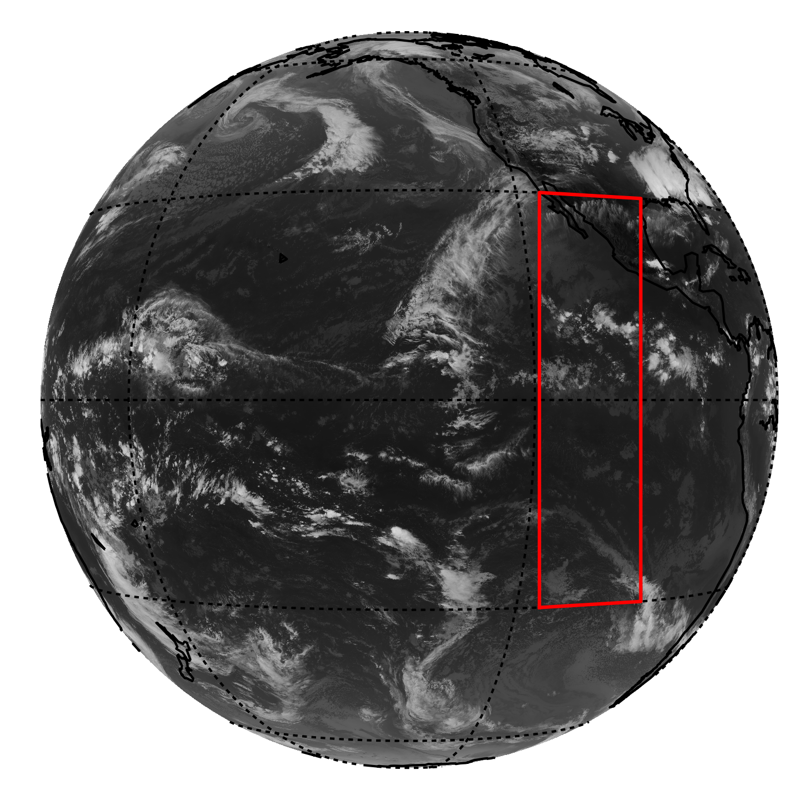
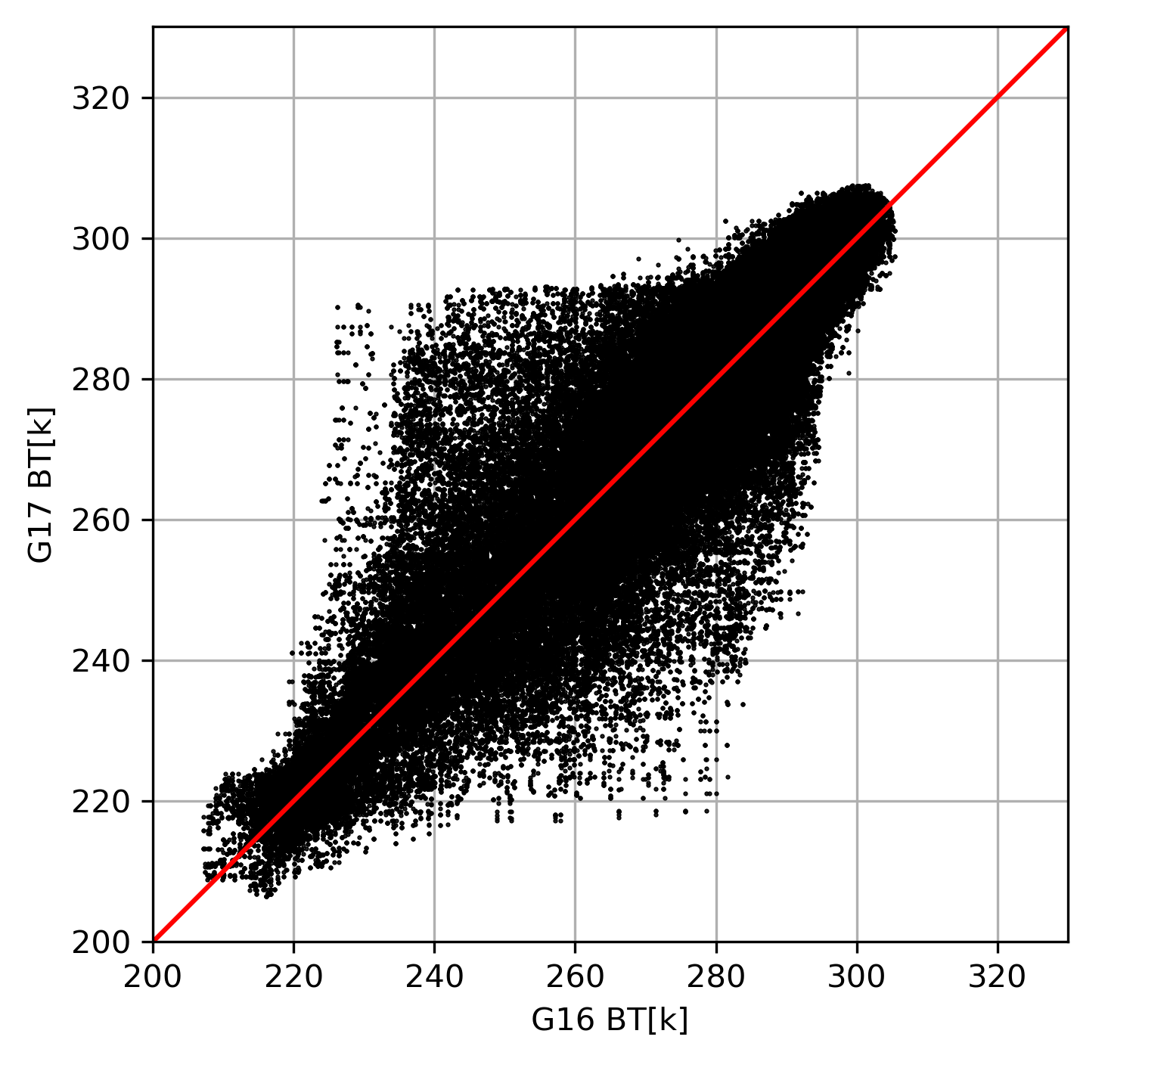
Parallax Effect
GOES17
GOES16
GOES16
GOES17
< 2 mins
channel 13, 10.3µm
Wrong collocation at deep convective
cloud edge, low BTs compared with high
BTs
Large standard deviation due the
small displacement of low clouds
Applying filter will remove most of
cold scenes.
|cos(zenith_G16)/cos(zenith_G17)| < 0.05

Slide 9
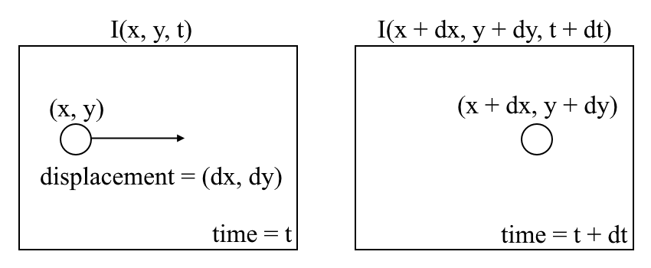
Can we calculate pixel displacement from two images?
Optical flow is the pattern of apparent motion of image objects between two consecutive frames caused by the movement of object or perspective.
It is 2D vector field where each vector is a displacement vector showing the movement of points from first frame to second.
Dense optical flow was computed for every points in the frame using Gunner Farneback's algorithm from OpenCV libraray.
The optical flow vector of a moving object in a video sequence.
https://en.wikipedia.org/wiki/Optical_flow
https://nanonets.com/blog/optical-flow/

Slide 10
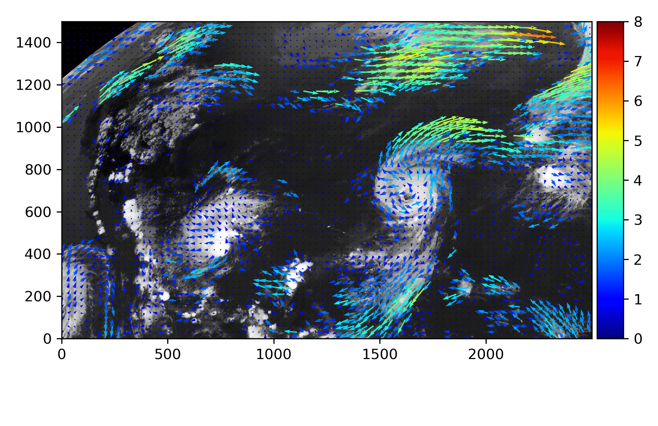
Optical Flow due to Target Moving
Optical flow is caused by the target moving from the same perspective.

Slide 11
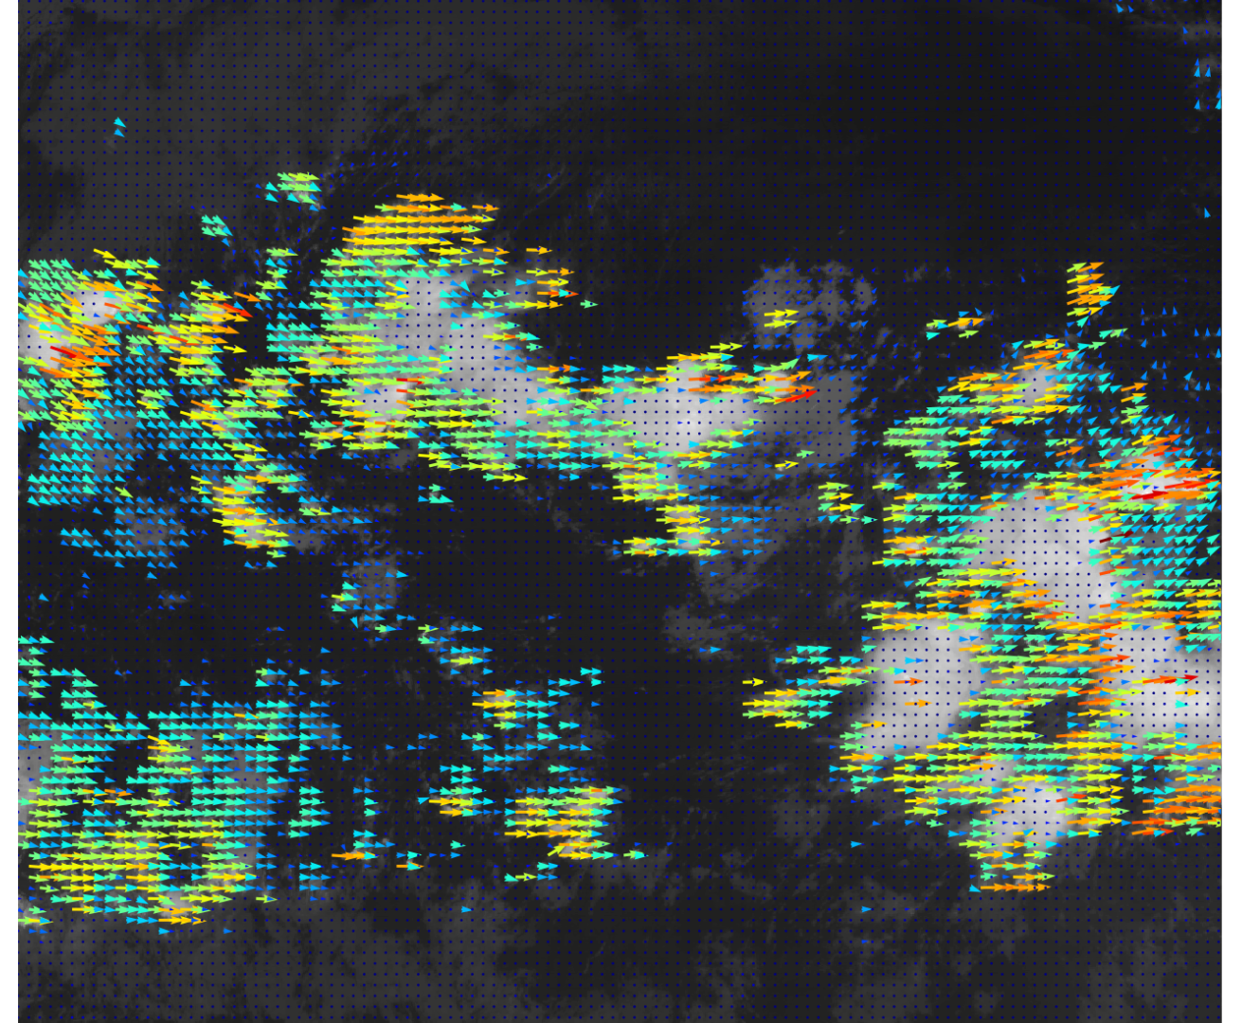
Optical Flow Due to Different Perspective
GOES16
GOES17
Optical flow is caused by the different perspective, apparent target moving.

Slide 12
BT Scatter BT Plot With vs Without Parallax Corraction
Without Parallax Correction
With Parallax Correction
Mean: -0.109 K
Stdev: 3.581 K
Mean: -0.092 K
Stdev: 2.073 K

Slide 13
Flowchart for GEO-GEO collocation
Select overlapped regions
Project Images into the same projection, e.g. GOES17 onto GOES16 projection
Pixel collocation using pixel displacement from computed optical flow field
Using zenith angle to fill out the data
Calculated optical flow
Saved paired pixels
Project back to original projection to find original pixels

Slide 14
Conclusion Remarks
A key challenge for GEO-GEO inter-calibration is to resolve Parallax effects. It results in pixel shifts during the pixel collocation.
The pixel shift is determined by the target altitude (unknow) and view zenith angle (known).
The optical flow computed from GOES image under the same projection perspective can estimate the pixel shift number and direction.
These can be used to improve collocation accuracy (if use them) or quality control (if not use them).

