Slide 1
CMA GDWG ANNUAL REPORT 2022
Tian Lin
CMA GDWG

Slide 2
Presentation Overview
CMA GPRC Website Operation
Update of the Landing Pages for WMO-OSCAR
New satellite data sharing scheme
Supporting RICH-CEOS Program

Slide 3
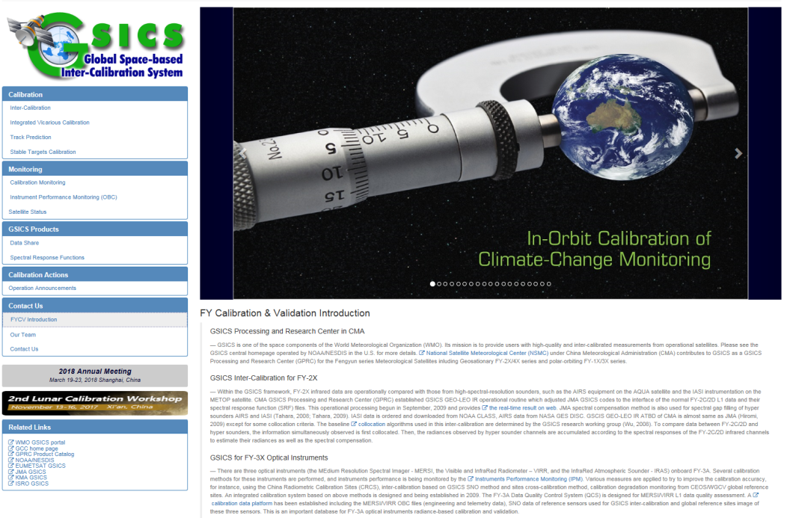
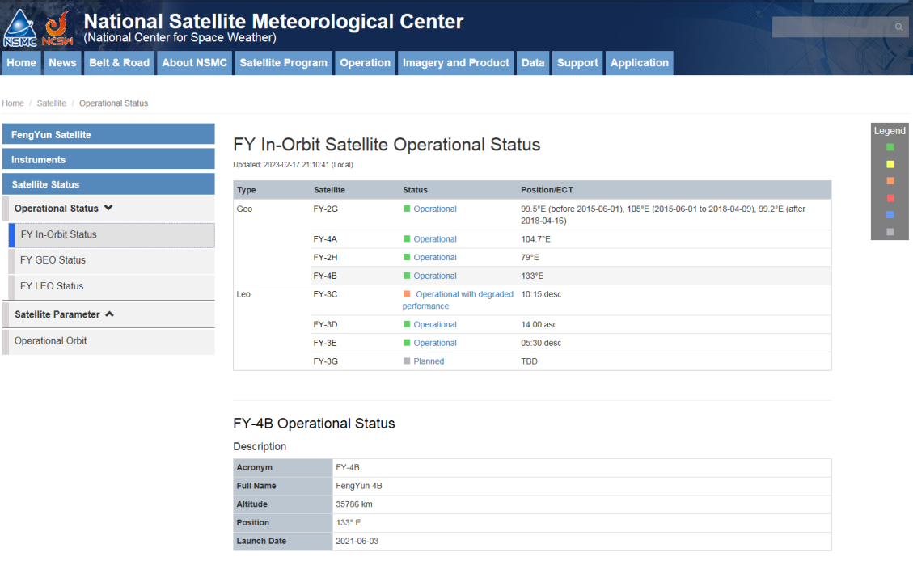
CMA GDWG TASK: CMA GPRC Website Operation
Keep CMA GPRC Website Content updating:
GPRC Information
CMA GSICS product sharing (Thredds)
FengYun Satellites Instrument Operation Status (Landing Pages）
CMA GDWG: Website construction and maintain
3
Notes:
GSICS Processing and Research Centres (GPRC)
Content: GPRC Information, CMA GSICS product sharing, Instrument Operation Status
CMA GRWG: Content provider
CMA GDWG: Website construction and maintain

Slide 4
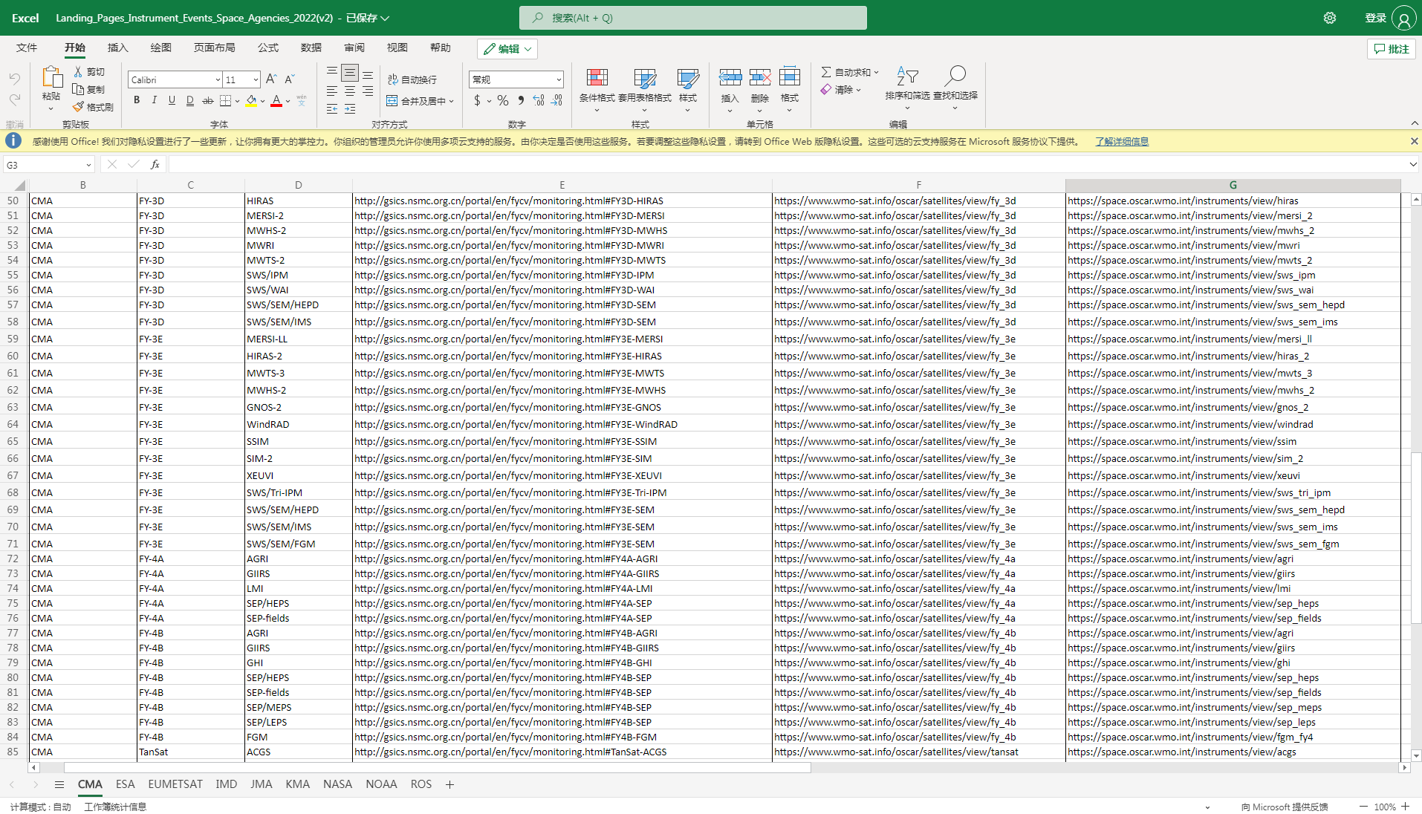
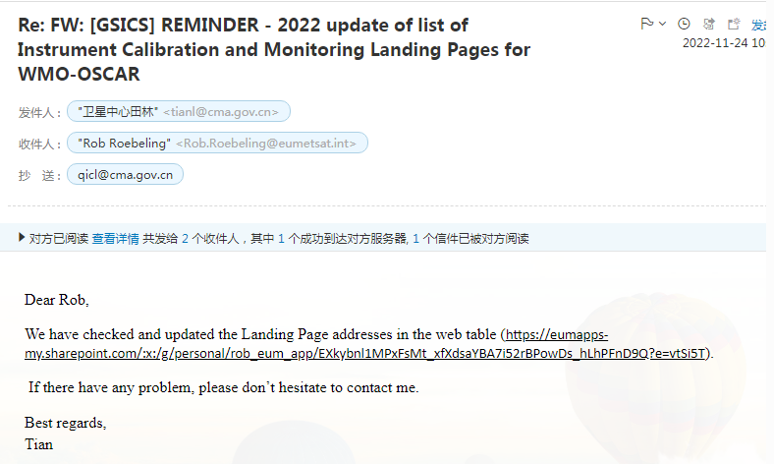
CMA GDWG TASK: Update of the Landing Pages for WMO-OSCAR
Updating the list of new Instrument Calibration and Monitoring Landing Page addresses:
FY-3E: MERSI-LL, HIRAS-2, MWTS-3, MWHS, GNOS-2, WindRAD, SSIM, SIM-2, XEUVI, SWS/Tri-IPM, SWS/SEM/HEPD, SWS/SEM/IMS, SWS/SEM/FGM;
FY-4B: AGRI, GIIRS, GHI, SEP/HEPS, SEP-fields, SEP/MEPS, SEP/LEPS, FGM;
Tan-Sat: ACGS, CAPI;
4
Notes:
GSICS Processing and Research Centres (GPRC)
Content: GPRC Information, CMA GSICS product sharing, Instrument Operation Status
CMA GRWG: Content provider
CMA GDWG: Website construction and maintain

Slide 5
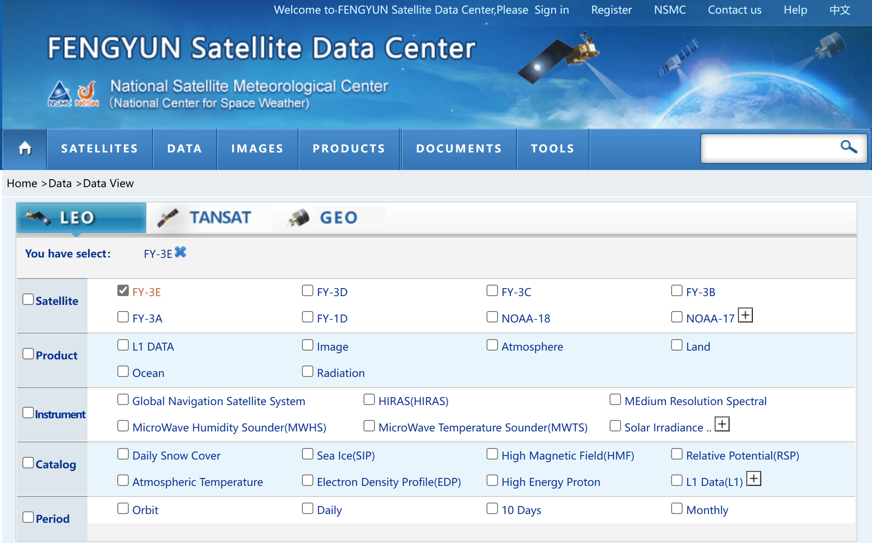
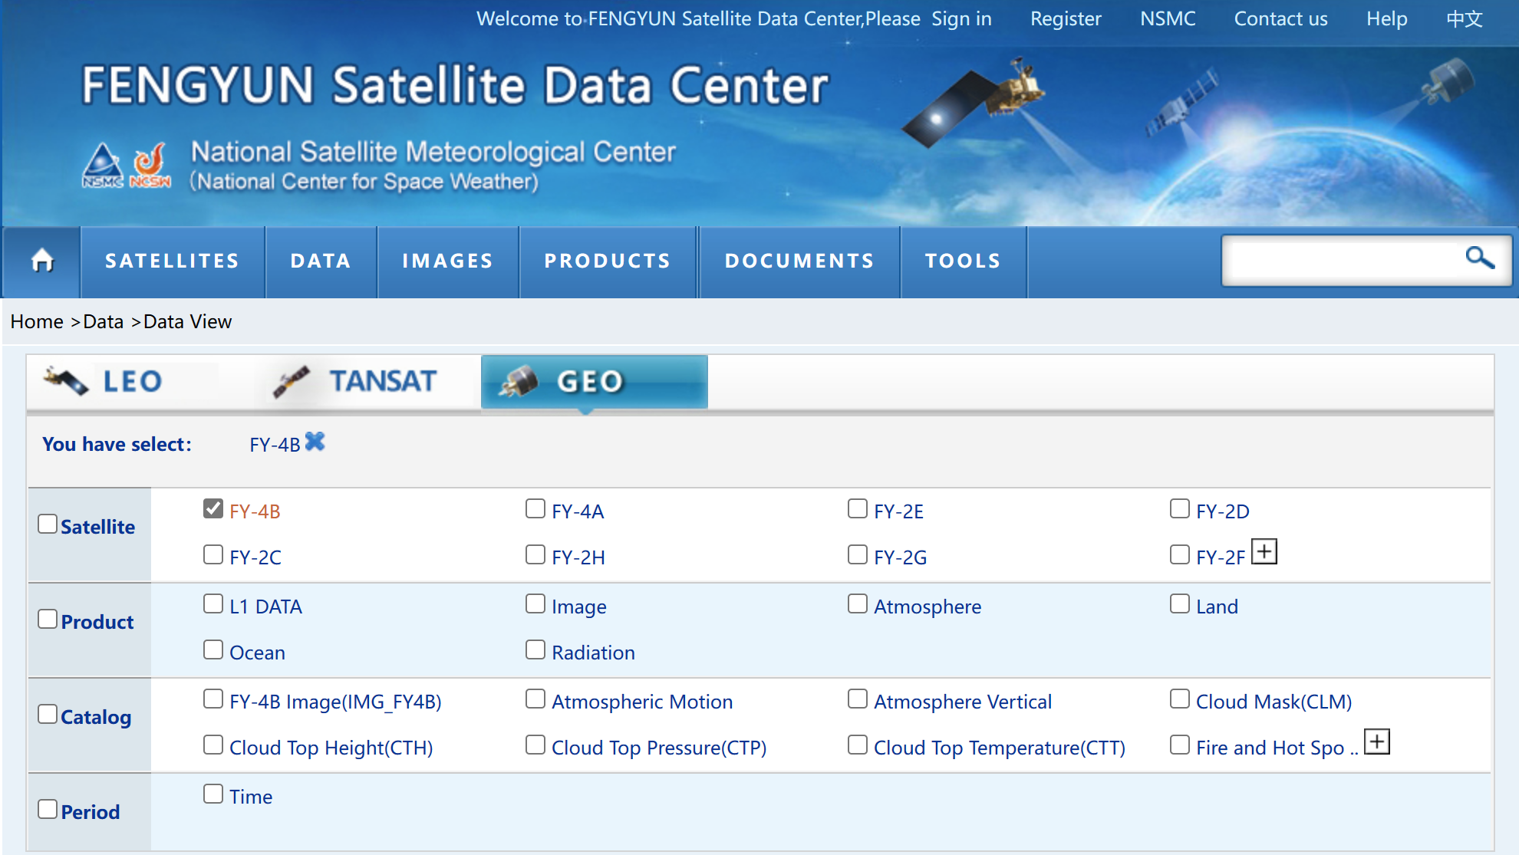
CMA GDWG TASK: New satellite data sharing scheme
WMO released the new data policy “WMO UNIFIED DATA POLICY”;
Following the “WMO UNIFIED DATA POLICY”, the FY-3E and FY-4B satellite data sharing scheme was drawn up;
International users were informed through the website of the National Satellite Meteorological Center, CMACast and e-mail.
5
Notes:
GSICS Processing and Research Centres (GPRC)
Content: GPRC Information, CMA GSICS product sharing, Instrument Operation Status
CMA GRWG: Content provider
CMA GDWG: Website construction and maintain

Slide 6
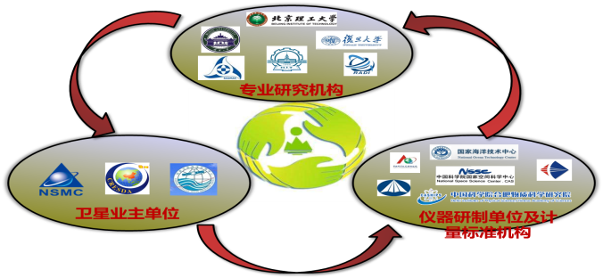
CMA GDWG TASK: Supporting RICH-CEOS Program
RetrospectIve Calibration of Historical Chinese Eerth Observation Satellite Data (RICH-CEOS)
18 Institutions Involved
National Key R&D Program of China Founded since 2018
RICH-FY ： Chinese Meteorological Satellites
RICH-ZY : Chinese Land Resources Satellites
RICH-HY : Chinese Marine Satellites
National Satellite Meteorological Centre (NSMC)
National Satellite Ocean Application Center (NSOAC)
China Center for Resources Satellite Date and Application (CRESDA)

Slide 7
CMA GDWG TASK: Supporting RICH-CEOS Program

Slide 8
Reprocessing Dataset: Overview
FY satellite reprocessing data set: 7 FCDR
Instrument | Temporal range | Temporal resolution | Spatial resolution | Data quality | DOI
VIRR | 20000120-20191230 | Daily | 3.3km(FY-1C/D); 1.1km(FY-3A/B/C) | Ref Difference <5% (FY/VIRR vs Aqua/MODIS)； TB Difference <5K (FY/VIRR vs MetOp/IASI)； | 10.12185/NSMC.RICHCEOS.FCDR.VIRRRecalOrb.FY1_FY3.VIRR.L1.GBAL.ORBIT.NUL.3300(FY1)_1100(FY3).HDF.2022.6.V1；10.12185/NSMC.RICHCEOS.FCDR.VIRRRSBsRecalCoef.FY.VIRR.L1.GBAL.POAD.NUL.TXT.2021.1.V1
MERSI | 20081112-20181231 | ORBIT | 1km | Error<8%; Std<2%; | 10.12185/NSMC.RICHCEOS.FCDR.MERSI-Recalibration.FY3.MERSI.L1.GBAL.ORBIT.NUL.1000M.HDF.2022.23.V1
IRAS | 20101111-20200203 | ORBIT | 17KM | Improving 3K(channel 1), 1K(channel 16), 2K(channel 18) | 10.12185/NSMC.RICHCEOS.FCDR.IRASRecalOrb.FY3.IRAS.L1.GBAL.POAD.NUL.17KM.HDF.2022.6.V1
VISSR | 20050101-20200812 | Daily | 无 | Ref Difference <8% ; TB Difference <1K ; | 10.12185/NSMC.RICHCEOS.FCDR.VISSRRecalTab.FY2C/D/E/G.VISSR.L1.GBAL.POAD.NUL.00000.HDF.2022.9.V1
MWTS | 20081129-20200509 | ORBIT | 60km (FY-3A & FY-3B); 33km (FY-3C & FY-3D) | RMSE<1k | 10.12185/NSMC.RCHCEOS.FCDR.MWTSRecalOrb.FY3.MWTS.L1.GBAL.ORBIT.NUL.33KM.HDF.2021.4.V2
MWHS | 20080630-20181230 | ORBIT | 015KM | RMSE<1K | 10.12185/NSMC.RICHCEOS.FCDR.MWHSRecalOrb.FY3.MWHS.L1.GBAL.POAD.NUL.015KM.HDF.2022.8.V1
MWRI | 20101110-20201230 | ORBIT | 010KM | RMSE<1.5K | 10.12185/NSMC.RICHCEOS.FCDR.MWRIRecalOrb.FY3.MWRI.L1.GBAL.POAD.NUL.010KM.HDF.2021.2.V1
Data accesse
http://www.richceos.cn

Slide 9
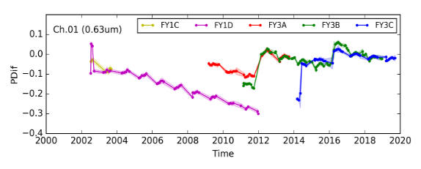
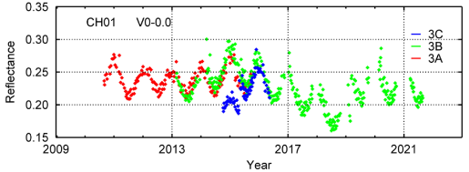
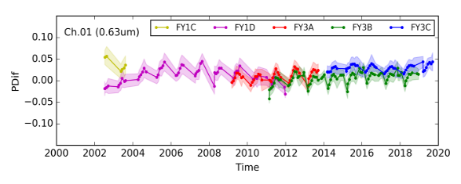
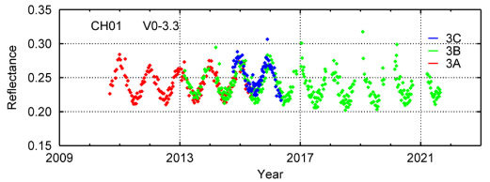
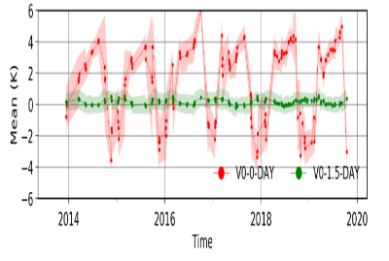
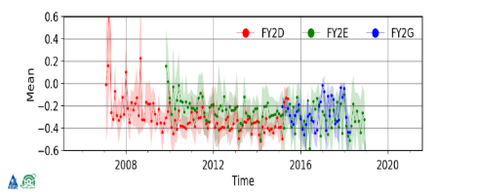
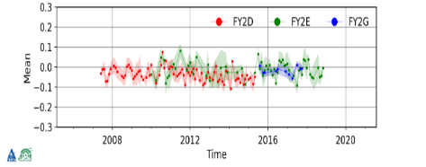
Reprocessing Dataset: Validation - Infrared and visible instruments
VIRR
MERSI
Before reprocessing
Before reprocessing
reprocessed
reprocessed
VISSR
IRAS
Before reprocessing
reprocessed

Slide 10
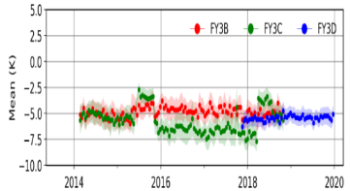
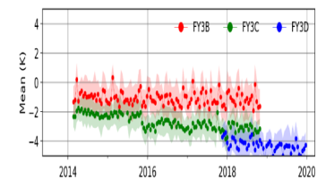
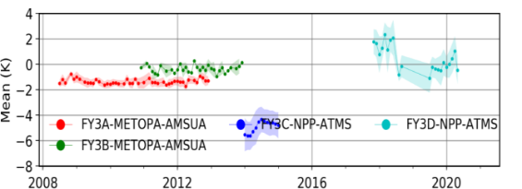
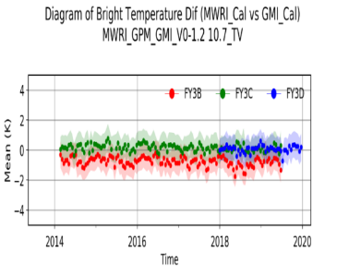
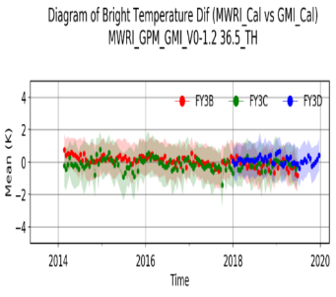
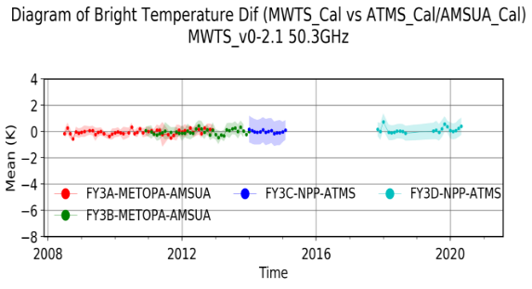
Reprocessing Dataset: Validation – Microwave instruments
MWRI
MWHS
MWTS
Before reprocessing
Before reprocessing
10.7GHz V
Before reprocessing
reprocessed
reprocessed
reprocessed
36.5GHz H
183.31±1GHz
50.3GHz

Slide 11
Reprocessing Products: Overview
FY satellite reprocessing products: 4TCDR
Products | Instrument | Temporal range | Temporal resolution | Spatial resolution | DOI
OLR | VIRR | 20081111-20191230 | Daily | 5000M | 10.12185/NSMC.RICHCEOS.TCDR.FY3VIRRReproDailyOLR.FY3.VIRR.L2.GBAL.POAD.GLL.5000M.HDF.2021.3.V2
SST | VIRR | FY-1:20001118-20120103 FY-3:20090107-20191231 | Daily | 5000M | 10.12185/NSMC.RICHCEOS.TCDR.SST.FY1-FY3.VIRR.L2.GBAL.POAD.NUL.5000M.HDF.2022.26.V1
LST | VIRR | 20090107-20191231 | Daily | 5000M | 10.12185/NSMC.RICHCEOS.TCDR.LST.FY3.VIRR.L2.GBAL.POAD.NUL.5000M.HDF.2022.25.V1
NDVI | VIRR | 19880907-20201231 | Monthly | 5000M | 10.12185/NSMC.RICHCEOS.TCDR.NVI.FY1-FY3.VIRR.L3.GBAL.POAM.NUL.5000M.HDF.2022.24.V1

Slide 12
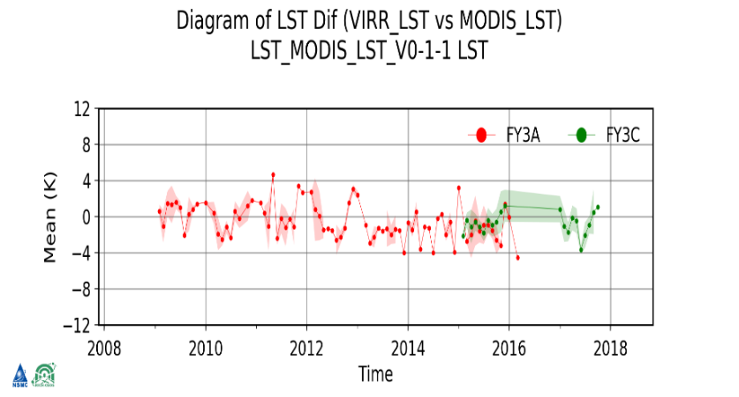
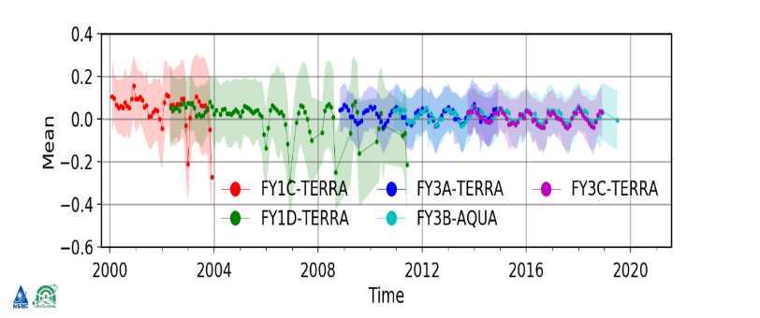
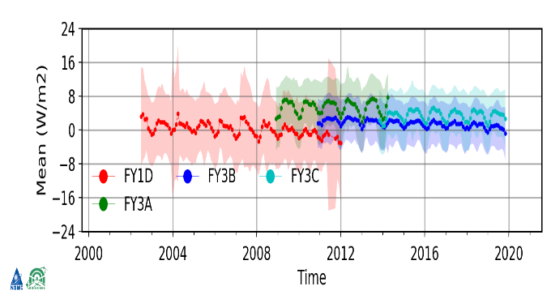
Reprocessing Products:Validation
Before reprocessing： bias -0.16 RMS 0.73
Reprocessed ：bias 0.06 RMS 0.57
FY-3 SST
FY-3 LST
NDVI
OLR

Slide 13
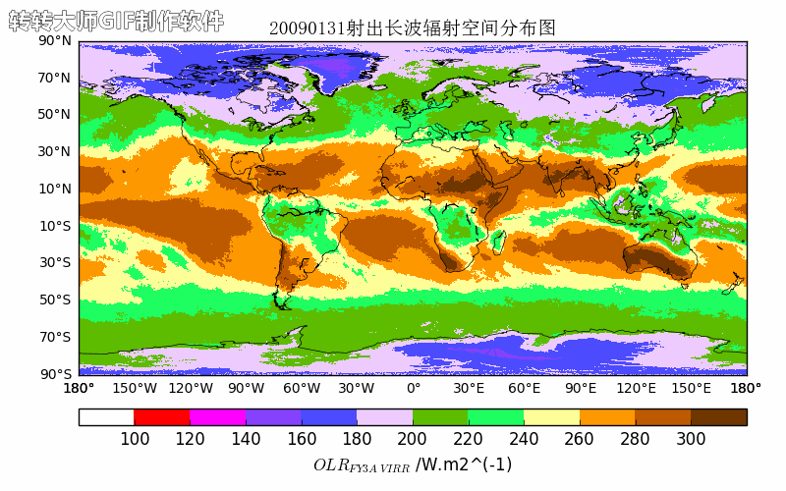
Reprocessing Dataset: Products animation
LST
NDVI
SST
OLR

Slide 14
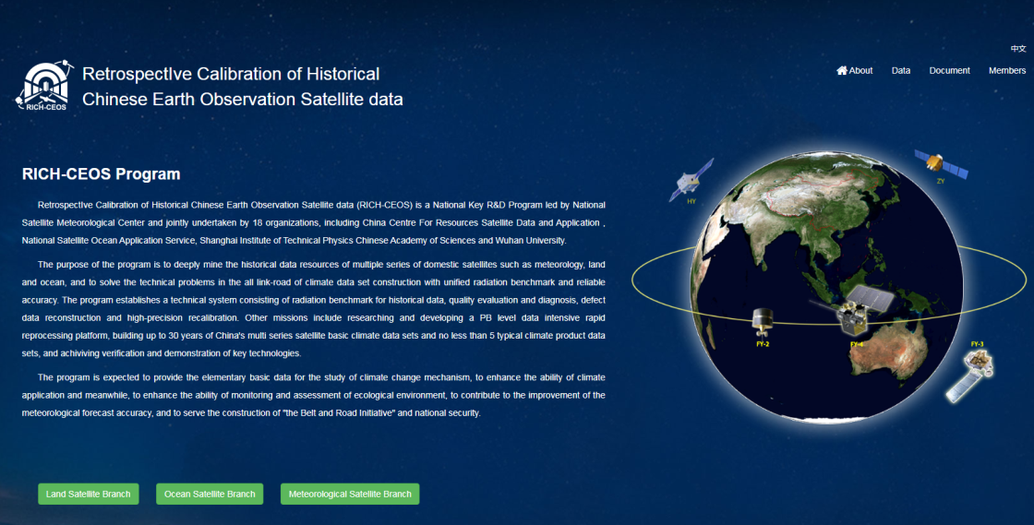
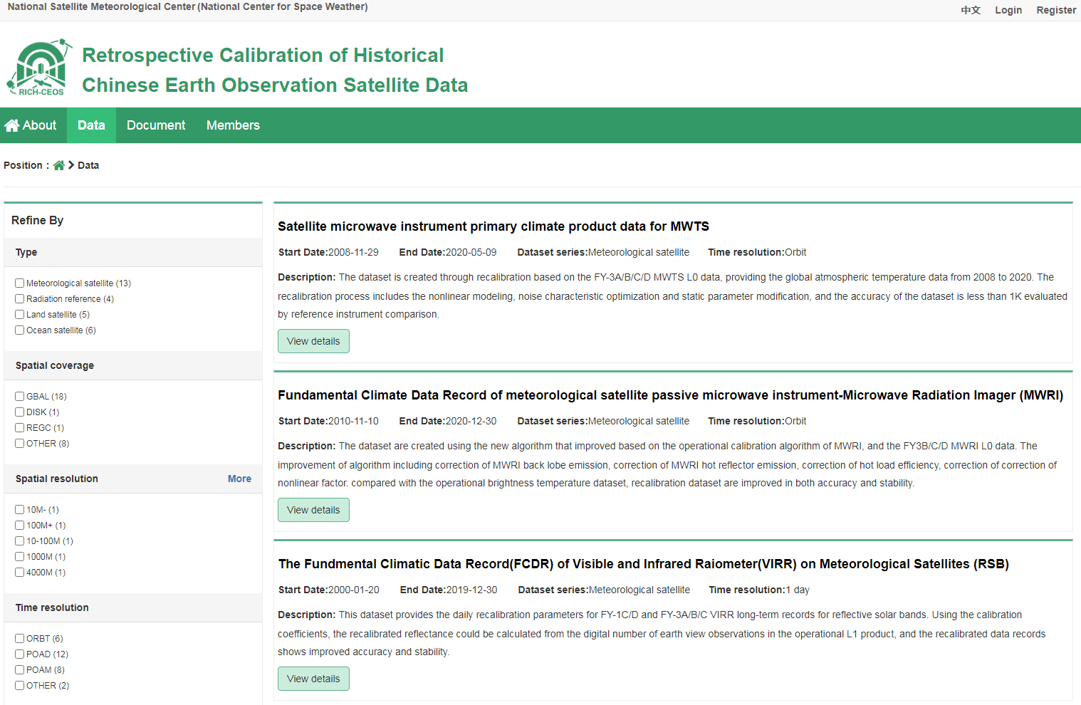
Reprocessing:Dataset Accessing
RICH-CEOS Program Website:
Satellite data search
Data Online visualization
DOI for Dataset
Data Access: http://www.richceos.cn

Slide 15
Thank you for your attention
WMO GSICS Portal
http://gsics.wmo.int
GSICS Coordination Centre http://www.star.nesdis.noaa.gov/smcd/GCC/index.php
GSICS Product Catalog https://www.star.nesdis.noaa.gov/smcd/GCC/ProductCatalog.php
GSICS Wiki
http://gsics.atmos.umd.edu/wiki/Home

