Slide 1
Update on Instrument Specifications and Calibration Information
Presenter Name
Rob Roebeling
GSICS DATA WORKING GROUP, March 1st 2023

Slide 2
Agenda
CGMS landing page action
Short description for first agenda point.
Status
Short description for second agenda point.
Proposed updates
Short description for third agenda point.

Slide 3
CGMS Landing Page action

Slide 4
Proposed Actions to GSICS From CGMS White Paper: CGMS-45-EUM-WP-33
The CGMS White Paper recommends to CGMS Satellite Operators:
To create and maintain, for their instruments, a set of stable Satellites/Instruments Landing Pages
To follow CGMS’s recommended common concept for Satellites/Instruments Landing Pages
To encouraged the use of common standards (metadata) for reporting on instrument events, to ensure traceability, uniformity, and interoperability across CGMS Satellite Operators.
To establish CGMS Task Team on Calibration Events Logging (CGMS Task Team), through GSICS, that:
coordinates the implementation and annual updates of landing pages
discusses steps towards achieving common nomenclature
The CGMS White Paper recommends to WMO:
To implement and maintain the links to the Satellites/Instruments Landing Pages on the WMO-OSCAR web-portal (-> Space capabilities -> Satellites)
To discuss further improvements and modifications to WMO-OSCAR with the CGMS Task Team
For details on CGMS recommended format for Instrument Landing see CGMS-45 working paper CGMS-45-EUMETSAT-WP-33 (assessed on 1 March 2023)

Slide 5
Concept of Standardised Landing Pages From CGMS White Paper: CGMS-45-EUM-WP-33
Landing Page Categories
Instrument Specifications
Instrument Events
Instrument Monitoring
Data
Outages
Relevant
Documents
Instrument Specifications
General information on the platform, instruments, and sensors operated in the mission that is relevant to all users of the satellite data (see OSCAR website).
Instrument Events
Database (and graphical interface) of events at satellite and processing level that are not occurring systematically and that impact the radiometric or geometric quality of the observations due to instruments calibrations, manoeuvres or miscellaneous.
Instrument Monitoring
Database (and graphical interface) of quasi continues information on the present state of the instruments and sensors operated on the platform.
Data Outages
Events that triggered the temporary or definitive end of the data collection.
Relevant Documents
Other documents relevant for calibration and event logging that the satellite operator wants to share.

Slide 6
Status landing pages (March 2023)
EUMETSAT (Rob Roebeling) coordinates Landing Page updates of CGMS operators
CGMS Task Team members are encouraged to follow the CGMS standard concept for their Landing Pages
CGMS Task Team members are encouraged to check/update their landing page links each year
The latest updates were made in 2022. The current status is summarized below.
GPRC | Representative | email | Landing Page | Last update | Status
WMO | Mr. Pohjola, Heikki (WMO) | hpohjola@wmo.int | N/A | N/A | N/A
WMO | Dr. Saunders, Roger | sat.metman@gmail.com | N/A | N/A | N/A
CMA | ?? Tain, Lin | tianl@cma.gov.cn | CGMS concept implemented | ! 2021: needs check/update | needs check
EUMETSAT | Dr. Roebeling, Rob | Rob.Roebeling@eumetsat.int | CGMS concept implemented | 2022: up-to-date | up-to-date
ESA | Dr. Goryl, Philippe | Philippe.Goryl@esa.int | CGMS concept implemented | ! 2021: needs check/update | needs check
IMD | Dr. Mitra, A.K. | ashimmitra@gmail.com | ! CGMS concept not implemented | ! Landing page not provided | needs creation
JAXA | ?? Murakami, Hiroshi ?? Kachi, Misako | murakami.hiroshi.eo@jaxa.jp kachi.misako@jaxa.jp | Not contacted yet | ! Needs to be contacted!
JMA | Mr. Okuyama, Arata | okuyama.arata@met.kishou.go.jp | CGMS concept implemented | 2022: up-to-date | up-to-date
KMA | Ms. Woo, Jin | superjwoo@korea.kr | CGMS concept implemented | ! 2017: needs update (links are not working) | needs update
NASA | Ms. Wicks, Jamie W Ms. McCarthy, Lacey G. | jamie.wilson.wicks@nasa.gov lacey.g.mccarthy@nasa.gov | ! CGMS concept not implemented | 2022: spreadsheet filled ! Landing page not provided | needs creation
NOAA | Mr. Bali, Manik | manik.bali@noaa.gov | ! CGMS concept not implemented | ! 2021: needs check/update | needs check
ROS | Dr. Rublev, Alex Ms. Kiseleva, Julia (del.) | alex.rublev@mail.ru julia.v.kiseleva@mail.ru | CGMS concept implemented | ! 2018: needs check/update | needs update

Slide 7
WMO OSCAR webpage

Slide 8
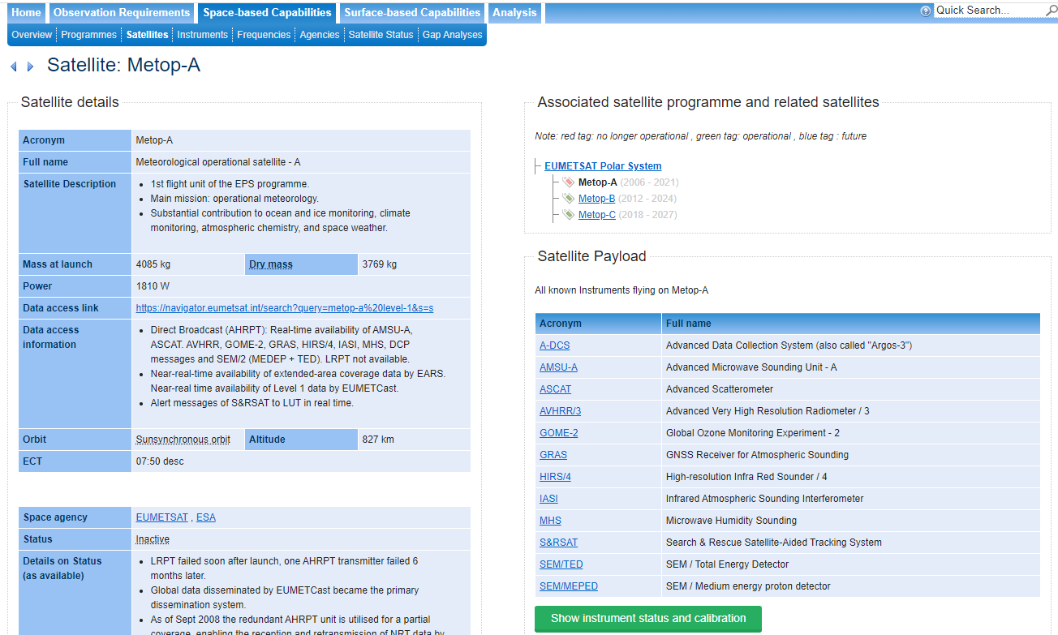
WMO-OSCAR Current link - one Instrument Landing Pages per Satellite

Slide 9
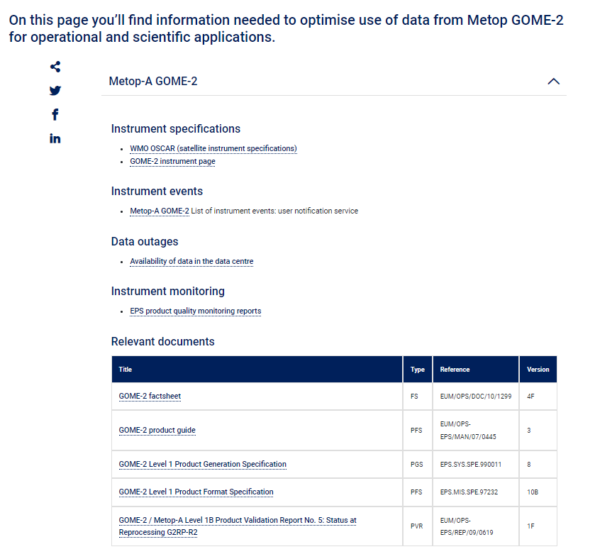
Example (one Instrument Landing Page for one satellite) GOME-2 Landing Pages for Metop-A (https://www.eumetsat.int/gome-2-instrument-status-calibration)
Summary current linking @WMO-OSCAR
Landing Page link appears on WMO-OSCAR -> “Space-based Capacities” -> “Satellites”
Landing Page links are hidden and difficult to find
CGMS-Operators are asked to provide one link per satellite per instrument

Slide 10
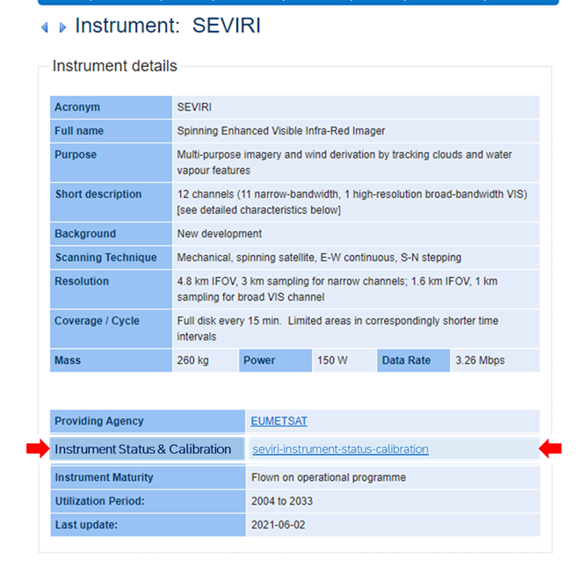
WMO-OSCAR Proposed link - one Instrument Landing Pages for multiple satellites

Slide 11
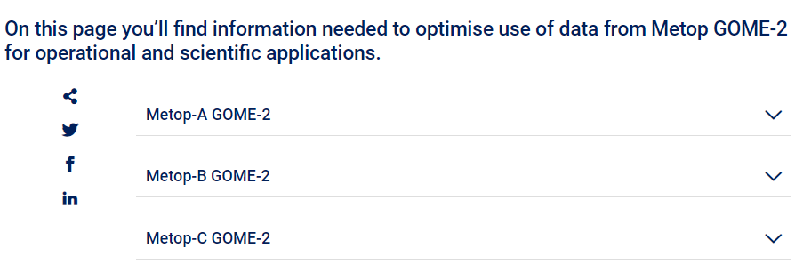
Example (one Instrument Landing Page for multiple satellites) GOME-2 Landing Pages for Metop-A (https://www.eumetsat.int/gome-2-instrument-status-calibration)
Summary proposed linking @WMO-OSCAR
Landing Page link appears on WMO-OSCAR -> “Space-based Capacities” -> “Instruments”
Landing Page links appear more prominent on WMO-OSCAR
CGMS-Operators are asked to provide one Landing Page per instrument for multiple satellites Note, this is already the case for most Landing pages

Slide 12
Discussion

Slide 13
Discussion
Are there any changes of representatives of CGMS Task-Team?
What CGMS satellite operators shall, at least, be still added to the CGMS Task-Team? (taking their weight in WMO-OSCAR as starting point)
How to achieve more members of the CGMS Task-Team:
providing an annual check/update of their Landing Pages?
implementing the CGMS Landing Page concept?
What role can the GSICS play in moving towards using common standards and nomenclature?

Slide 14
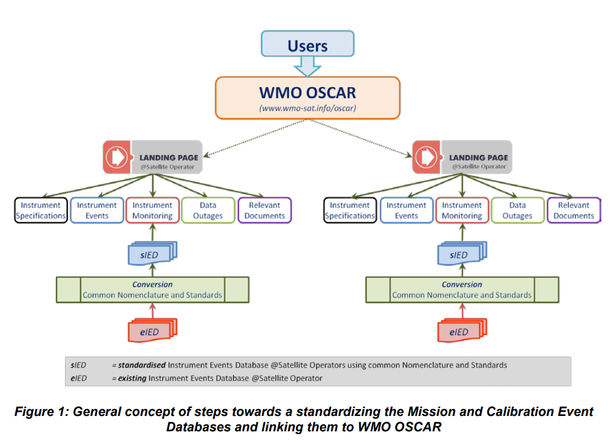
Discussion – Desired integrated concept on Instrument and Calibration Database

Slide 15
Thank you!
Questions are welcome.

