Slide 1
Impact analysis of change in input data on the AHI vicarious calibration
EIKI Misaki
Meteorological Satellite Center of Japan Meteorological Agency

Slide 2
Outline
・Himawari-8/9 AHI visible and near-infrared data calibration accuracy has been monitored by referring radiative transfer calculation.
・Input data of the vicarious calibration was updated.
・Impact of the change was investigated.

Slide 3
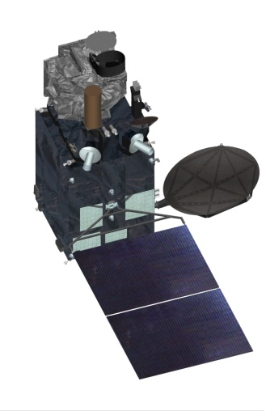
Himawari-8/9
Advanced Himawari Imager (AHI)
Band | (um)
B01 | 0.47
B02 | 0.51
B03 | 0.64
B04 | 0.86
B05 | 1.6
B06 | 2.3
B07 | 3.9
B08 | 6.2
B09 | 6.9
B10 | 7.3
B11 | 8.6
B12 | 9.6
B13 | 10.4
B14 | 11.2
B15 | 12.4
B16 | 13.3
Himawari-8 began operation on 7 July 2015.
Switchover of operational satellite from Himawari-8 to -9 was carried out on 13 December 2022.
Himawari-8 began operation as a backup for Himawari-9 on 13 December 2022.

Slide 4
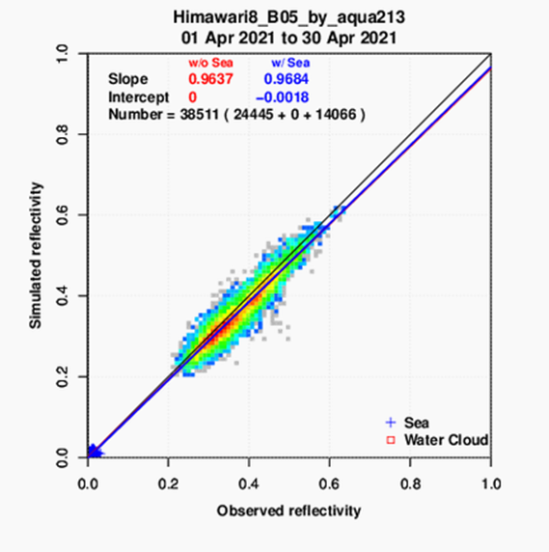
AHI VNIR vicarious calibration
・Radiative transfer calculation using the model "RSTAR" for a few types of targets
Input: Cloud and aerosol parameters retrieved from MODIS L1B(Aqua,Terra), Aura/OMI Ozone L3, JRA-55 (JMA‘s reanalysis data)
・Targets in use
Water cloud
Sea surface
used in
Band3-Band6(0.64-2.3um)
・Web page
https://www.data.jma.go.jp/mscweb/data/monitoring/gsics/vis/monit_visvical.html

Slide 5
Input data update
Change in input data on 29 October 2022.
(including a minor bug fix)
・Atmospheric profile (JMA’s Reanalysis data)
JRA-55 → JRA-3Q
・Ozone
Aura/OMI → SNPP/OMPS

Slide 6
Japanese Reanalysis for Three Quarters of a Century (JRA-3Q)
・JRA-3Q is the Japanese long-term reanalysis.
It covers the period from September 1947 to the current period.
・JRA-3Q is made by a high performance data assimilation system incorporating development results from the operational NWP system and sea surface temperature analysis since previous Japanese reanalysis.(JRA-55)
・JRA-3Q data is distributed in near real time(only inside of JMA).
The details about JRA-3Q are available from:
https://jra.kishou.go.jp/JRA-3Q/index_en.html

Slide 7
Impact analysis
Switchover of the operational satellite from Himawari-8 to Himawari-9 was carried out on 13 December 2022.
However, this comparison was made use of AHI on Himawari-8 data.
Case studies
1. JRA-55 vs. JRA-3Q(2020/08)
2. OMI vs. OMPS(2021/12)
3. OMI,JRA-55 vs. OMPS,JRA-3Q(2022/3-2022/12)

Slide 8
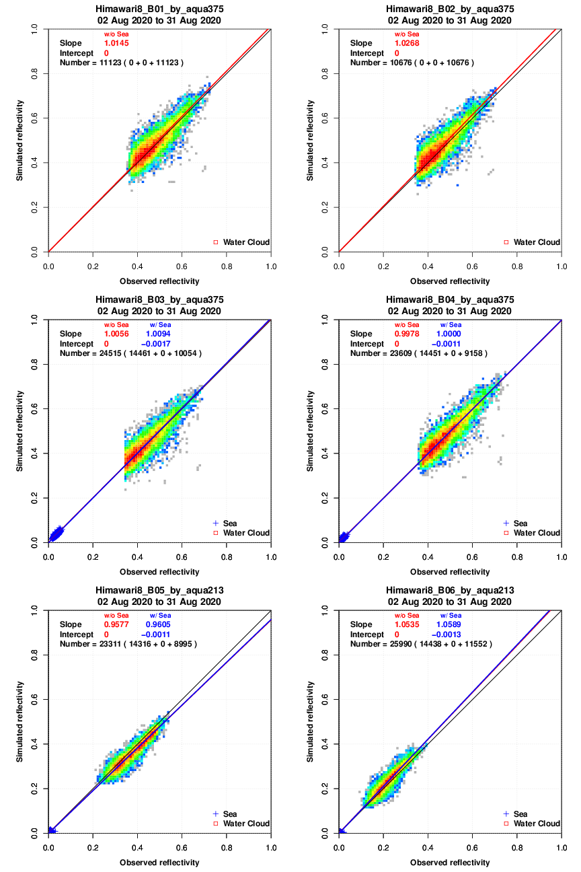
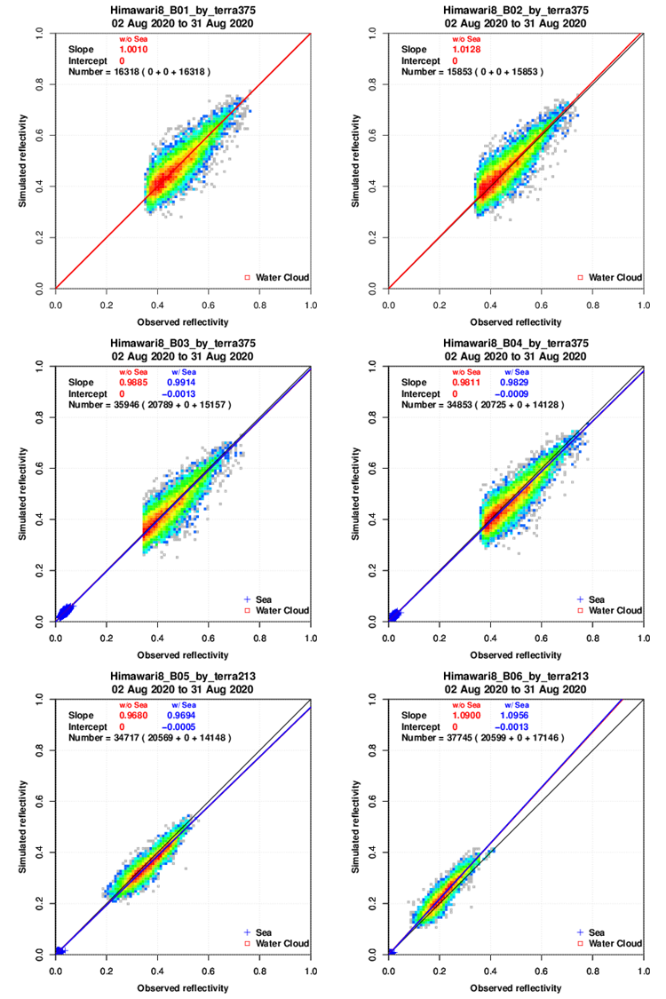
1. JRA-55 vs. JRA-3Q
JRA-55
B01
B02
B01
B02
Vertical:
Simulated reflectivity
Horizontal:
Observed reflectivity
B01: 0.47um
B02: 0.51um
B03: 0.64um
B04: 0.86um
B05: 1.6um
B06: 2.3um
0.0 0.2 0.4 0.6 0.8 1.0
0.0 0.2 0.4 0.6 0.8 1.0
0.0 0.2 0.4 0.6 0.8 1.0
0.0 0.2 0.4 0.6 0.8 1.0
0.0 0.2 0.4 0.6 0.8 1.0
0.0 0.2 0.4 0.6 0.8 1.0
0.0 0.2 0.4 0.6 0.8 1.0
0.0 0.2 0.4 0.6 0.8 1.0
B03
B04
B03
B04
0.0 0.2 0.4 0.6 0.8 1.0
0.0 0.2 0.4 0.6 0.8 1.0
0.0 0.2 0.4 0.6 0.8 1.0
0.0 0.2 0.4 0.6 0.8 1.0
0.0 0.2 0.4 0.6 0.8 1.0
0.0 0.2 0.4 0.6 0.8 1.0
0.0 0.2 0.4 0.6 0.8 1.0
0.0 0.2 0.4 0.6 0.8 1.0
B05
B06
B05
B06
0.0 0.2 0.4 0.6 0.8 1.0
0.0 0.2 0.4 0.6 0.8 1.0
0.0 0.2 0.4 0.6 0.8 1.0
0.0 0.2 0.4 0.6 0.8 1.0
0.0 0.2 0.4 0.6 0.8 1.0
0.0 0.2 0.4 0.6 0.8 1.0
0.0 0.2 0.4 0.6 0.8 1.0
0.0 0.2 0.4 0.6 0.8 1.0
Aqua/MODIS
Terra/MODIS

Slide 9
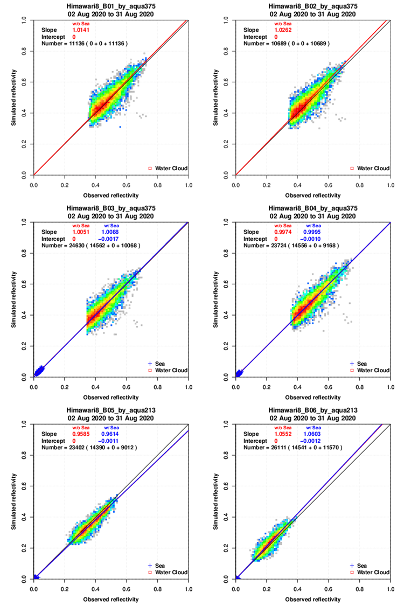
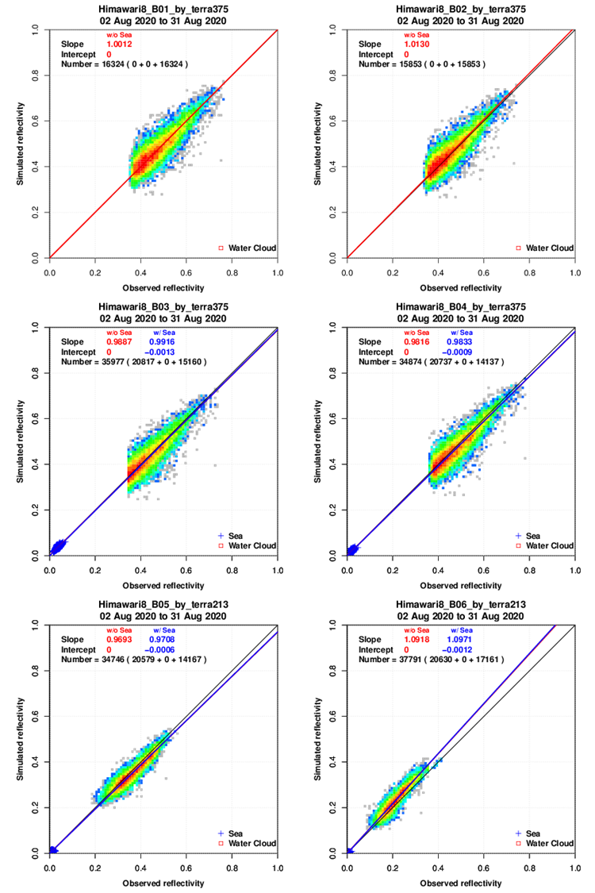
1. JRA-55 vs. JRA-3Q
JRA-3Q
B01
B02
B01
B02
Vertical:
Simulated reflectivity
Horizontal:
Observed reflectivity
B01: 0.47um
B02: 0.51um
B03: 0.64um
B04: 0.86um
B05: 1.6um
B06: 2.3um
0.0 0.2 0.4 0.6 0.8 1.0
0.0 0.2 0.4 0.6 0.8 1.0
0.0 0.2 0.4 0.6 0.8 1.0
0.0 0.2 0.4 0.6 0.8 1.0
0.0 0.2 0.4 0.6 0.8 1.0
0.0 0.2 0.4 0.6 0.8 1.0
0.0 0.2 0.4 0.6 0.8 1.0
0.0 0.2 0.4 0.6 0.8 1.0
B03
B04
B03
B04
0.0 0.2 0.4 0.6 0.8 1.0
0.0 0.2 0.4 0.6 0.8 1.0
0.0 0.2 0.4 0.6 0.8 1.0
0.0 0.2 0.4 0.6 0.8 1.0
0.0 0.2 0.4 0.6 0.8 1.0
0.0 0.2 0.4 0.6 0.8 1.0
0.0 0.2 0.4 0.6 0.8 1.0
0.0 0.2 0.4 0.6 0.8 1.0
B05
B06
B05
B06
0.0 0.2 0.4 0.6 0.8 1.0
0.0 0.2 0.4 0.6 0.8 1.0
0.0 0.2 0.4 0.6 0.8 1.0
0.0 0.2 0.4 0.6 0.8 1.0
0.0 0.2 0.4 0.6 0.8 1.0
0.0 0.2 0.4 0.6 0.8 1.0
0.0 0.2 0.4 0.6 0.8 1.0
0.0 0.2 0.4 0.6 0.8 1.0
Aqua/MODIS
Terra/MODIS

Slide 10
1. JRA-55 vs. JRA-3Q
There is no significant difference in appearance.
Difference of slope is about 0.2%
Slope of regression
 | JRA-55 (Aqua/ MODIS) | JRA-3Q (Aqua /MODIS) | JRA-55 (Terra/ MODIS) | JRA-3Q (Terra/ MODIS)
B01 | 1.014 | 1.014 | 1.001 | 1.001
B02 | 1.026 | 1.026 | 1.012 | 1.013
B03 | 1.009 | 1.008 | 0.991 | 0.991
B04 | 1.000 | 0.999 | 0.982 | 0.983
B05 | 0.960 | 0.961 | 0.969 | 0.970
B06 | 1.058 | 1.060 | 1.095 | 1.097

Slide 11
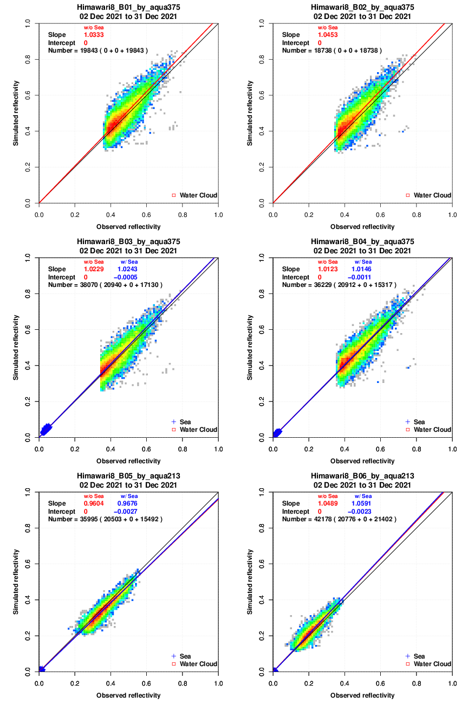
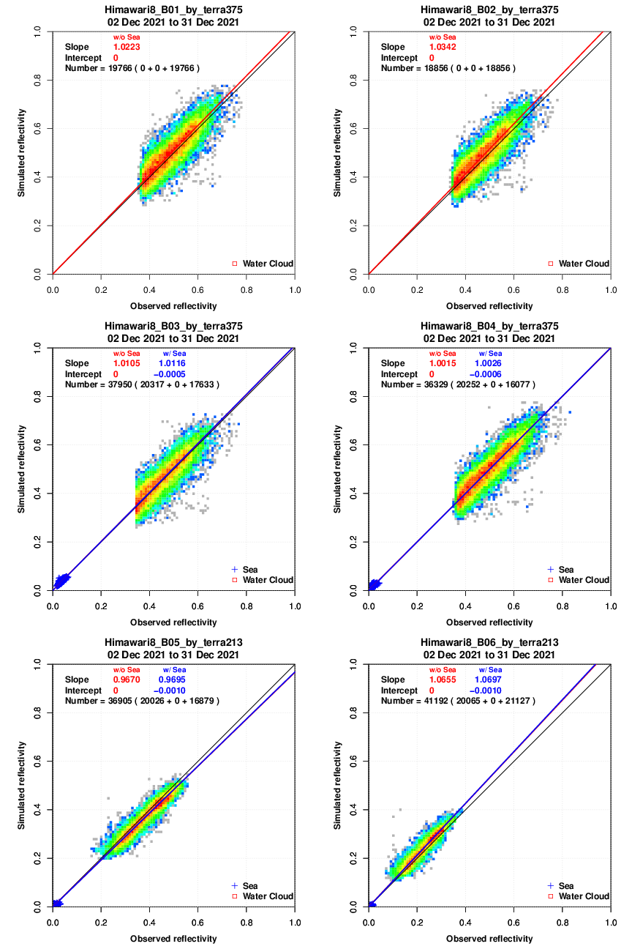
2. OMI vs. OMPS
OMI
B01
B02
B01
B02
Vertical:
Simulated reflectivity
Horizontal:
Observed reflectivity
B01: 0.47um
B02: 0.51um
B03: 0.64um
B04: 0.86um
B05: 1.6um
B06: 2.3um
0.0 0.2 0.4 0.6 0.8 1.0
0.0 0.2 0.4 0.6 0.8 1.0
0.0 0.2 0.4 0.6 0.8 1.0
0.0 0.2 0.4 0.6 0.8 1.0
0.0 0.2 0.4 0.6 0.8 1.0
0.0 0.2 0.4 0.6 0.8 1.0
0.0 0.2 0.4 0.6 0.8 1.0
0.0 0.2 0.4 0.6 0.8 1.0
B03
B04
B03
B04
0.0 0.2 0.4 0.6 0.8 1.0
0.0 0.2 0.4 0.6 0.8 1.0
0.0 0.2 0.4 0.6 0.8 1.0
0.0 0.2 0.4 0.6 0.8 1.0
0.0 0.2 0.4 0.6 0.8 1.0
0.0 0.2 0.4 0.6 0.8 1.0
0.0 0.2 0.4 0.6 0.8 1.0
0.0 0.2 0.4 0.6 0.8 1.0
B05
B06
B05
B06
0.0 0.2 0.4 0.6 0.8 1.0
0.0 0.2 0.4 0.6 0.8 1.0
0.0 0.2 0.4 0.6 0.8 1.0
0.0 0.2 0.4 0.6 0.8 1.0
0.0 0.2 0.4 0.6 0.8 1.0
0.0 0.2 0.4 0.6 0.8 1.0
0.0 0.2 0.4 0.6 0.8 1.0
0.0 0.2 0.4 0.6 0.8 1.0
Aqua/MODIS
Terra/MODIS

Slide 12
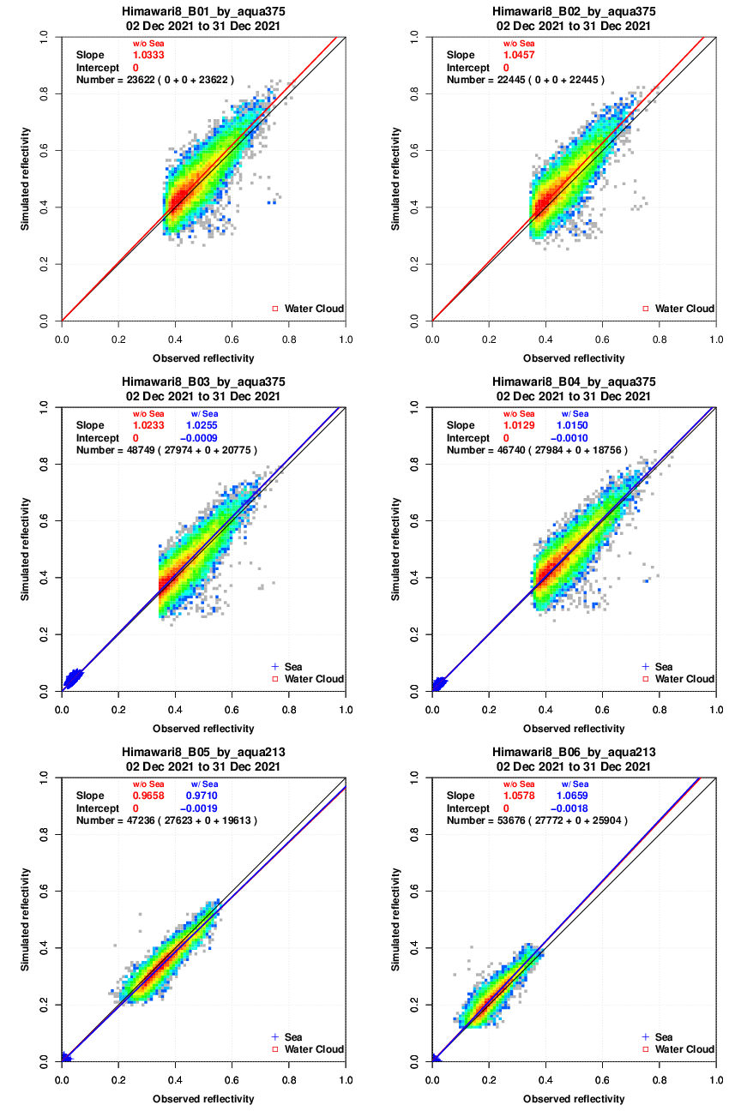
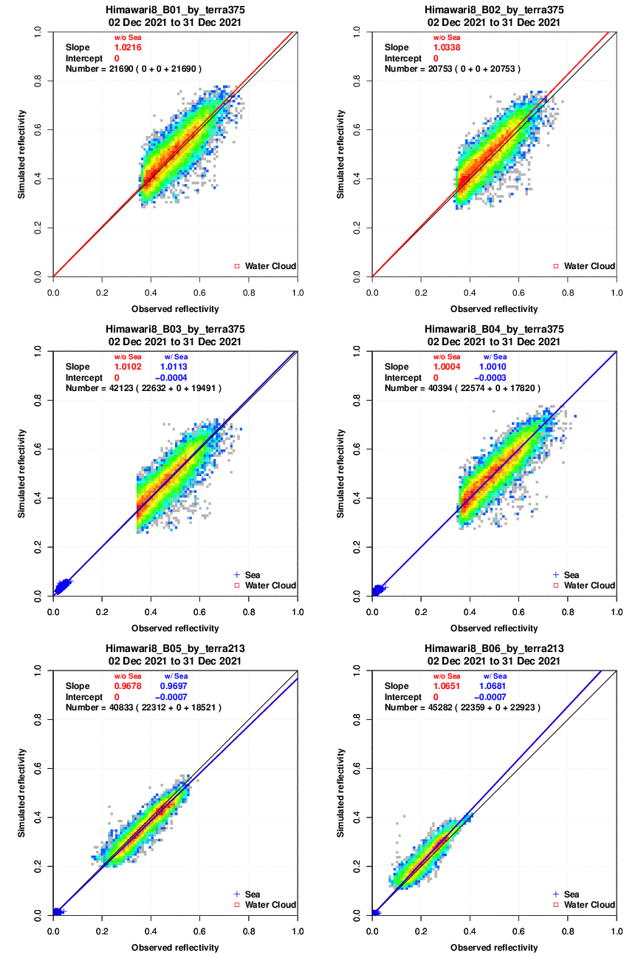
2. OMI vs. OMPS
OMPS
B01
B02
B01
B02
Vertical:
Simulated reflectivity
Horizontal:
Observed reflectivity
B01: 0.47um
B02: 0.51um
B03: 0.64um
B04: 0.86um
B05: 1.6um
B06: 2.3um
0.0 0.2 0.4 0.6 0.8 1.0
0.0 0.2 0.4 0.6 0.8 1.0
0.0 0.2 0.4 0.6 0.8 1.0
0.0 0.2 0.4 0.6 0.8 1.0
0.0 0.2 0.4 0.6 0.8 1.0
0.0 0.2 0.4 0.6 0.8 1.0
0.0 0.2 0.4 0.6 0.8 1.0
0.0 0.2 0.4 0.6 0.8 1.0
B03
B04
B03
B04
0.0 0.2 0.4 0.6 0.8 1.0
0.0 0.2 0.4 0.6 0.8 1.0
0.0 0.2 0.4 0.6 0.8 1.0
0.0 0.2 0.4 0.6 0.8 1.0
0.0 0.2 0.4 0.6 0.8 1.0
0.0 0.2 0.4 0.6 0.8 1.0
0.0 0.2 0.4 0.6 0.8 1.0
0.0 0.2 0.4 0.6 0.8 1.0
B05
B06
B05
B06
0.0 0.2 0.4 0.6 0.8 1.0
0.0 0.2 0.4 0.6 0.8 1.0
0.0 0.2 0.4 0.6 0.8 1.0
0.0 0.2 0.4 0.6 0.8 1.0
0.0 0.2 0.4 0.6 0.8 1.0
0.0 0.2 0.4 0.6 0.8 1.0
0.0 0.2 0.4 0.6 0.8 1.0
0.0 0.2 0.4 0.6 0.8 1.0
Aqua/MODIS
Terra/MODIS

Slide 13
2. OMI vs. OMPS
There is no significant difference in appearance.
Difference of slope is about 0.9%
Slope of regression
 | OMI (Aqua/ MODIS) | OMPS (Aqua /MODIS) | OMI (Terra/ MODIS) | OMPS (Terra/ MODIS)
B01 | 1.033 | 1.033 | 1.022 | 1.021
B02 | 1.045 | 1.045 | 1.034 | 1.033
B03 | 1.024 | 1.025 | 1.011 | 1.011
B04 | 1.014 | 1.015 | 1.002 | 1.001
B05 | 0.967 | 0.971 | 0.969 | 0.969
B06 | 1.059 | 1.065 | 1.069 | 1.068

Slide 14
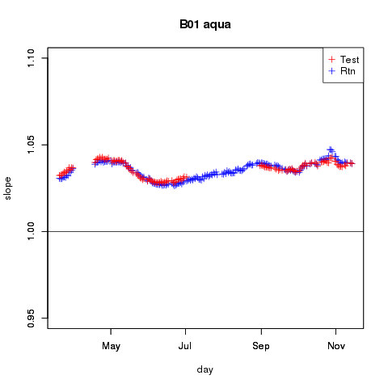
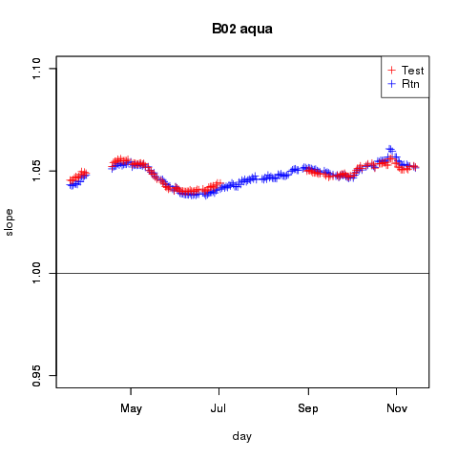
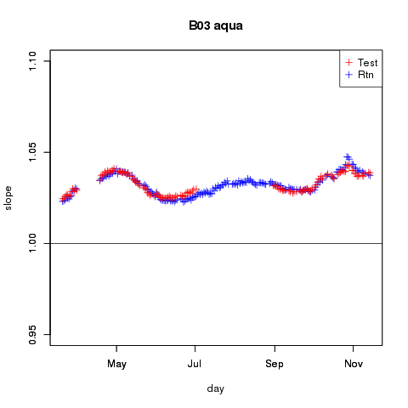
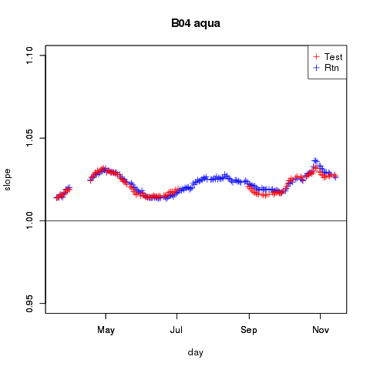
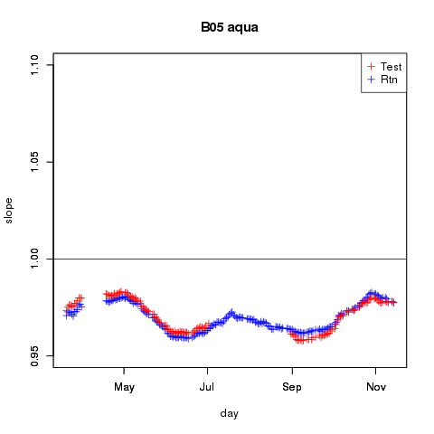
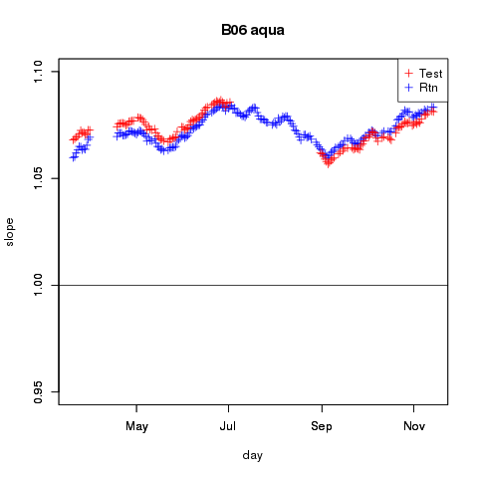
3. OMI,JRA-55 vs. OMPS,JRA-3Q
Slope of the regression(2022/03 to 2022/12)
Blue:OMI,JRA-55
Red:OMPS,JRA-3Q
B01
B02
B03
Slope
0.95 1.00 1.05 1.10
0.95 1.00 1.05 1.10
0.95 1.00 1.05 1.10
Difference of slope is about 0.4%
May Jul Sep Nov
2022
May Jul Sep Nov
2022
May Jul Sep Nov
2022
B04
B05
B06
Slope
0.95 1.00 1.05 1.10
0.95 1.00 1.05 1.10
0.95 1.00 1.05 1.10
May Jul Sep Nov
2022
May Jul Sep Nov
2022
May Jul Sep Nov
2022
Aqua/MODIS

Slide 15
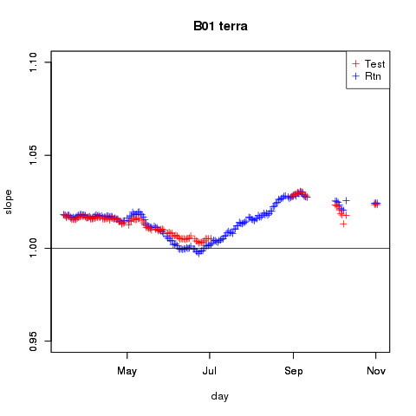
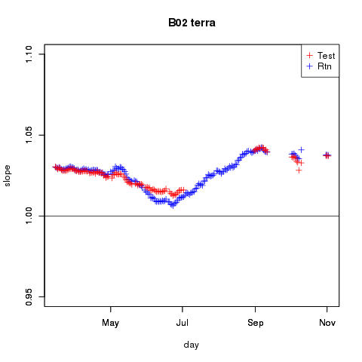
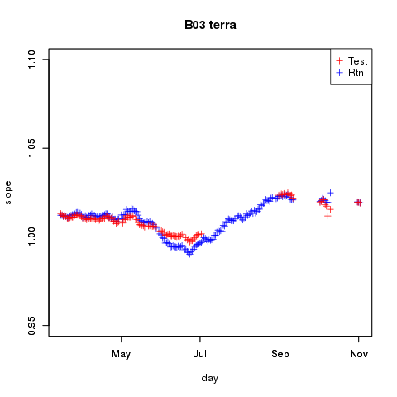
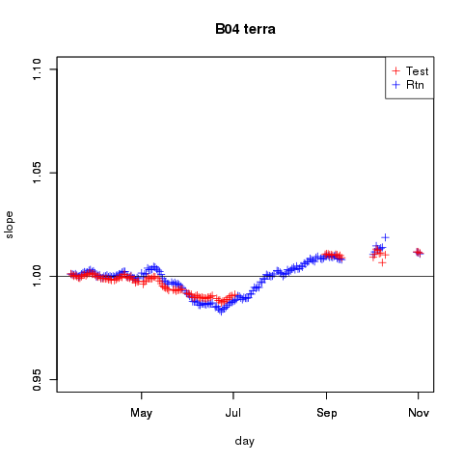
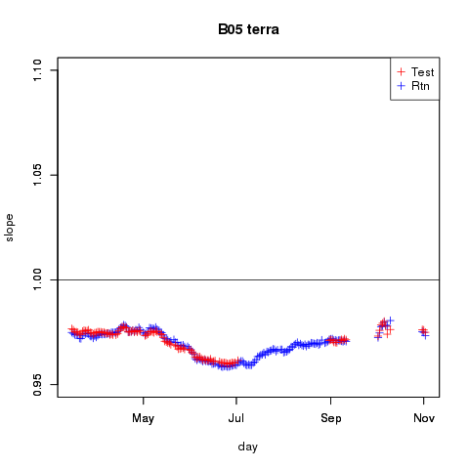
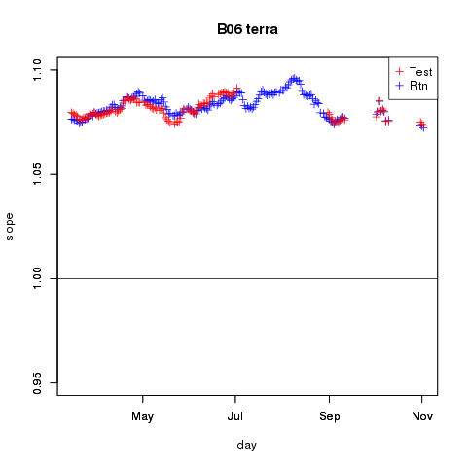
3. OMI,JRA-55 vs. OMPS,JRA-3Q
Slope of the regression(2022/03 to 2022/12)
Blue:OMI,JRA-55
Red:OMPS,JRA-3Q
B01
B02
B03
Slope
0.95 1.00 1.05 1.10
0.95 1.00 1.05 1.10
0.95 1.00 1.05 1.10
Difference of slope is about 0.3%
May Jul Sep Nov
2022
May Jul Sep Nov
2022
May Jul Sep Nov
2022
B04
B05
B06
Slope
0.95 1.00 1.05 1.10
0.95 1.00 1.05 1.10
0.95 1.00 1.05 1.10
May Jul Sep Nov
2022
May Jul Sep Nov
2022
May Jul Sep Nov
2022
Terra/MODIS

Slide 16
Summary and Future work
・Summary
JMA/MSC compares Himawari-8/9 AHI visible and near-infrared data with radiative transfer calculation to check its calibration accuracy.
Input data of vicarious calibration was changed.
There is no significant difference, which indicates that the vicarious calibration approach robust for the input atmospheric profiles.
・Future work
Transition from MODIS to VIIRS

Slide 17
Thank you for your attention

Slide 18
Reference
Kobayashi, S., Y. Kosaka, J. Chiba, T. Tokuhiro, Y. Harada, C. Kobayashi, and H. Naoe, 2021: JRA-3Q: Japanese Reanalysis for Three Quarters of a Century. Joint WCRP-WWRP Symposium on Data Assimilation and Reanalysis/ECMWF Annual Seminar 2021, online, 13-17 September 2021, O4-2.

Slide 20
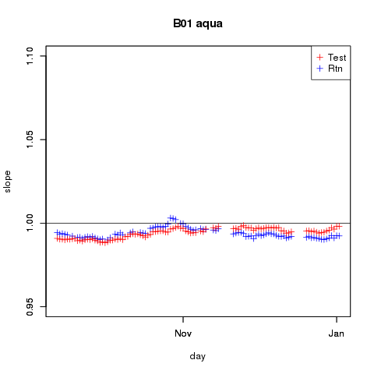
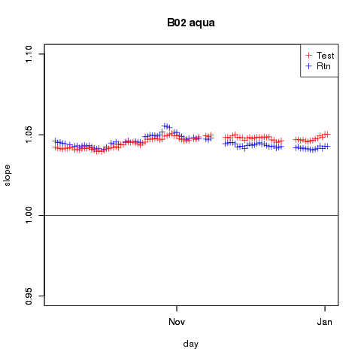
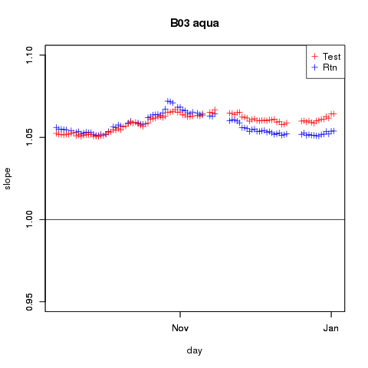
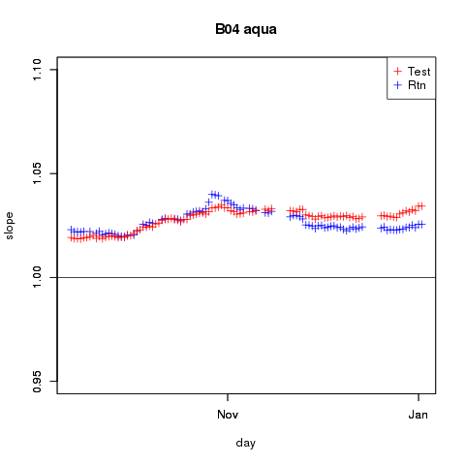
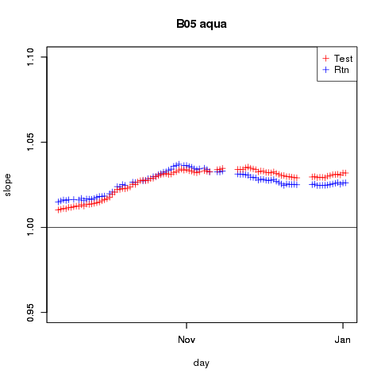
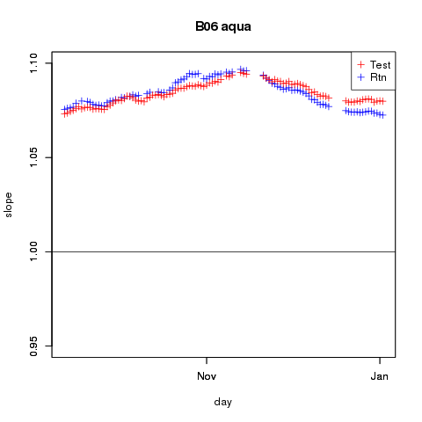
3. OMI,JRA-55 vs. OMPS,JRA-3Q Himawari-9
Slope of the regression(2022/09 to 2023/1)
Bule:OMI,JRA-55
Red:OMPS,JRA-3Q
B01
B02
B03
Slope
0.95 1.00 1.05 1.10
0.95 1.00 1.05 1.10
0.95 1.00 1.05 1.10
Nov Jan
2022 2023
Nov Jan
2022 2023
Nov Jan
2022 2023
B04
B05
B06
Slope
0.95 1.00 1.05 1.10
0.95 1.00 1.05 1.10
0.95 1.00 1.05 1.10
Nov Jan
2022 2023
Nov Jan
2022 2023
Nov Jan
2022 2023
Aqua/MODIS

Slide 21
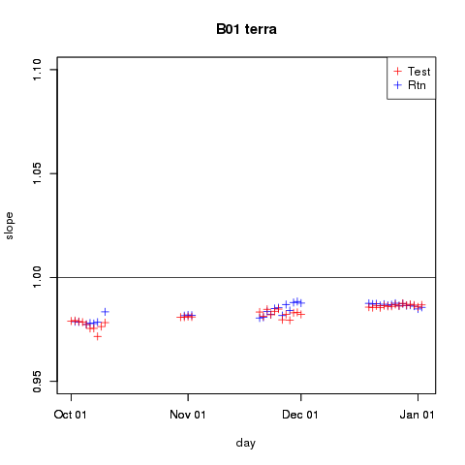
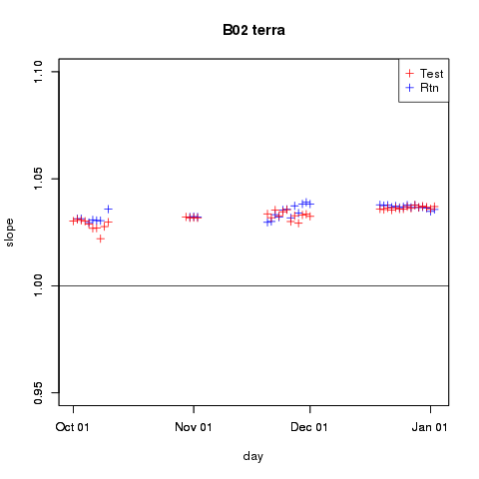
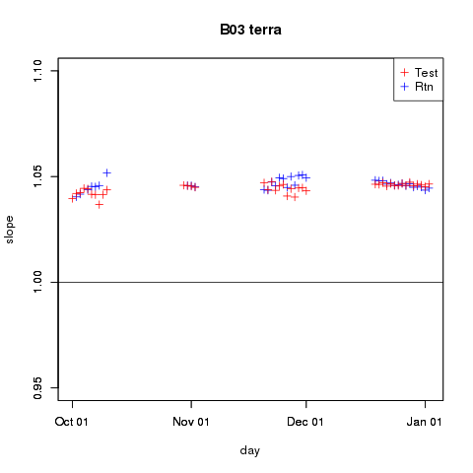
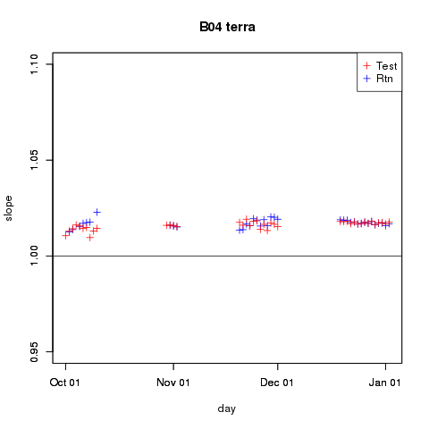
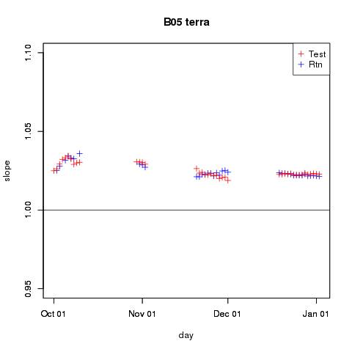
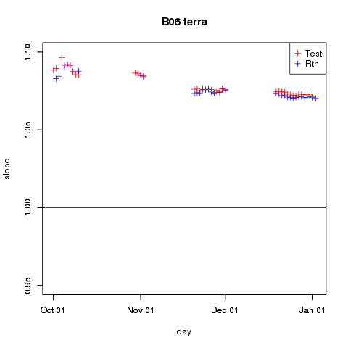
3. OMI,JRA-55 vs. OMPS,JRA-3Q Himawari-9
Slope of the regression(2022/10 to 2023/1)
Bule:OMI,JRA-55
Red:OMPS,JRA-3Q
B01
B02
B03
Slope
0.95 1.00 1.05 1.10
0.95 1.00 1.05 1.10
0.95 1.00 1.05 1.10
Oct Nov Dec Jan
2022 2023
Oct Nov Dec Jan
2022 2023
Oct Nov Dec Jan
2022 2023
B04
B05
B06
Slope
0.95 1.00 1.05 1.10
0.95 1.00 1.05 1.10
0.95 1.00 1.05 1.10
Oct Nov Dec Jan
2022 2023
Oct Nov Dec Jan
2022 2023
Oct Nov Dec Jan
2022 2023
Terra/MODIS

Slide 22
Input factors to radiative transfer calculation for water cloud
Input factors
Atmospheric profile temperature pressure water vapor sea surface wind speed | Japanese reanalysis
Ozone amount | OMI,OMPS
Cloud optical parameters optical thickness effective radius | MODIS

Slide 23
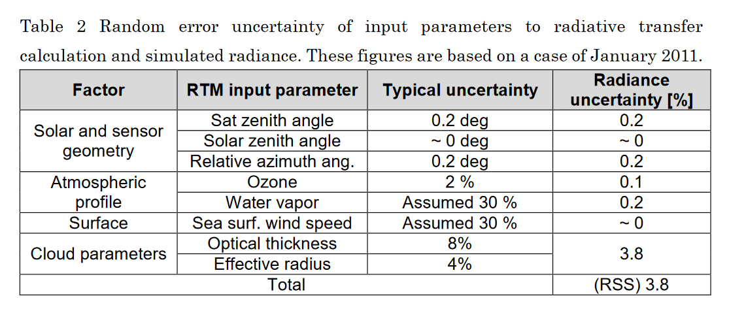
http://gsics.atmos.umd.edu/pub/Development/AtbdCentral/MTSAT_vis_vicarious_calibration_outline.pdf

