Slide 1
EUMETSAT Lunar activities in 2022
S. Wagner
With the support from V. Debaecker*, M. De Bartolomei, J. Nain, O. Henriquez**, M. Neneman, OPS team (S3 and MSG)
GSICS Annual Meeting – 27.02-03.02 2023
* Telespazio support
** CS support

Slide 2
Outline
Sentinel-3 lunar manoeuvres
Meteosat-8 end-of-life tests
Future developments

Slide 3
Outline
Sentinel-3 lunar manoeuvres
Meteosat-8 end-of-life tests
Future developments

Slide 4
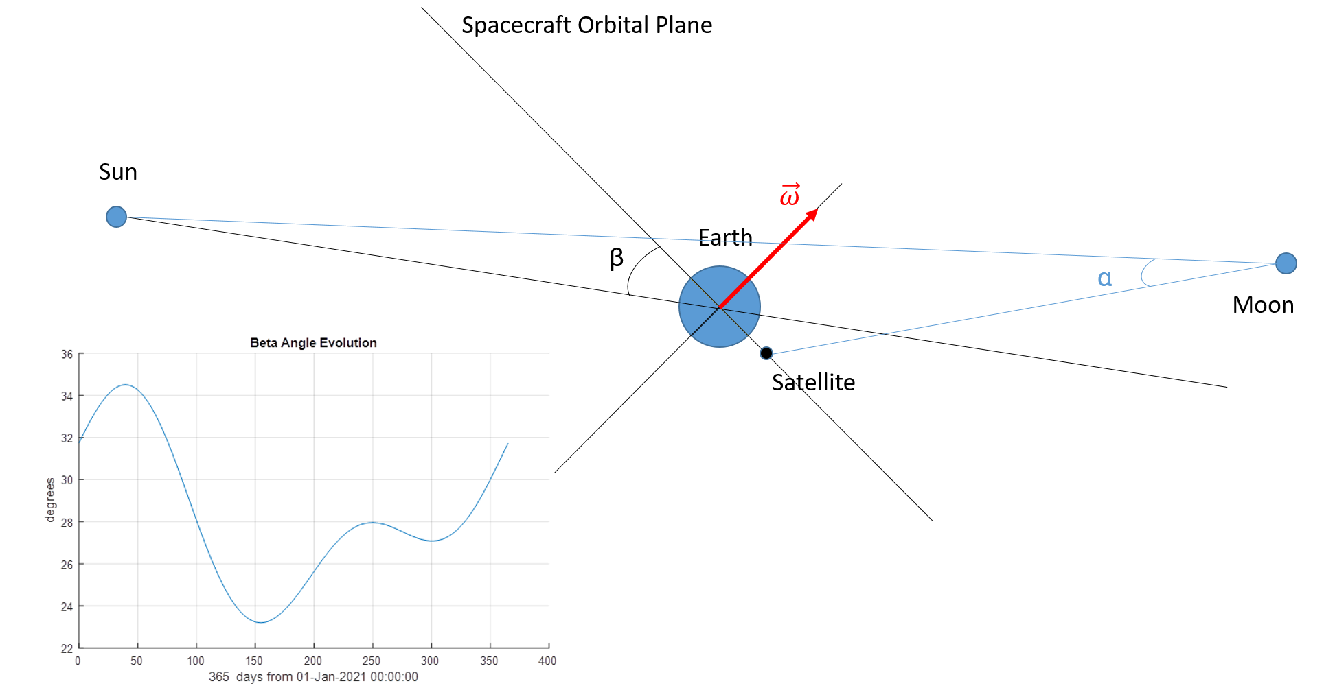
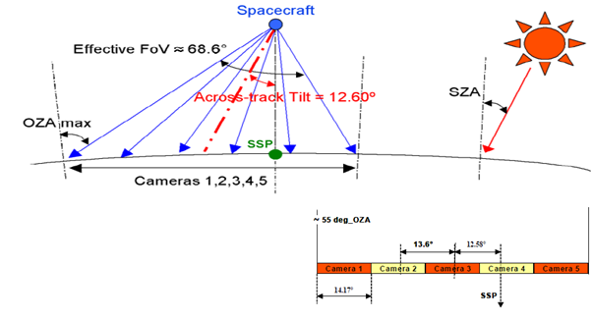
Sentinel-3 lunar manoeuvres - background
First acquisition with Camera#4 on OLCI-B in 2018 during commissioning
Purpose : assessment of the stray-light correction performances.

Slide 5
Sentinel-3 lunar manoeuvres – background + constrains
Roll angle = changing parameter to adjust the Moon position across track (➔ camera + position in the camera)
Maximum negative roll rotation allowed = -165 degrees ➔ star trackers not all pointing at the Earth.
Location of the Moon across track ➔ centrered
Moon phase |g| ∈ [5,8] deg
Cal window start + 20s < Moon < Cal window end – 20s for SL analysis

Slide 6
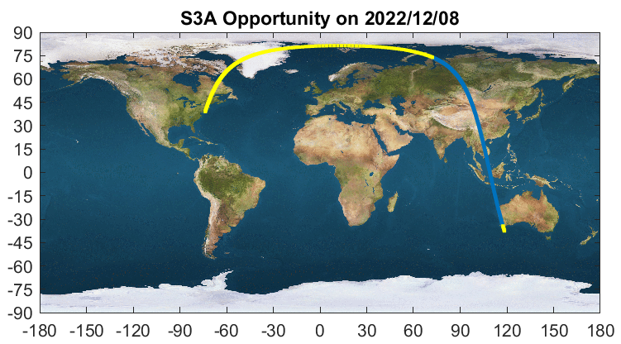
Sentinel-3 lunar manoeuvres – background + constrains
Example of ground track showing the full arc. In blue: yaw; in yellow: additional time (~1 minute before and 18 minutes after) in which the spacecraft will be in Geodetic pointing mode without yaw-steering (the same mode as used during In-Plane manoeuvres).

Slide 7
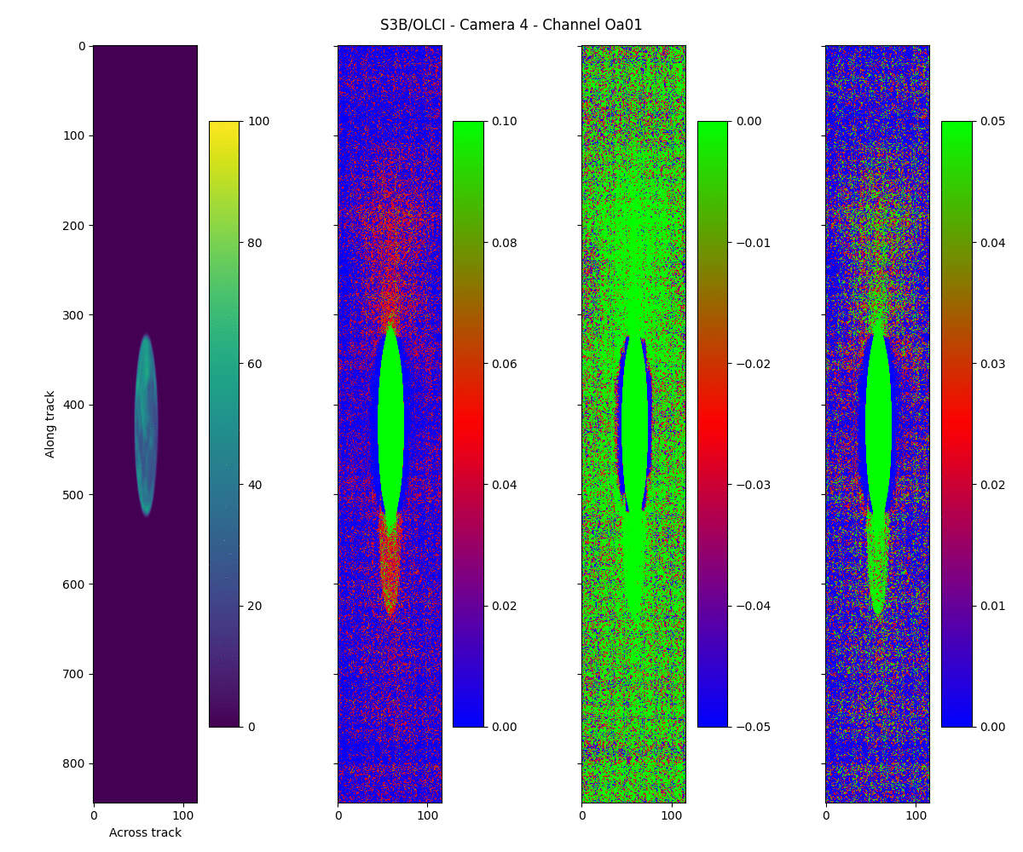
Sentinel-3 lunar manoeuvres
ACT
ALT
Extract from the original image

Slide 8
Sentinel-3 lunar manoeuvres
Outcome of 2018 manoeuvre led to:
One manoeuvre with S3A in 2020 (while in OPE) for Camera#4
Successful execution of inter-leaved monthly manoeuvres in 2022 for each camera of OLCI-A and OLCI-B
Continuation since Nov 2022 of those monthly manoeuvres with Camera#4 (for now approved till in end 2023)
2022 acquisition campaign = anchor points (snapshots):
Stray light correction performance assessment
Inter-band / inter-camera radiometric performance assessment
Routine acquisitions with Camera#4 = regular assessment
Radiometric stability assessment (including inter-band)
Inter-calibration

Slide 9
Sentinel-3 lunar manoeuvres – stray light
Stray light correction assessment:
SL correction globally improves the quality of the data even though significant residuals exist (with variations from camera to camera, and between channels).
Analysis still on-going but initial proposed enhancements significantly reduce for the NIR bands
However, impact on radiances to be further investigated
Plots from “Use of Moon Observations for Characterization of Sentinel-3B Ocean and Land Color Instrument”
M. Neneman , S. Wagner, L. Bourg, L. Blanot, M. Bouvet, S. Adriaensen and J. Nieke
Remote Sensing 2020

Slide 10
Sentinel-3 lunar manoeuvres – radiometric assessment
Lunar irradiance:
$$Irrad=\frac{1}{OSF}\sum_{i=0}^{N_{Moon pixels}}{Ω_{i}∙{Rad}_{i}}$$
Two parameters to be estimated as accurately as possible:
The oversampling factor OSF (which may vary in time)
The pixel solid angle Ω_{i} (which can vary from pixel to pixel)
Determination of the OSF:
Ellipse fitting to estimate OSF
Gives an order of magnitude
But not accurate (lunar phase + stray light + potential data filtering)
Calculation of the pointing angular rate on the Moon
ALT IFOV Moon = Pointing Angular Rate [deg/sec] * Sampling Time ([sec])
Oversampling = ALT IFOV Moon / ALT IFOV Earth

Slide 11
Determination of the oversampling factor

Slide 12
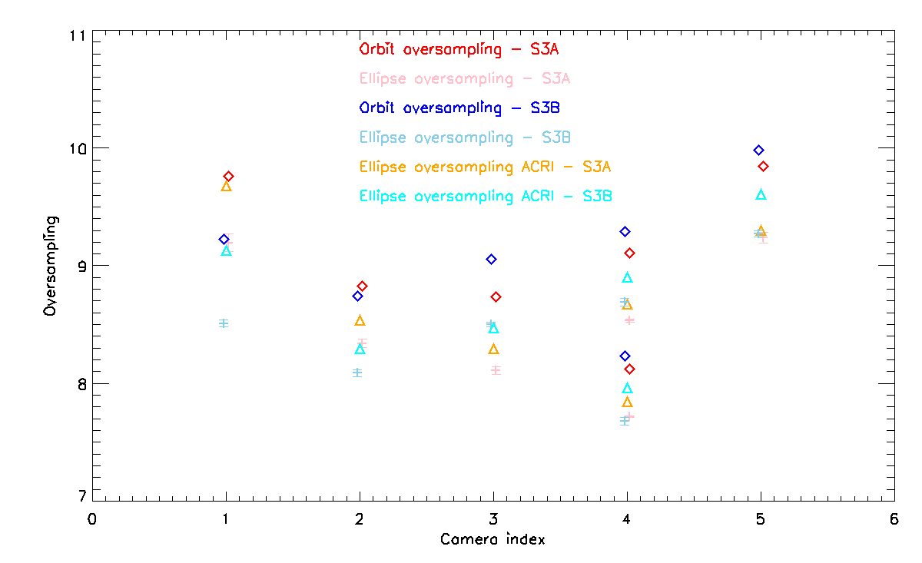
Determination of the oversampling factor

Slide 13
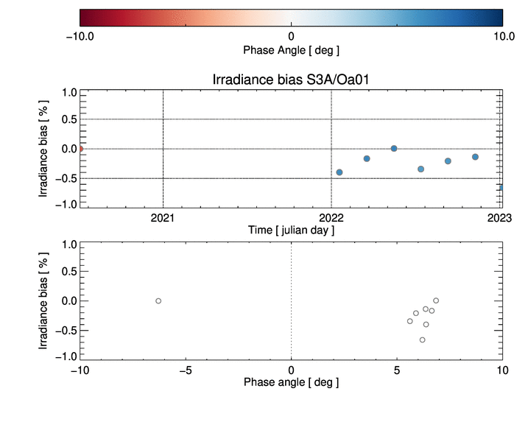
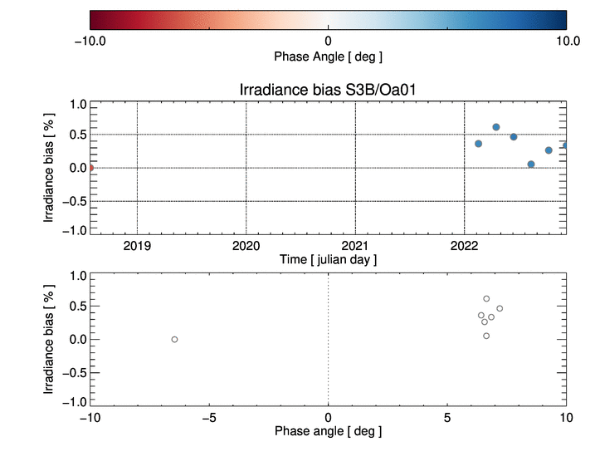
Sentinel-3 lunar manoeuvres - outcome
Initial analysis of the radiometry show stable results for Camera#4 for all bands
Time series also very stable with the other cameras when using SRFs for the Moon central pixel (within 0.5%)
Less stable for some bands when using SRFs at instrument level ➔ Impact of the SRF choice to be translated into an uncertainty source
1
4
1
2
4
4
5
2
4
5
3
3

Slide 14
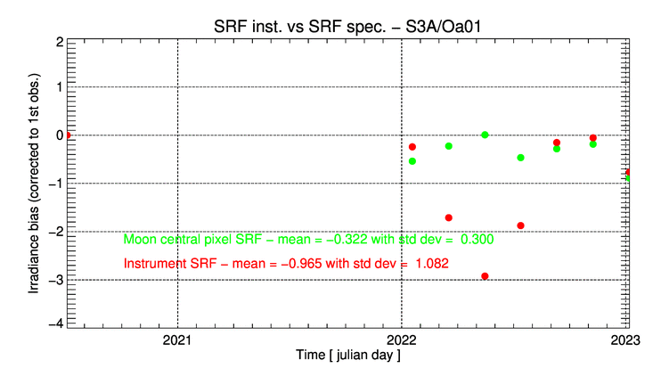
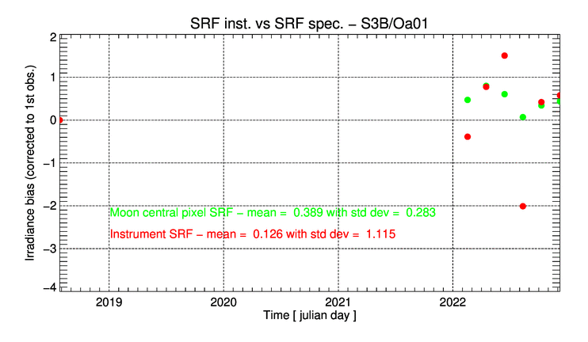
Sentinel-3 lunar manoeuvres - outcome
4
5
1
2
3
4
4
5
1
2
3
4

Slide 15
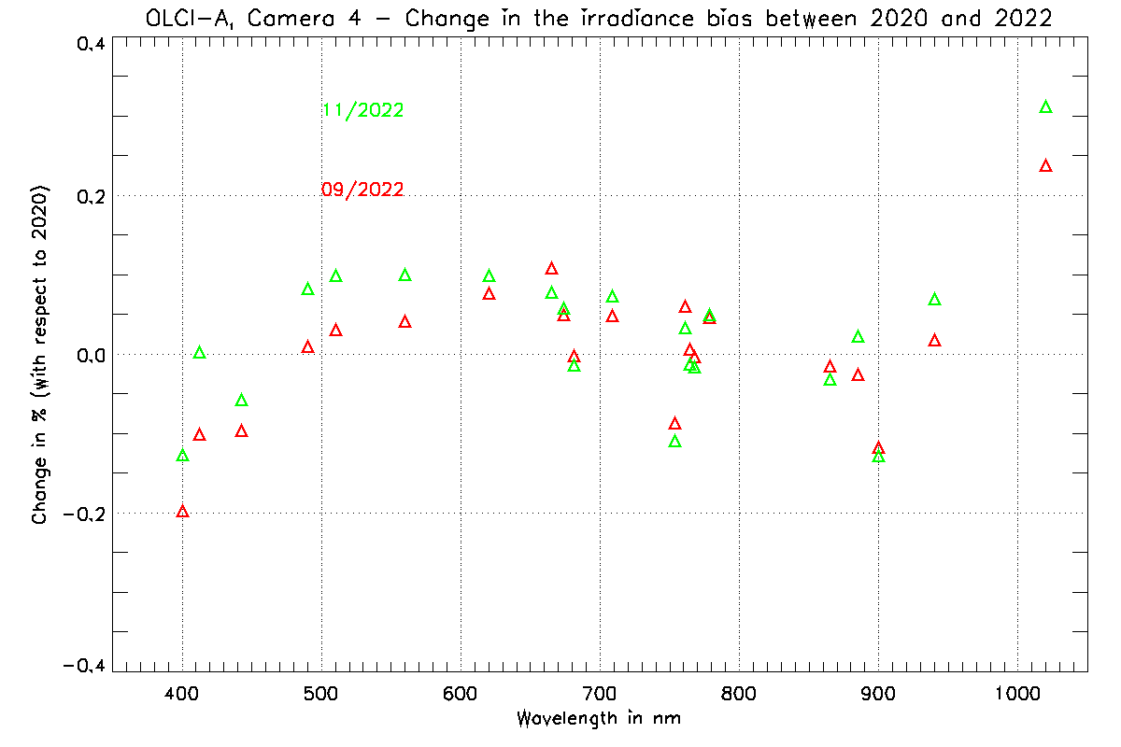
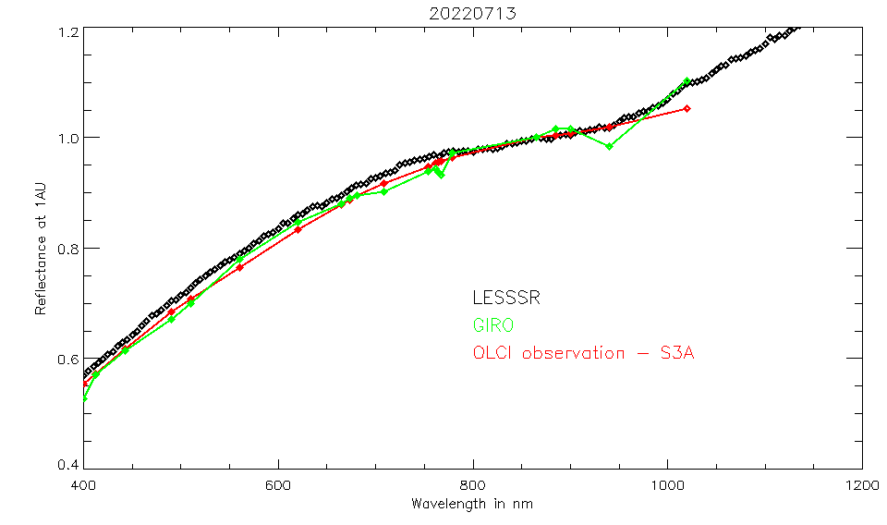
Sentinel-3 lunar manoeuvres - outcome
Spectral consistency:
Overall good spectral consistency when compared GIRO + LESSSR
Except for bands Oa01 (GIRO?) and Oa21 (instrument)
Spectral stability between 2020 and 2022:
Good spectral stability (slightly larger for Oa21) of the relative bias with the GIRO
Example of inter-band normalised at 865nm for OLCI-A

Slide 16
Sentinel-3 lunar manoeuvres - outcome
Radiometry ➔ Initial results show the benefits of OLCI lunar acquisitions to assess and monitor:
Temporal radiometric stability
Spectral consistency (except for Oa01 and Oa21 where difference w.r.t. models is larger - consistent with results from other monitoring methods)
Update on the OLCI radiometric status
Development of an lunar data extraction module in our MICMICS system to process SLSTR lunar observations (nadir view) + monitoring of radiometric performances of S1 to S6 using GIRO + LESSSR

Slide 17
Outline
Sentinel-3 lunar manoeuvres
Meteosat-8 end-of-life tests
Future developments

Slide 18
Meteosat-8 end of life tests
Two test sequences:
Each test = 8 hours long
Test 1: 09.09.2022, normal gain / dedicated rapid scan in the Southern hemisphere
Test 2: 12.09.2022, modified gain to try to de-saturate (some) IR channels (12.0 and 13.4μm) / nominal RSS over the Northern hemisphere

Slide 19
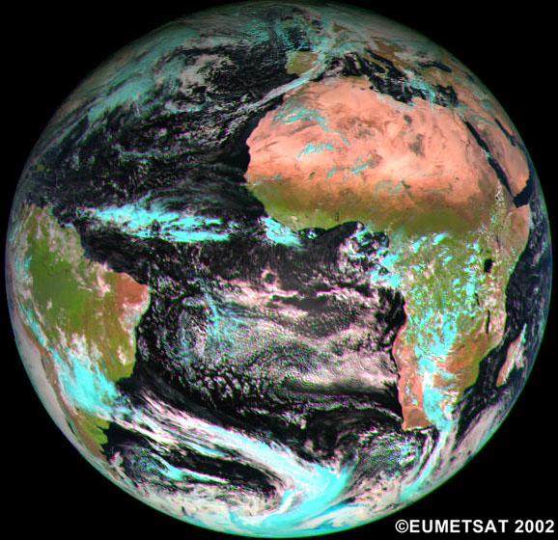
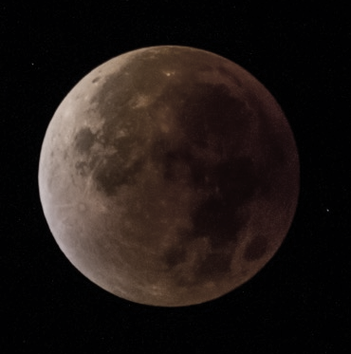
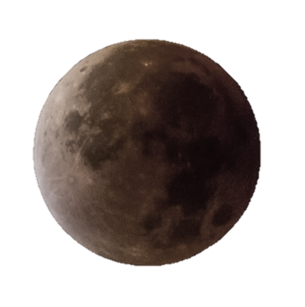
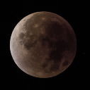
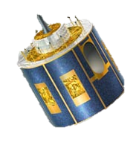
Meteosat-8 end of life tests

Slide 20
Meteosat-8 end of life tests

Slide 21
Meteosat-8 end of life tests

Slide 22
Meteosat-8 end of life tests

Slide 23
Meteosat-8 end of life tests

Slide 24
HRV sequence – 09.09.2022 (including retrace)

Slide 25
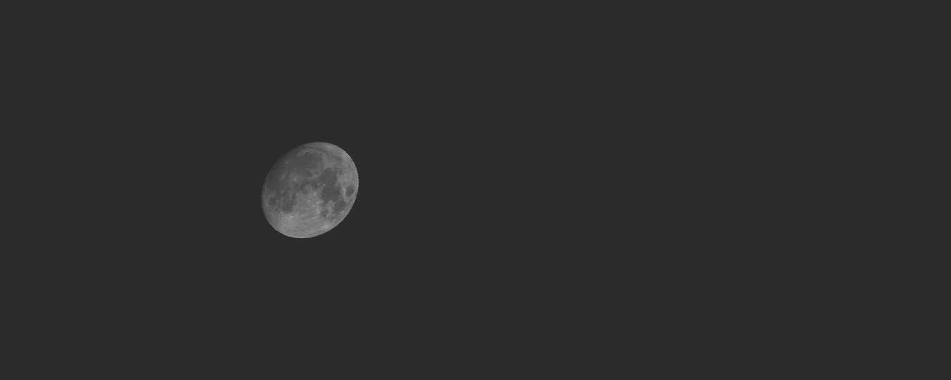
HRV sequence – 09.09.2022 (sliced)

Slide 26
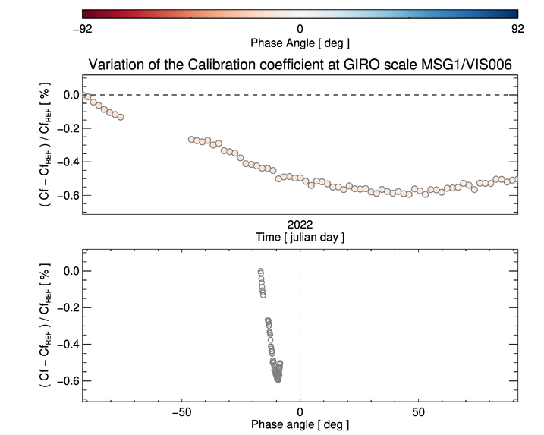
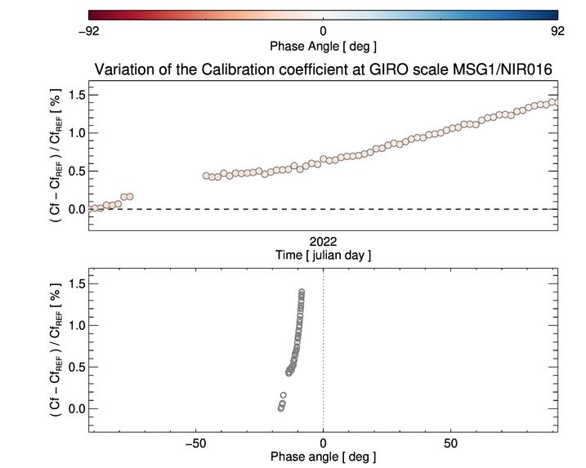
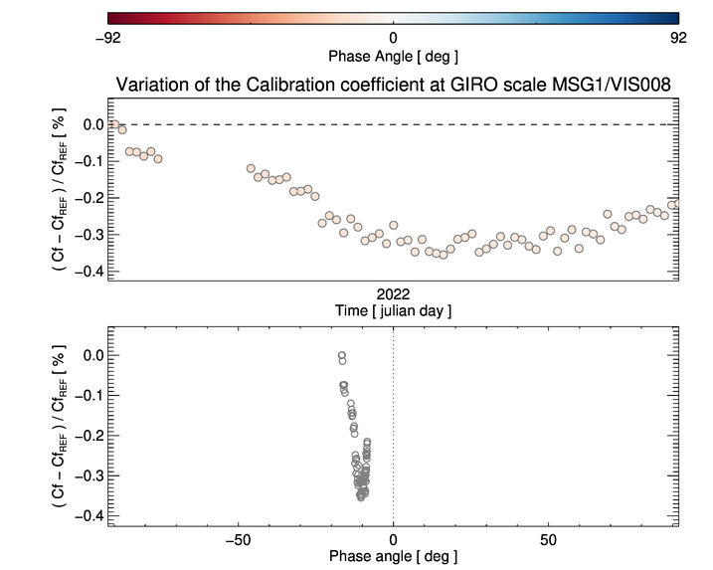
Results – relative calibration on the GIRO scale
Temporal evolution of the calibration. Related to a phase dependence in the model?
Phase dependence of the calibration also observed on other instruments (e.g. AHI)
Further analysis needed to fully understand the results…

Slide 27
Meteosat-8 end of life tests
Test 1 conducted successfully despite an initial anomaly (related to the set-up of the measurement triggering ) which reduce slightly the number of observations
Analysis of the data still on-going
Test 2 sequence to be further investigated after some issues with the measurements
The anomalies we faced during the two tests will allow a better definition of similar tests in the future.

Slide 28
Outline
Sentinel-3 lunar manoeuvres
Meteosat-8 end-of-life tests
Future developments

Slide 29
Future developments
At EUMETSAT, a (fast) growing need for in-flight assessments and radiometric performance monitoring capabilities using lunar measurements :
More complex instruments
More varied systems
More stringent requirements
Upcoming challenges are for EPS-SG ➔ EPS-SG preparations = Sentinel-3 activities
Engineering + scientific challenges
Coordination (EUMETSAT / ESA / Copernicus Services and stakeholders)
Development work to capitalise on GIRO + LESSSR (SCIAMACHY + RELAB based model) and contribute to the community effort:
External study to improve the current LESSSR model and make use of GOME-2 lunar data (in collaboration with ESA)
Inter-calibration of sensors such as GOME-2 and SCIAMACHY using the Moon (in collaboration with ESA)
Lunar model inter-comparison (in 2023)
International effort to reduce current uncertainties and to achieve absolute calibration + SI traceability (GSICS/IVOS, CLARREO, ARCSTONE, Air + Mauna Loa LUSI projects, international collaborations, TRUTHS, etc.)

Slide 30
Future developments
MFG
MVIRI
MTG
LI
S3
OLCI
S3
SLSTR
MTG
FCI
MSG
SEVIRI
EPS-SG
METimage
EPS-SG
3MI
EPS
GOME-2
CO2M
MAP + CLIM
S4
UVN
S5
UVNS
MTG
IRS
EPS-SG
MW inst.

Slide 31
Future developments
MFG
MVIRI
MTG
LI
S3
OLCI
S3
SLSTR
MTG
FCI
MSG
SEVIRI
EPS-SG
METimage
EPS-SG
3MI
EPS
GOME-2
CO2M
MAP + CLIM
S4
UVN
S5
UVNS
MTG
IRS
EPS-SG
MW inst.
GEOs versus LEOs

Slide 32
Future developments
MFG
MVIRI
MTG
LI
S3
OLCI
S3
SLSTR
MTG
FCI
MSG
SEVIRI
EPS-SG
METimage
EPS-SG
3MI
EPS
GOME-2
CO2M
MAP + CLIM
S4
UVN
S5
UVNS
MTG
IRS
EPS-SG
MW inst.
GEOs versus LEOs
Ops activities
+
CAL/VAL plans
Activities foreseen
Activities TBC

Slide 33
Thank you!
Questions are welcome.

