Slide 1
FY-3E/WindRAD instrument status and calibration accuracy evaluation
Mei Yuan, Jian Shang, Honggang Yin, Fangli Dou
NSMC, CMA
2023-03-02

Slide 2
WindRAD introduction
Instrument status
Cal/Val
Summary

Slide 3
PART 01
WindRAD introduction

Slide 4
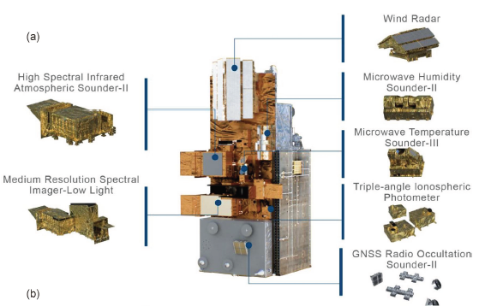
1. WindRAD introduction
Wind Radar (WindRAD) for Chinese FY-3E satellite
The first active remote sensing instrument of Fengyun series satellite of China.
Detecting global sea surface wind vector, including wind speed and wind direction.
dual-frequency: C & Ku band, both with VV & HH polarizations
advanced rotating fan-beam
WindRAD
FY-3E satellite
4

Slide 5
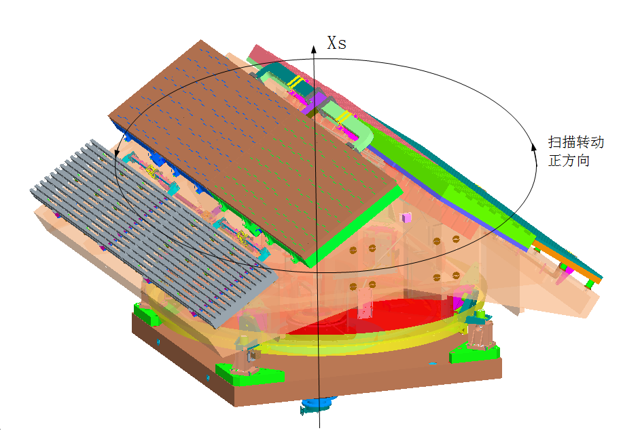
1. WindRAD introduction
Spectrum specifications
parameter | metric
Frequency | 5.4 GHz （C band） | 13.256 GHz（Ku band）
Polarization | VV、HH | VV、HH
Observing geometric specifications
parameter | metric
 | C band | Ku band
Spatial resolution（azimuth×range） | 25 ×0.5km | 10 ×0.5km
Swath | ＞ 1200km
Scanning mode | 360° conical scanning
Radiometric specifications
parameter | metric
 | C band | Ku band
Minimum detectable wind speed | 3 m/s(-26.2dB) | 3 m/s(-30.8dB)
Radiometric resolution | 0.5dB（wind speed≥5 m/s） 1.0dB（wind speed＝3 m/s）
Radiometric accuracy | ≤ 0.6dB
5

Slide 6
PART 02
Instrument status

Slide 7
2. Instrument status
FY-3E/WindRAD (Wind Radar)
WindRAD has been turned on and conducted the global observation since July 9th, 2021.
The status of instrument is quite stable.
Except for several operations for solving the turbulence influence of high-energy particle events and other mode testing.
20210907-09
20210922
20211101
20220111
20220213-23
20220301-02
20220312-13
20220709-10
20220918-19
high-energy particle events
(failed to recover automatically)
other mode testing
7

Slide 8
2. Instrument status
Major operational update for WindRAD
Major operational updates of WindRAD have been carried out in September , October and March 2021 and January and April 2022.
2021.09 Reduced points for secondary geolocation and resampling to improve timeliness
2021.10 Slice average for L1B processing
2021.11 Improve quality inspection methods
2022.01 In the calculation of backscattering coefficient, the threshold filtering of instrument zenith angle was added
2022.04 The backscattering coefficient correction was added to C V & Ku H/V
8
Notes:
2021.09 减点进行二次定位及重采样，以提高时效性；
2021.10 L1B切片求平均，以提高信号质量；
2021.11 改进质检方法：修改方位角角度差/时间间隔参数,添加OBC更新，添加返无测量模式包的返回码，添加容错；
2022.01 后向散射计算时增加用观测点的仪器天顶角阈值过滤，因为大入射角的数据质量较差，增加入射角阈值约束，提高数据质量；
2022.04 增加C V& Ku H/V后向散射系数校正，用雨林区域的ASCAT（C&V）数据和CFOSAT（Ku&H/V）数据校正，所有没有C H；

Slide 9
2. Instrument status
Actual rotation speed
Temperature of key components
Internal calibration value
High-energy particle events
Key telemetry parameters-(green: Ku, blue: C)
Actual rotation speed
Temperature
Internal calibration value
High energy particle events
Suspected high-energy particle events
9
Notes:
Actual rotation speed: stable, around 34.4°/s (0.6rad/s).
Internal calibration value: relatively stable on the whole, for both C band and Ku band.
Temperature of key components: operating temperature of IF receiver, microwave front end, etc.
Single particle event ：1 indicates that the internal calibration value is abnormal，2 indicates that the noise measurement value is abnormal，3 indicates that the sea surface measurement gain value is abnormal

Slide 10
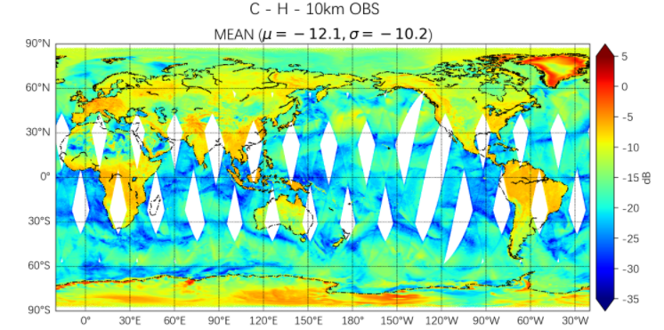
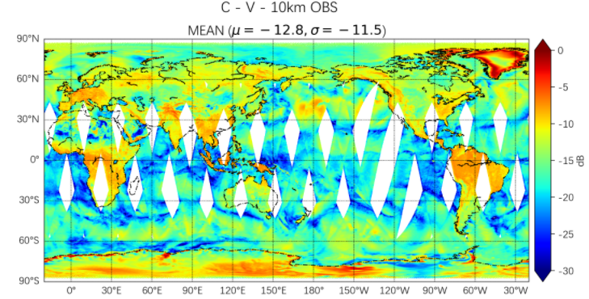
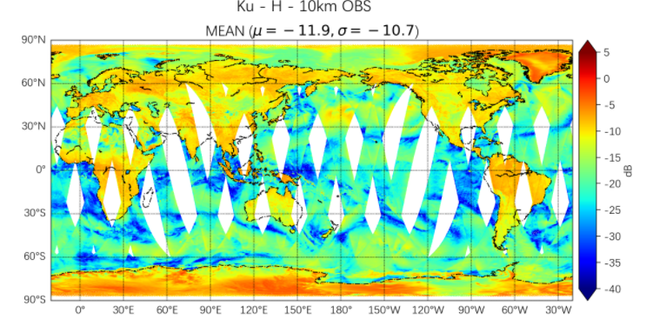
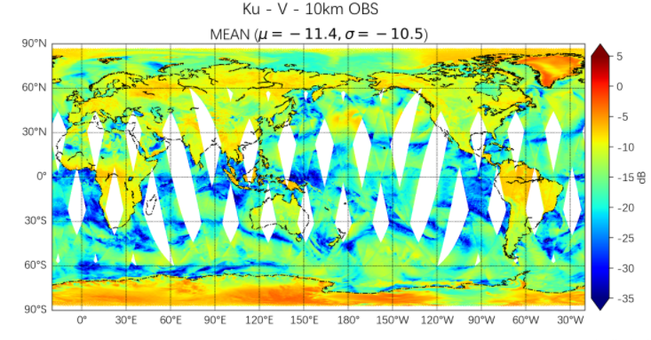
2. Instrument status
Global land/sea surface backscattering products of FY-3E/WindRAD (20230109)
10

Slide 11
PART 03
Cal/Val

Slide 12
3. Cal/Val
WindRAD L1 Calibration/Validation
Internal calibration: the internal calibration loop is used to monitor the instrument internal characteristics in real time to correct the internal effects of transmitter and receiver.
External calibration: active radar calibrators are used to carry out absolute calibration.
L1 product validation: the long term observation data from natural distributed targets and the data of similar instruments are used to evaluate L1 results.
ocean calibration, rainforest, SNO
12
Notes:
内定标: 内定标回路用于实时监测仪器内部特性，纠正发射机和接收机的内部影响。
外定标 :采用主动雷达校准器进行绝对校准。
L1产品验证：利用自然分布目标的长期观测数据和类似仪器的数据对L1结果进行评价。（重点）

Slide 13
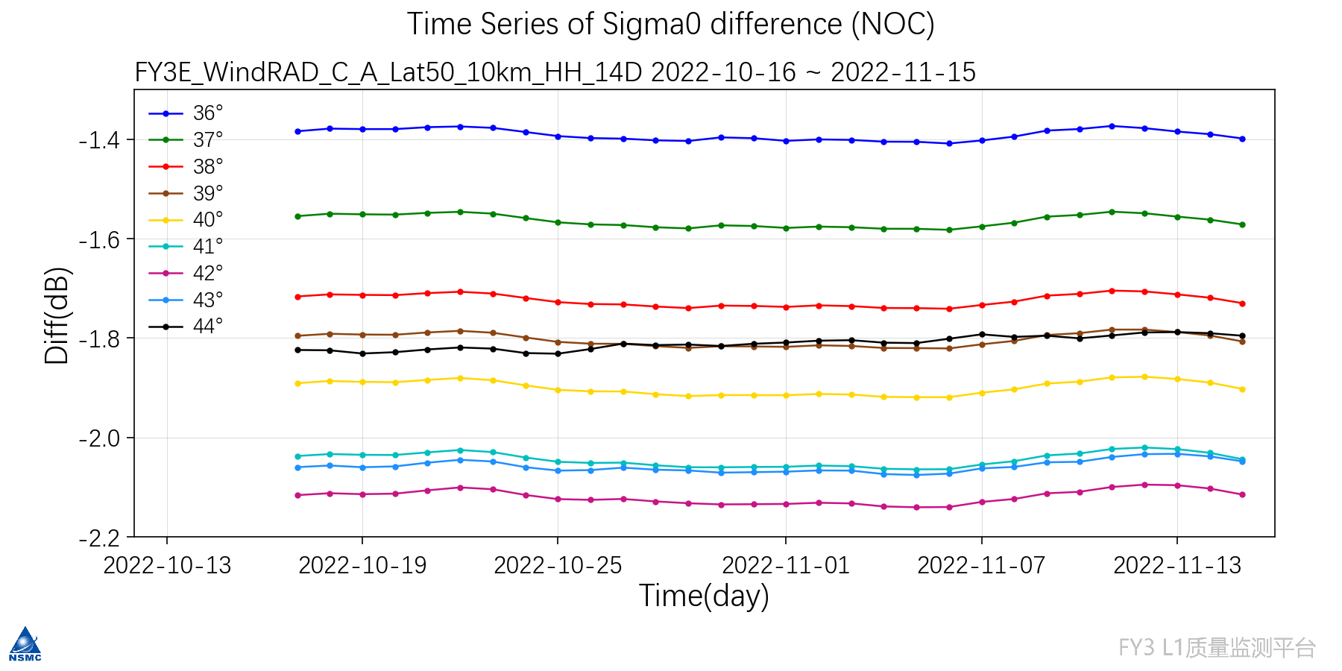
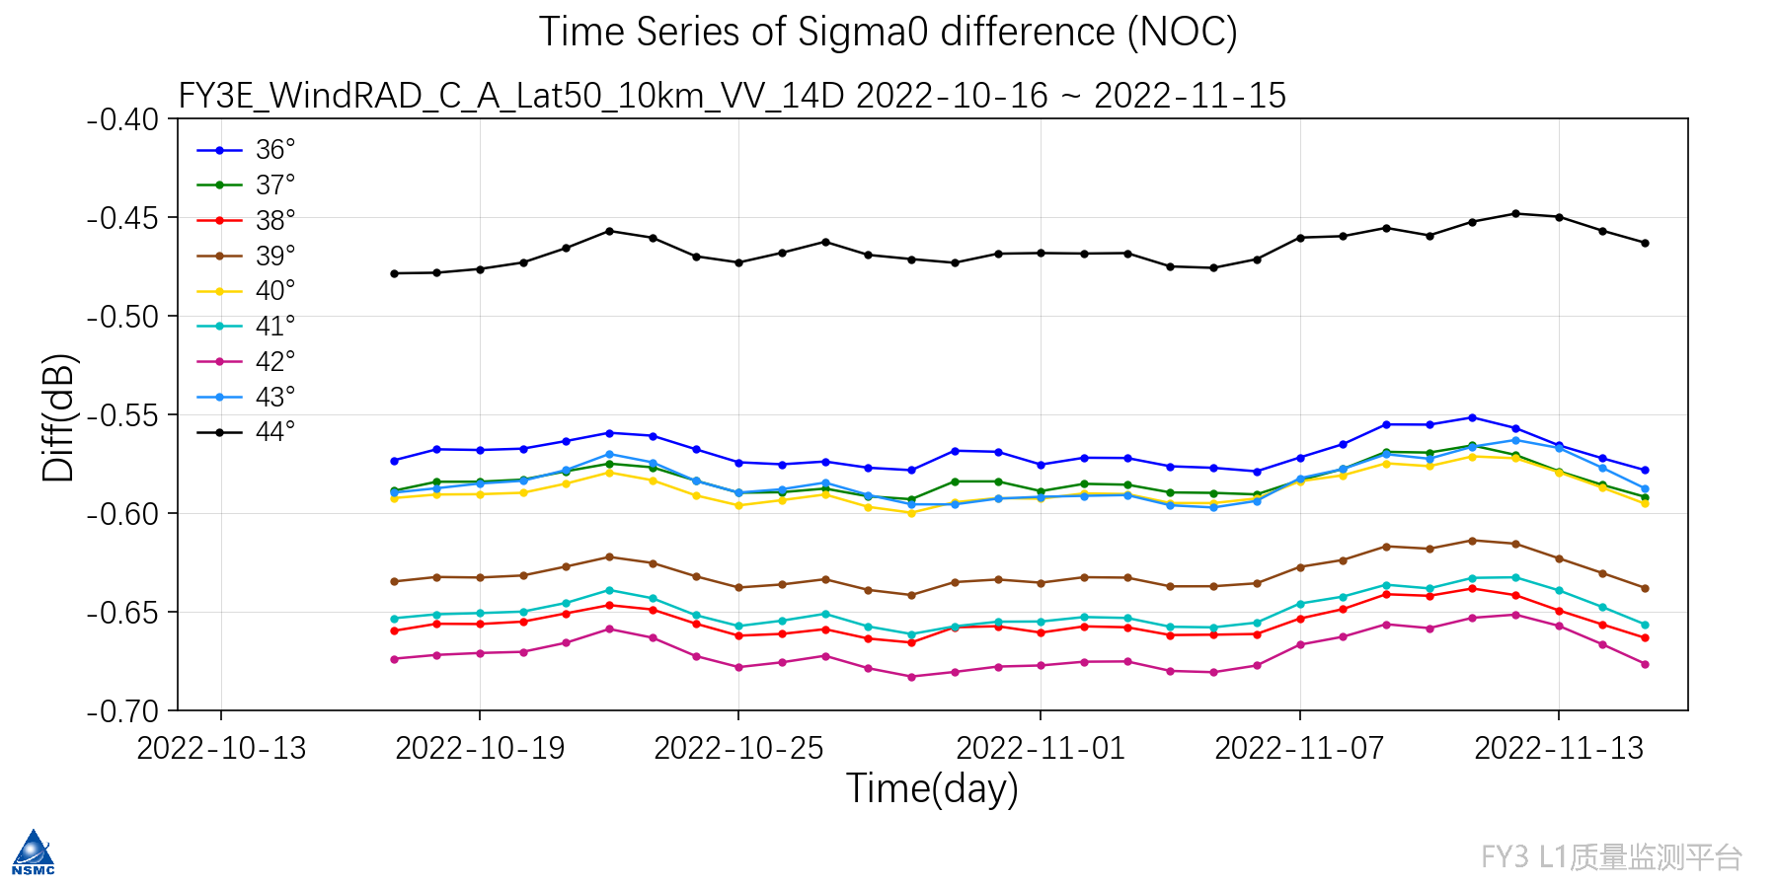
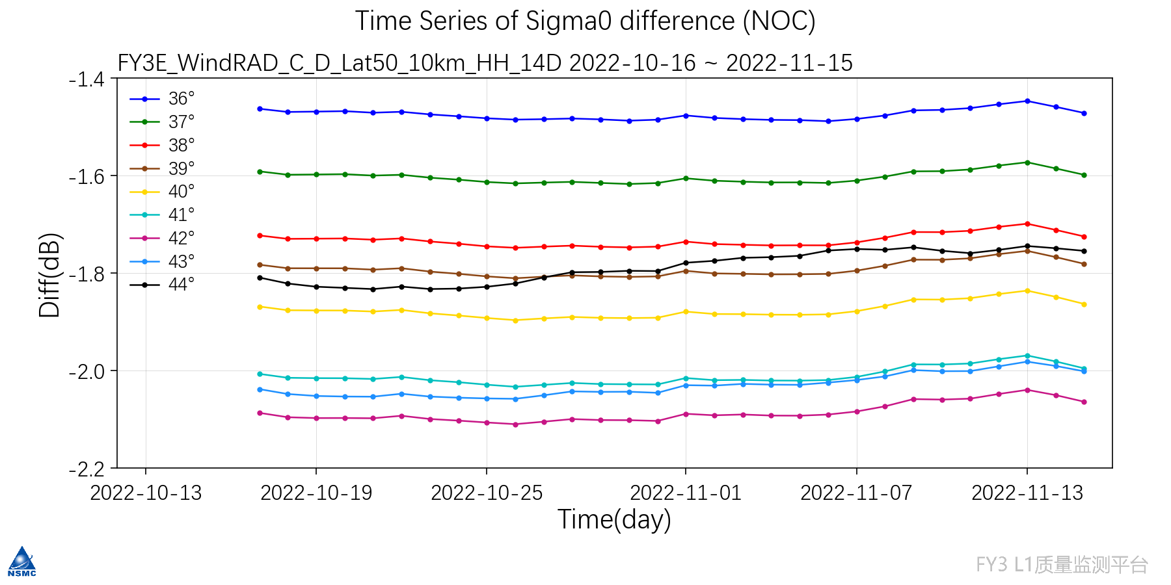
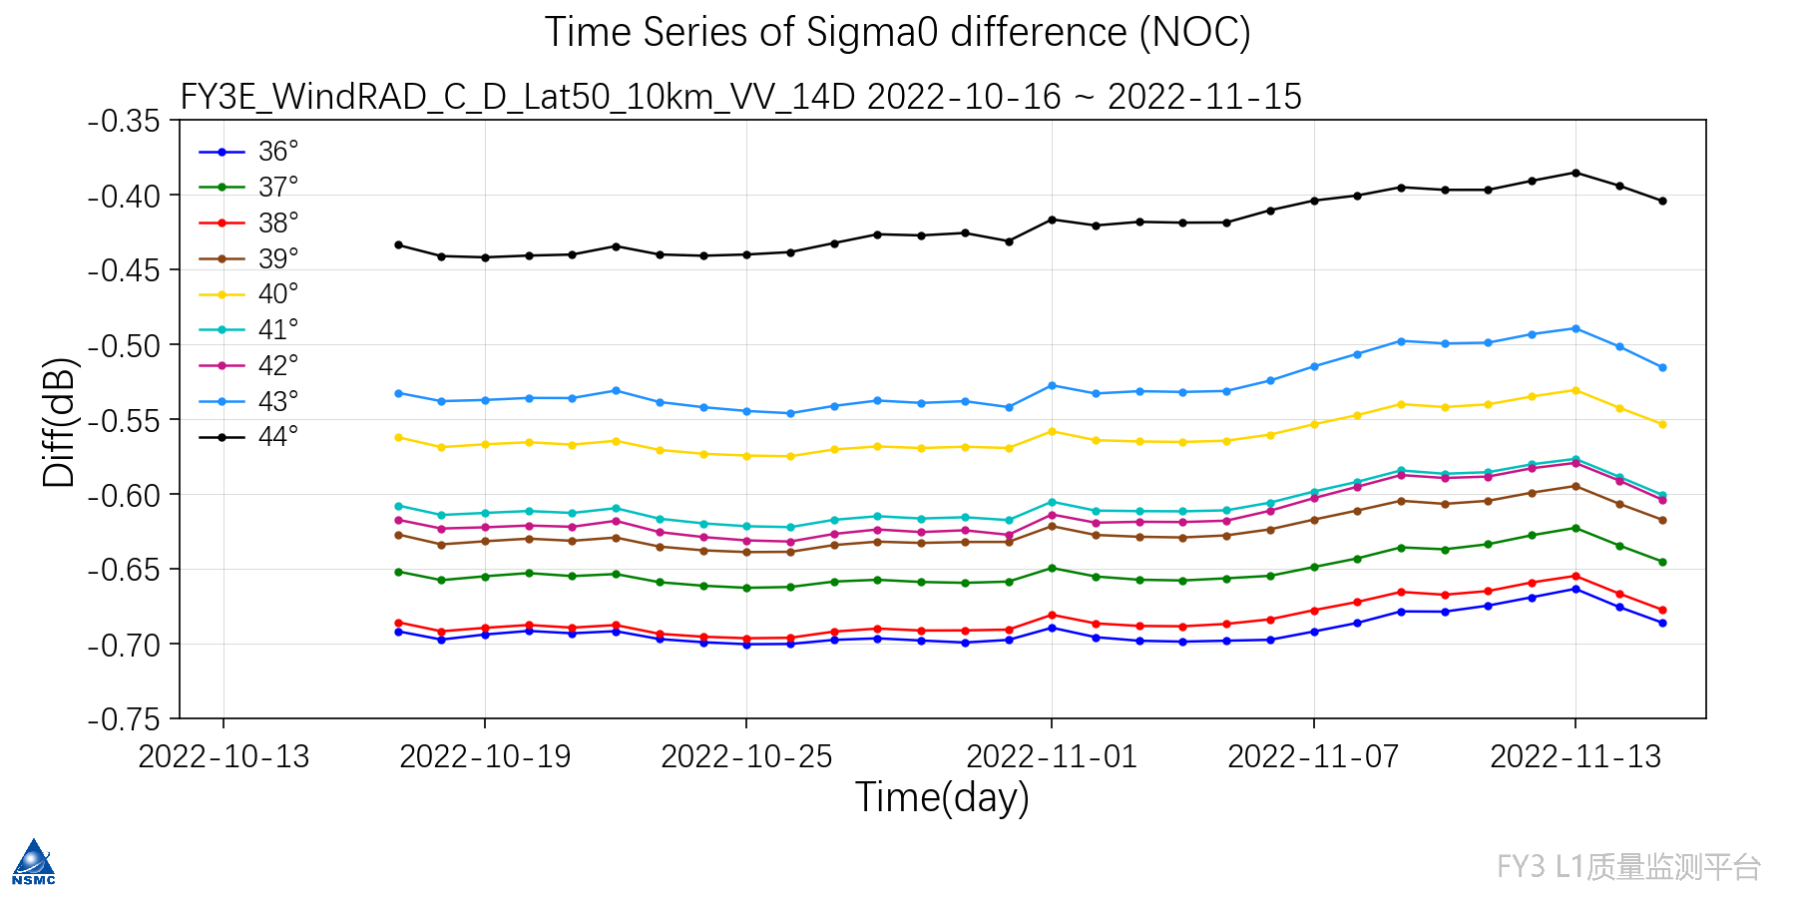
3. Cal/ Val
NOC (NWP Ocean Calibration)
Time series diagram of Sigma0 difference(NOC) for C-band WindRAD data from 20221016 to 20221115.
Smaller bias in C band VV polarization and larger bias in C band HH polarization.
C H Ascending(10km grid)
C V Ascending(10km grid)
C H Descending(10km grid)
C V Descending (10km grid)
13
Notes:
采用地球物理模式函数（NSCAT-4和CMOD7）进行海洋定标分析时，观测sigma0与仿真sigma0的偏差随着时间的变化图；
问的话，C HH偏大是和函数有关系，正在更新；分析图可以看出，偏差整体的变化比较平稳，不同入射角偏差不一样

Slide 14
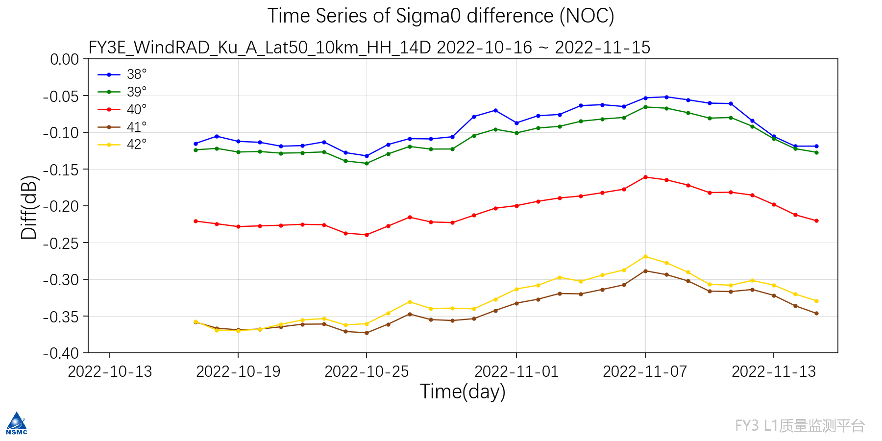
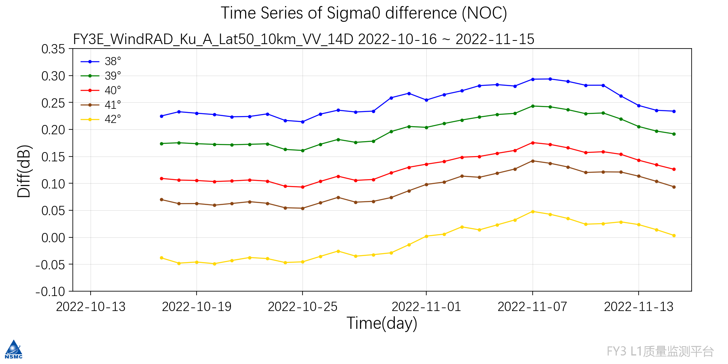
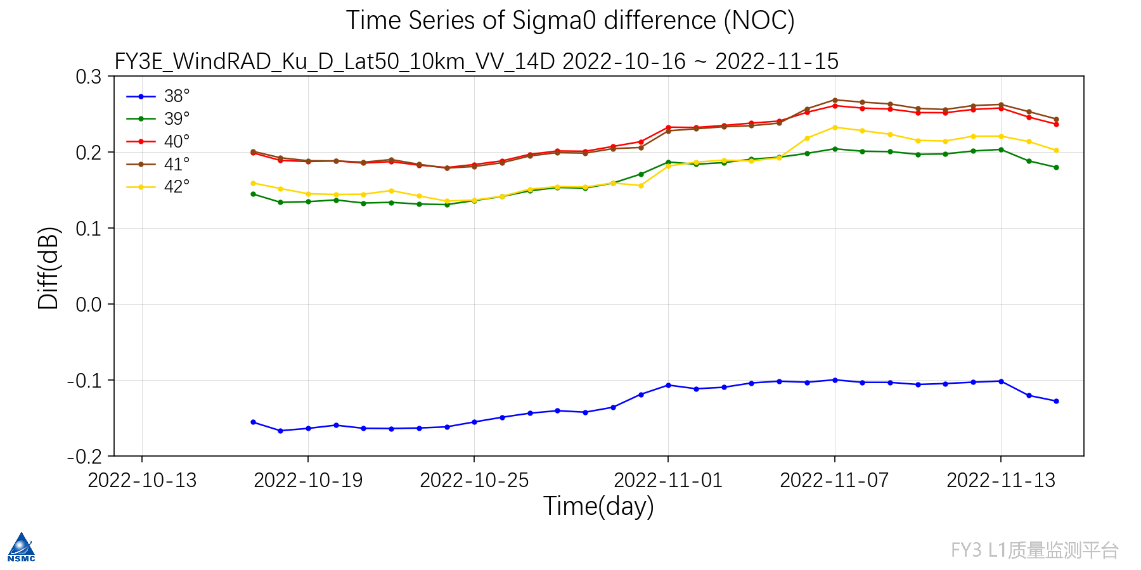
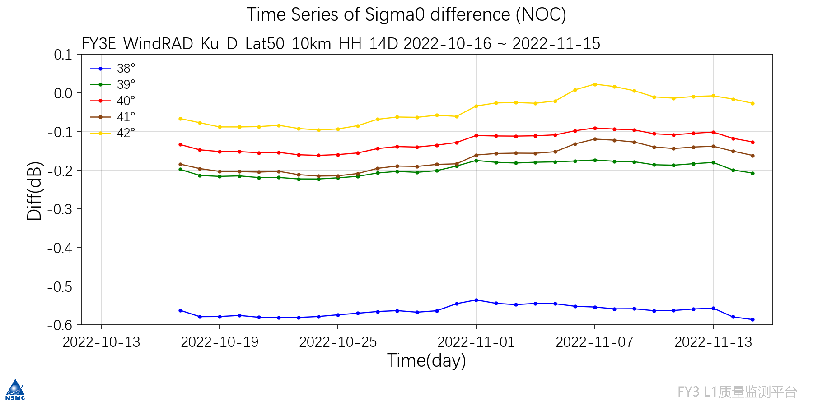
3. Cal/ Val
Time series diagram of Sigma0 difference(NOC) for Ku-band WindRAD data from 20221016 to 20221115.
Smaller bias in Ku band and larger bias in C band.
NOC (NWP Ocean Calibration)
Ku H Ascending(10km grid)
Ku V Ascending(10km grid)
Ku H Descending(10km grid)
Ku V Descending (10km grid)
14
Notes:
对比上图可以看到，Ku波段的偏差比C波段的小；

Slide 15
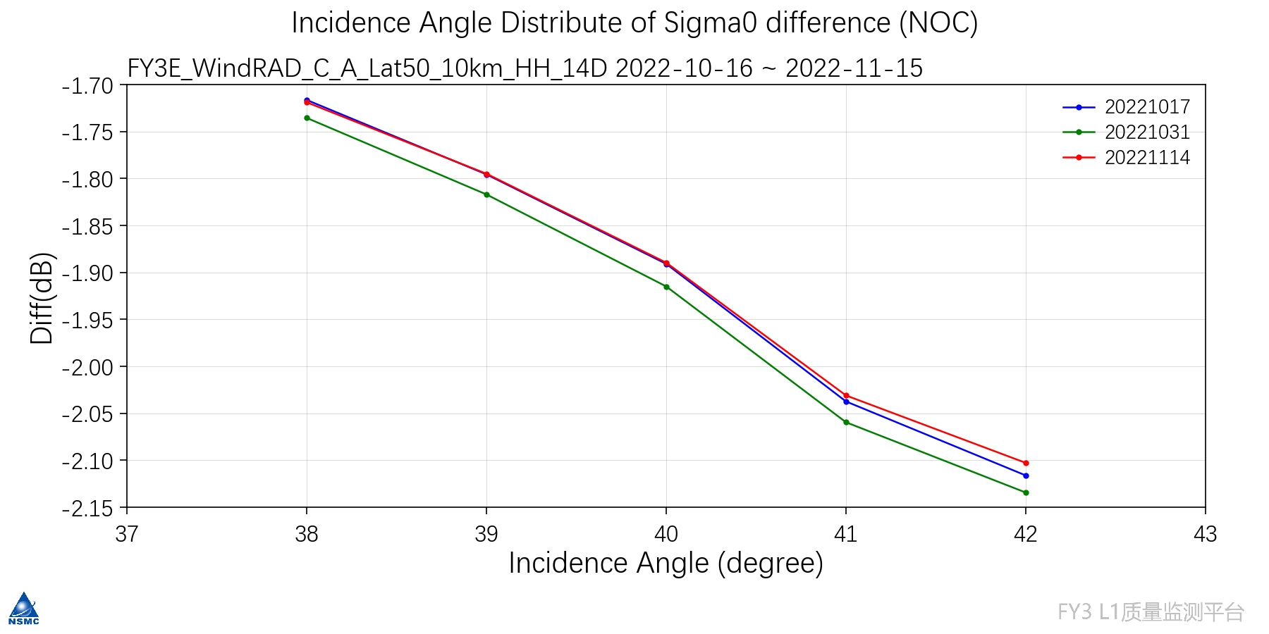
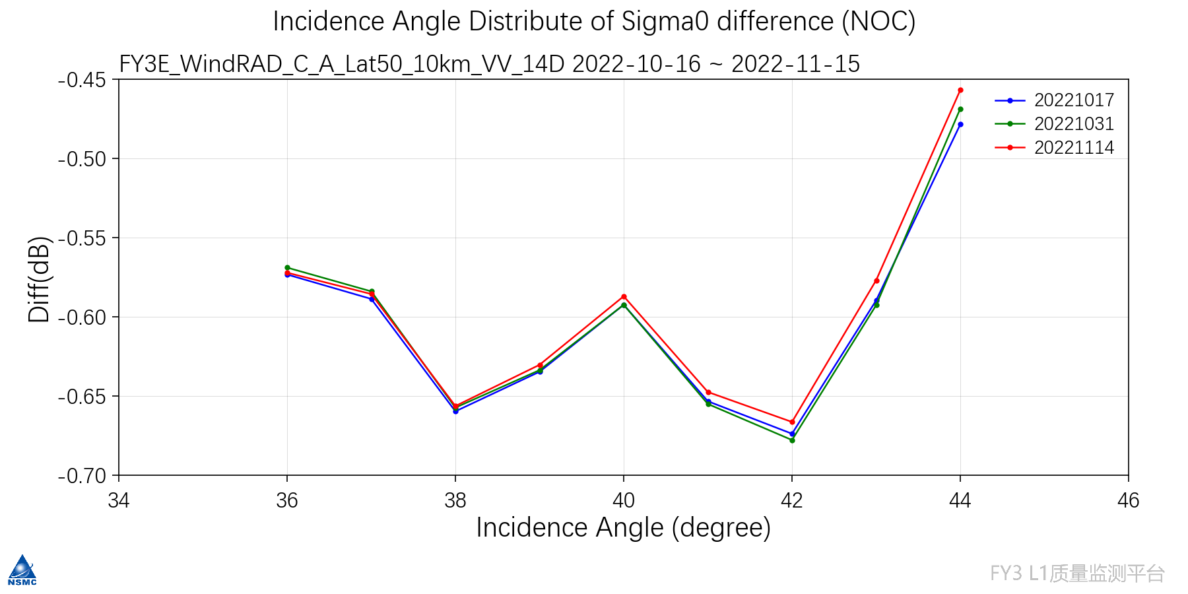
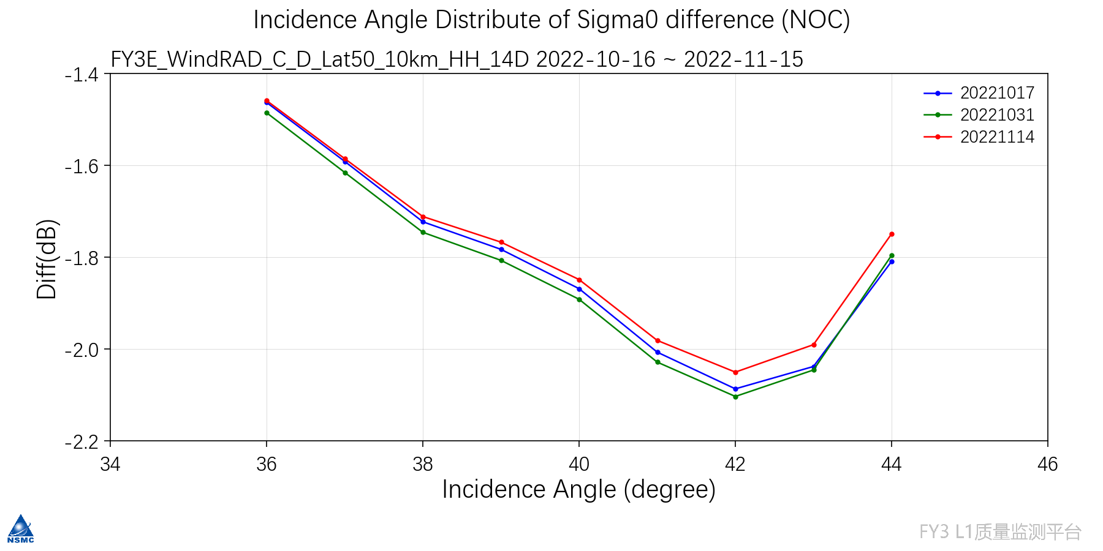
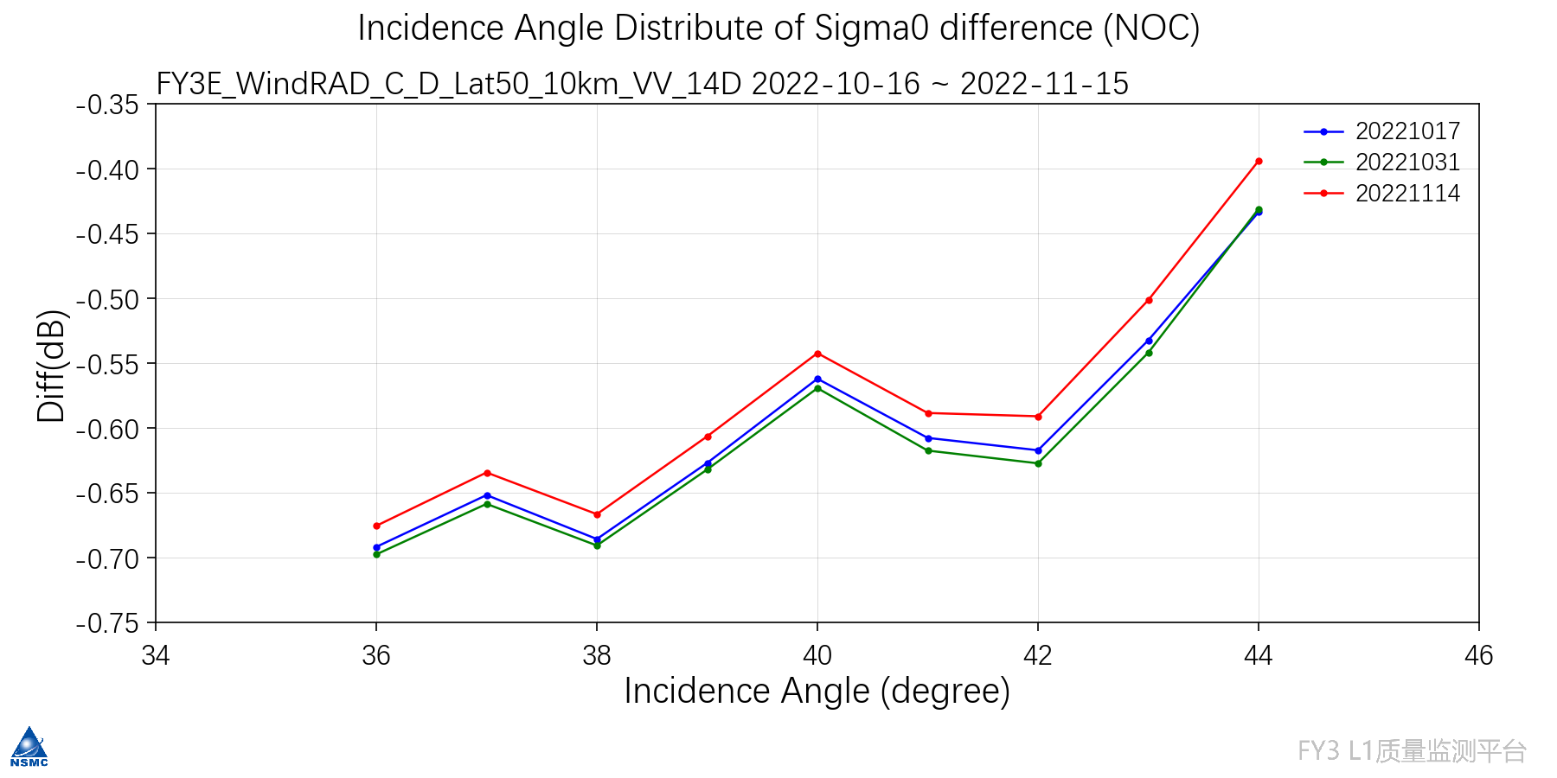
3. Cal/ Val
Incidence angle distribution of Sigma0 difference(NOC) for C band WindRAD data from 20221016 to 20221115.
Smaller bias in C band VV polarization and larger bias in C band HH polarization .
Smaller bias in Ku band and larger bias in C band.
NOC (NWP Ocean Calibration)
C H Ascending(10km grid)
C V Ascending(10km grid)
C H Descending(10km grid)
C V Descending (10km grid)
15
Notes:
海洋定标随入射角的变化图，可以更加清晰的看出定标偏差随角度的变化，后续可以进行角度修正；

Slide 16
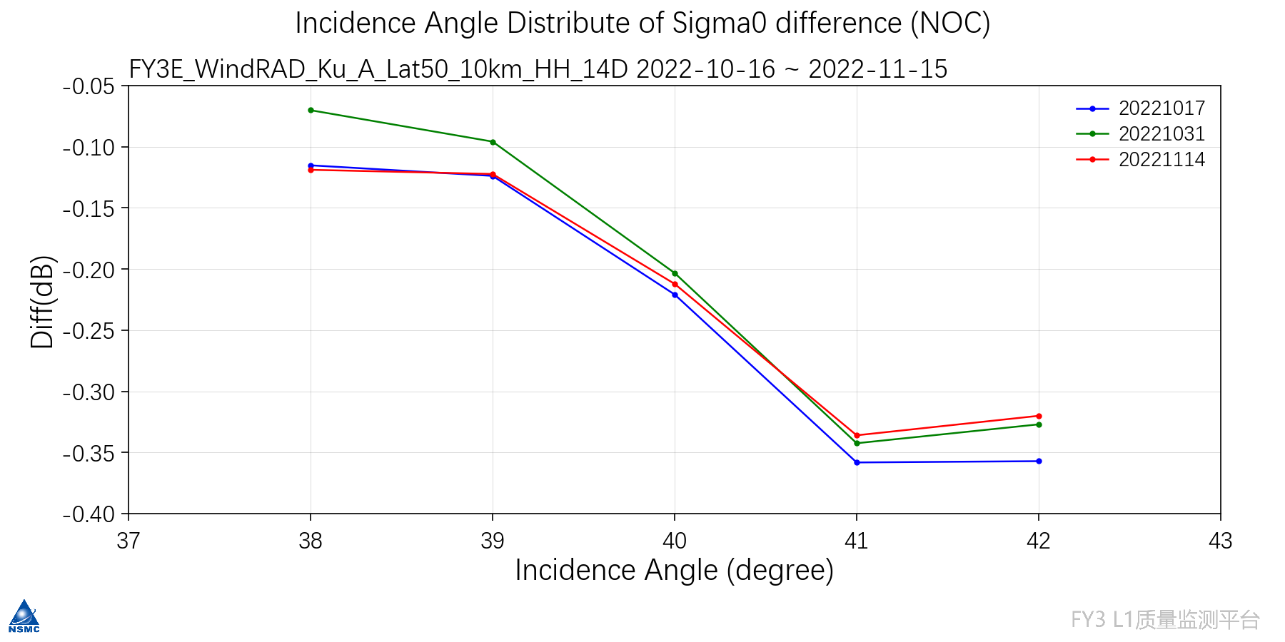
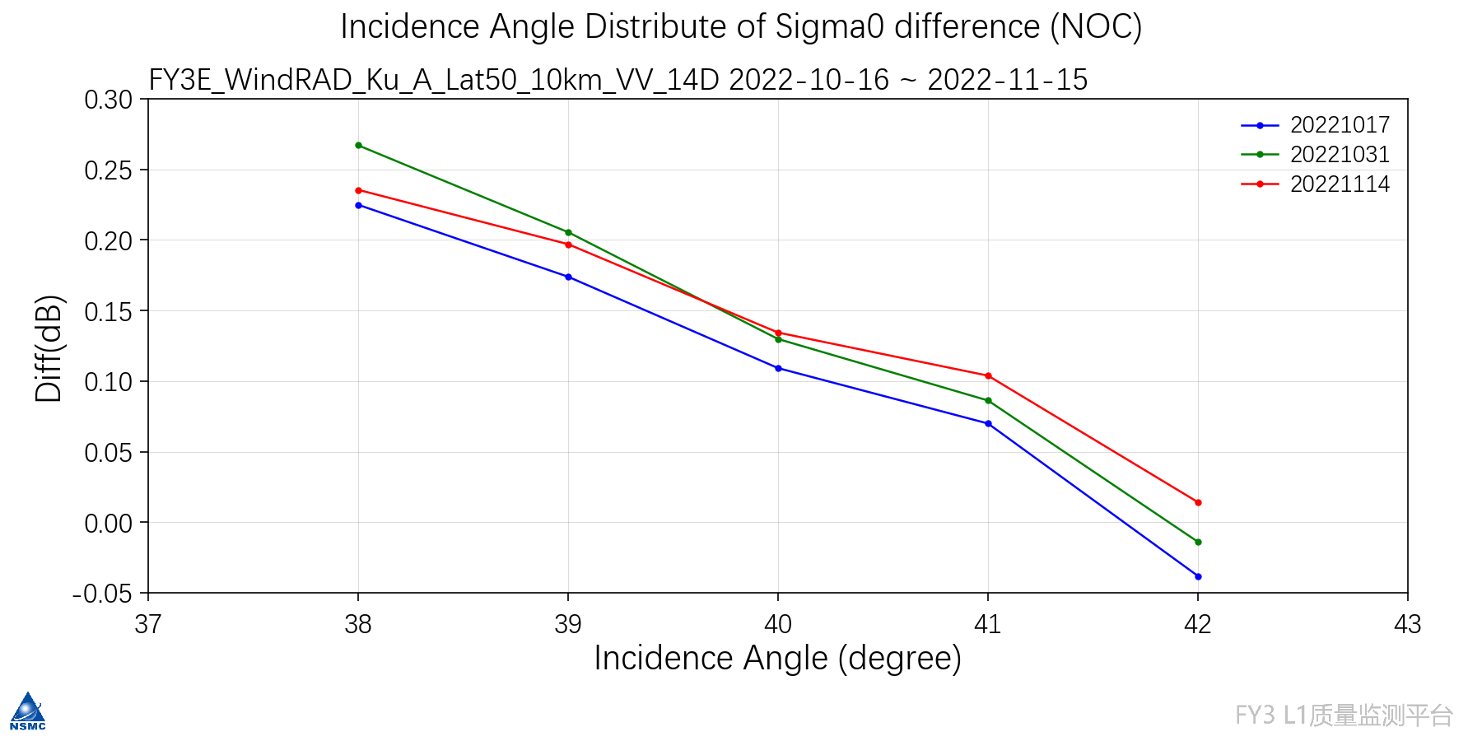
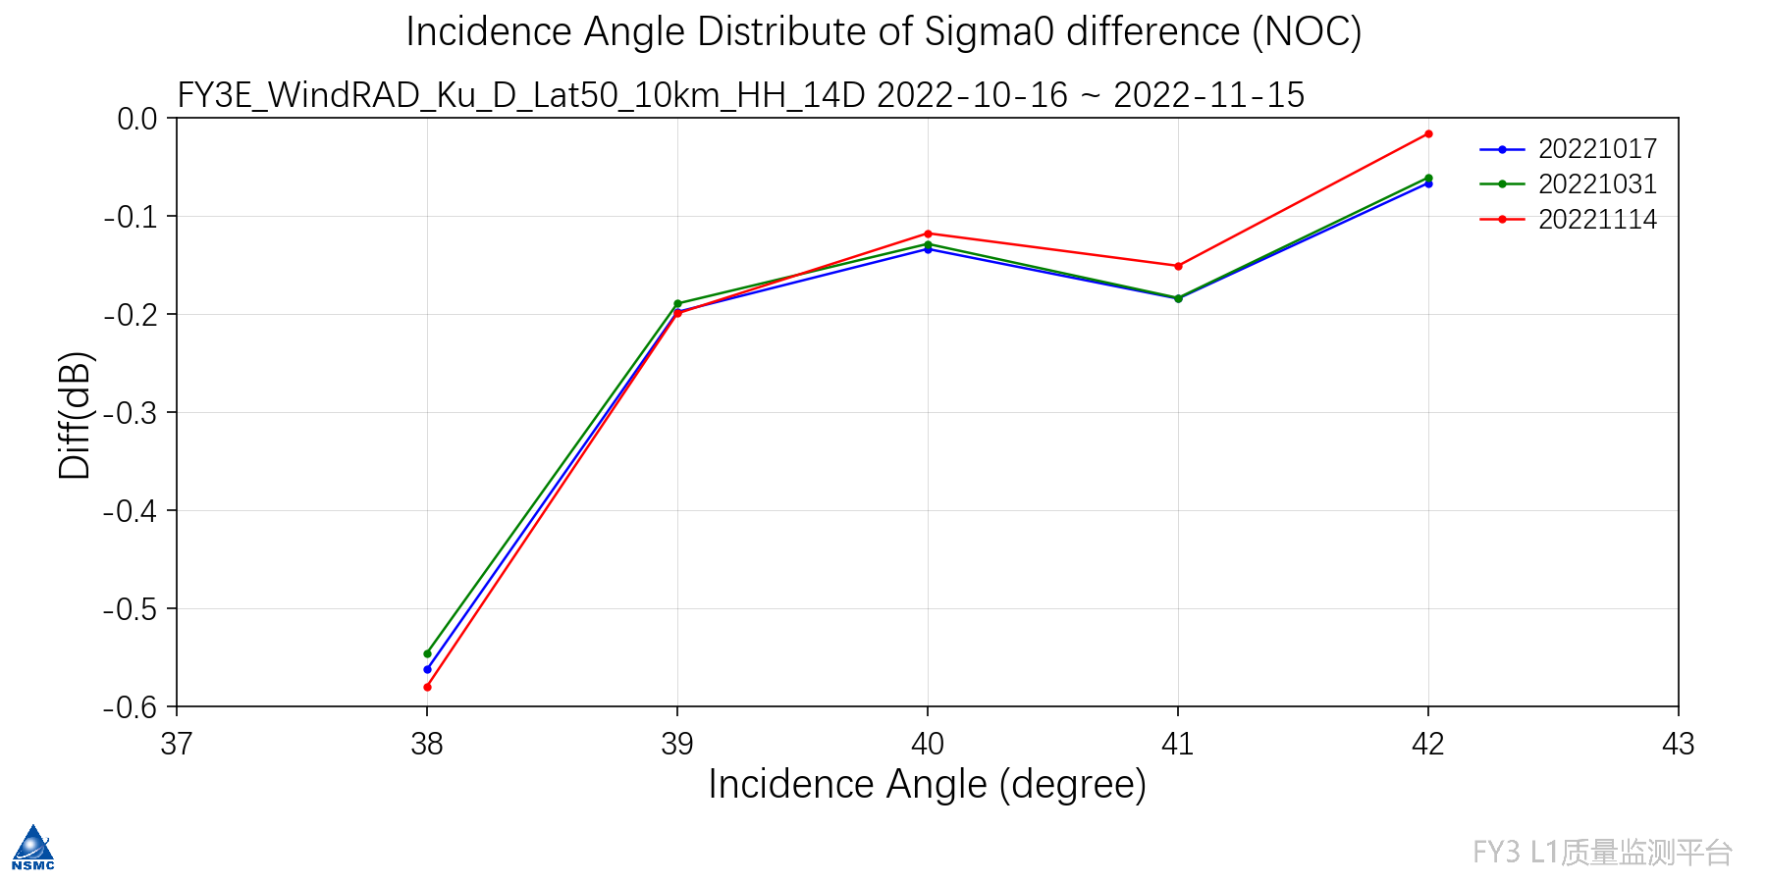
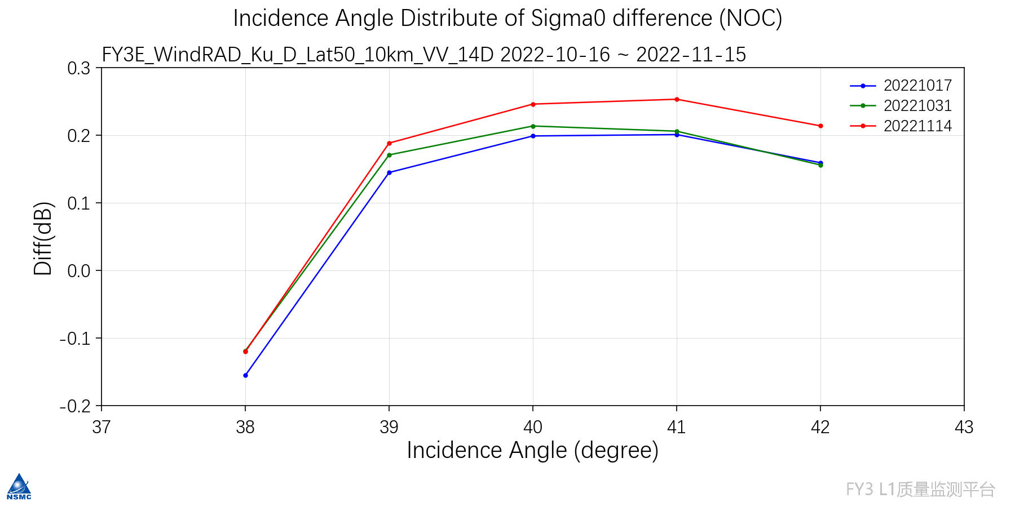
3. Cal/ Val
Incidence angle distribution of Sigma0 difference(NOC) for Ku band WindRAD data from 20221016 to 20221115.
Smaller bias in C band VV polarization and larger bias in C band HH polarization.
Smaller bias in Ku band and larger bias in C band.
NOC (NWP Ocean Calibration)
Ku H Ascending(10km grid)
Ku V Ascending(10km grid)
Ku H Descending(10km grid)
Ku V Descending (10km grid)
16
Notes:
海洋定标随入射角的变化图，可以更加清晰的看出定标偏差随角度的变化，后续可以进行角度修正；

Slide 17
3. Cal/ Val
NOC (NWP Ocean Calibration)
Evaluation of radiometric calibration accuracy based on nwp ocean calibration
Band | Mean bias（dB） |  |  | Std of bias（dB）
 | Ascend | Descend | All | Ascend | Descend | All
C-H-10km | -1.90 | -1.88 | -1.89 | 0.01 | 0.02 | 0.02
C-H-20km | -1.91 | -1.89 | -1.90 | 0.01 | 0.02 | 0.02
C-V-10km | -0.59 | -0.56 | -0.57 | 0.01 | 0.01 | 0.02
C-V-20km | -0.61 | -0.58 | -0.60 | 0.01 | 0.01 | 0.02
Ku-H-10km | -0.20 | -0.13 | -0.17 | 0.02 | 0.02 | 0.05
Ku-H-20km | -0.18 | -0.14 | -0.16 | 0.02 | 0.02 | 0.03
Ku-V-10km | 0.13 | 0.22 | 0.18 | 0.03 | 0.03 | 0.05
Ku-V-20km | 0.15 | 0.21 | 0.18 | 0.03 | 0.03 | 0.04
WindRAD data from 20221016 to 20221115.
The calibration accuracy <1dB（CH calibration accuracy is -1.9dB and is being tested）
Smaller bias in Ku band and larger bias in C band.
Smaller bias in C band VV polarization and larger bias in C band HH polarization .
Further improvements will be made in the near future.
17
Notes:
基于海洋定标评估辐射定标精度结果
According to the Marine calibration test results of L1 data in October 2022, the accuracy of C H calibration is -1.90dB, C V calibration is -0.60dB, Ku H calibration is -0.17dB, and Ku V calibration is 0.18dB. See Figure 2.6-2~2.6-5 and Table 2.6-1 for details.

Slide 18
3. Cal/Val
SNO for WindRAD L1 validation
each band, each polarization, each grid resolution or slice data
Time
Space
Incidence angle
Azimuth angle
Background uniformity
Metop ASCAT
C band, VV
CFOSAT SCAT
Ku band, HH & VV
HY-2 SCAT
Ku band, HH & VV
18

Slide 19
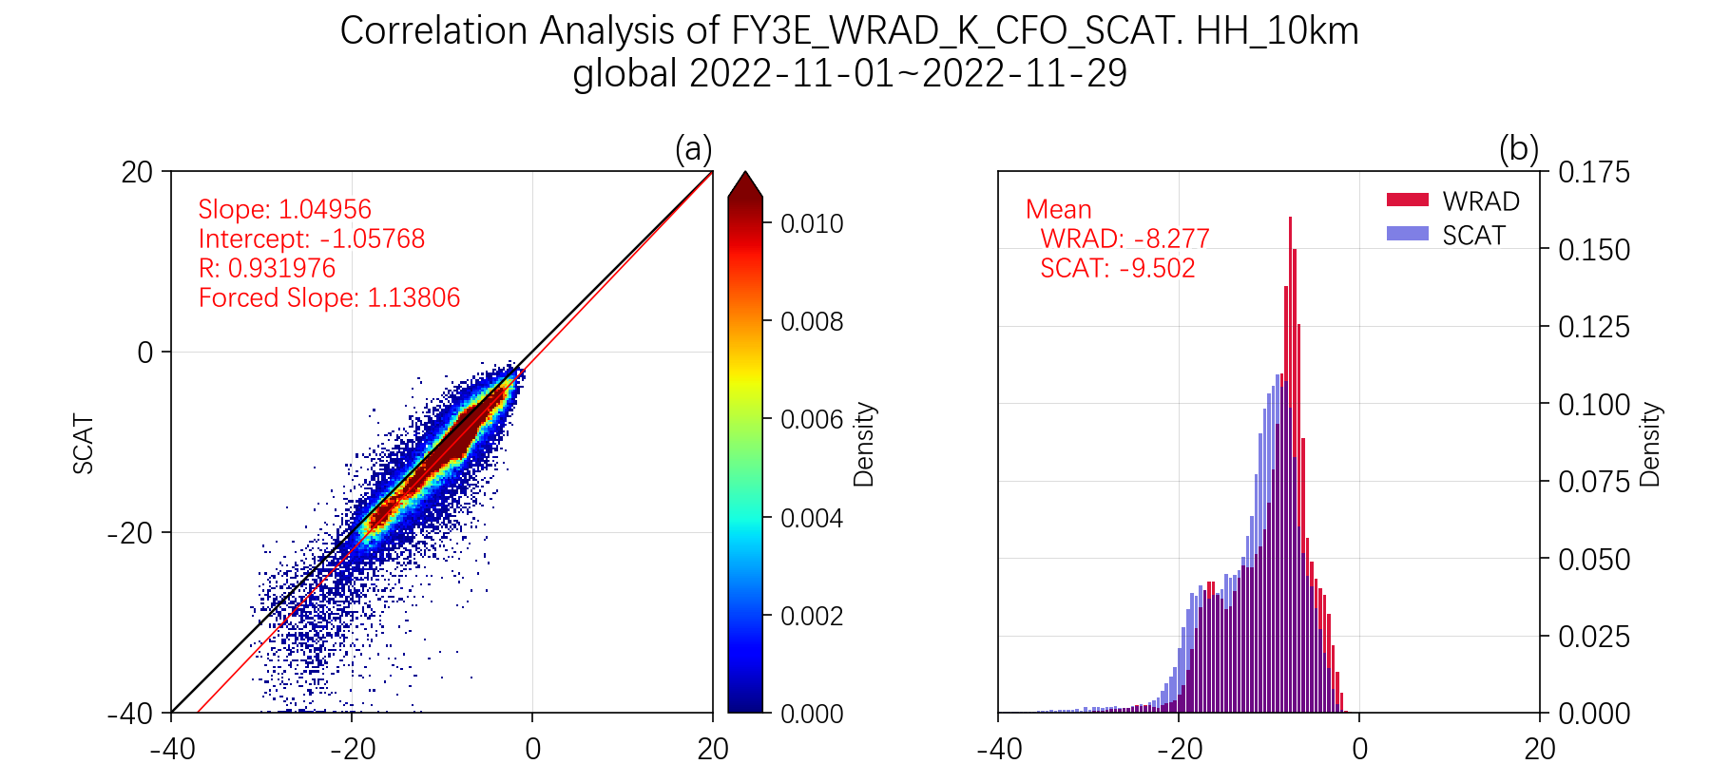
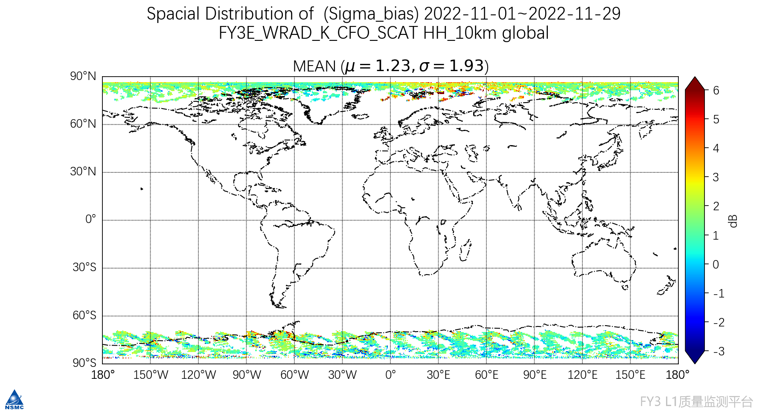
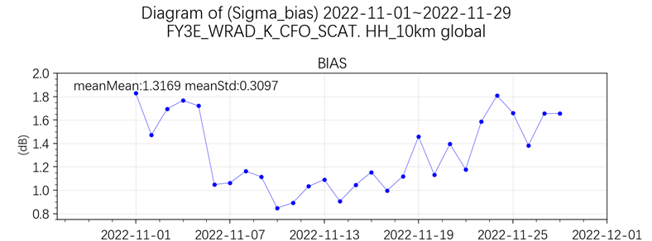
3. Cal/Val
WindRAD vs. CFOSAT SCAT | HH 10km | VV 10km
Matching points | 96182 | 487544
Correlation coefficient | 0.93 | 0.91
Mean / dB | 1.23 | 1.65
Std / dB | 1.94 | 2.97
Preliminary SNO results:
FY-3E WindRAD vs. CFOSAT SCAT
(WindRAD data, 20221101-20221129)
Ku HH
19
Notes:
下图为FY-3E WindRAD vs. CFOSAT SCAT的SNO偏差的空间分布图，相关性分析图以及时间序列图，匹配点数为96182个，匹配点分布在两级

Slide 20
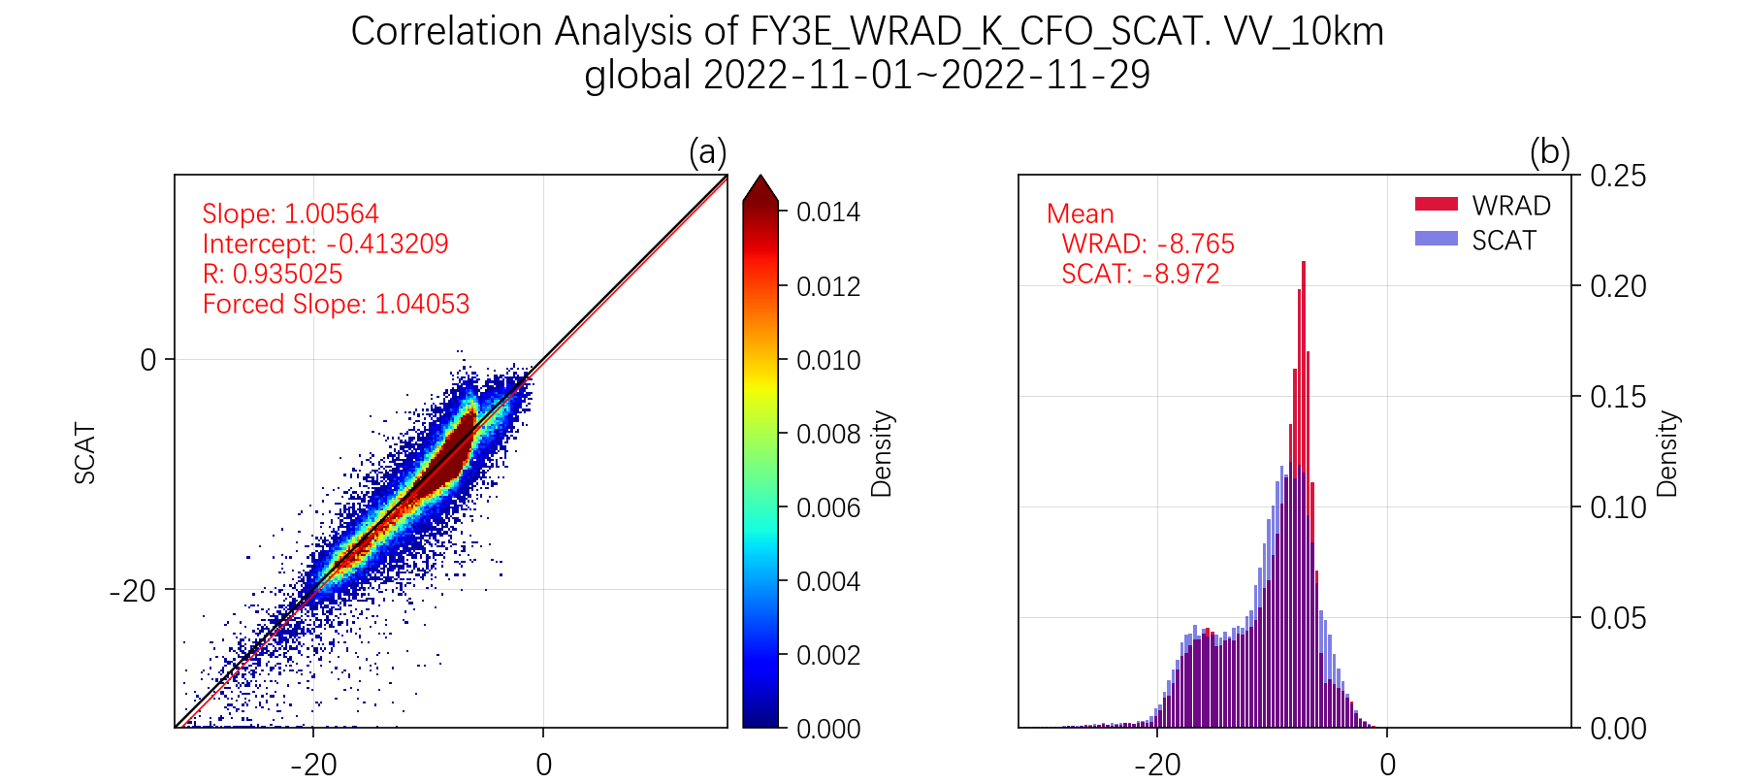
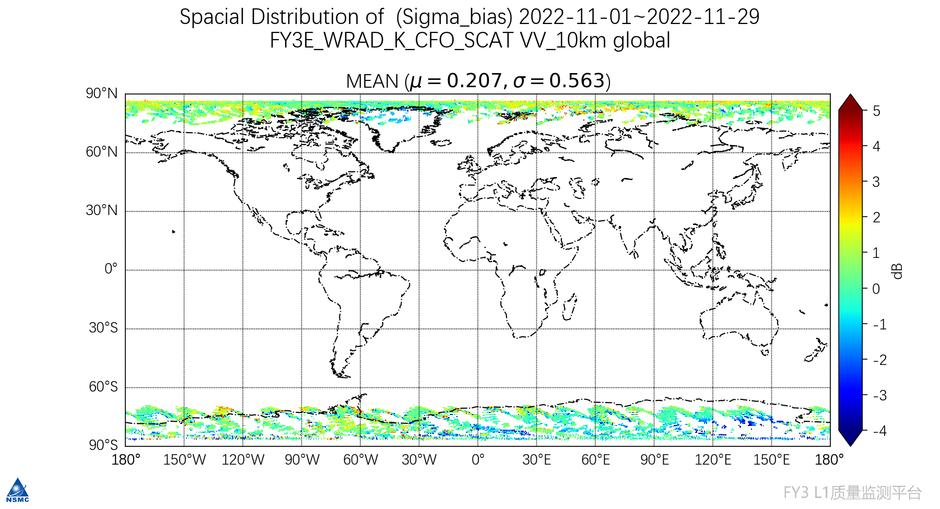
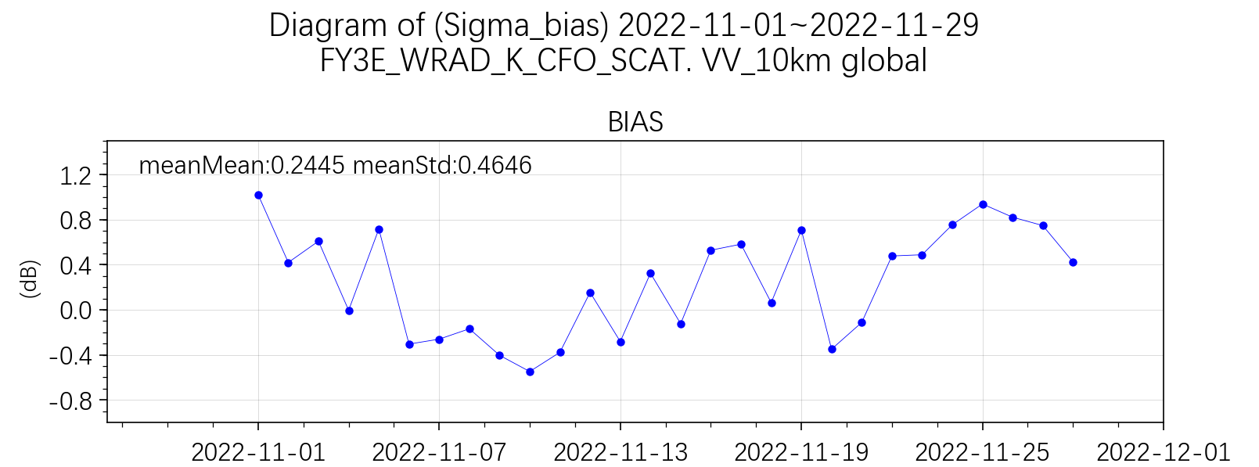
3. Cal/Val
WindRAD vs. CFOSAT SCAT | HH 10km | VV 10km
Matching points | 96182 | 88784
Correlation coefficient | 0.93 | 0.94
Mean / dB | 1.23 | 0.21
Std / dB | 1.94 | 0.56
Preliminary SNO results:
FY-3E WindRAD vs. CFOSAT SCAT
(WindRAD data, 20221101-20221129)
Ku VV
20

Slide 21
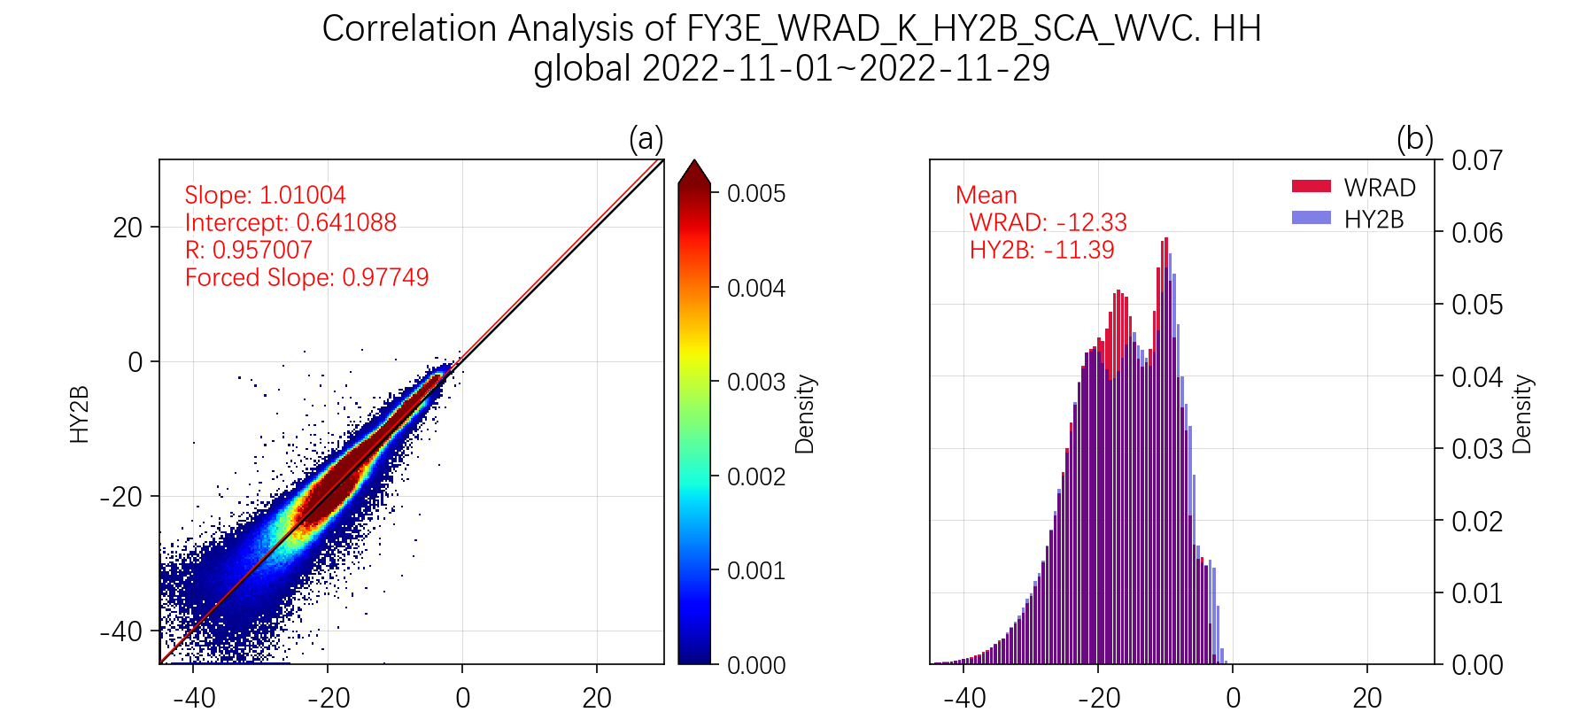
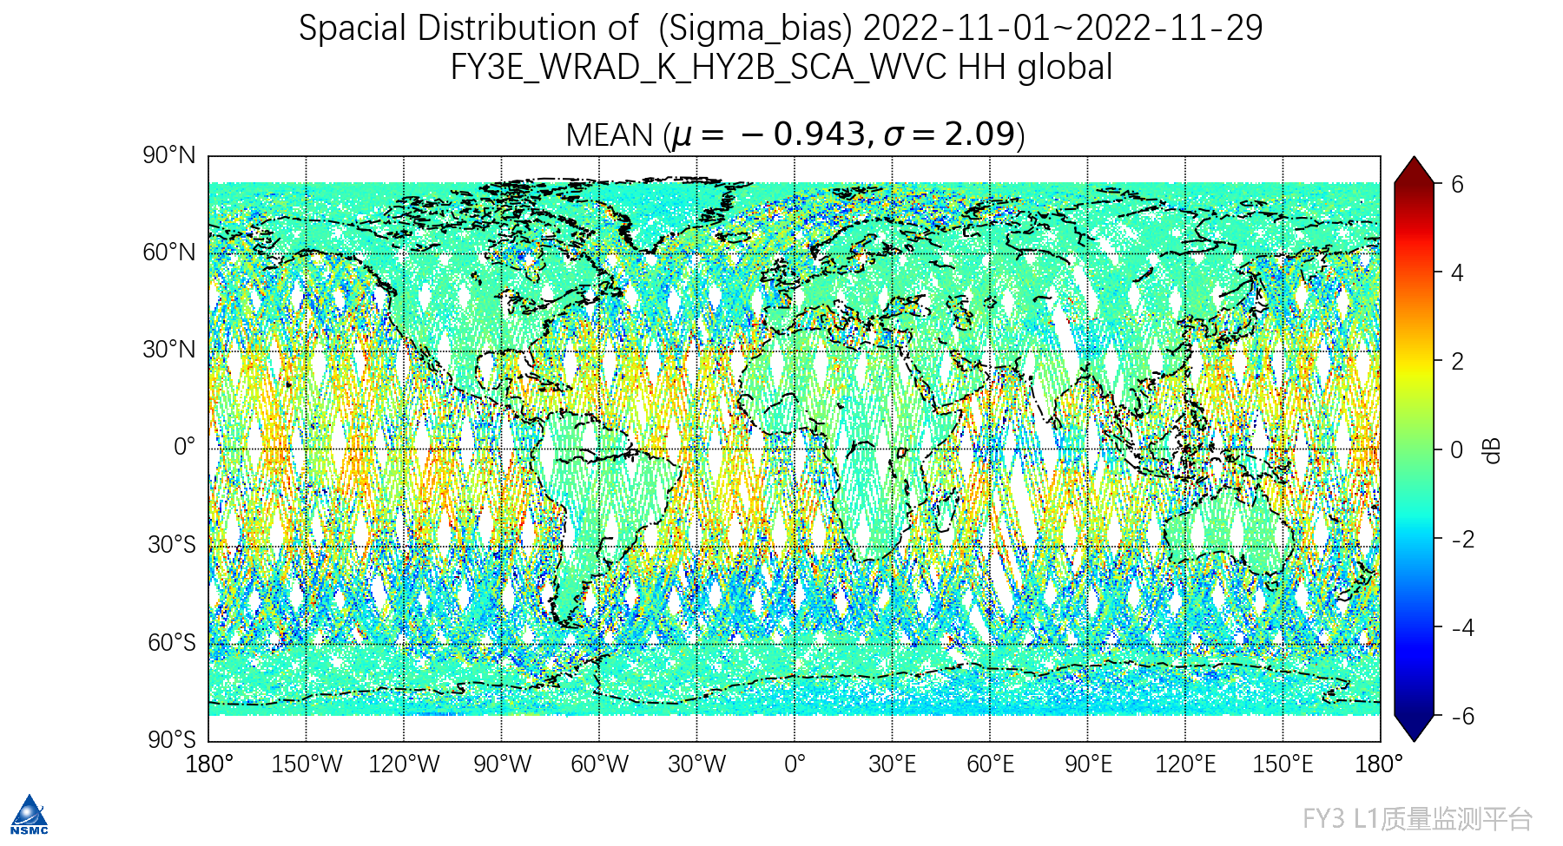
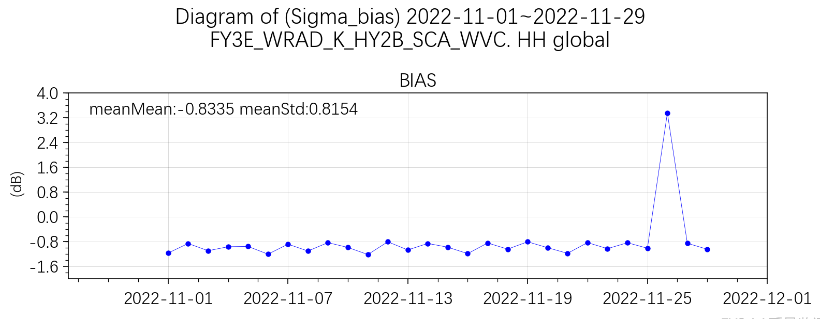
3. Cal/Val
WindRAD vs. HY-2B SCAT | HH WVC
Matching points | 540676
Correlation coefficient | 0.96
Mean / dB | -0.94
Std / dB | 2.09
Preliminary SNO results:
FY-3E WindRAD vs. HY-2B SCAT
(WindRAD 20221101-1129)
Ku HH
21

Slide 22
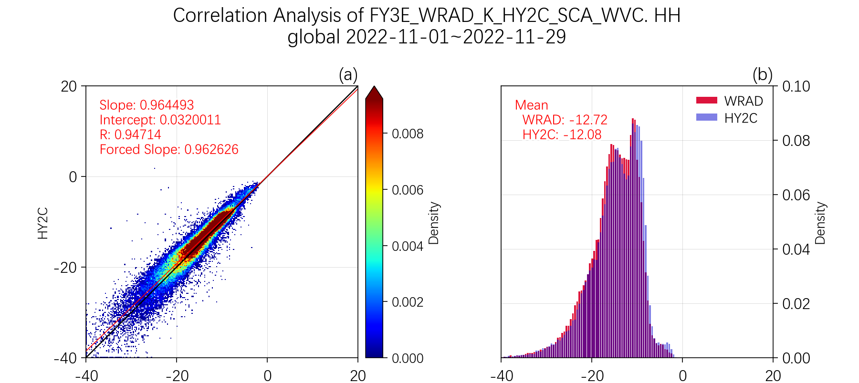
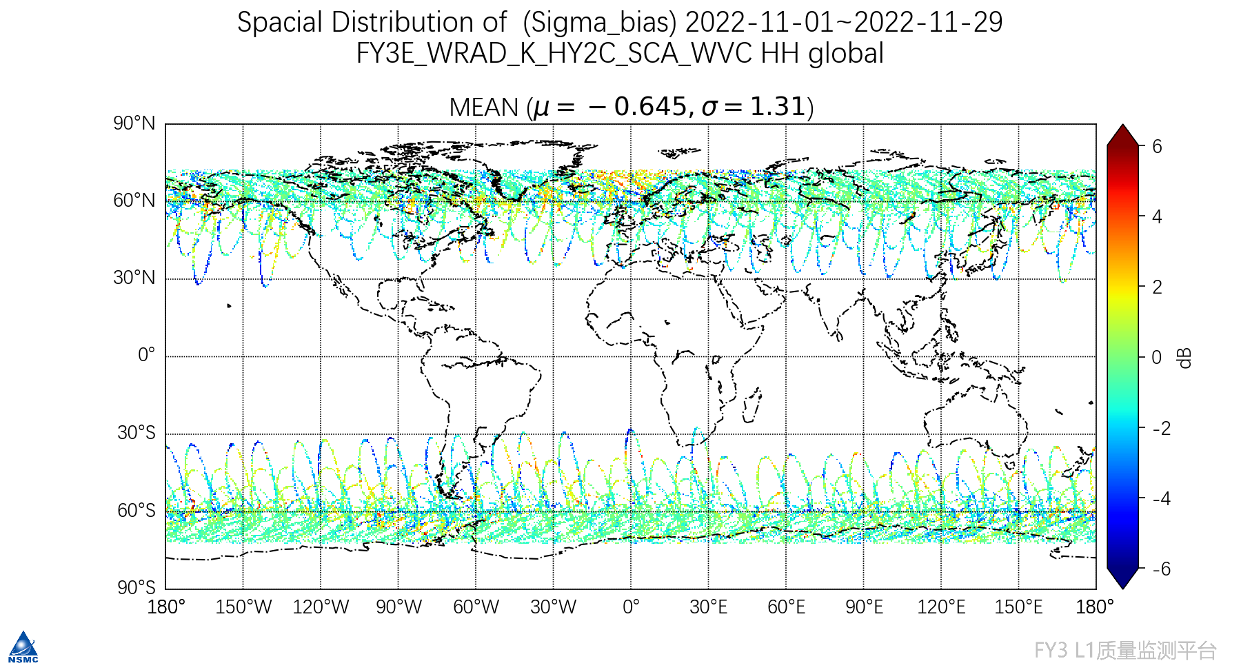
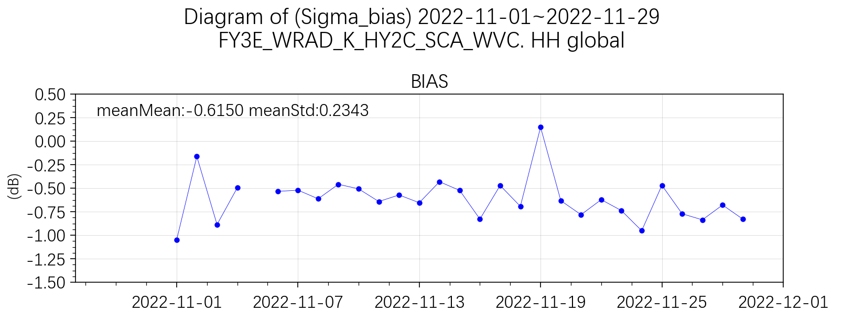
3. Cal/Val
WindRAD vs. HY-2C SCAT | HH WVC
Matching points | 80184
Correlation coefficient | 0.95
Mean / dB | -0.65
Std / dB | 1.31
Preliminary SNO results:
FY-3E WindRAD vs. HY-2C SCAT
(WindRAD 20221101-1129)
Ku HH
22

Slide 23
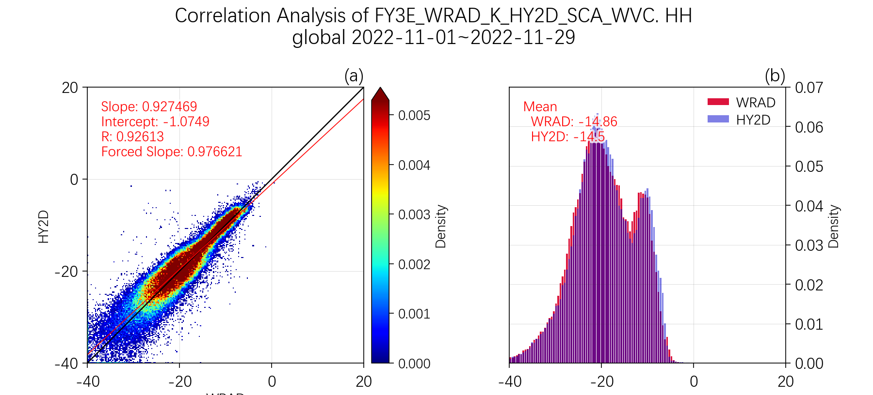
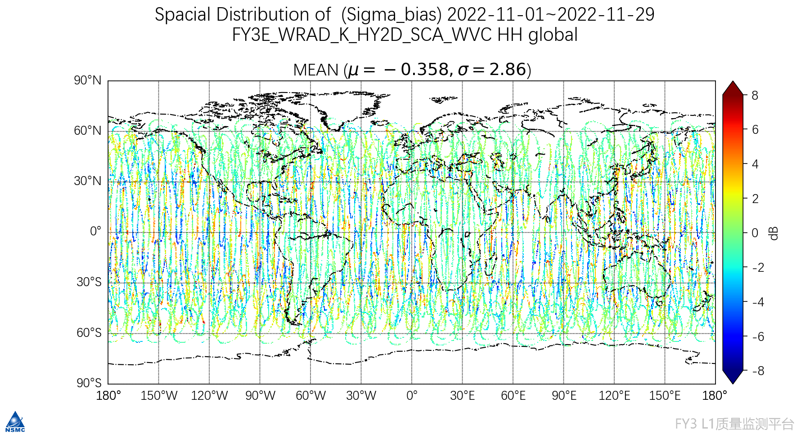
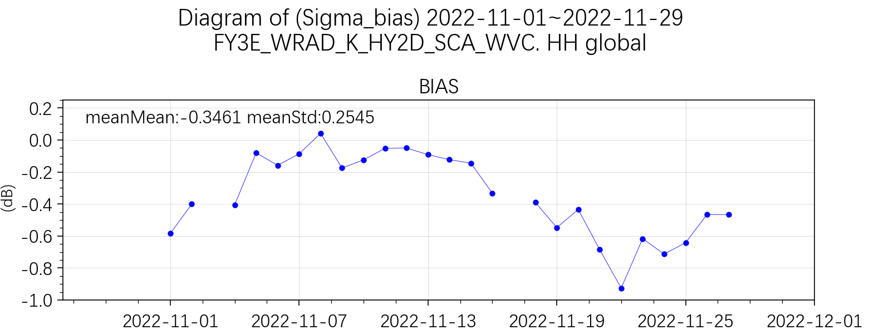
3. Cal/Val
WindRAD vs. HY-2D SCAT | HH WVC
Matching points | 115921
Correlation coefficient | 0.93
Mean / dB | -0.36
Std / dB | 2.86
Preliminary SNO results:
FY-3E WindRAD vs. HY-2D SCAT
(WindRAD 20221101-1129)
Ku HH
23

Slide 24
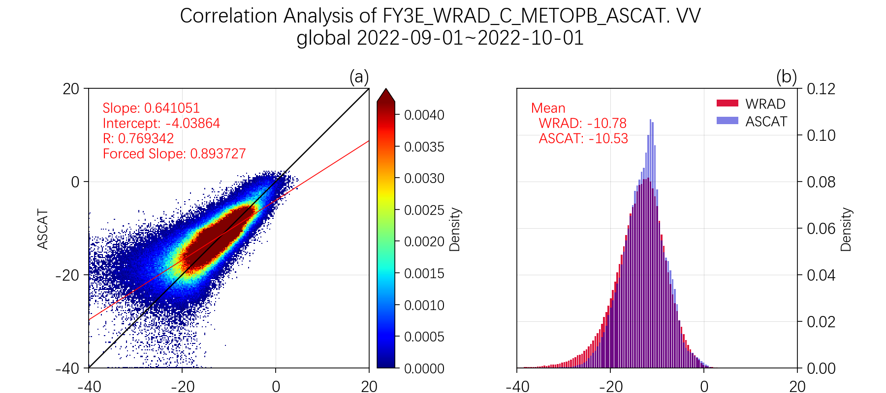
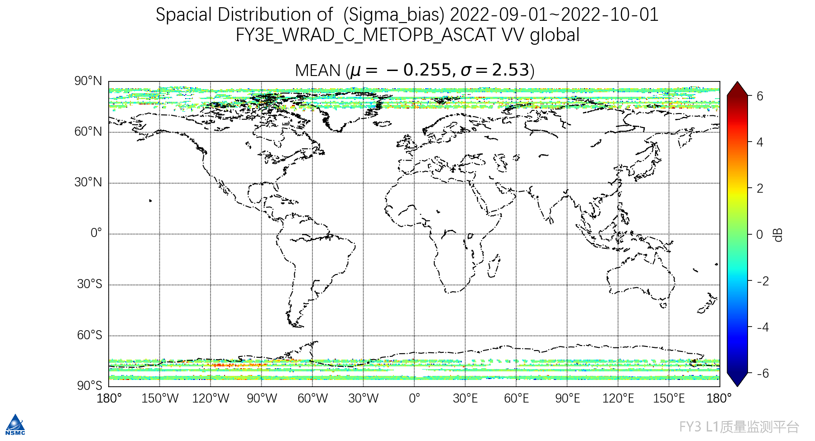
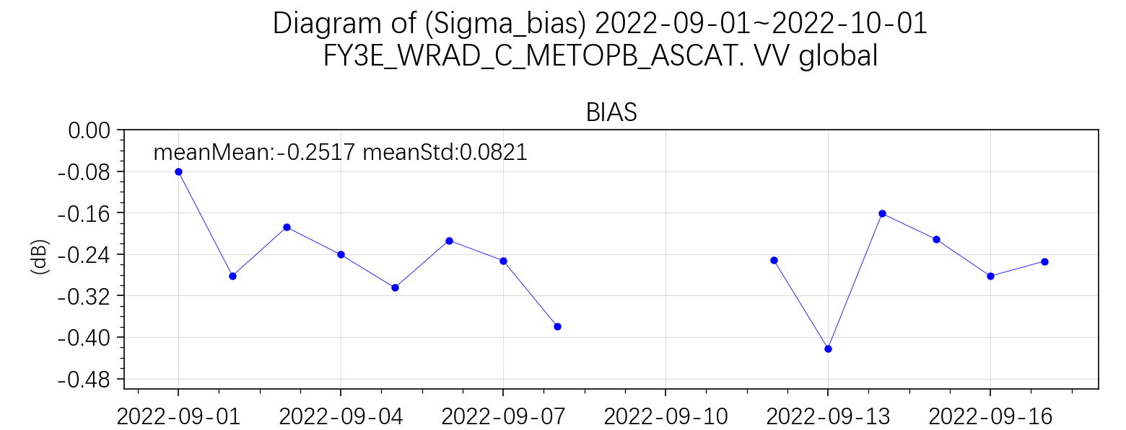
3. Cal/Val
Preliminary SNO results:
WindRAD vs. Metop-B ASCAT | VV WVC
Matching points | 449119
Correlation coefficient | 0.77
Mean / dB | -0.25
Std / dB | 2.53
FY-3E WindRAD vs. Metop-B ASCAT
(WindRAD data, 20220901-20221001)
C VV
24

Slide 25
3. Cal/Val
SNO for WindRAD L1 validation
The distribution characteristics of the sigma0 are generally consistent with those of similar instruments.
Operational updates will be made recently, after which SNO work will continue to be carried out to analyze the results of new data.
WindRAD vs. CFOSAT SCAT | HH 10km | VV 10km
Matching points | 96182 | 88784
Correlation coefficient | 0.93 | 0.94
Mean / dB | 1.23 | 0.21
Std / dB | 1.94 | 0.56
WindRAD vs. HY-2 SCAT | HY-2B HH WVC | HY-2C HH WVC | HY-2D HH WVC
Matching points | 540676 | 80184 | 115921
Correlation coefficient | 0.96 | 0.95 | 0.93
Mean / dB | -0.94 | -0.65 | -0.36
Std / dB | 2.09 | 1.31 | 2.86
WindRAD vs. Metop-B ASCAT | VV WVC
Matching points | 449119
Correlation coefficient | 0.77
Mean / dB | -0.25
Std / dB | 2.53
25
Notes:
与国际同类仪器相比，后向散射系数的分布特征基本一致
近期将进行业务变更，变更后继续开展SNO工作，分析新数据的结果

Slide 26
PART 04
Summary

Slide 27
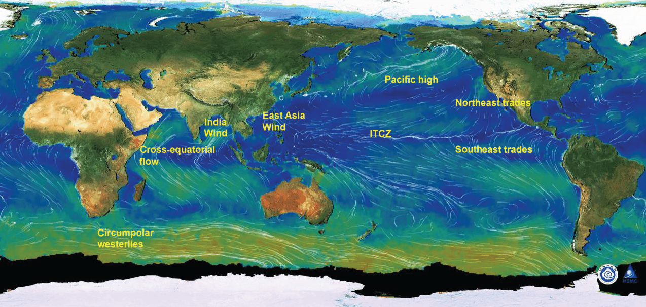
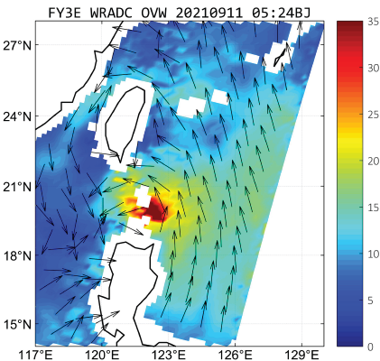
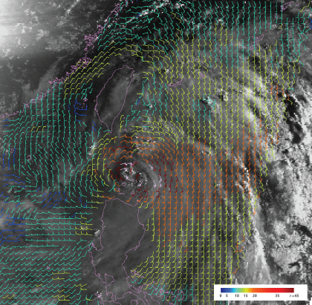
4. Summary
The status of WindRAD is quite stable. High-energy particle events happened many times and some observation data were influenced from these events.
Five important operational updates, including QA, L1B slicing, secondary geolocation and resampling, and backscattering coefficient.
According to the NOC results, the sigma0 deviation of Ku band is smaller. Smaller sigma0 deviation in C band VV polarization and larger sigma0 deviation in C band HH, which is under testing.
According to the SNO results, the distribution characteristics of the sigma0 are generally consistent with those of similar instruments.
After 6 months of trial operation, FY-3E ground system has been successfully entered the operational stage. WindRAD L2 products continue to provide services for typhoon monitoring, and has started assimilation application research in NWP.
Further improvements will be made to L1 data processing and new validation results will be ready in 2023.
27
Notes:
The backscattering coefficient correction was added to C V & Ku H/V

Slide 28
Thank you for your attention
yuanm@cma.gov.cn

