Slide 1
Atmospheric humidity and temperature sounding from the CubeSat TROPICS mission
John Xun Yang^{1,2}, Yong-Keun Lee^{1,2}, Chris Grassotti^{1,2}, Kevin Garrett², Quanhua (Mark) Liu², William Blackwell³, R. Vincent Leslie³, Tom Greenwald⁴, Ralf Bennartz⁵, Scott Braun⁶
¹ESSIC/CISESS, University of Maryland, College Park, MD
²NOAA/NESDIS/STAR, College Park, MD
³MIT Lincoln Laboratory, Lexington, MA
⁴CIMSS, University of Wisconsin, Madison, WI,
⁵EESD, Vanderbilt University, Nashville, TN
⁶NASA GSFC, Greenbelt, MD
March 2, 2023
GSICS MW Session

Slide 2
Background and Outline
NOAA MiRS was applied to TROPICS Pathfinder early data
  MiRS is expanded for TROPICS retrieval; here we focus on retrieved moisture and temperature
TROPICS highlights
  NASA CubeSat mission, PI is William Blackwell from MIT Lincoln Lab
  TROPICS Microwave Sounder (TMS) is the payload
  Four CubeSats; Pathfinder launched in Jun 2022; early-phase data from Aug to Nov 2021 were studied
  New channels at 205 GHz and F-band (near 118 GHz), in contrast to most traditional sensors with V-band (near 50 GHz) and G-band capped at 190 GHz
  New designs and electronics (e.g. purely V and H polarization by spinning the whole receiver, noise diode as warm reference)
Questions and challenges
  Can CubeSat and new frequencies (F-band and 205 GHz) provide sounding information comparable to the traditional sounders and channels?
  Challenges in expanding MiRS: coding, retrieval parameters setting and tuning, RTM, validation
Results
  Retrieval and validation with ECMWF and sensors including ATMS, AMSU/MHS
  Encouraging results
The scientific results and conclusions, as well as any views or opinions expressed herein, are those of the author(s) and
do not necessarily reflect those of NOAA or the Department of Commerce.

Slide 3
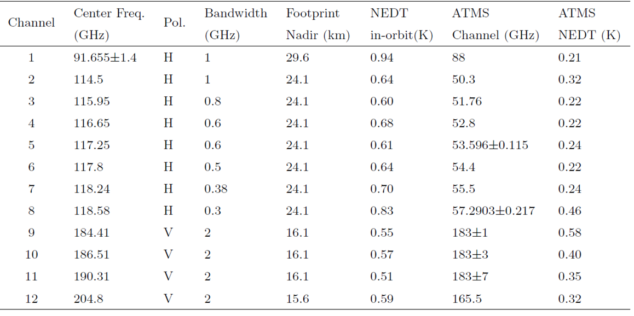
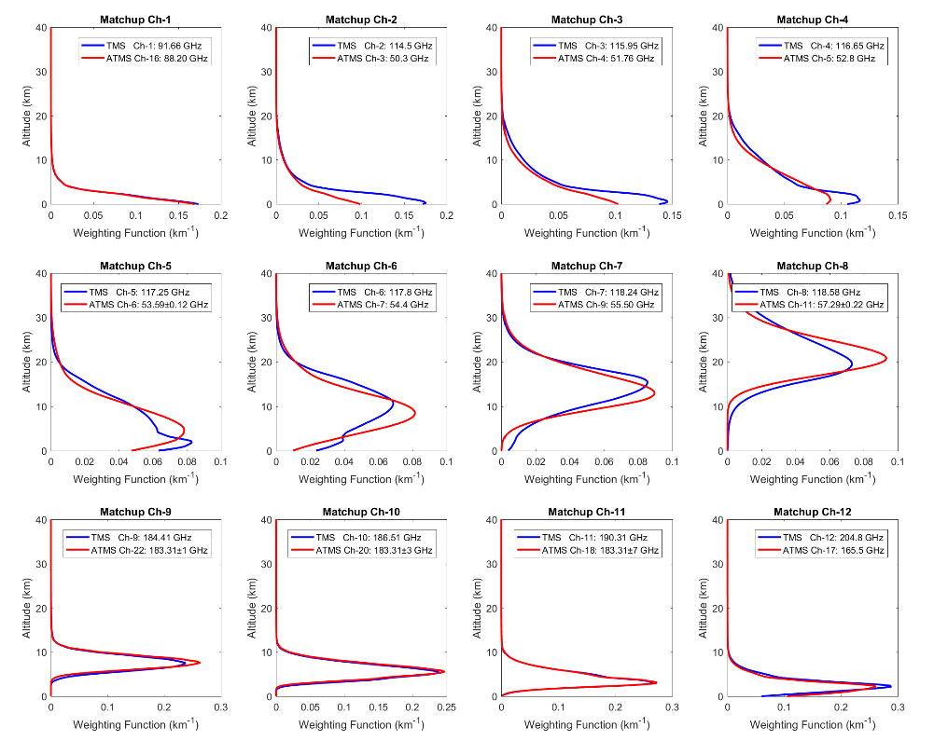
TROPICS TMS Specifications
A subset of ATMS channels that match up with TMS is used in retrieval, which permits a more direct comparison of the information content available between the V-band and F-band

Slide 4
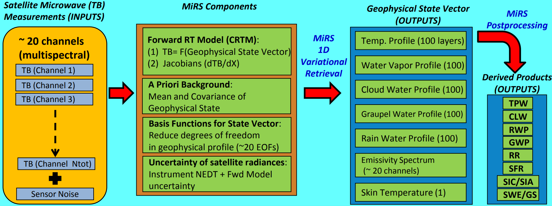
Microwave Integrated Retrieval System (MIRS)
1DVAR retrieval algorithm developed at NOAA/STAR for a range of geophysical variables
Covering microwave sounders of NOAA and EUMETSAT https://www.star.nesdis.noaa.gov/mirs/
MiRS expanded for TROPICS retrieval
  Writing and expanding scripts; Data ingesting; Computing and tuning static and semi-static parameters; Bias correction; Validation

Slide 5
A Taste of Retrievals

Slide 6
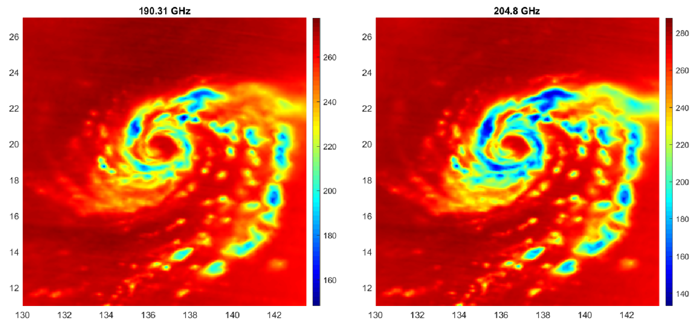
Typhoon Mindulle seen by TROPICS
190.31 GHz (left) and 204.8 GHz (right) of TROPICS for Typhoon Mindulle on 27 September 2021
The new 204.8 GHz resolves fine structures about typhoon eye and rainbands
Colder brightness temperature in rainband at 204.8 GHz, with larger dynamical range of 155 K, compared to 129 K at 190 GHz

Slide 7
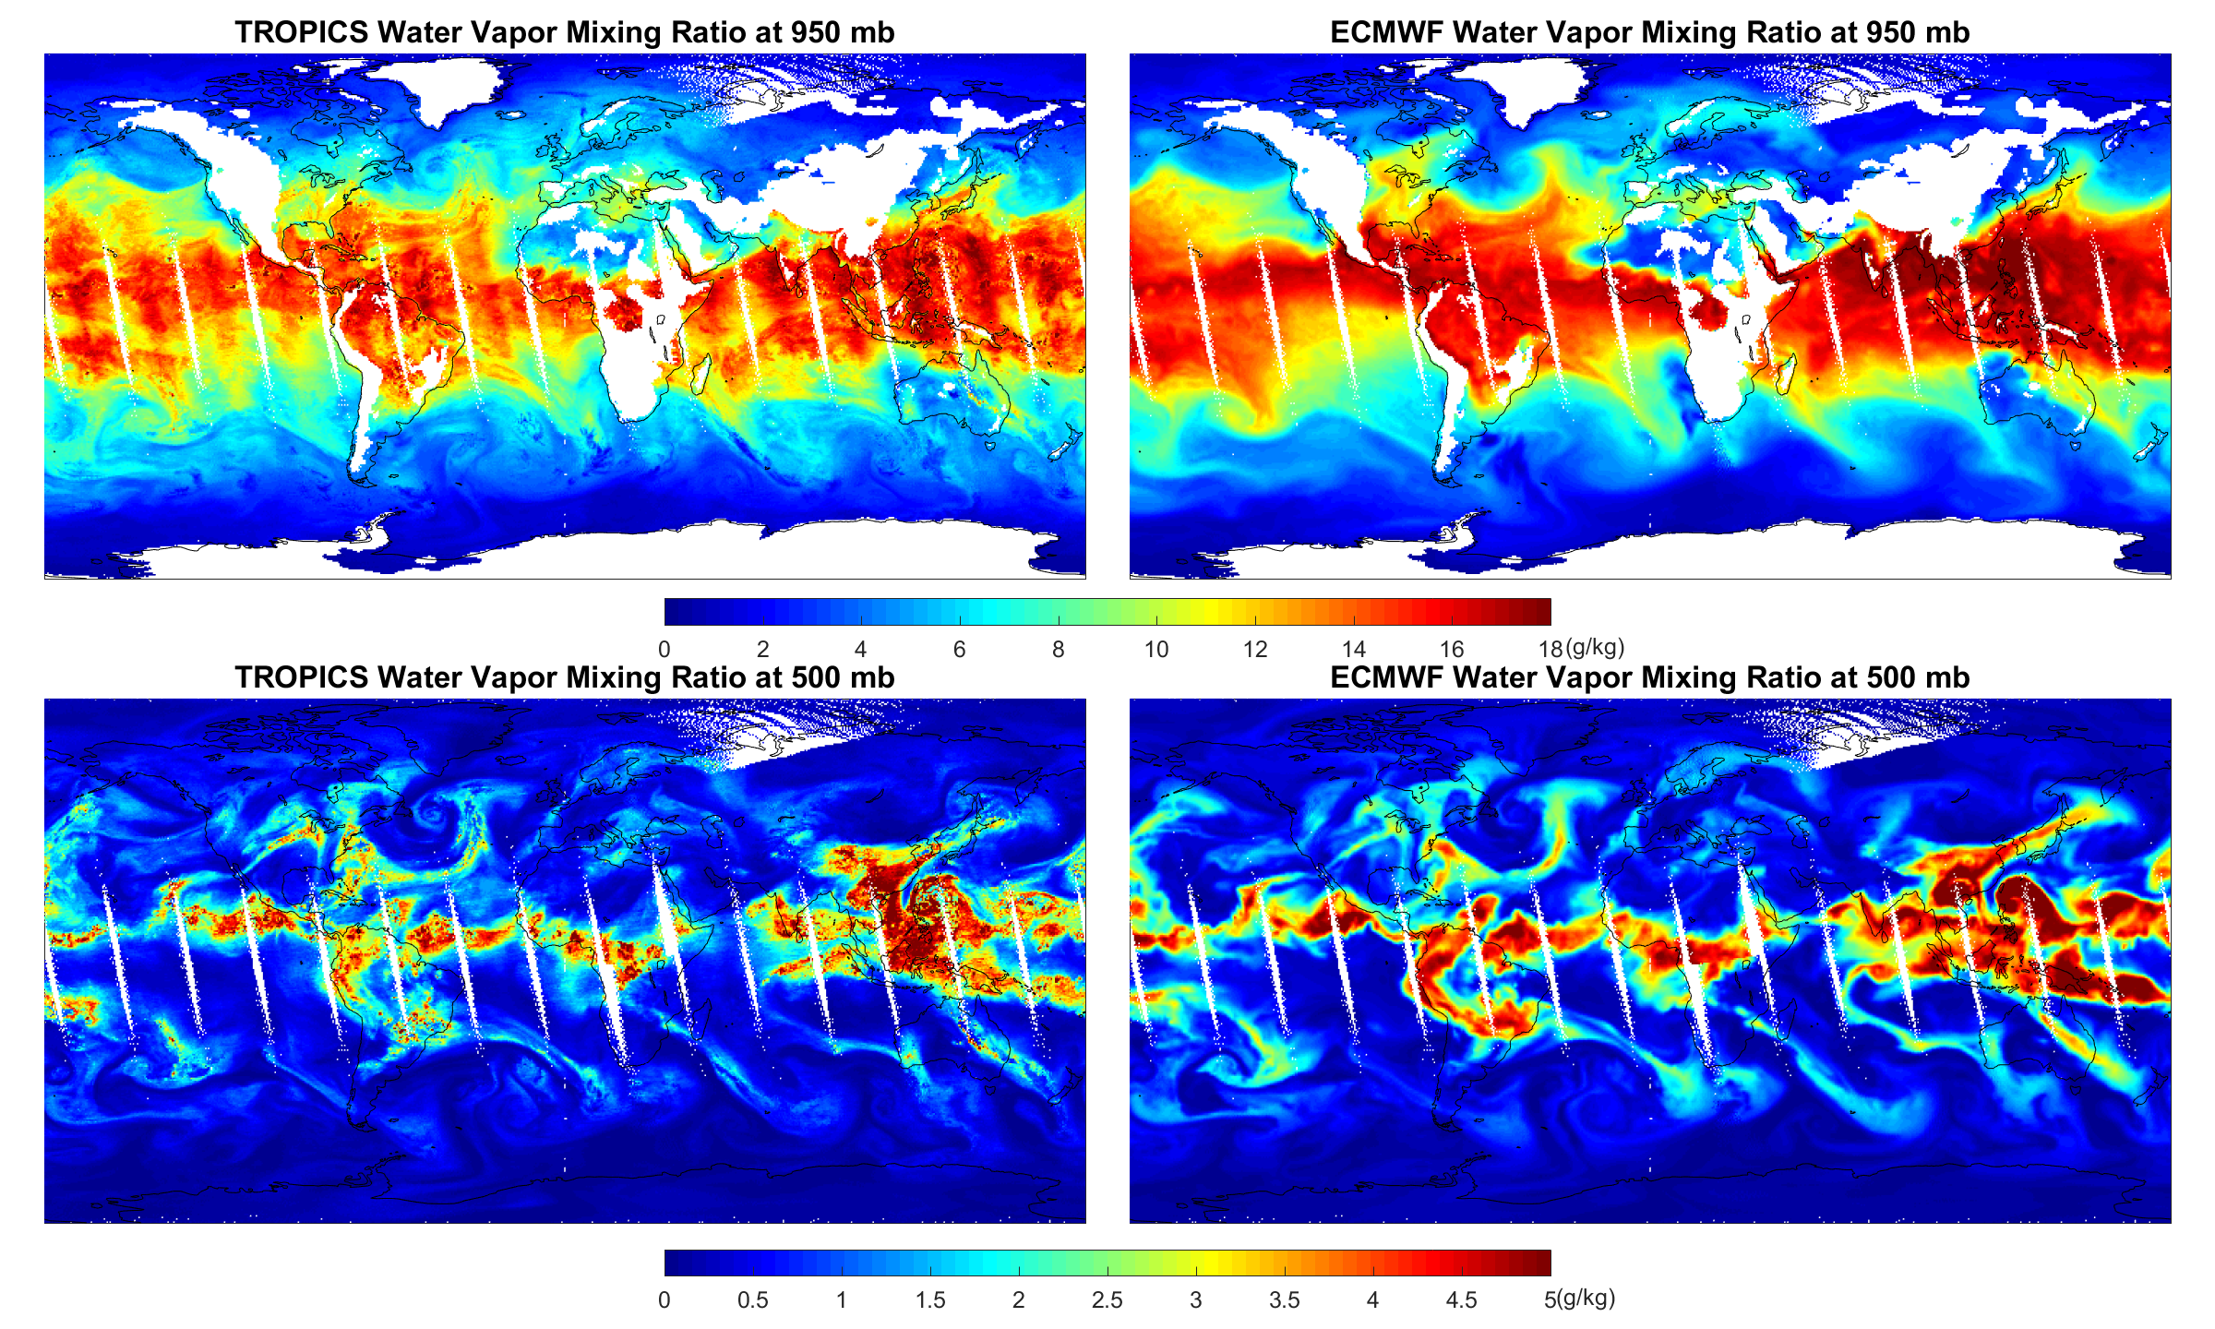
Retrieved Water Vapor compared to ECMWF

Slide 8
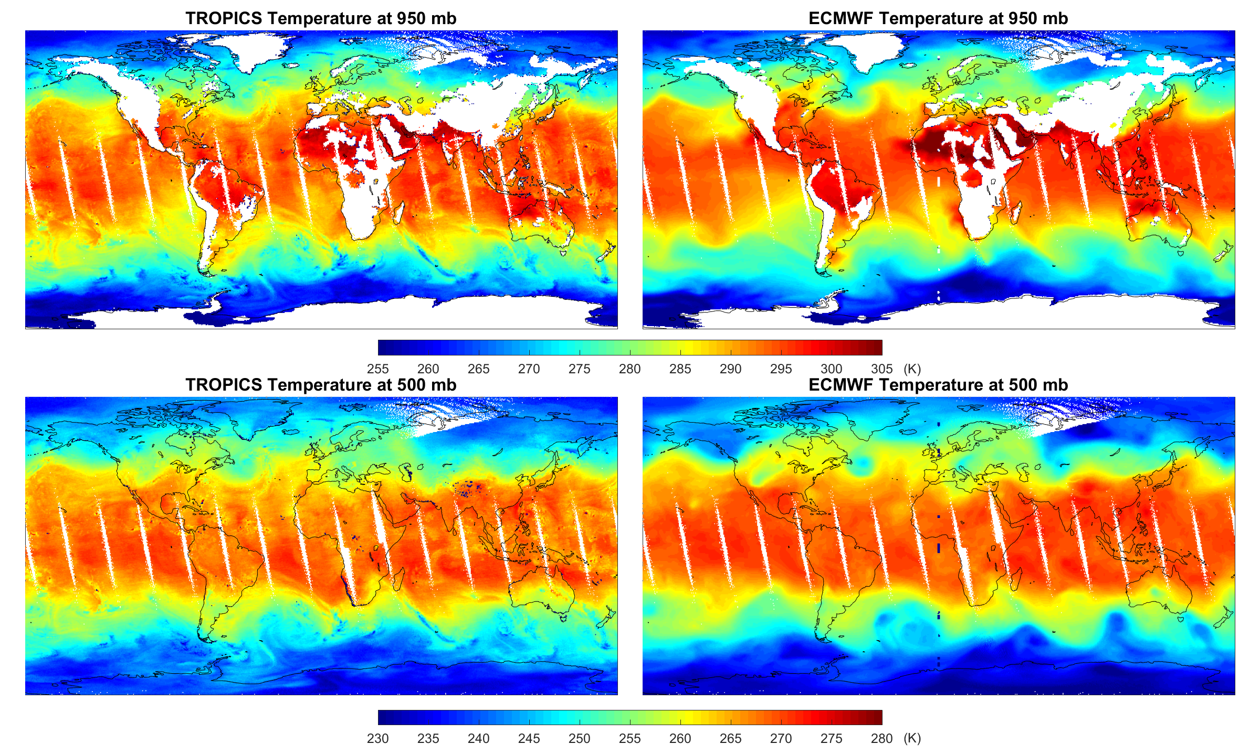
Retrieved Temperature compared to ECMWF

Slide 9
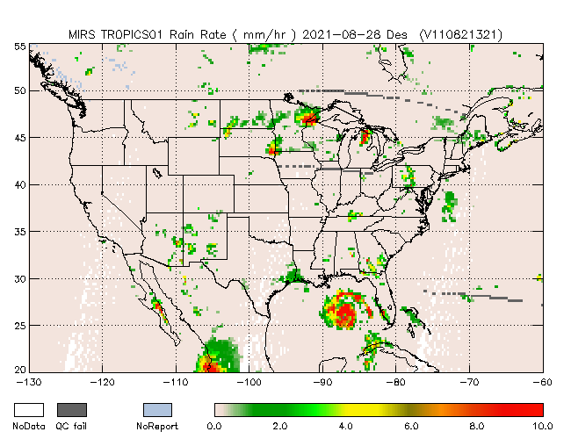
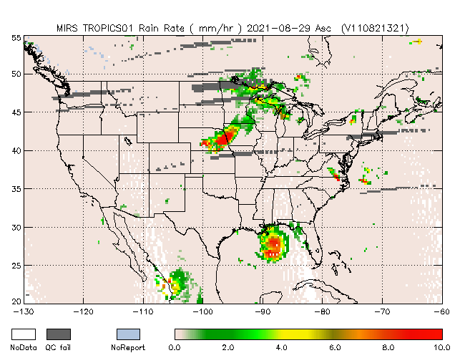
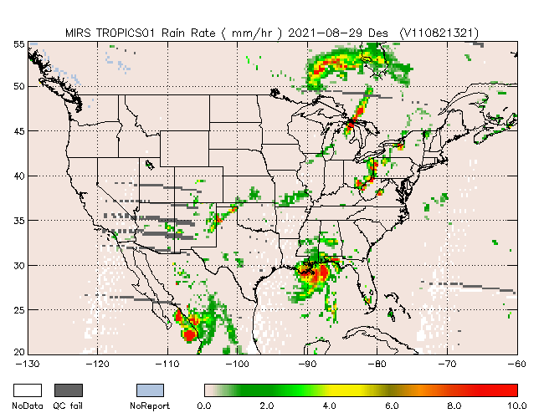
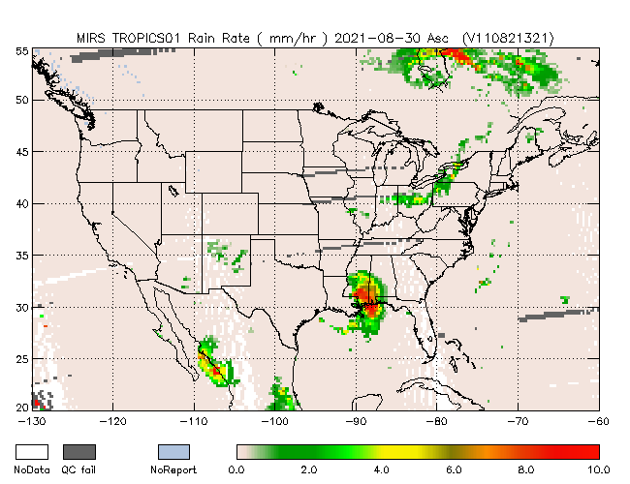
Hurricane Ida Rainfall
08/28 2:00 PM
08/29 14:00 PM
08/29 14:00 PM
08/30 2:00 AM
The retrieved rain rate captures well Hurricane Ida landfall in August 2021
Consistent with other sensors such as ATMS

Slide 10
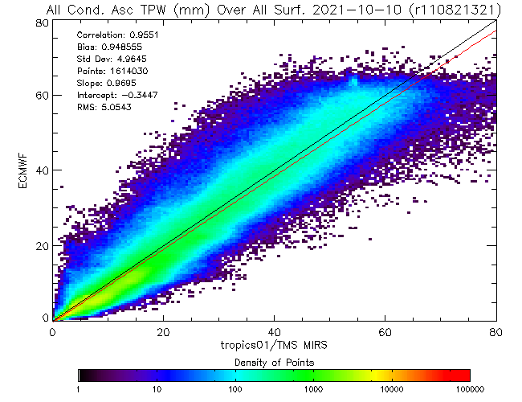
Total Precipitable Water (TPW) compared to ECMWF
 | All Condition All Surface
 | STD | Corr. | Bias | No.
TROPICS | 4.9645 | 0.9551 | 0.94855 | 1614030
N20 ATMS | 2.9465 | 0.9855 | 1.09589 | 1575011
MetOp-B AMSU-A MHS | 3.0767 | 0.9832 | 0.497388 | 1616118
ATMS Subset | 3.6226 | 0.9775 | 1.27695 | 1575018
Satisfactory retrieval with a high correlation of 0.9551
Slightly degraded compared to ATMS, MetOp-B, and ATMS Subset

Slide 11
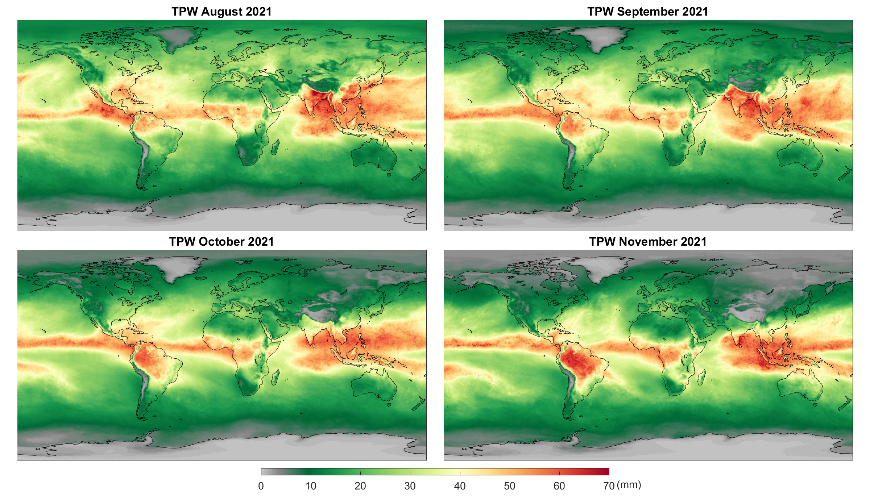
TPW Seasonality

Slide 12
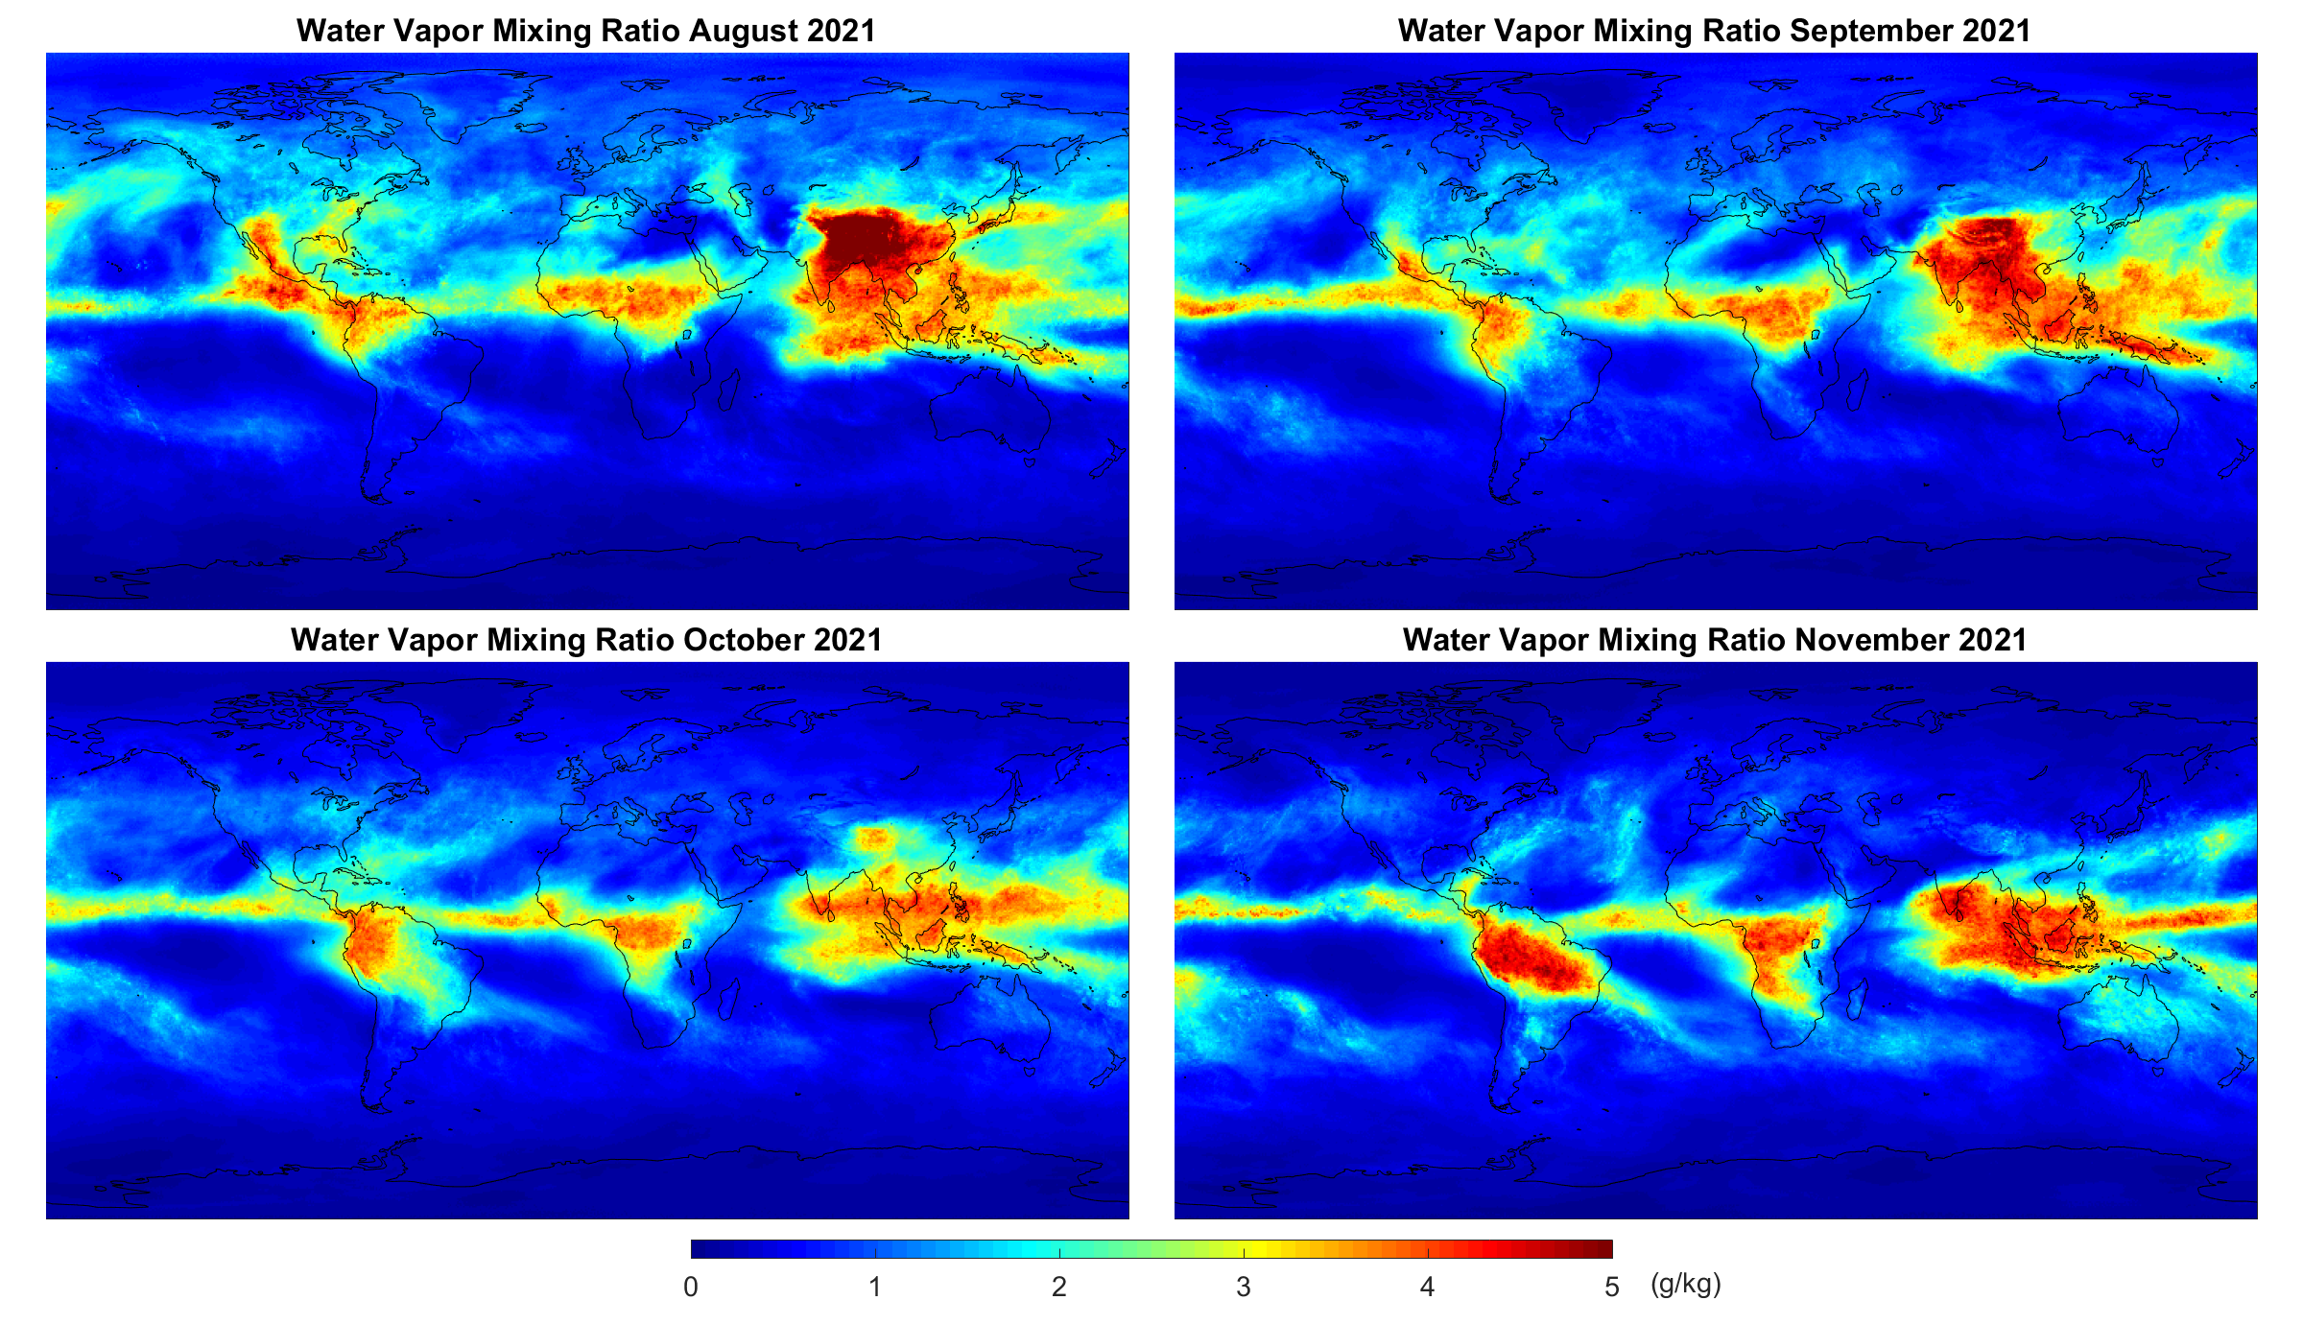
Water Vapor Seasonality

Slide 13
Evaluation and Comparison

Slide 14
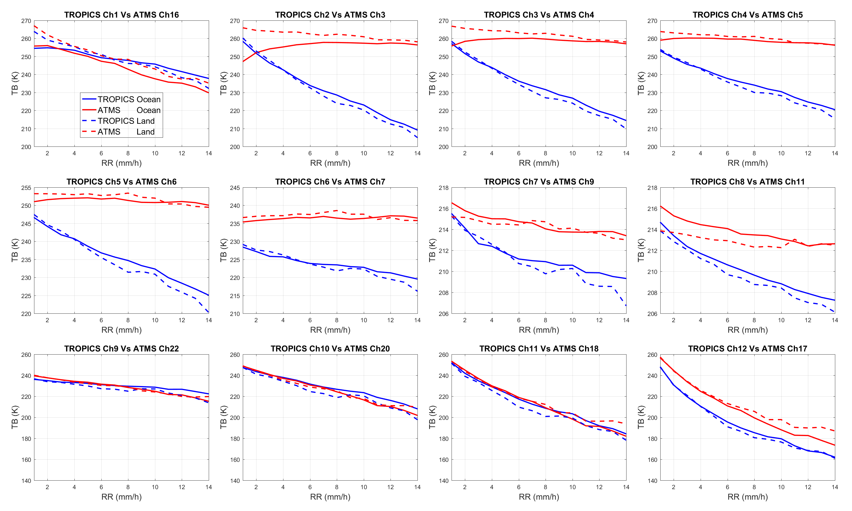
Sensitivity to Rainfall: TROPICS Vs ATMS
F-band is more sensitive to rain than V-band
The 205 GHz shows more scattering to rain compared to 190 GHz
Implying new information content for measuring hydrometeors

Slide 15
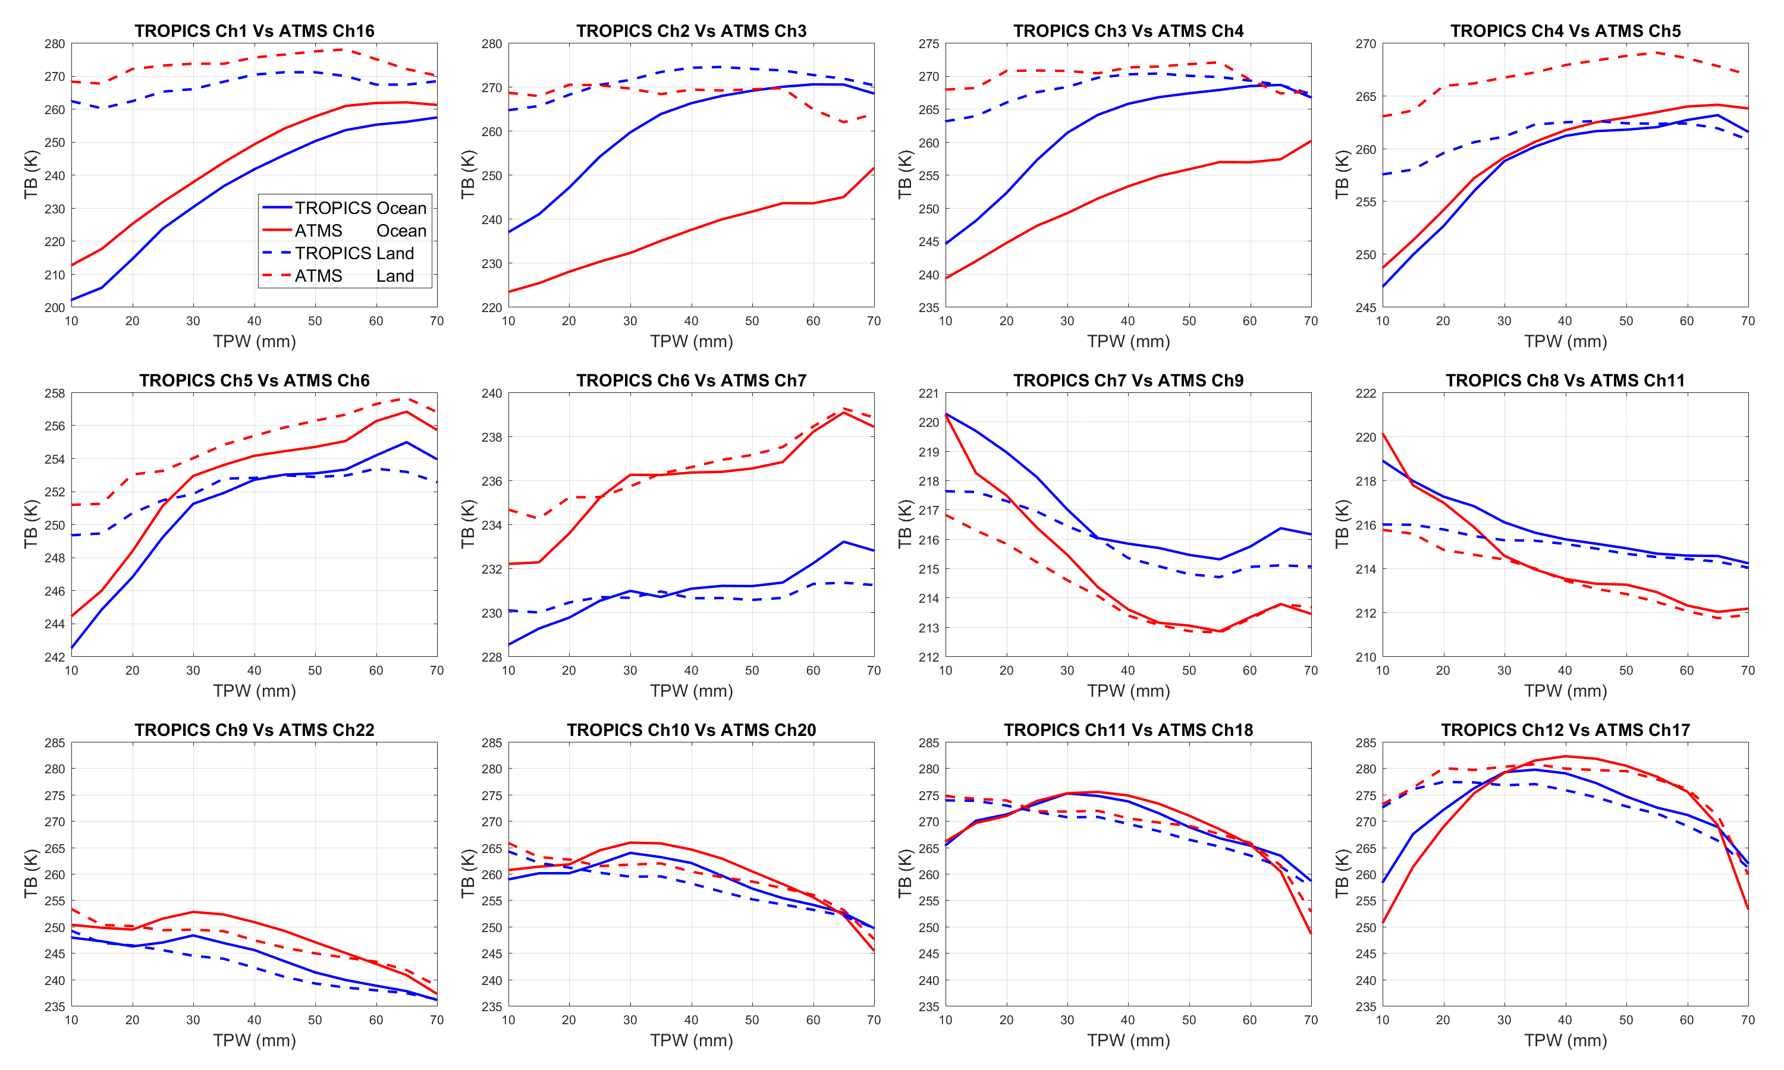
Sensitivity to TPW: TROPICS Vs ATMS
Sensitivity varies by channels, and clouds play a role
F-band and 205 GHz shows large sensitivity

Slide 16
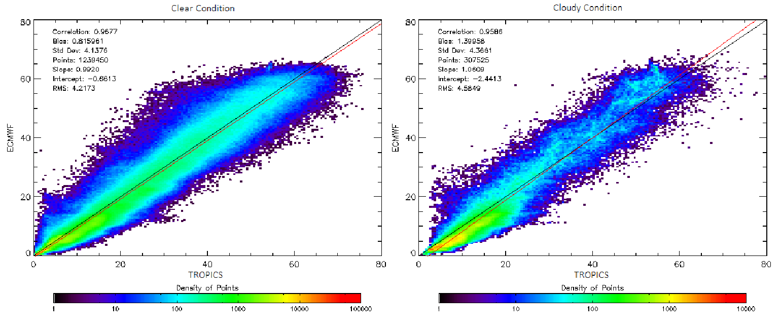
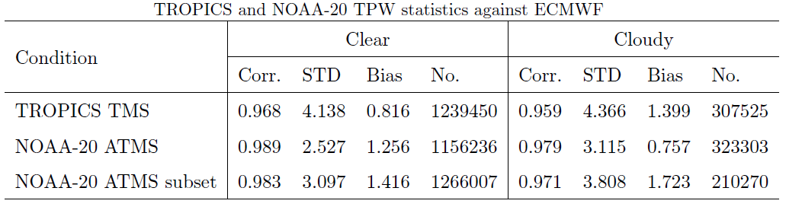
TPW under Clean and Cloudy Conditions

Slide 17
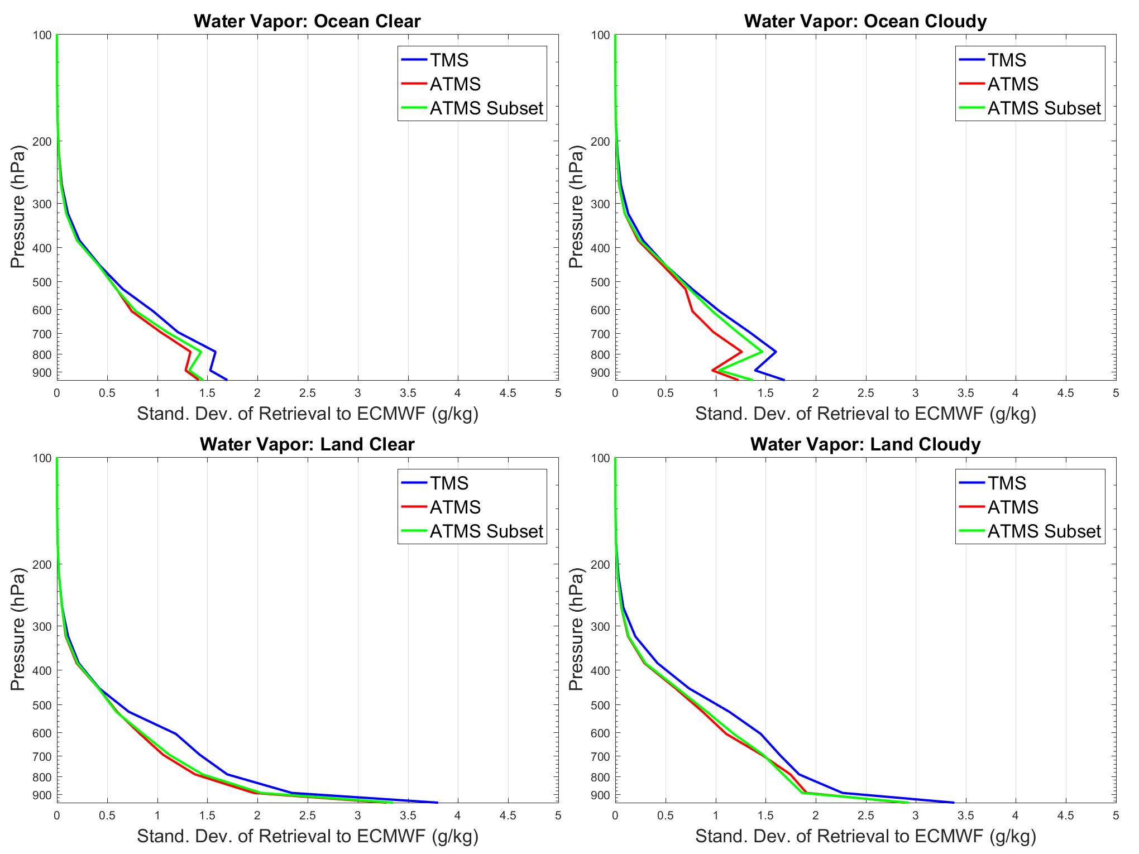
Water Vapor Profiles: STD to ECMWF
TROPICS shows successful retrieval in agreement with ATMS, with slightly degradation
Mean STD is 0.93, 0.76, and 0.80 g/kg for TROPICS, ATMS, and ATMS Subset, respectively

Slide 18
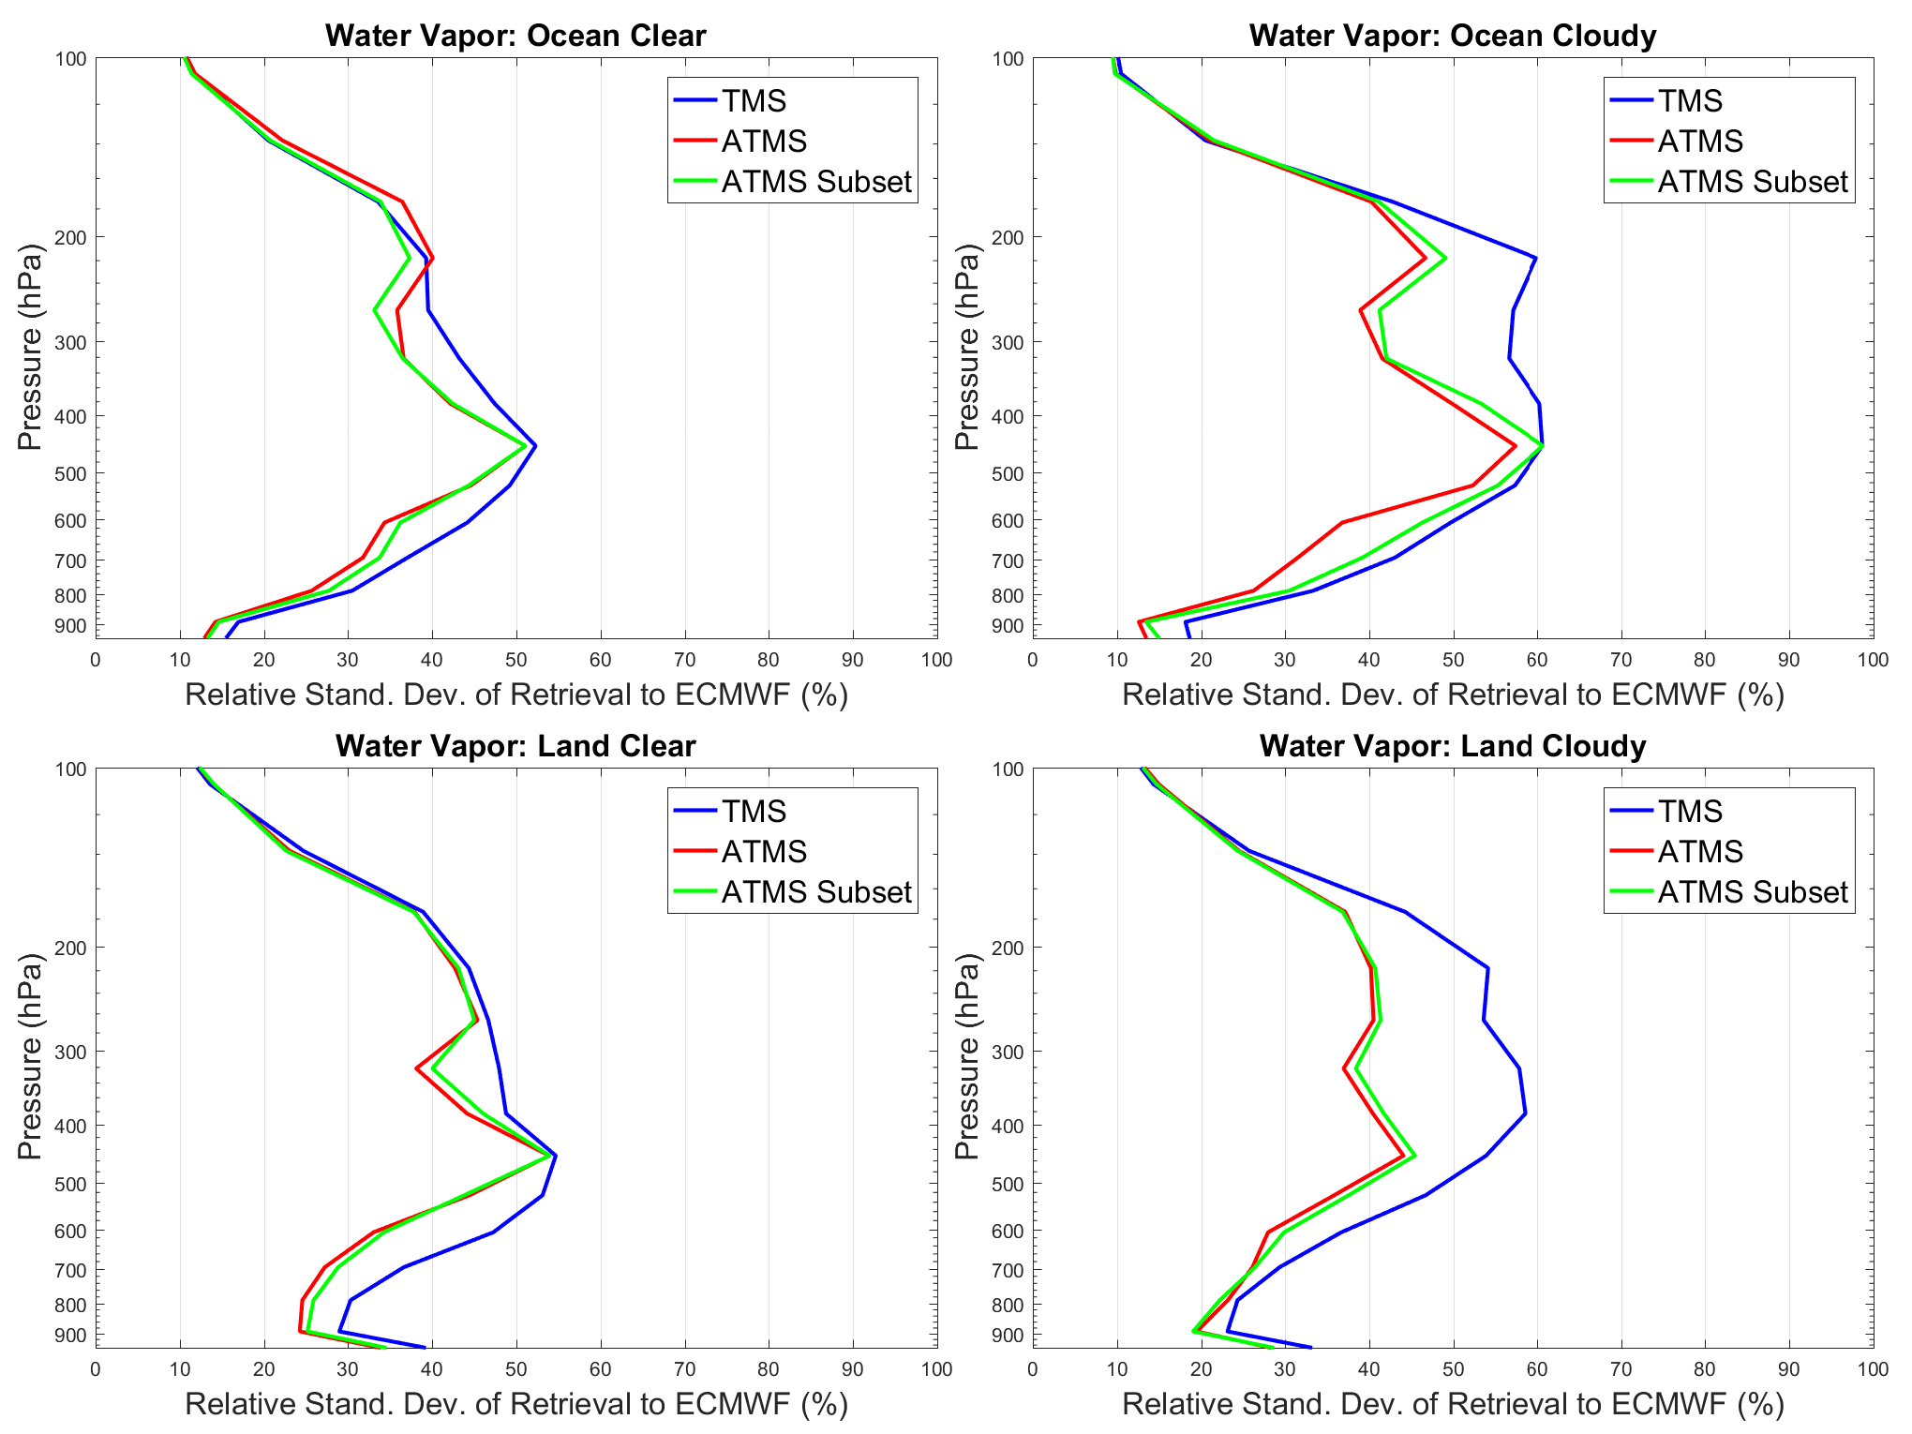
Water Vapor Profiles: Relative STD to ECMWF
Relative standard deviation (%): standard deviation divided by the mean
Good performance under ocean-clear, ocean-cloudy and land-clear conditions
More degradation under land cloudy conditions due to land surface complexity and sampling difference

Slide 19
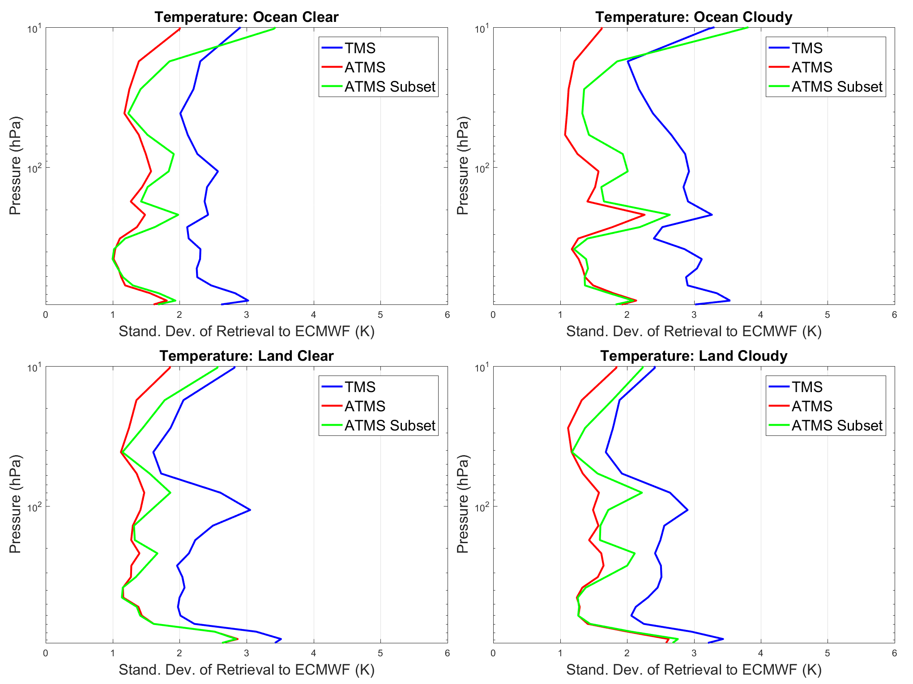
Temperature Profile
Consistent temperature retrieval: ~2.5, 1.5 and 1.6 K STD for TROPICS TMS, ATMS, ATMS Subset, respectively
Retrieval shows dependence on surface types and clouds
V-band and F-band contain temperature information, and V-band is less affected by hydrometeors such as cloud
As retrieval simultaneously solves for temperature and moisture, a degraded temperature can affect water vapor, which explains why water vapor retrieval is slightly degraded with matchup channels

Slide 20
Retrieval Statistics
Experiments | Temperature |  | Water Vapor |  | TPW
 | STD | Bias | STD | Bias | STD | Bias
TROPICS | 2.50 | -0.28 | 0.93 | -0.01 | 4.96 | 0.95
N20 ATMS | 1.45 | -0.06 | 0.76 | 0.03 | 2.95 | 1.10
ATMS Subset | 1.65 | -0.07 | 0.80 | 0.06 | 3.62 | 1.28

Slide 21
Summary and Outlook
TROPICS new F-band and 205 GHz appear to bring in new information content, exhibiting higher sensitivity to moisture and hydrometeors than V-band and G-band channels <190 GHz and resolving fine storm and precipitation structures
TROPICS retrieval is comparable to traditional sensors, w/ slightly degradation dependent on surface types and cloud
The sensitivity of F-band and 205 GHz to hydrometeors can affect sounding but facilitate the measurement of cloud, ice and precipitation which we will investigate
The early performance is encouraging, and the successful MiRS extension paves the way to explore more data and TROPICS potential

