Slide 1
Report Out for GSICS
UV/Vis/NIR Spectrometer Subgroup (UVN-S Subgroup)
L. Flynn (NOAA), Alessandra Cacciari (EUMETSAT)
All presentations are available for downloads at
http://gsics.atmos.umd.edu/bin/view/Development/Gsicsannualmeeting2023

Slide 2
Disclaimer
"The contents of this presentation are those of the authors and do not necessarily reflect any position of the US Government or the National Oceanic and Atmospheric Administration."

Slide 3
28 Feb 2023/ UVN Spectrometer Break Out Session Auditorium
Chair: Larry Flynn: Minutes: Alessandra Cacciari
Time (EST) | Title | Presenter
13:30 | 3a. CMA OMS pre-launch calibration & instrument performance | Yuan Li CMA (Remote)
13:45 | 3b. TropoMI Calibration | Melanie Coldewey-Egbers DLR (Remote)
14:00 | 3c. Changes in observed straylight in TROPOMI | Antje Ludewig KNMI (Remote)
14:15 | 3d. GOME-2 End of Life tests | Alessandra Cacciari EuMetSat (Remote)
14:30 | 3e. ESA FDR4ATMOS project | Melanie Coldewey-Egbers DLR (Remote)
14:45 | 3f. OMPS Calibration | Banghua Yan NOAA
15:00 | 3g. GEMS Calibration and Solar | Mijin Eo EWHA
15:15 | 3h. EPIC Calibration | Jay Herman (Remote)
15:30 | Break
15:45 | 3i. TEMPO Calibration | Xiong Liu CFA (Remote)
16:00 | 3j. OMI and TropoMI V2 solar records | Sergey Marchenko SSAI/NASA
16:15 | 3k. Inter-calibration approaches for GEMS | Yeeun Lee EWHA
16:30 | 3l. OCO-3/GEMS XCO2 and NO2 Near-Simultaneous Observations | Thomas Kurosu JPL (Remote)
16:45 | 3m. V8TOz as a transfer standard | Larry Flynn NOAA

Slide 4
Quick Summary of presentations (1/3)
A good mix of updates ranging from CDRs for past instruments (GOME/SCIAMACHY), to End-of-Life (Metop-A GOME-2), to “operational” sensors (EPIC, NPP OMPS), to newer sensors (GEMS / TropoMI), to recently launched (NOAA-21 OMPS), to soon to be launched (TEMPO, OMS) with excursions to solar irradiance studies (OMI / TropoMI) and product comparisons (OCO-3 and GEMS). Further details are in the minutes, or you can view an entire talk at the meeting website.
The first presentation by Yuan Li (CMA) gave the status of calibration for the OMS instrument. The OMS Launch on FY-3F is August 2023 into 10AM Desc.
The second presentation by Melanie Coldewey-Egbers (DLR) gave information on the status of TropoMI calibration and reprocessing.
The third presentation by Antje Ludewig (KNMI) continued with results for the reprocessing with emphasis on the improved straylight corrections for TropoMI.

Slide 5
Instrument specifications and measurement of OMS Limb
Pre-launch calibration
No. | Test items | Technical requirement
1 | Spectral range / nm | 290-500
2 | Spectral resolution / nm | 0.6
3 | Spectral sampling interval | Continuous sampling pixel by pixel
4 | Wavelength calibration accuracy / nm | 0.01
5 | Spatial resolution / km | 3 (vertical, i.e. the height direction of the Limb of the earth)
6 | Instantaneous field of view / ° | 2.3 (horizontal) × 0.045 (vertical)
7 | Dynamic range | 10⁵
8 | Relative radiometric calibration accuracy | Better than 2%
9 | Calibration accuracy of diffuse reflector | Better than 3%
10 | Absolute radiometric calibration accuracy | Better than 3%
11 | Signal to noise ratio | > 300@0.1mw /cm² × sr × nm (radiance)
  Band1：
    286.8-402.1nm,FWHM0.4-0.44nm
  Band2：
    390.1-504.1nm, FWHM0.44-0.48nm
  Band3 (polarization):
    289.8-503.9nm, FWHM5.60-30.43nm
  Vertical FOV: 0.038 °, 2.24km at Limb point
  Horizontal crossing FOV: 1.8 °, 108.79km at Limb point
  Along the track: 8.92km at 1.2s (determined by the detector integration time)
  Limb detection height: 15-60km
Secondary dispersion technology: Brewster prism plus grating
Detector: cooled two-dimensional CMOS detector * 3
Notes:
临边仪器采用了布鲁斯特棱镜加光栅的二级色散技术，使用3个带制冷的二维CMOS探测器分别记录大气散射与偏振信息。2个探测波段可以覆盖286.8-504.1nm光谱范围。二者中间有12nm的光谱重合，出于信噪比的考虑推荐重叠部分以波段2的观测为准。光谱分辨率从设计时0.6nm提高至优于0.5nm,视场角从设计的2.3*0.045提高至1.8*0.038度。
The Limb instrument[ˈɪnstrəmənt] realize[ˈriːəlaɪz] the secondary dispersion[dɪˈspɜːrʒn] technology[tekˈnɑːlədʒi] with Brewster prism and grating, and uses three two-dimensional[daɪˈmenʃənl] CMOS detectors with refrigeration[rɪˌfrɪdʒə'reɪʃ(ə)n] to record[ˈrekərd] the atmospheric[ˌætməsˈferɪk] scattering and polarization[ˌpoʊlərəˈzeɪʃn] information[ˌɪnfərˈmeɪʃn] respectively[rɪˈspektɪvli]. Two detection bands can cover the spectral range of 286.8-504.1 nm. There is 12 nm spectral overlap[ˌoʊvərˈlæp] between the two detection bands. For the sake of SNR, the overlapping part is recommended to be based on the observation of band 2. The spectral resolution changed from 0.6 nm to better than 0.5 nm, and the field of view increased from 2.3 * 0.045 to 1.8 * 0.038 degrees.

Slide 6
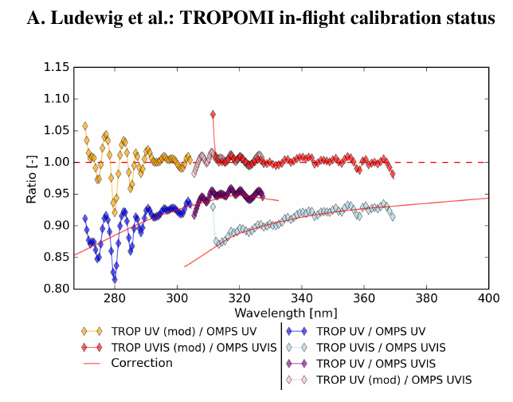
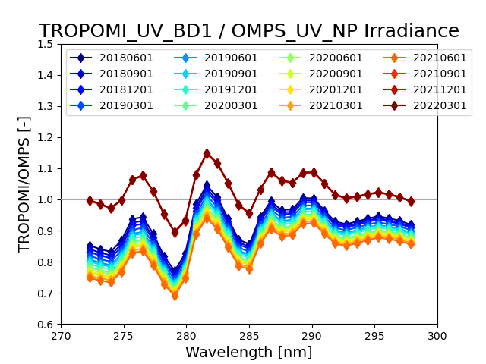
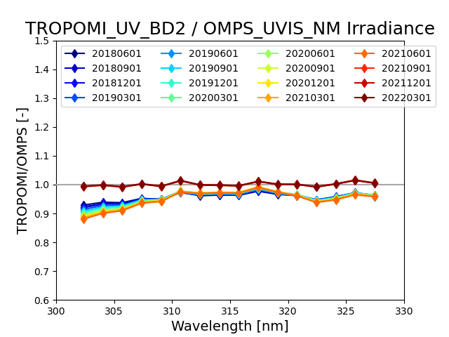
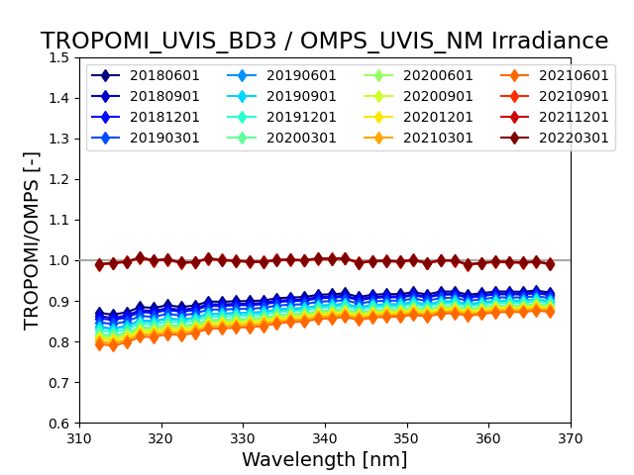
Comparison with other satellite sensors: OMPS/SNPP (2)
16 solar spectra (4 per year) from 06/2018 to 03/2022
Convolve spectra with Gauss function (FWHM 2.5nm)
Ludewig et al., 2020, their Fig.20
270nm - 300nm
→ TROPOMI UV Band1
→ OMPS Nadir Profiler
300nm - 330nm
→ TROPOMI UV Band2
→ OMPS Nadir Mapper
310nm - 370nm
→ TROPOMI UVIS Band3
→ OMPS Nadir Mapper
L1b v2
L1b v1

Slide 8
Quick Summary of presentations (2/3)
The fourth presentation by Alessandra Cacciari (EuMetSat) gave a summary of end-of-life tests and analysis for the Metop-A GOME-2.
The fifth presentation by Melanie Coldewey-Egbers (DLR) introduced the ESA FDR4ATMOS project with initial target of harmonization of GOME and SCIAMACHY Level 1 records.
The sixth presentation by Banghua Yan (NOAA) gave an update on the validation of the New NOAA-21 OMPS Nadir Mapper and Nadir Profiler measurements.
The seventh presentation by Mijin Eo (EWHA) gave information on the status of GEMS in-flight characterization and reprocessing including solar measurements.
The eighth presentation by Jay Herman (UMBC) discussed the use of EPIC and its hourly measurements of the full sunlit disk for comparisons to instruments on all platforms.

Slide 9
Conclusions for Metop-A GOME-2 EOL
Test n. | Title | Main outcome | Applicability to B & C
GOME-EOL-05 | Solar Measurement frequency change | No significant effects due to the increase of the sun measurement frequency could be seen during and after the test | could be useful in understanding the behaviour
GOME-EOL-11 | SU spinning | The increase in frequency of 60s SU spin cycles appears to be useful to reduce the motor scan torque and Scan Unit position error | Already applied to GOME-B and C
GOME-EOL-12 | Detectors Temperature Decrease | Detector leakage decreased significantly to a baseline level corresponding to 2-years before in the instrument life | Applicable to GOME-B and C
GOME-EOL-02 | Cross-Calibration with Metop-B and Metop-C | Test conducted during the loss of solar visibility, Comparison of selected radiance spectra | Applicable in period of solar visibility
GOME-EOL-09 | Long SLS Measurement | The dependence of spectral calibration on optical bench temperature has been quantified with the generation of correction coefficients to be applied to the GOME-2A spectral calibration | Applicable to GOME-B and C, to evaluate spectral shifts and determine corresponding instrument dependent correction coefficients
GOME-EOL-03 | Temperature Gradients (with Long SLS measurement)

Slide 11
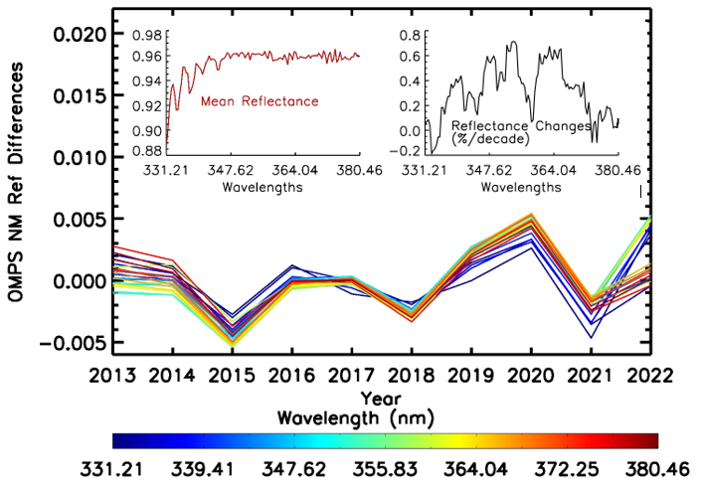
Three main sources of variations:
1. Differences from year-to-year in DCC distributions
2. Variations in the calibration accuracy with wavelength.
3. Year-to-year changes in the ozone and aerosols.
OMPS NM monthly mean Deep Convective Cloud (DCC) reflectance in March from 2013 to 2022 for wavelengths between 331.21nm and 380.46nm with the long-term average for each wavelength removed. The left insert is long-term mean reflectance for each wavelength. The right insert is estimate of reflectance changes over ten years. 1-Sigma uncertainties on the trend estimates are 0.3%/decade.
Notes:
Ding Liang et al. FEASIBILITY ANALYSIS OF OMPS NM SDR DATA LONG-TERM STABILITY ASSESSMENT USING DEEP CONVECTIVE CLOUD TARGETS (Submitted)

Slide 12
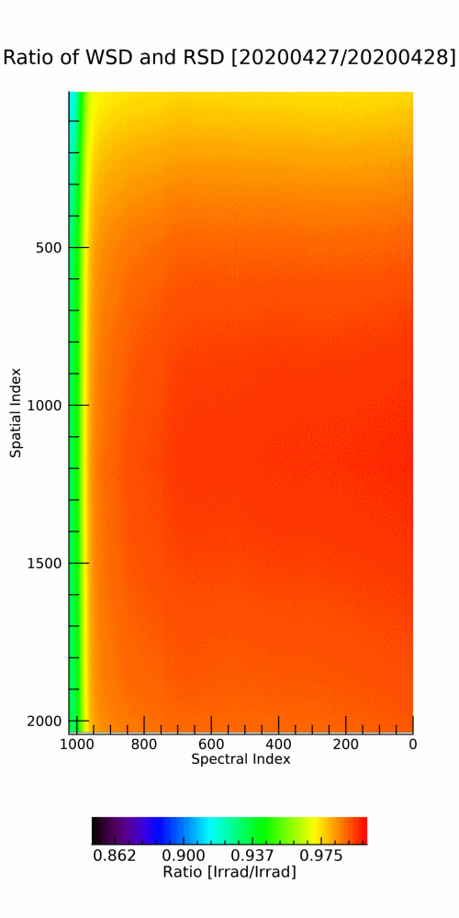
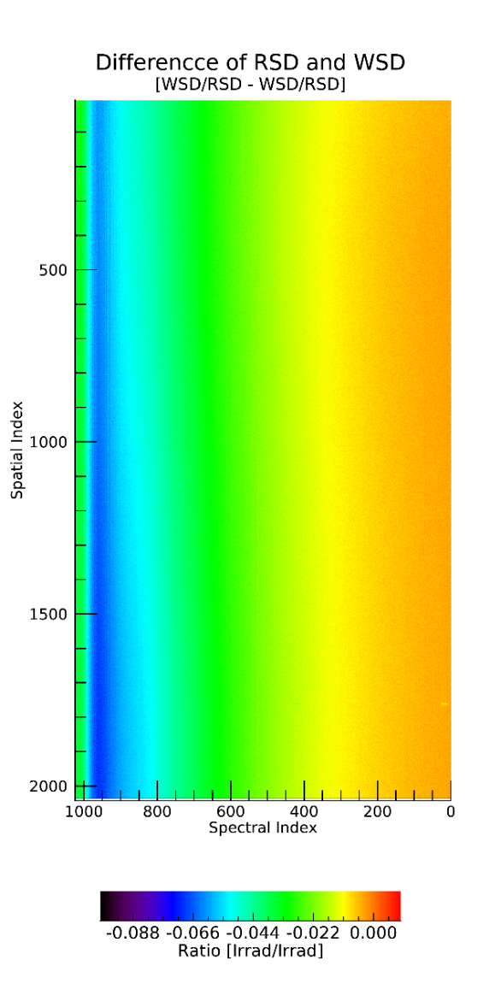
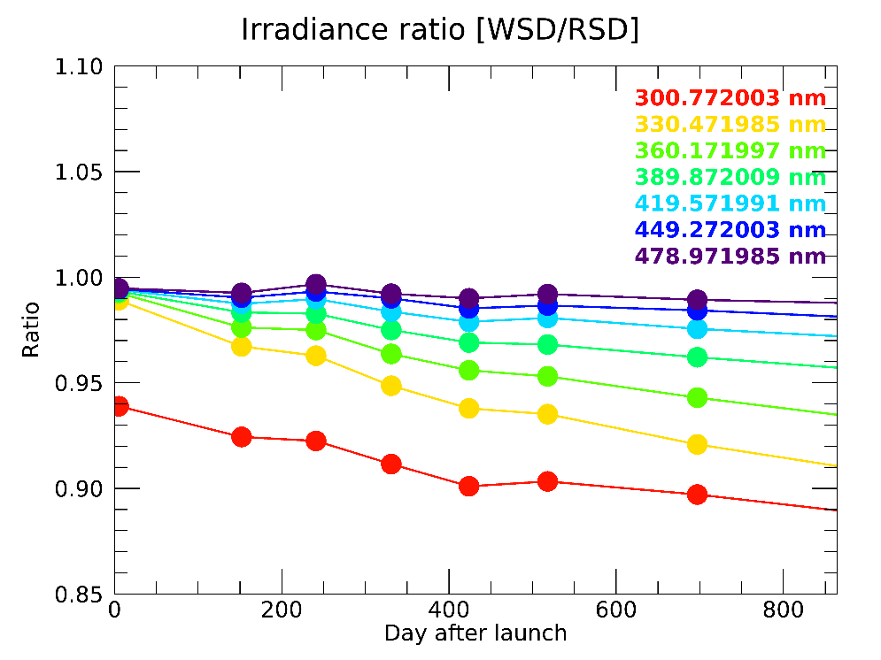
Trends in GEMS L1 irradiance
Use the reference solar diffuser to monitor the diffuser degradation
  Shorter wavelengths suffer the largest degradation (~15%) and under going
  The longer wavelengths, the degradation is much smaller
N
RSD : 2020 Apr 28
2020 Sep 22
2020 Dec 20
2021 Mar 20
2021 Jun 21
2021 Sep 23
2022 Mar 21
2022 Sep 23
WSD : 2020 Apr 27
2020 Sep 21
2020 Dec 19
2021 Mar 19
2021 Jun 20
2021 Sep 22
2022 Mar 20
2022 Sep 22
S
300 nm
500 nm
Notes:
GEMS diffuser degradation could be calculated by comparing WSD and RSD ratio
it shows the longer wavelength the less degradation)

Slide 13
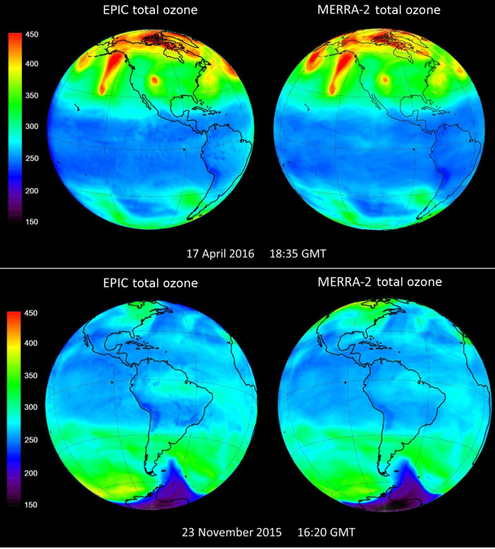
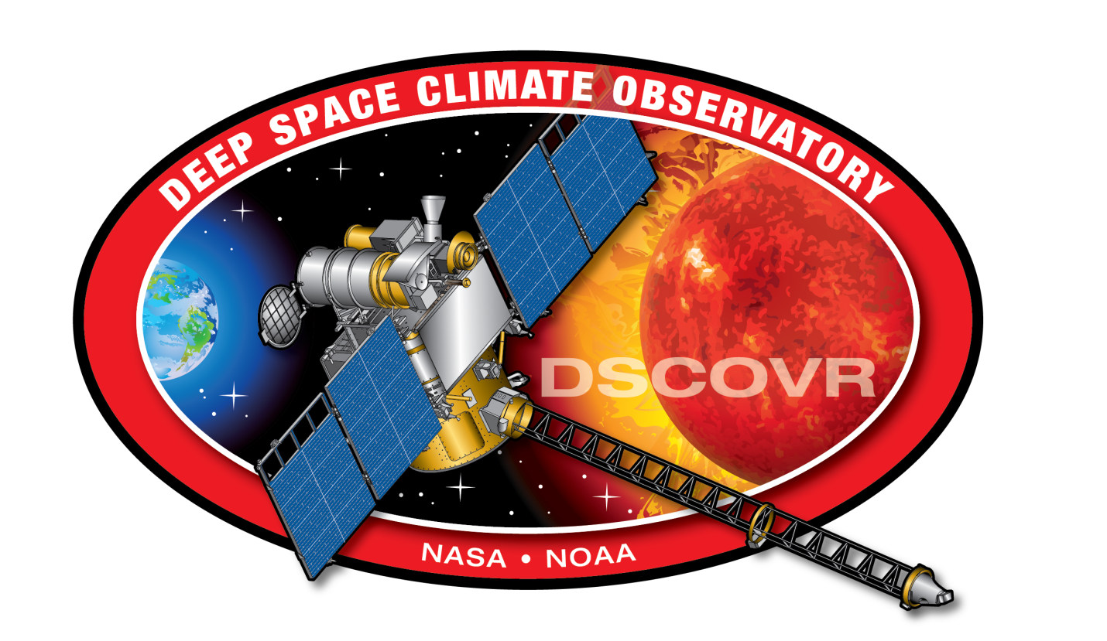
Comparison of EPIC O₃
With the MERRA-2 Data Assimilation Model

Slide 14
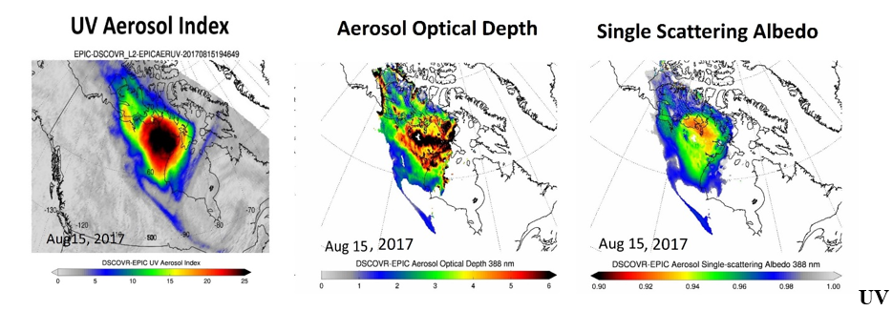
EPIC Aerosols
EPIC detection and Characterization of the August 2017 British Columbia PyroCb

Slide 15
Quick Summary of presentations (3/3)
The ninth presentation by Xiong Liu (CFA) gave an extensive description of the planned pre- and post-launch calibration and validation activities for the TEMPO instrument (April 2023 launch date).
The tenth presentation by Sergey Marchenko (SSAI/NASA) looked at the state-of-the-art capability of using solar measurements of Fraunhofer lines to identify drifts in stray light correction performance with OMI and TropoMI as examples.
The eleventh talk by Yeeun Lee (EWHA) gave the status of current and planned comparisons of GEMS measurements to other GEO and LEO instruments.
The twelfth talk by Thomas Kurosu (JPL) looked at SNO comparisons of OCO-3 XCO2 and GEMS NO2 products.
The thirteenth talk by Larry Flynn (NOAA) presented results using the V8TOz retrieval algorithm to compare the calibration of sensors in the UV for three channels (318 nm, 331 nm and 372 nm) for OMPS, GOME-2, TropoMI and GEMS.
Notes:
*CMA SIM could be compared to OMI time series with Sergey’s methods

Slide 16
L0_ccd + L0_wavcal &
In-flight Calibration
T-dependent gain correction
T-dependent dark current correction
Straylight correction with 1-D spectral PSF due to much smaller spatial straylight (correction with mean 2-D PSF to be developed)
Wavelength and slit function calibration: cross correlation with high-resolution solar reference & atmospheric absorption
Quality flagging: Flag bad/RTS from dark current measurements, flag transient, saturated, missing pixels.
Special solar measurements vs. integration time to derive ADC non-linearity via standard photon transfer methods.
Trending solar measurements from working & reference diffusers to derive degradation in radiometric coefficients and diffuser BTDF.
Co-addition
L0 dark, irradiance
radiance
Odd/even identification
Electronic offset removal
Nonlinearity correction
Cross-talk correction
Gain corr. (FPA/FPE T)
Smear correction
Dark processing
(T-depend, avg.)
DC
Exposure-time corr.
I, F
Dark current correction
L1a dark (corrected)
Straylight correction
Solar viewing
F
Noise calculation
Polarization Corr.
I
Radiometric calibration
BTDF Correction
F
Wavelength Calibration
L1b irradiance
I
GCISC 2023/UVN, Feb. 28, 2023
L1a radiance

Slide 17
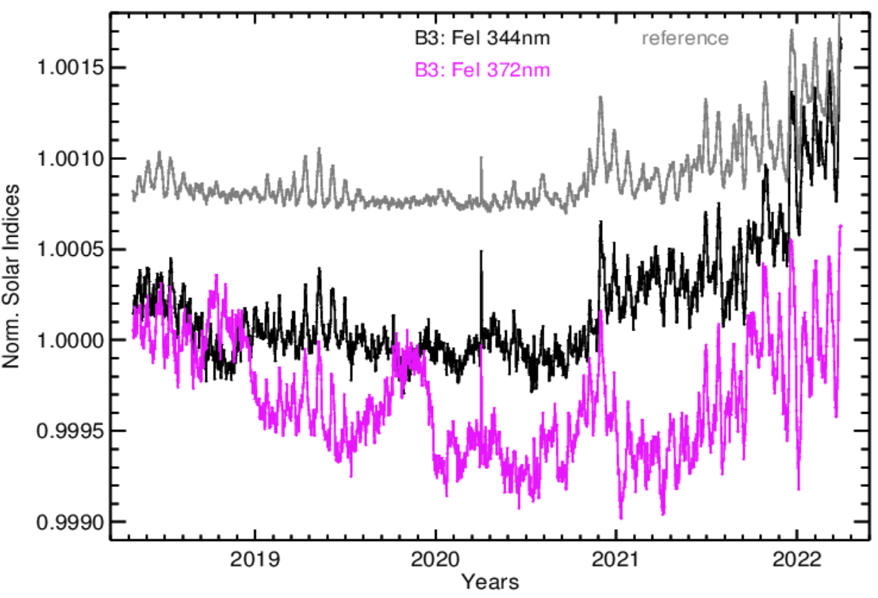
TROPOMI B3 (305-400 nm) line indices: an additive component
0.2 %

Slide 18
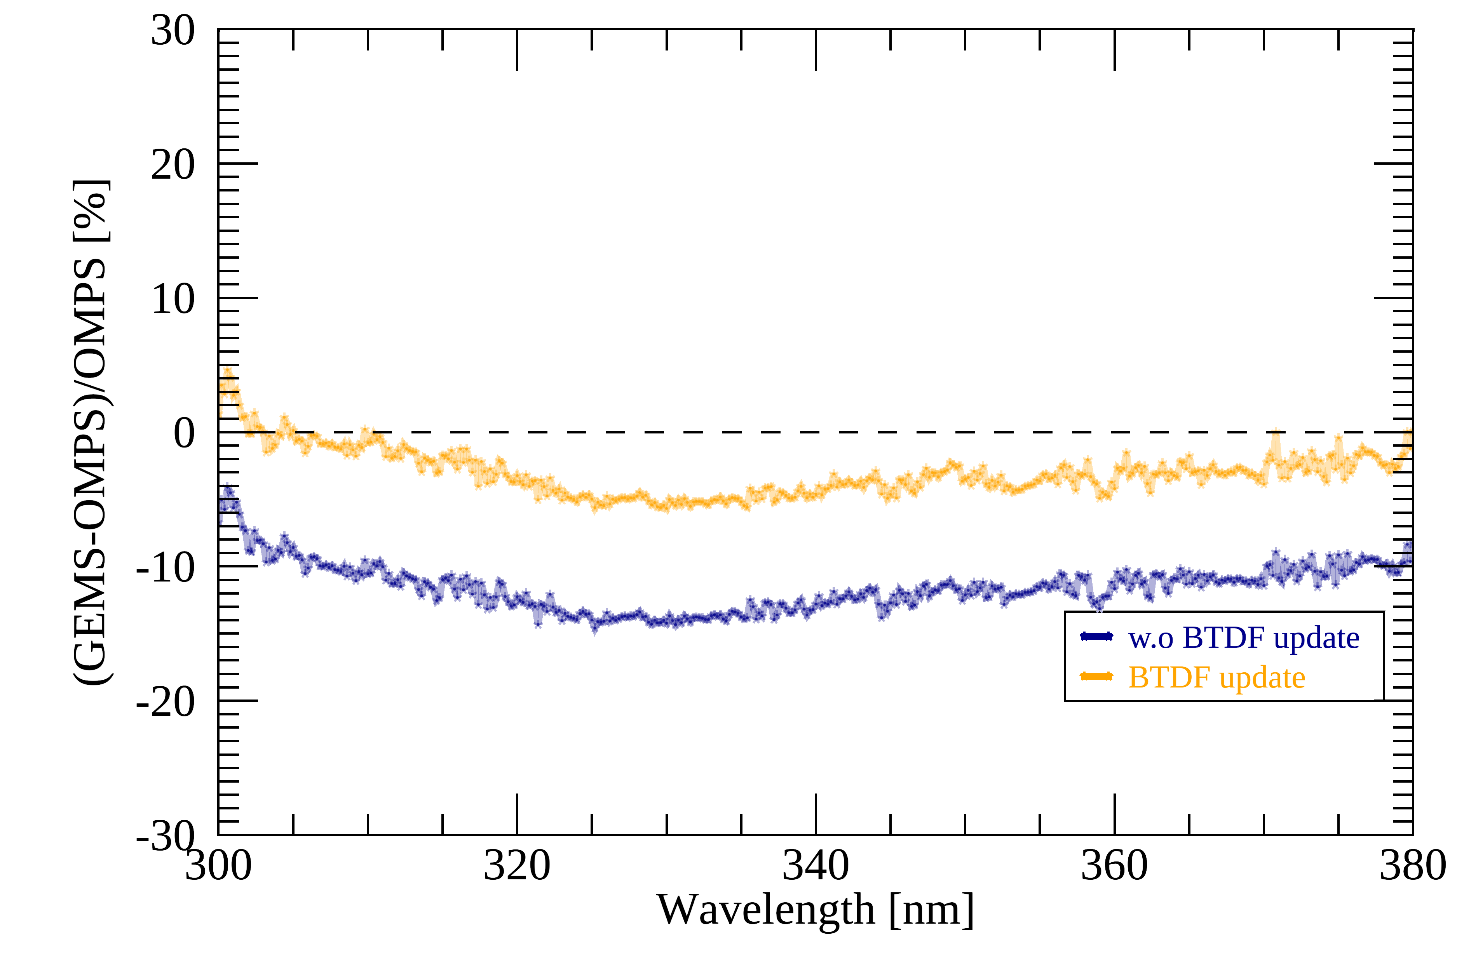
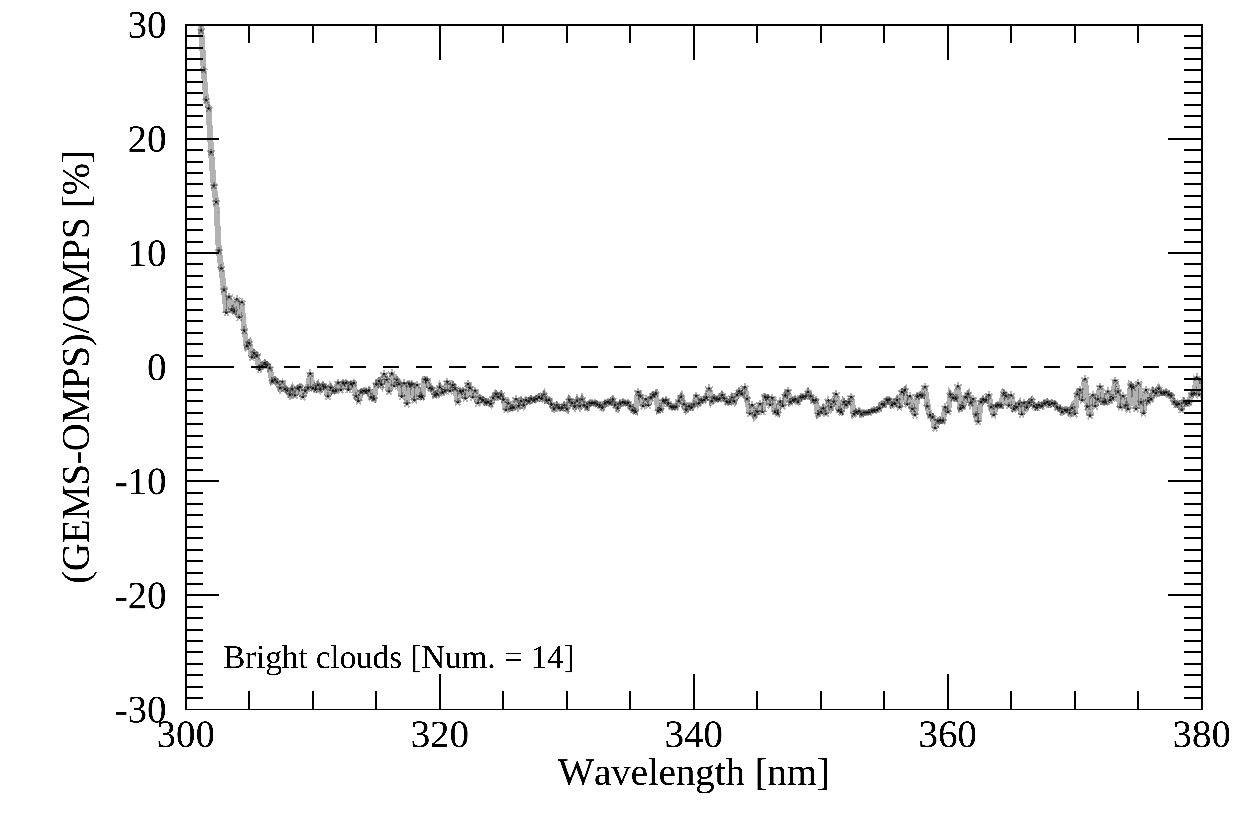
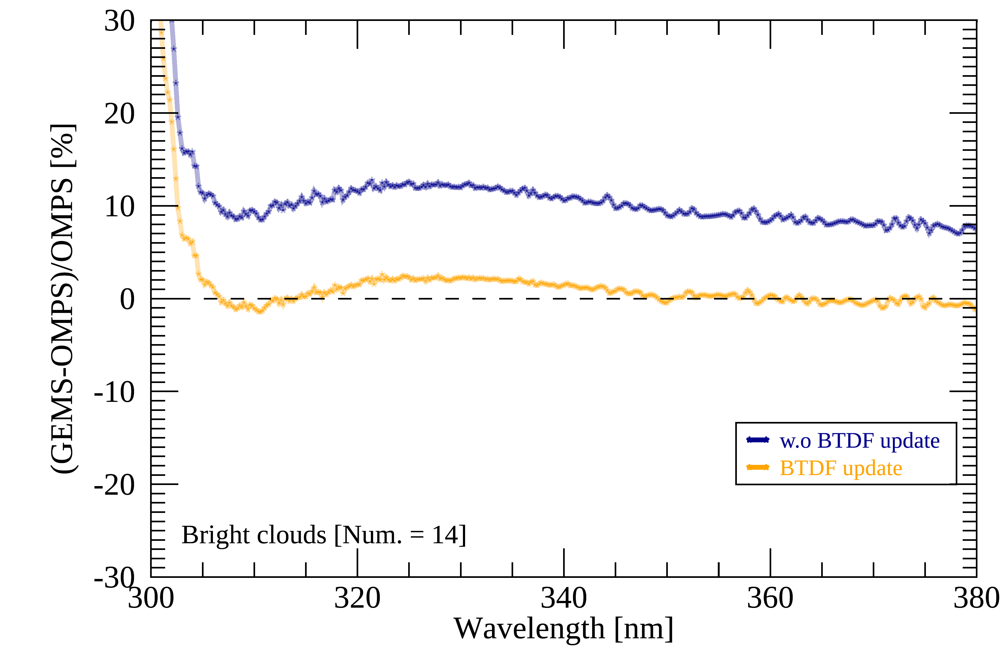
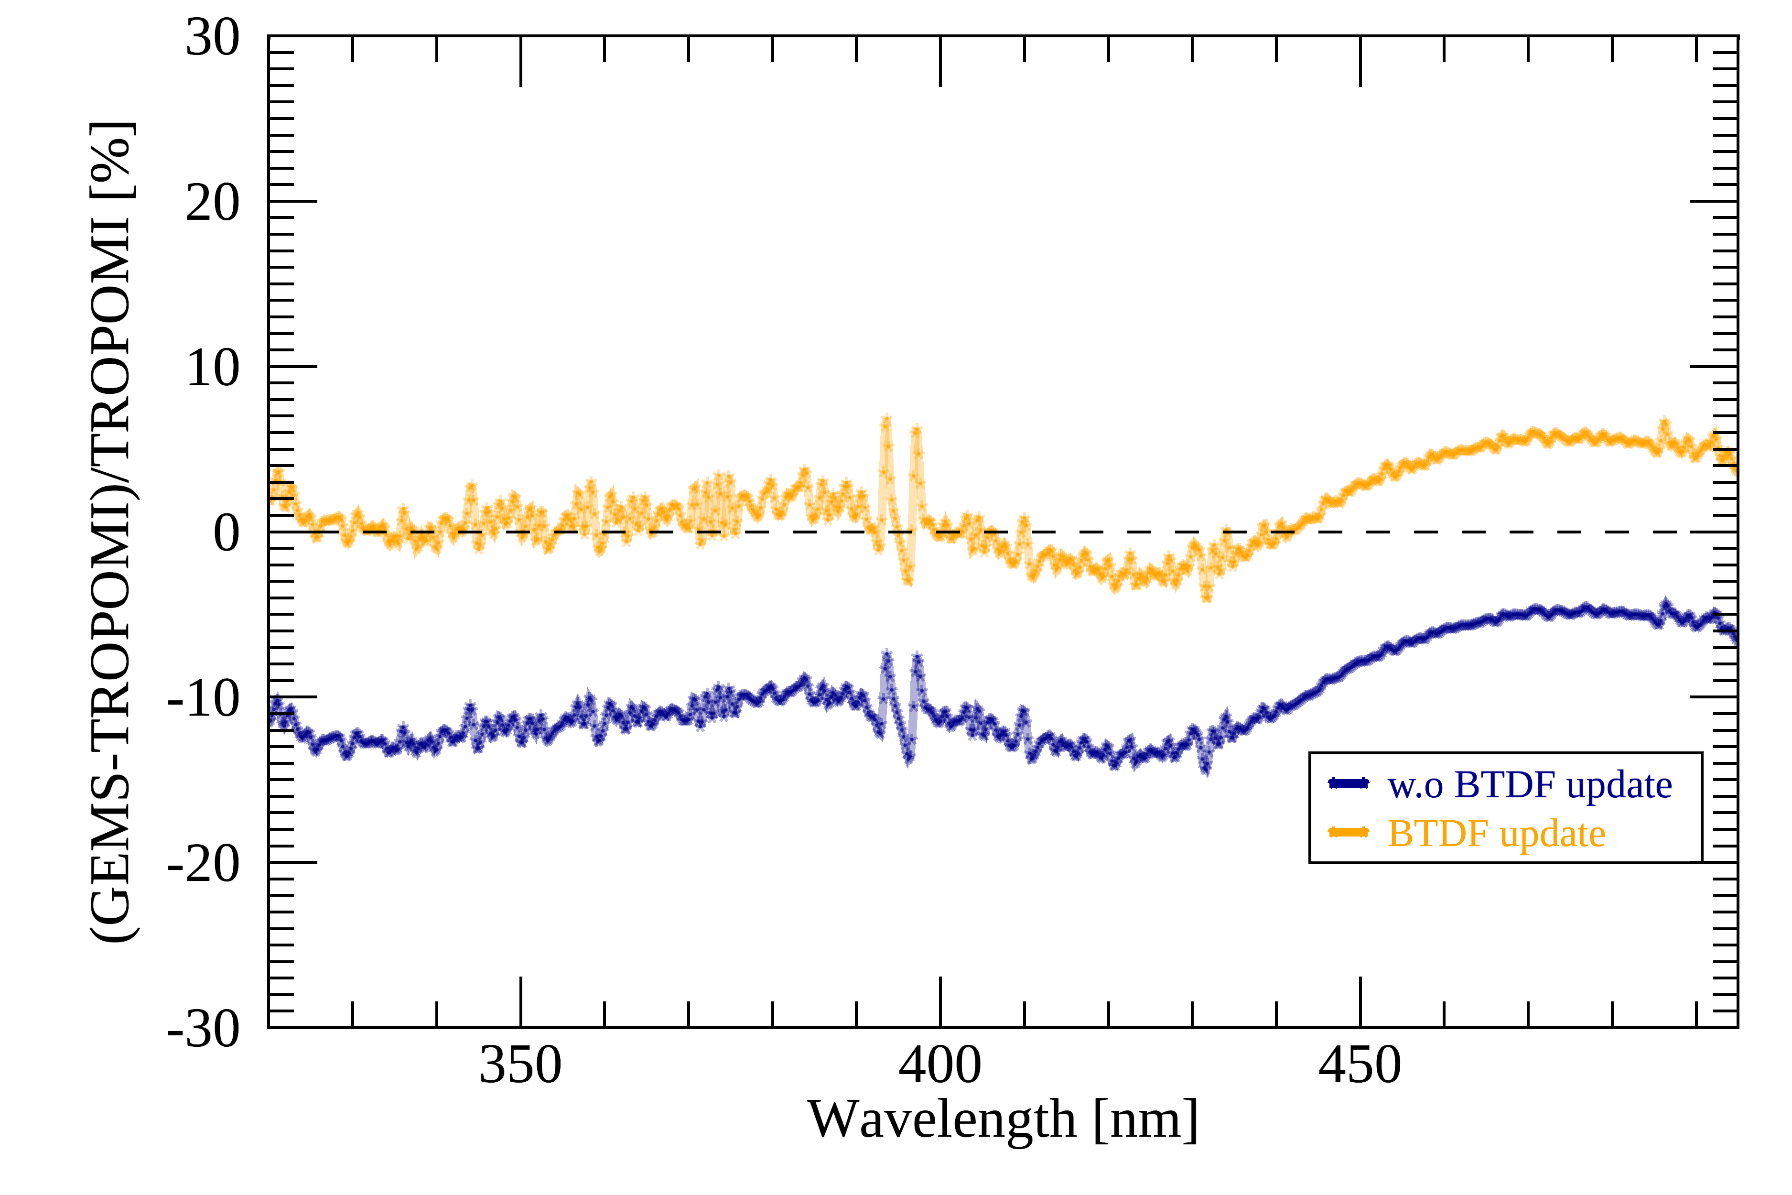
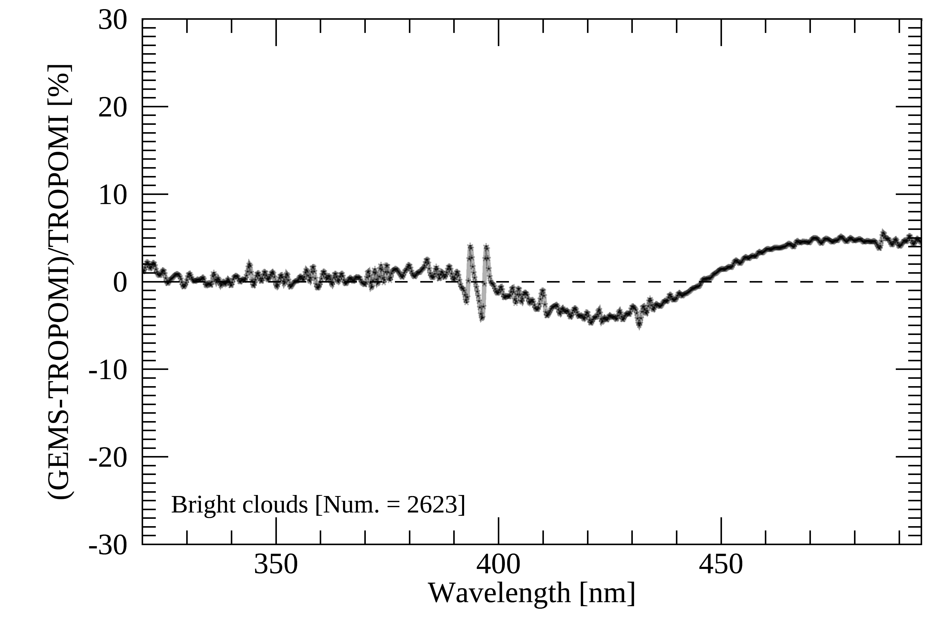
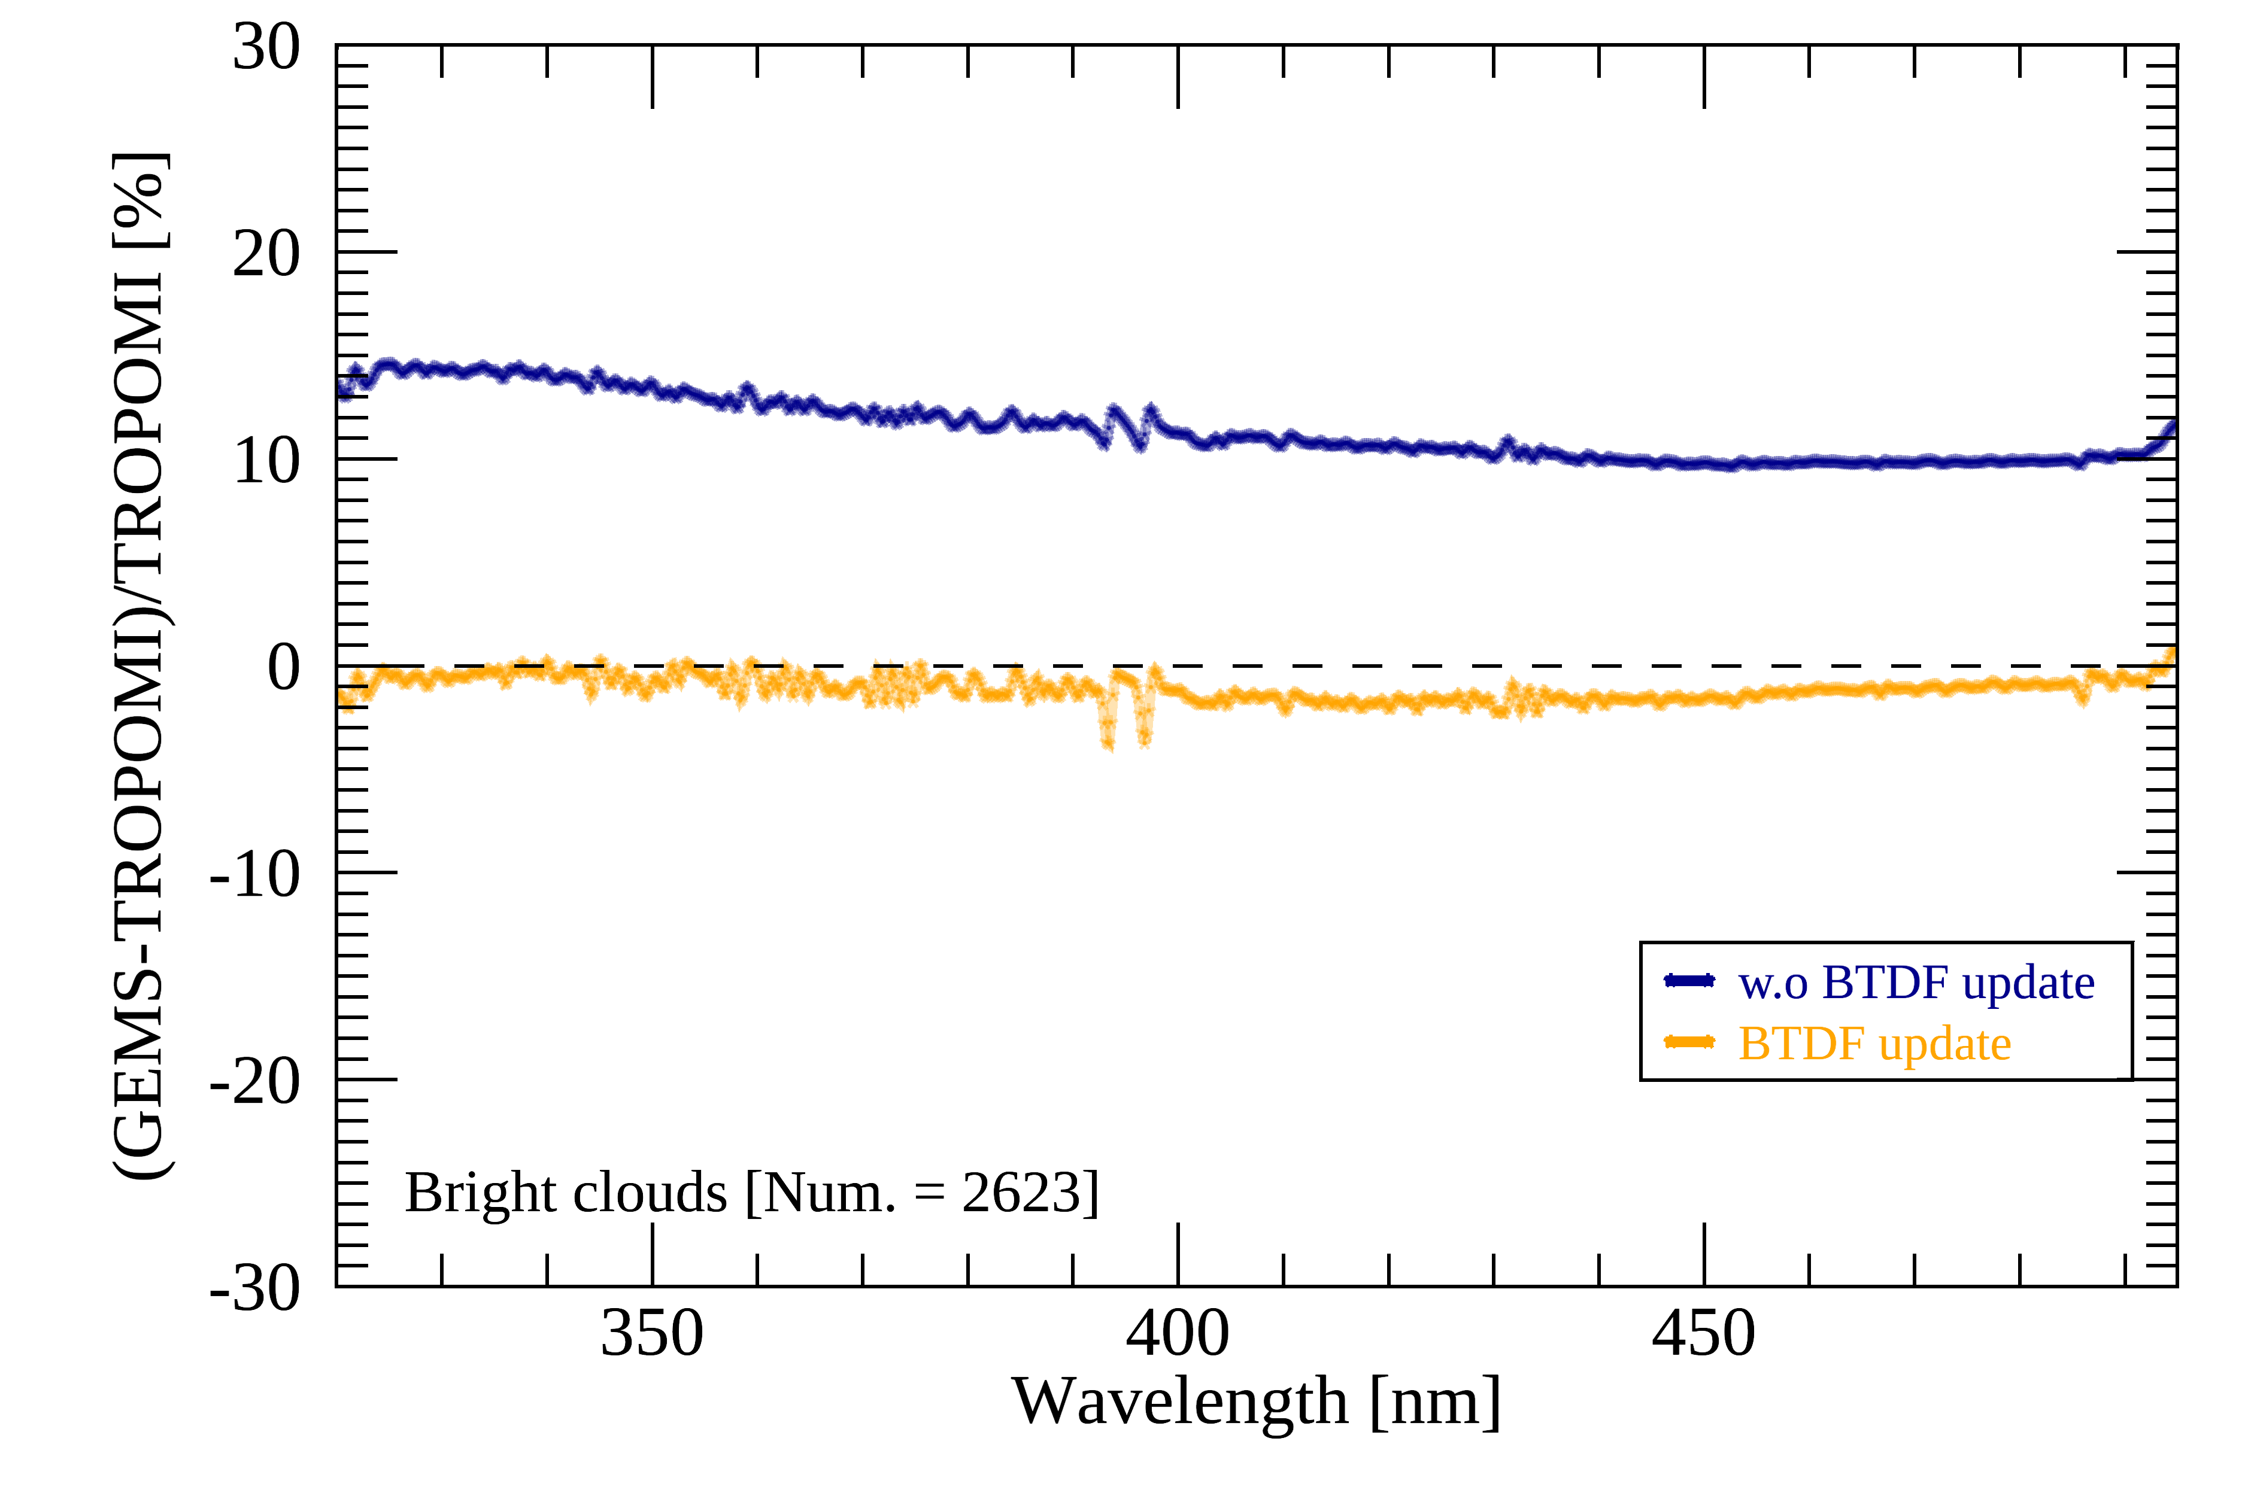
Remaining issues & future works
GEO-LEO comparison (TROPOMI & OMPS)
  Targeting DCC pixels (Sampling period: Nov 2020 – Jul 2021)
IRR
RAD
REF
OMPS NM
(300-380 nm)
IRR
RAD
REF
TROPOMI
(320-495 nm)

Slide 19
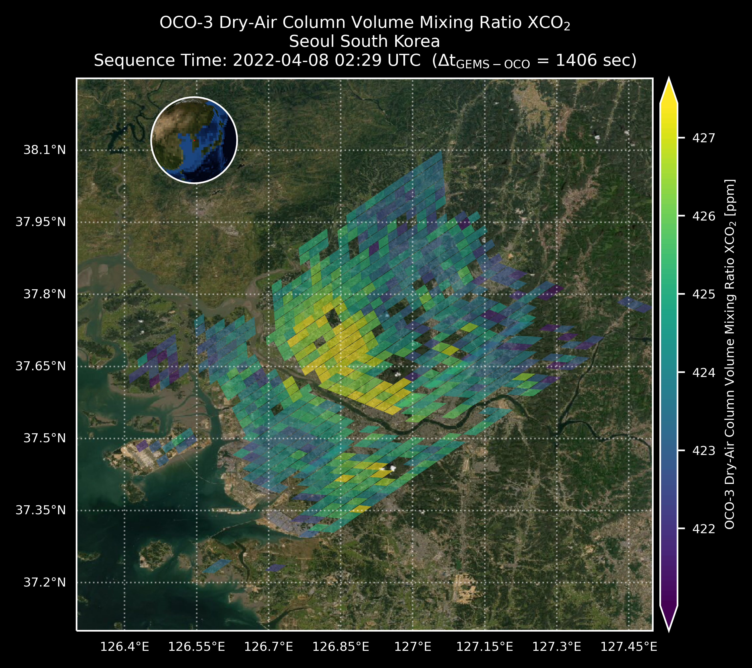
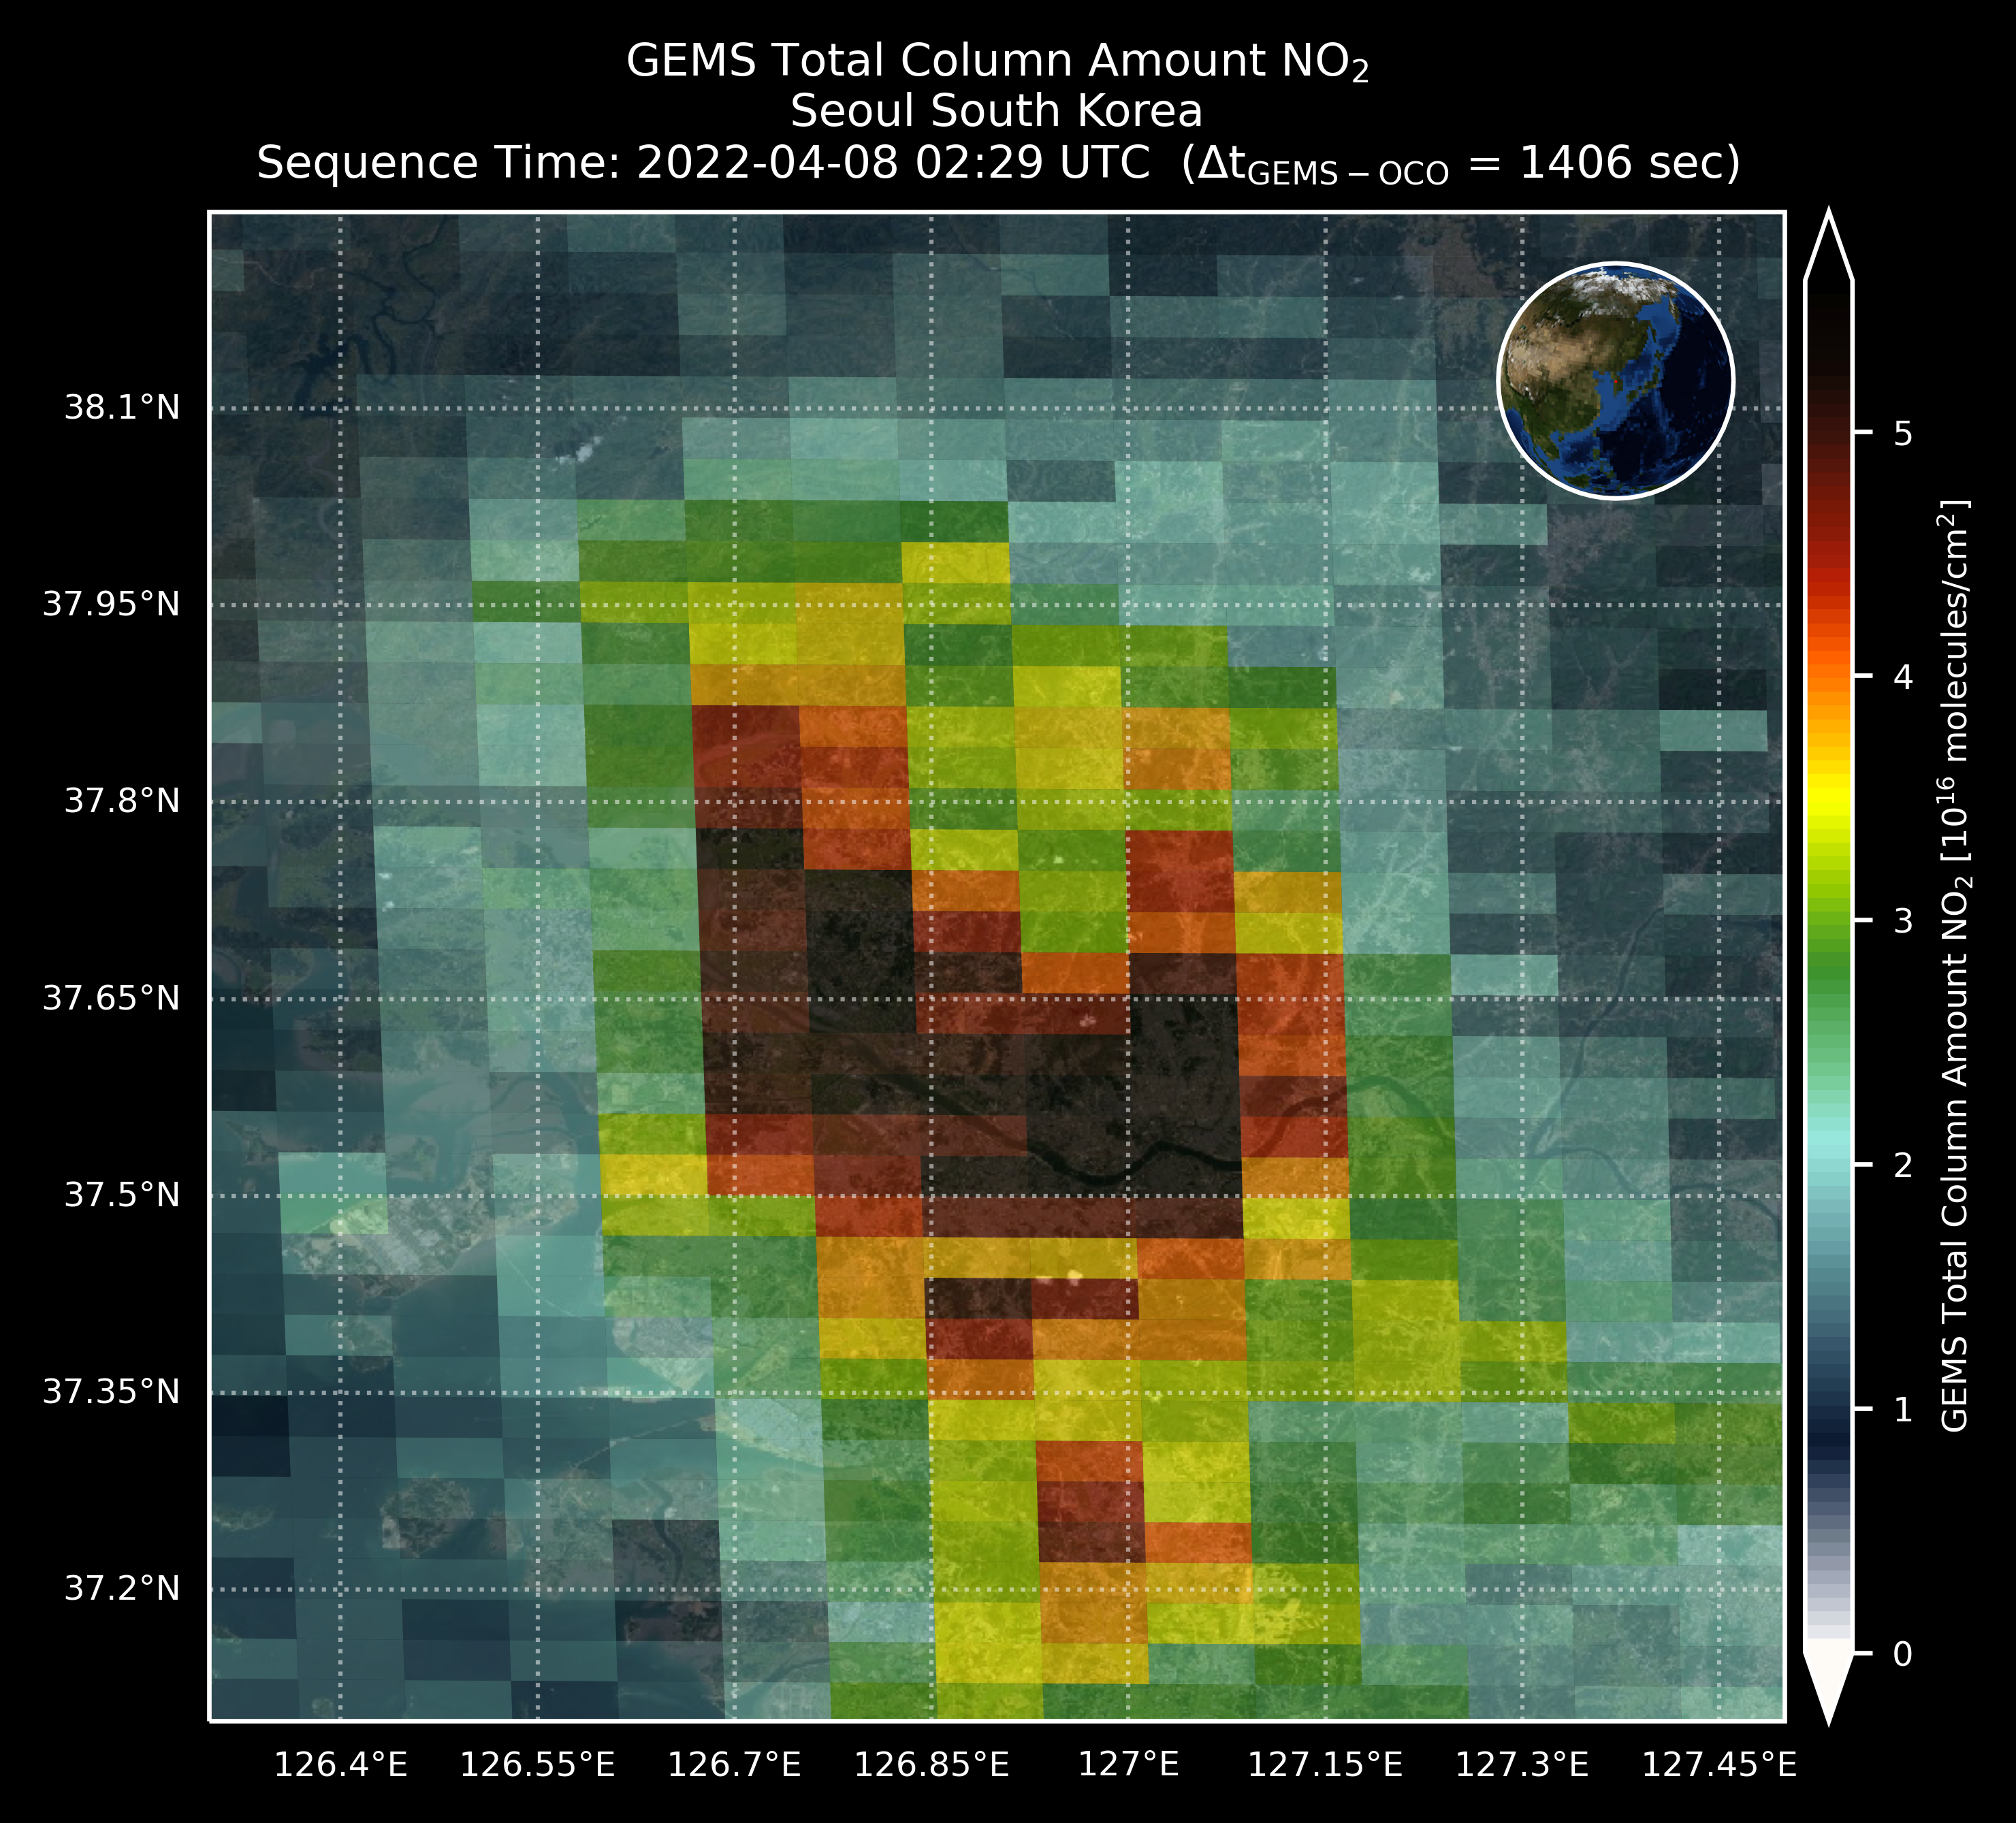
Comparisons of OCO-3 XCO2 and GEMS NO2
Better Luck with Fossil SAMs – Seoul, Korea 2022-04-08
native resolution
2022-04-08 02:29 UTC
2022-04-08 02:53 UTC
OCO-3 XCO2
GEMS NO2

Slide 20
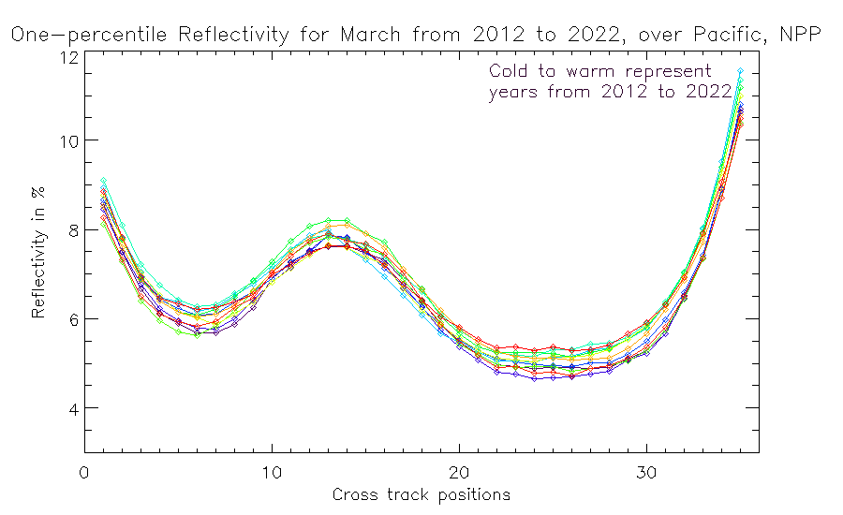
Two main sources of variations:
1. Differences from year-to-year in surface reflectivity, surface pressure and atmospheric aerosols.
2. Variations in the 331 nm channel calibration accuracy.
We will look at the NOAA-20 OMPS results for the last five years to compare the year-to-year changes.
Cross-track dependence over the Equatorial Pacific of one-percentile March V8TOz Effective Reflectivity estimates for S-NPP for 11 years. Colors are time-sorted Cold to Warm. This figure shows that the cross-track pattern for one-percentile reflectivity is very stable year-after-year, and the absolute values are stable at the 1% level. While we have used Effective Reflectivity values from comparison over the same time periods to make our soft calibration adjustment estimates, this suggests that there is some value to comparing the absolute results over time as a stability check.

Slide 21
Summary
UVN-S Subgroup members are making use of a range of GSICS methods including
  Deep Convective Cloud (DCC) Methods
  Ray tracing matchups
  Simultaneous Nadir Overpasses (SNO) with/without Double Differencing
  Radiative Transfer modeling
  Rayleigh scattering
  Comparisons to TSIS HSRS reference and OMI time series for solar studies
  Pseudo Invariant Calibration Sites (PICS) and other surface sites (e.g., Open Ocean, Ice fields, desert areas)
The OCO/GOSAT/TropoMI Calibration Team have productive quarterly meetings. They have invited GSICS and CO2M to those meetings. OCO, TropoMI & CO2M teams gave four NIR-spectrometer related talk in other sessions.
There is good communication across the community. There is significant overlap with the Vis/NIR group and we will continue to hold topical meetings with participation by both subgroups.

