Slide 1
GSICS Coordination Centre (GCC) Report for 2022-2023
Larry Flynn & Manik Bali
March 3, 2023
2023 GSICS Annual Meeting

Slide 2
Disclaimer
"The contents of this presentation are those of the authors and do not necessarily reflect any position of the US Government or the National Oceanic and Atmospheric Administration."

Slide 3
Outline
Introduction
GCC Activities
Global participation in GSICS activities
GSICS Quarterly Newsletter
Meeting Support
GSICS Product Status
New products accepted in past year
GSICS Action Tracker
GSICS Notebooks
GSICS Product Status System
Guidance from Executive Panel
Near Term Goals
Summary

Slide 4
GCC Activities – Participation in GSICS Activities
Interest in GSICS activities continues to grow

Slide 5
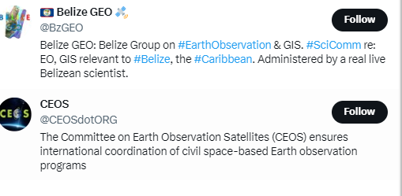
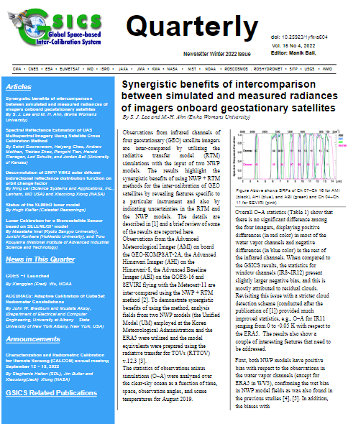
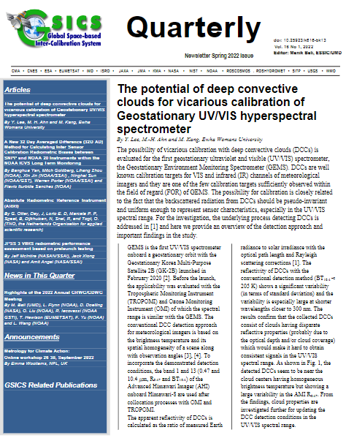
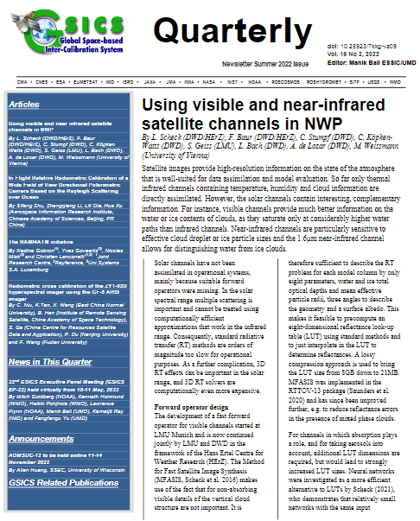
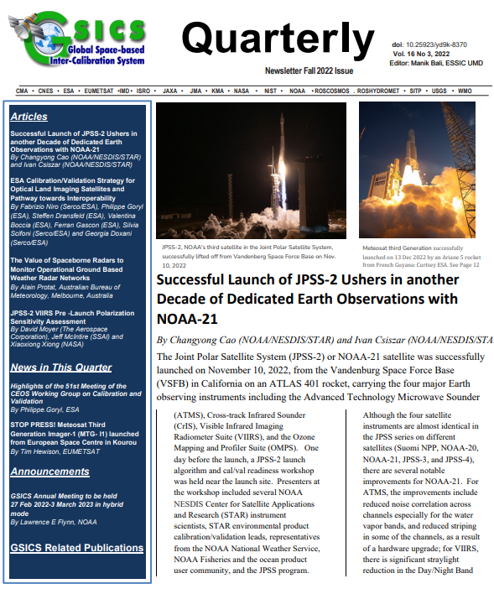
GSICS Activities-GSICS Newsletter
Special Thank you to our reviewers
Lawrence E. Flynn, NOAA
Lori Brown, NOAA
Martin Bergdorf, Uni Hamburg
Tim Hewison, EUMETSAT
Sri Harshara Madhavan, SSAI/NASA
Dave Doelling, NASA
Fangfang Yu, NOAA
Likun Wang, NOAA
Thanks to CEOS and Belzie GEO for sharing the newsletter on their official twitter handle
Over the last year, we published four Issues of the GSICS Newsletter
16 Research Articles and Six Topics of News to which
Approximately 70 Scientists contributed as Authors & Co-Authors.
Upcoming issues: Pre-Launch Cal, GSICS Tools, SOB and many more Ideas are welcome
https://www.star.nesdis.noaa.gov/smcd/GCC/newsletters.php

Slide 6
Meeting Support
GSICS Coordination Center supported the GSICS Annual Meeting 2022.
Meeting Minutes /Agenda can be accessed from GSICS Wiki http://gsics.atmos.umd.edu/bin/view/Development/Annualmeeting2022
Meeting Actions can be viewed at https://www.star.nesdis.noaa.gov/smcd/GCC/MeetingActions.php
Web meetings supported
2023-01-24/-25 | GRWG MW Subgroup - Q. Lu/Q. Liu | Microwave subgroup meeting
2023-01-12 | GVIS/NIR - Dave Doelling | Monthly Group Meeting
2023-01-05 | Planning GSICS 2023 Annual meeting - #2 | Webmeeting
2023-12-08 | GIR - Likun Wang | Lunar Calibration and Annual Meeting
2022-12-01 | GVIS/NIR - Dave Doelling | Monthly Group Meeting
2022-11-17 | Planning GRWG GDWG Annual Meeting 2023 | Webmeeting
2022-10-27 | GSICS Data Working Group | Webmeeting High Level Workplan
2022-10-13 | GVIS/NIR - Dave Doelling (Fred Wu) | Monthly Group Meeting
2022-10-06 | GIR - Likun Wang | GSICS Corrections and algorithm, and GOES ABI
2022-07-14 | GVIS/NIR - Dave Doelling | Monthly Group Meeting
2022-05-12 | GVIS/NIR - Dave Doelling | Monthly Group Meeting
2022-07-21 | GIR - Likun Wang | INSAT-3DR Intercalibration and Bias bias monitoring at ECMWF
2022-05-05 | GIR - Likun Wang | GSICS Algorithm and MERSI Status
2022-04-14 | GVIS/NIR - Dave Doelling | Monthly Group Meeting

Slide 7
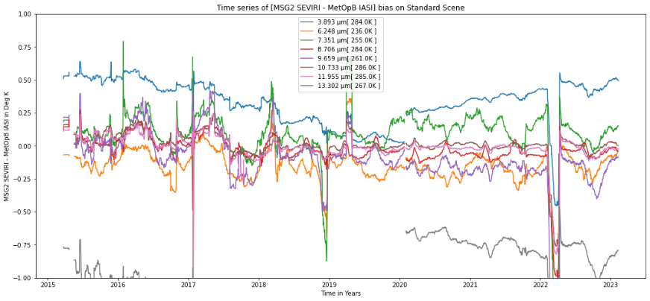
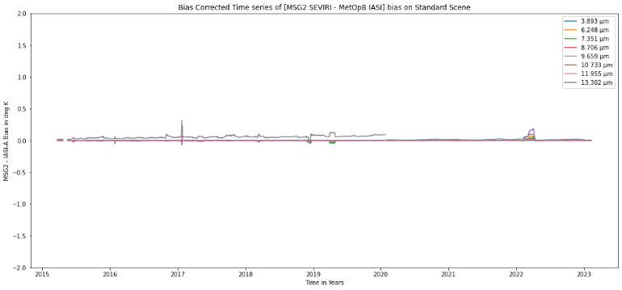
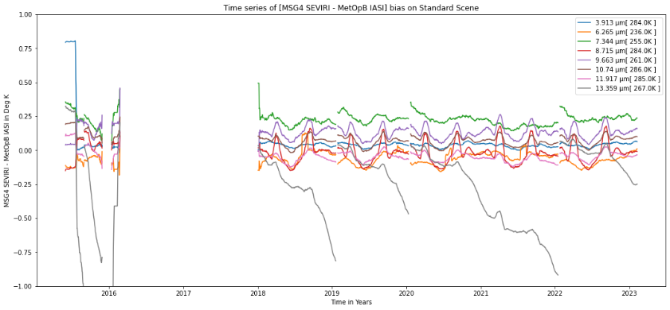
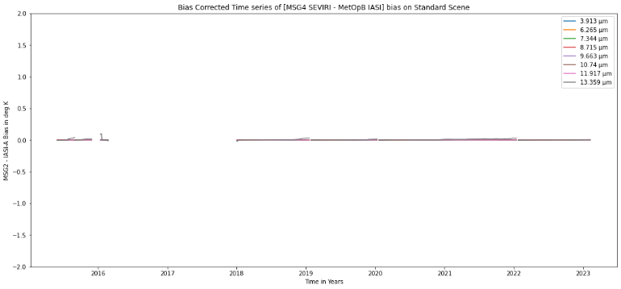
GSICS Products Status
A total of 72 Products presently delivered via the GSICS Product Catalog
Operational 12 product [12 EUMETSAT]
Preoperational 10 products [10 NOAA]
Demonstration 44 products [12 EUMETSAT, 13 NOAA, 12 JMA, 1 KMA, 2 ISRO]
Prototype 6 products [ 6 EUMETSAT]
JMA is ready to submit Himawari-9 products (using family of sensor quick approval).
Examples of GSICS products
Bias MSG-2 Vs IASI-B
Bias Corrected MSG-2 timeseries
MSG-2
Mean annual bias
Bias MSG-4 Vs IASI-B
Bias Corrected MSG-4 time series
Contact GCC if you wish to
Have inter-cal products specific
to your needs. E.g new space
MSG-4
Mean annual bias
Plots generated using colab note book click here to access
Notes:
Four demonstration products (NOAA) have ended production.
There are two prototype products.

Slide 8
NOAA GSICS Product Catalog
Migrating to new version of THREDDS server [ You might see interruptions ]
https://www.star.nesdis.noaa.gov/smcd/GCC/ProductCatalogImages.php
Product Type | Algorithm Type | Data Producer | Maturity Level | Monitored Instrument | Reference Instrument | Version | Data Start Date | Data End Date | Docs / Data Links
Prime Re-analysis correction | GEO-LEO Prime IR | EUMETSAT | Demonstration | MSG-1 SEVIRI | IASI-A | 0 | 6/1/2008 | Present | Docs Data
Prime Re-analysis correction | GEO-LEO Prime IR | EUMETSAT | Demonstration | MSG-2 SEVIRI | IASI-A | 0 | 6/1/2008 | Present | Docs Data
Prime Re-analysis correction | GEO-LEO Prime IR | EUMETSAT | Demonstration | MSG-3 SEVIRI | IASI-A | 0 | 8/12/2012 | Present | Docs Data
Prime Re-analysis correction | GEO-LEO Prime IR | EUMETSAT | Demonstration | MSG-4 SEVIRI | IASI-A | 0 | 9/8/2015 | Present | Docs Data
Re-analysis Correction | GEO-LEO IR | EUMETSAT | Demonstration | MSG-1 SEVIRI | IASI-A | 3 | 6/1/2008 | Present | Docs Data

Slide 9
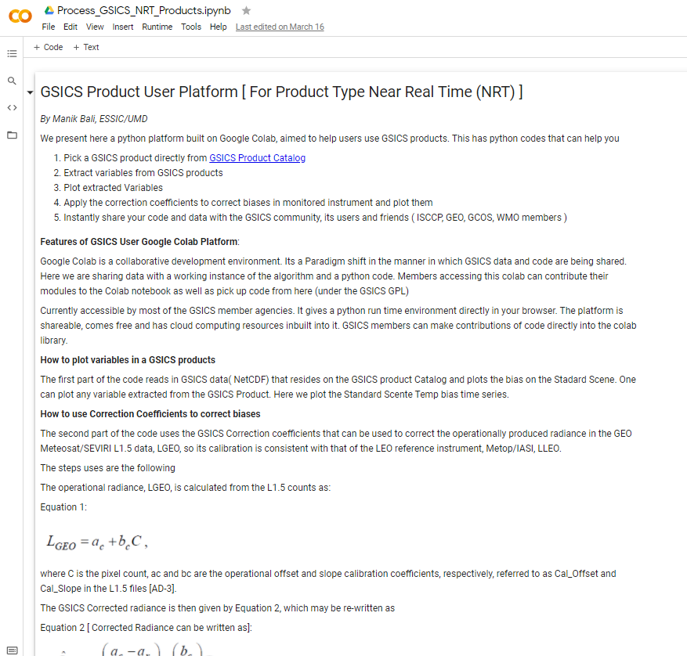
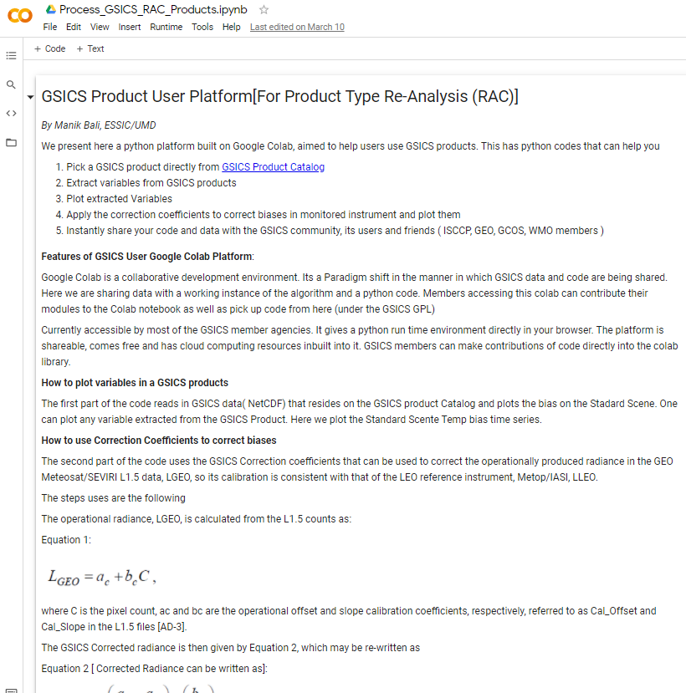
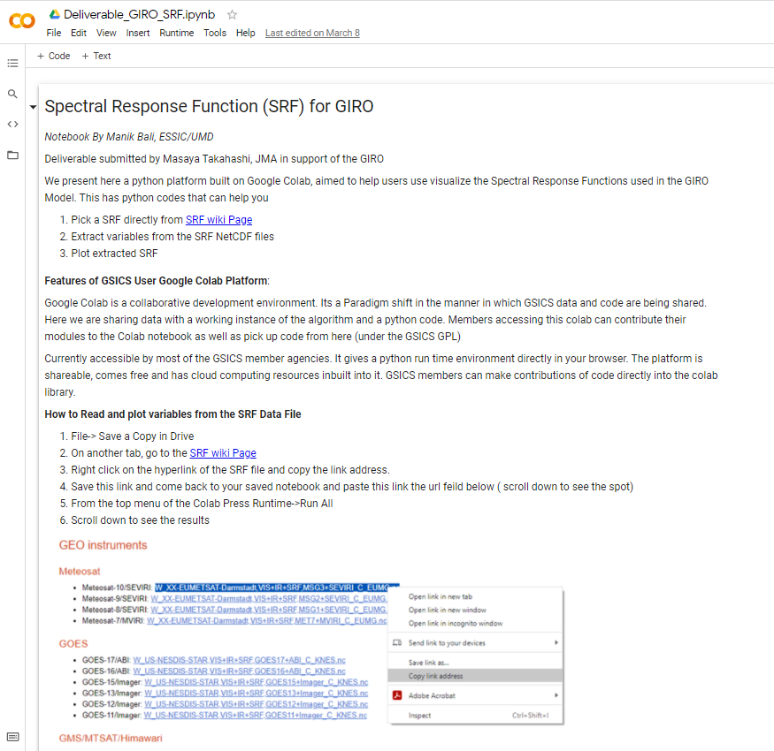
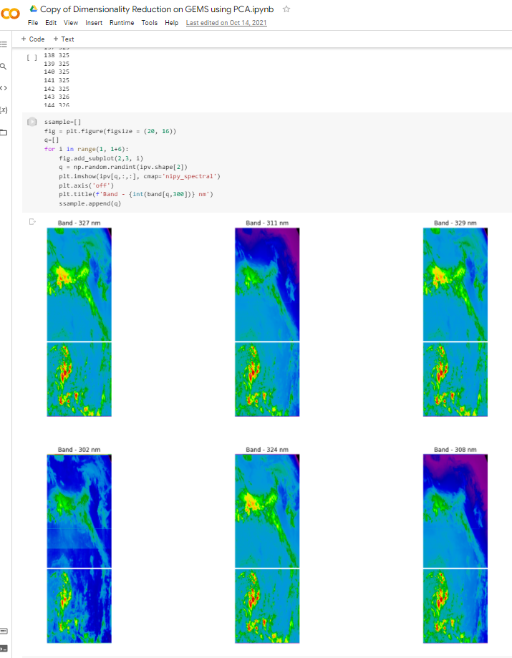
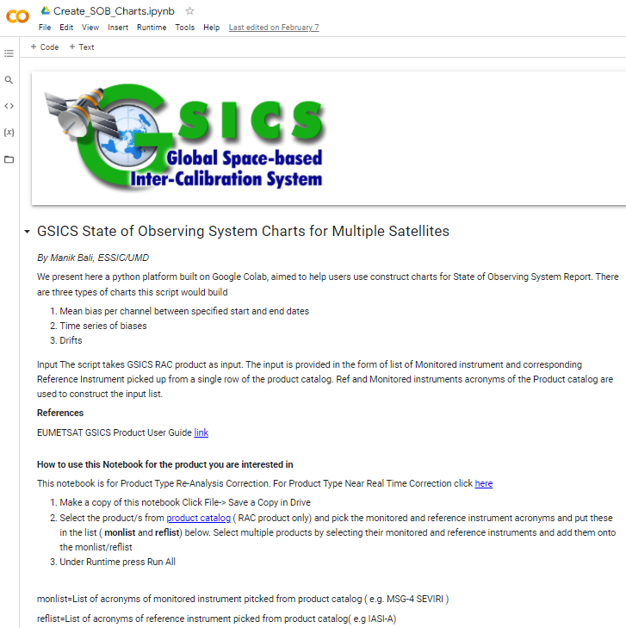
New GSICS Google Colab Notebook
New Colab files were created and previous maintained and supported.
The Python Script can read and use GSICS Products/Deliverables. These can be run directly from the browser.
Connects Users directly with product producers which helps in collaborative development.
Can be shared instantly. Click on hyperlinks below and start using GSICS Products/Deliverables
Seek EP/GRWG approval to designate Notebooks GSICS Deliverables
GSICS RAC Product
GSICS NRT Product
GSICS Deliverables SRF/Cal Tables
GEMS Data Processing
Generate State of Observing System Charts

Slide 10
GSICS Notebooks
Google Notebooks for Deliverables
Spectral Response Function (SRF) netCDF: SRFs used in GIRO in NetCDF format (Author: Masaya Takahashi, JMA) Note
GEO-LEO-IR Collocation netCDF: Intermediate Collocation data Himaware, METSAT 1R/2 Vs AIRS/IASI/MODIS (Author: Masaya Takahashi, JMA) [ Above Notebook can be tuned ]
LEO L1 netCDF: IASI Reference Radiances (Author: Masaya Takahashi, JMA) [Above Notebook can be tuned]
Level 1C inter calibration tables: Inter-Cal tables for Microwave Radiometers, e.g., SSMI series TRMM Constellation and GPM Radiometers (Author: Wes Berg, CSU)
Will SLIME become a deliverable?

Slide 11
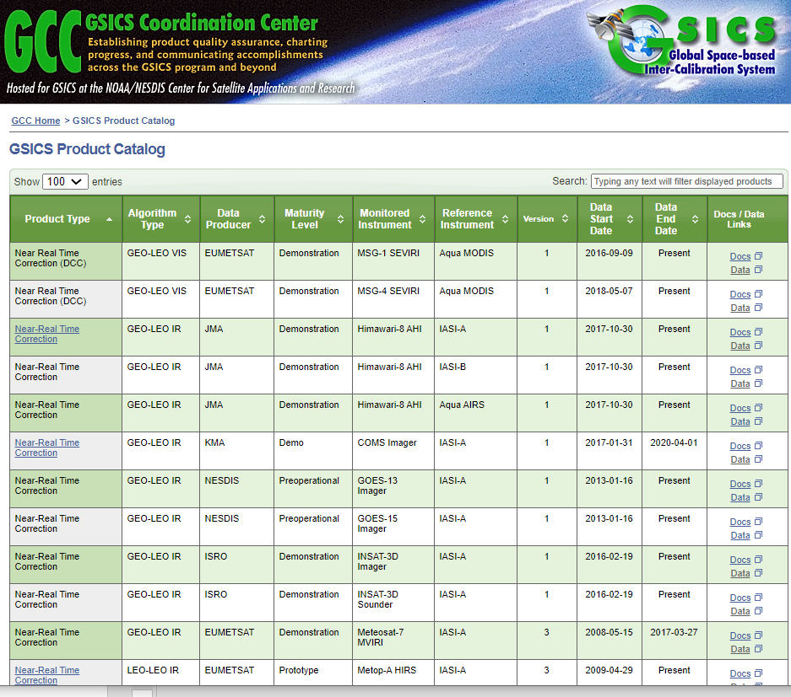
GSICS Product Status / Alert System: Background
The Global Space Based Inter-Calibration System ( GSICS ) maintains 72 inter-calibration products. These products are produced each day and disseminated via the THREDDS server or via the ftp servers on the https://www.star.nesdis.noaa.gov/smcd/GCC/ProductCatalog.php
The goal of status system is to inform the producers about the status of their GSICS product via an Email sent by the Alert System. The emails provide a list of un-updated products in a format similar to that on the GSICS Product Catalog.
For a Demo Click here
Relays the following information to the subscriber:
When was the last time the product upload took place on the THREDDS server
Whether or not the URL is active.
**System was updated to allow multiple users to access emails.

Slide 12
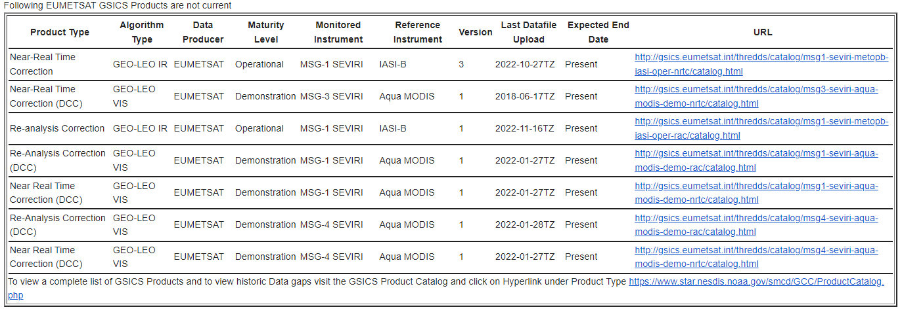
Status Emails
Status Emails help us to detect discontinuities in product creation and dissemination. E.G MSG-1 relocation was immediately conveyed

Slide 13
GCC Action Status [2022]
A.GCC.20220318.1 | GCC to edit an article on Notebooks, wiki and pages GSICS Tools |  | Open
A.GDWG.20220316.3 | GDWG members to inform GCC about the latest membership |  | Concurrent
A.GVNIR.20220318.6 | GRWG (Dave) to work with GCC lead a recommendation to EP of recommending TSIS-1 HSRS as a reference Solar spectrum | TSIS-1 recommended as reference solar spectrum | Closed

Slide 14
Actions Webpage
GCC maintains Actions page
One can update the 2022 Actions by
Visiting Actions Sheet 2022
https://www.star.nesdis.noaa.gov/smcd/GCC/MeetingActions.php

Slide 15
Near-term 2022-2023 Goals
Coordination
Continue to work with the GPRCs, GRWG and GDWG to expand and formalize the content in the Annual Instrument Reports.
Continue to coordinate efforts to establish the GSICS baseline algorithms, especially those for the GEO solar reflective channels, and increase the number of GSICS products for visible sensor measurements,
Continue to provide communication between the research group and users
GSICS Quarterly
Continue to compile, edit and distribute this important link to the GSICS community.
Support the inclusion of new products in the GPPA, and conduct reviews of GSICS Products, Deliverables and Resources
Meeting Support (additional proposed meetings in the Note Pages)
GSICS Annual Meeting for 2022
Continue collaborative development of the Action Tracker.
[ added sharepoint for updating actions]
Develop tools to help users
Develop User Guide and Google Notebook
Develop Product Status system
Improve outreach to potential Users of GSICS Products
Work closely with the NewSpace community and WMO OSCAR
Notes:
2020-01GDWGProgress Meeting
2019-??GVNIR - D.DoellingSolar Spectra
2019-??GVNIR - S.WagnerPICS data extraction and sharing
2019-??GVNIR - D.DoellingExtension of DCC method to NIR
2019-??GVNIR - D.DoellingSolicit inputs from all GPRCs on preferred sites to be characterized by CLARREO Pathfinder
2019-??GVNIR - D.DoellingPlan journal paper on DCC method
2019-??GVNIR - B.FougnieRayleigh scattering calibration
2019-??GUV - R.MunroUltraviolet Sub-Group web meeting
2019-??GIR - T.HewisonReview different GEO-LEO IR inter-calibration algorithm evolutions
2019-??GRWG - R.Roebeling/T.HewisonReprocessing/recalibration Workshop planning
2019-??GRWG - X.WuMTF characterization on the moon2019-??GDWGTHREDDS + Plotting Tool
2020-06-18GRWGECMWF Workshop on Error treatment

Slide 16
Summary
The GSICS Coordination Center continues to support and coordinate exchanges of ideas within GSICS.
GCC continues to play its role in reaching out to potential future members
GCC continues to publish the Newsletter.
GCC continues to support the collaboration and planning of GSICS research and other activities with complementary groups such as GRUAN, GNSS and WIGOS.
Established inter- comparison platform that has the capability to inter-compare any two platforms being established at UMD.
Suggestions, Feedback are welcome

Slide 17
Possible Discussion Topics
Next Year’s Meeting
Users’ Workshop
New product or deliverable types. We’re always open to ideas.
Chairs … and Monthly Thursdays?
Plotting tool (Discuss in 9n.)
Small Satellites – Do we have a presence in the CEOS New Space Group? (Discuss in 9l.)

Slide 18
Future Meetings
Eumetsat 2024?
Dear Fangfang,
We are pleased to offer to host the next GSICS annual meeting 2024 in EUMETSAT. The potential dates are
a. 19-23 Feb
b. 26 Feb – 1 March
c. 11-15 March
d. 18-22 March
We would need to pick a date this week to secure the EUMETSAT facilities and logistics, can we please add it to the discussions tomorrow?
Kind regards, Mounir
Asia 2025?
NASA LARC (CLARREO) or LASP (TSIS) 2026?

Slide 19
Users’ Workshop
What do the users want GSICS to do?
How to get them to tell us their problems as opposed to us telling them what we do?
What channels are most important to them, and with what level of uncertainties?
What channels are most problematic?
What dependencies are seen in the errors? (Viewing, diurnal, seasonal, signal level, etc.)
Do they want Level 1 Teams to apply GSICS “corrections”?
Should we make a new Survey?

Slide 20
Chairs
Keep Current Thursday schedule and allow SWx to pick their week?
GRWG?
GDWG?
Subgroups?
MW Subgroup co-chairs, Qifeng Lu and Mark Lui are stepping down.
Vis/Nir/
IR
UVN-S
SWx

Slide 21
Thank You

Slide 22
Backup / Old Slides

Slide 23
Seeking Guidance from the Executive Panel
It is a constant endeavor of GCC to meet the expectations of the members
To this end we seek guidance on the following:
Should we begin the process to include the Australian Space Agency or Bureau of Meteorology as members / observers in GSICS?
What is the path for private entities, like Planet-X to participate in GSICS?

