Slide 1
Applications of GIRO Models on the Calibration of GOES Imager Visible Channel
Fangfang Yu and Xiangqian Wu
12/02/2014-12/04/2014
Notes:
Changed GIRLO to GIRO

Slide 2
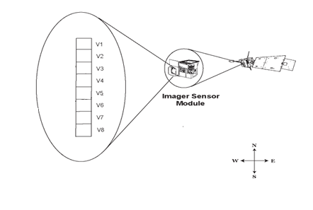
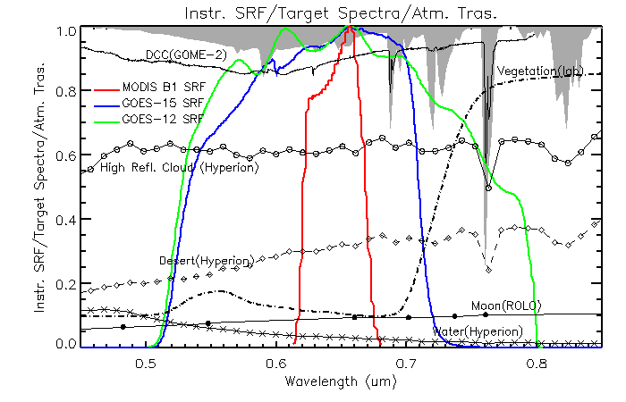
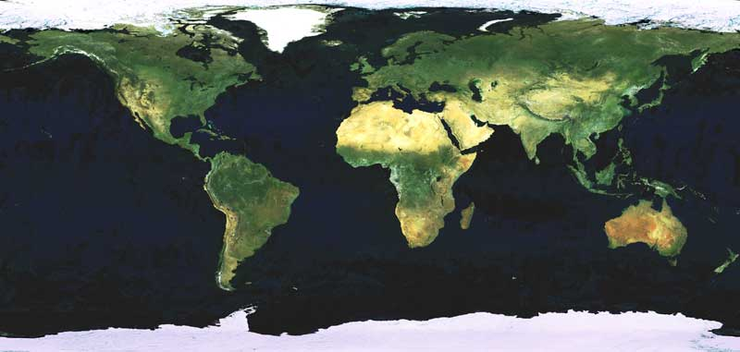
GOES Imager Visible Channel
Channel name | Central wvlen | Detector number | IGFOV | IGFOV at nadir (earth) | IGFOV at Moon Surface | E-W oversampling rate | Downlink resolution
1 | 0.65um | 8 | 28µrad | 1km | ~11km | 1.75 | 10-bits
GOES15(West): 105W
GOES12(East): 75W
GOES-W
GOES-E

Slide 3
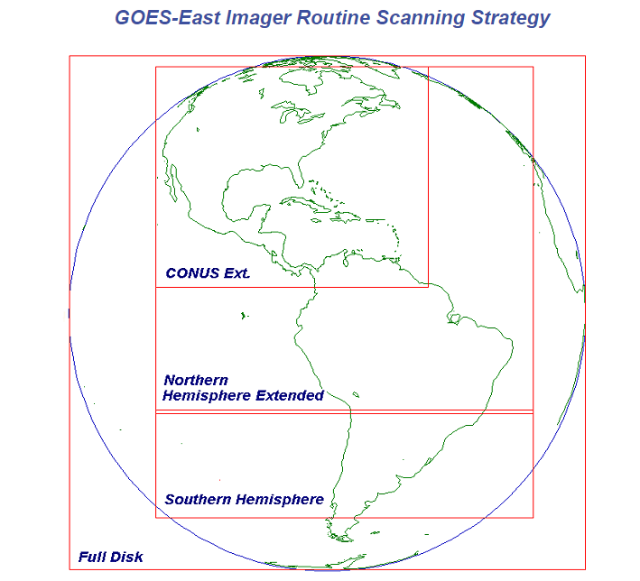
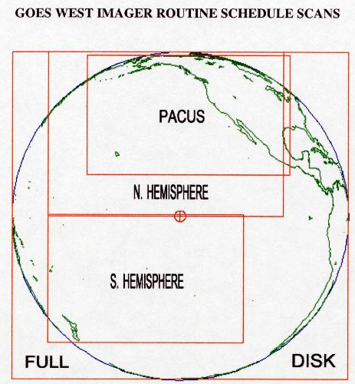
Moon Acquisition
Unscheduled Moon
Full Disk scan
Northern Hemisphere Extended (GOES-East)
Northern Hemisphere (GOES-West)
Only a few good data per year
Scheduled Moon
Since Oct. 2005
Using the 1-minute of star obs. window
About one or two times per month
Courtesy of : http://www.ospo.noaa.gov/Operations/GOES/east/routine_strategy.html
Notes:
Removed “after”

Slide 4
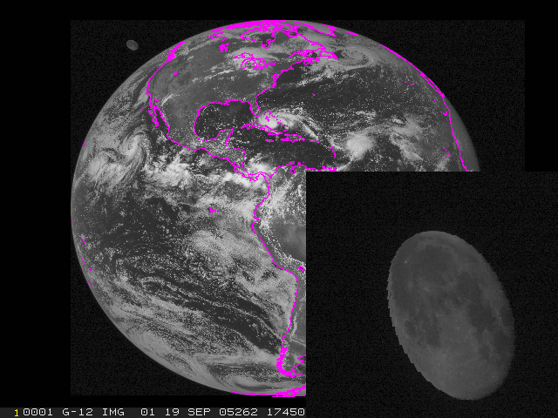
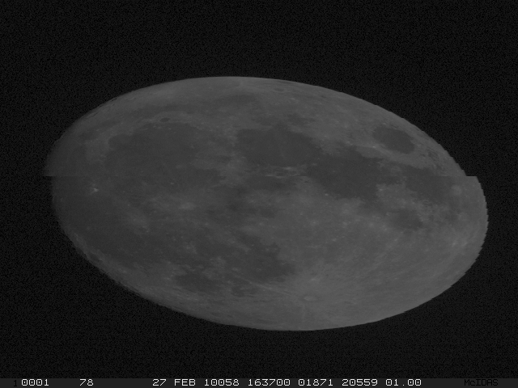
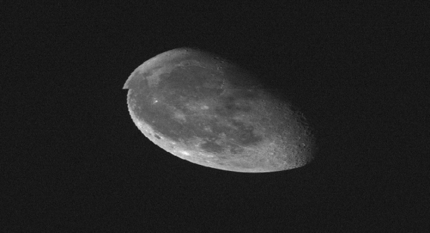
Moon Images
Unscheduled Moon image:
~2-6 good moons per year
Scheduled Moon Image
1-2 times per months, if not in conflict with Hurricane tracing event
P1 scan using the star obs. time slots
Space Calibration
Earth

Slide 5
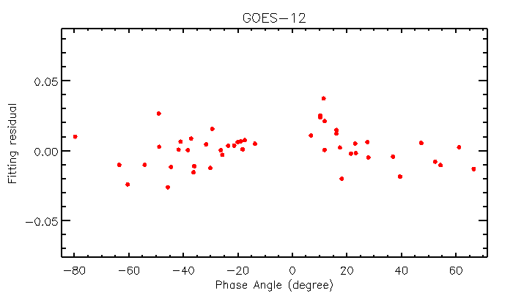
Phase Angle Range
Phase angle ranges
unscheduled moon: Could be any angle between [-90º, 90º], appear in the space area within GOES FOR.
Scheduled moon: [-75º, 75º] except for [-7º, 7º], 0.5º away from the Earth edge

Slide 6
GOES Imager Visible Calibration
No on-orbit calibration device
On-orbit calibrated with cold reference (space)
Clamp at space at every 2.2 sec (FD) or 36.6 sec (other mode)
Reset the zero-radiance output to a predetermined value of 29 raw count

Slide 7
GOES Lunar Irradiance
ω=7.18x10⁻¹⁰Sr⁻¹
S = constant
f = 1.75
Where n is the number of pixels associated with the moon illumination, ω_{i} is the solid angle subtended by moon pixel i, f_{i} is its oversampling factor, C_{i} is the pixel (i) output signal in count, C_{i,bk} is the background space signal in count, and S_{i} is the prelaunch calibration coefficient to convert instrument signal output from raw counts to radiance. Since the pre-launch calibration coefficients for the eight detectors of GOES imagers visible channel are similar, their medium value is used to calculate the lunar irradiance (http://www.star.nesdis.noaa.gov/smcd/spb/fwu/homepage/GOES_Imager_Vis_PreCal.php).

Slide 8
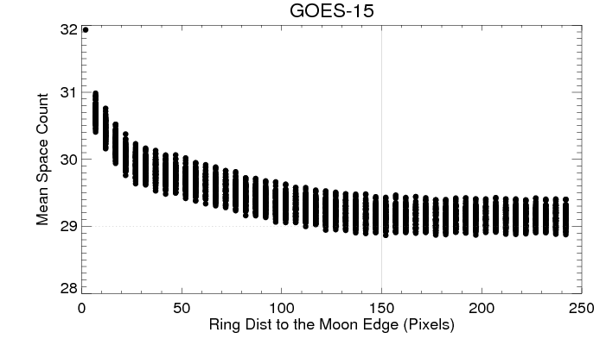
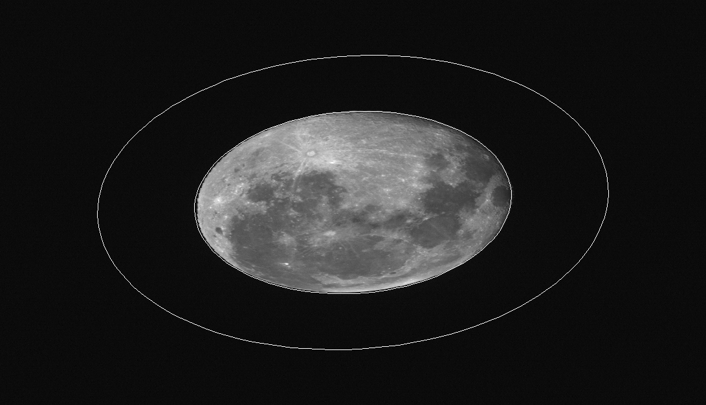
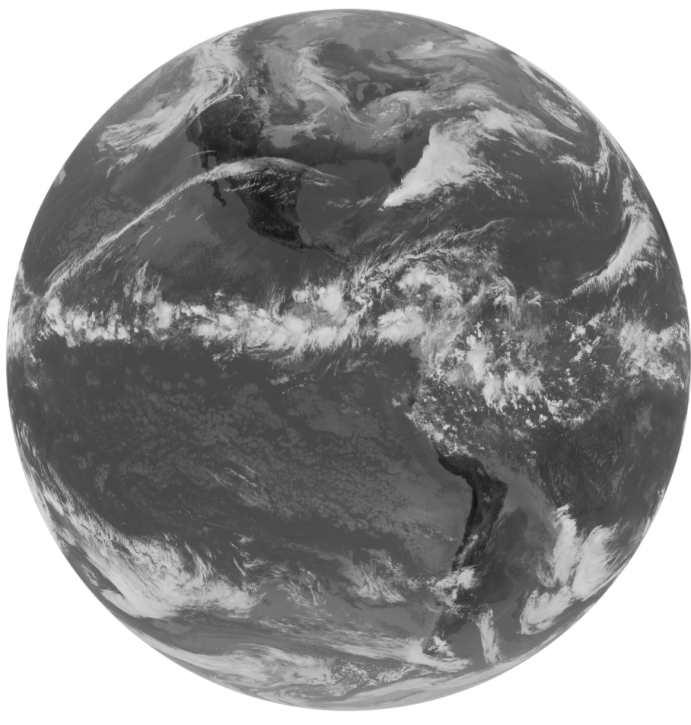
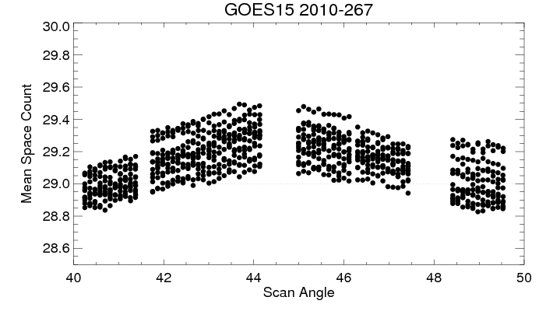
Background Count – 1) Stray-light
OOF response near the Moon
OOF response near the Earth

Slide 9
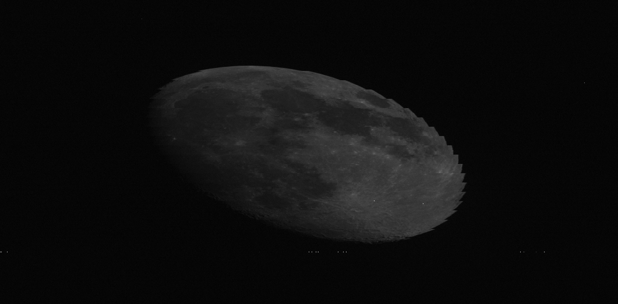
Background counts – 2) High Energy Particles
“Pepper & Salt” pixels
Cosmic rays, rare cases
Other noises
Very rare cases

Slide 10
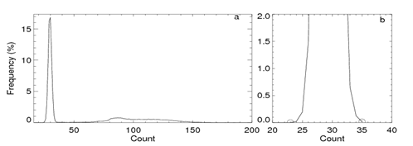
Background Count – 3) Calculation
10 pixels of interval
Mean count value of the un-contaminated space pixels in between the ellipse belt
150 and 160 pixels from the moon edge
~17,000pixels
150pixels

Slide 11
Oversampling
Constant value of 1.75 (ITT et al. 2010 GOES-NOP Data Book)
IFOV = 28urad
Scan rate (20 degree/second) x detector sample rate (21840 samples/second) = 16urad
E-W Oversampling factor = 28/16 = 1.75
N-S: oversampling factor = 1

Slide 12
Integration
i: pixels within the 150-pixel ellipse area
S: pre-launch calibration coefficient of the representative detector

Slide 13
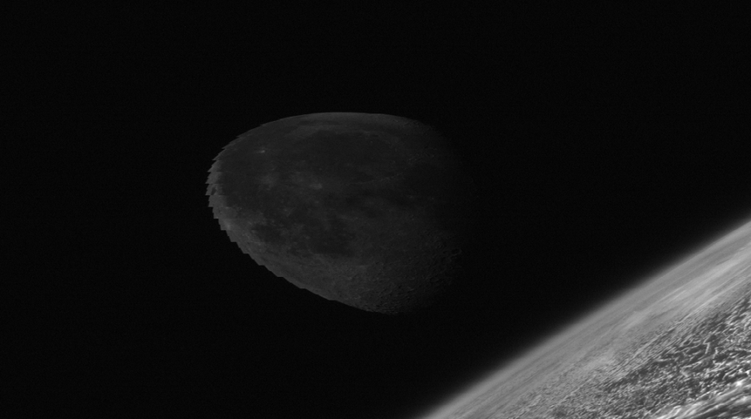
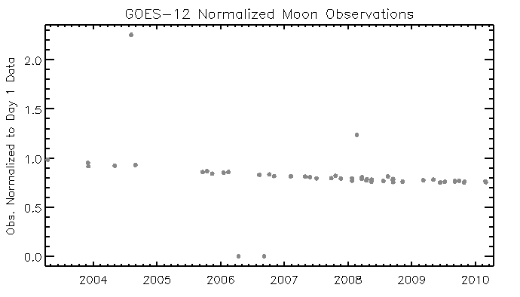
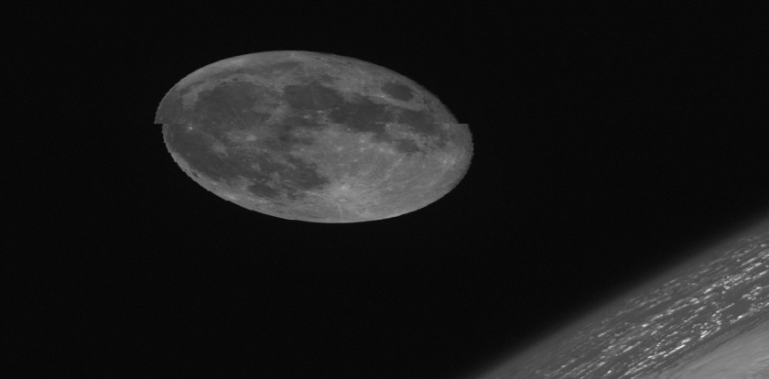
Special handling….
Unclipped moon data
Too close to the Earth edge (>0.5 degree from the Earth edge)
Challenging to derive the fitting ellipse automatically
0.22º
0.47º
Phase angle = 0.73º/1.02º

Slide 14
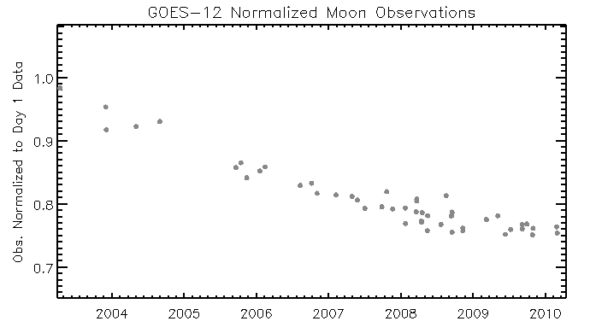
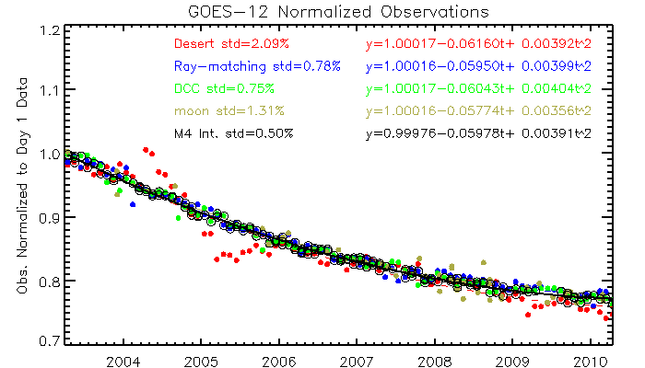
GIRO Results
Fitting function: y = a + bt + ct^2
Trending agrees very well with those of DCC and Ray-match methods
Deviations of Desert method results in 2004-2005 and 2009-2010 are apparent
Larger uncertainty than DCC and ray-match methods

Slide 15
Comparison with Integrated Method Results
Yu, F. and X. Wu, 2014, RSE, in review
Phase angle dependent calibration uncertainty ?
?
?

Slide 16
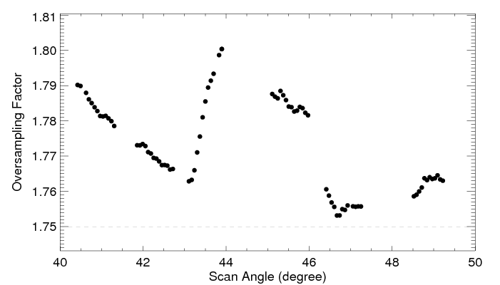
Discussions
Major Irr. Measurement Uncertainty Components
Oversampling factor: constant = 1.75?
INR(IMC uncertainty)
Moon-satellite relative movements
E-W
N-S
Instrument performance: space clamp
Background count
Cosmic rays and other noises
Stray-light from the Earth
Detector noise
Moon irradiance measurement
Stray-light from the illuminated moon pixels
MTF
Detector bright target recovery
Detector noise

Slide 17
Oversampling factor
Key number!
where D_{moon-sat} is the distance between the Moon and GOES satellite, ω is the solid angle extended from the detector (7.84x10⁻¹⁰Sr⁻¹), m is the number of illuminated moon pixels, r_{moon} is the moon radius (1735.5km), and fraction_{moon} is the fraction of illuminated moon, and ϕ is the selenocentric elongation of the Earth from the Sun.

Slide 18
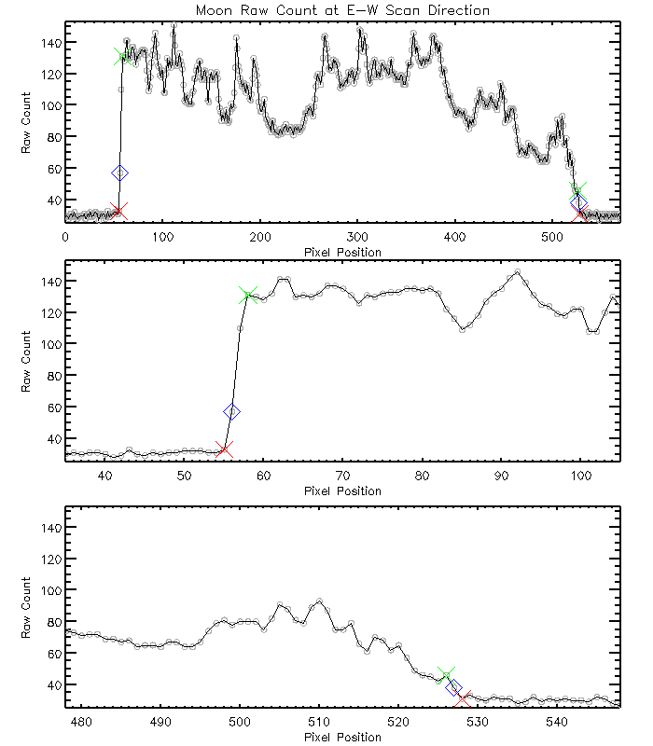
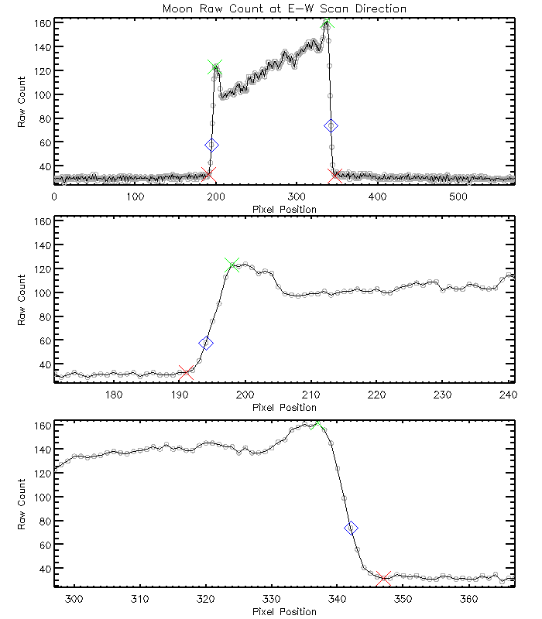
Illuminated Moon Boundary
Method 1: boundary identification
How to determine the illuminated moon boundary?
Sub-pixel illumination
Stray-light
MTF effect
Detector bright target recovery effect

Slide 19
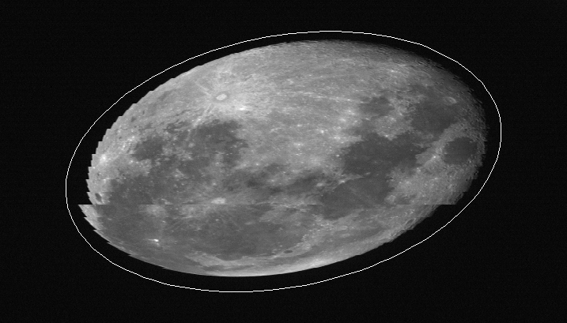
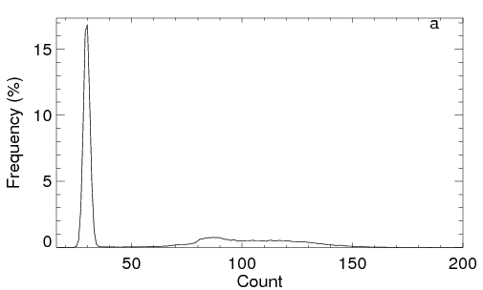
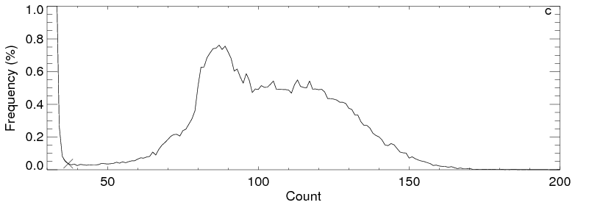
Illuminated Moon Pixels
Method 2 - Histogram
20pixels from the fitting ellipse
How to determine the threshold between stray-light contaminated space pixels and dark moon pixels, especially for the large phase angle images?

Slide 20
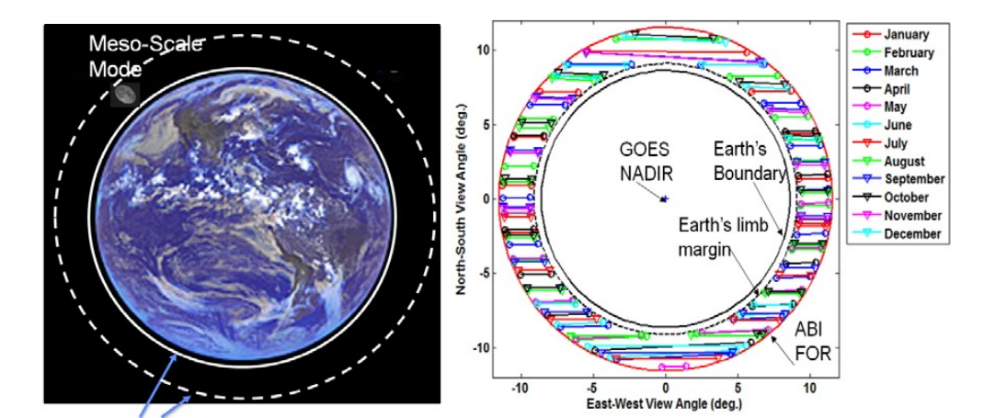
Future Instrument Cal. Spec.
GOES-R ABI
6 VNIR bands
Radiometric Calibration Accuracy Request
3% absolute calibration accuracy @ 100% albedo
0.5% stability over the mission life
Moon phase angle range at [-90º, 90º]
Band | Central wavlen(µm)
1 | 0.47
2 | 0.64
3 | 0.86
4 | 1.38
5 | 1.61
6 | 2.25
Courtesy of X. Shao and C. Cao

Slide 21
Needs for Lunar Model Development
Irradiance model (ROLO/GIRO)
Spectral irradiance
And how to derive channel irradiance from spectral irradiances, current method and potential improvement.
Quantify absolute calibration accuracy at difference phase angles
To meet the 3% abs. calibration accuracy specification
Plan for improvement
Quantify relative calibration accuracy at different phase angle
To meet the 0.5% stability specification

