Slide 1
S-NPP Visible Infrared Imaging Radiometer Suite (VIIRS) Lunar Calibration using GSICS Implementation of the ROLO model (GIRO) for Reflective Solar Bands
Taeyoung (Jason) Choi, Xi Shao, Changyong Cao, Fuzhong Weng
NOAA/NESDIS/STAR VIIRS Team.

Slide 2
Outline
Introduction
Descriptions of S-NPP VIIRS
About Moon Acquisitions
Scheduled/Free Moon Collections
Input Data Sets
VIIRS Observed Irradiance
Results
Effects of the Modulated RSR
GIRO Irradiance vs. Observed Irradiance
Summary
Future Plan

Slide 3
Introduction
Descriptions of S-NPP VIIRS
A whiskbroom scanning radiometer
Sun synchronous orbit
Field of view of 112.56⁰
Nominal altitude of 829 km
A large scan coverage of 3060 km
Equator crossing local time of approximately 13:30 pm
22 spectral bands
16 moderate resolution bands (M bands)
5 imaging resolution bands (I bands)
1 panchromatic day and night band (DNB band)

Slide 4
Introduction
Description of S-NPP VIIRS
Band | Center wavelength [um] | Spatial reso. at nadir [km] | Gain | Band | Center wavelength [um] | Spatial reso. at nadir [m] | Gain
M1 | 0.412 | 750 | High/Low | M12 | 3.70 | 750 | Single
M2 | 0.445 | 750 | High/Low | M13 | 4.05 | 750 | High/Low
M3 | 0.488 | 750 | High/Low | M14 | 8.55 | 750 | Single
M4 | 0.555 | 750 | High/Low | M15 | 10.76 | 750 | Single
M5 | 0.672 | 750 | High/Low | M16 | 12.01 | 750 | Single
M6 | 0.746 | 750 | Single | I1 | 0.640 | 375 | Single
M7 | 0.865 | 750 | High/Low | I2 | 0.865 | 375 | Single
M8 | 1.24 | 750 | Single | I3 | 1.61 | 375 | Single
M9 | 1.38 | 750 | Single | I4 | 3.74 | 375 | Single
M10 | 1.61 | 750 | Single | I5 | 11.45 | 375 | Single
M11 | 2.25 | 750 | Single | DNB | 0.7 | 750 | H/M/L†
*The shaded area indicates thermal emissive bands.

Slide 5
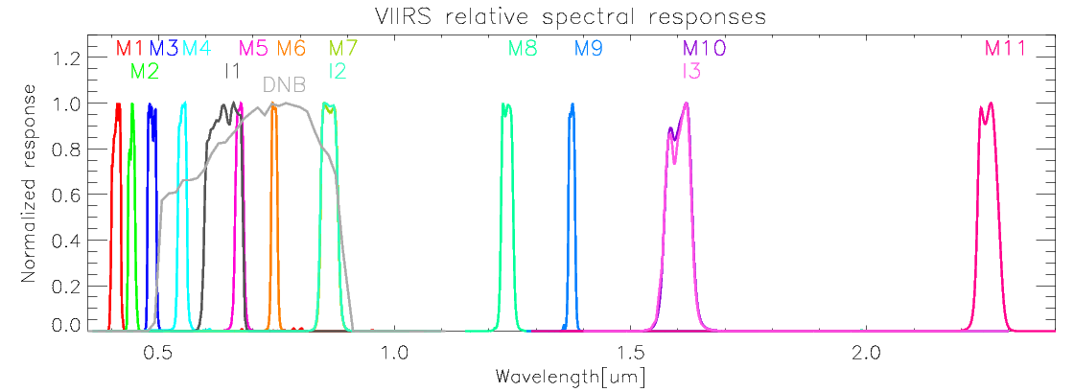
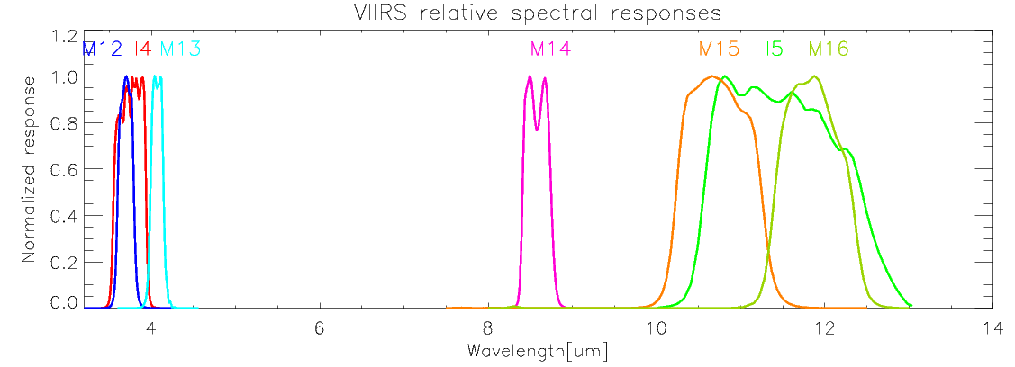
Introduction
SRF of S-NPP VIIRIS

Slide 6
Introduction
About Moon Acquisitions
Scheduled Moon Collections
Moon observation made through the Space View (SV).
Sector rotation is applied to place moon in the nadir Earth View (EV) frame.
During the sector rotation, the VIIRS observations are set to be fixed High Gain (HG) mode.
Spacecraft roll maneuvers are required.
Free Moon Collections
Sometimes, moon appears in the SV.
Free moon collections have BBR problems.
On-Board Calibration (OBC) files are not compensated compared to normal EV Science Data Records (SDR) products.
Focused on the scheduled moon collection in this study.

Slide 7
Introduction
Focal Plane Interface Electronics
From VIIRS Radiometric ATBD.

Slide 8
Introduction
Free Moon Collection Examples (through SV)
11/14/2013
1/8/2014
3/8/2014
3/12/2014

Slide 9
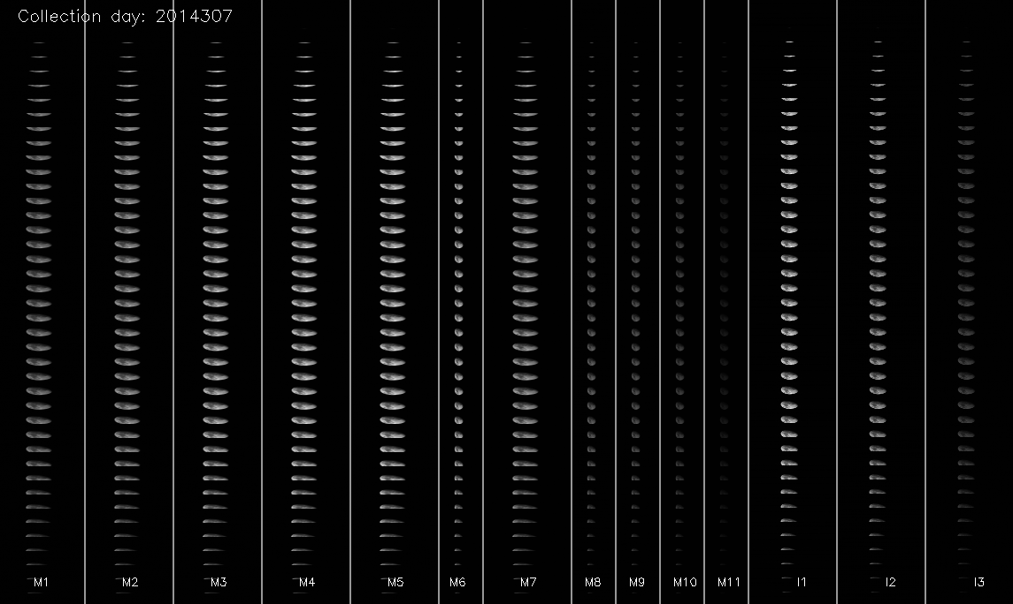
Introduction
Scheduled Moon Collection Example (SV but sector Rotated)

Slide 10
Introduction
04/02/2012 23:05:11
05/02/2012 10:20:06
10/25/2012 06:58:15
11/23/2012 21:18:20
12/23/2012 15:00:50
02/21/2013 09:31:25
03/23/2013 03:29:00
04/21/2012 19:47:54
10/14/2013 21:39:19
11/13/2013 06:57:41
Used 19 scheduled moon collections
12/12/2013 19:35:46
01/11/2014 09:59:45
02/10/2014 05:34:12
03/12/2014 01:11:43
04/10/2014 20:53:17
05/10/2014 13:13:00
06/09/2014 03:48:42
10/04/2014 17:29:10
11/03/2014 01:08:04
Notes:
5/21/13 miss

Slide 11
VIIRS Observed Irradiance
VIIRS irradiance calculation
VIIRS at aperture radiance
L_{ap}(B) = F·(C0 + C1·dn + C2·dn²)/RVS(θ_{SV}, B)
The dn values are bias corrected signal.
In each line, bias (background) values are estimated and removed by dark signal on the either sides of the moon.
The C0, C1, and C2 are detector temperature and electronics temperature dependent.
The F factors are interpolated from the daily operational values for each band, scan, detector, gain, and HAM side.
C0=0 update is also considered in the calculation.
Update date is May 1, 2014.

Slide 12
VIIRS Observed Irradiance
VIIRS observed irradiance
‘Num_pixel’ is effective number of pixels.

Slide 13
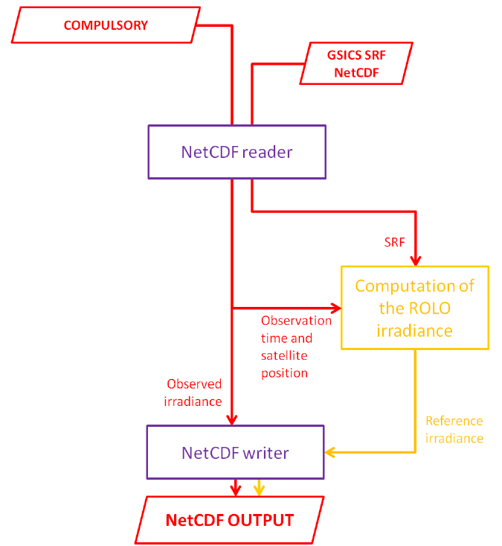
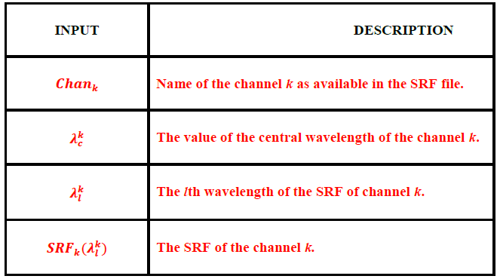
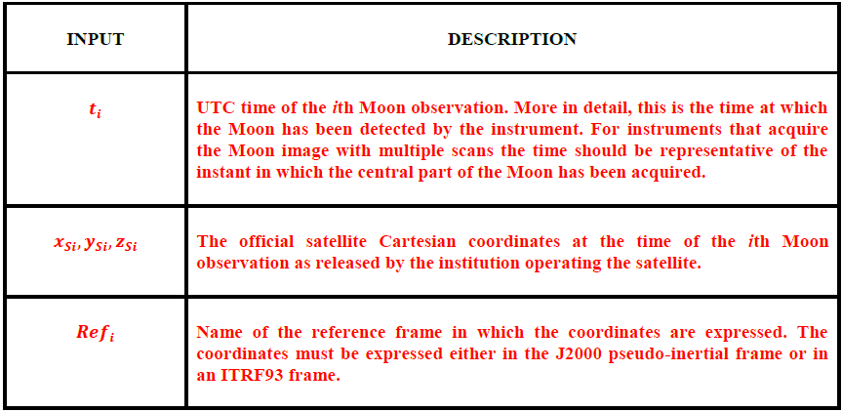
Results: GIRO option
Current option is compulsory with V4.
Figure is taken from the ‘High Level Description of the GIRO Application and Definition of the Input/Output Formats’

Slide 14
Results: Effects of the Modulated RSR
SNPP VIIRS Modulated RSR (or SRF) Released due to tungsten contamination in the Rotating Telescope Assembly (RTA).
The modulated RSR has been applied beginning of April 5, 2013.
For previous dates of the RSR update, Northrop Grumman (NG) provided official band-averaged RSR functions are used.
The GIRO output differences are less than 0.14% between the two RSR functions.
Only band M1 shows 0.13% level whereas all other bands are less than 0.07% or less.
NG RSR functions are used before April 5, 2013.
Modulated RSR function are used after the update.

Slide 15
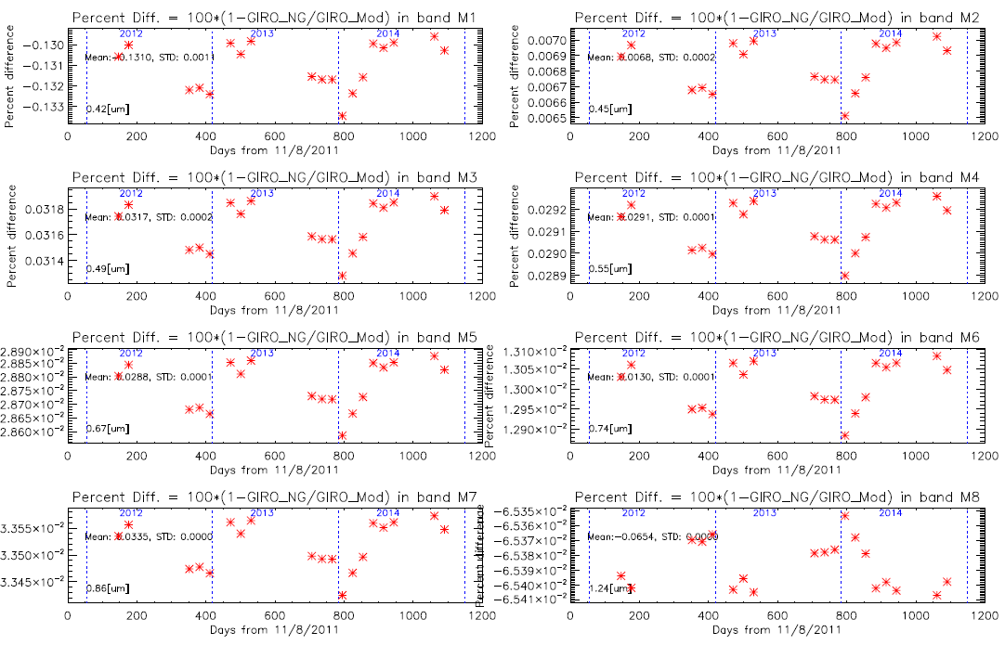
Results: NG’s SRF Vs. Modulated SRF

Slide 16
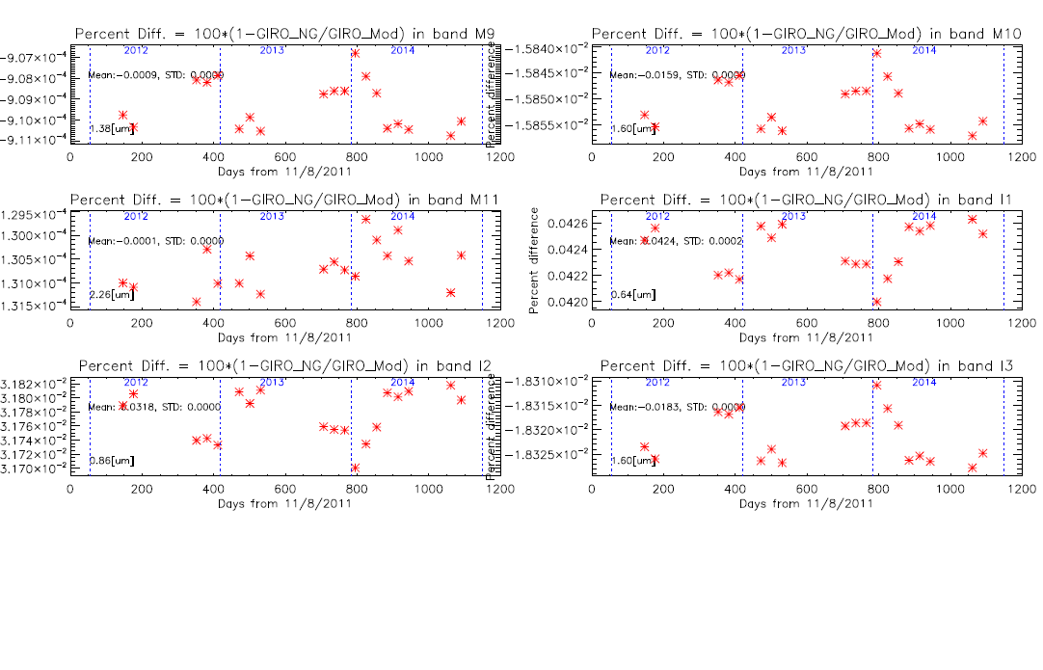
Results: NG’s SRF Vs. Modulated SRF

Slide 17
Results

Slide 18
Results

Slide 19
Results

Slide 20
Results

Slide 21
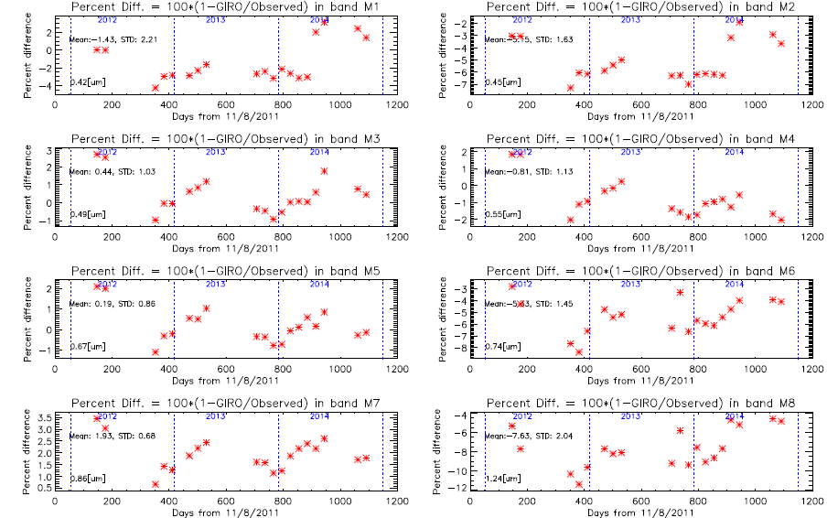
Results

Slide 22
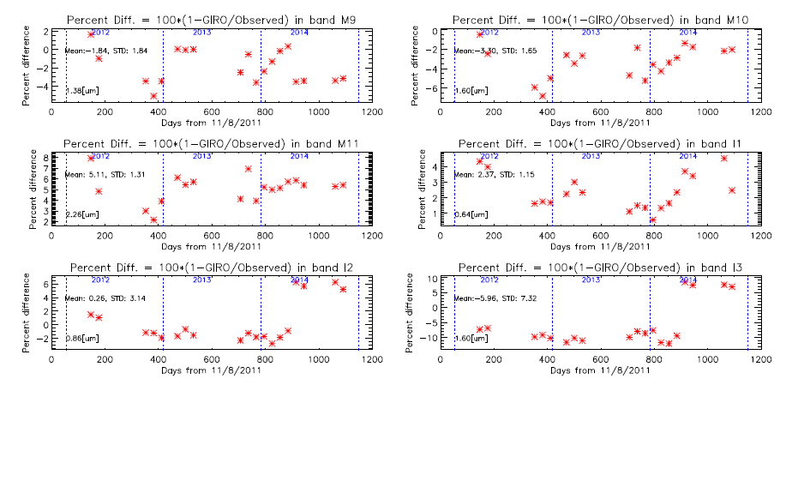
Results

Slide 23
Results

Slide 24
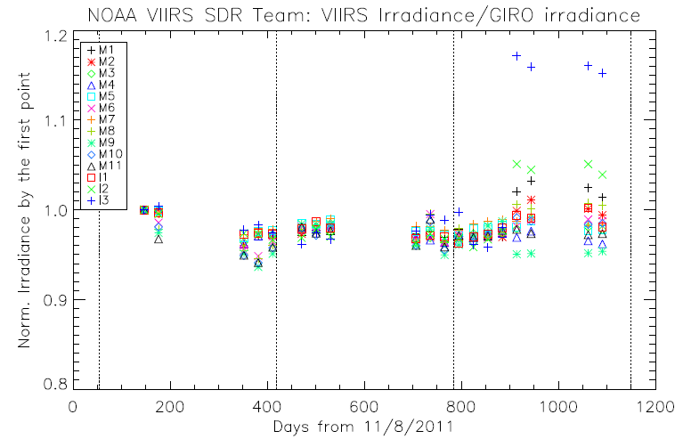
Results
Normalized to the first point

Slide 25
Summary
The GIRO version 4 was successfully implemented and produced lunar irradiance values for SNPP VIIRS scheduled moon collections.
Corresponding VIIRS irradiance values are calculated using effective pixel averaging method.
In irradiance scale, specific bands M2, M6, M8, M11 and I3 shows static differences larger than 5%.
M11 has low SNR and I3 has C0=0 update issues.
Other bands show reasonable agreements between GIRO and observed irradiances approximately within 3%.

Slide 26
Future Plan
Based on GIRO irradiance results, the Lunar calibration coefficient (F-factor) will be compared to the operational F-factors.
Not using the relative comparisons.
I_{moon}(B,M,G) = Mean_radiance(B,M,G,D) ·Ω
= Σ_{pixel} {(C0 + C1·dn + C2·dn²)/RVS(θ_{SV}, B)}/N_Pixel ·Ω
Work on free moon collections.

Slide 27
Backup Slides

Slide 28
Results
Some VCST data points are taken from VIIRS SDR meeting PPT titled with
VIIRS RSB Lunar Calibration Result Update After Roll Event February 10th, 2014
2014-03-12 Z. Wang and J. Fulbright VIIRS Characterization Support Team

