Slide 1
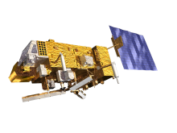
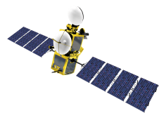
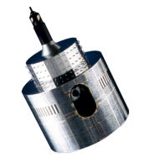
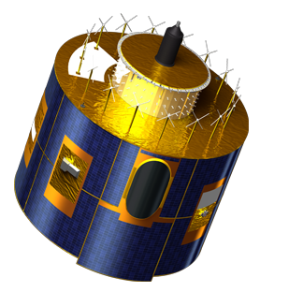
Sensitivity ANALYSIS
Sébastien Wagner (EUMETSAT)
In collaboration with
Tom Stone (USGS)
Sophie Lachérade, Bertrand Fougnie (CNES)
Jack Xiong (NASA)
With the great support of B. Viticchie, M. Takahashi, T. Hewison

Slide 2
What do we want to achieve?
Needs:
For users to know how reliable is the information they look at...
For the developers to understand where systems / processing are critical (characterization, accuracy, stability) ➔ tell where improvements can be done and what is the impact
For calibration / inter-calibration: need to look at
Acquisition chain
Processing algorithms / methods
Reference uncertainties
Goal of the sensitivity analysis w.r.t. Lunar Calibration Workshop:
Raise awareness about understanding the typical uncertainties on the input data
Show how GIRO results vary by changing the input data.
Initiate discussion on how to establish a uncertainty budget (to support calibration/inter-calibration products and their quality assessment)
Not meant to be exhaustive and complete. It is mainly to start the process and exchange experience and knowledge...

Slide 3
Sensitivity tree
Data source, measurement technique
Source of degradation:
Out of band rejection
On-orbit degradation
Non-linearity
Spectral response
Dark signal correction
Oversampling
Integration step
Absolute calibration
Sensitivity study parameters
Data source
ΔSRF
ΔI
Δ(x,y,z)
SRF
Sensor Irradiances
Satellite position
GIRO inputs
GIRO

Slide 4
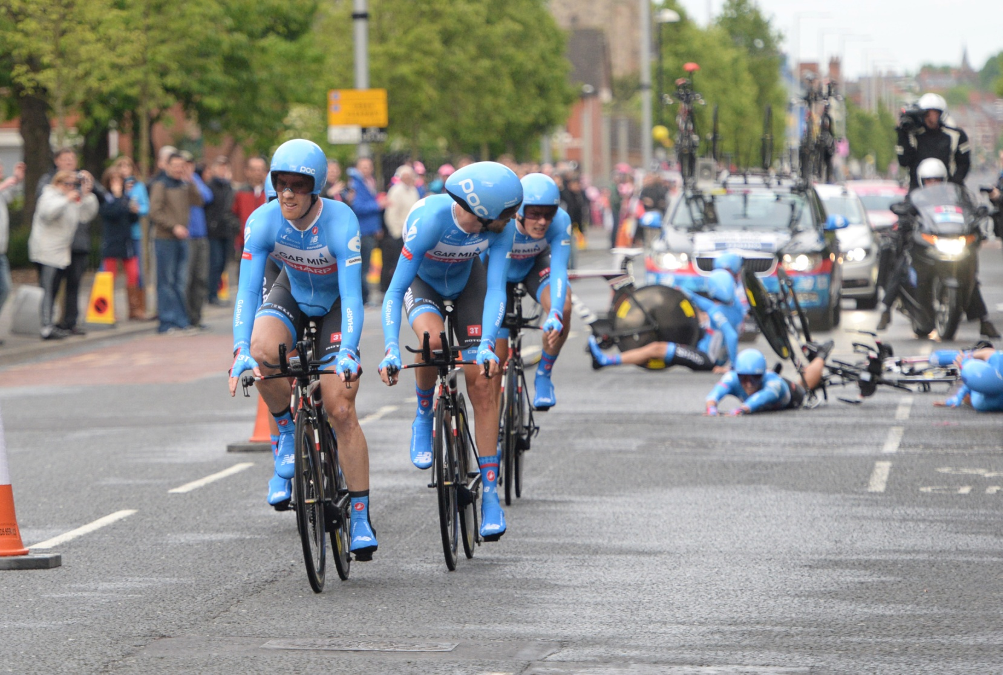
Sensitivity analysis... It is all about perturbation...

Slide 5
Sensitivity tree
Data source, measurement technique
Source of degradation:
Out of band rejection
On-orbit degradation
Non-linearity
Spectral response
Dark signal correction
Oversampling
Integration step
Absolute calibration
Sensitivity study parameters
Data source
ΔSRF
ΔI
Δ(x,y,z)
SRF
Sensor Irradiances
Satellite position
GIRO inputs
GIRO

Slide 6
Sensitivity tree
Data source, measurement technique
Source of degradation:
Out of band rejection
On-orbit degradation
Non-linearity
Spectral response
Dark signal correction
Oversampling
Integration step
Absolute calibration
Sensitivity study parameters
Data source
Achievable only when imagettes are available or at image processing time at home!
ΔSRF
ΔI
Δ(x,y,z)
SRF
Sensor Irradiances
Satellite position
GIRO inputs
GIRO

Slide 7
Perturbation tool and sensitivity analysis
Tool developed at EUMETSAT in C ➔ the GIRO PERTurbation tool (GIRO_PERT)
Currently four tests implemented to test the sensitivity of the GSICS Implementation of the ROLO model to:
random perturbation of the satellite position,
rigid shift of the SRF (for the tests, done in both directions [short WL, long WL]),
change in the wavelength sampling of the SRF (by removing SRF information), and
random perturbation of the SRF shape.
Sensitivity assessment done using the ROLO reference irradiance and the phase angle
Set-up = pre-defined list of images from each data set = input
Each input is perturbed by selecting the type of perturbation
Re-generation of a dummy input to the GIRO and extraction of the relevant output for the analysis.
Runs managed by a shell script
Should run on participants’ systems as it is built as the GIRO. TO BE TESTED.

Slide 8
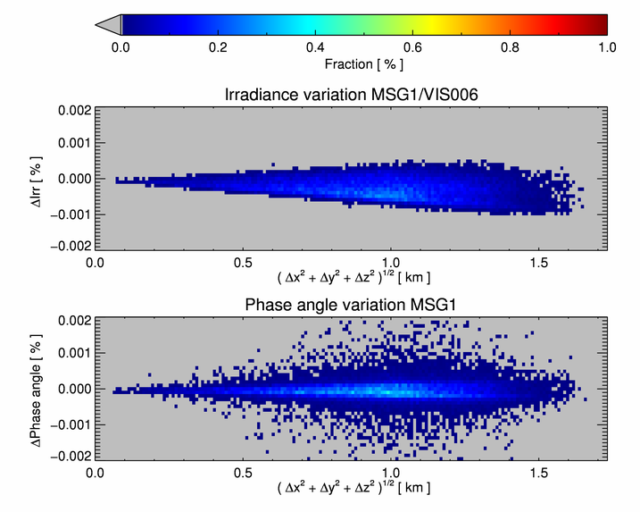
Typical results post-processing – Satellite position
Random perturbation along x, y, and z with uniform distribution between [ -500, 500] m,
100 runs,
ΔIrr is the difference between the unperturbed irradiance and the perturbed ones.

Slide 9
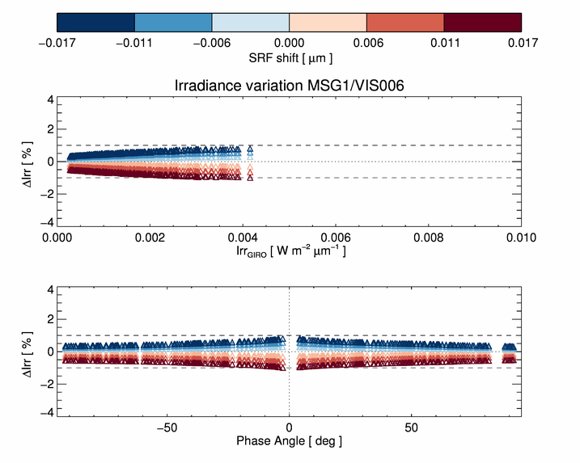
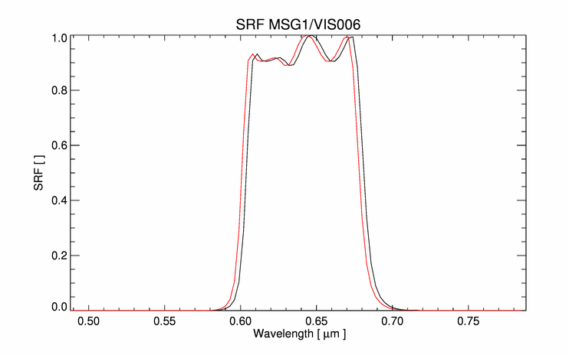
Typical results post-processing – Rigid SRF shift
Rigid shift of the SRF: an example from a run (red = original, black = modified)
6 shifts of the SRF (i.e., 6 runs)
ΔIrr is the difference between the unperturbed irradiance and the perturbed ones.

Slide 10
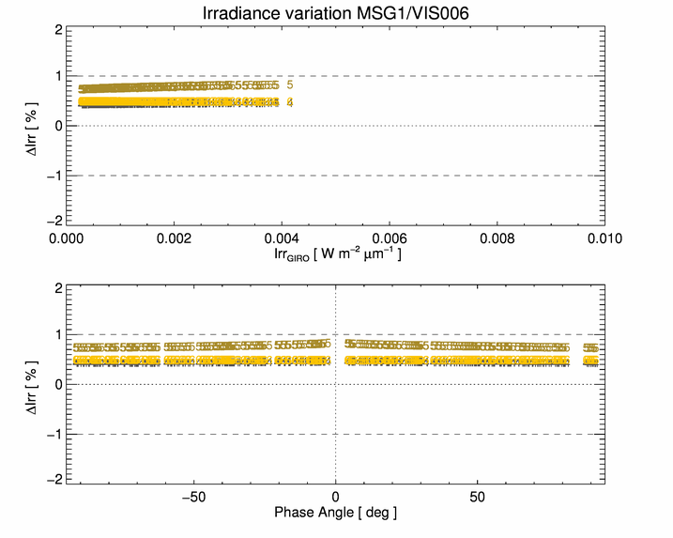
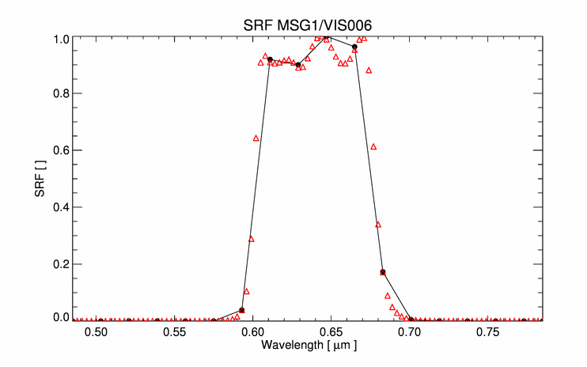
Typical results post-processing – change on SRF sampling
Change of sampling of the SRF: an example from a run (red = original, black = modified)
3 runs performed after keeping a SRF point every 4, 5, and 6 wavelengths.
ΔIrr is the difference between the unperturbed irradiance and the perturbed ones.

Slide 11
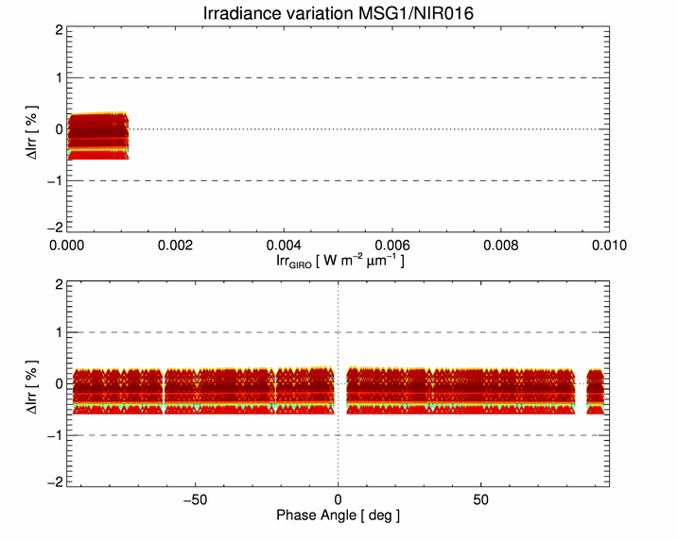
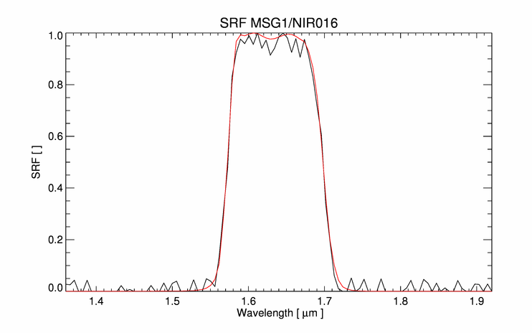
Typical results post-processing – Noise on the SRF
Change of shape of the SRF: an example from a run (red = original, black = modified)
Random noise added to the SRF at each wavelength point with uniform distribution between [-0.05, 0.05],
100 runs,
ΔIrr is the difference between the unperturbed irradiance and the perturbed ones.

Slide 12
Questions to be answered
How sensitive are the instruments to the tested parameters?
Do we observe significant differences between instruments with similar SRFs?
What other parameters should we address and how?
➔ discussions pointed out to the over sampling factor...

Slide 13
Conclusion
We have a tool to start sensitivity analysis activities
Participants to estimate typical uncertainties on the set of parameters required by Lunar Calibration (including image processing)
Be ready for brain storming and discussion on the topic: is what we do valid? Enough? What should be addressed? How? When? Etc.

