Slide 1
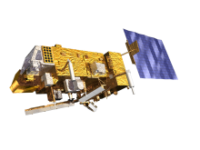

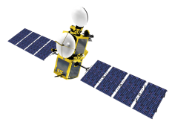
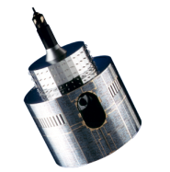
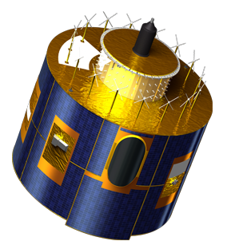
Future eumetsat missions: MTG/FCI, MTG/UVNS and EPS-SG/METimage
Sébastien Wagner, Bartolomeo Viticchiè ,Tim Hewison
In collaboration with:
Claude Ledez, Gary Fowler (MTG/FCI)
Marcel Dobber, Gary Fowler (MTG/UVNS)
Pepe Philips, Peter Schlussel (EPS-SG/MetImage)

Slide 2
EUMETSAT future missions with (potentially) lunar observations
Meteosat Third Generation – FCI
Meteosat Third Generation – UVNS (S4)
EPS Second Generation - METimage

Slide 3
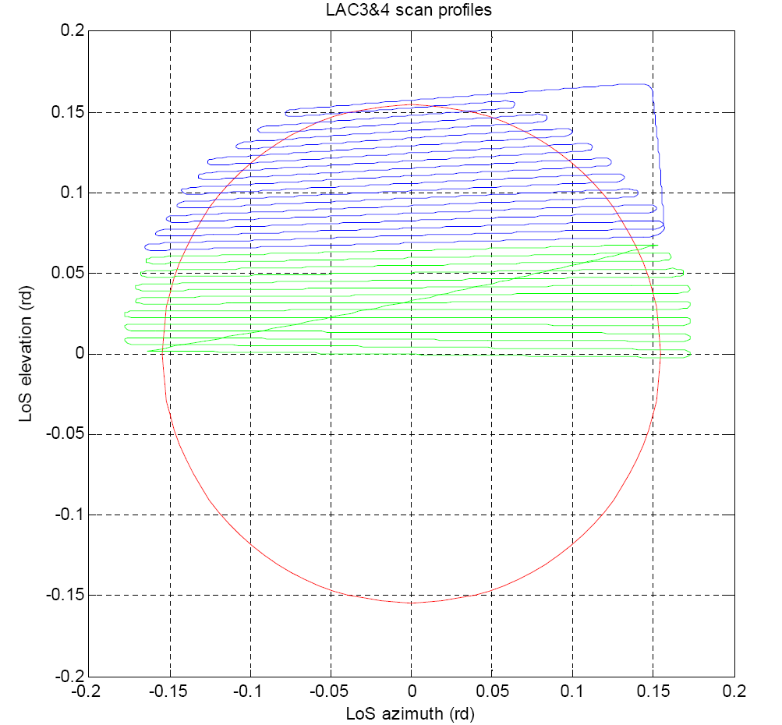
Meteosat Third Generation - Flexible Combined Imager
FCI main characteristics:
On-board a 3-axis stabilised platform
Coverage area: Full disc (FDC), FDC/2, FDC/3, FDC/4
Instantaneous field of view 210 km north-south swath (with 30 km overlap).
Scanning alternately E-W and W-E, FDC in 10 minutes.
Calibration: black body, MND solar filter
Scan mirror with east-west and north-south axes.
Spatial Sampling Distance: 0.5, 1.0, 2.0 km
Spectral Channels: 4 @ HRFI, 12 @ FDHSI spatial resolutions, 1 fire channel
HRFI = High Resolution Fast Imagery mission
FDHSI = Full Disc High Spectral resolution Imagery mission

Slide 4
Meteosat Third Generation - Flexible Combined Imager
Spectral Channel | Central Wavelength, λ₀ | Spectral Width, Δλ₀ | Spatial Sampling Distance (SSD)
VIS 0.4 | 0.444 µm | 0.060 µm | 1.0 km
VIS 0.5 | 0.510 µm | 0.040 µm | 1.0 km
VIS 0.6 | 0.640 µm | 0.050 µm | 1.0 km 0.5 km ^{#1}
VIS 0.8 | 0.865 µm | 0.050 µm | 1.0 km
VIS 0.9 | 0.914 µm | 0.020 µm | 1.0 km
NIR 1.3 | 1.380 µm | 0.030 µm | 1.0 km
NIR 1.6 | 1.610 µm | 0.050 µm | 1.0 km
NIR 2.2 | 2.250 µm | 0.050 µm | 1.0 km 0.5 km ^{#1}
IR 3.8 (TIR) | 3.800 µm | 0.400 µm | 2.0 km 1.0 km ^{#1}
WV 6.3 | 6.300 µm | 1.000 µm | 2.0 km
WV 7.3 | 7.350 µm | 0.500 µm | 2.0 km
IR 8.7 (TIR) | 8.700 µm | 0.400 µm | 2.0 km
IR 9.7 (O₃) | 9.660 µm | 0.300 µm | 2.0 km
IR 10.5 (TIR) | 10.500 µm | 0.700 µm | 2.0 km 1.0 km ^{#1}
IR 12.3 (TIR) | 12.300 µm | 0.500 µm | 2.0 km
IR 13.3 (CO₂) | 13.300 µm | 0.600 µm | 2.0 km
Monitoring using, among other methods, lunar calibration
SEVIRI heritage
#1 : Regional rapid scan

Slide 5
Meteosat Third Generation - Flexible Combined Imager
Spectral Channel | Min. Signal, α_{min} | Max. Signal, α_{max} | Ref. Signal, α_{ref} | Radiometric Noise (SNR) | Medium Term Radiometric Stability | Long Term Radiometric Stability | Radiometric Accuracy
VIS 0.4 | 0.01 | 1.20 | 0.01 | >25 | <0.1% | <2% | <5%
VIS 0.5 | 0.01 | 1.20 | 0.01 | >25 | <0.1% | <2% | <5%
VIS 0.6 | 0.01 | 1.20 | 0.01 | >30 >12^{#1} | <0.1% | <2% | <5% <10%^{#1}
VIS 0.8 | 0.01 | 1.20 | 0.01 | >21 | <0.1% | <2% | <5%
VIS 0.9 | 0.01 | 0.80 | 0.01 | >12 | <0.1% | <2% | <5%
NIR 1.3 | 0.01 | 0.80 | 0.01 | >40 | <0.1% | <2% | <5%
NIR 1.6 | 0.01 | 1.00 | 0.01 | >30 | <0.1% | <2% | <5%
NIR 2.2 | 0.01 | 1.00 | 0.01 | >25 >12^{#1} | <0.1% | <2% | <5% <10%^{#1}
#1 : Regional rapid scan
For comparison, SEVIRI requirements are:
10% radiometric accuracy
2% long term radiometric stability

Slide 6
Meteosat Third Generation - Flexible Combined Imager
Use of the lunar calibration for instrument monitoring (in addition to other methods):
  The FCI level 1 processor may include a lunar calibration, however a lunar calibration dataset will be output when available at level 1b for external comparison
Main identified issues in the image processing:
Swath Overlap: how to handle it in the preparation of the lunar data? The shape of the overlap also changes from south to north due to the scan mechanism
Oversampling: it changes at the beginning and at the end of each swath due to the scan mechanism (slow down before turning and speed up after turning).
Equalisation of the detectors: still to be defined whether or not lunar observations can be extracted after equalisation
+ potentially, new issues due to the new scan mirror configuration resulting from the 3-axis stabilisation

Slide 7
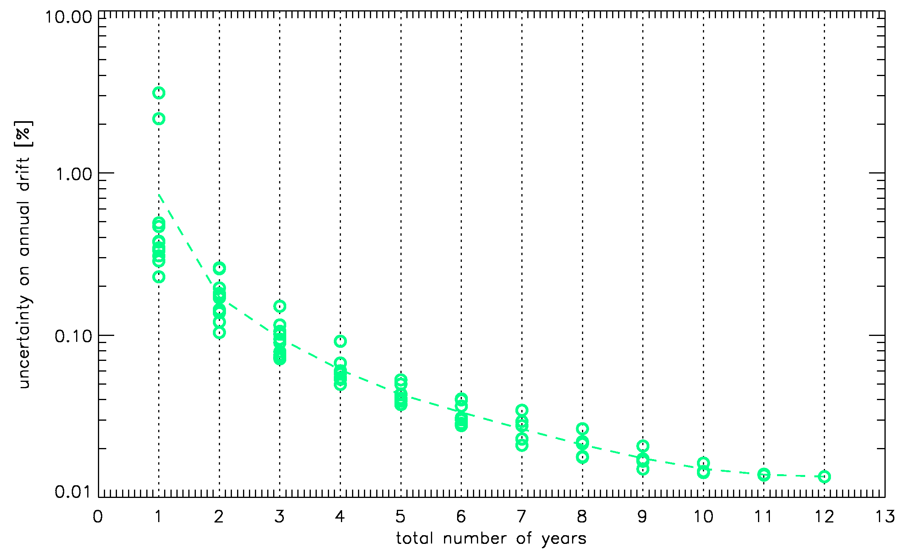
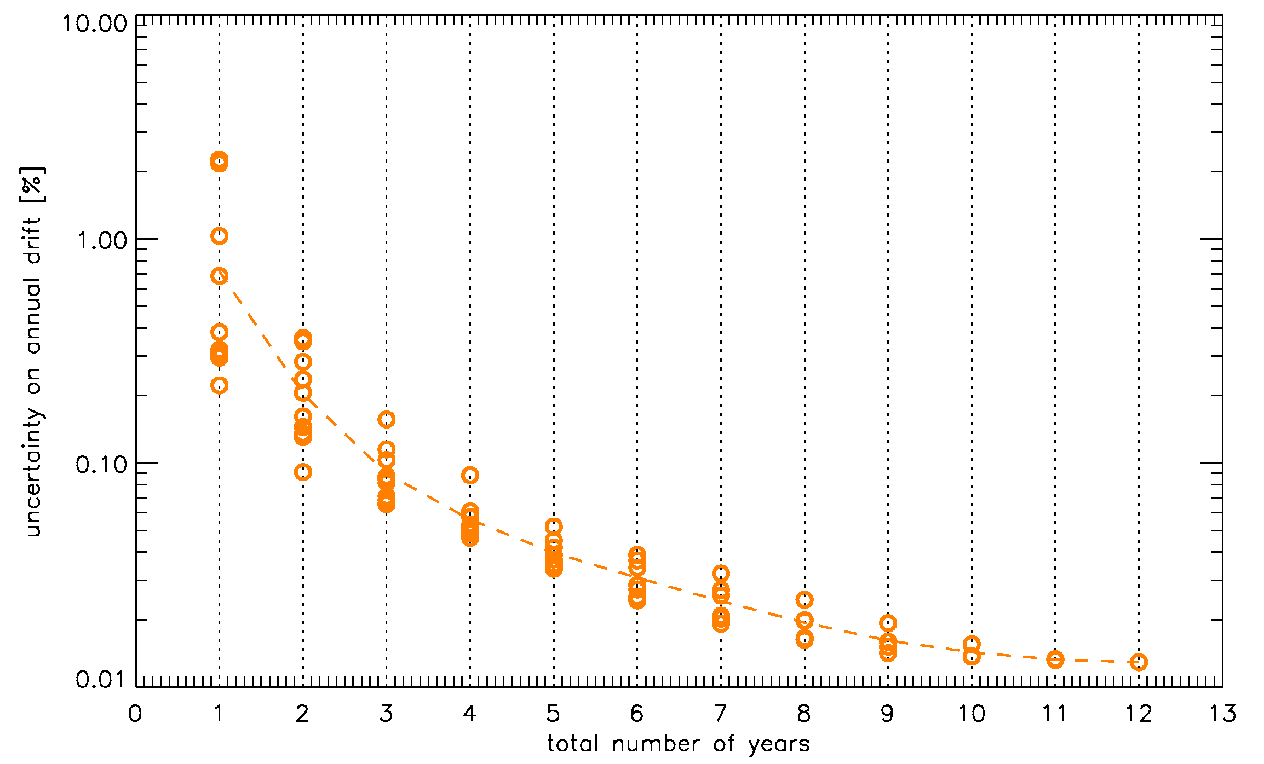
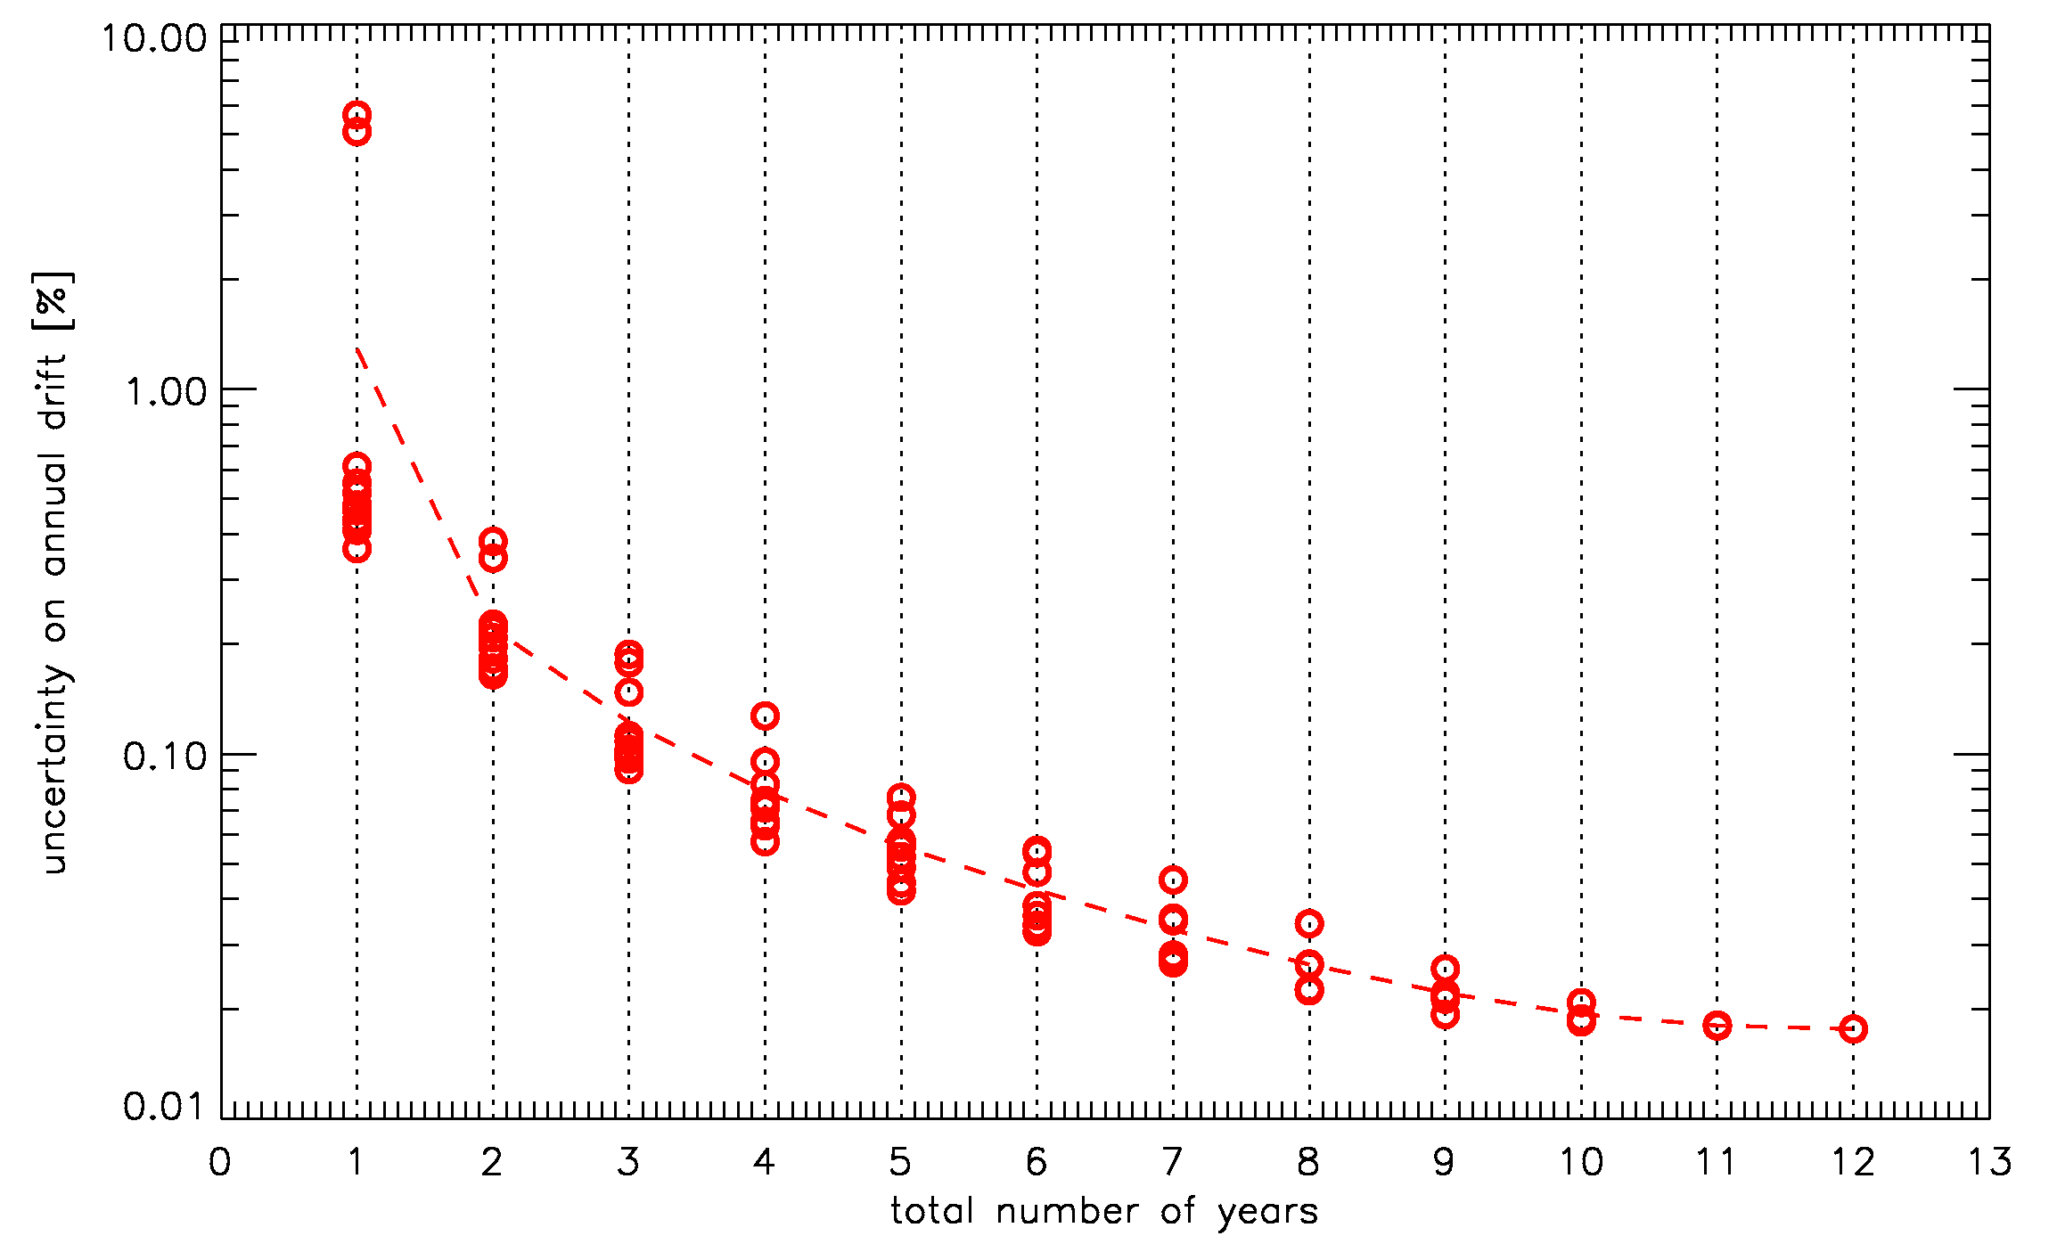
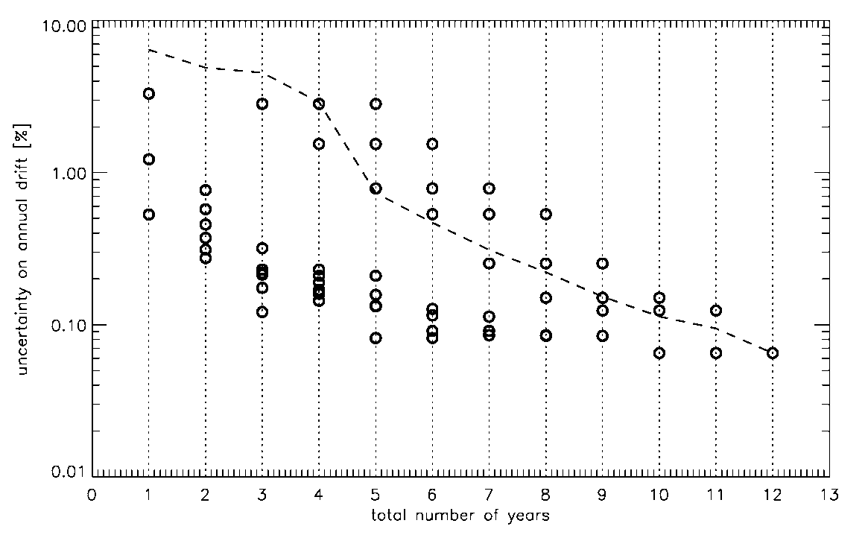
Another issue: phase-angle dependence and drift estimate accuracy
Variation of the drift estimate accuracy, using independent time windows including different total number of years
Meteosat-8
VIS0.6
VIS0.8
NIR1.6
HRVIS

Slide 8
Phase-angle dependence
Impact depends on:
  The location of the channel on the solar spectrum and the bandwidth
  The range of phase angle in which the Moon is observed
Particularly critical for GEO imagers
2 solutions to remove the phase angle dependence:
  Establish a correction using as many observations as possible ➔ Relies on observation frequency and illumination range.
  Update the ROLO model to remove this dependence ➔ depends on USGS. Recent attempt together with CNES to fund the work failed.

Slide 9
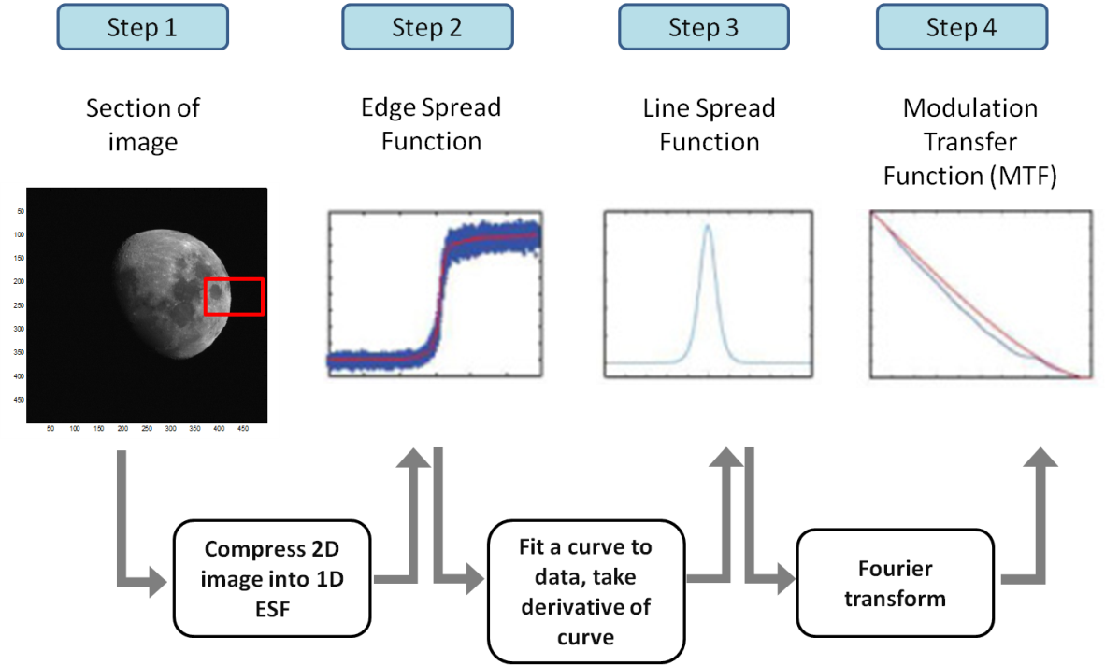
On-orbit MTF characterization
Assessment on MSG-1 over 3½ years (46 HRV images and 176 LRES images)
Good agreement, in particular N-S
In-orbit MTF measurement limited to channels with no saturation over the Moon (warm channels for SEVIRI).
For FCI: possibility to change the gains during commissioning ➔ MTF characterization also for IR channels

Slide 10
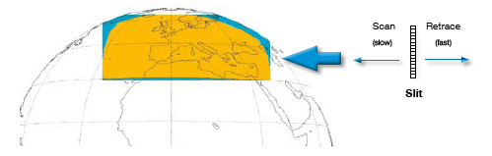
MTG - Ultraviolet Visible and Near-Infrared Sounder
UVN main characteristics:
Coverage area Europe
Instantaneous field of view north-south swath.
Scanning from east to west in 1 hour
Only measures earth radiance when earth is illuminated.
During night time: various calibrations (White Light Source, LEDs, dark measurements).
Solar irradiance measurements: 2 on-board diffusers (one daily, one monthly).
2 frame-transfer CCDs.
Scan mirror with east-west and north-south axes.
Heritage Europe: GOME, SCIAMACHY, OMI, GOME-2, TROPOMI (Sentinel-5 precursor), Sentinel-5: all LEO.
Spectral range 305-500 nm (UVVIS) & 750-775 nm (NIR).
Spectral resolution UVVIS 0.5 nm & NIR 0.12 nm, spectral oversampling >3 px.
Polarisation sensitivity <1% at level-0 (no polarisation correction in 0-1b processing).

Slide 11
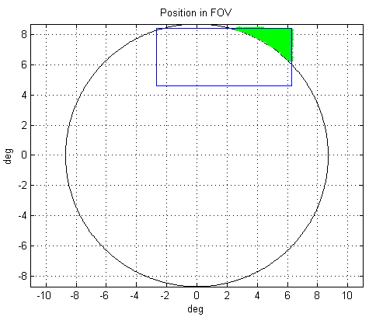
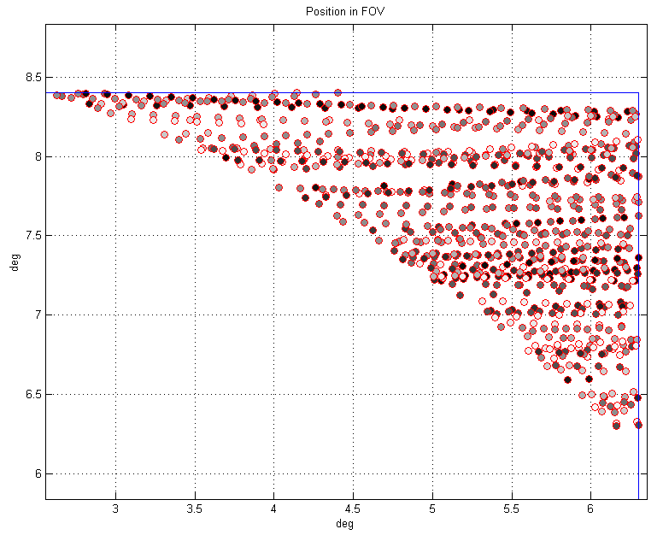
MTG - Ultraviolet Visible and Near-Infrared Sounder
Simulations covering the period from the expected launch date till the expected end of the mission
Black = new Moon
White = full Moon

Slide 12
MTG - Ultraviolet Visible and Near-Infrared Sounder
Use of the lunar calibration still to explored...
Main identified issues:
Moon availability in the Field of Regard: extended FOR for star detection. Possibility to extend the FOR for lunar observation still under discussion
Acquisition process: scan across the Moon? Slit blocked with a drifting Moon? Integration time?
Hyperspectral instrument: how to handle the data?

Slide 13
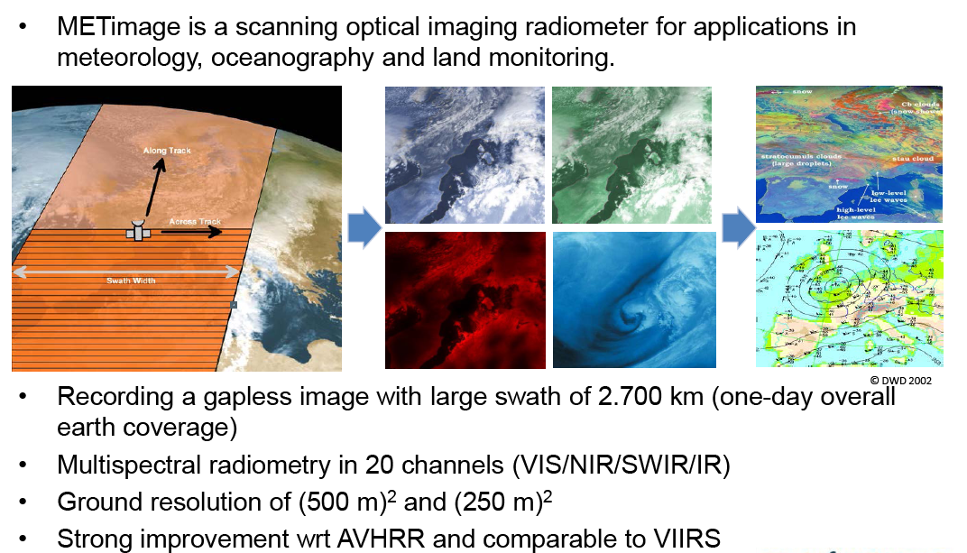
EPS Second Generation – METimage

Slide 14
EPS Second Generation – METimage solar channels
MRD Channel No | Central wavelength |  | FWHM [μm] | FWHM tolerance [nm] | R_{Typical} | R_{High} | R_{Low} | SNR at R_{Typ}
 | [µm] | tolerance[nm] |  |  | [W m⁻² sr⁻¹ μm⁻¹]
Solar Bands
VII-4 | 0.443 | ±3 | 0.03 | ±3 | 42.0 | 704 | 7.80 | 221
VII-8 | 0.555 | ±4 | 0.02 | -5, +3 | 22.0 | 678 | 5.70 | 215
VII-12 | 0.670 | -3, +5 | 0.02 | -3, +2 | 9.5 | 673 | 2.90 | 66
VII-15 | 0.763 | -1, +2 | 0.01 | ±2 | 20.0 | 370 | 0.36 | 500
VII-16 | 0.752 | -2, +1 | 0.01 | ±2 | 28.0 | 434 | 1.70 | 500
VII-17 | 0.865 | ±5 | 0.02 | ±5 | 6.0 | 379 | 0.80 | 60
VII-20 | 0.914 | ±2 | 0.02 | ±5 | 15.0 | 294 | 6.10 | 250
VII-22 | 1.240 | ±5 | 0.02 | ±7 | 5.4 | 150 | 5.40 | 90
VII-23 | 1.375 | -2, +6 | 0.04 | ±3 | 6.0 | 81 | 2.00 | 300
VII-24 | 1.630 | ±6 | 0.02 | ±9 | 7.3 | 72 | 0.40 | 300
VII-25 | 2.250 | ±10 | 0.05 | ±10 | 1.0 | 32 | 0.12 | 110

Slide 15
EPS Second Generation – METimage calibration concepts
Calibration concept addresses accuracy, stability and spectral and spatial homogeneity.
Accuracy is achieved using on-board 2-point linear calibration by viewing cold space as the low dynamic range reference and a target at known temperature/radiance for the high dynamic range reference -> solar diffuser (solar channels) and black body (thermal channels).
Stability monitoring to be achieved through:
  Solar diffuser monitor (2nd diffuser to monitor degradation of primary diffuser).
  Lunar calibration
  Cross-calibration

Slide 16
EPS Second Generation - METimage
Use of the lunar calibration for reflective solar bands is foreseen
Similarities with VIIRS
Main identified issues:
No spacecraft manoeuvres during routine operation ➔ impact on:
  Moon availability in the Field of Regard
  Moon phase angle when observing
Initial simulations show that with current instrument set-up, EPS orbit (09:30 equator crossing) and no spacecraft manoeuvres, lunar intrusions expected around 9 times per year with a range of phase angles (varying from 20 to 80 degrees).
Interesting point: question was raised regarding the possibility to use lunar observations to monitor the thermal bands.
  Currently no lunar model to describes lunar irradiance ➔ potential future development?

Slide 17
Conclusion
In the future, more missions will be able to acquire Moon images:
  MTG/FCI
  MTG/UVNS
  EPS SG/METimage
Need for putting in place operational infrastructures for the monitoring of the reflective solar bands of these future missions ➔ we can capitalize on current existing missions to prepare the ground.
New systems come with higher requirements in terms of uncertainties on absolute calibration and long term stability. Tools to ensure we reach these targets are essential and lunar calibration is one of them.

